Slide 1

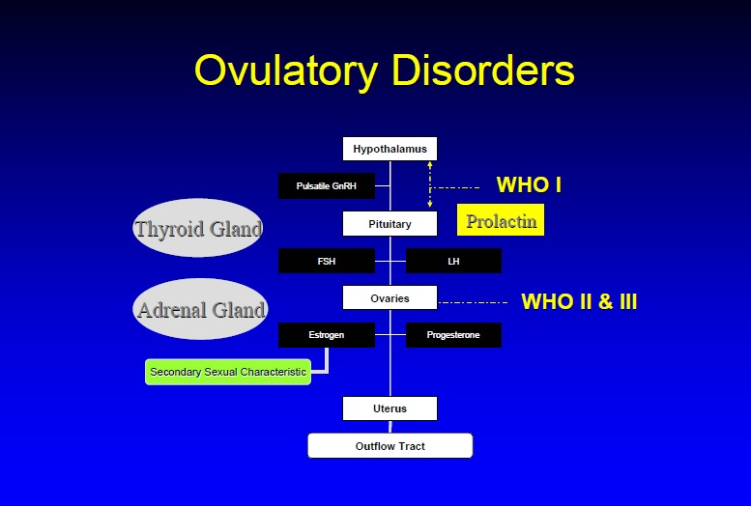
Induction Of Ovulation
Dr Muhammad M Al Hennawy Ob/gyn consultant Egypt mmhennawy.site44.com

Slide 2
Anovulation may be the cause for infertility in 25% of couples presenting to infertility clinics.
Ovulatory disorders are a common cause of infertility, which in most cases is treatable with ovulation induction agents.
The goal of therapy in these women is monofollicular development and subsequent ovulation.
This approach should be differentiated from stimulation of multiple follicle development in ovulatory women, as is done with assisted conception techniques.

Slide 3
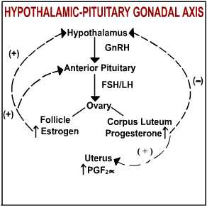

Slide 4
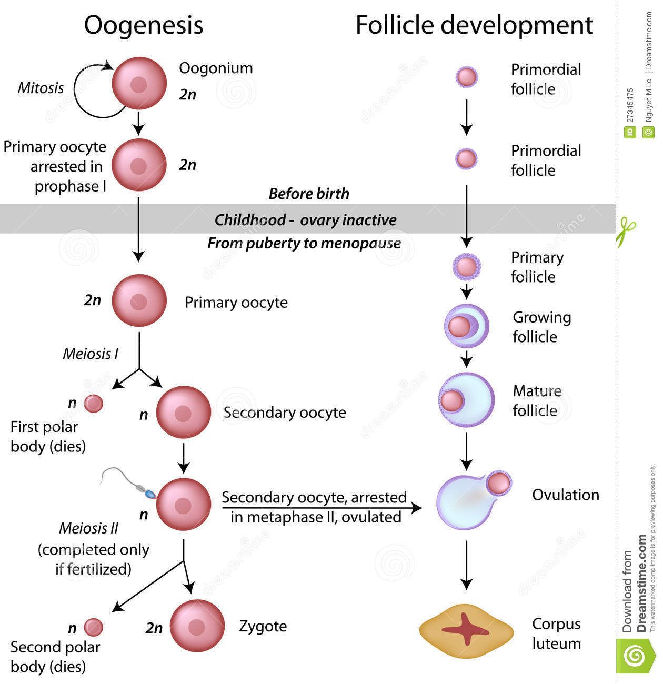
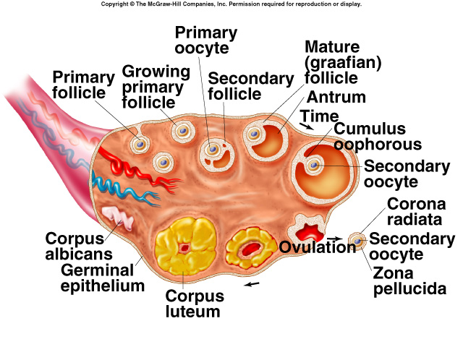

Slide 5
Basic fertility work up
History
Physical examination
Ovulation evaluation
Semen analysis
Tubal patency:
HSG
LS

Slide 6
Diagnostic studies to confirm Ovulation
Basal body temperature
Inexpensive
Accurate
Endometrial biopsy
Expensive
Static information
Serum progesterone
After ovulation rises
Can be measured
Urinary ovulation-detection kits
Measures changes in urinary LH
Predicts ovulation but does not confirm it

Slide 7
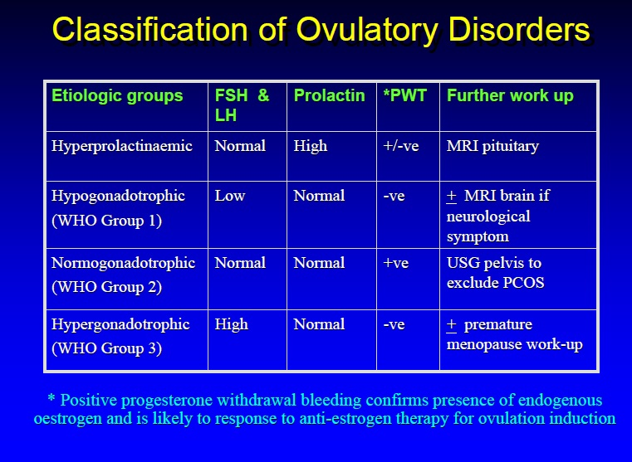

OVULATION DISORDERS WHO Classification
Group 1 (10%) Hypothalamic pituitary failure
low gonadotrophins - low oestrogen
Group 2 (85%) polycystic ovaries
two of the following three criteria
-presence of at least 10 follicles measuring
2–9 mm in diameter and/or
-clinical and/or biochemical hyperandrogenism
-oligo- and/or anovulation
Group 3 (5%) Ovarian failure
high gonadotrophins - low oestrogen

Slide 8
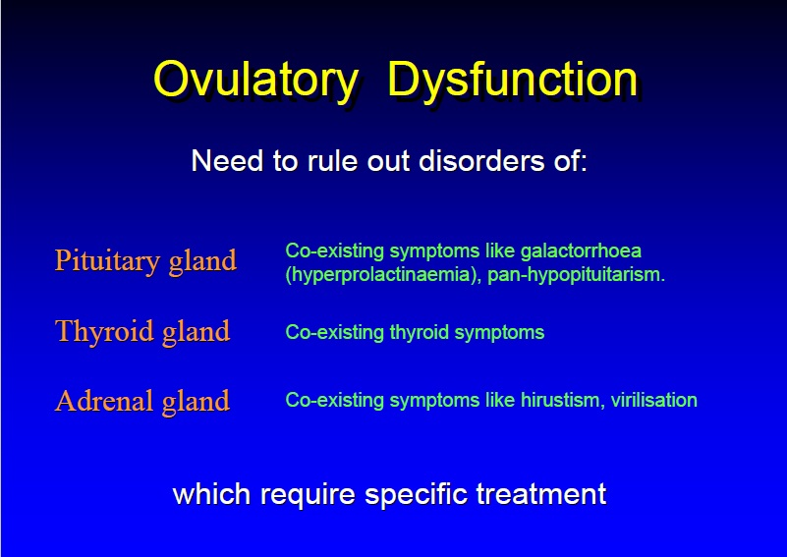

Slide 9
Assessment of ovarian reserve
recommended for women older than age 35
measurement of basal levels of serum FSH and/or estradiol on day 3 of the menstrual cycle
measurement of AMH
High FSH
High Estradiol
Low ovarian reserve

Slide 10
Ovulation Induction/Controlled Ovarian Stimulation
There are two general treatment strategies that focus on ovulation:
“ovulation induction” (OI)
Ovulation induction is pursued in patients who are not ovulating (Monofolliculogenesis)
“controlled ovarian stimulation” (COS).
for women who are already having ovulatory cycles but are still experiencing infertility (MULTIFOLLICULOGENESIS)
Both treatments incorporates many of the same medications.

Slide 11
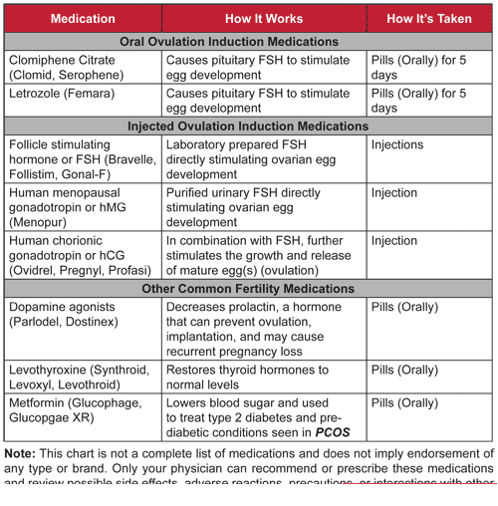
ORAL AGENTS
*Clomiphene Citrate
*Tamoxifene
*Aromatase inhibitors
INJECTABLES AGENTS
Gonadotrophins
*Urinary
*HP Urinary
Recombinant GnRh analogues:
* Agonists
* Antagonists
Others

Slide 12
Clomid ( Resistance Or Faliure)
+ Decrease Wt even surgical
+ Metformin
+ Tamoxifene
+ N Acetyl Cystiene
+ Dexamethasone
+ klimadynon
+ L-carnitine
+ pregnitude (diatery supplement)
+ Cupping Therapy
+ Ovarian Drilling
+ GNT (sequencial )
Letrozole + GNR ( sequencial )
+ metformin
GNT (Alone ) fixed dose or Variable
( step up ( standard, low dose.chronic low) , step down , step up and down )
+ GnRH Agonist
+ GnRH Antagonist
Others
Prolactin lowering drugs
Thyroxin
Dexamethasone

Slide 13
The method of ovulation induction selected by the clinician should be based upon the underlying cause of anovulation and the efficacy, costs, risks, and potential complications associated with each method as they apply to the individual woman. One size fits all Does not apply to infertility

Slide 14
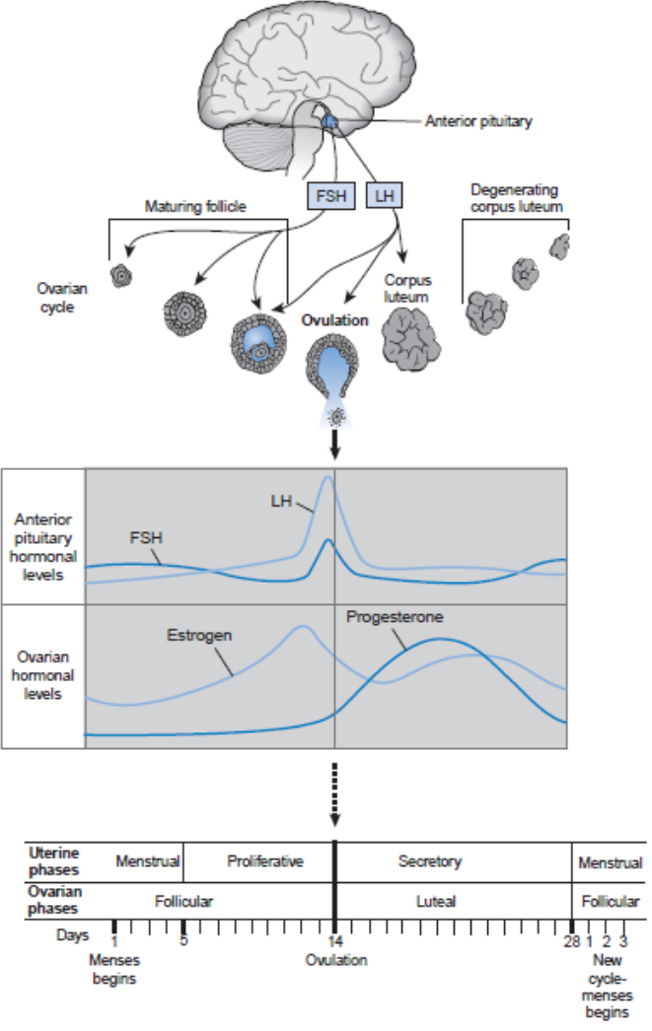
OVULATION INDUCTION
Anovulatory women with adequate ovarian reserve and
no other treatable cause are candidates for OI.
mimic the hormonal patterns of the normal menstrual cycle.
The goal of OI is the development of a single dominant follicle

Slide 15
OVULATION INDUCTION
The choice of medications for OI is dictated by hypothalamic-pituitary- ovarian function.
With adequate hypothalamic function, an oral regimen of Clomiphene citrate which exhibits estrogen agonist and antagonist activity, is often utilized first line.
Clomiphene citrate inhibits estrogen binding in the hypothalamus to stimulate release of GnRH and pituitary gonadotropins and induce ovarian follicular development.
Oral aromatase inhibitors are increase release of GnRH and pituitary gonadotropins through an estrogen antagonist effect

Slide 16
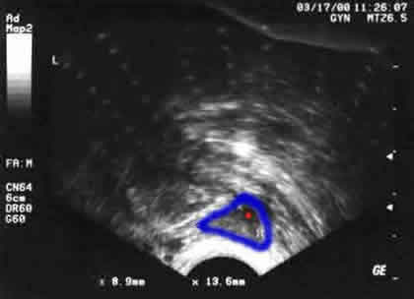
OVULATION INDUCTION
If hypothalamic or pituitary dysfunction is detected or if oral regimens are not successful,
injectable gonadotropins are administered.
The most common gonadotropin regimens use FSH administered alone or in combination with LH:
“step-up” protocol represents the natural progression of gonadotropin release during the menstrual cycle. Initial daily injections of 50 to 75 international units are increased in increments of 37.5 international units as necessary for a follicular response
“step-down” protocol uses higher initial daily doses of 150 international units until a dominant follicle is apparent on ultrasound. The daily dose is then decreased incrementally until ovulation is triggered.

Slide 17
Gonadotropins for Ovulation Induction/Controlled Ovarian Hyperstimulation
Ingredient | Product Name | Dosage Form | Route
hMG (menotropin) | Menopur MENOGON MERIONAL IVF-M | Powder for reconstitution: 75 i.u. FSH activity and 75 i.u. LH activity/vial | SC
Urinary FSH (urofollitropin) | Bravelle FOSTIMON UROFOLLITROPIN B.POOYESH DAROU | Powder for reconstitution: 75 international units FSH activity/vial | IM or SC
Recombinant FSH (follitropin alfa) | FOLLITROPE GONAL-F PUREGON Cinnal-F | Powder for reconstitution: 75 international units FSH activity/vial | SC
Recombinant FSH (follitropin beta) | Follistim | AQ Vial Solution: 75 or 150 international units FSH/vial | IM or SC
Recombinant LH (lutropin alfa) | Luveris | Powder for reconstitution: 75 international units LH/vial | SC
Urinary hCG | CHORAGON CHORIOMON IVF-C CHORIONIC GONADOTROPHIN HUMAN D.P | Powder for reconstitution: 5000,1500,500 international units LH activity/vial | IM
Recombinant chorionic gonadotropin alfa | Ovidrel | Prefilled syringe: 250 mcg r-hCG | SC

Slide 18
CONTROLLED OVARIAN STIMULATION
The oral and injectable medications intended to develop multiple ovarian follicles.
Clomiphene citrate is the most common initial choice because of the convenience and low cost of an oral regimen and the widespread experience with its use.

Slide 19
CLOMIPHENE CITRATE
The competitive binding of CC to estrogen receptors in the hypothalamus stimulates release of GnRH.
gonadotropin release from the anterior pituitary
leading to follicular development, increased estradiol production,
ovulation.

Slide 20
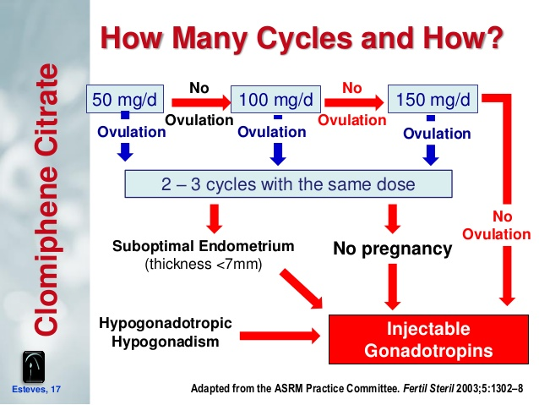
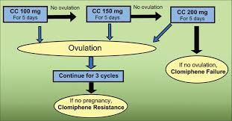
CLOMIPHENE CITRATE
The typical initial dosing regimen for CC is 50 mg once daily for 5 days starting on day 5 of the menstrual cycle.
Some clinicians prefer initiating therapy on day 3, although there is no clinical advantage
Ovulation typically occurs 5 to 12 days after the fifth dose is taken.
If ovulation is documented but pregnancy does not occur, the same dose of CC is used in future cycles.
If ovulation does not occur, then the dose is increased by 50 mg with each subsequent cycle.
Although the product labeling does not recommend doses above 100 mg per day, CC doses as high as 250 mg have been described in the literature.
Alternative medication approaches are typically recommended if daily doses of 150 mg are not successful.1

Slide 21
CLOMIPHENE CITRATE
associated with per-cycle pregnancy rates ranging from 3% to 8%.
It is frequently combined with intrauterine insemination (IUI) which introduces a processed semen sample directly to the uterus via a catheter placed through the cervix.
using a urinary ovulation home test kit to identify the natural LH surge or injecting hCG to trigger ovulation and planning the IUI 24 to 36 hours later
Multiple treatment cycles with the combination of CC and IUI are commonly pursued, but there is little evidence for effectiveness beyond six attempts.
Aromatase inhibitors or gonadotropins are suitable alternatives to combine with IUI.

Slide 22

Adverse effects of clomiphene
Vasomotor symptoms (10% to 20%)
night sweats, hot flashes, and flushes.
headache,
irritability,
mood swings,
Nausea
Long-term concerns
multiple gestation in 8% to 10%
Minimal risk of increased rates of ovarian cancer in women exposed to more than 12 cycles

Slide 23
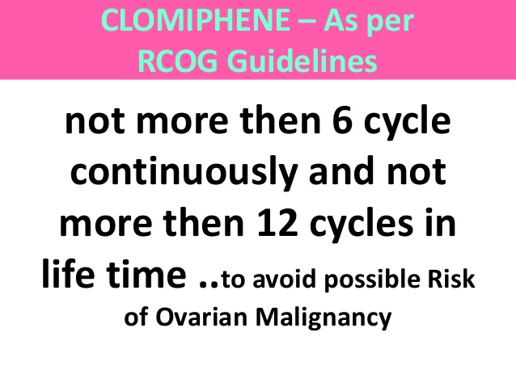

Slide 24
Metformin
Metformin alone compared with placebo increases the ovulation rate in women with polycystic ovary syndrome (PCOS)
but should not be used as first-line therapy for anovulation because oral ovulation induction agents such as clomiphene citrate (CC) or letrozole alone are much more effective in increasing ovulation, pregnancy, and live-birth rates in women with PCOS.
metformin may increase the live birth rate among women undergoing ovulation induction with gonadotrophins.
At this moment, evidence is insufficient to show an effect of metformin on multiple pregnancy rates and adverse events

Slide 25
N-acetyl cysteine (NAC)
N-acetyl cysteine (NAC), a safe and cheap drug available in the market many years ago as mucolytic agent,
clomiphene citrate 50-mg tablets twice daily with N-acetyl cysteine 1,200 mg/day orally for 5 days starting on day 3 of the menstrual cycle.
N-Acetyl cysteine is proved effective in inducing or augmenting ovulation in polycystic ovary patients
NAC promotes lipid profile, hormonal levels, ovulation, and consequently, the long-term health status of women with both PCOS and CC-resistant PCOS through inhibition of oxidative stress and improvement of peripheral insulin.

Slide 26
Dexamethasone
Clomiphene citrate 100 mg, was given from days 3 until 7
from days 5 to 14 of their cycles , oral dex (Dexamethasone 0.5 mg), 2 mg/day, in two divided doses
Or
Dexamethasone is given as a single pill (1/2 tablet) at bedtime on a daily basis (unlike Clomid, which is taken for 5 days only).
Addition of dex to CC enhances the number of mature follicles significantly but the ovulation and pregnancy rate is comparable to CC alone.

Slide 27
L-carnitine
250 mg clomiphene citrate from day three until day seven of the cycle plus L-carnitine (LC) 3g daily
when treating clomiphene-resistant PCOS patients not only improved the quality of ovulation and the pregnancy rate with an acceptable patient tolerability, but also enhanced the patient lipid profile and body mass index.

Slide 28
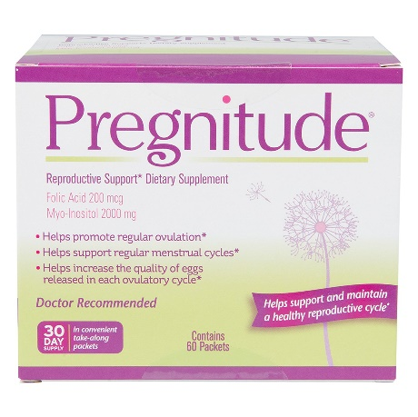
Pregnitude
Pregnitude Reproductive and Dietary Supplement, 60 Fertility Support Packets
The Pregnitude Reproductive Support consists of 2 main ingredients that prove to be the most affective at ensuring proper ovulatory function, menstrual cyclicity, and quality of eggs. These ingredients have all been clinically tested and proven to be safe.
Folic acid is a synthesized version of a B-vitamin known as folate or Vitamin B9. Folic acid is very crucial for women looking to finally become pregnant as it ensure that during pregnancy,
Myo-inositol is a very crucial ingredient as it helps induce ovulation with women who have polycystic ovary syndrome (PCOS), as it enhances insulin sensitivity and utilization. This regulates the insulin levels in the ovaries, which in turn: decreases serum androgen and triglycerides, increases HDL cholesterol, and lowers blood pressure.

Slide 29
Cimicifuga racimosa extract- black cohosh (Klimadynon)
Phyto-oestrogen can be used as an alternative to clomiphene citrate for ovulation induction in women with polycystic ovarian syndrome.
clomiphene citrate 100mg daily for 5 days, and the other group (n=50) received C. racimosa 20mg daily for 10 days.
starting from the second day of the cycle for three consecutive cycles,

Slide 30
Tamoxifen Citrate
Nolvadex 10 mg
May be used alone
or
In combination with CC to act in synergy for better response or in cases resistant to CC alone.
Or In combination with GNT

Slide 31
AROMATASE INHIBITORS
The aromatase inhibitors letrozole and anastrazole are emerging as oral alternatives to CC, although they are not FDA-labeled for ovulation induction or COS.
Aromatase is an enzyme that converts androstenedione to estrone and testosterone to estradiol.
reduce systemic estrogen levels in the ovary
Ovulation.
increased gonadotropin secretion
follicular development.

Slide 32
AROMATASE INHIBITORS
The recommended administration schedule is similar to clomiphene: once daily for 5 days beginning on cycle days 3 to 5.
letrozole 2.5 or 5 mg
anastrozole 1 mg
There is a reduced incidence of multiple gestation pregnancy compared with CC because of the development of fewer follicles
Pregnancy rates with letrozole appear to be similar to clomiphene.

Slide 33
AROMATASE INHIBITORS
Adverse effects:
Aromatase inhibitors do not affect cervical mucus or endometrial development, but this finding has not translated into improved pregnancy outcomes in clinical studies.
Initial concerns of the teratogenic potential of aromatase inhibition during fetal development prompted a warning against use in premenopausal women who are or may become pregnant to be included in the product labeling.
surveillance studies of letrozole cycles do not demonstrate higher rates of congenital malformations as compared to CC.
The early timing of administration in the cycle reduces the risk of fetal exposure.

Slide 34
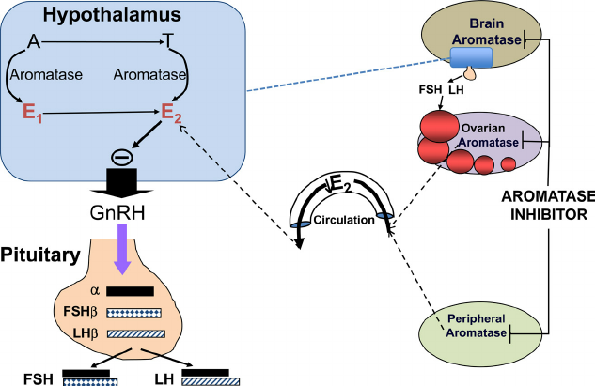
Aromatase inhibitors are a class of drugs that block the conversion of testosterone and androstenedione to estradiol and estrone, respectively (unlike clomiphene which blocks estrogen action), thereby reducing negative estrogenic feedback at the pituitary. In contrast to CC, they appear to be free of the adverse effects on endometrial and cervical mucus attributed to clomiphene citrate

Slide 35
injectable gonadotropins
injectable gonadotropins are administered.
The most common gonadotropin regimens use FSH administered alone or in combination with LH:
“step-up” protocol represents the natural progression of gonadotropin release during the menstrual cycle. Initial daily injections of 50 to 75 international units are increased in increments of 37.5 international units as necessary for a follicular response
“step-down” protocol uses higher initial daily doses of 150 international units until a dominant follicle is apparent on ultrasound. The daily dose is then decreased incrementally until ovulation is triggered.

Slide 36
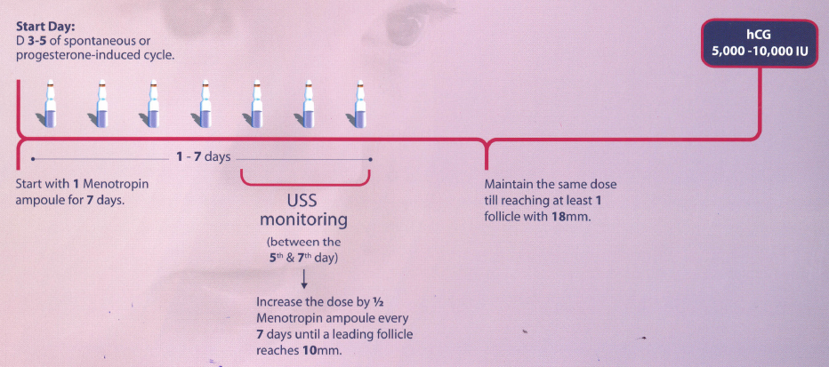
Standard Protocol
May fit PCOS patients

Slide 37
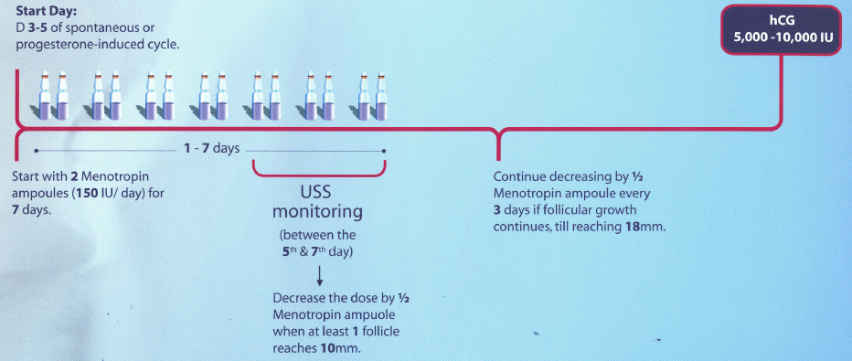
Step-Down Protocol

Slide 38
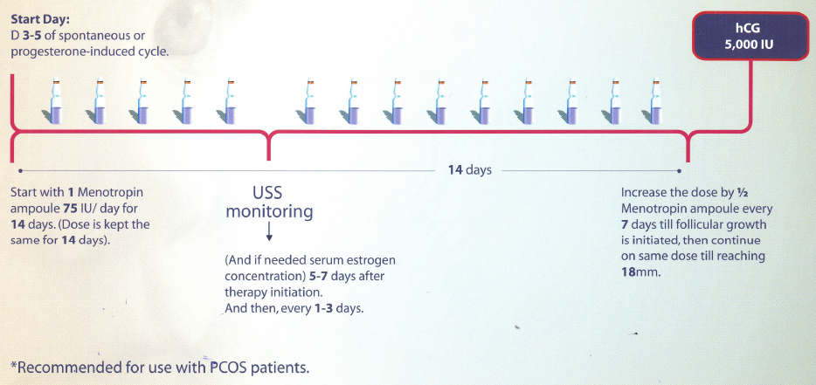
Step-Up Protocol

Slide 39
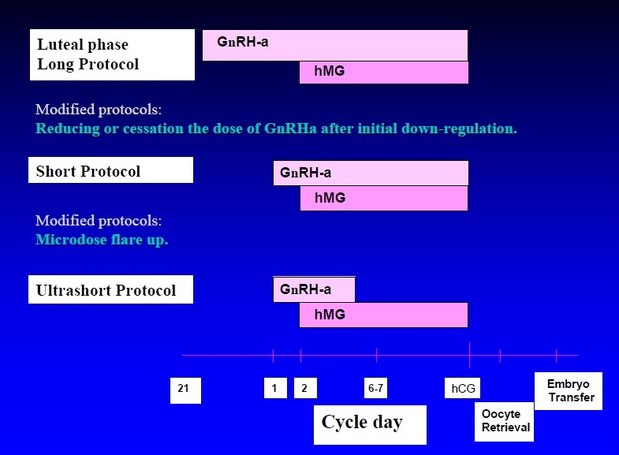
Recombinant GnRh analogues: * Agonists

Slide 40
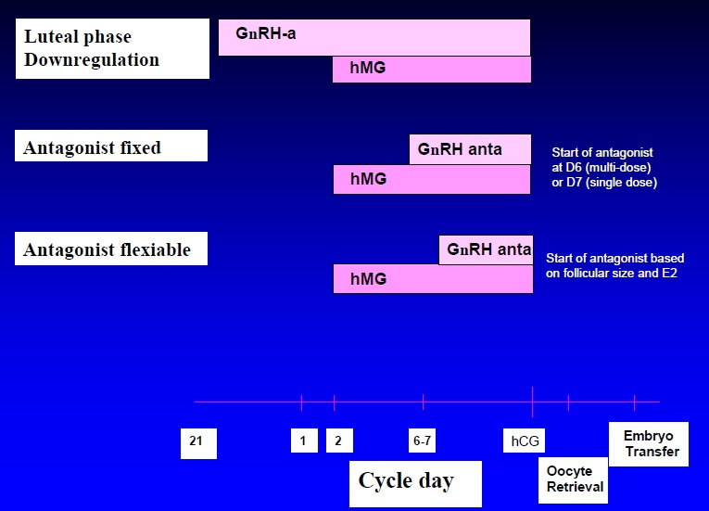
Recombinant GnRh analogues: * Antagonists

Slide 41
Prolactin Reducing Medications
- For Hyperprolactinaemia associated infertility.
Causes:
Pituitary adenoma (prolactinoma).
Hyperactive lactotrophs.
Medications: tranquilizers, hallucinogens, painkillers, alcohol,..
Diseases of the kidney or thyroid gland.
Dopamine agonist: - Bromocriptine.
- Quinagolide.
- Cabergoline

Slide 42
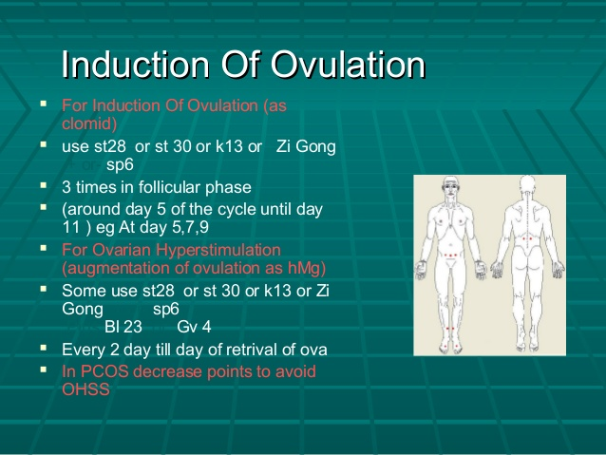
Cupping Therapy

Slide 43
Ovarian Drilling
Unilateral laparoscopic ovarian drilling (ULOD)
Bilateral laparoscopic ovarian drilling (BLOD)

Slide 44
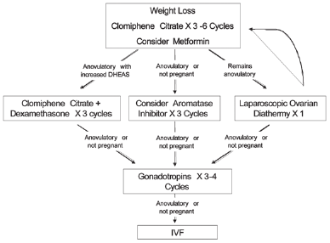
PCOS
First-line treatment for ovulation induction
when fertility is desired is clomiphene citrate.
Second-line strategies may be equally
effective in infertile women with clomiphene
citrate–resistant PCOS are
combined metformin/letrozole and bilateral
ovarian drilling are similarly effective

Slide 45
Comparative effectiveness of 9 ovulation-induction therapies in patients with clomiphene citrate-resistant polycystic ovary syndrome 2017
26 randomized clinical trials with 2722 participants and 9 types of therapies:
clomiphene citrate (CC), metformin, letrozole, follicle stimulating hormone (FSH), human menopausal gonadotropin (hMG), unilateral laparoscopic ovarian drilling (ULOD), bilateral laparoscopic ovarian drilling (BLOD), the combination of metformin with letrozole (metformin+letrozole), and the combination of metformin with CC (metformin+CC).
The network meta-analysis demonstrates that hMG therapy result in higher pregnancy rates than BLOD, ULOD and CC therapies.
Pregnancy, live birth and ovulation rates are significantly higher in metformin+letrozole and FSH groups than CC group.
The abortion rate in the metformin+letrozole group is significantly lower than that in the metformin+CC group.
Ranking probabilities show that, apart from gonadotropin (FSH and hMG), metformin+letrozole is also potentially more effective in improving reproductive outcomes than other therapies.
In conclusion, owing to the low quality of evidence and the wide confidence intervals, no recommendation could be made for the treatment of ovulation-induction in patients with CCR PCOS.

