Slide 1
Loop (Device Or System) Insertion During Cesarean Section
Dr Muhammad M Al Hennawy
Ob/gyn consultant Egypt
mmhennawy.site44.com
ekotob.site44.com
rebch.site44.com
www.drhennawy.8m.net
www.mmhennawy.20fr.com
www.ayolab.20m.com

Slide 2
What is an ( IUCD or IUCS ) ?
It is a small, flexible, plastic device that contains
Either metal e.g. copper (IUCD = intrauterine contraceptive device)
or
Hormones e.g. progesterone (IUCS= intrauterine contraceptive system)
and
Is inserted into the uterus
To prevent pregnancy.

Slide 3
Intrauterine contraception is highly effective, very safe, and generally well tolerated by most women.
As such, it has become an increasingly popular method of contraception.
Despite the overall excellent safety profile, side effects and complications can occur at the time of insertion and at different time points following insertion.

Slide 4
IUCD History
the first use of IUDs to caravan drivers who allegedly used intrauterine stones to prevent pregnancies in their camels during long journeys I
n the early 1800s from the stem pessary. This cup-shaped device had a stem that fit into the cervical canal and was designed to be placed in the vagina to support the uterus
n 1902 Hallwig designed a version with a stem that extended into the uterine cavity.
The first published paper on actual IUD insertions was made by Dr. Richard Richter in 1909 in Germany.
The device he inserted was a ring made of silkworm gut, with 2ends of nickel and bronze wire which protruded from the cervical os enabling him both to check the device and remove it.
Shortly after Karl Pust recommended a silkworm ring placed in the uterus with a stiff cervical extension of a tightly wound silk thread and a glass button to cover the cervix.
in the mid 1920s, Ernest Graefenberg the silkworm gut with a coiled metal ring made of an alloy of copper, nickel, and zinc.
Pure silver rings had to be abandoned because silver was absorbed and led to gingival argyrosis of the gums, analogous to the lead line
Dr. Halton used silkworm gut. She wound it around her finger, pressed the ring into a gelatine capsule and pushed the capsule into the uterine cavity, where the gelatine liquefied and the thread spread out. with and without a beaded tail
in 1930, Gräfenberg using rings made of coiled silver and gold, and then steel. Although the Graefenberg ring was widely used, it was considered a risky method in continental Europe and in the U.S.
In 1934 in Japan, Ota modified this design slightly by adding a supportive structure to the ring (the center of his gold or silver plated ring).
As late as 1959, Dr. Alan Guttmacher co-authored a paper in which the IUD was condemned for its ineffectiveness, potential source of infection, and its carcinogenic potential.
Since 1960, various kinds of IUDs were made of plastic (polyethylene) impregnated with barium sulfate so that they would be visible on an x-ray.
the coil in January I962. Dr. J. Lippes The next year brought the Birnberg "BOW" and the double coil, the so-called safety-coil. The devices were widely distributed
After that the Maizlin spring, the Incon ring, the Antigon, the "M" device, the LEM, the Dalkon Shield, and more than a dozen others.
in the 1960s and 1970s with the introduction of such models as the Margulies Spiral, the Lippes Loop, the Saf-T-Coil, the Birnberg bow, and the Dalkon Shield
From 1985 to 1988, by the Alza Corporation only the Progestasert IUD In 1976 was available in the United States
the copper-containing by Jaime Zipper of Chile The Cu-7 with a copper wound stem was developed in 1971 ParaGard IUD, introduced in 1988, contains 300 mm² of copper on the vertical arm and 40 mm² on each of the horizontal arms, the Nova T, and the Multiload-375
for a total of 380 mm levonorgestrel-containing Mirena IUD in 2001
modern generation of IUDs in China includes a stainless steel ring with copper wire that also releases indomethacin (very effective with a low expulsion rate and less blood loss), a V-shaped copper IUD, and a copper IUD shaped like the uterine cavity.
Future IUDs Modifications of the copper IUD are being studied throughout the world. The Ombrelle-250 and Ombrelle-380, designed to be more flexible in order to reduce expulsion and side effects, have been marketed in France. A frameless IUD, the FlexiGard (also known as the Cu-Fix or the GyneFix),

Slide 5
Intrauterine Device Or System Classification
nonmedicated first generation Eg: Lippes loop
IUCD or IUCS medicated second generation Eg: Copper IUCD
third generation Eg:Hormonal IUCS

Slide 6
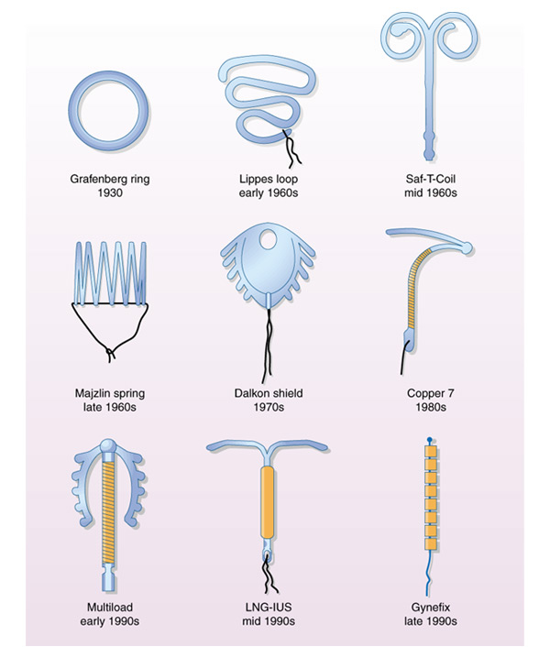
g

Slide 7
A fair number of women undergoing caesarean section are good candidates for using the IUCD for contraception.
It offers the obstetrician an opportunity to insert the IUCD into the uterus under vision,
thus obviating the fear of perforating the uterus during the procedure.
A number of women fail to return for availing contraceptive services, once they leave hospital.
IUCD insertion also offers women a chance to avail this method of contraception at the same time as they have caesarean section

Slide 8
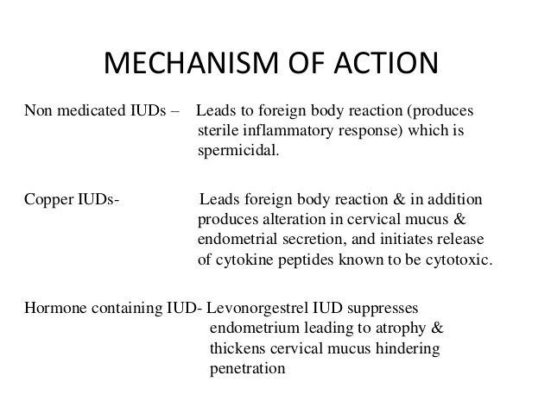
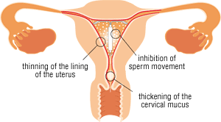

Slide 9


Advantages
Inserting an IUD at the time of CS is
a very attractive option.
It adds very little time and
very little cost to the procedure.
The patient does not have to come back especially for follow-up
There is no risk of primary perforation as it is performed under direct vision (secondary perforation is possible).
When it remain in place a 5-year follow-up seems to indicate that it will behave similarly to interval insertion in woman with and without CS.

Slide 10
Complications Of IUCD
Bleeding
Pain
Embedment Partial penetration or embedment of ParaGard® in the myometrium can make removal difficult. In some cases, surgical removal may be necessary.
Perforation
Migeration IUD might become embedded in the wall of the uterus or slowly migrate completely through the uterine wall. If this happens, the device could possibly damage nearby internal organs.
Expulsion (partial , complete )
Pregnancy (intrauterine,extrauterine)
Infection (upper GTI, lower GTI )
Missed threads ( threads torn, threads retracted in cervical canal or in the uterus , embedded , perforation ,migeration , expulsion )
Malposition and displacement of IUCD
Infertility
Wilson’s Disease Theoretically, ParaGard® can exacerbate Wilson’s disease, a rare genetic disease affecting copper excretion.

Slide 11
Two Early Problems With PPIUDCS
The first problem is Initial expulsion rates,
although not as high as those after vaginal birth post-partum insertion, are still unacceptably high (5%–10%). This is the only time an IUD is inserted into the uterine cavity under direct vision, and the use of the correct anchor with suturing into the uterine muscle techniques, and additional training for those inserting the devices.has the ability to make the expulsion rate close to zero.
The second problem of importance is missing threads.
In many GS situations ultrasound is often not available
their presence in the vagina exist, but often necessitate trimming and so may require an extra post-partum follow-up.

Slide 12
Decrease Expulsion Rate
With the appropriate technique,
IUDs inserted immediately after placental delivery or Cesarean section can be safe and effective.
Expulsion rates for postpartum insertion vary greatly depending on both the IUD type and provider’s technique.
Current information indicates that the expulsion rates may be higher from 10 minutes to 48 hours after delivery than in the first 10 minute period.
To minimize risk of expulsion, only properly trained providers (according to relevant national or institutional standards) should insert IUDs postpartum.
Use of an inserter for IUD placement tends to reduce expulsion risk.
Clients should be counseled that expulsion rates are higher postpartum than for interval insertion and should be carefully trained to detect expulsions.

Slide 13
When can an IUD be inserted postpartum?
An IUD may be inserted:
● Immediate Postpartum:
o Postplacental: Insertion within 10 minutes after expulsion of the placenta following a vaginal delivery on the same delivery table.
o Intracesarean: Insertion that takes place during a cesarean delivery,
after removal of the placenta and before closure of the uterine incision. Or
immediately after a Cesarean section (special training required)
● Within 48 hours after delivery: Insertion within 48 hours of delivery and prior to discharge from the postpartum ward.
● Postabortion: Insertion following an abortion, if there is no infection, bleeding or any other contraindications.
● Extended Postpartum/Interval: )
o As early as four- to six-weeks postpartum, to accommodate women who come to the clinic for routine postpartum care and who request an IUD. Copper T IUDs may be safely inserted at this time.
o For other types of IUDs, it may be prudent to wait until six-weeks postpartum.
o While women continue to breastfeed.

Slide 14
Duration Of Action
All copper IUCDs are licensed for at least 5 years of use and some are recommended for longer use.
The TCu380A is effective for up to 12 years of use and licensed for 10 years.
In the UK it is widely accepted that if a copper-containing IUCD is inserted when a woman is 40 years or over it can be retained and will remain effective until the menopause is confirmed.[

Slide 15
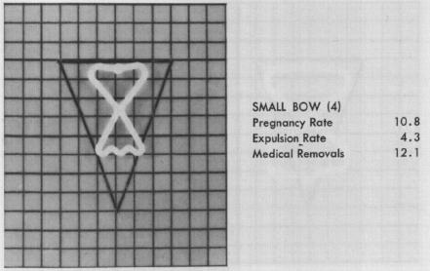
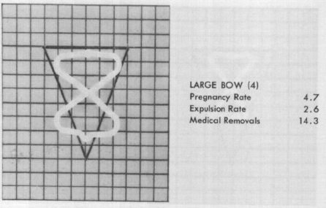
The first study on the use of PPIUDCS was by Zerzavy in 1967
He inserted a Birnberg Bow
size 5 or 7 and
sutured it in place at CS.
After that there were relatively few studies over many years.
Sporadic attempts to revive the procedure were made in the 1970s and 1980s.
This anxiety regarding PPIUDCS began to dissipate in the 1990s due to the realization that the IUD is not primarily responsible for causing infection

Slide 16
Inclusion criteria
1. any age; adolescents may receive post-placental IUD insertion
2. desiring Paragard or Mirena IUD
3. anticipated vaginal (including vaginal birth after cesarean) or cesarean delivery
4. any language for which adequate translation can be obtained

Slide 17
Exclusion criteria
1. history of sexually transmitted infection during the index pregnancy
2. recent (within the last 3 months) or active intrauterine infection
3. known abnormal uterine cavity
4. standard absolute contraindications (eg: Wilson’s disease, no Paragard)

Slide 18
After enrollment
subjects should be excluded if:
1. Intrapartum fever greater than 38.0 degrees
2. Postpartum hemorrhage (greater than 500 ml blood loss for vaginal deliveries; 1,200cc for cesarean deliveries)
3. Rupture of membranes for greater than 24 hours prior to delivery
4. Retained placenta requiring manual removal or D&C

Slide 19
Insertion In Relation To Uterine Closure
After removal of the placenta
= before closure of the uterine wound
or
= during closure of the uterine wound
(half closure or
two third closure),
the device was inserted

Slide 20
Methods Of Insertions
With threads (Hang up technique)
- From ouside
- From inside
- from inside frameless loop
. With knotted loop of 2-0 chromic catgut suture
Without threads
frameless loop
- Anchor method
copper T 380 , Multiload or Mirena
-Manually
- Assisted by ring forceps
- IUCD applicator
+ or - Immediate Post-placental Anchoring of TCu380 by Two strands of catgut were knotted on both transverse arms of the T

Slide 21
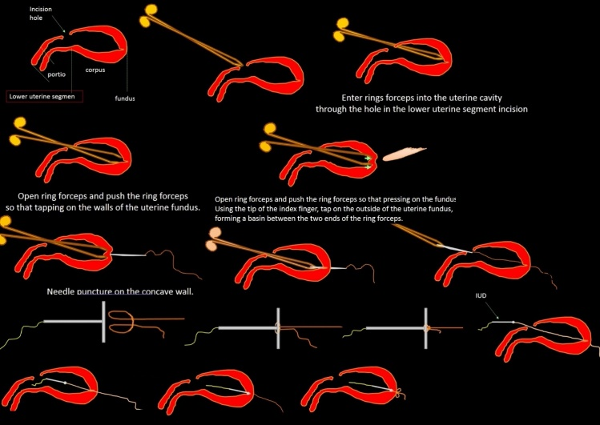
Hang up technique from outside
Straight needles and surgical thread (chromic catgut or PGA) are used.
Needle is inserted perpendicularly from the outside to penetrate the median of the fundus wall to get into the uterine cavity.
Once the surgical thread entered the uterine cavity, the needle is clamped with rings forceps and pulled out through the lower uterine segment incision.
Subsequently, an anchor knot is made on the cross-ing arm so that the IUD is balanced and hanging flexibly on the wall of the fundus.
The IUD string is then cut in the middle of the long thread. Using ring forceps for clamping the IUD,
it is inserted into the uterine cavity while simultaneously pulling the surgical thread out of the uterus so that the IUDs
horizontal arm is attached to the middle uterine fundus wall.
The position of IUD remains suspended by the thread.
Then, a knot is made on the outer surface of the uterus so the IUD will be fixed and hangs from the fundus

Slide 22
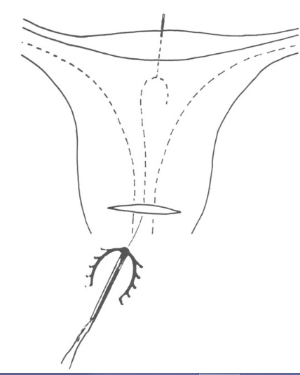
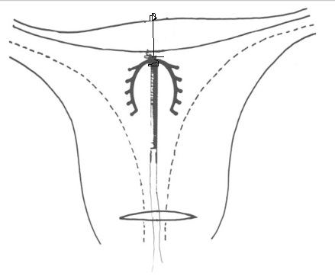
Hang up technique from Inside
After delivering the fetus and removing the Placenta the uterus is delivered out from The abdomen through the laparotomy wound.
A '0' chromic catgut strand is tied at the junction of
the vertical and The curved limbs of the Multiload Cu 375
by a single knot, The straight round body needle is employed to take one end of this catgut through the wall of the Uterine fundus At its centre, from inside out
The position of IUD remains suspended by the thread.
Then, a knot is made on the outer surface of the uterus so the IUD will be fixed and hangs from the fundus

Slide 23
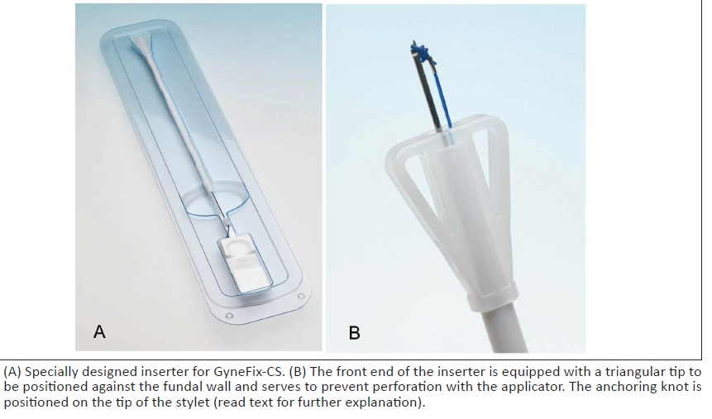

GyneFix Postpartum With Cone-Shaped Anchor
the technique consists of the precise placement of the anchoring knot immediately below the serosa of the uterus, followed by fixing the
knot in place with an absorbable suture.

Slide 24
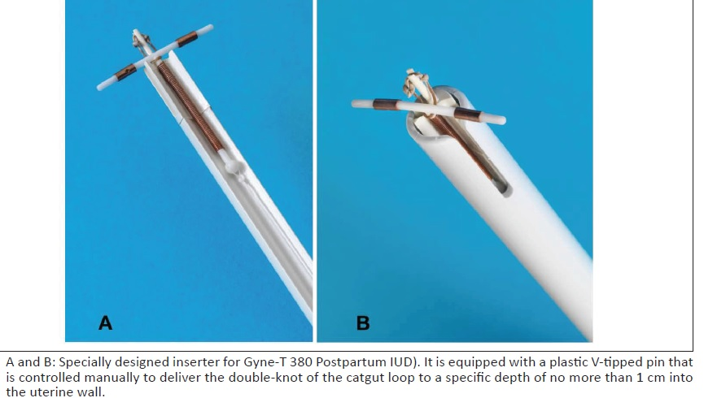
Insertion of Copper T with knotted loop of 2-0 chromic catgut suture
knotted loop of 2-0 chromic catgut suture around the top
of the vertical arm, which is inserted approximately 1
cm into the fundal myometrium
A special inserter had to be designed for the T 380 Postpartum
IUD.
The inserter was equipped with a plastic V-tipped rod
that was controlled manually, permitting the clinician
to determine accurately the depth of the insertion into
the uterine wall.
The rod delivered the knotted loop of 2-0 chromic catgut into
the uterine wall to a depth of no more than 1 cm
When the insertion was completed, the transverse arms of the
T were flush with the endometrial surface at the top of the
Fundal cavity.
After insertion, the catgut dissolved over the next
4 to 6 weeks, leaving the IUD free in the endometrial cavity.
By this time the uterus had involuted to its normal
prepregnancy shape and size.

Slide 25
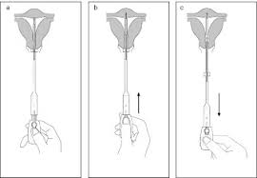
Immediate Post-placental Anchoring of Frameless IUD
below the polypropylene anchoring knot, a cone-shaped biodegradable
body (polycaprolactone), 4x4 mm in size, is added to retain the device in the muscular tissue of the uterine fundus
The technique consists of the precise placement of the anchoring knot immediately below the serosa of the uterine fundus

Slide 26
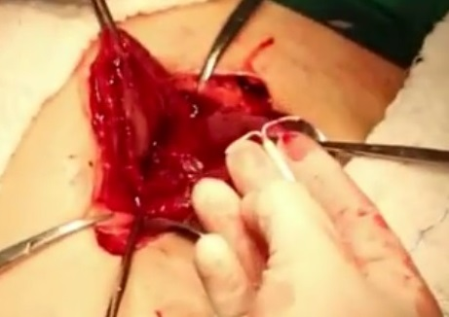
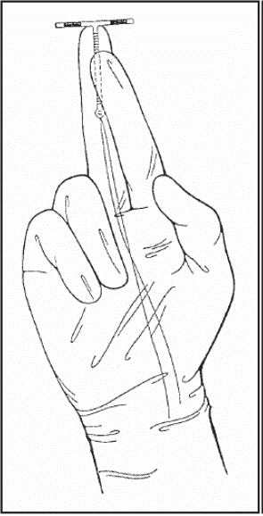
Manual Insertion Of PPIUCD
Holds the IUCD between the index and middle fingers of the hand,
Passes it through the uterine incision and places it at the uterine fundus;
Slowly withdraws the hand, ensuring that the IUCD remains properly placed; and
If the cervix is closed, dilate
Closes the uterine incision,
Taking special care not to incorporate the IUCD strings into the suture.

Slide 27
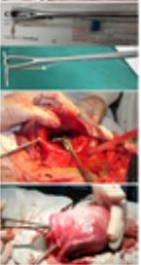
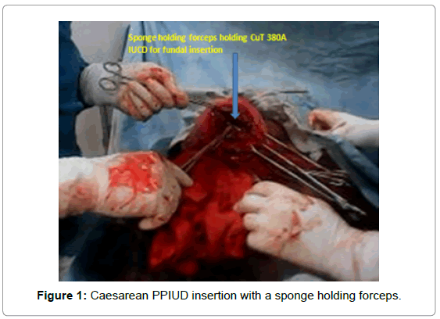
Assisted By Ring Forceps
After removal of placenta and membranes,
uterine cavity was cleaned with sterile gauze
Copper T 380A was introduced through uterine incision with the help of long sponge holding forceps (Mirena strings may need to be trimmed prior to placement).
It was placed high at the uterine fundus using non touch technique
If the cervix is closed, dilate
Strings were folded upwards pointing towards the fundus to avoid their inclusion into the suture and it minimizes any chance of spontaneous expulsion .
Closure of uterus

Slide 28
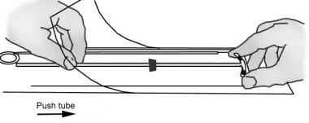
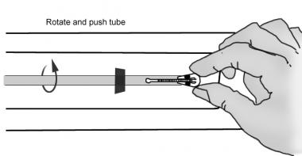
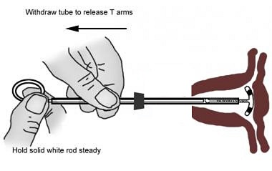
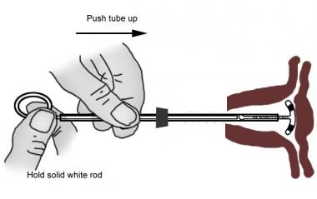
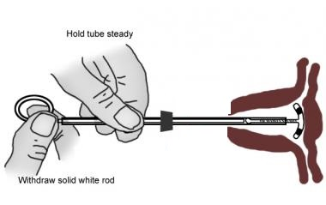
IUD insertion by the applicator
The IUD should be placed in the applicator no earlier than 5 minutes before placing 1. Open the package partly in place where the OPEN sign is. 2. Insert the applicator rod - tube until almost touching the bottom / end of the insert T. 3. Remove the bag and hold the ends of the horizontal arms, insert your thumb and index fingers. With your other hand, push the applicator so that the touch pad. Then place the arms deposited in the applicator pad only as far as necessary, to shoulder pads were made. 4. Please check the position of the ring very low on the enclosed sheet to point to the depth of the uterus. Now insert is ready to set up.
. Gently insert the applicator (the rod tube) through the uterine incision , when the movable contacts the bottom of the upper part of the uterus. 3. Holding the rod in position to slide the applicator tube so as to free the spiral arms 4. Gently push the applicator tube to the front in the direction of the uterus, until a light resistance occurs. This ensures that the pad is close to the bottom of the uterus. 5. Remove the applicator: - First remove the tube while holding the rod in position, then gently pull the tube rotation
If the cervix is closed, dilate
Strings were folded upwards pointing towards the fundus to avoid their inclusion into the suture and it minimizes any chance of spontaneous expulsion .
Closure of uterus

Slide 29
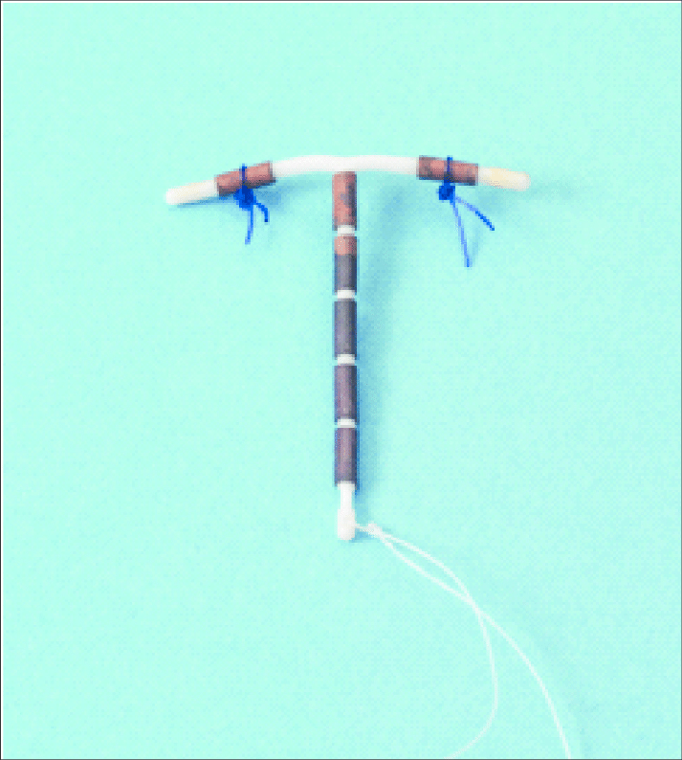
Immediate Post-placental Anchoring of TCu380
Delta-TCu380 postpartum IUD.
Two strands of catgut were knotted on both transverse arms of the T
in an attempt to provide better retention of the iUD in the uterine cavity.
When the insertion was completed,
the transverse arms of the T were flush with the endometrial surface at the top of the fundal cavity.
After insertion, the catgut dissolved over the next 4 to 6 weeks,
leaving the IUD free in the endometrial cavity.
By this time the uterus had involuted to its normal prepregnancy shape and size.

Slide 30
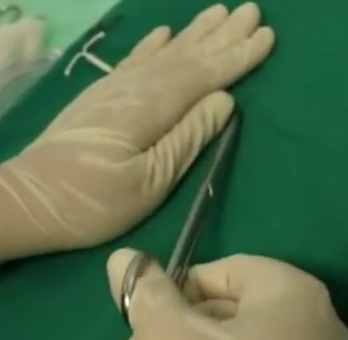
Threads = To cut or not to cut
during caesarean section, after delivery of
the baby, placenta and membranes, IUCD was inserted
through the incision in the uterus and the shortened
thread pushed through the cervix from inside the uterus.
Or pushed high in uterine cavity
The IUCD was not anchored to the uterus.
Paragard strings are 12 cm and should not be visualized after insertion;
if the strings are visible, the IUD may be too low and reinserted should be considered. The strings usually descend spontaneously through the cervix and can be trimmed at a follow-up visit.
If fundal placement is confirmed and strings are seen, trim to the level of the cervix.
Mirena strings should also be trimmed to the level of the cervix.

Slide 31
Early Complications
IUD insertion did not significantly increase postoperative pain, hospital stay, the volume or duration of bleeding, or frequency of infection.
The results suggest that IUD insertion during cesarean is a safe and effective method of fertility control for patients at high reproductive risk.

Slide 32
Late Complications
Retention rate of PPIUCD was high.
Spontaneous expulsion in intra-caesarian IUCD was less as fundal placement was assured at the time of insertion.
Bleeding problems were the major complaint and the main reason for removal of PPIUCD
Results
Retention rate was 86.33%.
Spontaneous expulsion was 8.54.
Bleeding was the main symptom perceived by 88.71% women
followed by long thread 26.02% and
pain in lower abdomen 15.90%.
Total 61.29% women were satisfied and were continuing the method.

Slide 33
Bleeding Problems
Proper insertion (to avoid Malposition and displacement ), custom fitting to avoid dimensional incompatibilities, or changes in the size, material, or shape of the IUD have failed to significantly improve IUD-associated bleeding problems.
The addition of copper to inert devices appears to slightly improve bleeding by reducing antifibrinolytic activity,
although the improvement may be related more to reductions in the size of the device
Hormone-releasing devices significantly reduce the amount of bleeding, but a post-insertion phase of irregular spotting often occurs.

Slide 34
How Can an IUD Cause an Infection?
IUDs don’t directly cause infections.
If woman have an existing infection, inserting the IUD may spread it.
Two common sexually transmitted diseases (STDs) are chlamydia and gonorrhea.
That’s why some doctors may want to test for STDs before inserting an IUD.
slightly higher risk of pelvic inflammatory disease (PID) for a few weeks after IUD is inserted.
The vagina normally contains some bacteria. If bacteria are pushed up into the reproductive organs during IUD insertion, it may result in PID.
May expose client to infection during insertion if infection prevention practices are not followed (this is minimal with good infection prevention procedures).

Slide 35
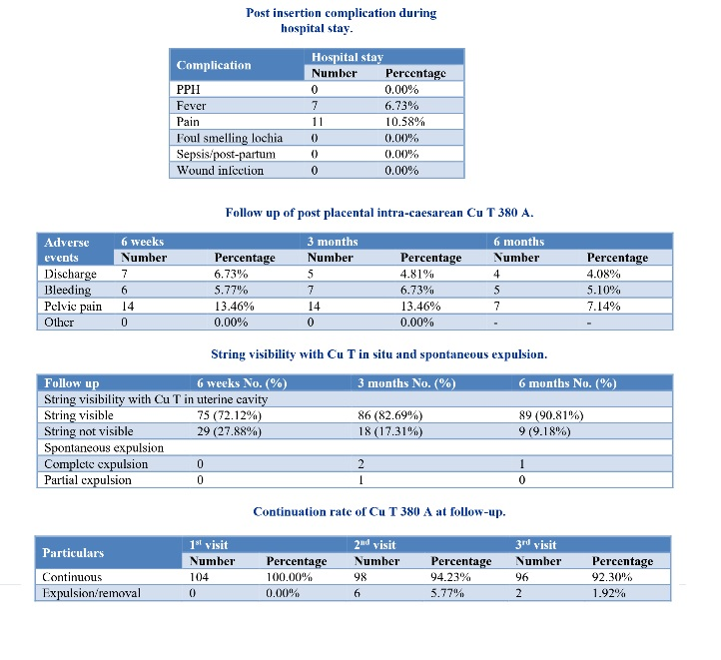

Slide 36
Conclusion
PPIUDCS has many practical advantages.
The recipient can leave with the IUD in place and will be protected from pregnancy even if she does not attend follow-up, provided the IUD remains in place.
Further evidence from systematic review of recent studies is providing us with new information to help make this a more acceptable option for women in the GS and elsewhere.
In order to expand access to this procedure there are three main problems to be solved, namely:
1) prevent expulsion – whether by device design or suture technique and provider’s technique(manual , with ring forceps or with applicator;
2) ensure that strings are visible, and if possible do not require adjustment; and
3) reduce puerperal bleeding – hopefully by the use of cheaper hormone releasing devices, which should soon become available.
it can be concluded that, the quality of evidence was moderate and trials of adequate power are needed to estimate expulsion rates and side effects.
• The benefit of effective contraception immediately after delivery May outweigh the disadvantage of increased risk for expulsion

