Slide 1

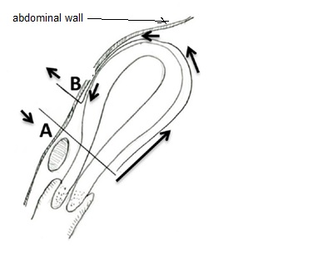
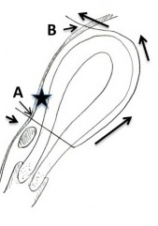
Aboulfalah Removable Uterine Compression Brace Suture
Dr Muhammad M Al Hennawy Ob/gyn consultant Egypt mmhennawy.site44.com

Slide 2
“A new removable uterine compression by a brace suture in the management of severe postpartum hemorrhage”
ORIGINAL RESEARCH ARTICLE
published: 17 November 2014
Abderrahim Aboulfalah*, Bouchra Fakhir, Yassir Ait Ben Kaddour , Hamid Asmouki and Abderraouf Soummani
Department of Gynecology and Obstetrics,
University Hospital Mohammed VI,
Marrakech,
Morocc

Slide 3
Postpartum hemorrhage (PPH) is a life-threatening complication of delivery. It is the leading cause of maternal death
with 1 to 13% of births around the world affected
It occurs in approximately 4% of vaginal deliveries and 6% of cesarean deliveries
Definition of PPH differs between authors; in general, it is a loss of more than 500 ml of blood after vaginal delivery or 1000 ml after cesarean section
Severity criteria are uncontrolled bleeding after initial medical management of PPH, hemodynamic instability even resuscitation by crystalloids and red blood cells, and presence of coagulation disturbances.

Slide 4
Surgery is then indicated.
Since the first publication of B-lynch technique in 1997
different uterine compression sutures have been described and performed as an alternative to hysterectomy.
Based on compressive sutures, they have proven to be valuable and safe in the control of massive PPH
Recently, uterine synechia has been reported as a frequent complication of those sutures,
with 18–54% frequency, which surely compromises fertility
Sutures that run through the full thickness of both anterior and posterior uterine walls and infection are involved in this complication.
In order to prevent synechia and using two uterine bleeding control mechanisms,
we conceptualized and performed from 2006 to 2011 a new uterine compressive brace suture procedure

Slide 5
Surgical technique description
The principle of the technique is a removable uterine brace suture, which compresses uterus against the pubis.

Slide 6
Under general anesthesia,
the patient is placed in the Lloyd Davis position,
a urinary catheter in place, and
an assistant is positioned between the patient’s legs to assess vaginal bleeding.
The same incision as for a cesarean section can be used or if PPH occurs after vaginal delivery, both below umbilical median or transversal incisions can be performed.

Slide 7
After uterine exteriorization and pelvic exploration,
a test is carried out to assess the effectiveness.
We proceed by front curving and compressing the uterus against the pubis,
if bleeding has decreased or stopped,
the procedure has a high chance of stopping PPH

Slide 8

First, the bladder peritoneum is reflected inferiorly.
Using a number 2 sliding non-resorbable suture wire with 70 mm round-bodied hand needle or with wire guide,
the first stitch is applied from outside,
running through the full thickness of anterior abdominal wall above the pubis immediately and 2 cm laterally from the median line.
Starting from the right side or left side is the same.

Slide 9

After that, the needle is passed through the inferior uterine segment from the anterior to posterior wall as low as possible,
under sutured hysterotomy, and 2 cm inside from uterine artery cross.
The wire is then passed over as a brace to compress the uterine fundus by approximately 3 or 4 cm inside the corneal border

Slide 10

Finally, the last stitch is applied from inside to outside through the abdominal wall 2 cm above the first parietal stitch but 4 cm laterally from the median line.
The same procedure is realized from the other side of the median line.

Slide 11

Finally, the right and the left lower suture extremities are tied anteriorly, followed by the upper extremities with added curves and compression of the uterus against the pubis
The throws are visible to the skin

Slide 12
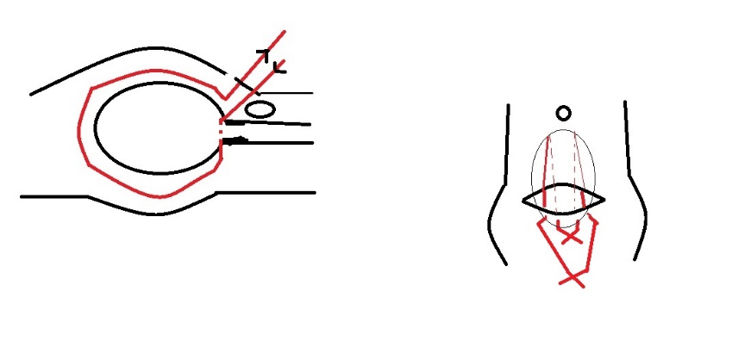
Efficacy is immediately checked.
Twenty-four to forty-eight hours later maximum,
the throws are cut, and
sutures are removed
by simple wire traction
without any anesthesia.

Slide 13
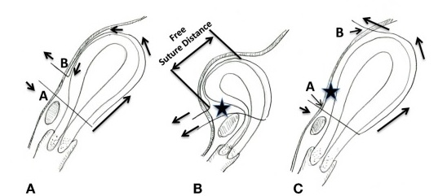
Modification Of Aboulfalah Removable Uterine Compression Brace Suture
Schematic presentation of the Aboulfalah removable uterine compression suture (A,B),
(A) The Aboulfalah technique. The upper inset illustrates the anterior view. (B) Tying the suture in the Aboulfalah technique. The suture is pulled (arrows) and tied, and, thus, the uterus assumes an anteflexed position. The suture runs freely along the anterior uterine wall. There is a space between the suture and the anterior uterine surface (star). The upper inset illustrates the anterior view.
(C) modificationof aboualfalah. Compared with the Aboulfalah technique [(A,B), point B], point B is more cephalad. Thus, the anterior uterine wall becomes compressed against the abdominal wall. There is no space [comparing the star between this figure and (B)].

Slide 14
Results
In our 15 procedures,
PPH occurred in 11 cases (73%) after vaginal delivery and in 4 cases (27%) after cesarean section.
Eighty percent were caused by uterine atony.
In 11 cases, the technique was realized secondarily after vascular ligature failure alone, and in 1 case after partial uterine resection for accret placental.
One hundred percent of hemostasis was obtained;
one (7%) secondary hysterectomy was done for bleeding relapse 3 h later.
One death occurred secondary to preeclampsia with cerebral vascular accident.
No particular complications were noted.
During post-operative follow up, all patients regained their normal menstrual cycles.
Five pregnancies were attempted, and three normal pregnancies were achieved.

Slide 15
Discussion
We describe an innovative method, which is
simple,
effective,
easy to learn,
tried with successful outcome for the control of severe PPH
as an alternative to more complicated surgeries like hysterectomy.
This technique uses two mechanisms of bleeding control by compression of placental site by tight compression of uterine walls and by obstruction of blood flow through uterine arteries by extreme forward flection of the uterus.

Slide 16
Preventing uterine synechia is possible because uterine cavity is respected, there is no need to open the cavity by a new hysterotomy compared to original B-Lynch suture
and suture does not pass through the full thickness of both anterior and posterior uterus body wall compared to cho sutures
or to compressing U-sutures
Also it is known that inflammation around sutures and infection are responsible of synechia.
So, the most innovative particularity of our technique is the removal of the suture 24 or 48 h later. T

Slide 17
This is the first time that a compressing uterine suture technique is followed by removal of the suture, and these three details may be the key of preventing synechia by decreasing the risk of infection.
There is no foreign body inside the uterine cavity, and spontaneous cervical drainage is done after suture removal; hence,
pyometra is avoided. Also, removing sutures prevents joining of endometrial walls over time, which itself increases the risk of infection.

Slide 18
Conclusion
The year 1997 opened a new era of PPH treatment.
However, the concept of a UCS (uterine compression sutures ) is not yet complete.
The presence of various modifications of the UCS indicates that there is no “best” method for placing or removing a UCS.
Removable uterine brace compressive against pubis suture is a promising technique,
simple,
safe, and
effective in management of severe PPH,
adapted to most of PPH causes, from uterine atony to placenta accreta.
It may prevent synechia and help maintain fertility by respecting uterine cavity and
this more precisely by percutaneous removing of the suture 24–48 h later.
A removable UCS may be promising and its introduction may open a second new era of PPH treatment.
Wider discussion may hasten adoption of this technique.

