Slide 1

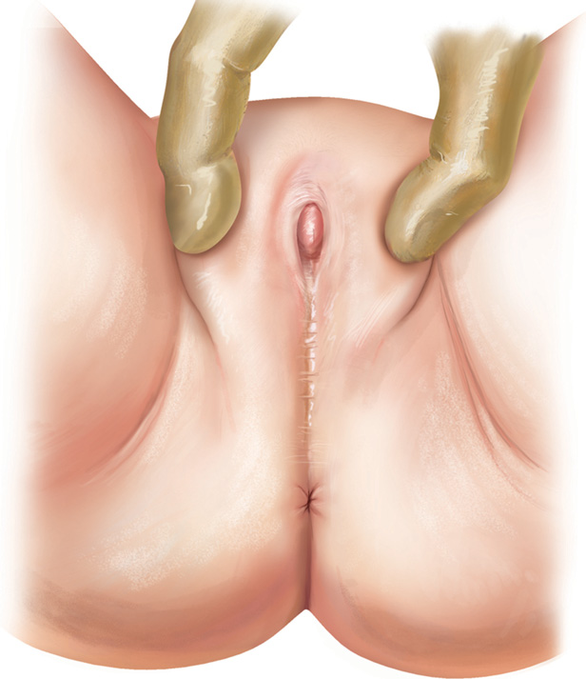
Labia Minora Adhesions (LMA)
Muhammad M Al Hennawy
First Consultant Obstetrician & Gynacologist
Egypt 01222503011

Slide 2
Definition
Labial agglutination (Adhesion) or “fused labia”
It is defined as the partial to complete fusion of the labia minora (or labia majora).
In which the opposing epithelial surfaces of labia minora stick together without any union of deeper tissues

Slide 3
Membranous structure
Fusion of medial adjacent mucosal surfaces of labia minora
Ranging
From thin , transeparent
To thick and fibrous

Slide 4
Labial fusion is almost never present at birth,
usually develops around one to two years of age.
Labial adhesions are usually an innocent finding and a trivial problem, are a common finding in the girls.
Usually, this condition is asymptomatic
spontaneously disappears during adolescence
but its importance is that it is frequently
misdiagnosed as congenital absence of the vagina

Slide 5
Labial adhesion is relatively common,
but the condition is little known among doctors and parents.
It is a source of great paternal anxiety
And are commonly misdiagnosed or unnecessary investigations may be orderd

Slide 6
Names
Labial adhesion
Labial fusion
Labial synechia
Labial agglutination
synechia vulvae

Slide 7
Incidence
it is estimated to occur in 0.6 – 3.3 % of prepubertal girls
However, this may be significantly higher as many children with this condition are asymptomatic and remain unreported.
Rates as high as 21.3% and 38.9% have been documented

Slide 8
Causes Of labial adhesion in PrePubertal Girls
Exact cause is uncertain
Microtraumas l ike overcleaning causing mechanichal mucosal injury of the perineium == Lead to adhesion of labia minora Because all mothers were cleaned the perineum of their daughter too much
Chonic irritation
chronic inflammation from fecal soiling, vulvovaginitis (inflammation around the area of the vagina), eczema or dermatitis (skin inflammation) from soaps or detergents. Eg
- chemical trauma
-Infections (candida albicans,entobius vermicularis,various bacteria)
-Bad hygiene
-Sexual abuse
Trigger inflammation of hypoestrogenised vulva

Slide 9
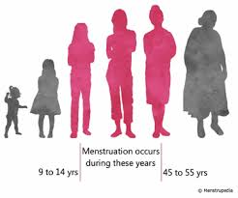
The most common causes of labial adhesion in adult women (PostPartum, PostMenopausal)
Oestrogen deficiency associated with atrophic vaginitis
Vulval lichen sclerosus
Erosive lichen planus
Mucous membrane pemphigoid
Behcet syndrome
Stevens-Johnson syndrome / toxic epidermal necrolysis
Vulval cancer
Complications of childbirth
Female circumcision operation (illegal in many countries)
Complications from vulvectomy

Slide 10
Symptoms
Labial adhesions are usually asymptomatic
Symptomatic common symptoms or complaints can include: Urinary dribbling which is due to urine that gets trapped behind the adhesion or fused labia, later dribbling out.
Skin or vaginal irritation or redness.
Frequent urinary tract infections as a result of the adhesions.
Eg
-UTI
-Pain or discomfort during activity
-Post voiding dribbling
-Abnormal urinary stream
-Urinary retension

Slide 11
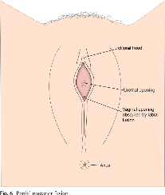
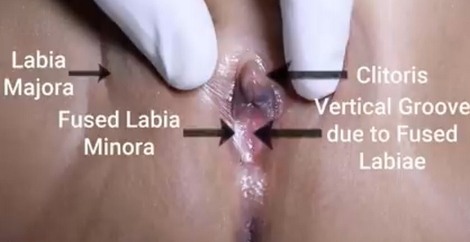
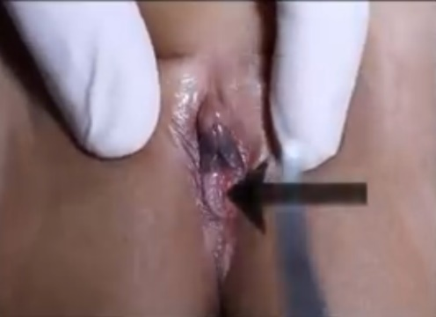
Signs Labial fusion is diagnosed by visual inspection
• Fusion of the labia minora in the midline (extends from just below the clitoris to the posterior fourchette) until onley a small opening is left superiorly through which urine is passed
No urethral or vaginal opening are seen in complete type
Adhesion between a labium minor and corresponding labium major results in resorption, shrinking or disappearance of the labium minor.
• Retention of urine in the vestibule or vagina resulting in irritation, discharge, and odor

Slide 12
Workup and Evaluation
Laboratory: No evaluation indicated.
Imaging: No imaging indicated.
Special Tests: None indicated. Although an endoscopic examination is frequently performed in the diagnosis and treatment of lower and upper urinary tract disease, the use of cystoscopy in patients with labial fusion and urinary retention has not been reported
Diagnostic Procedures: History and physical
examination.

Slide 13
Spontaneous resolution
50% in cases within 6 monthes
90% in cases within 12 monthes
100% in cases within 18 monthes

Slide 14
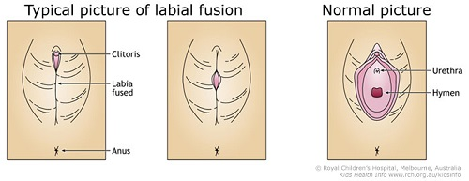
Differential Diagnosis
Labial adhesive should be distinguished from congenital deformities,
as visually there is a mid-line raphe (line of fusion) present with labial adhesion
that would not be apparent in a congenital condition.
Eg an imperforate hymen or Intersex
DD from-- Female circumcision
DD From--Sexual abuse

Slide 15
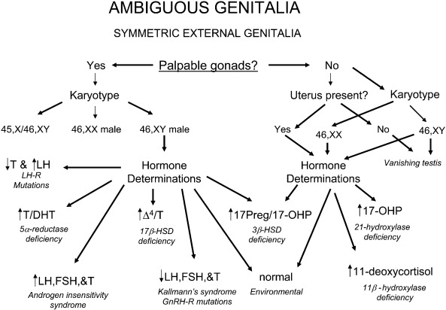

Slide 16
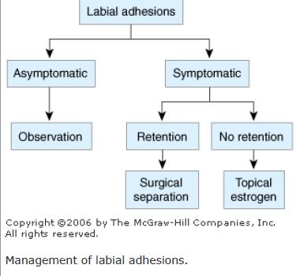
Mangement
If there are no symptoms and no problems in urinating, the doctor might want to wait for the girl to reach puberty and start to produce estrogen
Topical estrogen
Topical betamethazone
Manual separation (manual adhenolysis ) under local anaesthesia
Surgical separation ( surgical adhenolysis )under general anaesthesia

Slide 17
Leaving It alone
Leaving labial fusion alone is the safest and most effective treatment.
for the girl to reach puberty and start to produce estrogen

Slide 18
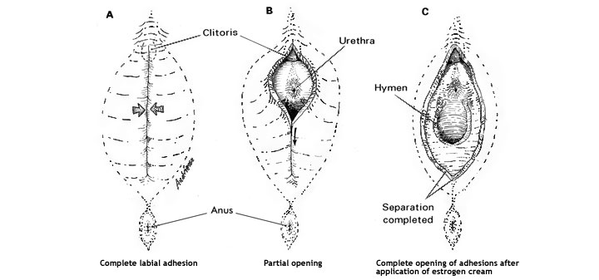
Topical Estrogen
If the adhesions cover a large area, or are causing problems,
apply cream containing estrogen for about a month.
It is important to apply the cream in the right amounts.
Side effects of treatment could include bleeding, breasts starting to grow, and irritation.
These things generally disappear when the cream is stopped. If the cream works to separate the lips,
Apply petroleum jelly or some other ointment for another period of time.

Slide 19
Topical Steroid
betamethasone 0.5%.
in addition to estrogen,
or in place of estrogen.
Betamethasone use should be limited to a certain period of time, such as 3 months.

Slide 20
Manual or surgical separation
If creams do not work, it is usually because the adhesion is thick. In very few cases, separation might be needed if the adhesions are causing problems, such as blocking urine or causing many infections. Only doctors who are experienced should do a manual separation. The procedure calls for local anesthesia and possibly sedation. Surgical separation generally is only needed if the girl cannot urinate or if other treatments do not work. Surgery is also suggested for the rare labial adhesion that occurs after a pregnancy.

Slide 21
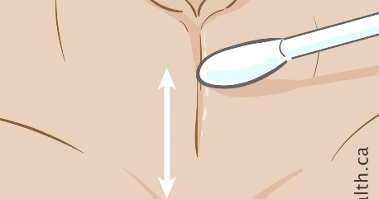
Manual separation
applied local anaesthetic cream and
then used manual separation ,
cotton buds,
a probe or
tenaculum
Post-surgical aftercare with oestrogen is recommended for 1 – 2 weeks, and with vaseline for 6 – 12 months

Slide 22
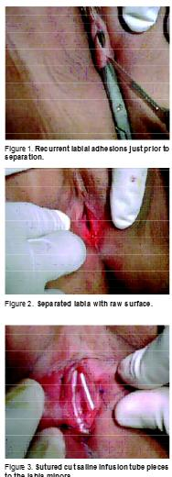
Surgical technique
Surgery was performed under general anaesthesia
Adhesions were incised sharply and the cut edges were reapproximated with 7-0 chromic.
or
During surgery labial fusion was separated by sharp
dissection
Saline infusion tube cut to the length
of the raw area of the separated labial adhesions were
sutured on to the edges using 3/0
The tubes were removed on day 7.
This effectively
prevented contact of the raw surfaces until epitheLialisation
Other surgical techniques
like
amniotic membrane and
rotational skin flaps have been tried to prevent recurrentlabial adhesions with varying success

Slide 23
Adhesion tend to recur
Preventive measures
Gentle labial separation to visualse introitus
Daily bath
Avoidance of irritants ( soapy water, bubble bath )
Vulvar airig ( daily period of time when diaper is removed or not wear underwear with night clothes

Slide 24
Conclusion
There is no clear-cut effective treatment for labial adhesion, and
there is no reason to treat girls in the absence of symptoms
. The condition resolves spontaneously in all, at puberty if not before.
Any child with symptoms that may be due to the adhesion should be referred to a paediatrician.
Healthcare professionals at public health clinics are advised to look for adhesion at check-ups in children aged two years and under.
It is important to provide sufficient information – to ensure that parents do not become alarmed if an adhesion is discovered subsequently.
It is also important to avoid unnecessary investigation and treatment.

