Slide 1

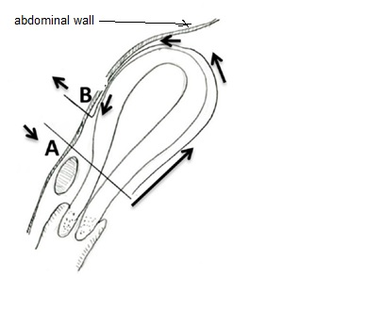
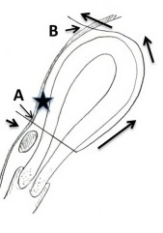
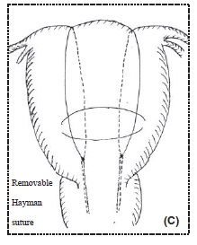
3 New Removable Uterine Compression Sutures( RUCS)
Dr Muhammad M Al Hennawy Ob/gyn consultant Egypt mmhennawy.site44.com

Slide 2
Primary postpartum haemorrhage (PPH) remains the leading
cause of maternal death worldwide1 and accounts for
over 25% of maternal mortality.2 Conservative management,
such as uterine fundal massage or bimanual uterine
compression, various uterotonic agents and intrauterine
gauze tamponade or an intrauterine balloon catheter, will
control the majority of PPHs.3,4 However, the failure of relatively
non-invasive management has prompted more invasive
treatments, including uterine artery ligation, iliac
artery ligation or, as a last resort, hysterectomy. Postpartum
hysterectomy under emergency conditions is a life-saving
surgery but its adverse outcome is not only related to the
unexpected loss of fertility and considerable psychological
trauma, but also to serious morbidities such as injury of
the urogenital tract.5,6

Slide 3
In 1997, B-Lynch et al.7 introduced the B-Lynch uterine
compression suture. Since then, various uterine compression
sutures have been used. In years some complications
have emerged.
In this case series we discuss three types of
removable uterine compression sutures which may reduce
the risk of possible harmful consequences of compression
and evaluate their effectiveness and safety in the management
of PPH

Slide 4
Postpartum hemorrhage (PPH) is a life-threatening complication of delivery. It is the leading cause of maternal death
with 1 to 13% of births around the world affected
It occurs in approximately 4% of vaginal deliveries and 6% of cesarean deliveries
Definition of PPH differs between authors; in general, it is a loss of more than 500 ml of blood after vaginal delivery or 1000 ml after cesarean section
Severity criteria are uncontrolled bleeding after initial medical management of PPH, hemodynamic instability even resuscitation by crystalloids and red blood cells, and presence of coagulation disturbances.

Slide 5
Surgery is then indicated.
Since the first publication of B-lynch technique in 1997
different uterine compression sutures have been described and performed as an alternative to hysterectomy.
Based on compressive sutures, they have proven to be valuable and safe in the control of massive PPH
Recently, uterine synechia has been reported as a frequent complication of those sutures,
with 18–54% frequency, which surely compromises fertility
Sutures that run through the full thickness of both anterior and posterior uterine walls and infection are involved in this complication.

Slide 6
In order to prevent synechia and
using two uterine bleeding control mechanisms,
We discuss New Removable compression sutures
Removable brace suture compression suture
Removable B-Lynch compression suture
Removable Hyman compression suture

Slide 7
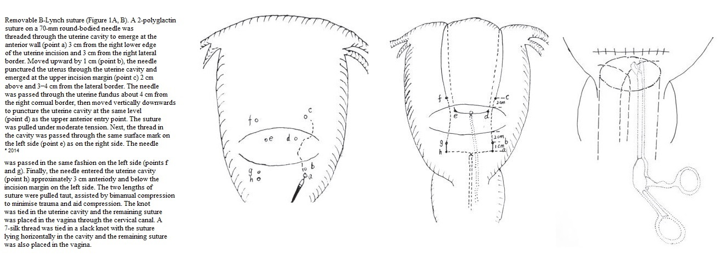
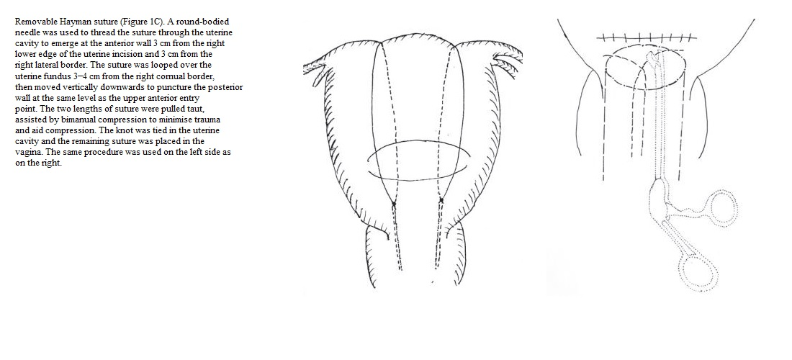
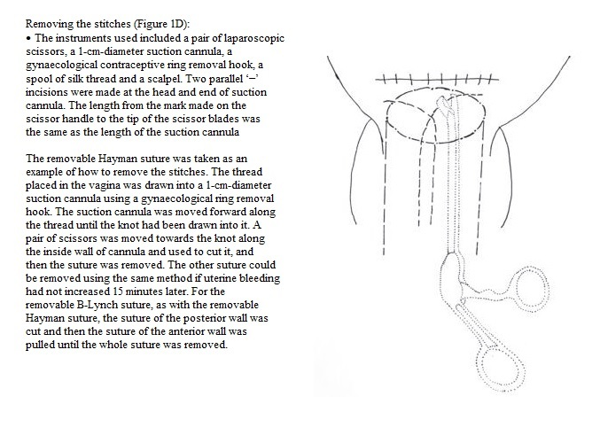
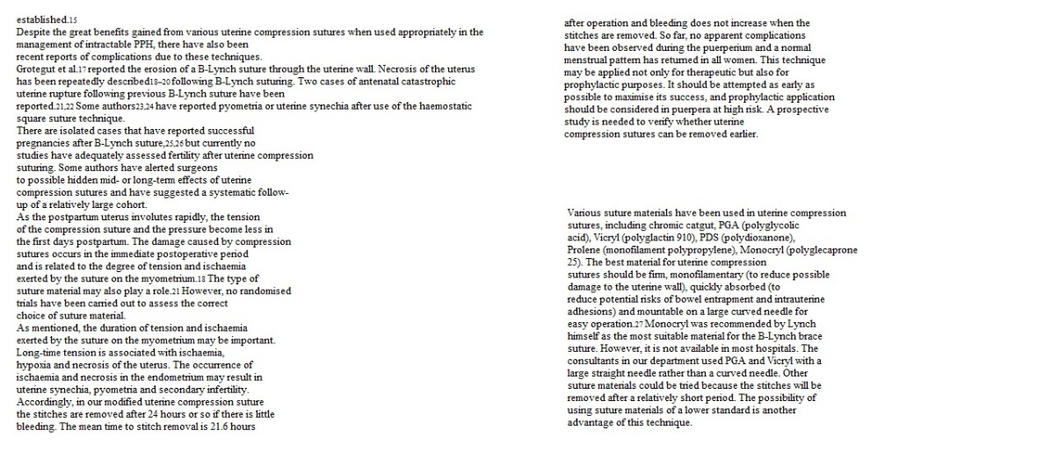

Slide 8
“A new removable uterine compression by a brace suture in the management of severe postpartum hemorrhage”
ORIGINAL RESEARCH ARTICLE
published: 17 November 2014
Abderrahim Aboulfalah*, Bouchra Fakhir, Yassir Ait Ben Kaddour , Hamid Asmouki and Abderraouf Soummani
Department of Gynecology and Obstetrics,
University Hospital Mohammed VI,
Marrakech,
Morocc

Slide 9
Surgical technique description
The principle of the technique is a removable uterine brace suture, which compresses uterus against the pubis.

Slide 10
Under general anesthesia,
the patient is placed in the Lloyd Davis position,
a urinary catheter in place, and
an assistant is positioned between the patient’s legs to assess vaginal bleeding.
The same incision as for a cesarean section can be used or if PPH occurs after vaginal delivery, both below umbilical median or transversal incisions can be performed.

Slide 11
After uterine exteriorization and pelvic exploration,
a test is carried out to assess the effectiveness.
We proceed by front curving and compressing the uterus against the pubis,
if bleeding has decreased or stopped,
the procedure has a high chance of stopping PPH

Slide 12

First, the bladder peritoneum is reflected inferiorly.
Using a number 2 sliding non-resorbable suture wire with 70 mm round-bodied hand needle or with wire guide,
the first stitch is applied from outside,
running through the full thickness of anterior abdominal wall above the pubis immediately and 2 cm laterally from the median line.
Starting from the right side or left side is the same.

Slide 13

After that, the needle is passed through the inferior uterine segment from the anterior to posterior wall as low as possible,
under sutured hysterotomy, and 2 cm inside from uterine artery cross.
The wire is then passed over as a brace to compress the uterine fundus by approximately 3 or 4 cm inside the corneal border

Slide 14

Finally, the last stitch is applied from inside to outside through the abdominal wall 2 cm above the first parietal stitch but 4 cm laterally from the median line.
The same procedure is realized from the other side of the median line.

Slide 15

Finally, the right and the left lower suture extremities are tied anteriorly, followed by the upper extremities with added curves and compression of the uterus against the pubis
The throws are visible to the skin

Slide 16
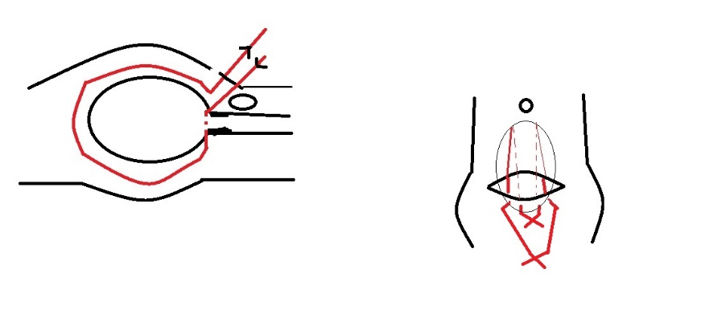
Efficacy is immediately checked.
Twenty-four to forty-eight hours later maximum,
the throws are cut, and
sutures are removed
by simple wire traction
without any anesthesia.

Slide 17
Results
In our 15 procedures,
PPH occurred in 11 cases (73%) after vaginal delivery and in 4 cases (27%) after cesarean section.
Eighty percent were caused by uterine atony.
In 11 cases, the technique was realized secondarily after vascular ligature failure alone, and in 1 case after partial uterine resection for accret placental.
One hundred percent of hemostasis was obtained;
one (7%) secondary hysterectomy was done for bleeding relapse 3 h later.
One death occurred secondary to preeclampsia with cerebral vascular accident.
No particular complications were noted.
During post-operative follow up, all patients regained their normal menstrual cycles.
Five pregnancies were attempted, and three normal pregnancies were achieved.

Slide 18
Discussion
We describe an innovative method, which is
simple,
effective,
easy to learn,
tried with successful outcome for the control of severe PPH
as an alternative to more complicated surgeries like hysterectomy.
This technique uses two mechanisms of bleeding control by compression of placental site by tight compression of uterine walls and by obstruction of blood flow through uterine arteries by extreme forward flection of the uterus.

Slide 19
Preventing uterine synechia is possible because uterine cavity is respected, there is no need to open the cavity by a new hysterotomy compared to original B-Lynch suture
and suture does not pass through the full thickness of both anterior and posterior uterus body wall compared to cho sutures
or to compressing U-sutures
Also it is known that inflammation around sutures and infection are responsible of synechia.
So, the most innovative particularity of our technique is the removal of the suture 24 or 48 h later. T

Slide 20
This is the first time that a compressing uterine suture technique is followed by removal of the suture, and these three details may be the key of preventing synechia by decreasing the risk of infection.
There is no foreign body inside the uterine cavity, and spontaneous cervical drainage is done after suture removal; hence,
pyometra is avoided. Also, removing sutures prevents joining of endometrial walls over time, which itself increases the risk of infection.

Slide 21
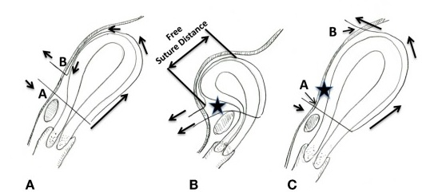
Modification Of Aboulfalah Removable Uterine Compression Brace Suture
Schematic presentation of the Aboulfalah removable uterine compression suture (A,B),
(A) The Aboulfalah technique. The upper inset illustrates the anterior view. (B) Tying the suture in the Aboulfalah technique. The suture is pulled (arrows) and tied, and, thus, the uterus assumes an anteflexed position. The suture runs freely along the anterior uterine wall. There is a space between the suture and the anterior uterine surface (star). The upper inset illustrates the anterior view.
(C) modificationof aboualfalah. Compared with the Aboulfalah technique [(A,B), point B], point B is more cephalad. Thus, the anterior uterine wall becomes compressed against the abdominal wall. There is no space [comparing the star between this figure and (B)].

Slide 22
Conclusion
The year 1997 opened a new era of PPH treatment.
However, the concept of a UCS (uterine compression sutures ) is not yet complete.
The presence of various modifications of the UCS indicates that there is no “best” method for placing or removing a UCS.
Removable uterine brace compressive against pubis suture is a promising technique,
simple,
safe, and
effective in management of severe PPH,
adapted to most of PPH causes, from uterine atony to placenta accreta.
It may prevent synechia and help maintain fertility by respecting uterine cavity and
this more precisely by percutaneous removing of the suture 24–48 h later.
A removable UCS may be promising and its introduction may open a second new era of PPH treatment.
Wider discussion may hasten adoption of this technique.

Slide 23
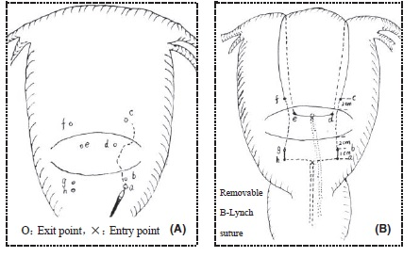
Removable B-Lynch Suture
A 2-polyglactin suture on a 70-mm round-bodied needle
was threaded through the uterine cavity to emerge at the anterior wall (point a) 3 cm from the right lower edge of the uterine incision and 3 cm from the right lateral border.
Moved upward by 1 cm (point b),
the needle punctured the uterus through the uterine cavity and emerged at the upper incision margin (point c) 2 cm above and 3–4 cm from the lateral border.
The needle was passed through the uterine fundus about 4 cm from the right cornual border,
then moved vertically downwards to puncture the uterine cavity at the same level (point d) as the upper anterior entry point.
The suture was pulled under moderate tension.
Next, the thread in the cavity was passed through the same surface mark on the left side (point e) as on the right side.
The needle was passed in the same fashion on the left side (points f and g).
Finally, the needle entered the uterine cavity (point h) approximately 3 cm anteriorly and below the
incision margin on the left side.

Slide 24
The two lengths of suture were pulled taut,
assisted by bimanual compression to minimise trauma and aid compression.
The knot was tied in the uterine cavity and the remaining suture
was placed in the vagina through the cervical canal.
A 7-silk thread was tied in a slack knot with the suture lying horizontally in the cavity and
the remaining suture was also placed in the vagina.

Slide 25
Removable Hayman Suture
Removable Hayman suture
A round-bodied needle was used to thread the suture through the uterine cavity to emerge at the anterior wall 3 cm from the right lower edge of the uterine incision and 3 cm from the
right lateral border.
The suture was looped over the uterine fundus 3–4 cm from the right cornual border
then moved vertically downwards to puncture the posterior wall at the same level as the upper anterior entry point.
The two lengths of suture were pulled taut, assisted by bimanual compression to minimise trauma
and aid compression.
The knot was tied in the uterine cavity and the remaining suture was placed in the
vagina.
The same procedure was used on the left side as on the right

Slide 26
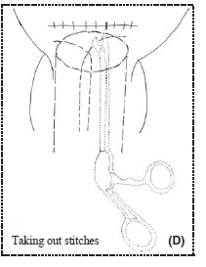
Removing the stitches
• The instruments used included a pair of laparoscopic scissors,
a 1-cm-diameter suction cannula,
a gynaecological contraceptive ring removal hook,
a spool of silk thread and a scalpel.
Two parallel ‘–’ incisions were made at the head and end of suction
cannula.
The length from the mark made on the scissor handle to the tip of the scissor blades was the same as the length of the suction cannula.

Slide 27
The removable Hayman suture was taken as an example of how to remove the stitches
.The thread placed in the vagina was drawn into a 1-cm-diameter suction cannula using a gynaecological ring removal hook.
The suction cannula was moved forward along the thread until the knot had been drawn into it.
Ampair of scissors was moved towards the knot along the inside wall of cannula and used to cut it, and then the suture was removed.
The other suture could be removed using the same method if uterine bleeding had not increased 15 minutes later.
For the removable B-Lynch suture, as with the removable Hayman suture, the suture of the posterior wall was cut and then the suture of the anterior wall was
pulled until the whole suture was removed.

Slide 28
Discussion
Primary postpartum haemorrhage occurs in approximately 4% of vaginal and 6% of caesarean deliveries.
The prevalence of severe PPH is estimated in 6.7/1000,9 and deaths from PPH occur in approximately 1/1000.10 Different compression sutures have been applied to control PPH, including the B-Lynch suture,7 the Cho suture,11 the Hayman
suture and the Matsubara–Yano (MY) suture.
Up to now, neither randomised control trials (RCTs) nor controlled trials have been performed to determinewhich uterine compression suture is the best for achieving haemostasis.
The average rate of haemostasis is 97% (103/109), varying from 76 to 100% according to the summarised original articles, but there are no
reliable data for this.
In a UK study the success rate was lower than that of other reports but compression sutures still showed an overall success rate of 75%.
The efficacy of the compression suture has been tested over a substantial period of time and can be said to be almost established.

Slide 29
Despite the great benefits gained from various uterine compression sutures when used appropriately in the management of intractable PPH, there have also been recent reports of complications due to these techniques. Grotegut et al. reported the erosion of a B-Lynch suture through the uterine wall. Necrosis of the uterus has been repeatedly described following B-Lynch
suturing. Two cases of antenatal catastrophic uterine rupture
following previous B-Lynch suture have been reported. Some authors have reported pyometria
or uterine synechia after use of the haemostatic square suture technique.

Slide 30
There are isolated cases that have reported successful pregnancies after B-Lynch suture,
but currently no studies have adequately assessed fertility after uterine compression suturing.
Some authors have alerted surgeons to possible hidden mid- or long-term effects of uterine compression sutures and have suggested a systematic follow- up of a relatively large cohort.

Slide 31
As the postpartum uterus involutes rapidly, the tension of the compression suture and the pressure become less in the first days postpartum.
The damage caused by compression sutures occurs in the immediate postoperative period and
is related to the degree of tension and ischaemia
exerted by the suture on the myometrium.
The type of suture material may also play a role.
However, no randomized trials have been carried out to assess the correctchoice of suture material.

Slide 32
As mentioned, the duration of tension and ischaemia exerted by the suture on the myometrium may be important.
Long-time tension is associated with ischaemia, hypoxia and necrosis of the uterus.
The occurrence of ischaemia and necrosis in the endometrium may result in uterine synechia, pyometria and secondary infertility.
Accordingly, in our modified uterine compression suture the stitches are removed after 24 hours or so if there is little bleeding.
The mean time to stitch removal is 21.6 hours after operation and bleeding does not increase when the stitches are removed.
So far, no apparent complications have been observed during the puerperium and a normal menstrual pattern has returned in all women.
This technique may be applied not only for therapeutic but also for prophylactic purposes.
It should be attempted as early as possible to maximise its success, and prophylactic application should be considered in puerpera at high risk
A prospective study is needed to verify whether uterine compression sutures can be removed earlier.

Slide 33
Various suture materials have been used in uterine compression sutures, including chromic catgut, PGA (polyglycolic acid), Vicryl (polyglactin 910), PDS (polydioxanone),
Prolene (monofilament polypropylene), Monocryl (polyglecaprone
The best material for uterine compression sutures should be firm, monofilamentary (to reduce possible damage to the uterine wall), quickly absorbed (to
reduce potential risks of bowel entrapment and intrauterine adhesions) and mountable on a large curved needle for easy operation.
Monocryl was recommended by Lynch himself as the most suitable material for the B-Lynch brace suture.
However, it is not available in most hospitals. The consultants in our department used PGA and Vicryl with a large straight needle rather than a curved needle.
Other suture materials could be tried because the stitches will be removed after a relatively short period.
The possibility of using suture materials of a lower standard is another advantage of this technique.

Slide 34
Conclusion
In our case series we introduced two kinds of removable
uterine compression sutures. This is a novel concept, with
the potential to reduce morbidity related to compression
sutures and lower the standard required for suture materials,
but it needs further evaluation.
This technique may encourage more hospitals to consider its application not only for therapeutic but
also for prophylactic purposes.

