Slide 1

Preeclampsia
Muhammad M Al Hennawy
Consultant Obstetrician & Gynacologist
Ras El Bar Central Hospital ,
Dumyat Specialised Hospital ,
Egypt

Slide 2
Hypertensive disorders of pregnancy
They are divided into four categories :
1-gestational hypertension
2-chronic hypertension
3-chronic hypertension with superimposed preeclampsia
4- preeclampsia-eclampsia

Slide 3
Epidimiology
Hypertensive disorders of pregnancy complicate nearly 10 % of pregnancy and their incidence is increasing
Preeclampsia causes 50000 – 60000 deaths per year worldwide
In addition to causing significant maternal and fetal morbidity in hundreds of thousands of others
Some of these outcomes can be prevented or improved upon through implementation of the updated recommendations in clinical practice

Slide 4
Preeclampsia
Preeclampsia is a multi-system progressive disorder characterized by the new onset of hypertension and proteinuria, or hypertension and end-organ dysfunction with or without proteinuria, in the last half of pregnancy or postpartum
The disorder is caused by placental and maternal vascular dysfunction and always resolves after delivery
Although most affected pregnancies deliver at term or near term with good maternal and fetal outcomes, these pregnancies are at increased risk for maternal and/or fetal mortality or serious morbidity.
In addition, women with preeclampsia are at increased risk for future cardiovascular disease.

Slide 5
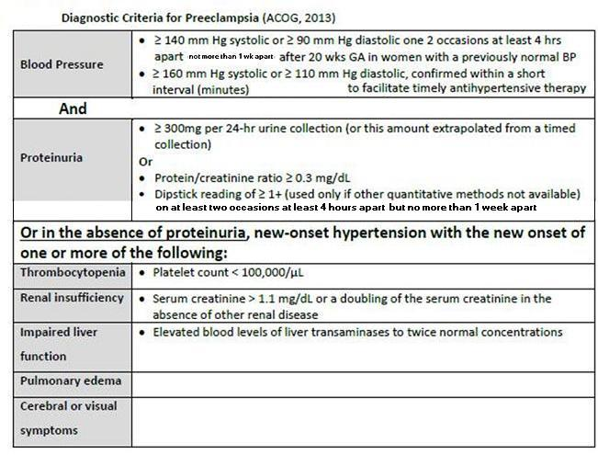

Slide 6
No longer in use are the criteria of
Increase in blood pressure above baseline measurements of 30 mmHg systolic, 15 mmHg diastolic, or 20 mmHg mean arterial pressure.
Edema is a common finding in the gravid patient, occurring in approximately 50% of women. Lower extremity edema is the most typical form of edema.

Slide 7
Classification Of Preeclampsia
Preeclampsia may be classified as
Severe (also called preeclampsia with severe features) or
Mild (also called Preeclampsia without severe features )

Slide 8
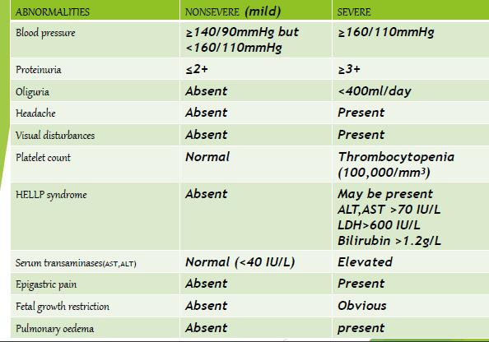
Severity Of Preeclampsia

Slide 9
HELLP Syndrome
A particularly severe and serious form of preeclampsia is HELLP syndrome characterized by hemolysis, elevated liver enzymes, and low platelets.
Prompt recognition is vital to improving outcomes.
Due to the different number of assays used to measure liver enzymes, clinicians should be familiar with the upper limit values used in their own laboratory.
Criteria for HELLP syndrome are:
LDH > 600 IU/L (more than 2 times the upper limit of normal values) or
bilirubin > 1.2 mg/dL,
AST > 70 IU/L (more than 2 times the upper limit of normal values), and
platelets < 100,000/μL.(Sibai, 2004)
Proteinuria may or may not be present with HELLP syndrome

Slide 10
Pathophysiology
The precise mechanism for the development of preeclampsia is unknown
The pathophysiology of preeclampsia likely involves both maternal and fetal/placental factors.
A major component in the development of preeclampsia is the excessive placental production of antagonists to both vascular epithelial growth factors( VEGF) and transforming growth factorB ( TGF-B )
These antagonists to VEGF and TGF-B disrupt endothelial and renal glomerular function resulting in edema , hypertension and proteinuria
In addition there appears to be a heritable component and oxidative stress and abnormal placental implantation can further increase the risk of developing the disease

Slide 11
Aetiology of preeclampsia
(Genetic predisposition)
(Abnormal immunological response)
(Deficient trophoplast invasion)
(Hypoperfused placenta)
(Circulating factors)
(Vascular endothelial cell activation)
Generalized vasospasm Activation of coagulation system Abnormal hemostasis Altered thromboxane-to-prostacyclin ratio Endothelial cell injury Abnormal hemodynamics Reduced uteroplacental blood flow
(Clinical manifestations of the disease)

Slide 12
Prevention
In women with history of a delivery at less than 34 0/7 weeks gestation Or with history of preeclampsia in multiple pregnancies
Daily low dose aspirin therapy is suggested
Low dose aspirin is not associated with increasd bleeding or placental abruption
Supplementation with antioxidant ( vit C , E) or magnesium
folic acid or fish oils or algal oils or garlic is not recommended in prevention of preeclampsia
Supplementation of calcium in women with preeclampsia is only indicated in those who are calcium deficient
Bed rest and salt restriction are not recommended in prevention pf preeclampsia

Slide 13
Preeclampsia Cannot Reliably Be Predicted.
There are currently no tests available in early pregnancy that can accurately distinguish women who will go on to develop preeclampsia from those who will not
The American College of Obstetricians and Gynecologists does not recommend screening to predict preeclampsia beyond obtaining an appropriate medical history to evaluate for risk factors
For this reason, obstetric care providers focus primarily on early detection of the disease.
All pregnant women are monitored for evidence of preeclampsia at each of their prenatal visits

Slide 14
SCREENING
Screening for traditional risk factors for preeclampsia is of value at the first prenatal visit to identify women at high risk of developing the disease, as these women are offered low-dose aspirin therapy to reduce their risk of developing the disease.
All pregnant women are at risk for preeclampsia, and evidence supports routinely screening for the disorder by measuring blood pressure at all provider visits throughout pregnancy
The value of any laboratory or imaging test for screening has not been established

Slide 15
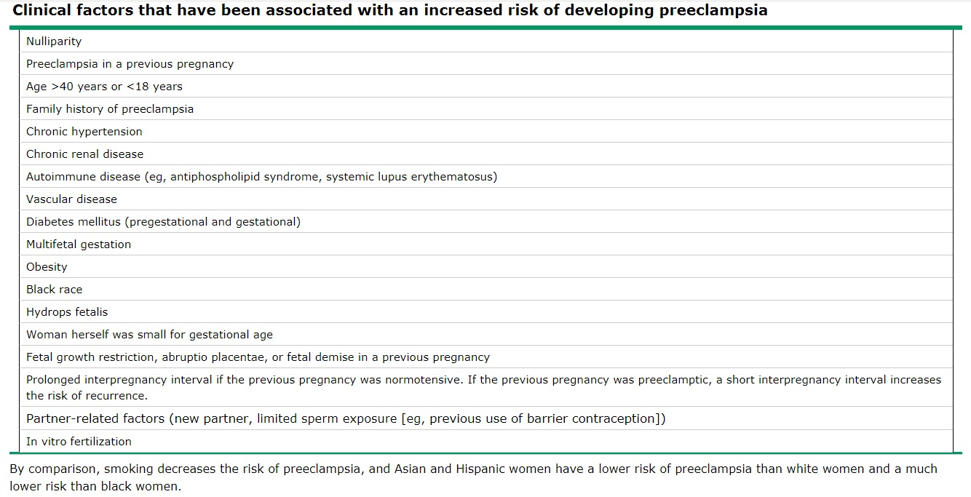

Slide 16
Investigations
Complete urine examination: for proteinuria, pus cells, RBCs, casts, specific gravity, culture and sensitivity.
Kidney function tests: serum uric acid > 6 mg % is abnormal during pregnancy. It is more specific for pre-eclampsia than creatinine. Serum creatinine level over 1.1 mg/dL
Liver enzymes (AST of >70 U/L and LDH of >600 U/L)
Hemolysis-related results are as follows: Abnormal peripheral smear. Indirect bilirubin level over 1.2 mg/dL . LDH level greater than 600 U/L
Coagulation status: Platelet count, FDP , Elevated PT (prothrombin time )or aPTT( activated partial thromboplastin time) , Decreased fibrinogen as DIC may develop.
Eye fundus examination.
Tests for foetal well being: as
ultrasound,
daily foetal movement count,
non-stress test,
oxytocin challenge test (if needed).

Slide 17
CT Scanning and MRI
Computed tomography (CT) scanning and magnetic resonance imaging (MRI) scans have revealed numerous abnormalities in patients with eclampsia, such as cerebral edema, focal infarction, intracranial hemorrhage, and posterior leukoencephalopathy
Currently, however, there is no pathognomonic CT scan or MRI finding for eclampsia. Furthermore, cerebral imaging is not necessary for the condition’s diagnosis and management. However, head CT scanning is used to detect intracranial hemorrhage in selected patients with sudden severe headaches, focal neurologic deficits, seizures with a prolonged postictal state, or atypical presentation for eclampsia.

Slide 18
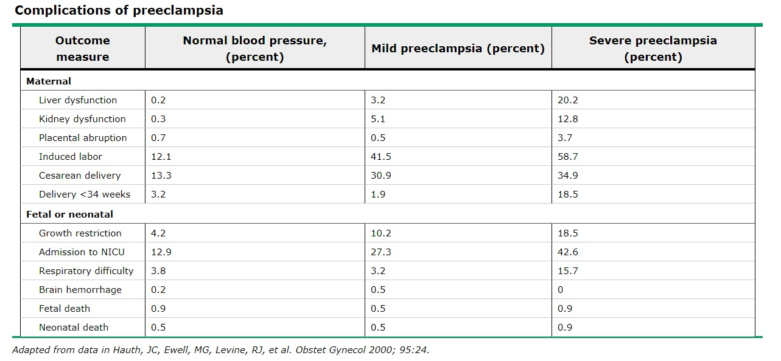

Slide 19
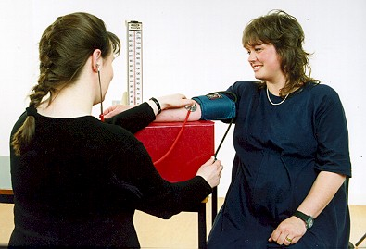
Measurement of blood pressure
No caffeine , No smoking , No use of substances containing adrenergic stimulants in the preceding hour.
room temperature,Bladder and bowel comfortable , No tight clothing
Allow women to sit quietly for 5-10 minutes before measuring the blood pressure.
Blood pressure should be measured with the woman rested in the sitting position, her back well supported and arm supported at the level of the heart.
her feet should touch the floor and legs should not be crossed.
with the cuff at the level of the heart
Proper cuff size (80% of arm circumference)
To avoid incorrect measurement of blood pressure, if the midarm circumference is greater than 33 cm, a large cuff should be used. Slow deflation of bladder (2mmHg/s)
Korotkoff phase 1 should be used to measure systolic BP
and Korotkoff 5 is the appropriate measurement of diastolic
blood pressure.
The method used to record blood pressure
should be consistent and documented.
The patient should be instructed
not to talk prior and during the procedure.

Slide 20
Proteinuria
Proteinuria may be defined as: ≥ 300 mg per 24-hour urine collection (or this amount extrapolated from a timed study—for instance, if the patient has a 12 hour urine collection)
Protein/creatinine ratio ≥ 0.3mg/dL
Dipstick reading of 1+ (this is used only if other methods are not yet available, and is to be used only as a screening tool at this facility)

Slide 21
Treatment
Prophylactic
Curative

Slide 22
Prophylactic
Proper antenatal care:
To detect the high risk patients who may develop PIH through the screening tests.
Early detection of cases who have already developed PIH and examine them more frequently.
Low dose aspirin:
It inhibits thromboxane production from the platelets and the AII binding sites on platelets.
A low dose (60 mg daily) selectively inhibits thromboxane due to higher concentration of such a low dose in the portal circulation than systemic affecting the platelets when they pass through the portal circulation. The Prostacyclin production from the systemic vessels will not be affected.

Slide 23
Curative
Delivery of the foetus and placenta is the only real treatment of pre-eclampsia.
As the conditions are not always suitable for this, the treatment aims to prevent or minimize the maternal and foetal complications till reasonable maturation of the foetus.

Slide 24
Decrease Complications (Of The Mother) and Increase Maturation (Of The Fetus )
clinicians must try to minimize maternal risk while maximizing fetal maturity.
The primary objective is the safety of the mother
and then
the delivery of a healthy newborn.

Slide 25
General measures:Observation
Maternal:
Foetal:
blood pressure twice daily.
urine volume and proteinuria daily,
oedema daily,
body weight twice weekly,
fundus oculi once weekly,
blood picture including platelet count, liver and renal functions particularly serum uric acid on admission.
daily foetal movement count,
serial sonography,
non-stress and stress test if needed.

Slide 26
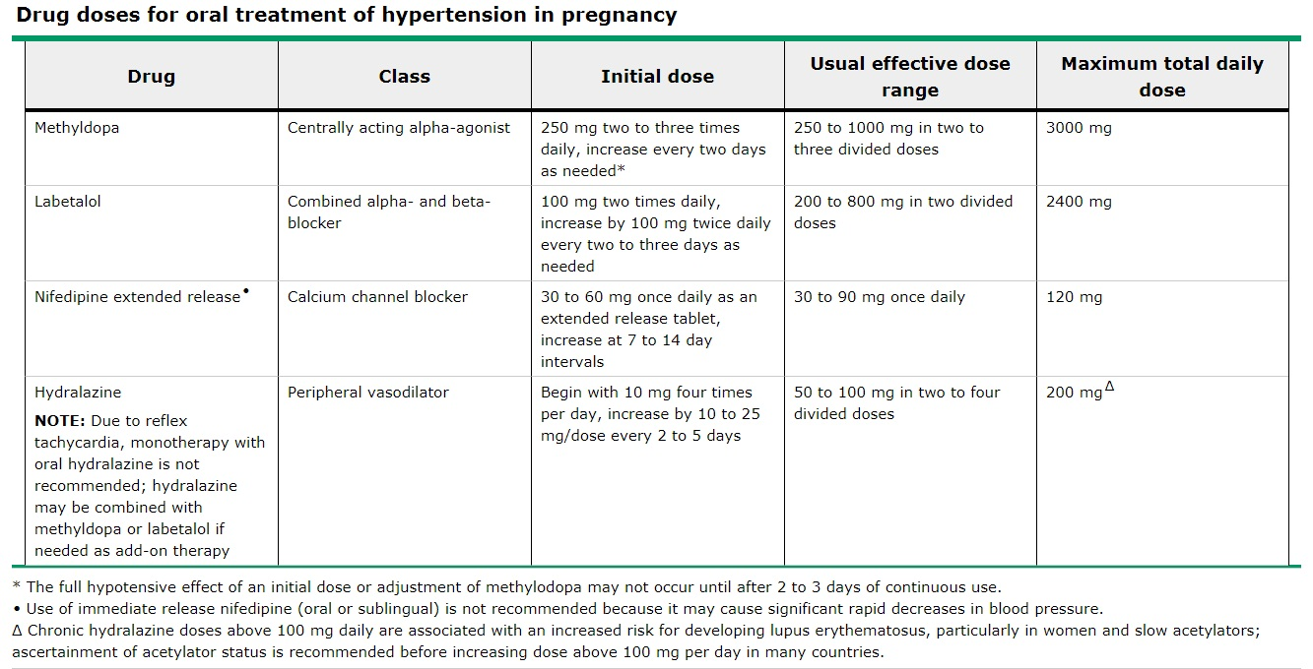
Medical treatment Antihypertensives

Slide 27
Blood pressure readings > 160/110 require antihypertensive drugs
Goal of treatment to decrease BP to 140/90 not more

Slide 28
Obstetric measures
Timing of delivery
Method of delivery
Intrapartum care
Postpartum care

Slide 29
Timing of delivery
depends on Severity of disease ,Fetal maturitya and Condition of cervix
A: >37wk terminate without delay
B: <37wk, expectant management at least till 34wks
C: unstable maternal or fetal conditions irrespective of gestational age, should be delivered as soon as the maternal status is stabilized – immediate delivery
start seizure prophylaxis and steroids if<34wks

Slide 30
Time of Delivery
Mild severe
> 37w > 37w 34-37w < 34w
deliver deliver stable unstable unstable stable
mother or fetus mother or fetus
deliver stabiise tertiary
center
at 37w immediate
delivery

Slide 31
Immediate Delivery
In the emergency setting, control of BP and seizures should be priorities.
Don’t wait
Don’t hesitate
Within 6 hour
Terminate

Slide 32
Method of delivery:
Vaginal delivery may be commenced in vertex presentation by:
amniotomy + oxytocin if the cervix is favourable.
prostaglandin vaginal tablet (PGE2) if the cervix is not favourable.
Caesarean section is indicated in:
Foetal distress.
Late deceleration occurs with oxytocin challenge test.
Failure of induction of labour.
Other indications as contracted pelvis, and malpresentations.

Slide 33
Intrapartum care:
Close monitoring of the foetus is indicated.
Proper analgesia to the mother.
Anti-Hypertensives may be given if needed.
2nd stage of labour may be shortened by forceps.

Slide 34
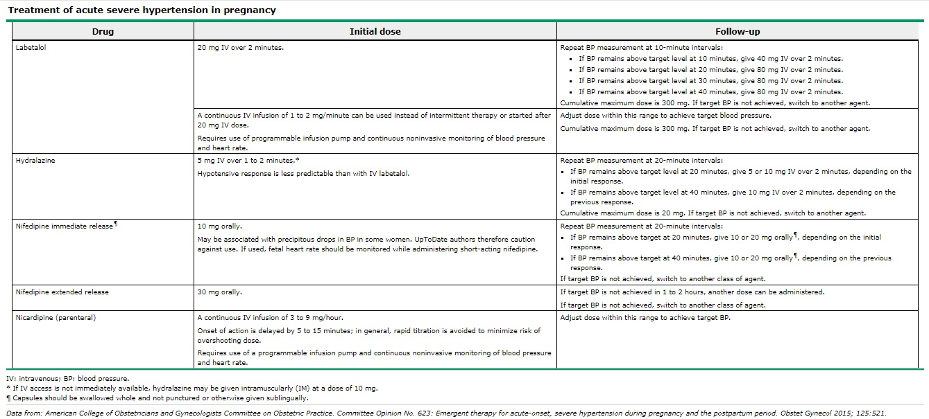
Emergency Antihypertensive

Slide 35
Postpartum care
Methergin (Ergometrine) is better avoided as it may increase the blood pressure.
Continue observation of the mother for 48 hours.
Anti- hypertensive drugs are continued in a decreasing dose for 48 hours.

Slide 36
Prophylactic treatment with magnesium sulfate is indicated for all patients with preeclampsia with severe features
Lorazepam and phenytoin may be used as second-line agents for refractory seizures
magnesium sulfate was safer and more effective for prevention of recurrent seizures than phenytoin, diazepam, or lytic cocktail (ie, chlorpromazine, promethazine, and pethidine)

Slide 37
magnesium sulfate regimen
The most common magnesium sulfate regimen, and the one that we use, is a loading dose of 4-6 g of a 10 percent solution intravenously over 15 to 20 minutes followed by 1-3 g/hour as a continuous infusion
An alternative regimen is 5 g of a 50 percent solution intramuscularly into each buttock (total of 10 g) followed by 5 g intramuscularly every four hours.
These regimens generally result in similar magnesium levels; however, intramuscular administration results in more fluctuation and is associated with more side effects, particularly pain at the injection site
Clinical assessment for magnesium toxicity should be performed every one to two hours.
The maintenance dose is only given when a patellar reflex is present (loss of reflexes is the first manifestation of symptomatic hypermagnesemia), respirations exceed 12 breaths/minute, and urine output exceeds 100 mL over four hours.
If magnesium toxicity is suspected, the maintenance dose should be decreased or eliminated and the magnesium level should be checked

Slide 38
Management of Eclampsia :
Prompt delivery of fetus to achieve cure
Avoidance of diuretics & hyper osmotic agents
Limitation of I.V fluid
Intermittent antihypertensive to control BP judiciously
Control of convulsion by MgSO4 (IM/IV route)
Protection & supporting care during convulsion
Protection in a railed cot Protection of airway &
prevention of tongue bite
Correction of hypoxia & acidosis
Managed in Eclampsia room.

Slide 39
Recurrence of preeclampsia
Uncommonly, patients have antepartum preeclampsia that is treated with delivery but that recurs in the postpartum period.
Recurrent preeclampsia should be considered in postpartum patients who present with hypertension and proteinuria.

Slide 40
WILL PREECLAMPSIA HAPPEN AGAIN IN FUTURE PREGNANCIES?
Women who do not develop preeclampsia in their first pregnancy are at low risk of developing it in a subsequent pregnancy.
Women with preeclampsia without severe features of the disease near term have only a 5 percent chance of developing it again. However, women who developed severe features of preeclampsia and were delivered before 30 weeks gestation have a high risk (up to 70 percent) of preeclampsia in future pregnancies

Slide 41
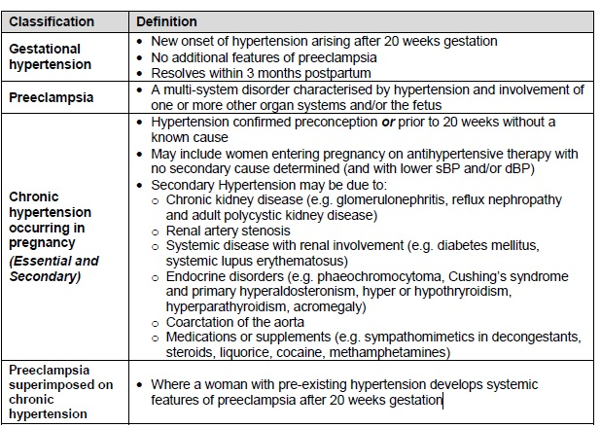
Clasification Of Hypertension During pregnancy

Slide 42
Differential Diagnosis
It includes
exacerbation of underlying renal disease,
acute fatty liver of pregnancy,
thrombotic thrombocytopenic purpura or
hemolytic uremic syndrome, and
exacerbation of systemic lupus erythematosus.
❖ Pre-existing hypertension,
❖ New/gestational hypertension
❖ Pre-eclampsia
❖ Eclampsia
❖ Exacerbation of underlying renal disease/Superimposed pre-eclampsiaeclampsia
❖ SLE
❖ ΔΔ ECLAMPSIA
❖ -Epilepsy,
❖ -Intracranial haemorrhage/thrombosis,
❖ -meningitis,
❖ -cerebral malaria,
❖ -amniotic fluid embolism can mimic eclampsia.

Slide 43
Conclusion
Hypertensive syndrome that occurs in pregnant women after 20 weeks' gestation, consisting of new-onset, persistent hypertension with either proteinuria or evidence of systemic involvement.
It require close assessment and monitoring for pre-eclampsia and its complications.
Blood pressure readings > 160/110 require pharmacologic treatment
Goal of ttt to decrease BP to 140/90 not more
Nifedipine , labetalol and methyldopa are approved for treatment of hypertensive disorders of pregnancy
Patients with gestational hypertension and preeclampsia should be monitored with regular labs , sonograms and antenatal testing
Delivery of fetus and placenta is a definitive treatment of preeclampsia
Delivery results in resolution of the disease.
During delivery -- Main stays of management include antihypertensive therapy, seizure control, and fluid restriction
hypertensive disorders in pregnancy are an indication of early delivery
Timing of delivery is based upon a combination of factors, including disease severity, maternal and fetal condition, and gestational age.

Slide 44
Magnesium sulphate injection is indicated in severe preeclampsia For prevention of eclampsia
It is also preferred agent for treatment of eclampsia
Hypertensive disorders of pregnancy can be present in postpartum period
Preeclampsia is associated with increase risk of cardiovascular disease later in life
Initiation of daily low dose aspirin late in the first trimester is indicated for prevention of preeclampsia in certain high risk women
Can occur in subsequent pregnancies; therefore, women should be counselled about the risk

Slide 45
Following delivery, the patient should be fluid restricted in order to wait for the natural diuresis.
A platelet transfusion is recommended prior to Caesarean section or vaginal delivery when the platelet count is < 20 x 109 ml.
Methyldopa should be avoided postnatally.
All women with severe pre-eclampsia should return to the hospital for post-natal review within 12 weeks of delivery to debrief, complete any outstanding investigations and plan for the next pregnancy.

