Slide 1

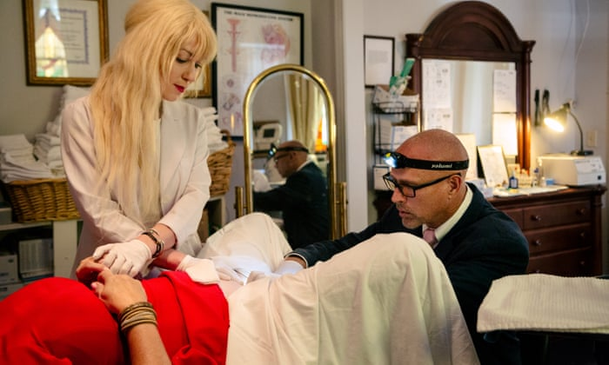
Platelet-Rich Plasma In Intimate Female Treatment
Muhammad M Al Hennawy
Senior Consultant Obstetrician & Gynacologist
Ras El Bar Central Hospital ,Egypt
mmhennawy.site44.com

Slide 2
Introduction
Regenerative biomedicine continues to progressively emerge at the forefront of healthcare in a number of medical disciplines
Platelet-rich plasma (PRP) is becoming more popular as a nonoperative treatment option for a broad spectrum of medical disorders.
PRP is widely used in orthopedic and sports medicine to relieve pain through the natural promotion of healing in musculoskeletal diseases such as tendonitis, arthritis, ligament sprains, and tears.
These growth factors have been found to promote natural healing responses by researchers across multiple specialties, such as dentistry, dermatology, urology, and gynecology

Slide 3
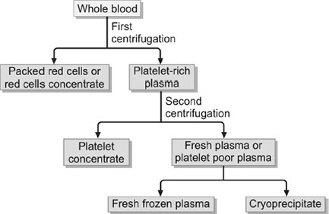
What is Platelet Rich Plasma (PRP)?
It’s a autologous ( means patient’s own blood) concentration of platelets in a small volume of plasma usually 5 to 10 fold the normal level of the whole blood.
Since the platelets is so concentrated, so do all the growth factors also will be 5 to 10 folds higher.

Slide 4
FDA approval
PRP does not require FDA approval
Since
It is not a medicine or a device.
PRP comes from patient own body.
Patient own blood is drawn and sterilely processed in a highly specialized FDA approved collection kit and centrifuge to concentrate the platelets 6 times their natural values in pure plasma without any red cells.

Slide 5
Short history
1905 : German surgeon August Bier discovered that, injected with their own blood, patients with bone fractures heal faster.
1935 – 1980:before antibiotics, autohemotherapy (intramuscular injection of a small amount of blood taken from the same individual) and autoserotherapy (treatment with blood from the patient’s blood) were among the most popular secondary treatments.
1980 : maxillofacial surgeon Robert E. Marx was the first to use blood plasma as a gel; the discovery that platelets contain protein factors (PRP factors) that stimulate cellular regeneration opened the way for the autologous plasma gel production technology; this was developed mainly for use in stomatology (the Harvest company, USA).
2003 : the Russian scientists Renat R. Akhmerov (Professor, Doctor of Medicine, plastic surgeon and maxillofacial surgeon, oncodermatologist) and Roman F. Zarudy (Doctor of Medicine, maxillofacial surgeon, implantologist) were the first in the world to use platelet-rich autologous plasma to treat inflammatory and atrophic diseases, in the postoperative period; the technology was named Plasmolifting™.
2004 : Plasmolifting ™ clinical trials were carried out on the two Russian scientists and on volunteers, to treat photodermatosis, hair loss and acne, with good results (in addition to the therapeutic effects, the patients’ skin was rejuvenated); Roman F. Zarudy explained that the new injecting form of plasma opened up new possibilities for them, as maxillofacial surgeons (especially for tissue regeneration), and the method revolutionized this sphere of surgical practice; at first, their colleagues were skeptical of his new technology’s success, but – with time – the Plasmolifting™ method began to be applied in various fields of medicine.
2011 : with the support of doctors Akhmerov and Zarudy, the Plasmolifting Company was set up; it exclusively produces and distributes the equipment necessary for the Plasmolifting™ method, wishing to offer everyone this natural healing method; today, the Plasmolifting Company has created a vast distribution network in Europe, develops and distributes the Plasmolifting™ tubes and organizes specialty courses; the aim of the company is to convert autologous plasma injections into a routine biological stimulation method.

Slide 6
PRP composition and activation
Platelets contain high concentrations of cytokines and growth factors stored within α-granules. These growth factors include platelet-derived growth factor, insulin-like growth factor, vascular endothelial growth factor, platelet-derived angiogenic factor, transforming growth factor beta, fibroblast growth factor, epidermal growth factor, connective tissue growth factor, and interleukin-8. In addition to growth factors, platelets contain other substances, such as fibronectin, vitronectin, and sphingosine 1-phosphate, that initiate wound healing
Platelet activation triggers the release of these growth factors by a variety of substances or stimuli such as thrombin, calcium chloride, and collagen. Each method influences both the physical form of PRP and the amount of growth factors released, as well as the kinetics of release. No evidence has been found regarding the ideal concentration of activator required to trigger the optimal release of growth factors during the activation process of PRP, and different concentrations may therefore lead to different results

Slide 7
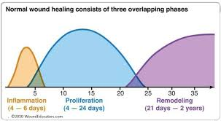
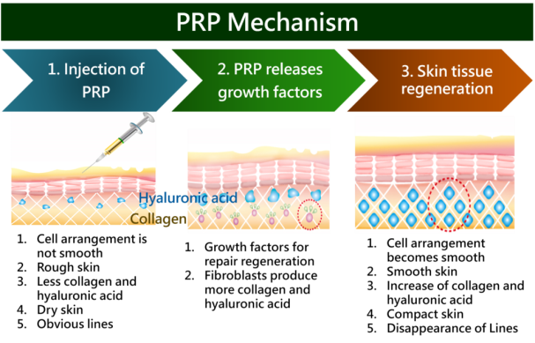
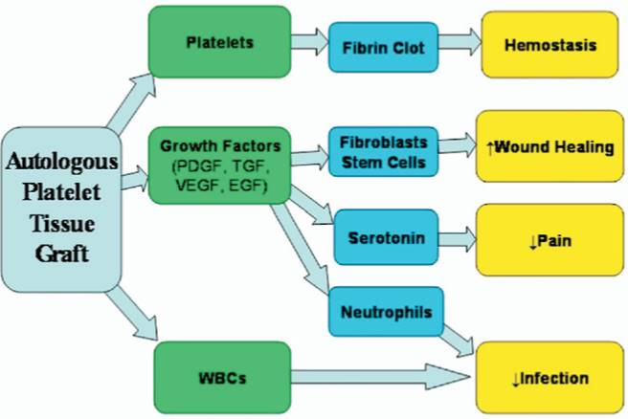
The theory underlying this treatment modality
It was derived from natural healing processes, as the body's first response to tissue injury is to deliver platelets to the injured area.
Platelets promote healing and attract stem cells to the site of the injury.
Moving from basic science to clinical practice,
PRP injections have been applied to diseased ligaments, tendons, and joints, with superb outcomes in terms of repair

Slide 8
Growth Factors In Platelets
Platelets is part of the cell in our blood that help in the clotting mechanisms. It’s a very tiny cells but inside the contain a lot of important growth factors such as:-
Platelet Derived Growth Factors (PDGF)
Vascular Endothelial Growth Factors (VEGF)
Insulin Like Growth Factors ( IGF 1& 2)
Transforming Growth Factors beta( TGF-b)
Fibroblast Growth Factors ( FGF)
Epidermal Growth Factors ( EGF )
Connective Tissue Growth Factors (CTGF)
Interleukin 8 (IL 8)
All these growth factors are very important for healing, formation of new vessels, collagen production and regeneration!

Slide 9
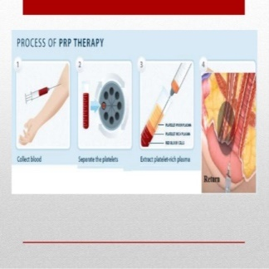
The science of PRP
PRP preparation
The preparation of PRP is an outpatient procedure that involves a blood draw, preparation of the PRP, and the injection of PRP into the diseased area.
Multiple methods have been developed for PRP preparation, with variation in the speed and timing of centrifugation
The following steps present a representative method of preparing PRP:
(1) venous blood (15–50 mL) is drawn from the patient's arm in anticoagulant-containing tubes;
(2) the recommended temperature during processing is 21℃–24℃ to prevent platelet activation during centrifugation of the blood;
(3) the blood is centrifuged at 1,200 rpm for 12 minutes;
(4) the blood separates into three layers: an upper layer that contains platelets and white blood cells, an intermediate thin layer (the buffy coat) that is rich in white blood cells, and a bottom layer that contains red blood cells;
(5) the upper and intermediate buffy layers are transferred to an empty sterile tube. The plasma is centrifuged again at 3,300 rpm for 7 minutes to help with the formation of soft pellets (erythrocytes and platelets) at the bottom of the tube;
(6) the upper two-thirds of the plasma is discarded because it is platelet-poor plasma;
(7) pellets are homogenized in the lower third (5 mL) of the plasma to create the PRP;
(8) the PRP is now ready for injection. Approximately 30 mL of venous blood yields 3–5 mL of PRP;
(9) the affected area is disinfected before the PRP injection;
(10) providing assurance to the patient and discussing the procedure make the injection easier and less painful;
(11) PRP stimulates a series of biological responses, and the injection site may become swollen and painful for roughly 3 days.

Slide 10
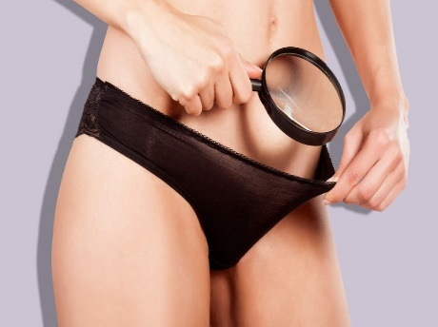
PRP Usage In Various Gyne-sexological Disorders

Slide 11
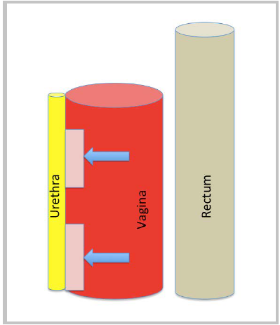
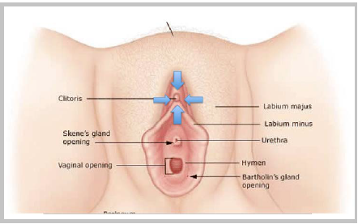
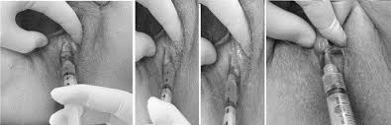
O (Orgasmic ) Shot Or Love Shot
non surgical tool to treat patients with female sexual dysfunction and urinary incontinence labia majora
to rejuvenate the female orgasmic system, hence the name the O-Shot
Two injections of PRP were given through a 27-gauge needle in the anterior vaginal wall in to a space between vagina and urethra most distal from bladder include G-spot , and 4 injections into the clitoris (at 12, 3, 6 and 9o-clock) , may also include labia majora
The benefits include: greater arousal from clitoral stimulation; younger, smoother vulvar skin; a tighter vaginal opening; stronger more frequent orgasms; increased libido and lubrication; less pain with intercourse, and even decreased urinary incontinence

Slide 12
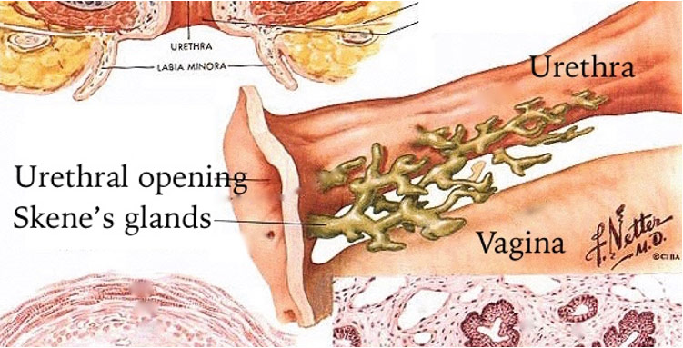
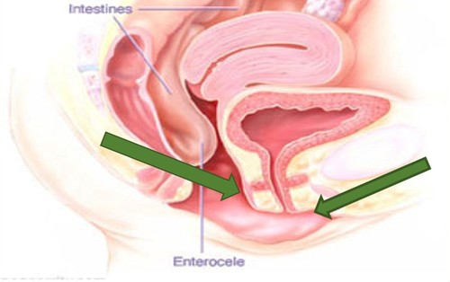
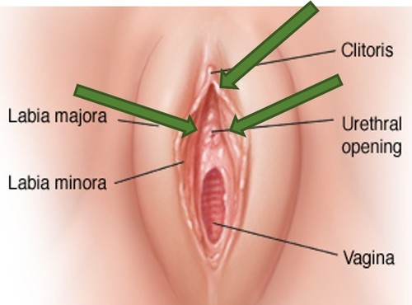
First, a topical anesthetic cream was applied to the anterior vaginal wall. The clitoral hood was retracted and cream applied to the clitoris.
Delaying the PRP injection for 20 minutes after anesthetic application achieved complete or near complete analgesia for the procedure.
Peripheral blood was drawn from the arm and centrifuged to yield 5 cc of PRP. One of either of two FDA-approved, proprietary collection systems were used according to the standard recommendations for each system: (1) Regen® or (2) TruPRP® Both systems use centrifugation to separate and concentrate PRP. The TruPRP® system concentrates 5 ml of PRP from 60 ml of whole blood using a laser device that visualizes the buffy coat to separate the PRP from RBC’s. The Regen® system concentrates 5ml of PRP from 10 ml of whole blood using a gel separator.
After isolation of the PRP, calcium chloride (0.5ml) was added to the 5 ml of PRP isolate to activate the thrombin cascade, thereby causing degranulation of platelets, releasing growth factors and cytokines, and starting the transformation of the PRP to platelet rich fibrin matrix (PRFM)
Before the PRFM became too gelatinous for passing through a needle (less than 10 minutes), two injections were given through a 27-gauge needle, one injection into each of two specific sites:
(1) the anterior vaginal wall into a space between vagina and urethra most distal from bladder), and
(2) into the clitoris. All authors were trained ,agreed to perform the procedure in a uniform manner

Slide 13
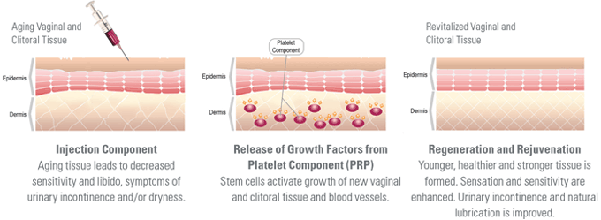
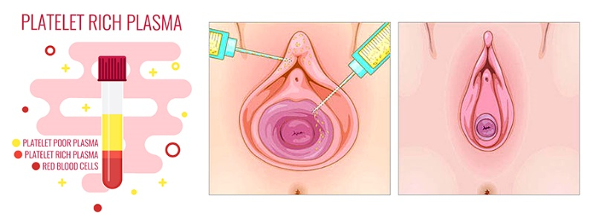
Vaginal rejuvenation (‘Vampire’ vagina injections)
Aesthetic practitioners have used PRP for the regeneration of vaginal mucosa, muscles, and skin.
After PRP injection, vaginal vascularity is increased, with a subsequent dramatic increase in sensitivity. In addition, the skin becomes thicker and firmer, making the vagina look much more youthful. Moreover, the ligaments and muscles supporting the urethra become stronger, alleviating urinary incontinence
the application of autologous lipofilling mixed with PRP in a patient with vaginal atrophy produced relief of symptoms and contour restoration. The rejuvenated appearance of the external genitalia provided a pleasing cosmetic outcome to the patient

Slide 14
PRP In Reconstructive Surgery For Vulvar Cancer
The efficacy of platelet gel application in women after radical surgery.
Platelet gel placed on the vaginal breach during reconstructive surgery,
Significantly lower rates of wound infection ,necrosis of vaginal wounds ,and wound breakdown
A reduction in the postoperative fever rate, a shorter hospital stay, and faster wound healing

Slide 15
PRP in breast reconstruction
PRP together with adipose tissue has been used in breast reconstruction by breast soft-tissue defects.
PRP mixed with fat grafts led to improvements in the maintenance of breast volume in patients affected by breast soft-tissue defects.

Slide 16
How long does the entire process take?
The injection takes less than 5 minutes,
but an hour is scheduled to provide ample time for patient
to meet with the doctor to ensure that there are no contraindications, review pre and post procedure expectations, draw blood, centrifuge the blood and prepare the treatment in a relaxed, comfortable environment.

Slide 17
What prep is given for local anesthesia?
After counseling, patient will empty her bladder and
move to the treatment table where patient will undress from the waist down, and cover with a sheet.
doctors find that an extra injection of local pain control often hurts more than the shot itself.
Therefore, doctors use 20 – 30 minutes of a topical numbing cream (Benzocaine, Lidocaine, Tetracaine).
This is applied to the clitoral and vaginal areas, with a piece of plastic wrap placed over the cream by the patient and the medical assistant just before the blood draw.
Patient MUST tell doctor BEFOREHAND if patient have any allergic reactions to any of these medications, so doctors can make arrangements.

Slide 18
Contraindications to PRP Therapy
Acute infectious diseases.
Viral hepatitis B and C.
Systemic diseases.
Allergic reactions to anticoagulants.
Immunosuppressive conditions.
Blood-clotting disorder.
Pregnancy and lactation.
Mental disorders.
With a personal history of oncology.
Age under 18 years.

Slide 19
Are there side effects?
Be assured the treatment rarely has side effects.
Even patients that have drug allergies can safely opt for the procedure and enjoy significant improvement within a few weeks following the treatment.
Occasionally there is a small amount of bruising or tingling in the injected areas.
There are no infections or cancers or other adverse side effects known.

Slide 20
Recommended course of PRP Therapy
A course of 1 to 4 procedures is recommended,
depending on the intensity of changes,
the time between injections being 1 month.
doctors recommend 1 treatment to start and see how patient response is.
Your provider may recommend more depending on a multitude of patient-specific factors.
Re-evaluate after 12-18 months

Slide 21
What if it doesn't work?
A majority of women experience definite improvement in their symptoms.
If patient have followed every instruction properly,
doctors will review a full assessment of the potential reasons for the sub-optimal results.
The main issue is usually not the preparation or performance of the injection, but a woman’s own particular body’s ability to heal, using its own blood components, and her following the pre and post procedure instructions precisely.
doctors will consider performing a second injection only after 6 months of healing and a full assessment.

Slide 22
Benefits of PRP Therapy
The PRP Therapy uses patient’s own blood, therefore, this method has the minimum number of contraindications, and the risk of allergy, rejection and other “side effects” is completely excluded, which ensures complete biocompatibility of the administered preparation.
The PRP Therapy does not require special training and, under certain conditions, can be performed immediately at the doctor’s office. The whole procedure takes no more than 30 minutes. After the autoplasma injection, the patient can continue her daily routine at once.
The PRP Therapy is designed to create a “favorable background” for the successful treatment of many gynecological diseases.
The PRP Therapy reduces the drug load (the need to take a lot of medicines) on the body and minimizes the risk of recurring pathology.

Slide 23
Recommendations after PRP Therapy
For 3 days after the administration, it is recommended to abstain from: Sexual activity. Taking steam baths. Visiting saunas and taking baths.
Use cotton underwear for 5 days after the PRP Therapy.
In order to avoid hyperpigmentation at the injection site, it is not recommended to use a tanning bed/booth and undergo prolonged exposure to direct sunlight (tanning) for 1 week.

Slide 24
The success of this technique
entirely depends on
the speed of blood collection and transfer to the centrifuge.
In fact, without anticoagulant, the blood sample starts to coagulate almost immediately upon contact with the tube glass, and it does take a minium of few minutes of centrifugation to concentrate fibrinogen in the middle and upper part of the tube.
Quick handling is the only way to obtain a clinically usable PRF clot.

Slide 25
Conclusion
PRP is an innovative therapeutic modality,
as it is affordable,
simple,
cheap,
easily performed, and
effective.
It is also a noninvasive modality with promising results and
no side effects.
In the field of gynecology, the few studies that have been conducted are pilot studies, case series, and case reports.
The risks of PRP therapy as infection, bleeding, and nerve damage, appear to be minimal.
Large randomized controlled studies are required to confirm its efficacy and safety in various gynecological disorders.

