Slide 1

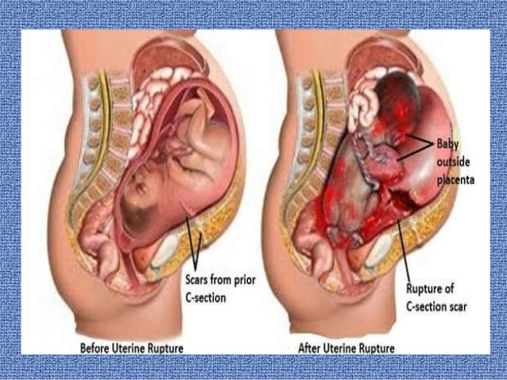
Uterine Rupture (The Most Dramatic Serious Obstetric Emergency)
Muhammad M Al Hennawy
Consultant Obstetrician & Gynacologist
Ras El Bar Central Hospital ,
Dumyat Specialised Hospital ,
Egypt

Slide 2
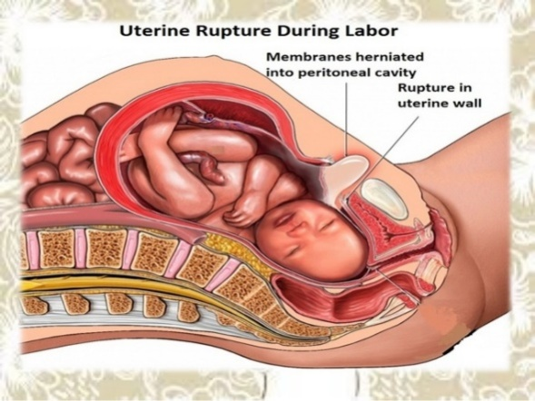
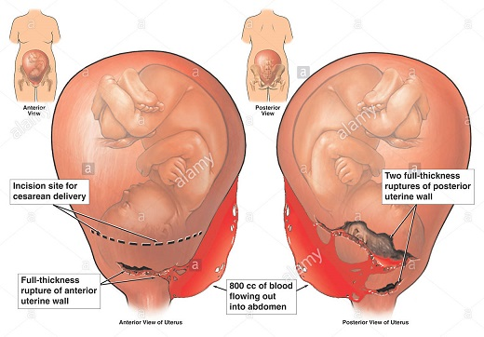
Definition
Uterine rupture is defined as
a non-surgical disruption or tear of the myometrium
with or without serosa of the uterus
with or without expulsion of the fetus and placenta
It is a life threatening condition for both the mother and the fetus.
It occur Usually during labour, occasionally happen during later weeks of pregnancy

Slide 3
Incidence Of Uterus Rupture
0.05% for all pregnancies
0.8% after previous lower segment caesarean section(LSCS)
>5% after classical caesarean section
Scar dehiscence has an incidence of 0.6% in pregnancies with previous C/S and has a more favorable outcome for both mother and fetus than does uterine rupture

Slide 4
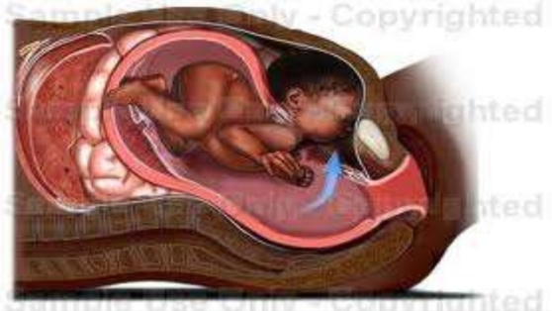
Etiology
Scarred Uterus Rupture: History of cesarean section , hysterotomy , myomectomy , excision of a uterine septum, metroplasty , previous perforation of uterus (D&C, hysteroscopy, forceps delivery)
Unscarred Uterus Rupture:
Traumatic/ iatrogenic rupture
Surgical intervention
Internal version
Forceps delivery
Forcible dilatation(cervical tear)
Manual removal of placenta
Destructive operations.
Medical intervention
Uterine hyper-stimulation (oxytocin with pitocin induction or augmentation of labor)
Spontaneous rupture
Feto-pelvic disproportion
Congenital uterine anomalies
Soft tissue obstruction

Slide 5
Etiology
(A) During pregnancy
(I) Spontaneous:
Rupture of a uterine scar: e.g. previous C.S. especially upper segment, myomectomy, hysterotomy, uteroplasty or perforation..
Abruptio placenta with severe concealed haemorrhage.
Anterior sacculation in case of incarcerated retroverted gravid uterus or posterior sacculation due to previous ventrofixation of the uterus.
Rupture of a rudimentary horn at the 4th - 5th month.
Perforating vesicular mole.
(II) Traumatic
Perforation during vaginal evacuation.
External trauma.

Slide 6
Etiology
(B) During labor:
(I) Spontaneous:
1. Obstructed labor.
2. Rupture of a uterine scar. Grand multipara: due to degeneration and over-thinning of the uterine muscles.
(II) Traumatic :
1. Internal version: particularly after drainage of liquor.
2. Manual separation of the placenta.
3. Destructive operations.
4.Extending cervical tear due to e.g. forceps or ventose applications before full cervical dilatation.
(III) Improper use of oxytocins.

Slide 7
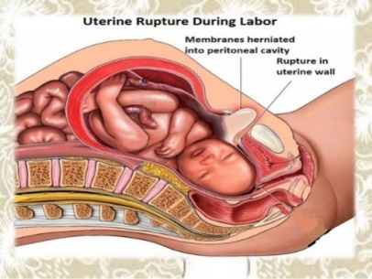
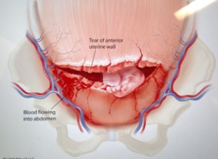

Types
A- Scarred Uterus Rupture
Uterine scar dehiscence: herniation of intact amniotic membrane into an existing uterine scar ( when there is separation of previous scar with intact peritoneum)
Uterine scar rupture: separation of scar along entire length with involvement of the amniotic membranes
B- Unscarred Uterus Rupture
Complete Uterine rupture: total disruption of the wall of the pregnant uterus with or without extrusion of its content ( when uterine cavity communicate directly with peritoneal cavity )
Incomplete Uterine rupture: partial disruption of the wall of the pregnant uterus without extrusion of its content ( uterine cavity is separated from peritoneal cavity by visceral peritoneum or broad ligament )

Slide 8
Weak Cesarean Scar
One layer CS
Locked Suture
Imperfect suture with improper coaptation of the edges.
Bad hemostasis -- Infection
Suture material
Upper segment or T or J incisions
A short inter-pregnancy interval after a previous cesarean delivery
Subsequent implantation of the placenta over it
Subsequent over-distension of the uterus e.g. polyhydramnios or multiple pregnancy.
Repeated vaginal deliveries after a previous C.S weaken the scar
Number of CS & Age of patient

Slide 9
Classification of Uterine Rupture
Classification by Atiology
Scarred Uterus Rupture: Previous caesarean scar or myomectomy
Unscarred Uterus Rupture
Classification by Pathogenesis
Spontaneous - Histochemical etiology of uterine rupture - occurs without any function of uterus :
(i) Anatomy anomaly
(ii) Dystrophy diseases (connective tissue autoimmune disease, Inflammatory disease of uterus)
Voluntary - result of hyperfunction of uterus :
(i) Disproportion between sizes of presenting part and maternal pelvis (malpresentation)
(ii) Extra doses of uterotonic drugs
Classification by Layers of Uterus involved in Rupture
Complete rupture : commonly spontaneous
Incomplete rupture : commonly traumatic.

Slide 10
Classification of Uterine Rupture
Classification by Location of Rupture
Lower segment rupture
Rupture of corpus/fundus of uterus
Classification by time
During pregnancy
During Labour
Classification by Carelessness or Negligence?
carelessness of the patient
negligence of the doctor.

Slide 11
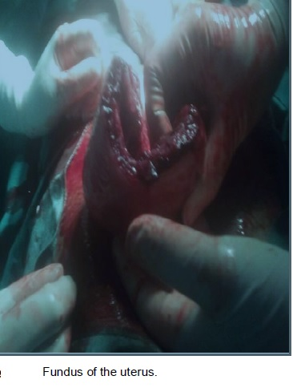
The Most Common Site Of Ruptured Uterus
Damage to the uterus prior to labour is usually in the uterine body
During labour is usually in the lower segment.
It depends upon the cause of rupture.
In obstructed labour:
It is usually in lower uterine segment.
Usually oblique or transverse.
More on the left side due to;
dextrorotation of the uterus.
left occipito-positions are more common.
Extended tear may pass laterally injuring the uterine vessels leading to broad ligament hematoma formation.
This rupture may involve the ureter or bladder.
2) In rupture scar:
At the site of the scar.

Slide 12
Golden Rule
Uterine rupture
should be first ruled out in all pregnant women
presented with acute abdominal pain
regardless of their gestational age.

Slide 13
Signs of Threatened Or Impending Uterine Rupture
Signs that occur just during the labor
Excessive uterine activity. Uterine contractions are very fast and painful
Overdistended Lower uterine segment, thinned and tender at palpation
Edematous cervical os margins due to compression which may extends to the vagina and the perineum
Difficult Urination due to compression of the bladder and urethra between the bony pelvis and the fetal head
Some vaginal bloody discharge maybe presented (depends)
Pathological contractile Bandl’s ring is presented

Slide 14
Signs of Uterine Rupture During Pregnancy
Typically
Acute abdominal pain
Features of shock & intra-abdominal hemorrhage
Absent fetal heart sound
Easily palpable fetal parts in complete rupture
Contracted uterus felt on one site
Atypically
Incomplete rupture producing localized abdominal pain & tenderness
Frank signs of hemorrhage & shock develop slowly
It may confuse with accidental hemorrhage

Slide 15
Early Pregnancy Uterine Rupture
The most common cause of uterine rupture is dehiscence of a previous Caesarian section scar
Rupture at the site of a previous uterine scar may occur with few warning signs because the scar is relatively avascular
It is a rare and potentially life threatening event which incidence is increasing given the actual high cesarean section rate.
Clinical signs of this condition are nonspecific and must be distinguished from other acute abdominal emergencies and other obstetric events.
Cesarean scar pregnancy must be considered as a major risk factor leading to early uterine rupture.

Slide 16
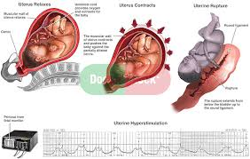
Signs of Uterine Rupture During Labour
Sudden appearance of fetal distress during labour ( most common sign)
Uterine contractions suddenly stop
Palpation of fetus in the abdomen (outside the uterus) in complete rupture
Fetal death
In incomplete rupture, the foetus still inside the uterus with suprapubic painful tender swelling which is an accumulated blood in the vesico-uterine pouch
Hemorrhage then hypovolemic shock in mother Signs and Symptoms in the Uterine Rupture that has happened
Silent Rupture: minimal symptoms may occur in rupture lower segment scar due to presence of fibrosis and minimal internal hemorrhage.

Slide 17
Investigations
CTG
Fetal distress (as evidence by abnormalities in fetal heart rate)
Diminished baseline uterine pressure
Loss of uterine contractility
Radiographic features
US
MRI
Intrauterine pressure catheters

Slide 18
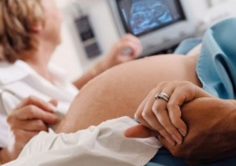
Ultrasonography
It is probably the safest and most useful imaging technique during pregnancy
Before rupture: a uterine wall thinner than 2 mm, as determined with ultrasonography performed within 1 week of delivery, significantly increased the risk of uterine rupture. Positive and negative predictive values were 73.9% and 100%, respectively.
A French study suggests that a uterine wall thickness of greater than 4.5 mm has negative predictive value of 100% but unfortunately the positive predictive value of thickness less than 3.5 mm is poor at only 11.8%

Slide 19
Ultrasonography
After rupture
Reported sonographic signs of uterine rupture include:
Identification of the protruding portion of the amniotic sac
Endometrial or myometrial defect ( an anterior hypo-/anechogenic line corresponding to the uterine tear)
Bulky empty uterus with gas bubbles
The fetus and placenta in the abdominal cavity
Extra-uterine hematoma
Hemoperitoneum or free fluid

Slide 20
MRI
It allows clear visualization of the uterine wall;
therefore, it helps to diagnose both ante-partum uterine rupture in patients with indeterminate ultrasound evidence,
showing the tear itself and other uterine wall defects including uterine dehiscence (separation of the myometrium with preservation of the overlying peritoneum and internal fetal membranes) and
uterine sacculation (uterine wall ballooning because of a functional weakening of the myometrium)

Slide 21
Intrauterine Pressure Catheters
They are sometimes used but may fail to show loss of uterine tone or
Loss of contractile patterns following uterine rupture.

Slide 22
Differential Diagnosis
Abruptio Placentae (Similar presentation)
Hepatic Rupture in severe pre eclampsia (Look for other signs of pre-eclampsia)
Chorioamnionitis (Look for fever, PROM, Tender uterus
Disturbed advanced extrauterine pregnancy.
Other causes of acute abdomen.

Slide 23
Treatments of Threatening Uterine Rupture
Whenever a threatening uterus rupture is seen,
immediate Caesarean section must be done!

Slide 24
Managements of Uterine Rupture

Slide 25
Intensive resuscitation
Correct hypovolemia from:
Hemorrhage Sepsis Dehydration
Intravenous broad spectrum antibiotics:
Cephalosporin + Metronidazole combination
Monitor to ensure adequate fluid and blood replacement
Blood volume expansion may worsen the bleeding from damaged vessel.
So the laparotomy should not be delay, once patient condition has improved

Slide 26
Emergency exploratory laparotomy with cesarean delivery
Several studies have shown that delivery of the fetus within 10-37 minutes of uterine rupture is necessary to prevent serious fetal morbidity and mortality.
Types of surgical treatment depends on
Type of uterine rupture :
Extent of uterine rupture
Degree of hemorrhage
High parity
Edges of rupture are ragged and irregular
General condition of the mother
Mother's desire for future childbearing.

Slide 27
Emergency exploratory laparotomy with cesarean delivery
Surgery
Repair of uterus without tubal ligation
Repair of uterus with tubal ligation
Removal of uterus (hysterectomy), Total or Sub-total ( no cervical injury )
in cases of lateral rupture involving lower uterine segment and uterine artery where hemorrhage and hematoma obscure the operative field, ligation of the ipsilateral hypogastric artery to stop bleeding may be needed.

Slide 28
Conservative surgical management
Involving uterine repair should be reserved for women who have the following findings:
Desire for future childbearing (the patient did not complete her family )
Low transverse uterine rupture
No extension of the tear to the broad ligament, cervix, or paracolpos
Easily controllable uterine hemorrhage
Good general condition
No clinical or laboratory evidence of an evolving coagulopathy

Slide 29
Surgical Management
Hysterectomy should be considered the treatment of choice when intractable uterine bleeding occurs or when the uterine rupture sites are multiple, longitudinal, or low lying.
Exploration of the other viscera mainly the bladder.
Internal iliac artery ligation may be needed in case of broad ligament haematoma as the uterine artery is usually retracted and difficult to be identified.
Vaginal repair: may be amenable if there is slight extension of a cervical tear with accessible apex.

Slide 30
Complications
A) Maternal:
Postoperative infection.
Damage to ureter , bladder or visceral injury.
Amniotic fluid embolus.
Massive maternal hemorrhage
Disseminated intravascular coagulation (DIC).
Pituitary failure
Paralytic ileus
B) Foetal :
Death due to asphyxia from detachment of the placenta

Slide 31
Preventive measures
Antenatal care
High risk cases Early detection of causes of obstructed labour as contracted pelvis and malpresentations.
Proper use of Oxytocics
Observe Previous caesarean section
Augmentation of labour
NOTE!!!
During trial of scar watch out for…….
Fetal heart abnormalities
Maternal tachycardia
Vague abdominal pain in between contractions
Suprapubic tenderness
Vaginal bleeding
Bladder tenesmus

Slide 32

Counselling for future pregnancies
If tubal ligation was not performed at the time of laparotomy, explain the increased risk of rupture with subsequent pregnancies, and discuss the option of permanent contraception
If the defect is confined to the lower segment the risk of rupture in a subsequent pregnancy is similar to that of someone with a previous caesarean section
If there are extensive tears involving the upper segment, future pregnancy may be contraindicated
Women with a history of uterine rupture should have a planned elective caesarean section (37 to 38 weeks’ gestation) in their next pregnancy

Slide 33
Conclusion
Uterine rupture is a rare but often catastrophic obstetric complication with an overall incidence of (0.07%). pregnancies
In modern industrialized countries, the uterine rupture rate during pregnancy for a woman with a normal, unscarred uterus is (0.012%). pregnancies
The vast majority of uterine ruptures occur in women who have uterine scars, most of which are the result of previous cesarean deliveries.
A single cesarean scar increases the overall rupture rate to 0.5%, with the rate for women with 2 or more cesarean scars increasing to 2%.
Other subgroups of women who are at increased risk for uterine rupture are those who have a previous single-layer hysterotomy closure, a short inter-pregnancy interval after a previous cesarean delivery, a congenital uterine anomaly, Macrosomic fetus, prostaglandin exposure, and a failed previous trial of a vaginal delivery

Slide 34
Conclusion
. Surgical intervention after uterine rupture in less than 10-37 minutes is essential to minimize the risk of permanent perinatal injury to the fetus.
However, delivery within this time cannot always prevent severe hypoxia and metabolic acidosis in the fetus or serious neonatal consequences.
The most consistent early indicator of uterine rupture is the onset of a prolonged, persistent, and profound fetal bradycardia.
Other signs and symptoms of uterine rupture, such as abdominal pain, abnormal progress in labor, and vaginal bleeding, are less consistent and less valuable than bradycardia in establishing the appropriate diagnosis.

Slide 35
Conclusion
The general guideline that labor-and-delivery suites should be able to start cesarean delivery within 20-30 minutes of a diagnosis of fetal distress is of minimal utility with respect to uterine rupture.
In the case of fetal or placental extrusion through the uterine wall, irreversible fetal damage can be expected before that time; therefore, such a recommendation is of limited value in preventing major fetal and neonatal complications.
However, action within this time may aid in preventing maternal exsanguination and maternal death, as long as proper supportive and resuscitation methods are available before definitive surgical intervention can be successfully initiated.

Slide 36
Thank You

