Slide 1


Prophylactic Bilateral Salpingectomy For epithelial ovarian, fallopian tubal, and peritoneal carcinoma risk reduction
Muhammad M Al Hennawy
Consultant Obstetrician and Gynecologist
MOH

Slide 2
Ovarian cancer is the leading cause of death due to gynecologic malignancy
The fifth most common cause of cancer deaths in developed countries
The more aggressive epithelial ovarian carcinomas represent at least 90% of all cases of ovarian cancer and are responsible for 90% of deaths due to ovarian cancer
Opportunistic Salpingectomy as a Strategy for Epithelial Ovarian Cancer Prevention
ACOG Committee Opinion No. 774 Summary Obstetrics & Gynecology: April 2019

Slide 3
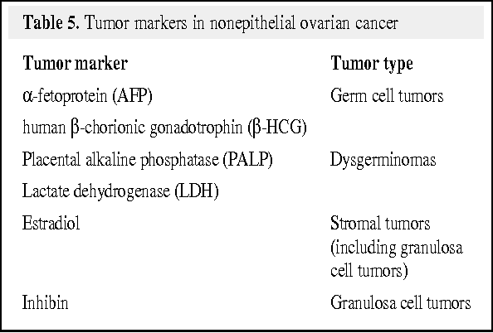
In both general population and high-risk women,
Screening (TVUS (tranvaginal ultrasound) and ca-125) for ovarian cancer is not recommended,
As screening have been unsuccessful and are associated with false-positive test results that lead to unnecessary surgery and surgical complications
As no mortality benefit has been demonstrated even with strict adherence to screening protocols

Slide 4
Unlike breast and cervical cancers, there is no supported standard screening method to detect preinvasive or early ovarian cancer.
The result is 70% of women present with late-stage iii and iv disease and poor prognosis

Slide 5
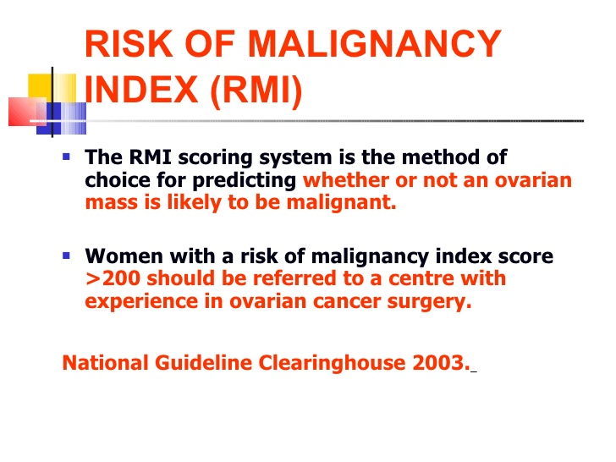
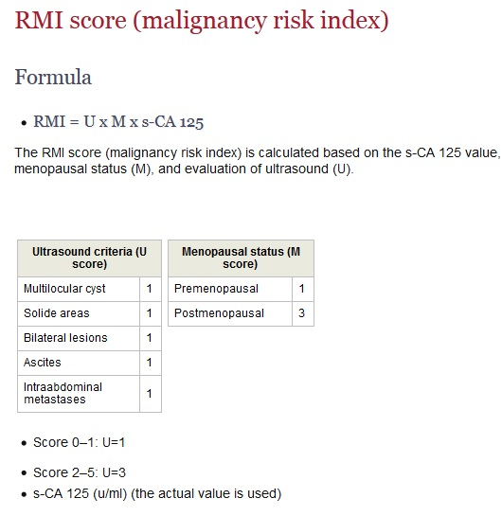
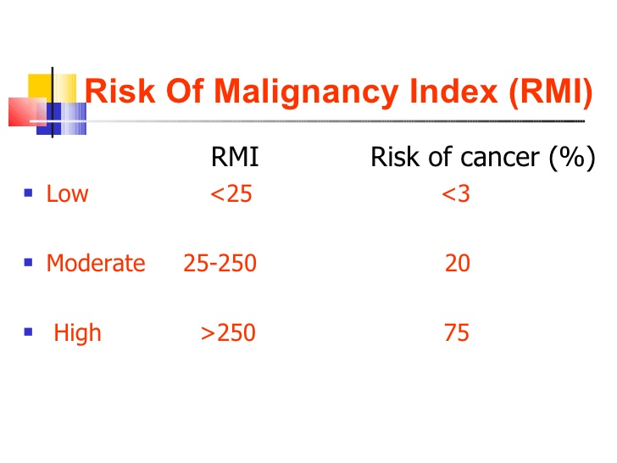
RMI score (malignancy risk index) for ovarian mass
RMI = U x M x s-CA 125
The RMI score (malignancy risk index) is calculated based on the s-ca 125 value, menopausal status (M), and evaluation of ultrasound (U).

Slide 6
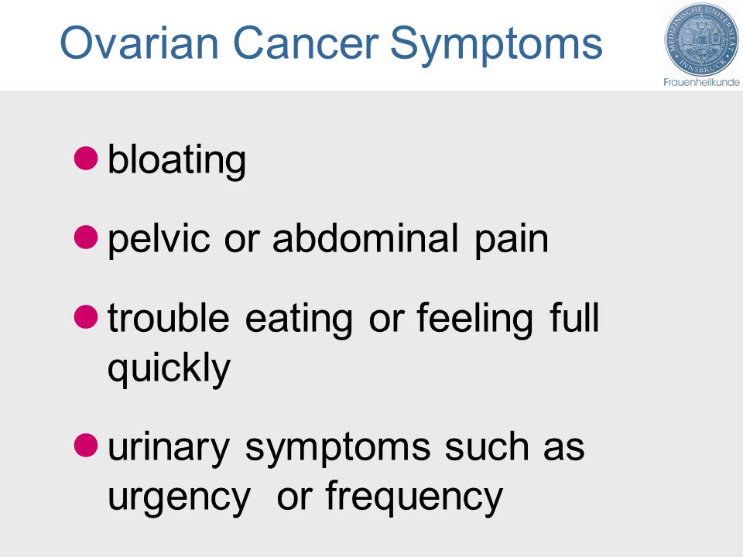
Symptoms of ovarian cancer are non-specific
Often do not arise until the cancer is in a late stage,
The point at which the majority of women are diagnosed

Slide 7
Five-year overall survival is less than 50 %
It has not substantially changed in the last two decades

Slide 8
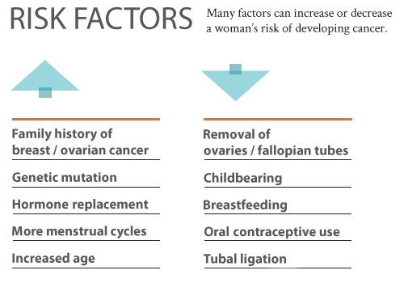
Risk factors

Slide 9
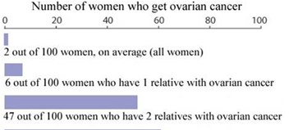
Family history of ovarian cancer
Women with a mother, sister, grandmother or aunt who has had ovarian cancer have a higher risk of developing the disease.
The risk depends on the number of first- and second-degree relatives with ovarian cancer and their age at diagnosis.

Slide 10
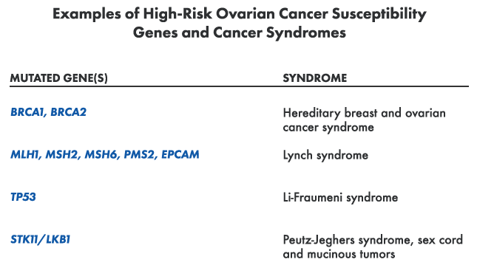
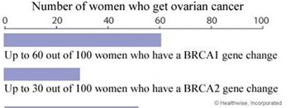
Gene mutations
In women with a BRCA1 or BRCA2 mutation, the risk of ovarian and breast cancer may be as high as 54% and 82%, respectively.
Mutation rates for these genes have been reported to be as high as 8% to 10% in the general population.
There are other gene mutation

Slide 11
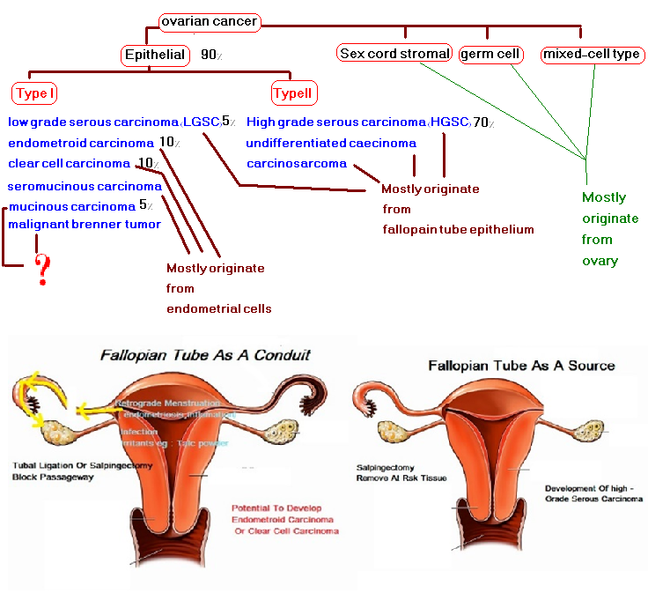

Slide 12
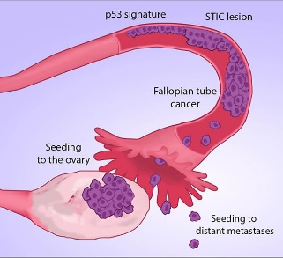
Theory of epithelial ovarian carcinogenesis
The most compelling theory of epithelial type II ovarian carcinogenesis suggests that many serous carcinomas are derived from the fallopian tube and endometrioid, and clear cell carcinomas are derived from from the endometrium that migrate to the ovary by retrograde menstruation and not directly from the ovary
It is important to remember that some types of epithelial ovarian cancer still primarily arise from the ovary.
In addition, nonepithelial ovarian cancer, such as germ cell tumors and sex-cord stromal tumors, also arise from the ovary rather than the fallopian tube.
Thus, although opportunistic salpingectomy offers the opportunity to significantly decrease the risk of ovarian cancer, it does not eliminate the risk of ovarian cancer entirely.

Slide 13

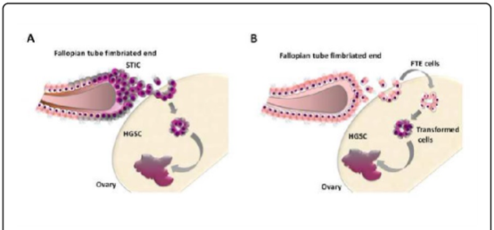
Fallopian tube hypothesis on the origin of high-grade serous carcinoma (HGSC)
1- Fallopian tube epithelium (FTE) cells of the distal and ampullo-fimbrial ends of fallopian tube undergo initial neoplastic transformation, becoming serous tubal intraepithelial carcinoma (STIC) that invasing the ovarian surface.
The ovarian microenvironment, rich in hormonal and inflammatory factors, drives the full neoplastic transformation to invasive HGSC
Alternatively,
2-The normal (FTE )fallopian tube epithelium cells are entrapped in the ovary favored by their anatomical proximity and physiological ovulation process. Entrapped FTE cells undergo progressive neoplastic transformation inside the ovary through the accumulation of molecular alterations
Because ?
Gene expression and molecular profiling studies demonstrate that ovarian hgscs more closely resemble fallopian tube epithelium than ovarian surface epithelium.
Tp53 (the tp53 tumor suppressor gene ) mutations are extremely common in both serous tubal intraepithelial carcinoma (STIC) lesions and ovarian hgscs, and more importantly, the particular mutations in these 2 lesions have been shown to be identical.

Slide 14
High-grade serous carcinoma (HGSC)
It is the most common, accounting for approximately 70 % of invasive ovarian carcinomas
It is usually diagnosed at an advanced stage,
Although it is initially highly responsive to chemotherapy, most women with HGSC ultimately relapse, develop resistance to chemotherapeutic agents and succumb to their disease.

Slide 15
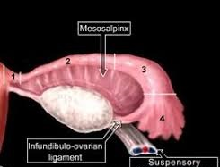
Fallopian Tube
the fallopian tubes consist of four main parts, from medial to lateral:
intramural (interstitial) part, which is located within the myometrium of the uterus, is 1 cm long and 0.7 mm wide.
the isthmus, which is a lateral continuation of the intramural part. it is a rounded, muscular part of the fallopian tube. it is 3 cm long and between 1 and 5 mm wide.
the ampulla, which is longest part of the tube. it has a diameter of 1 cm at its widest point and is 5 cm long. it has a thin wall, a folded luminal surface and fertilisation usually takes place within its lumen.
the infundibulum, which is the distal end of the tube. it is funnel shaped and opens into the peritoneal cavity at the abdominal ostium. finger like mucosal projections are attached to the distal end of the infundibulum and are referred to as fimbriae.
these fimbriae are 1 mm wide and project over the medial surface of the ovaries. the longest of the fimbriae, the ovarian fimbria, attaches to the superior aspect of each ovary

Slide 16
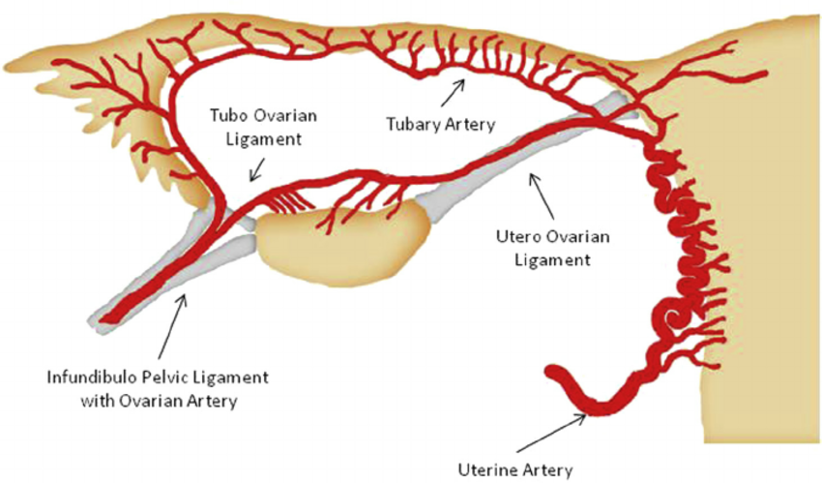
Blood supply of the tube and ovary
The principal blood supply of the tube is from the upper end of the uterine artery, which bifurcates and sends a large branch or ramus below the tube to anastomose with the ovarian artery.
The uterine artery supplies the medial two-thirds of the tube, whilst the lateral third is supplied by the ovarian artery.
Anastomoses between uterine and ovarian arteries in the mesosalpinx are variable but always present.
The main arterial supply to the ovary is via the paired ovarian arteries. These arise directly from the abdominal aorta (inferior the renal arteries). There is also a contribution from the uterine arteries.

Slide 17
Definition
Salpingectomy is the process of surgically removing one or both of the fallopian tubes while leaving the uterus and ovaries intact
Complete salpingectomy is preferred over fimbriectomy because precursors to fallopian tube cancer (or ovarian cancer) can be found throughout the fallopian tube
However, if complete salpingectomy cannot be performed, then removing as much of the fallopian tubes as possible, excluding the interstitial portion, still may have value

Slide 18
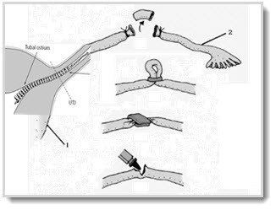
Types of salpingectomy
Complete
- opportunistic salpingectomy
- Risk reducing salpingectomy
Partial
- Tubal ligation like Bipolar coagulation , Monopolar coagulation Fimbriectomy , Irving's procedure , Tubal clip ,Tubal ring ,
Pomeroy tubal ligation, Essure tubal ligation , Adiana tubal ligation
- Excision as treatment of ectopic

Slide 19
Opportunistic salpingectomy
Opportunistic salpingectomy is the removal of the fallopian tubes for the primary prevention of ovarian cancer in a woman already undergoing pelvic surgery for another Indication
Eg cesarean section, sterlisation and other pelvic operations eg hysterectomy , myomectomy and treatment of endometriosis,
in whom fertility is no longer desired
or fallopian tubes are damaged

Slide 20
Risk-reducing salpingectomy
Women who have BRCA1 or BRCA2 germline mutations
or family history should be counseled regarding bilateral salpingo- oophorectomy, after completion of childbearing,
they should be counseled regarding risk-reducing salpingectomy when childbearing is complete followed by oophorectomy in the future,

Slide 21
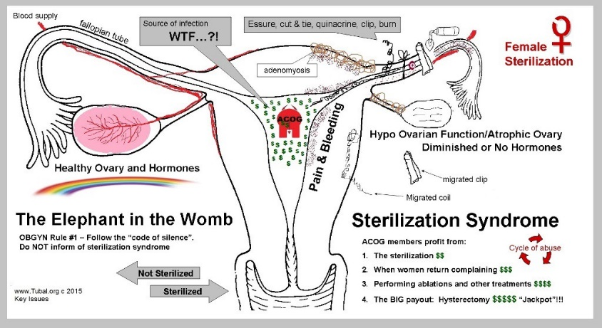
Bilateral tubal ligation is not without risks
The modified pomeroy technique is the most common postpartum sterilization method performed in the united states, with a 10 year failure rate of < 1%
Hydrosalpinx, torsion, and tubal pregnancy are all potential complications of tubal ligation, which often require an additional procedure

Slide 22
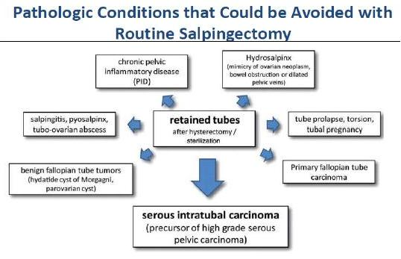
Leaving tubes after hysterectomy is not without risks

Slide 23
In the Swedish study a nation wide population-based study 2015
women who underwent bilateral salpingectomy had a 65% reduction in the risk of ovarian cancer
and
women who underwent sterilization had a 28% reduction in risk
compared with women who did not undergo steriliza-tion, salpingectomy, hysterectomy, or bilateral salpingo-oophorectomy
These patients were monitored for a minimum of 30 years after salpingectomy
Falconer H, Yin L, Gronberg H, Altman D. Ovarian cancer risk after salpingectomy: a nation wide population-based study. J Natl Cancer Inst 2015;107(2):dju410

Slide 24
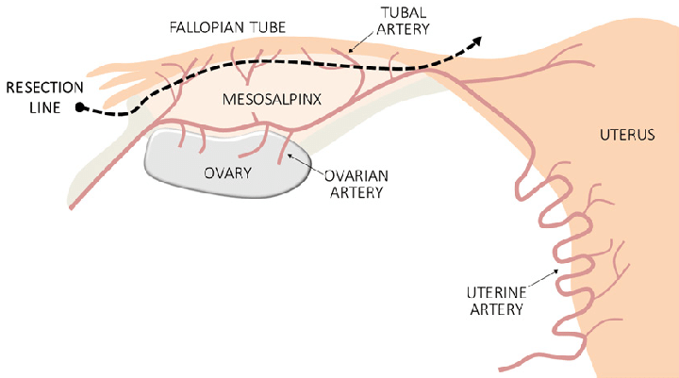
Technique of complete salpingectomy
Salpingectomy should remove the tube completely from its fimbriated end and up to the uterotubal junction;
The interstitial portions of the tubes do not need to be removed.
Any fimbrial attachments on the ovary should be cauterized or removed.
Stay as close as possible of the tube (to respect ovarian blood supply)
Tubal surgery uses the basic principles of microsurgery.

Slide 25
How is the procedure performed?
There are several techniques to perform salpingectomy, but the most common and preferred method is laparoscopy
Some surgeons prefer to do away with a viewing instrument and would make an incision in the lower abdomen to remove the tube instead. This process is termed minilaparotomy.
A more invasive approach is termed laparotomy and requires the surgeon to make a large incision in the lower abdomen to allow a better exploration of the abdomen area. This approach is especially considered if there is a need to remove both fallopian tubes.
In rare cases, salpingectomy is performed through a surgical incision in the vagina, termed colpotomy. In this method, the affected fallopian tube is approached through the vagina.

Slide 26
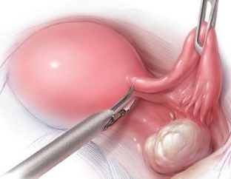
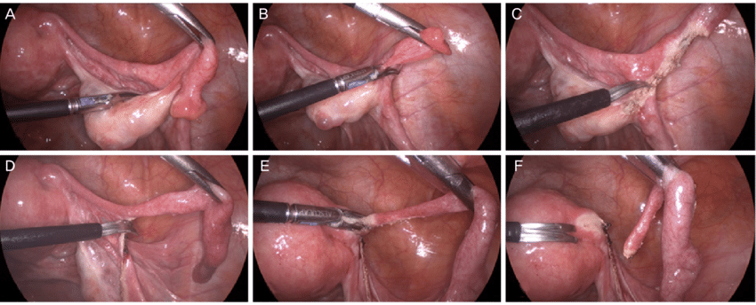
Laparoscopic salpingectomy
Fallopian tubes are resected from the fimbrial end to the uterine cornu. Careful resection is performed at the posterior margin of the fallopian tubes, while conserving the mesosalpinx.

Slide 27
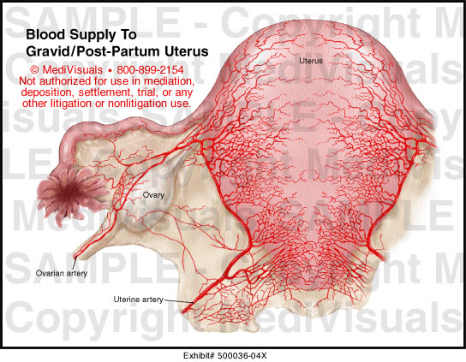
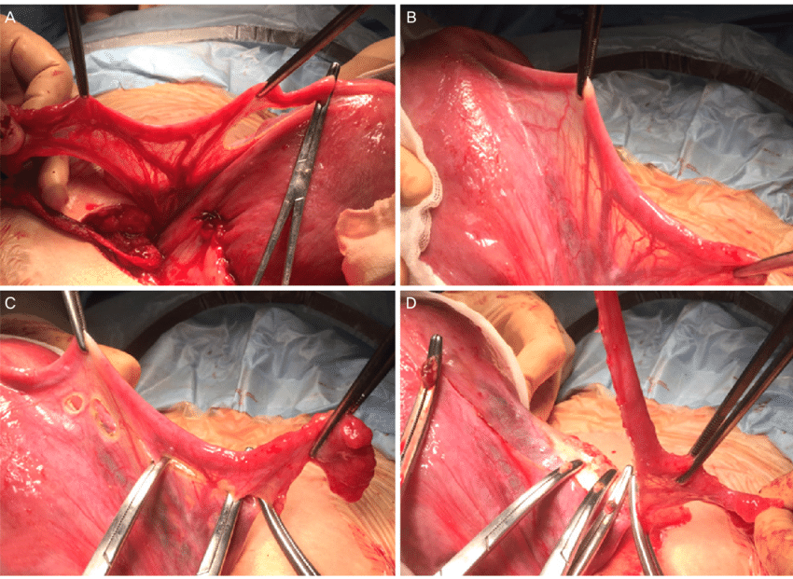
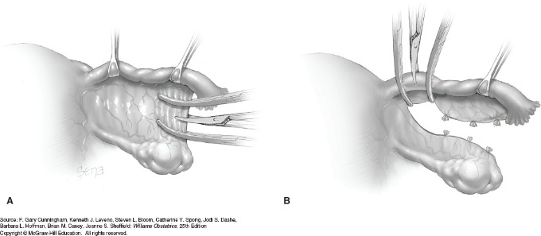
Salpingectomy during cesarean delivery
The engorged vessels in the mesosalpinx and the broad ligament during pregnancy;
Resection of the tubo-ovarian ligament and mesosalpinx as close as possible to the fallopian tube, with ligation of engorged tubal vessels, clamping and suturing step by step ; and
Resection of the fallopian tube at the uterine cornu.

Slide 28
Vaginal salpingectomy
Studies that reviewed the feasibility of salpingectomy at the time of vaginal hysterectomy demonstrate that opportunistic salpingectomy can be successfully performed 75–88% of the time.
Reasons that salpingectomy could not be done included pelvic or adnexal adhesions and fallopian tubes that could not be accessed vaginally
Plans to perform an opportunistic salpingectomy should not alter the intended route of hysterectomy

Slide 29
Possible risks and complications of salpingectomy
Based on a physician survey of members of the american college of obstetricians and gynecologists,
77% perform bilateral salpingectomy at the time of hysterectomy for benign indications.
The respondents also performed bilateral salpingectomy at the time of sterilization at the following rates: 53% during interval sterilization, 26% during postpartum sterilization; and 37% during cesarean deliveries
Other than a significant increase in operative time for salpingectomy with hysterectomy (16 minutes) and with sterilization (10 minutes),
No significant differences in length of hospital stay, readmissions, blood transfusions, or postoperative complications, infections, and fever have been identified in cases with and without salpingectomy
Larger studies that are powered to detect possible differences in complications are necessary.

Slide 30
Ovarian function
Ovarian function does not appear to be affected by salpingectomy at the time of hysterectomy based on surrogate serum markers or response to in vitro fertilization
Salpingectomy alone does not appear to significantly affect ovarian stimulation parameters or clinical pregnancy rates.
Furthermore, salpingectomy is recommended in cases of hydrosalpinx.

Slide 31
Counselling
Counseling women who are undergoing routine pelvic surgery about the risks and benefits of salpingectomy should include an informed consent discussion about the role of oophorectomy and bilateral salpingo-oophorectomy
The risks and benefits of salpingectomy should be discussed with patients who desire permanent sterilization.
Obstetrician–gynecologists should counsel women who have undergone salpingectomy of potentially relevant signs and symptoms of ovarian cancer

Slide 32
Time of prophylactic salpingectomy
= Opportuinistic salpingectomy with CS or hysterectomy or other pelvic operations
= planned
-Tubal sterlization salpingectomy
-Risk-reducing salpingectomy
- Family history –-- early age of onset of ovarian cancer in the family
-Gene mutation
-At age 35–40 for BRCA1 carriers or
-At age 40–45 for BRCA2 carriers

Slide 33
Treatment Review
Low risk cancer ( not carrying BRCA mutations or no family history ). ----opportunistic bilateral salpingectomy (bilateral salpingectomy with ovarian retention (BSOR)), including cs , sterlisation and other pelvic operations eg hysterectomy , myomectomy and treatment of endometriosis, in whom fertility is no longer desired or fallopian tubes are damaged
Moderate risk cancer : family history
–risk reducing bilateral salpingectomy early age of onset of Ovarian cancer in the family
- or risk reducing salpingectomy-delayed oophorectomy early age of onset of Ovarian cancer in the family
Then bilateral oophorectomy upon completion of child-bearing
High risk cancer (carrying BRCA mutations). Bilateral Mastectomy (90% ‐ 95% reduction of breast cancer risk
plus
Risk reducing salpingectomy-delayed oophorectomy
-At age 35–40 for BRCA1 carriers or
-At age 40–45 for BRCA2 carriers
Then bilateral oophorectomy upon completion of child-bearing
Or - salpingo-oophorectomy (80‐90% reduction of ovarian cancer risk)

Slide 34
 | Average Risk | Slightly Increased Risk | Moderately Increased Risk | Very Increased Risk
age |  | +
wt |  | +
Infertility history |  | +
Fertility drugs |  | +
Endometriosis |  | +
HRT postmenopause |  | +
Family history |  |  | + Women with a mother, sister, grandmother or aunt who has had ovarian cancer
Genetic BRCA1,2,others |  |  |  | +
 | Opportunistic bilateral salpingectomy =during sterilisation =during CS =during hysterectomy =during any gynecologic operations |  | =TVU and the CA-125 blood test two times per year = chemoprevention – oral contraceptive pills (cop,pop) = risk reducing bilateral salpingectomy +oopherectomy on early age of onset of ovarian cancer in the family | TVU and the CA-125 blood test two times per year starting at age 30–35 until the ovaries and fallopian tubes are removed preventively =once child-bearing is complete Risk-reducing bilateral salpingo-oophorectomy (RRBSO) at age 35–40 for BRCA1 carriers or At age 40–45 for BRCA2
 |  |  |  | a staged approach of initial bilateral salpingectomy once childbearing is complete (reduce ovarian cancer), followed by bilateral oophorectomy closer to natural menopause(reduce breast cancer)

Slide 35
Recommendations and conclusions
Population-based screening should not be encouraged as a method of “ovarian” cancer risk reduction (strong, high).
Salpingectomy at the time of hysterectomy or as a means of tubal sterilization appears to be safe and does not increase the risk of complications such as blood transfusions, readmissions, and postoperative complications, infections, or fever compared with hysterectomy alone or tubal ligation.
Ovarian function does not appear to be affected by salpingectomy at the time of hysterectomy based on surrogate serum markers or response to in vitro fertilization.
The surgeon and patient should discuss the potential benefits of the removal of the fallopian tubes during a hysterectomy in women at population risk of ovarian cancer who are not having an oophorectomy.
Removal of the ovaries in premenopausal women may increase the risk of cardiovascular disease and is not recommended without clinical indication (strong, high).
Counseling women who are undergoing routine pelvic surgery about the risks and benefits of salpingectomy should include an informed consent discussion about the role of oophorectomy and bilateral salpingo-oophorectomy.
Although data are limited, postpartum salpingectomy and salpingectomy at time of cesarean delivery appear feasible and safe.
The risks and benefits of salpingectomy should be discussed with patients who desire permanent sterilization.
Plans to perform an opportunistic salpingectomy should not alter the intended route of hysterectomy

Slide 36
Thank you

