Slide 1

Thrombocytopenia During Pregnancy
Muhammad M Al Hennawy
Consultant Obstetrician & Gynacologist
Ras El Bar Central Hospital ,
Dumyat Specialised Hospital ,
Egypt

Slide 2
The haemostatic role of platelets was established in the 1880s by Bizzozero who observed their ability to adhere and aggregate at sites of vascular injury.
It was only some 80 years later that the function of platelets in maintaining the structural integrity of intact blood vessels was reported by Danielli.
Subsequent studies have demonstrated further that platelets are continuously needed to support intact mature blood vessels.
More recently, platelets were shown to safeguard developing vessels, lymphatics, as well as the microvasculature at sites of leukocyte infiltration, including inflamed organs and tumours..

Slide 3
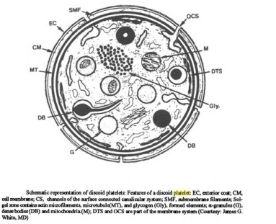
Thrombocytes or platelets
They are small non nucleated colourless cell fragments
Size -- 1-4 micrometer in diameter
It is 6 nanometer thick and contains lipids ( phospholipids , cholesterol , glycolipids ), carbohydrates ( glycocalyx) , proteins and glycoproteins
Life span -- Remain alive for 5-10 days
Shape --spherical or rod shaped , when unactivated platelets are biconvex discoid (lens –shaped strucure)
Approximately 1 x 10 11 new platelets are released each day into the circulation from bone marrow where they are formed by fragmentation from megakaryocytes along with red and white blood cells
Normally two thirds of thrombocytes circulate in the blood and One third of thrombocytes is stored in spleen ( sequestrated)
Old platelets are destroyed by phagocytosis in spleen and the liver ( kupffer cells)

Slide 4
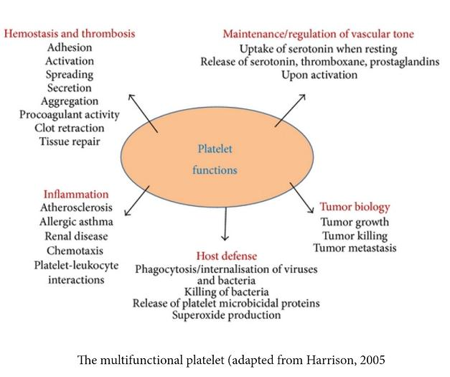
Functions Of The Platelets
It maintains capillary endothelial cells
1) platelets physically block potential gaps in the vascular lining
2) platelets and platelet components promote the growth of endothelial cells
3) platelets help maintain the endothelium ultrastructure and
4) platelets release soluble factors that enhance the barrier function of the endothelium
5) platelets promote re-endothelialisation following vascular injury or tissue ischaemia, and to stimulate the differentiation of progenitor cells into endothelial cells
It is involved in physiological hemostasis
Glycoprotein coat in the surface of platelets adhere to injuried endothelial cells to prevent bleeding
Phospholipids in the membrane activate intrinsic system of blood coagulation
Actin , myosin and thrombosthenin ( contractile proteins ) cause clot retraction
Glycoproteins prevent platelets from adherence to normal endothelium

Slide 5
Spontanuos Extravasation Of Red Blood Cells Into The Surrounding Tissues In Thrombocytopenia
When platelets fall below critical levels (usually under 10,000 to 20,000 per cubic millimeter), The interruption of the normal interaction between platelets and endothelial cells
Thinning and fenestration of the endothelium of postcapillary venular vessels , as well as an increase in microvessel permeability and degradation or rupture of the basal lamina surrounding vasculature
Causing extravasation of erythrocytes into the surrounding tissues ( petechiae).

Slide 6
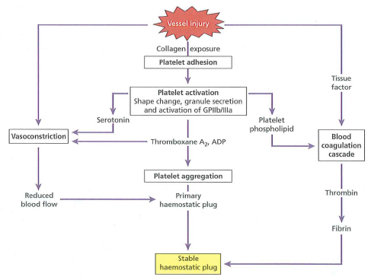
Process of Hemostasis
1-Vascular injury
-Serotonin and thromboxane A2 (TxA2) for vasoconstriction
-Exposure of basement membrane and collagen (negatively charged surface)
2-Platelet adhesion and activation
3- Platelet aggregation (1o homeostatic plug)
4-Fibrin formation via coagulation cascade (2o homeostasis)
5-Clot retraction
6-Fibrinolysis and healing

Slide 7
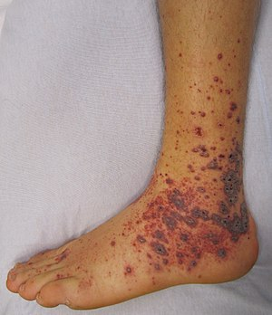
Size Of Bleeding
Blood to leak slowly from minute tears in smallest blood vessels ( capillaries ) that do not blanch on applying pressure.
Causing bright or dark red pinpoint –size hemorrhages appear on the skin
Called petechiae measure less than 3 mm
Or purpura measure from 3–10 mm
Or ecchymoses measure greater than 1 cm

Slide 8
Site Of Bleeding
On skin--- often occur in the lower limbs ( where gravity exerts increased pressure on the blood vessel walls)
Or along areas constricted by tight clothing ( such as brassiere straps)
On mucous membranes --- on the inside of the cheeks ( owing to pressure from chewing )
Or bleeding of the gums or blisters in the mouth
Or Nose bleeds
Easy bruising
Prolonged or heavy menstrual periods
Prolonged bleeding after a minor cut or after dental or surgical procedures
Bleeding into the stomach or intestine---black or tarry stools
<10,000: risk for spontaneous intracranial hemorrhage (sudden onset of severe headache , nausea , vomiting , vission loss or confusion)

Slide 9
Degrees Of Thrombocytopenia
Thrombocytopenia is defined as a platelet count below the lower limit of normal (ie, <150,000/microL [150 x 10⁹/L] for adults).
According to count of platelets
Mild (platelet count 100,000 to 150,000/microL),
Moderate (50,000 to 99,000/microL), and
Severe (<50,000/microL)
According to f the underlying disease, and may be unpredictable.
Eg, in the setting of gestational thrombocytopenia, we consider a platelet count between 80,000 and 150,000/microL to represent mild thrombocytopenia;
in the setting of immune thrombocytopenia [ITP], we consider a platelet count <30,000/microL to represent severe thrombocytopenia)

Slide 10
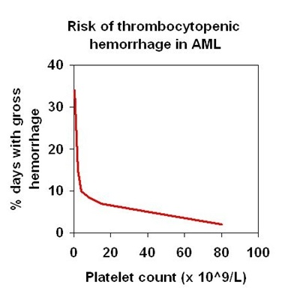
Risk Of Bleeding
Platelet counts (PCs) in humans 150-450 platelets/nL( average 250 platelets/nL
Assess the risk of bleeding according to the platelet count.
50 to 150, no risk of bleeding.
30 to 50, rarely causes bleeding ( purpura) even with trauma.
10 to 30, may cause bleeding with minimal trauma but is unusual with normal day to day activity. Many patients are asymptomatic.
< 10, may have spontaneous bruising or bleeding and constitutes as hematological emergency
Note: Bleeding risk is also dependent on whether other parts of the haemostatic process are involved e.g., coagulation factor , abnormalities in liver disease
The underlying systemic effects of sepsis, cancer, inflammation, or associated immunologic processes that can directly injure the microvasculature, compromising interjunctional endothelial integrity.

Slide 11
A Physiological Fall In The Platelet Count
Pregnancy is associated with a physiological fall in the platelet count with a leftward shift in the platelet count distribution
The cause for the physiologic decrease in platelet count is multifactorial and is related to
hemodilution,
increased platelet consumption, and
increased platelet aggregation driven by increased levels of thromboxane A2.
Platelet count may also be lower in women with twins as compared with singleton pregnancies, perhaps due to a greater increase in thrombin generation.
Pregnant women with thrombocytopenia tend to have fewer bleeding complications than nonpregnant women due to the procoagulant state induced by increased levels of fibrinogen, factor VIII and von Willebrand factor, suppressed fibrinolysis and reduced protein S activity.

Slide 12
Thrombocytopenia During pregnancy
These conditions have implications for both mother and fetus.
Thus, it is important to consider both
MATERNAL THROMBOCYTOPENIA The antepartum diagnosis of maternal thrombocytopenia has become more common because platelet counts are now routinely obtained as part of prenatal screening.
And
FETAL THROMBOCYTOPENIA

Slide 13
Thrombocytopenia Causes.
Can be broadly classified in to five categories based on the mechanism behind reduced platelet count:
1- Pseudo or Spurious Thrombocytopenia
2-Dilutional Thrombocytopenia
3-Decreased Platelet Production
4-Increased Platelet Destruction
5-Altered Distribution of Platelets ( Increased Sequestration)
Most common mechanisms are decreased platelet production and increased destruction

Slide 14
Maternal Thrombocytopenia

Slide 15
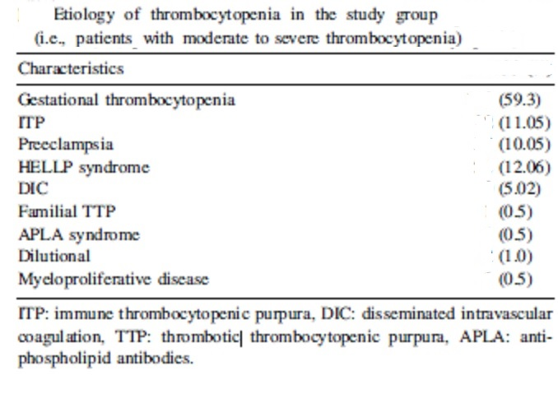
Maternal thrombocytopenia Causes
Gestational thrombocytopenia (GT) (59.3%),
Immune thrombocytopenic purpura (ITP) (11.05%),
Preeclampsia (10.05%), and
HELLP (Hemolysis, elevated liver enzymes and low platelet count) syndrome (12.06%)
There are additional, rarer causes of thrombocytopenia during pregnancy, including
Disseminated intravascular coagulation (DIC),
Thrombotic thrombocytopenic purpura (TTP),
Autoimmune conditions such as anti-phospholipid antibodies syndrome (APLA) , Systemic lupus erythematosus (SLE),
• Bone marrow disorders such as MDS, myelofibrosis
Acute fatty liver of pregnancy ( AFLP)
Dilutational ,
Hemolytic uremic syndrome (HUS).
Drugs as Heparin induced thrombocytopenia or aspirin induced thrombocytopenia
• Inherited, Type IIB vWD
• Nutritional deficiencies B12, folate
Pseudothrombocytopenia

Slide 16
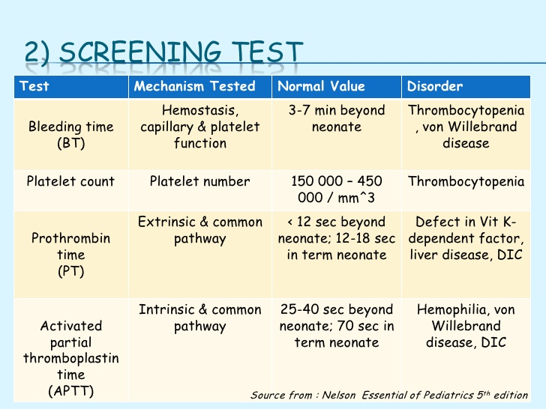
Investigations
mm

Slide 17
Complete blood count (CBC). This common blood test is used to determine the number of blood cells, including platelets, in a sample of blood. With ITP, white and red blood cell counts are usually normal, but the platelet count is low.
Blood smear. This test is often used to confirm the number of platelets observed in a complete blood count.
Bone marrow exam. This test may be used to help identify the cause of a low platelet count, though the American Society of Hematology doesn't recommend this test for children with ITP.

Slide 18
Pseudothrombopenia
A reduced platelet count in EDTA-treated blood may result from platelet aggregation or from platelet adhesion to leukocytes.
This laboratory phenomenon can be identified as such by the microscopic examination of blood smear

Slide 19
Gestational Thrombocytopenia (GTP) Or Incidental Thrombocytopenia Of Pregnancy
It is a mild (usually more than 70,000/μL platelet count),
Common in approximately 8% of all pregnancies
Accounts for more than 70% of cases with thrombocytopenia in pregnancy
Asymptomatic thrombocytopenia
That occurs during pregnancy , especially during the third trimester
The cause of thrombocytopenia in these women is unclear,
But may be an acceleration of the physiologic pattern of increased platelet destruction (Increase in blood volume , Platelet activation , Increased platelet clearance).
It is a diagnosis of exclusion

Slide 20
Women with this diagnosis are healthy, not at risk for fetal thrombocytopenia or bleeding complications, and have no history of autoimmune thrombocytopenia.
Platelet counts return to normal after delivery within 12 weeks of delivery
It can be difficult to distinguish GTP from autoimmune thrombocytopenia If thrombocytopenia is found late in pregnancy and counts are more than 70,000/μL, GTP is the most likely diagnosis.
However, other causes of thrombocytopenia, including preeclampsia, should be excluded.
Women with GTP do not require additional testing or specialized care
Gestational thrombocytopenia can recur; the risk of recurrence, however, is unknown.

Slide 21
Autoimmune Thrombocytopenia, Or Idiopathic Thrombocytopenicpurpura (ITP)
It is a syndrome characterized by immunologically mediated thrombocytopenia.
The disorder is caused primarily by autoantibodies to platelet membrane glycoproteins, leading to increased platelet destruction.
In adults, ITP is typically a chronic disorder.
It can be difficult to distinguish from other causes of thrombocytopenia and is a diagnosis of exclusion.
The most common signs and symptoms include petechiae, ecchymoses, easy bruising, epistaxis, gingival bleeding, and menorrhagia.
Serious spontaneous bleeding complications are rare, even in severely thrombocytic individuals with platelet counts of less than 10,000/μL
When thrombocytopenia is profound and detected early in pregnancy, suspicion is high that the diagnosis is ITP.
It often coexists with pregnancy because the disease usually presents in the second to third decade of life and has a female preponderance of 3 : 1

Slide 22
Few diagnostic tests are useful in the evaluation of ITP.
A complete blood count (CBC) and peripheral blood smear are helpful to exclude other causes of thrombocytopenia (e.g., pancytopenia, leukemias).
The peripheral smear may show an increased proportion of slightly enlarged platelets.
Bone marrow biopsy is sometimes helpful to clarify the diagnosis as increased numbers of immature megakaryocytes may be seen and inadequate platelet production may be excluded.

Slide 23
The focus of maternal therapy is to avoid bleeding complications associated with severe thrombocytopenia. Because labor and delivery pose a substantial risk for bleeding, most authorities recommend more aggressive medical therapy for women in the late second or third trimesters.

Slide 24
Current recommendations about maternal therapy for ITP are derived largely from expert opinion.
Pregnant women who are asymptomatic and who have platelet counts of over 50,000/μL do not require treatment.
In the first and second trimesters, asymptomatic women with platelet counts of 30,000–50,000/μL also do not require treatment.
It is controversial as to whether women with counts between 30,000 and 50,000/μL should be treated during the third trimester.
Treatment is considered appropriate for women with
1 - Platelet counts of less than 10,000/μL at any gestational age;
2 - Platelet counts of 10,000–30,000/μL during the second or third trimesters; or
3 - Platelet counts of 10,000–30,000/μL with bleeding at any gestational age.

Slide 25
PREGNANCY TREATMENT AND CARE

Slide 26
Medications
Drugs that suppress immune system.
an oral corticosteroid, such as prednisone.
Injections to increase blood count. an injection of immune globulin (IVIG) or antiD immunoglobulins
Drugs that boost platelet production. Thrombopoietin receptor agonists — such as romiplostim (Nplate) and eltrombopag (Promacta)
Other immune-suppressing drugs. Rituximab (Rituxan) helps reduce the immune system response that's damaging platelets, thus raising the platelet count.
Emergency treatment
transfusions of platelet concentrates,
intravenous corticosteroid (methylprednisolone) and
intravenous immune globulin.
Treatments for resistant disease
Removal of spleen. If condition is severe or persists despite initial drug treatment,
Other drugs. Azathioprine (Imuran, Azasan) has been used to treat ITP. But it can cause significant side effects, and its effectiveness has yet to be proved. Possible side effects include fever, headache, nausea and vomiting, and muscle pain.

Slide 27
Glucocorticoids
They are standard first-line treatment in both pregnant and nonpregnant adults.
Non pregnant: (60-80 mg/d, 1 mg/kg/d) , Pregnancy: lower doses (20-30 mg/d): safe and effective for 2–3 weeks.
If platelet counts reach acceptable levels, the drug is tapered by 10–20% per week until the lowest dosage required to maintain the platelet count at an acceptable level is achieved that will maintain a satisfactory (>50 x 109/L) maternal platelet count
Some increase in platelet count occurs in approximately 70% of patients, and complete remission has been reported in up to 25% of cases
A response to glucocorticoids is usually apparent in 3–7 days and will reach a maximum in 2–3 weeks
The benefits of steroids appear to outweigh the risks in women requiring treatment for ITP

Slide 28
Intravenous immunoglobulin (IVIG)
Indication:
- resistant cases - women likely to require prolonged therapy
- women requiring a high maintenance dose of prednisolone or
- who are intolerant of prednisolone.
Mechanism: delaying clearance of IgG-coated platelets from the maternal circulation
Response:
- more rapid (24-48 h) than with steroids: useful if a rapid response is required.
-lasts for two to three weeks
Disadvantages:
- Expensive
- seldom produces long-term remission.
Dose: 0.4 g/kg/ day for five days or 1 g/kg over eight hours, repeated two days later if there is an inadequate response.
This dose of IVIG will substantially increase the platelet count in 75% of patients and will restore normal platelet counts in 50% of patients
However, in 70% of cases, the platelet count will return to pretreatment levels within 1 month after treatment

Slide 29
Intravenous anti-D immunoglobulin
Indication: treat ITP , non-splenectomised , rhesus-positive women.
Mechanism: creating a decoy to competitively inhibit the destruction of antibody-coated platelets: raise platlet count.
Doses: IV bolus 50 to 70 μg/kg.
Safe and effective in 2nd and 3rd Trimester.
Monitor baby neonatal jaundice anaemia, and direct antiglobulin test positivity after delivery
The use of anti-D is attractive because it is less expensive and has a shorter infusion time than IVIG.

Slide 30
Splenectomy
It was the first therapy recognized to be effective for ITP and
Induces complete remission in approximately 80% of patients.
The postsplenectomy platelet counts increase rapidly and are often normal within 1–2 weeks.
The procedure is usually avoided during pregnancy
But can be safely accomplished, although preferably in the second trimester.
Splenectomy during pregnancy is reserved for women with platelet counts of less than 10,000/μL who are bleeding and who fail to respond to steroids and IVIG
The procedure is not recommended for asymptomatic women with platelet counts of more than 10,000/μL

Slide 31
Platelet transfusions
It should be used only as a temporary measure to prepare a patient for splenectomy or surgery, or for life-threatening hemorrhage.
However, the usual elevation in platelet counts of approximately 10,000/μL per unit of platelet concentrate transfused is not achieved in patients with ITP because antiplatelet antibodies also bind to donor platelets. Thus,
6–10 units of platelet concentrate should be transfused.

Slide 32
Platelet counts below which transfusion should be considered
•< 10,000/L - prophylactic transfusion
•< 20,000/L - in the presence of bleeding, fever, infection, platelet function defect, or coagulopathy
• <50,000/L - prior to minor procedures, in actively anticoagulated patients or in the presence of active bleeding
• <75,000/L - prior to general surgery
•< 100,000/L - prior to neurologic or ophthalmologic surgery

Slide 33
Thrombopoietin receptor agonists
Such as romiplostim (Nplate) and eltrombopag (Promacta)
Help bone marrow produce more platelets.
Possible side effects include headache, dizziness, nausea or vomiting, and an increased risk of blood clots

Slide 34
Rituximab
Rituximab is increasingly being used to treat ITP in non-pregnant women;
Rituximab (Rituxan) helps reduce the immune system response that's damaging platelets, thus raising the platelet count.
Possible side effects include low blood pressure, fever, sore throat and rash.
however, it is classified as a class C drug in pregnancy.
As information is limited in pregnancy
It should be avoided unless there are no other options.

Slide 35
specialized care beyond attention to platelet count
These patients should be instructed
avoid salicylates, nonsteroidal anti-inflammatory agents, And
avoid trauma.
• Risk of intrapartum haemorrhage , especially from a surgical incision
• Higher chance of pre-term delivery
• Theoretical risk of epidural haematoma, however, epidural is considered safe if the platelet count
>80–100 × 109/l14
• Avoid im injections if platelet count <40 × 109/l
• • Maintain iv access during labour
• Caesarean section only for obstetric reasons
• Avoid ventouse and forceps delivery ,There is a small risk of fetal intracranial haemorrhage, with chance of fetal bruising and significant cephalhaematoma
• Avoid fetal blood sampling and cordocentesis
• • The anaesthetist may prefer a spinal anaesthetic to an epidural
Regardless of route of delivery, platelets, fresh frozen plasma (FFP), and IVIG should be readily available

Slide 36
In all cases of possible fetal thrombocytopenia, whether secondary to ITP or alloimmune thrombocytopenia,
a neonatologist or other clinician familiar with the condition should be present to care for potential bleeding complications and the anticipated decrease in neonatal platelet count during the first several days after birth.
The use of scalp electrodes, forceps, and vacuum extractors should be avoided in these patients.
Aim for normal vaginal delivery if all is otherwise well
• Leave adequate length of umbilical cord, below the cord clamp, to allow blood samples to be taken
• Active management of third stage of labour; consider use of iv Syntocinon if im injections are contraindicated
• All perineal trauma to be sutured promptly and expertly
• Take placental cord blood for neonatal platelet count, and ascertain if other samples are required
• Confirm with paediatrician if the neonatal vitamin K can be given im
Although there is a theoretical risk of neonatal thrombocytopenia, women with ITP should not be discouraged from breastfeeding
Risk of postpartum haemorrhage if platelet count is low
• ITP secondary to pre-eclampsia or HELLP syndrome often deteriorates immediately post delivery
• The risk of thrombocytopenia in the neonate cannot be predicted from clinical or laboratory test results in the mother
• 6% risk of the neonate having severe thrombocytopenia with a limited risk of intracranial haemorrhage

Slide 37
Route of delivery
It was once considered critical to neonatal outcome in women with ITP. Passage through the birth canal was proposed as the reason for bleeding in thrombocytopenic fetuses and this together with anecdotal reports and case series led to recommendations for delivery by cesarean section
However, vaginal delivery has never been proven to cause ICH and
several studies have shown no association between route of delivery and neonatal bleeding complications
At this time, it seems prudent to deliver by cesarean section for the usual obstetric indications without determination of the fetal platelet count in most women.
Nonetheless, the substantial rate of ICH probably justifies cesarean delivery in pregnancies with severe NAIT.
However, the matter remains controversial.

Slide 38
Preeclampsia
Preeclampsia and HELLP syndrome are considered to be the cause of thrombocytopenia in pregnancy in about 21% of cases
Thrombocytopenia in patients with preeclampsia is usually moderate and platelet count rarely decreases to less than 20,000/μl.
Thrombocytopenia in patients with preeclampsia always correlates with the severity of the disease.
The maternal platelet count returns to normal within 3–5 days of delivery.

Slide 39
HELLP syndrome
HELLP syndrome occurs in 10% pre-eclamptic women
It is characterized by hemolytic anemia, elevated liver enzymes, and a low platelet count (usually below 100 109/l)
Distinguishing features - Microangiopathic H/A, LDH >600U/L, AST ≥70U/L and Plt <100 x109/L
It is responsible for maternal deaths (up to 3.0% of HELLP cases may end in maternal mortality) and stillbirth (in up to 20% of cases), especially as a result of placental abruption and preterm delivery
The maternal platelet count returns to normal within 3–5 days of delivery.

Slide 40
Acute fatty liver of pregnancy (AFLP)
AFLP is a rare disorder with an incidence of 1 in 10,000-15,000 pregnancies,
maternal mortality of 18% and fetal mortality of 23%.
Patients are usually nulliparous and there is an increased incidence in twin pregnancies
AFLP is thought to be due to abnormalities in intramitochondrial fatty acid beta oxidation.
Maternal heterozygosity for long chain 3 hydroxyacyl CoA dehydrogenase deficiency leads to reduced oxidation of the fatty acids. This combined with dietary factors exacerbate the condition.
When a heterozygous woman carries a fetus that is homozygous, fetal hepatotoxic fatty acids accumulate and return to maternal circulation, causing maternal liver and vascular damage.

Slide 41
Patients usually present in the third rimester with nausea, vomiting, malaise, right upper quadrant pain and cholestatic liver dysfunction.
Laboratory findings include normal to low platelet count, normochromic normocytic anemia, elevated leucocyte count, prolonged prothrombin time, and low fibrinogen and antithrombin III (AT III) levels along with raised transaminases.
AFLP is more likely associated with liver and renal failure and concomitant coagulopathy, hypoglycemia and encephalopathy than HELLP syndrome.
Half of the patients will have criteria for preeclampsia and some may have features that overlap with HELLP.
DIC is the hallmark for AFLP, whereas only 7% with preeclampsia and 20-40% with HELLP have DIC.
Intensive supportive care with blood product support for the underlying coagulopathy along with immediate termination of pregnancy is recommended as spontaneous recovery during pregnancy is unlikely

Slide 42
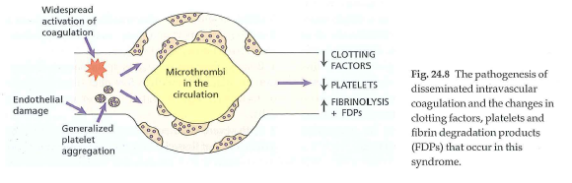
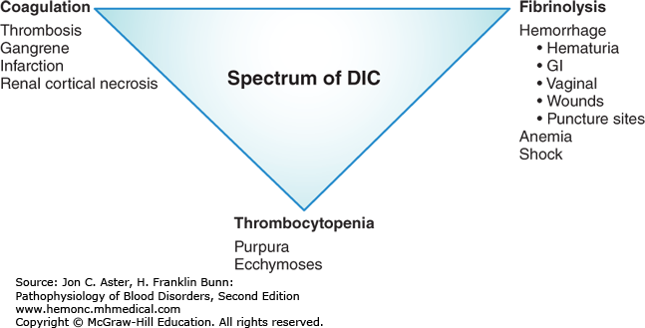
Disseminated intravascular coagulation
This may occur due to a number of reasons in pregnancy, the most common being placental abruption, amniotic fluid embolism and uterine rupture.
There is profound activation of the coagulation system due to the rapid release of tissue factor-rich material into the maternal circulation, leading to consumption of the coagulation factors and hypofibrinogenemia.
It is associated with prolonged PT/PTT, thrombocytopenia, low fibrinogen, elevated fibrin degradation products and the presence of D dimers.
DIC may also occur with retained products of conception, where it is more gradual in onset, and thrombocytopenia may be the presenting feature

Slide 43
Nutritional deficiencies
Severe folic acid and B12 deficiency may cause low platelet count, but is usually accompanied by low red blood cell and leucocyte counts.
These are however rare in pregnancy as women receive folic acid supplementation to prevent neural tube defects.
Vitamin B12 deficiency is rare in pregnancy because those with established B12 deficiency are subfertile.

Slide 44
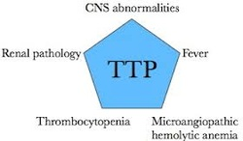
Thrombotic thrombocytopenic purpura (TTP)
Pregnancy can trigger acute TTP
Typically 3rd trimester or during postpartum period
Physiological changes of pregnancy may increase the risk
the condition is caused by an autoantibody to a protease enzyme of von Willebrand factor , causing intravascular platelet agglutination in vivo and the precipitation of a microangiopathic haemolytic anaemia.
Diagnosis→ Microangiopathic H/A, thrombocytopenia & clinical picture (fever, fluctuating neurological signs, renal impairment)
The condition is suspected clinically by thrombocytopenia, red cell fragmentation on the blood film, and a reticulocytosis.
Prompt & aggressive treatment
Plasmapheresis & urgent delivery if possible
Differentiating TTP from HELLP is occasionally only possible when Sx persist weeks after delivery

Slide 45
Dilutional or Post-transfusion purpura
• This is an acquired abnormality
Large quantities of PRBC transfusion to treat massive hemmorhage can lead to dilutional TP.
Due to absence of viable platelets in packed RBCs.
• It is a rare complication presenting 7-10 days after the transfusion
• Patients are usually multiparous women who are negative for the human platelet antigen 1a
• Antibodies to this antigen develop that are somehow responsible for the immune destruction of the patient’s own platelets
Can be prevented by giving platelet concentrates to patients receiving more than 20 units PRBCs in a 24 hour period

Slide 46
Marrow infiltrative disorders
These are unlikely in women of child bearing age.
Bone marrow biopsy may be indicated if the diagnosis is suspected.
The management plan would depend on the exact diagnosis, stage of pregnancy and the risks to the mother by delaying treatment.

Slide 47
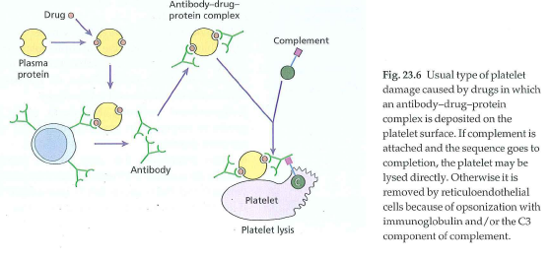
Drug induced thrombocytopenia
Isolated thrombocytopenia
It is thrombocytopenia with normal RBC, WBC and no sign or symptoms of systemic illness.
Antibody against new epitopes of platelet glycoprotein.
Moderate to severe thrombocytopenia.
Drop in platelet count within 2-3 days up to 1-3 weeks.
Recovery in 5-10 days after drug stoppage
Should be suspected when patient has recurrent episodes of thrombocytopenia with prompt recovery
Drugs eg penicillin, cephalosporins , Aspirin and non-steroidal anti-inflammatory agents , quinine, sulphonamides, rifampicin

Slide 48
Heparin Induced Thrombocytopenia (HIT)
>50% decrease in platelet count or total platelet< 1,00,000/cumm, while the patient is on heparin.
It occurs during unfractionated heparin therapy in up to 5% of patients, but is less frequently associated with low molecular weight heparins
Rare(1-3 %)
Median Platelet count 50,000-80000. Rarely below 20000/cumm.
It is due to the formation of antibodies to heparin that are bound to platelet factor 4, a platelet granule protein. The immune complexes activate platelets and endothelial cells, resulting in thrombocytopenia and thrombosis coexisting
Clinical manifestations may include venous or arterial thrombosis, necrotic skin lesions at heparin injection sites, or acute systemic reactions subsequent to IV heparin bolus administration

Slide 49
Aspirin, Non-Steroidal Anti-Inflammatory Agents, And Glycoprotein IIb/IIIa Antagonists
They are the most common cause of acquired platelet dysfunction.
For this reason aspirin and the IIb/IIIa antagonists are used therapeutically as antiplatelet agents.
Aspirin acts by irreversibly inhibiting cyclo-oxygenase activity in the platelet, resulting in impairment of the granule release reaction and defective aggregation.
The effects of a single dose of aspirin last for the lifetime of the platelet (7-10 days).

Slide 50
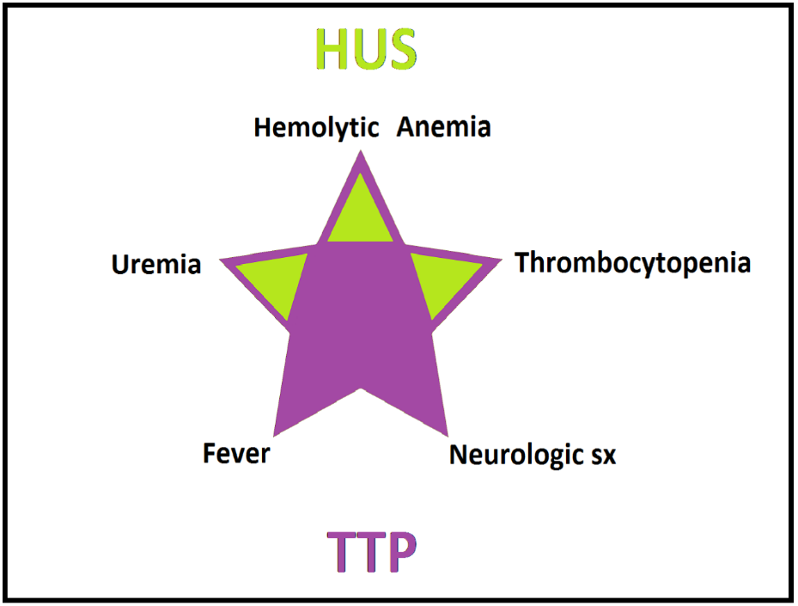
Hemolytic Uremic Syndrome (HUS),
Bleeding in uraemic patients is most commonly from defects in platelet adhesion or aggregation,
Though thrombocytopenia, severe anaemia with packed cell volume 20% or coagulation defects can also contribute.

Slide 51
Appartent Or Distributional Thrombocytopenia
Total platelet mass is normal.
About 1/3rd of circulating platelets are normally sequestrated in spleen.
Splenic sequestration of platelets may increase to 90% in splenomegaly ( hypersplenism) secondary to portal hypertension or other causes .
May be associated with leucopenia and/ or anemia.
Circulating platelet count decreases but total platelet mass and overall platelet survival remain normal.
Hence, these patients can have significant “apparent” thrombocytopenia but rarely have clinical bleeding ( since total available platelet mass is normal)

Slide 52
Autoimmune disease chronic thrombocytopenia
Autoimmune disease such as systemic lupus erythematosus and antiphospholipid syndrome:
These disorders are characterized by vascular thrombosis and pregnancy complications, with secondary immune thrombocytopenia as a potential manifestation of the disorder.
The thrombocytopenia is less severe than seen with ITP.
Treatment is similar to ITP for severe symptomatic thrombocytopenia

Slide 53
Fetal and neonatal thrombocytopenia

Slide 54
Fetal and neonatal thrombocytopenia Causes
Kinetic Mechanisms
• Decreased platelet production about 75% of cases, • Accelerated platelet destruction or sequestration
Pathophysiologic Categories
• Immune-mediated • Infectious • Genetic • Drug-related • Disseminated intravascular coagulation • Miscellaneous

Slide 55
Laboratory evaluations
Mean platelet volume (MPV) is a measure of the average size of circulating platelets.
MPV is normal (7.5-9.5 fL) when thrombocytopenia is caused by reduced production, and
MPV is elevated (> 10-12 fL) when caused by accelerated destruction.
Larger platelets are evident when the bone marrow is stimulated to produce more immature platelets in response to increased platelet utilization.
The percentage of reticulated platelets (RPs) is another indicator of the kinetic mechanism.
RPs are newly produced platelets that have a higher ribonucleic acid content than do older platelets.
RP% is low (< 2%) when platelet production is low, and
High (> 10%) when platelets are being consumed at an accelerated rate

Slide 56
Fetal and neonatal alloimmune thrombocytopenia (NAIT)
Fetomaternal incompatibility for platelet antigens (similar to Rhesus haemolytic disease of the newborn) , human platelet antigens (e.g., HPA-1, HPA-2), with alleles designated as “a” or “b.”
No maternal symptoms and the mother is not thrombocytopenic.
The condition develops in utero, affects all children including the first born, but is usually (except in the case of Subsequent siblings) diagnosed after birth.
Incidence: 1 in 2000 causes 10% of all cases of neonatal thrombocytopenia.
It is usually diagnosed after birth when an infant is found to have thrombocytopenia, petechiae, or ecchymoses. Affected infants are often severely thrombocytopenic, and 10– 20% have ICH
Fetal ICH can occur in utero and a significant number of cases can be diagnosed by antenatal ultrasound.

Slide 57
The goal of the obstetric management of pregnancies at risk of NAIT is to prevent ICH and its associated complications.
In contrast to ITP, the dramatically higher frequency of ICH associated with NAIT justifies more aggressive interventions. Also, therapy must be initiated antenatally because of the risk of in utero ICH.
Possible NAIT should be suspected in cases of otherwise unexplained fetal or neonatal thrombocytopenia, ICH, or porencephaly.
It seems prudent to individualize management of these cases depending on the antigen involved and the severity of NAIT during previously affected pregnancies.
Proposed therapies to increase fetal platelet counts and prevent ICH include maternal treatment with steroids and IVIG, fetal treatment with IVIG, and fetal platelet transfusions.
No therapy is effective in all cases.
Low-dose maternal steroids do not appear to improve fetal platelet counts. The efficacy of high-dose steroids is uncertain.
IVIG administered directly to the fetus has had inconsistent results.
Platelet transfusions are effective but the short half-life of transfused platelets requires weekly procedures

Slide 58
Conclusion
The common cause of moderate to severe thrombocytopenia in pregnancy is mainly GT,
While ITP, preeclampsia, and HELLP syndrome are less common.
Patients with GT and ITP have favorable maternal and perinatal outcomes.
On the other hand, preeclampsia and HELLP syndrome are associated with IUGR.
The rarer and more serious group of causes of thrombocytopenia, including DIC, familial TTP, APLA syndrome, and myeloproliferative disease, are associated with placental abruption, low Apgar scores (<7) at 1 and 5 min, and stillbirths.
A thorough history and physical examination is important to rule out major causes.
Management of pregnant women with thrombocytopenia requires a multidisciplinary approach with a close collaboration between the hematologist and the obstetrician in order to try to reduce maternal and neonatal morbidities

