Slide 1
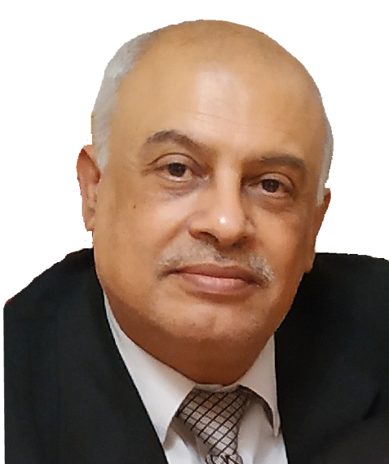

Recommendoma Syndrome Or VIP (very important person ) Syndrome
Muhammad Muhammad Al Hennawy
Senior Consultant Obstetrician & Gynacologist
Ras El Bar Central Hospital ,Egypt
mmhennawy.site44.com
www.drhennawy.8m.net

Slide 2
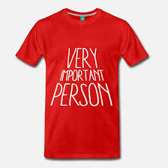
Definition
The presence of numerous unexpected and unusual complications in recommended patients that the treating physician is trying to give a better assistance

Slide 3
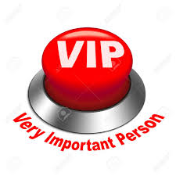
VIPs are given
the best care,
faster and
greater access,
enhanced and more convenient facilities, and
special attention from physicians,
VIP care can be singularly harmful

Slide 4
Unfortunately, trying to provide better care sets up the VIP for a higher complication rate and a greater chance of death.

Slide 5
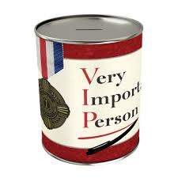
Recommended Or VIP Patients?
It is a person given special privileges in view of his or her status or wealth.
Examples of VIPs include
Royalty,
Politicians,
Celebrities,
Corporate leaders,
Wealthy individuals , and
Medical personnel or their relatives

Slide 6

Names
Recommendoma Syndrome
Recommendosarcoma syndrome
Syndrome of recommended patient
VIP (very important person) syndrome

Slide 7
History
This situation was first documented in a paper published in the 1960s which noted that VIP patients have worse outcomes.
Then described by Dr. Walter Weintraub of the University of Maryland School of Medicine in a 1964 paper,
VIP Syndrome is shorthand for how the influence of wealth and the allure of fame can cause doctors to veer into risky territory when they cater to stars.

Slide 8
Causes

Slide 9
Patients' Attitude
Stars may reject medical advice
Stars may demand ineffective treatments.
Star-struck doctors may order unnecessary tests or not enough.
Chairperson’s syndrome is pressure from the patient, family member, hospital representative, or even the VIP patient to be cared for by the department chairperson.

Slide 10
A VIP may insist on the senior-most specialist at an academic institution or teaching hospital—the chair of the department of medicine, or of surgery, for instance. But the senior-most, or most eminent, caregiver is not necessarily the most skilled at performing a given procedure. Such an individual may be out of practice, or no longer up-to-date, and the "no name" subordinate may actually be much more skilled.

Slide 11
Inefficient Use Of Health Resources
Medical professionals can be vulnerable to clouded judgment, and thus cause harm to their patients
When physicians suffer a loss of judgment in the face of the glamour and prestige of a famous client
(Doctors Didn’t Follow Standard Practices because the Patient was a VIP”)
Absence of an adequate register of clinical data and
Change in usual clinical practice on interpretation of diagnostic tests as well as
In the indication of treatment of these patients

Slide 12
Every test has its own set of possible complications. Each consultant feels compelled to add something to the evaluation, which usually means even more tests, and more possible complications. And once too many consultants are involved, there is no “captain of the ship” and care can become fragmented and even more inefficient and dangerous.

Slide 13
VIPs may be prescribed narcotics or other controlled substances when an ordinary patient would be denied them, or they may be over-medicated with larger amounts of such drugs than appropriate.
VIP medicine can be extravagant and wasteful. Excessive drug prescriptions may be written and imaging studies ordered

Slide 14
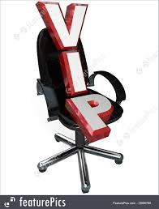
Using his or her status to influence a given professional or institution to make unorthodox decisions under the pressure or presence of said VIP—that relates to the accessibility and quality of health care

Slide 15
When treating a V.I.P., doctors may avoid giving bad news. In hopes of sparing their special patient from pain or time-consuming care, a doctor may opt to skip basic tests or procedures — even though these exams may have provided important information. The flip side is that V.I.P. treatment may result in extra and unnecessary tests

Slide 16
Prominent or famous people who fall ill have obvious reasons for desiring instant and ample medical care. Additionally, they have a desire to avoid public scrutiny in matters of private medical care, as all patients do, and may demand special accommodations on this basis. They may want to avoid the prying eyes of journalists as well as those of the curious onlookers among the hospital staff who may not be directly involved in their care. Their desire for privacy is an understandable aspect of their need for extra security. Often the pressure on medical staff for special accommodations comes from a VIP's entourage rather than from the patient.

Slide 17
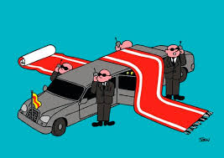
Hospital administrators may meddle in decisions if the patient is a potential financial donor.

Slide 18
Some observers object that, although it is not surprising that those with fame or wealth receive more attention when sick, it seems unfair that they should get "better" medical care than others, especially in cases where scarce resources, including time, are reallocated to accommodate them.

Slide 19
Like

Slide 20
when former President Gerald Ford was discharged from the hospital with the diagnosis of an inner-ear infection when, in fact, he had suffered a stroke

Slide 21
Prince died of an opioid addiction that may have been facilitated by physicians prescribing too powerful a drug under circumstances in which they were not licensed or registered to prescribe them.

Slide 22
Jackson's personal doctor, Conrad Murray, spent two years in prison after his involuntary manslaughter conviction in the King of Pop's 2009 death. Jackson had requested a surgical anesthetic, propofol, to help him sleep, calling it his "milk," according to trial testimony. Prosecutors said Murray supplied the drug and didn't notice when Jackson stopped breathing.

Slide 23
Another doctor took a cellphone photo of Joan Rivers on the operating table, according to a recently settled malpractice lawsuit. That's a clear sign of clouded judgment, Dinwiddie said.

Slide 24

Prevention

Slide 25

The best way to prevent this "syndrome of recommended patient" is to
maintain, even within these patients, an attitude based on solid clinical knowledge and
to follow up the same clinical rules accepted for other patients.

Slide 26
Mariano and McLeod
Based on their experience caring for three American presidents, Mariano and McLeod⁷ offered three directives for caring for VIPs:
Vow to value your medical skills and judgment
Intend to command the medical aspects of the situation
Practice medicine the same way for all your patients.⁷
In this paper, we hope to extend the sparse literature on the VIP syndrome by proposing nine principles of caring for VIPs, with recommendations specific to the type of VIP where applicable.

Slide 27

Guzman et al offer 9 principles in handling VIPs

Slide 28

“that’s where you’ve got to
take a deep breath
and reassess.”

Slide 29
Principle 1
Don’t bend the rules.
Any deviation of clinical practice when caring for a VIP can compromise delivery of the right care.

Slide 30
Principle 2
Work as a team, not in “silos.”
Teamwork is crucial in ensuring good clinical outcomes.

Slide 31
Principle 3
Communicate, communicate, communicate.
Heightened communication should include the patient, family, and other health staff members involved in providing care.

Slide 32

Principle 4
Carefully manage communication with the media.
Confidentiality in the physician-patient relationship must be guarded.

Slide 33
Principle 5
Resist “chairperson’s syndrome.”
Chairperson’s syndrome is pressure from the patient, family member, hospital representative, or even the VIP patient to be cared for by the department chairperson.

Slide 34
Principle 6
Care should occur where it is most appropriate.
Decisions on where to place the VIP patient should be made on the basis of the venue where the optimal care can be delivered.

Slide 35
Principle 7
Protect the patient’s security.
Ensuring security is of paramount importance in managing VIP syndrome.

Slide 36
Principle 8
Be careful about accepting or declining gifts.
It is suggested that physicians decline gifts graciously to minimize unmet expectations and misunderstandings, and also affirm the care that is free of gifts.

Slide 37
Principle 9
Work with the patient’s personal physicians.
Effective interactions with the VIP’s personal caregivers can facilitate communication and decision making for the patient.

Slide 38
Not To Treat Our Own Family Members
To provide the best care, a physician needs to be detached and objective. That’s why we are advised not to treat our own family members. I’ve spoken to several doctors who admitted that they too often sought and received V.I.P. care when they became ill, particularly from their own hospitals.

Slide 39
“When you’re contemplating superhuman or very heroic, unorthodox behavior in your zeal to help a famous patient,” Lerner said, “that’s where you’ve got to take a deep breath and reassess.”

