Slide 1
Thromboprophylaxis Of Venous ThromboEmbolism (VTE ) In Obstetrics And Gynaecology
Muhammad M Al Hennawy
First Consultant Obstetrician & Gynacologist
Ras El Bar Central Hospital ,
Dumyat Specialised Hospital ,
Egypt

Slide 2
A thrombus is a blood clot in circulatory system.
It stays attached to the site where it was formed and impedes blood flow.
A thrombus is more likely to occur in people who are immobile, and who are genetically predisposed to blood clotting.

Slide 3
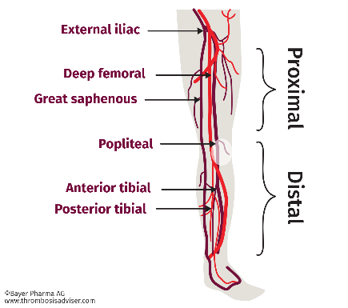
Sites
1- In an artery: arterial thrombosis eg coronary,cerebral.
2 -In a vein
- superfacial vein: thrombophlebitis
- deep vein :deep vein thrombosis (DVT)- lead to PE.
or
3-surrounding tissue

Slide 4
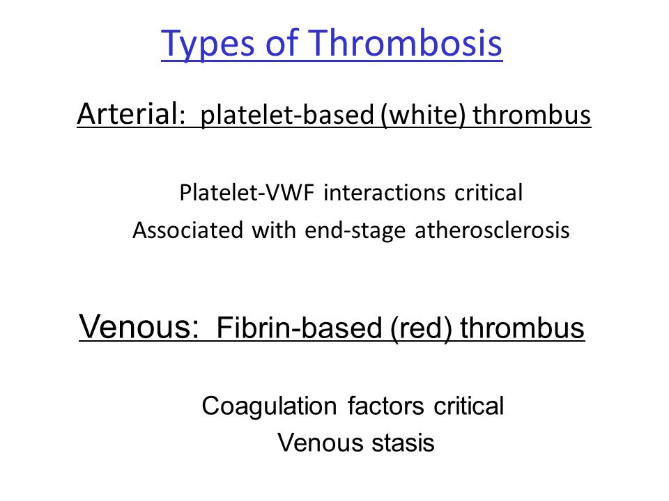

Slide 5
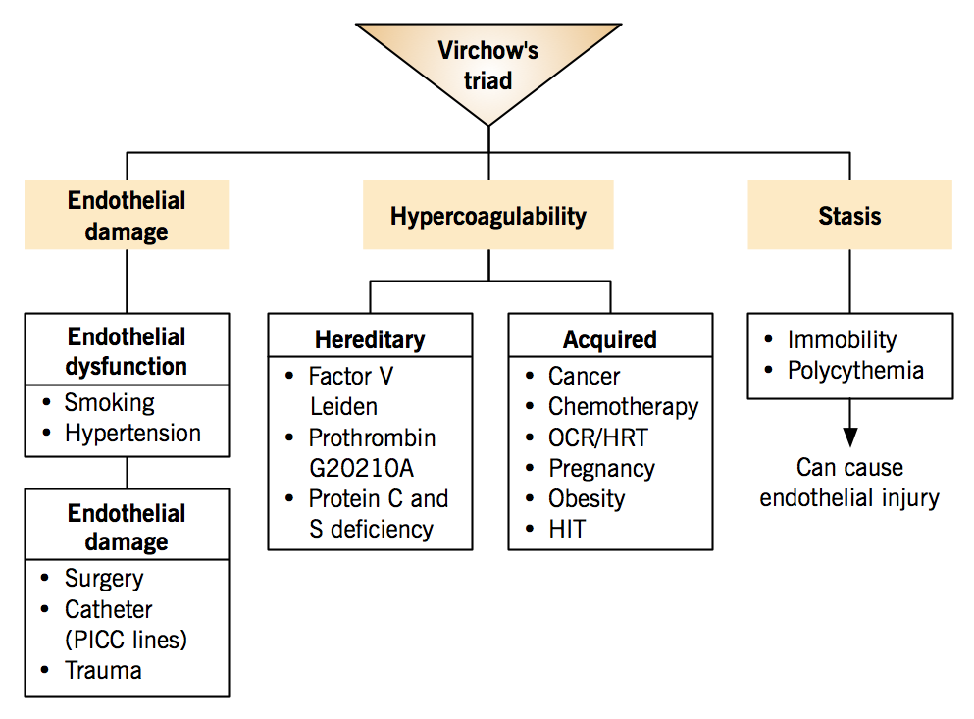
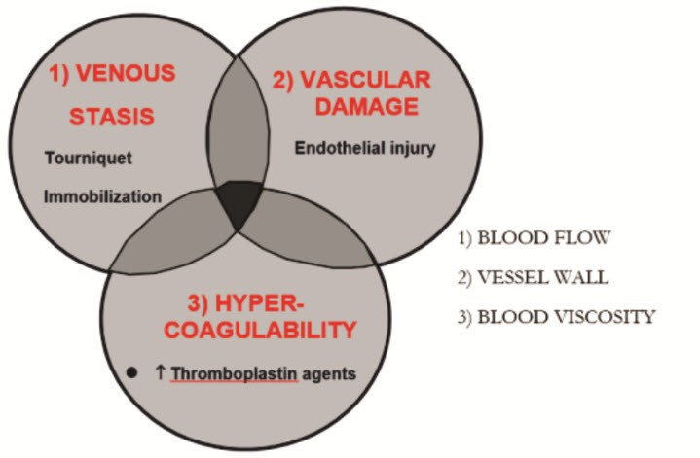
Causes
The three factors of stasis, hypercoaguability, and alterations in the blood vessel wall represent Virchow's triad, and changes to the vessel wall are the least understood.
Various risk factors increase the likelihood of any one individual developing a thrombosis

Slide 6
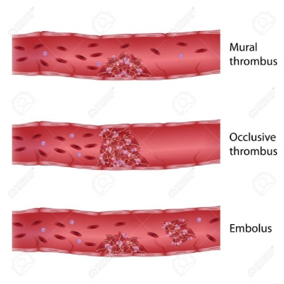
Venous thromboembolism (VTE) is associated with considerable morbidity, and mortality in the absence of thromboprophylaxis.
Pulmonary embolism (PE) is the leading cause of maternal death worldwide.

Slide 7
VTE
(venous thromboembolism)
in gynaecology

Slide 8
PE is the cause of ~20% of deaths following hysterectomy.
The prevalence of deep vein thrombosis (DVT) in patients having major gynaecologic surgery ranges between 15% and 40

Slide 9
Oestrogen and VTE risk
Oestrogen use increases the risk of VTE as a class effect which is dose dependant.
The risk of VTE is dependent on the route of administration.
There is lower associated risk with transdermal and intra-uterine hormonal therapy as well as the progesterone-only oral contraceptive.

Slide 10
Gynaecological surgery and VTE risk
Patient-related risk factors include: age >60 years, prior history and family history of VTE, immobility, dehydration, sepsis, underlying malignancy, pregnancy, oestrogen therapy, obesity, hereditary thrombophilia, inflammatory bowel disease, human immunodeficiency virus infection, and autoimmune diseases including antiphospholipid syndrome.
Procedure-related risk factors include: duration of the procedure; degree of tissue damage; degree of immobility following surgery and nature of the surgical procedure.

Slide 11
Combined Oral Contraceptive
The post-operative risk of VTE in patients on the combined oral contraceptive (COC) increases from 0.5% to 1%.
The risk of VTE needs to be balanced against the risk of stopping the COC prior to surgery. There is insufficient evidence at this time to recommend discontinuation of the COC prior to surgery or immobilisation.
Hormonal therapy does not need to be stopped prior to surgery if appropriate thromboprophylaxis is used.

Slide 12
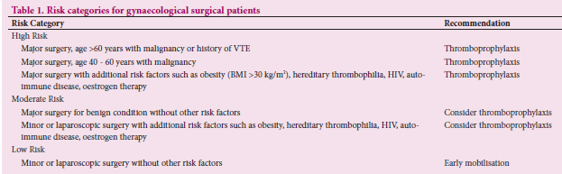

Slide 13
Diagnosis
Doctors use several different methods to diagnose the effects or presence of thrombus formation.
Duplex ultrasound is the most common test for diagnosing DVT. This method uses sound waves to create pictures of blood flowing through the arteries and veins.
A D-dimer test measures a substance in the blood that results when a blood clot breaks down. If the test shows high levels of the substance, then a DVT or any other type of blood clot may be present, but this is not certain. If the test result is normal and few risk factors are present, DVT is considered unlikely.
Venography involves a dye injected into a vein in the affected leg. This dye makes the vein visible on some types of X-ray, such as a fluoroscopy. If this shows blood flowing slower than usual in the vein, it may indicate the presence of a thrombus.
Magnetic resonance imaging (MRI) and CT scanning create pictures of organs and tissues and can also be used to look at blood vessels.
A VQ scan is a nuclear imaging study that shows the flow of air and blood within the lungs.
Blood tests may be used to check for an inherited blood clotting disorder. This may be necessary in cases of repeated, but unexplained blood clots. Thrombi found in the liver, kidney, or brain also may be due to an inherited clotting disorder.

Slide 14
Thromboprophylaxis Following Gynaecological Surgery
Low-molecular-weight heparin (LMWH) is the anticoagulant of choice:
- Enoxaparin 40 mg subcutaneous (sc) once daily
-Dalteparin 5 000 units sc once daily
- Nadroparin 2 850 units sc once daily.
It is recommended to use weight-adjusted LMWH dosing in patients at extremes of weight.
It is recommended to start LMWH 6 - 12 hours after surgery, provided there is no active bleeding.
In patients at high risk of bleeding or undergoing neuraxial anaesthesia, it is recommended to start LMWH a minimum of 12 hours postoperatively.
LMWH prophylaxis should be continued until the patient is fully mobile.
For major cancer surgery, 5 weeks of thromboprophylaxis is recommended.
For major surgery, in patients with additional risk factors, at least 7 - 10 days of thromboprophylaxis is indicated.
.

Slide 15
Avoid additional antiplatelet drugs for analgesia during anticoagulation.
In patients at high risk of bleeding, use of mechanical prophylaxis such as intermittent pneumatic compression (IPC) should be considered
There is, however, limited evidence for graduated compression stockings

Slide 16
Superfacial Thrombophlebitis
It is a common disease of the superficial veins that most commonly occurs in the lower extremities (especially in the great saphenous vein [vena saphena magna]) and often is connected with varicose veins. It can also occur elsewhere, e.g. on the neck (external jugular vein), on the chest (Mondor’s disease) or in the upper extremities.

Slide 17
Superficial vein thrombosis is not a lifethreatening disease, but the risk of concomitant DVT cannot be ignored.
Superficial venous thromboses cause discomfort but generally not serious consequences, as do the deep vein thromboses (DVTs) that form in the deep veins of the legs or in the pelvic veins. Nevertheless, they can progress to the deep veins through the perforator veins or, they can be responsible for a lung embolism mainly if the head of the clot is poorly attached to the vein wall and is situated near the sapheno-femoral junction.
Color-coded duplex sonography should be performed in patients with SVT to rule out DVT.

Slide 18
The prognosis of superficial thrombophlebitis is usually good. A more extensive superficial venous thrombosis may spread to the deep veins.
Deep venous thrombosis has been described to be associated with about 20% and pulmonary embolism with about 4% of superficial venous thromboses that have been more than 5 cm in length.Ultrasonography is helpful in the differential diagnostics and it is recommended to exclude deep vein thrombosis.D dimer is not helpful in the differentiation between superficial and deep venous thrombosis
.A superficial thrombophlebitis of ≥ 5 cm in length is according to current guidelines treated with a mid-treatment dose of LMWH or with a prophylactic dose of fondaparinux for 6 weeks. In addition, topically administered NSAIDs may be used if needed. Muscular vein thrombosis and superficial thrombophlebitis are often mixed up. Muscular vein thrombosis is not a superficial thrombophlebitis but a sub-category of deep vein thrombosis, in which the thrombosis is located in the muscular veins of the calf region (plexus soleus or plexus gastrocnemius).

Slide 19
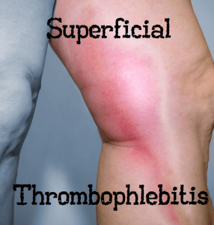
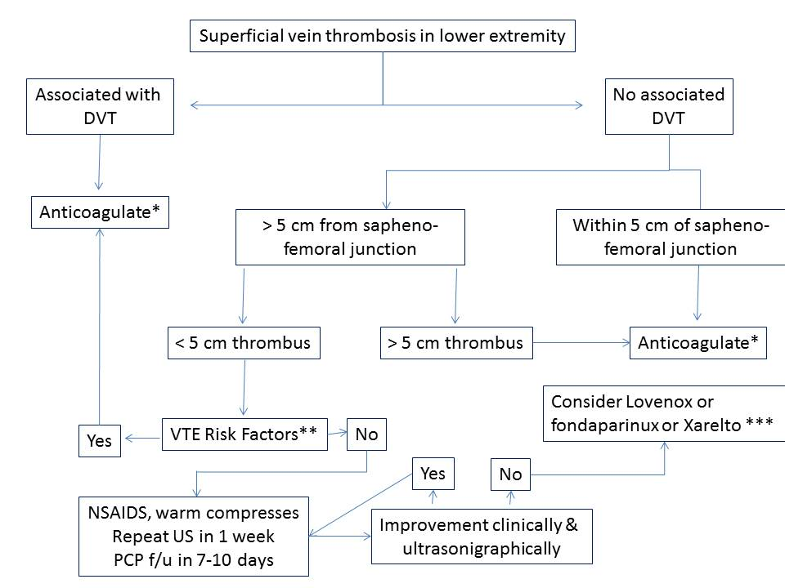
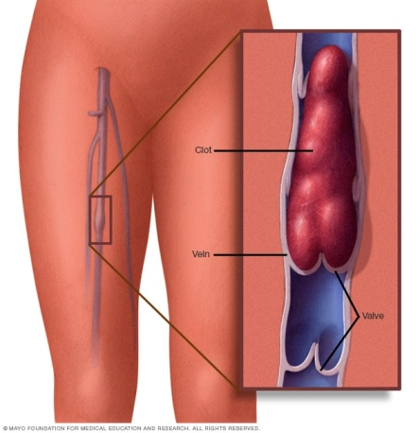
;

Slide 20
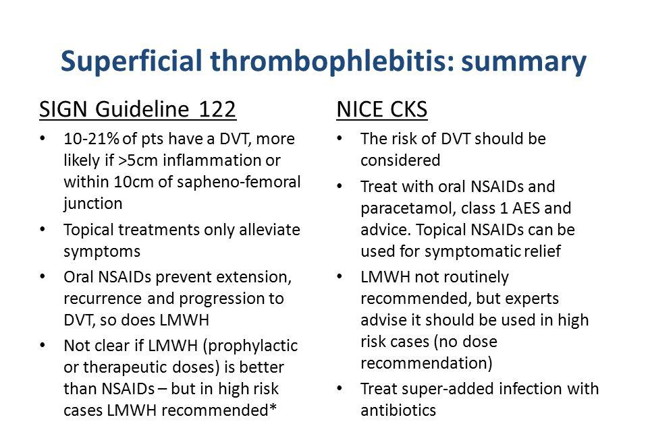

Slide 21
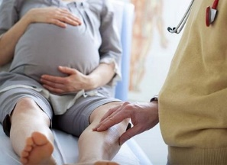
VTE (venous thromboembolism) in obstetrics

Slide 22
Thromboembolism in Pregnancy
Pregnant women have a fourfold to fivefold increased risk of thromboembolism compared with nonpregnant women
Approximately 80% of thromboembolic events in pregnancy are venous with a prevalence of 0.5–2.0 per 1,000 pregnant women
Venous thromboembolism, including pulmonary embolism, accounts for 1.1 deaths per 100,000 deliveries or 9 % of all maternal deaths in the United States
In the developing world, the leading cause of maternal death is hemorrhage however, in developed nations, where hemorrhage is more often successfully treated and prevented, thromboembolic disease is one of the leading causes of death

Slide 23
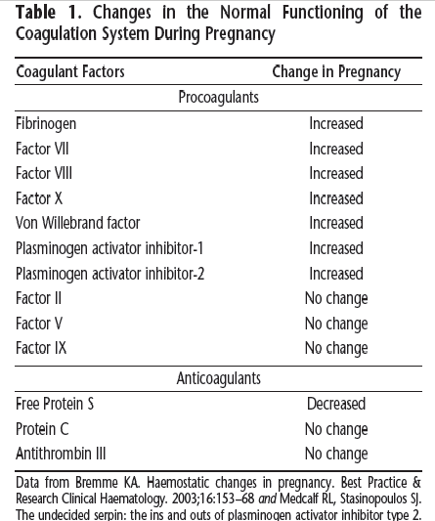

Slide 24
Caesarean delivery and VTE risk
Caesarean delivery (CD) is an important independent risk factor for VTE in the postpartum period
The risk of VTE after an emergency CD is twice greater than after an elective CD.
In hospital, thromboprophylaxis should be considered in all women who have undergone an elective CD.
Additional risk factors for VTE post CD include: multiple pregnancy, BMI ≥30 kg/m2, severe pre-eclampsia, re-operation, prolonged immobilisation and placenta praevia.

Slide 25
Antepartum and postpartum thromboprophylaxis
The ideal anticoagulant in pregnancy should be one that does not cross the placenta and can be easily reversed.
The oral direct thrombin and factor Xa inhibitors should not be used in pregnancy as the molecules are small and cross the placenta.
Warfarin is associated with a teratogenic effect, especially between 6 and 12 weeks’ gestation. In addition, there is an increased risk of miscarriage, prematurity and fetal bleeding (including intracranial haemorrhage resulting in brain damage) at any time during pregnancy.
The preferred anticoagulant is LMWH.
Allergic skin reactions can occur with LMWH but are uncommon. In pregnant women with severe allergic skin reactions, an alternative LMWH should be used.
It is recommended that the platelet count be monitored one week after initiation of LMWH and at regular follow-ups thereafter.
Fondaparinux may be considered in consultation with a haematologist

Slide 26
Antepartum prophylaxis should be initiated early in pregnancy.
Postpartum thromboprophylaxis should be continued for 6 weeks in high-risk women, for 10 days in intermediate-risk women and at least until discharge from hospital in low-risk women.
In the presence of ongoing risk factors, e.g. prolonged hospital admission, wound infection, surgery extended thromboprophylaxis until the risk factor is no longer present should be considered.
The use of mechanical prophylaxis, such as IPC, can be considered in patients at high risk of bleeding.

Slide 27
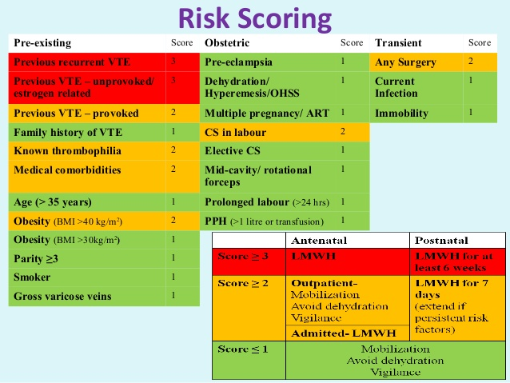
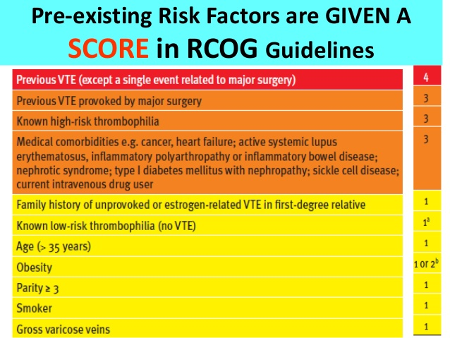
r

Slide 28
LMWH dose
Fixed doses of LMWH, e.g. dalteparin 5 000 units daily or nadroparin 2 850 units daily or enoxaparin 40 mg daily are recommended.
This is practical and covers most of the obstetric population.
There is an increased dose requirement of LMWH during pregnancy because of increased volume of distribution and renal clearance. Therefore, regular anti-Xa monitoring is suggested.
Dose adjustments (increase or decrease by 10 mg) to achieve a target anti-Xa level of 0.3 - 0.5 units/mL in conjunction with a haematologist is suggested.
It is recommended to use weight-adjusted LMWH dosing with anti- Xa monitoring in patients at extremes of weight
Anti-Xa monitoring is also indicated in renal disease and severe pre-eclampsia

Slide 29
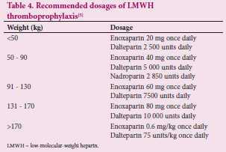

Slide 30
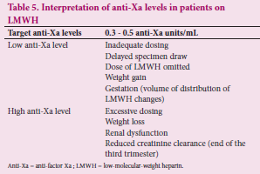

Slide 31
Anti-factor Xa (AFXa) level
This test measures anti-activated factor X (anti-Xa) in blood
The amount of factor Xa in blood is affected by the amount of heparin in the body. This test is used to monitor heparin levels in patients being treated with standard heparin or low molecular weight heparin
While monitoring of prophylactic AFXa levels may not be needed in the majority of patients,
It may still be required in certain patient groups to optimize treatment.
Due to a lack of data, the AFXa for prophylactic dosages of LMWH has not been clearly defined,
A reasonable AFXa target range for LMWH DVT prophylaxis may be 0.3-0.5 IU/mL,
However, prospective studies are required to validate this recommendation.

Slide 32
(APTT) Activated Partial Thromboplastin Time
test measures how long it takes for blood to clot.
It is used to assess bleeding or blood clotting problems and to monitor treatment with heparin

Slide 33
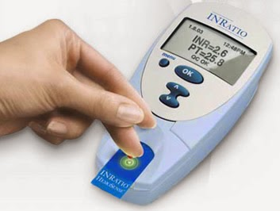
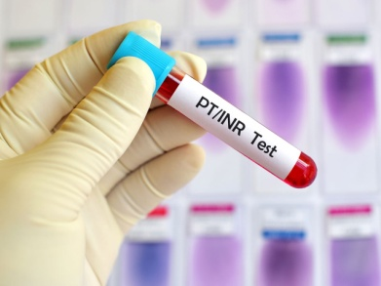
International Normalized Ratio (INR)
A prothrombin time (PT) is a test used to help detect and diagnose a bleeding disorder or excessive clotting disorder;
The international normalized ratio (INR) is calculated from a PT result and is used to monitor how well the blood-thinning medication (anticoagulant) warfarin is working to prevent blood clot
In healthy people an INR of 1.1 or below is considered normal. An INR range of 2.0 to 3.0 is generally an effective therapeutic range for people taking warfarin for disorders such as atrial fibrillation or a blood clot in the leg or lung. In certain situations, such as having a mechanical heart valve, you might need a slightly higher INR

Slide 34
Formula:
INR = (PT_{patient}/PT_{normal})^{ISI}
Where,
PT_{patient} = Patient's Measure PT (seconds)
PTPT_{normal} = Laboratory's Geometric Mean Value for Normal Patients (seconds)
ISI = International Sensitivity Index

Slide 35
Prothrombin Time: The prothrombin time (PT) is a test used to help diagnose bleeding or clotting disorders. The prothrombin time (PT or pro-time) is the actual time calculation, measured in seconds, for an anti-coagulated sample of plasma or whole blood to clot after it is added to a thermoplastic reagent. A prothrombin time test tells you how long it takes your blood to clot. International Normalized Ratio (INR): International Normalized Ratio (INR), also known as Prothrombin Time (PT_{normal}) is a system for reporting the results of blood coagulation tests. INR calculation is based on the results of PT test that is used to monitor treatment with the blood-thinning medication warfarin. International normalized ratio (INR) is a calculation made to standardize prothrombin time. International Sensitivity Index: International Sensitivity Index (ISI) is a value assigned by the manufacturers for the tissue factors they manufacture. The ISI value indicates how a particular batch of tissue factor compares to an international reference tissue factor. The ISI is usually between 0.94 and 1.4 for more sensitive and 2.0-3.0 for less sensitive thromboplastins.

Slide 36
Delivery
It is recommended that all pregnant women receiving antepartum thromboprophylaxis have a delivery plan.
The mode of delivery is determined by the obstetric indication.
A planned CD is often indicated.
Prophylactic LMWH should be discontinued at least 12 hours prior to the expected time of epidural analgesia or delivery.
Patients should be advised to discontinue thromboprophylaxis upon the onset of spontaneous labour.

Slide 37
Spinal and epidural anaesthesia
The catheter should not be placed within 12 hours of the last dose of LMWH.
LMWH should be started at least 6 hours after removal of the catheter.
LMWH should be delayed at least 24 hours if there is blood in the needle or neuraxial catheter during needle insertion.
Neurological monitoring is mandatory for a minimum of 12 hours and ideally for 72 hours after neuraxial blockade.
Extreme caution should be exercised in patients on other agents such as aspirin, clopidogrel and non-steroidal anti-inflammatories that may interfere with normal haemostasis

Slide 38
Postpartum
Assess for major bleeding postpartum (resulting in a drop in the haemoglobin concentration ≥2 g/dL or bleeding requiring transfusion of at least 2 units of packed red blood cells)
Every woman should have a repeat VTE risk assessment after delivery.
• Prophylactic LMWH may be started/restarted 6 - 12 hours post delivery or should be delayed if there is any evidence of bleeding from the surgical site.
• Warfarin, LMWH, fondaparinux and UFH are safe to use in breastfeeding mothers. The oral direct thrombin and factor Xa inhibitors should be avoided.

Slide 39
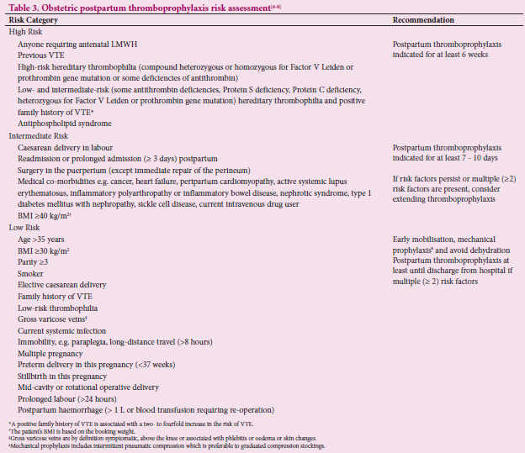

Slide 40


Prevention
It is not always possible to prevent a thrombus from forming. However, there are steps that people can take to reduce their risk:
avoiding or quitting smoking tobacco products
maintaining a healthful weight
following a healthful diet
exercising regularly
It is particularly important for people to get up and move around whenever possible after a surgical procedure or during long-distance travel.
Those who are known to be at an increased risk of developing a blood clot may also be given anticoagulant therapy, as well as medications to reduce blood pressure and cholesterol levels in the blood.

Slide 41
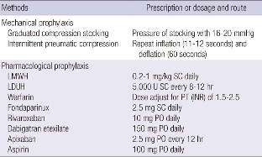
Thromboprophylaxis

Slide 42
Treatment
The aim of thrombus treatment is to quickly and effectively:
control symptoms
restore blood flow
reduce and remove the thrombus

Slide 43
The following treatments
They are typically used to deal with the effects of thrombi:
Surgery
Surgery for the effects of thrombosis will always be a medical emergency. It can involve directly accessing and unblocking an affected artery. In other cases, blood flow will be diverted or will completely bypass the blocked artery.
Inferior vena cava filters (IVC)
IVC filters are small mesh devices put in the inferior vena cava, which is a large vein, usually under local anesthetic. The IVC filter traps blood clot fragments and can stop them reaching the heart and lungs.
An IVC filter can be permanent and are typically combined with anticoagulation medication therapy when possible. However, doctors may remove the IVC filter after the risk of a blood clot has reduced.
Anticoagulants
Anticoagulants are often referred to as blood thinners. This name is misleading, however, because they do not thin the blood. Instead, they can reduce the likelihood of the blood forming clots, and this can reduce the size of thrombi.
If anticoagulants do not work, or if the person taking them is intolerant to them, then doctors will consider other treatments.

Slide 44

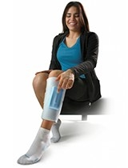
Compression stockings
Compression stockings may be recommended alongside other treatments, to help manage the risk of complications occurring.
Doctors may recommend that people wear compression stockings while taking anticoagulant therapy for DVTs.
The stockings help prevent calf pain and swelling, and they reduce the risk of complications.
A person should wear compression stockings during the day for as long as their doctor recommends.
Raising the affected leg
Along with compression stockings, it is good to keep the legs affected by thrombi raised at night so that the foot is higher than the hip. This relieves pressure in the veins, improves blood circulation, and can help avoid complications.
Exercise
Once a doctor has prescribed compression stockings, they will usually advise people to stimulate blood circulation by walking or exercising more frequently

Slide 45
Outlook
If a person gets the right treatment at the right time, then even potentially fatal medical emergencies associated with thrombosis can be successfully treated.
Aftercare is of particular importance because complications can develop months or even years after the thrombus first formed, even after successful treatment.
Post-thrombotic syndrome is one of the potential complications of a DVT. This refers to the damage to surrounding tissue caused by the DVT formation, such as increase of pressure in the vein when blood flow is blocked, ulcerations, and pain. This can result in permanent damage, and under rare circumstances, the limb may even need to be removed.
Recovery depends on the location of the clot, as well as how much and for how long the blood flow was disrupted. The sooner the condition is dealt with, the less likely it is that long-term damage or complications will develop.

Slide 46
What postpartum hormonal contraceptive options are appropriate for women with thrombophilias?
The risk of venous thromboembolism among women taking estrogen-containing oral contraceptives increases 35-fold to 99-fold and increases 16-fold among women heterozygous for factor V Leiden and prothrombin G20210A mutations
The annual risk of venous thromboembolism is 5.7 per 10,000 among factor V Leiden carriers but increases to 28.5 per 10,000 among factor V Leiden heterozygous women using estrogen containing contraceptives (relative risk, 34.7)
Therefore, alternative methods, such as intrauterine devices (including those containing progestin), progestin-only pills or implants, and barrier methods should be used However, screening all women for thrombophilias before initiating combination contraception is not recommended

Slide 47
Summary of Recommendations and Conclusions

Slide 48
The following recommendation is based on good and consistent scientific evidence (Level A):
When signs or symptoms suggest new onset DVT, the recommended initial diagnostic test is compression ultrasonography of the proximal veins.
The following recommendations and conclusions are based on limited or inconsistent scientific evidence (Level B):
In general, the preferred anticoagulants in pregnancy are heparin compounds.
Because of its greater reliability and ease of administration, low-molecular-weight heparin is recommended rather than unfractionated heparin for prevention and treatment of VTE within and outside of pregnancy.
ACOG Practice Bulletin No. 196: Thromboembolism in Pregnancy July 2018 - Volume 132 - Issue 1 - p e1–e17

Slide 49
A reasonable approach to minimize postpartum bleeding complications is resumption of anticoagulation therapy no sooner than 4–6 hours after vaginal delivery or 6–12 hours after cesarean delivery.
Because warfarin, low-molecular-weight heparin, and unfractionated heparin do not accumulate in breast milk and do not induce an anticoagulant effect in the infant, these anticoagulants are compatible with breastfeeding.
The following recommendations are based primarily on consensus and expert opinion (Level C):
Women with a history of thrombosis who have not had a complete evaluation of possible underlying etiologies should be tested for antiphospholipid antibodies and for inherited thrombophilias.
ACOG Practice Bulletin No. 196: Thromboembolism in Pregnancy July 2018 - Volume 132 - Issue 1 - p e1–e17

Slide 50
Adjusted-dose (therapeutic) anticoagulation is recommended for women with acute thromboembolism during the current pregnancy or those at high risk of thrombosis, such as women with a history of recurrent thrombosis or mechanical heart valves.
When reinstitution of anticoagulation therapy is planned postpartum, pneumatic compression devices should be left in place until the patient is ambulatory and until anticoagulation therapy is restarted.
Every unit should have a protocol for when pregnant women and postpartum women should have anticoagulant medications held and when women who are receiving thromboprophylaxis are eligible for neuraxial anesthesia.
Women receiving anticoagulation therapy may be converted from low-molecular-weight heparin to the shorter half-life unfractionated heparin in anticipation of delivery, depending upon the institution's protocol.
ACOG Practice Bulletin No. 196: Thromboembolism in Pregnancy July 2018 - Volume 132 - Issue 1 - p e1–e17

Slide 51
For women who are receiving prophylactic low-molecular-weight heparin, discontinuation is recommended at least 12 hours before scheduled induction of labor or cesarean delivery; a 24-hour interval is recommended for patients on an adjusted-dose regimen.
Placement of pneumatic compression devices before cesarean delivery is recommended for all women, and early mobilization is advised after cesarean delivery.
Each facility should carefully consider the risk assessment protocols available and adopt and implement one of them in a systematic way to reduce the incidence of VTE in pregnancy and the postpartum period
ACOG Practice Bulletin No. 196: Thromboembolism in Pregnancy July 2018 - Volume 132 - Issue 1 - p e1–e17

