Slide 1


Active
Management
Of Infertility
Dr Muhammad El Hennawy
Ob/gyn Consultant
دكتور محمد محمد الحناوى
Rass el barr central hospital and
dumyat specialised hospital
Dumyatt – EGYPT
www. mmhennawy.co.nr

Slide 2

This Lecture explains my personal opinion
In spite that this lecture contains medical evident informations
If you accept this lecture,
take it as a science
If you do not accept it,
take it as a fun

Slide 3
Infertility is faliure of a couple to concieve with continous coitus without use of contraception
for one year if (primi ) age below 35y
for two year if (multi ) age below 35y
For six monthes if age above 35y
For immediate if age above 40 y
Delayed Conception is faliure of a couple to concieve with continous coitus without use of contraception
When they or one of them come to complain at any time
(may be infertility or before it )

Slide 4
most newly married couples are asked
sometimes even as soon as they have returned from the honeymoon !
There is a lot of pressure on couples to have a baby, especially in traditional families, where the wife's role is still seen to be one of perpetuating the family name by producing heirs.
Many couples still naively expect they will get pregnant the very first month they try ( the result of watching too many films , perhaps !) - and are concerned when a pregnancy does not occur.
All of us go through a brief interlude of doubt and concern when we do not achieve pregnancy the very first month we try and we start wondering about our fertility.

Slide 5


Warning over delayed conception
Women who spend a long time unsuccessfully trying for a baby could face problem births once they do finally become pregnant.
The finding, from Danish researchers, applies equally to natural conceptions and those due to fertility treatment.
A total of 56,000 births were analysed - thsoe conceived after more than a year of trying were more likely to be born early or need caesarean section.
The study was published in the journal Human Reproduction.

Slide 6
The properties of the fecund male include
1) Normal spermatogenesis and ductal system (normal count, motility, and biologic structure/function
2) Ability to transmit the spermatozoa to the female vagina, through :
- Adequate sexual drive
- Ability to maintain an erection
- Ability to achieve a normal ejaculation
- Placement of ejaculate in the vaginal vault

Slide 7
The properties of the fecund female include
1) Adequate sexual drive and sexual function to permit coitus
2) Functioning reproductive anatomy and physiology which includes:
- A vagina capable of receiving spermatozoa
- Normal cervical mucus to allow passage of
spermatozoa to the upper genital tract
- Ovulatory cycles
- Fallopian tubes which will function to permit the sperm and ovum to meet and allow migration of the conceptus to the uterus
- A uterus capable of developing and sustaining the conceptus to maturity
- Adequate hormonal status to maintain pregnancy
3) Normal immunologic responses to accommodate sperm, conceptus, and fetal survival.
4) Adequate nutritional, chemical, and health status to maintain nutrition and oxygenation of placenta and fetus

Slide 8

FERTILITY AND DURATION OF MARRIAGE FOR
COUPLES WITHOUT CONTRACEPTION
25% of pregnancies occur within 1 month
>60% of pregnancies occur within 6 months
75% of pregnancies occur within 9 months
80% of pregnancies occur within 12 months
90% of pregnancies occur within 18 months

Slide 9
While women under age 30 have approximately a 20 percent per month chance of conceiving, only 5 percent of women over age 40 will conceive
The fertility potential of the average woman begins to decline appreciably at the age of 35 years, and begins to decline dramatically beyond the age of 40 years
The biggest obstacle most women over 40 face is two-fold:
- diminishing ovarian reserve
- coupled with poor embryo quality (the phenomenon of chromosomal aneuploidy )

Slide 10

the effects of paternal age on a couple's fecundity
They are real and may be greater than previously believed.
After adjustment for other factors, the probability that an ultimately fertile couple will take >12 months to conceive nearly doubles from ~8% when the man is <25 years to ~15% when he is >35 years
paternal age is a further factor to take into account when deciding the prognosis for infertile couples.
What Age Does to Sperm
Decreased Motility
Decreased Strength
Decreased Potency
Altered Genetic Make-Up

Slide 11
Infertility is faliure of a couple to concieve with continous coitus without use of contraception
for one year if (primi ) age below 35y
for two year if (multi ) age below 35y
Six monthes if age above 35y
immediate if age above 40 y
Delayed Conception is faliure of a couple to concieve with continous coitus without use of contraception
When they or one of them come to complain at any time
(may be infertility or before it )

Slide 12



3 Methods Of Management
Rapid ( Active ) Or standard Or Expectant management Of Delayed Conception Or Infertility
1 - Rapid ( Active management) in 1 year
2 - standard management ( EBM )
3 - Expectant management in years ( old )

Slide 13
Expectant management Of Infertility
Infertility is always an important problem for the patient but never an urgent one.
The general attitude is one of “let’s wait and watch” and let “Nature take its own course”.
Since many couples and doctors know of patients who have conceived naturally after many years of previously fruitless marriage,
they commonly adopt this attitude
This approach was acceptable in the past, when there was so little we could offer in any case for these couple.

Slide 14

When a couple or one of them come to me complaining of delayed coneption of any time
I explain to them or one of them that there is 2 methods of management
1 - Rapid ( Active management) in 1 year
2 - standard management
and I let them to choose after my explaination

Slide 15

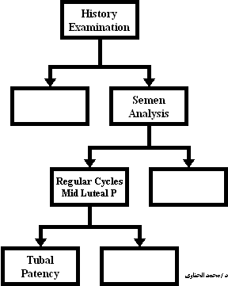
Standard Management Of Infertility

Slide 16
Rapid ( Active ) management Of Delayed Conception Or Infertility
It is worthwhile drawing an analogy to the current management of labour and childbirth.
In older days, when no drugs were available, doctors were often forced to wait and watch.
They could do little to intervene and it was common for labours to last for over 2-3 days often resulting in stillbirths and even maternal deaths.
With the advent of drugs like oxytocin and prostaglandins, all that has changed!
Obstetricians now take an active approach to provide a favourable outcome in a quicker time frame.

Slide 17
Today, unfortunately, the investigation and management of infertility still leaves a lot to be desired.
It is often slow, time-consuming and costly. The infertile couples are seldom seen together.
Investigations are performed in a piecemeal fashion rather than as part of an overall strategy.
Doctors are also keen to “do something” and repeated curettages and laparoscopies (done unnecessarily) are a common feature in the medical history of these hapless couples.
Also, myomectomies may be performed for small fibroids; ovarian cystectomy and wedge resections done for simple ovarian cysts which should have been left well alone; as well as “uterine ventrisuspension” when all else fails.
These procedures commonly induce adhesions and damage a previously normal pelvis.

Slide 18
Both patient and doctor suffer from the inefficient treatment of this problem.
The doctor feels inadequate and unable to help his patient, and trust between the doctor and patient breaks down.
The temptation to try many empirical, possibly useless medical treatments is considerable; and patients often end up spending large sums of monies at the hands of quacks and “spiritual healers”.
This is why taking an active success-oriented approach to infertility is important today.
The couple must be seen together and treated as a unit. The workup to establish a diagnosis should be completed in 1 months.
The timing of the procedures is important, and we have found the following strategy cost-effective.

Slide 19

Why active is preferable !!
Active Versus Standard And Expectant Management
1. Couples today marry at an older age.
Their biological time clock is running out
and we often need to accelerate events
we cannot sit back and wait and watch.
2. Effective treatment is available today to enhance Nature’s efficiency
(or rather its inefficiency in the case of these couples).
This treatment must be judiciously employed, to give couples their best chance.

Slide 20
Age-related decline in fertility
A decrease in the number and health of the eggs to be ovulated.
A decrease in sperm counts.
A decrease in the frequency of intercourse.
The presence of other medical and gynecologic conditions, such as endometriosis, which may interfere with conception.

Slide 21

in less than 15 - 30 days ! They just need to make 3 visits to the clinic, thus saving a lot of time, money and energy.
a detailed medical history from the couple, and also performs a physical examination for both of them, to determine if this can provide clues as to the cause of the problem.

Slide 22
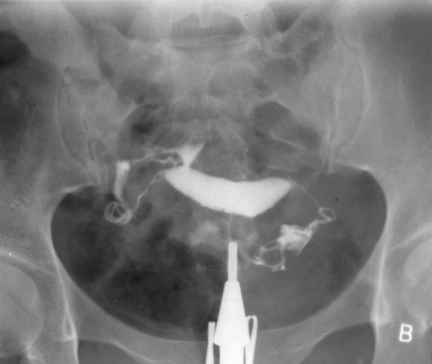
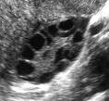
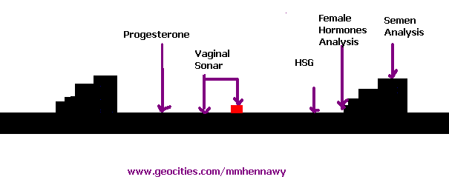
Investigations
Start at the time which they come in it and regulate other times to end all these investigation in 15 - 30 days
Semen analysis (during the wife’s menstrual period)
FSH, LH, TSH, Prolactin Blood Tests ( at third day from beginning of cycle)
Hysterosalpingogram ( at Fifth - seventh day from beginning of cycle)
Vaginal Ultrasound For Ovulation Monitoring And Assessing Endometrial Thickeness And Texture ( at eleventh - sixteenth day from beginning of cycle)
Serum Progesterone Level For Ovulation ( at twenty-one day from beginning of cycle)

Slide 23

Some doctors will perform further testing during the rest of the month, though we rarely do these tests in our own practise
They include: ultrasound scans for ovulation monitoring between Day 11-16 ; and the scan results can be used for timing the PCT (postcoital test) as well, during which time the cervical mucus is assessed also.
. Some doctors will also performed a laparoscopy in the same month (Day 20-25) ; and combine it with an endometrial biopsy , if desired

Slide 24


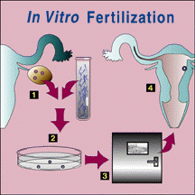
Treatment
All these ttt takes only one year
Timed intercourse, 6 cycles;
Intrauterine insemination (IUI)- 4 cycles;
Superovulation with HMG plus IUI -3 cycles;
then IVF or GIFT. Don’t waste time!
As a rule of thumb, if a treatment is going to work, it should work in 4 cycles.

Slide 25

While no one can predict what the out-come of treatment is going to be for any infertile couple,
at the end of it all,
they should at least have the satisfaction of knowing that they tried everything that was possible.

Slide 26
What is your Opinion???
1 - Rapid ( Active management)
2 - standard management
3 - Expectant management

