Slide 1

Cesarean Section
And Associated
Surgeries
From The Same Incision
Dr Muhammad M El Hennawy
Ob/gyn Consultant
Ras el bar –dumyat - egypt

Slide 2
Cesarean section being the most commonly performed surgery in Egypt,
the incidents of cesarean delivery in general hospitals were found to be nearly 50.6%,
whereas,
in private hospitals such cases were reported to be much higher.
Many disorders, either gynecological or non-gynecological
could coexist or precede a cesarean delivery.
These disorders need to be managed surgically;
invariably most patients will prefer to undergo a cesarean section with concomitant surgery for any associated pathology

Slide 3
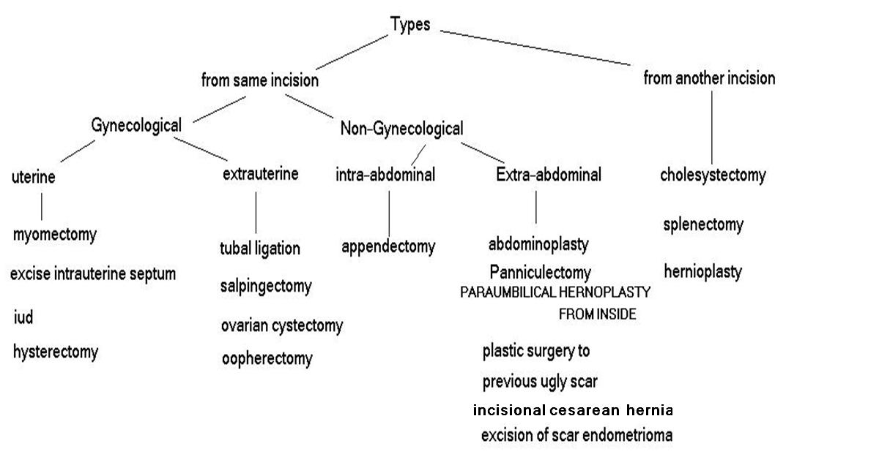
Many operations are now-a-days done simultaneously with cesarean sections, with different success rates and complications

Slide 4
May be
Planned
Elective as appendectomy
On demand as tubal ligation
Emergency as appendectomy

Slide 5
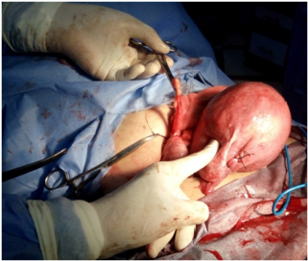
Cesarean Section With Appendectomy
- Some surgeons have advocated and performed elective appendectomy at CS because an acute presentation of appendicitis has a high risk of complications
- Potential benefit to routine examination of the appendix at the time of all cesarean section (visualize and palpate the appendix ) and
removal if it appears pathologic (evidence of inflammation or disease )
Also
- Prophylactic appendectomy in selected cases in Women with a palpable fecalith, abnormal appearing appendix, or history of pelvic pain or endometriosis or anticipated intra-abdominal adhesions have increased risk of having subsequent surgery to rule out appendicitis
Systematic reviews were found to support appendectomy or elective appendectomy at cesarean section with no added risks or complications

Slide 6
Cesarean Section With Myomectomy with a good patient selection and expertise
Myomectomy added a mean time of 15 min to the operative time of cesarean section.
No hysterectomy was performed at the time of the cesarean section.
No complications were developed during the puerperium.
The difference between the preoperative and postoperative hemoglobin mean value was statistically significant (P=0.001) but did not differ between isolated cesarean and myomectomy-combined cesarean groups.
None of the patients received blood transfusion due to devascularization techniques to
reduce blood loss
The length of hospitalization was comparable between the two groups
Despite controversial literature data, we suggest that myomectomy during cesarean section could be generally recommended. Depending on size and location of myomas, the associated risks are similar to those of isolated cesarean section.

Slide 7
Cesarean Section With Hysterectomy
Cesarean hysterectomy remains an operation with indications that arise infrequently in obstetric practice. However, the incidence of cesarean section has increased steadily over the past decade, and consequently there has also been a rise in the occurrence of placenta accreta, or placenta previa with accreta. Also In uterine rupture, either after vaginal delivery trial or due to previously scared uterus. Hysterectomy was indicated if hemorrhage persisted
These patients often require cesarean hysterectomy. All physicians who care for pregnant patients must prepare themselves to manage these problems.
.Hysterectomy was either total or sub-total, depending on the site of rupture , site of placenta and the patient’s condition
When the need for cesarean hysterectomy arises, it often does so under adverse circumstances. Cesarean hysterectomy is one of the most difficult of obstetric operations when it is performed as an emergent procedure.
Whilst some experience with uncomplicated, unhurried, preplanned cesarean hysterectomy is valuable in the educational development of obstetrics and gynecology specialists, it is recognized that these opportunities are limited.
Physicians should consider calling in another senior colleague with superior gynecological surgical skills early in the process.

Slide 8
Cesarean Radical Hysterectomy
radical hysterectomy and bilateral pelvic lymphadenectomy with the fetus in situ and
others who underwent cesarean delivery followed by radical hysterectomy and bilateral pelvic lymph node dissection.
The mean operative time was 281 minutes, and
The mean blood loss was 777 mL for radical hysterectomy with the
fetus in situ plus lymphadenectomy and
1750 mL when cesarean section preceded the cancer operation.
The surgical morbidity was minimal for the whole Group, and after documentation of fetal maturation, healthy infants were delivered.

Slide 9
Cesarean Section With Ovarian Cysts
Ovarian tumors incidentally diagnosed and excised during cesarean delivery are rare and mostly benign
were:
mature cystic teratomas (34.9%), mucinous cystadenomas (16.3%) and serous cysts or cystadenomas (14.0%). Other histopathologies included: endometriomas (11.6%), luteomas (7.0%), paraovarian cysts (4.7%), corpus luteum cyst (2.3%), fibroma (2.3%), inclusion cyst (2.3%), serous-mucinous cyst (2.3%) and borderline serous cystadenoma (2.3%).
Ovarian Cystectomy procedure during the cesarean section did not alter the morbidity of the patient
Also excision of such lesions should be considered.

Slide 10
Cesarean Section With adnexal mass
The adnexae are examined for solid and cystic masses. An ovarian cyst or mass identified incidentally at the time of cesarean delivery should be removed
Complete surgical removal is preferred over aspiration and cytologic evaluation of cystic fluid since malignancy could be missed with the latter.
In most cases, the patient will not have an appropriate incision for surgical staging.
Therefore, gynecologic oncologists suggest a frozen section of the resected neoplasm during operation.
If it is malignant, oophorectomy can be performed and,
postpartum, the patient is referred to a gynecologic oncologist for counseling, staging, and possible hysterectomy within the next one to two weeks

Slide 11
Cesarean Section With Tubal Ligation
The most common operation done with cesarean section is tubal sterilization
Tubal ligation at the time of cesarean delivery requires significant additional physician work even though the technical work of the procedure is brief. Informed consent by the patient requires considerably more counseling.
Tubal ligation with cesarean delivery involves removal of a segment of fallopian tube, which is sent for histologic confirmation.
This risk is low, but real. Furthermore, sterilization failure occurs in about 1 in 100 cases even though the operation was performed properly. This failure also carries a liability risk.
They concluded that a majority of female sterilization procedures were performed using cesarean section.
The procedure was found to be safe and effective also tubal sterilization during cesarean section is more practical and safe than planned tubal sterilization alone.

Slide 12
Cesarean Section With salpingectomy (Tubectomy)
Incidental (elective, opportunistic, prophylactic, risk-reducing) salpingectomy is now widely offered at cesarean section
Cesarean tubectomy is a safe and popular method can be offered to patients who
desire a permanent method of sterilization and
may also benefit from ovarian cancer risk reduction (bilateral tubectomy
in the special population)

Slide 13
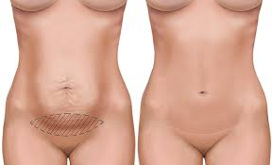
Cesarean Section With plastic surgery to previous ugly scar
Scars will form differently based on a number of factors such as where the injury took place, age of the person and health of the skin in general. To repair the damage done by an injury, the body has to produce new collagen fibers.
an ugly unattractive old c-section scar ( keloid or previous infection ) on the abdomen from a previous C-section can safely be removed at the time of a second (or third).
The new scar replacing it is usually longer but still covered by bikini style underwear and bathing suits

Slide 14
Cesarean Section With abdominplasty
the higher incidence of postoperative complications,
unesthetic results, and
the dissatisfaction results
render this practice not recommended and not encouraged. Therefore, we recommend that this practice be limited and restricted to patients wishing to undergo only one surgical setting for both procedures,
after clear explanation and emphasis on the side effects and the possible unsatisfactory esthetic results.
the application of abdominoplasty combined with cesarean section
should be discouraged

Slide 15

Cesarean Section With Panniculectomy
Panniculectomy may be performed as a single procedure or combined with a tummy tuck. The procedure may also be performed with another abdominal surgery, such as a hysterectomy, repair of the abdominal wall, or hernia repair.
When done alone the panniculectomy is intended to only to remove the overhanging skin and fat and is not a cosmetic procedure.
The procedure takes approximately three to five hours and involves an incision just above the pubic area extending outward toward the hips.The length of the incision depends upon the amount of skin to be removed.
Depending on the size of the pannus, the naval might get pulled down or completely removed with the panniculectomy. the surgeon will be able advise patient of this in his pre-operative consult.

Slide 16
Cesarean Section With Liposuction
it’s possible to have liposuction done at the time of a c-section but “NO!” it’s not optimal.
The uterus needs several weeks to contract back down to a non-pregnancy state as do the skin and muscles of the abdomen. The stretch and strain on the abdomen and the water retention from pregnancy make performing a tummy tuck at the same very difficult to estimate how much extra skin can come off versus how much will contract back on its own.

Slide 17
Cesarean Section With Intra Uterine Loop Insertion
The results suggest that IUD insertion during cesarean is a safe and effective method of fertility control for patients at high reproductive risk. At the end of this section,
it can be concluded that, the quality of evidence was moderate and trials of adequate power are needed to estimate expulsion rates and side effects.
The benefit of effective contraception immediately after delivery may
outweigh the disadvantage of increased risk for expulsion.

Slide 18
Hernioplasty
the clinical outcome of inguinal or umbilical hernioplasty performed at the time of cesarean section, it is feasible and safe
Abdominal wall hernia repair concomitant to cesarean section seems feasible and beneﬁcial to the patient,
the repair of diaphragmatic hernia following the emergency cesarean section, in which they found a part of the transverse colon and a part of omentum trapped in the thorax,

Slide 19
Cesarean Section With paraumbilical hernia
Combined cesarean delivery and paraumbilical hernia repair with or without mesh had the advantage of a single incision ( repair from inside ), single anesthesia, and a single hospital stay while avoiding re-hospitalization for a separate hernia repair and it is safe, effective, and well accepted..

Slide 20
Cesarean Section With incisional cs hernia
Incisional hernias are relatively common after caesarean sections.
Specially vertical abdominal incisions rather than transeverse abdominal incisions
The reason is that the lower half of the abdominal wall, below the umbilicus, is inherently weaker than the upper: one layer of tissue is missing.
Surgeries performed in the lower abdomen more often progress to hernia. Surgery for an incisional hernia is usually carried out by placing a mesh to cover the hernia hole. The mesh is made of polypropylene. The recurrence rate is about
5% or less if a mesh is used,
and is about 40% if no mesh is used.

Slide 21
Cesarean Section With stone in urinary bladder
Vesicle calculi, Stone removal during cesarean
should be avoided
as it is associated with high rate of infection and fistula formation.
When a cesarean section is indicated, intraoperative cystotomy with removal of the calculus is mandatory, even if it seems to increase the risk of urinary fistula if it is a cause of dystocia.

Slide 22
Cesarean Section with Abdominal scar endometrioma
It is a type of cutaneous endometriosis arising on or near a Cesarean section Scar
It is a rare form of extrapelvic endometriosis
Deposits of endometrial glands and stromal cells can be located at
the dermis of skin,
subcutaneous tissue,
sheath,
rectus muscle,
intraperitoneally, or
in the uterine myometrium (within uterine wall Cesarean section scars).
In general, the treatment of choice for abdominal wall scar endometriosis or CS scar endometrioma is surgical excision, even for recurrent cases.
Wide surgical excision with at least a 1 cm margin and/or patch grafting for fascia defect have been emphasized to prevent hernias

Slide 23
Cesarean Section With septum resection in septate uterus
the removal of the septum during cesarean section resulted in uneventful postoperative courses, and subsequently in successful pregnancies and births of healthy infants
If surgeon see a uterine septum during the c-section , may be resect it
but
because the wall of the uterus is overdistended and the septum may not
retract properly in to the wall and the uterus is quite vascular
there may be the risk of causing significant bleeding.

Slide 24
Cesarean Section With splenectomy
Immune thrombocytopenic purpura (ITP) associated with pregnancy often involves considerable risk both for mother and child, and usually worsens in the third trimester of gestation. Pregnancy and delivery are especially difficult in patients with severe ITP (platelet count below 20 x 10(9)/L), who are resistant to prednisone and high dose intravenous immunoglobulin (IVIgG).
In those cases we applied cesarean section (CS), to prevent intracranial haemorrhage due to fetal/neonatal ITP, and
splenectomy at the same time as an effective therapeutic strategy for ITP.
We propose that splenectomy following cesarean section should be considered as approach for delivery and treatment option for mothers with severe resistant ITP.

Slide 25
Cesarean Section With cholecystectomy
Most of them were diagnosed with cholelithiasis at or before the first antenatal scan. Cholecystectomy was performed by subcostal mini-laparotomy, after assessing the anatomy via the cesarean wound.
Combined cesarean section and cholecystectomy avoids rehospitalisation for separate cholecystectomy. With an additional small subcostal incision, single anaesthesia, and single hospital stay, the combined procedure confers valuable advantages for both patient and hospital in time, cost, and convenience, including avoiding the separation of mother from newborn entailed by reoperation. It also prevents the possibility of developing acute cholecystitis while the patient is waiting for cholecystectomy.
The results indicate that the combination approach is safe, effective, and well accepted.

Slide 26
CONCLUSIONS
Many surgeries could be performed safely in association with
cesarean delivery
within less time and
minimal blood loss.
The perspective towards the concept of non-association of other operations with cesarean delivery
needs to be changed.

