Slide 1


Funny Methods
To guess
The Gender
Of The Fetus
During Pregnancy naturally!
Old Wives Tales
Dr Muhammad M Al Hennawy
Ob/gyn consultant
Egypt
www.mmhennawy.co.nr

Slide 2
This Lecture explains my personal opinion
In spite that this lecture contains medical evident informations
If you accept this lecture ,
take it as a sciense
If you do not accept it,
take it as a fun

Slide 3
It is interesting to learn about these gender prediction tests, and fun to try some of the old ways of predicting the sex of an unborn baby.
Sometimes, however, it can become frustrating listening to the contradicting predictions of family and friends.
Pregnancy is a joy to all, a celebration of life, in which everyone seems to want to be a part of.
Just relax and know that as soon as they place that baby into your arms for the first time, you will love it beyond all reason whether it is a boy or a girl.

Slide 4
1. Shape
When the face gets narrower and longer you are said to be carrying a boy;
when the shape takes on a fuller and rounder form you are said to be carrying a girl.

Slide 5

2. Skin
Acne are more prevalent when the mother to be is carrying a girl;
if the skin stays clear and free from spots then she is carrying a boy.

Slide 6

3. Hair # 1
The hair of an expectant mother that is carrying a girl will often seen to be duller and thinner than before she became pregnant;
when the hair becomes more glossy and full of body then she is carrying a boy.
It should also be a girl if reddish highlights are found in the hair during pregnancy.

Slide 7

4. Hair # 2
Pull a pregnant woman’s hairs up from the back of her neck.
If you find new hair growth that forms in “V” shape, she is carrying a boy.
If new hairs are growing straight across the neck, she is having a baby girl.

Slide 8
5. Nose
When pregnant, the expectant mother can also expect to notice changes in the size and shape of her nose when she is carrying a boy.
These changes where the nostrils will get bigger and wider are only temporary and the nose will return to its former shape once her infant son is born

Slide 9

6. Eye Vein
By studying the white part of the eye under the iris you can also predict the sex of your unborn child.
If there is the presence of a vein, either “v”, “y”, or “U” shaped under the left eye then you are said to be carrying a girl;
when this vein is present under the right eye it is said that you are carrying a boy.
When there are veins present in both eyes then the sex of the unborn child is female;
no veins at all mean that you are carrying a boy.

Slide 10
7. Overall Beauty
For the pregnant women, if you feel yourself or your friends tell you that you look prettier than before, you are probably carrying a son.
If unfortunately your beauty disappears when you are pregnant, you are more likely having a daughter.

Slide 11
8. Breast Size # 1
The breasts of women who are carrying girls will grow faster and gain bigger size than those of women who are carrying boys.

Slide 12
9. Breast Size # 2
If the right breast is larger than the left one, then it is a boy.
If the left bust is bigger, it is a girl.

Slide 13
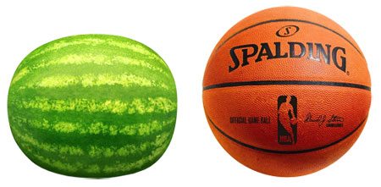
10. Belly Shape
The sex of the unborn child can also be predicted by studying the shape of the belly.
When the belly expands to the sides and towards the hips like a watermelon, you are said to be carrying a girl;
when the belly is basketball shaped and is all out the front then you will give birth to a son

Slide 14
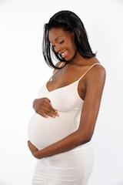
11. Belly Softness
If the belly of the pregnant female remains soft then she is carrying a girl;
when the belly is tense and hard she will give birth to a son.

Slide 15
12. Position of Carrying
The sex of an unborn child can be determined by looking at how his/her mother is carrying him/her in the womb.
When the baby is positioned high up the mother-to-be is carrying a girl;
when the mother-to-be is carrying low she will give birth to a son.

Slide 16
13. Legs
If an expectant mother is suffering from swelling in the legs at the earlier stages of pregnancy then it is said that she is carrying a girl;
if her legs don’t swell at all or swelling only occurs in later stage of pregnancy then she will give birth to a baby boy.

Slide 17
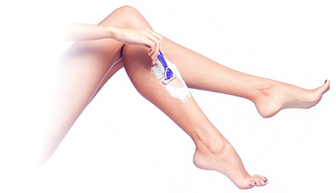
14. Leg Hair
If you notice acceleration in the growth of hair on your legs then it is said that you are carrying a boy.

Slide 18
15. Hands
The sex of the unborn child can also be predicted by looking at the hands of the expectant mother.
When she skin stays soft and supple she is carrying a girl;
when the skin becomes hard and cracked she is carrying a boy.

Slide 19
16. Nail
Nails grow faster and stronger, it is a boy.

Slide 20
17. Belly button
If the navel starts to protrude when you are pregnant then your unborn child is male;
if your belly button stays the same then you are carrying a girl.

Slide 21
18. Stretch Marks
Stretch marks come with the territory of being pregnant, most especially in the tummy. However, you can determine the sex of your unborn child by looking carefully at these marks;
more marks on the left hand side of the tummy mean that you are carrying a boy;
if there are more stretch marks on the right hand side then you are carrying a girl.

Slide 22
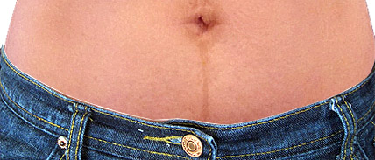
19. Linea Nigra
The dark line that runs up from the pubic bone to the navel during pregnancy is called linea nigra. When this line goes far past the navel and reaches the rib cage, the baby is a boy;
when the line stops at the belly button, it is a baby girl.
OR
If there is another line above the navel, and the two lines meet at the navel, it is a boy.
If the two lines do not meet, it is a girl.

Slide 23
20. Entire Body
If from behind the expectant mother doesn’t seem to be pregnant then it’s a boy,
but if she looks pregnant from all sides, then it’s a baby girl.

Slide 24
21. Vaginal Discharge
If you are seeing the passing of whitish liquid (in small quantities) during your pregnancy from vagina, you would have a baby boy.
If you are passing through small dots of blood occasionally during your pregnancy, it is believed to be a baby girl.

Slide 25
22. Heartburn
According to old wives’ tales, heartburn means the baby will come out with a head full of hair.
The fact is that most women experienced severe heartburn during pregnancy got a boy.

Slide 26
23. Headache
It is more likely that women who are carrying boys get frequent headaches,
while those who are carrying girls do not or only occasionally get headaches.

Slide 27
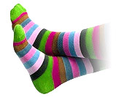
24. Cold Feet
Cold feet in this context mean having icy cold feet rather than being scared of the birth of a baby.
Myth has it that if pregnant women have cold feet during your pregnancy then they are more likely to be expecting a boy.

Slide 28
25. Sex Drive
Once the pregnancy has been confirmed, a woman who loses some of her sex drive is said to be carrying a girl;
when her sex drive becomes stronger she is said to be carrying a boy.

Slide 29

26. Cravings # 1
Not all but most pregnant woman will experience cravings during her pregnancy.
When she craves salty or spicy or sour foods then she is said to be carrying a boy;
when she craves sweets she is said to be carrying a girl.

Slide 30
27. Cravings # 2
Woman loves red meat if she is carrying a boy.
She loves to eat fruit or drink fruit juice if she is carrying a girl.

Slide 31
28. Appetite
When a mother to be is continually hungry during her pregnancy it is said that she will give birth to a baby boy;
when her appetite stays the same or decreases she will give birth to a daughter.

Slide 32

29. Vitality
If you become lazy when pregnant and suffer from lower than normal levels of energy it is said that you are carrying a girl;
when you stay active during your pregnancy then it is said that you are carrying a boy.

Slide 33
30. Morning Sickness
The majority of pregnant woman will report morning sickness at some stage during their pregnancy, but the severity of the sickness can help predict the sex of the unborn child.
Mothers who are carrying a daughter are more likely to suffer from severe nausea,
this sickness being far less severe when the mother will have a son.
Swedish researchers discovered that 56% of women hospitalized with severe morning sickness ended up giving birth to baby girls.

Slide 34
31. Quickening
It is a son if the fetus moves early

Slide 35
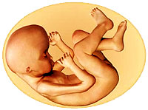
32. Fetal Movement
Movement is stronger for male than for female fetus, when they are at the same developmental phrase.

Slide 36
33. Call from behind
For this method to work, the pregnant woman has to be walking in a southerly direction when someone calls out her name from behind.
If the woman turns back to see who is calling her from the left then she is said to be carrying a boy;
if she turns from the right then she is carrying a girl.
Well, don’t shout too loud to the mother-to-be or you will scare her and her baby!

Slide 37
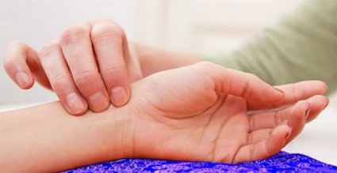
34. Pulse
When the left wrist pulse feels more slippery and rapid, it should be a boy.
If the right wrist pulse feel more slippery and rapid. It is a girl.
This method is far more accurate when you visit a TCM practitioner, and it should be noted that it is only a valid method when the first trimester of pregnancy has passed.

Slide 38
35. Green excrement
For this method to work a pregnant woman needs to hold an infant of another woman who has not yet reached the teething stage.
When she is holding a baby that is the same gender as her own unborn child then the excrement of the baby will remain the same;
when she is carrying a baby of the opposite gender to that in her womb the next time the infant passes a motion the excrement will be green.

Slide 39
36. Color of the nipples/areolae
During any pregnancy the nipples and areolae of the expectant mother will change in form, shape, and color.
If during pregnancy, the color of nipple and areola shows on left breast is darker than that at the right side, she is carrying a boy.
If the color at the right side is darker, it is a girl.

Slide 40

37. The Children’s Palace
by observing the areas known as the children’s palace, which are located below the eyes.
If the children’s palace of the mother-to-be seems white or yellow then she is carrying a boy;
when these areas are showing a greenish color then she is carrying a girl.

Slide 41
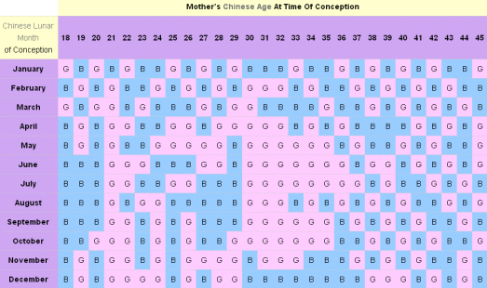
38. Chinese Gender Chart
This is probably the most common gender predictor nowadays.
The Chinese Gender Chart claims to have an accuracy rate of over 90%. It is based on the mother’s Chinese age at the time of conception and the lunar month that she conceived in.

Slide 42
39. The 49 method
For this one needs to know both the Chinese lunar month in which the mother-to-be conceived and the Chinese lunar age at the time she got pregnant (find both of them at the lunar age calculator) in order to determine the sex of the unborn baby. Here is the formula
49 + (Chinese lunar month in which the mother conceived) – (the Chinese lunar age at the time the mother got pregnant) + 19
If the result is an odd number, the baby is a boy.
An even number means a baby girl.

Slide 43
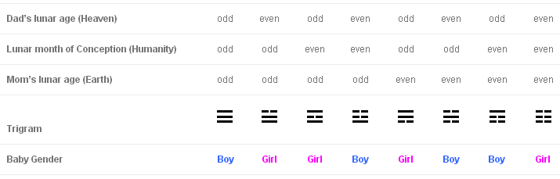

40. The Bagua (eight trigrams) method
In Taoism, Bagua is the representation of naturally occurring processes. With the (lunar) age of the father, the (lunar) month in which the mother conceived, and the (lunar) age of the mother, a trigram can be formed. Since each trigram stands for either a yin or yang, the gender of baby can be determined.
To predict the baby gender, find out whether the following values are odd or even, and then check the table below
the lunar age of the father at the time the mother conceived (Heaven)
the lunar month in which the mother conceived (Humanity)
the lunar age of the father at the time the mother conceived (Earth)

Slide 44
41. Fists
This method involves the mother-to-be clenching her firsts and checking the formation of the skin between the palm of her hand and her little finger.
When the skin is pointed then the woman is carrying a boy;
when the skin is rounded it means she is carrying a girl.
This method has various levels of success but only limited to the first time the woman is pregnant.

Slide 45
42. Alcohol Test
A test that uses the first pee in the morning to mix with medical alcohol (isopropyl alcohol).
If the alcohol does not change color you are carrying a girl;
if it turns red then you will have a boy.

Slide 46
43. Baking Soda Test
This test involves peeing on a little baking soda in a plastic cup.
If the mix fizzles then you are said to be carrying a boy;
a mix that does not fizzle is said to indicate that you are carrying a girl.

Slide 47
44. Ancient Egyptian Test
In Ancient Egypt, the sex of an unborn child was predicted using wheat and barley. The mother-to-be would urinate over seeds of both barley and wheat.
If the barley sprouted then the woman was carrying a boy and
if the wheat sprouted she was carrying a girl.

Slide 48
45. Drano Test
For this test you will need a glass and two tablespoon of blue crystal Drano. You should then add your urine to the glass and watch the color of the mix.
If the mix turns dark brown almost straight away then you are carrying a boy.
If there is no color change or darkening after 15 seconds then you are expecting a girl.
The drano test combines a tablespoon of Drano and urine together. If the mixture turns green, it’s a girl. If it turns blue, it’s a boy.

Slide 49
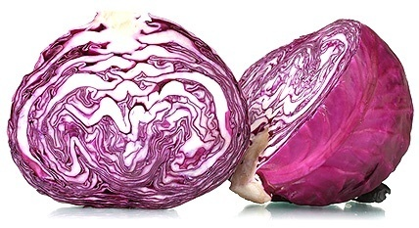
46. Cabbage Test
For this test you will need a red cabbage. The size of the cabbage is not important as you will chop it into pieces and place them in a pan of boiling water. Allow the cabbage (it will be purple in color) to boil for ten minutes and then take the pan off the heat. Once the cabbage has finished boiling you need to urinate in a clean cup. Then combine an equal amount of your pee with an equal amount of the water from the cabbage.
If the mix of urine and water turns purple you are carrying a girl;
if it turns red then you will give birth to a boy.

Slide 50
47. Urine Color
You can predict the sex of your unborn child by looking at the color of your urine.
Bright colored urine is supposed to indicate you will have a boy and
dull colored urine a girl.

Slide 51

48. Mayan Method
In ancient times, the Maya used math to calculate various activities in their daily lives Amongst these calculations they developed one specifically for predicting the gender of an unborn child. To calculate this they took into consideration the age of the mother and the year of conception.
When both number were even or odd then the unborn child was female;
when one number was odd and the other even the child would be a boy.
E.g.
32 years old woman, who was conceived in 2006 = girl
29 years old woman, who was conceived in 2006 = boy

Slide 52
49. Brazilian Method
The Brazilian version varies from that of the Mayan method in that they use the month of conception as opposed to the year as well as the age of the mother to be when she conceives. Once again however, when one number is odd and the other even the mother is expecting a boy; when both are odd or even the child will be a girl.
E.g.
28 years old woman, who was conceived on July = boy
27 years old woman, who was conceived on May = girl

Slide 53
50. The Remainder Method
This approach is provided by a Japanese senior midwife, the accuracy of this method is said to be as high as 98%. Sum up the Chinese lunar month in which the mother conceived, the mother’s Chinese lunar age at the time she conceived, and the father’s Chinese lunar age at the time his wife conceived, and then divide it by 3.
If there is no remainder or if the remainder is 2, then she is carrying a girl.
If the remainder is 1, she is carrying a boy
E.g.
Mother’s birth date : 12/5/72
Father’s birth date : 3/30/66
Mother conceived date : 12/10/14
———————————————-
Use the lunar month and age calculator, you will get
Mother’s lunar age : 43
Father’s lunar age : 49
Lunar month of conception : 9
(43+49+9)/3 = 33, with a remainder 2
It is a girl

Slide 54
51. Blood Renewal Theory
This gender predictor is said to be a Russian folklore. According to the theory, the male has his blood renewal every four years, and the female every three years. Baby gender is determined by the newest blood at the moment when the mother is conceived. So to do this test, you will need 1) the father’s birthday, 2) the mother’s birthday, and 3) the possible conception day.
Here is how you do it. Keep adding 4 yr to the father’s birth year, until the year closest (without over) to the year of conception. Do the same thing to the mother’s birthday except only adding 3 yr to the mother’s birth year. The one which is closer to the date of conception means the blood is “newer” and the unborn baby will have the same sex as that person.
Example
Father’s birthday : May 6, 1986
Mother’s birthday : June 12, 1988
Date of conception : December 18, 2014

Slide 55
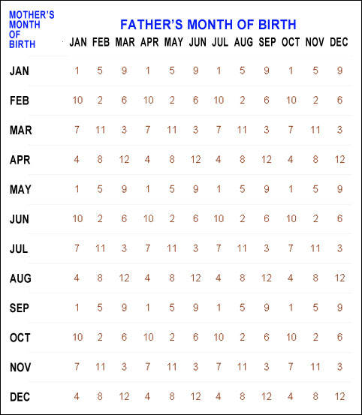
52. Japanese Gender Chart
To know the gender of the baby, you will need to know the father’s month of birth, the mother’s month of birth and the month of conception.
Step 1 ~ At table 1 below, find out the number where the father’s month of birth meets the mother’s month of birth. It is the secret number .

Slide 56
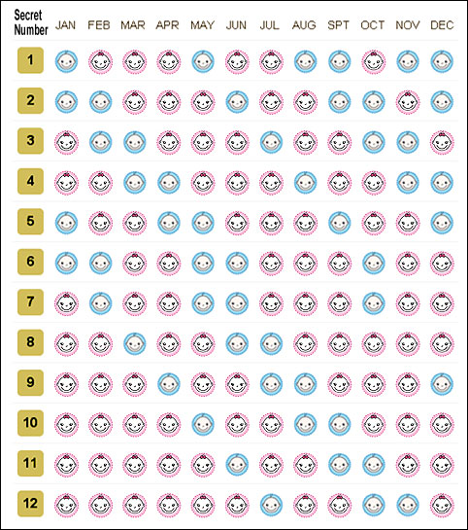
Step 2 ~ At table 2, find out the baby gender by crossing the month of conception with the secret number.
E.g.
Father’s month of birth : July
Mother’s month of birth : September
Month of conception : April
———————————————-
At table 1, you get the secret number 1 by crossing the father’s month of birth (July) with the mother’s of birth (September). Then at table 2, cross the secret number 1 with the month of conception (April), and you will get the predicted gender which is a girl.

Slide 57
53. Ring Test
To perform this test you will need a ring and a piece of string, a hair, or a string of dental floss. Simple dangle the ring over your belly and wait until it starts to move.
If the ring moves from side to side you will be having a boy;
a ring that swings in a circular motion indicates that you are carrying a girl.

Slide 58
54. Pencil Test
This test not only shows a pregnant woman the sex of the baby that she is carrying, but also shows her how many babies she will have and what gender they are. In fact, all women can perform this test even they are not yet pregnant.

Slide 59

55. Birthstone Test
For this test you need a birthstone pendant. If you don’t have one, then you can take a birthstone and tie it to a string. Now tell a friend to hold it over you.
Get a friend to ask you several questions for which he/she does not know the answers, like “have you eaten chicken today, or did you read a book last night?” Do not reveal the answers to your friend, but notice what kind of movement do the pendant show in response your answers. In other words, if the answer if “yes”, notice whether the pendant moves in back-and-forth motion or in a circular motion.
Now tell that person to hold the pendant over your belly and ask: “Is the baby that [YOUR NAME] is carrying a girl?” If you see the pendant swings in the same way as with your “yes” answer, then it is a girl. Otherwise, it is a boy.

Slide 60

56. Sleep Position :
If the mom-to-be always sleep on her left side, it is a son.
If she prefers to sleep on her right side, it is a daughter.

Slide 61
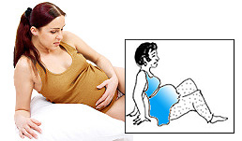
57. Get Up
Wake up a pregnant woman, and ask her to sit on the bed.
If she gets up by pushing herself with both hands behind her, she is probably having a daughter.
If she uses one of her arms at her side to get up, tha baby is a son.

Slide 62

58. Mug Test
Ask the expectant mother to pick up a cup or mug.
If she uses the handle to pick up the mug then she will have a boy;
if she grasps the body of the mug then she will have a girl.

Slide 63
59. Palms Up or Down
Get someone to ask a pregnant woman to show her hands.
If she shows her hands with the palms down, it is going to be a boy.
If her palms up, it is a girl.

Slide 64

60. Key Test
For this test to work, the pregnant woman needs to be unaware that the test is being carried out. Simply hand a key to the mother to be and watch how she grabs it.
If she grabs the round part first then she is carrying a boy;
when she grabs the narrow part first she will give birth to a girl.

Slide 65

61. Name
When parents are choosing a name for their unborn child, if between them they can only decide on a name of the same sex, then this is the sex of the child to be born.

Slide 66
62. Mother Knows Best
Predict gender solely from mother’s gut feeling.
A study was carried out by Dr Victor Shamas and Amanda Dawson at the Arizona Birth and Women’s health center in Tuscon where 100 mothers to be were asked to predict the sex of their unborn child. Of those that claimed that they had an intuition about the sex of the child, an astounding 70% were indeed correct.

Slide 67

63. Dreams
Dreams have often been significant indicators of fetal sex.
In many European countries, dreams of a knife or an ax indicate a son.
Dreams of a fountain or a spring indicate a daughter.
In India, dreams oflotus blossoms, mango trees ormen’s food are believed to predict a boy.

Slide 68
64. Father’s Weight
If the father-to-be gains weight while his wife is pregnant, it’s a girl.
If he doesn’t gain weight, it’s a boy.

Slide 69

65. Baby’s heart rate
Predicting the sex of your unborn child by using the heart rate is a popular old wives tale.
If the heart rate is less than 140 BPM then you are carrying a boy;
a heart rate that is faster than 140 beats per minutes indicates that you will give birth to a baby girl.

Slide 70
66. Baby’s heart sound
If the heart beat sounded like a train, it is a boy.
If it sounded a horse galloping, it will be a girl.

Slide 71
67. What the sibling says
If a young kid keeps telling the mom-to-be the sex of his/her unborn sibling,
he/she is probably right.

Slide 72
68. Mama or Dada
This tale only applies to the second and following children. If your first child’s first word was dadda (dada), you’ll have a boy.
If the first word was momma (mama), you will have a girl.
Same method applies for all the immediate younger sibling.

Slide 73
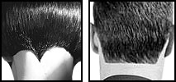
69. Hairline at the Back of Neck
In India, mothers look at the hairline of their children to predict the sex of their next child.
When the hairline of their first child is straight, the unborn child she is carrying will be of the same sex;
if the hairline is pointed (or V-shape) then her next child will be of the opposite sex.

Slide 74
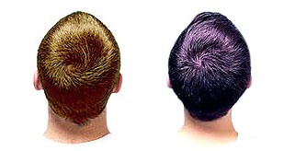
70. Hair Whorl
To predict the gender of your baby you can also study the hairline of your previous child. The hair whorl will go in a clockwise or anticlockwise direction;
if your child has an anticlockwise hair whorl you next child will be a girl,
if the whorl is clockwise then you are expecting a boy.

Slide 75
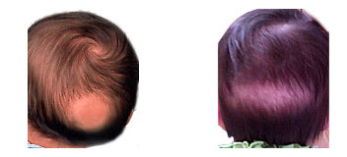
71. Baby Bald Spot (Patch)
This one was told by a Korean old lady.
If there is a rounded bald spot founded on the back of your baby, your next child will be a girl.
If it is a long spot across the back, your next child will be a boy.

Slide 76
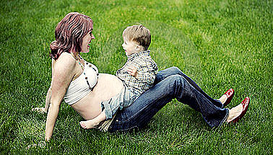
72. Toddler
If a toddler shows interest in your belly or likes to hang out with you when you are pregnant, you are having the opposite gender of the toddler.
In other words, if the toddler is a boy, you are having a girl, and vice versa

Slide 77
73. Inverted Nipples
If the nipples of your baby are inverted (invaginated) at birth, your next child will be the opposite sex,
if the nipples are not inverted, your next child will be the same sex.

Slide 78
74. Wrinkles
If wrinkles are found on the upper part of a newborn child, the next child will be the opposite sex.

Slide 79

75. New Moon
In Touraine, France, to see a new moon within six days after a baby was born foretold that the next child would be of the same sex;
if after more than six days, of the opposite sex.

Slide 80

76. Moon Phase
This philosophy suggests that during a full moon the eggs are attracted to male sperm and during a new moon to female sperm. Therefore
if your ovulation falls at the time of a new moon (from the start of a new moon up until one day before full moon) then you will carry a girl.
If you ovulate during a full moon and the days up to the next new moon then you will carry a boy.
In order for this test to work you need to calculate the day that you will ovulate in your menstrual cycle as well as study the patterns of the moon. The test is supposed to be accurate, other than when you ovulate on the day before either a new moon or a full moon, where it is said to be a 50-50 chance which sperm will be attracted to the egg.

Slide 81
77. Salt Test
If you wish to know whether a pregnant woman is carrying a girl or a boy, then sprinkle some salt over her head while she is sleeping, so gently that she is unaware of it. Take notice of the name she calls first once she wakes up.
If she calls a man’s name then she will give birth to a boy, but
if she call’s a girl’s name then she will give birth to a girl.

Slide 82
78. Left Foot or Right Foot
When a pregnant lady walks with her right foot first, she is carrying a boy for sure.
If she walks with her left foot first, it is a baby girl.

Slide 83
79. Counting fetal kicks
Not just the numbers, but where you feel the kicks is also indicative about the gender of your child.
It is believed that if you feel the kicks higher up in your ribs, it is a girl.
While kicks felt lower in the abdomen indicate that it’s a boy

Slide 84
80. your body hair or nails grow
If your body hair or nails grow faster during your pregnancy, you're having a baby boy. If hair and nails grow slower, you're carrying a girl.
While pregnant women carry an abundance of beta-HCG (pregnancy hormone), hair and nail growth are not clear indicators of a baby's gender. "Your age will affect your hair texture more than your pregnancy," Leggett says. Hormone levels between boy and girl babies are not sufficient to make any noticeable changes to the mother's body

Slide 85
81. Bloodshot eyes and nosebleeds
Bloodshot eyes and nosebleeds are said to also predict a girl.

Slide 86
82. Time of Conception
The person that is most aggressive in bed at the time of conception is the opposite of what the baby will be.

Slide 87
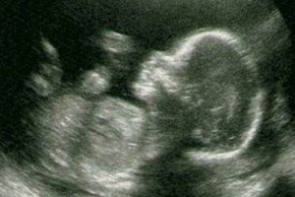
83. skull theory
if you notice that your baby has a sloping forehead and a squared lower jaw you’re more likely to be carrying a boy.
If your baby’s lower jaw is rounded and the top of the head is tapered, you’re more likely to be carrying a girl

Slide 88
84. Milk on Glass
let a drop or two of her milk be expressed on a smooth glass or a bright knife, or else on the nail of one of her fingers.
If the milk flows and spreads widely upon it, by and by then is it a woman child:
but if the drop continues to stand still upon that which it is milked on, then is it sign of a man child.

Slide 89

85. Wooden Spoon Test
For this test, ask a pregnant woman to throw a wooden spoon on the floor.
If it lands hollow side down then she is carrying a boy;
when it lands arch side down then it is a girl.

Slide 90

86. Penny Test
For this test you will need to lick your thumb and wipe it on a penny coin.
Once the penny is wet you should hold it against a wall with the split side looking at the wall. Press the penny on to the wall for 30 seconds and then let go;
if the penny sticks to the wall you are carrying a girl,
of it falls down then you will have a boy.

Slide 91
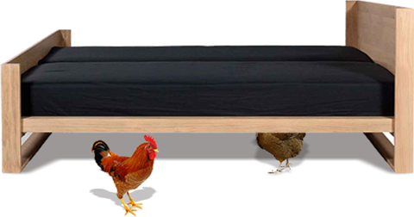
87. Chicken under the Bed
Put two chickens, a hen and a rooster, under the bed of the pregnant woman (and her husband).
The sex of the baby will be the same as whichever chicken comes out first.

Slide 92

88. Pin or Needle
This is a Persian folklore. A pregnant woman who happens to find a pin in the street will have a male child,
but finding a needle presages a female child.

Slide 93
89. Spider Web
In Hungary, a pregnant woman might make a hole with her finger in a spider web;
if the spider repairs the damage of the web, expect a male child.

Slide 94
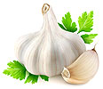
90. Garlic Test
If a pregnant woman eats a clove of garlic and
the smell does not come out of her pores, it’s a girl.
If the smell seeps out of her pores, it’s a boy.

Slide 95
91. Louse test
This is a Moroccan folklore. Dropping a louse on a pregnant woman’s exposed abdomen.
If the insect lands on its legs, the unborn baby is believed to be a male

Slide 96
92. Toilet Test
In Japan, when the dad-to-be calls the mom-to-be while she is on the toilet,
if she turns suddenly to the right, the baby is a son.
To the left, a daughter.

Slide 97
93. Spoon and Fork Test
In order to carry out this method for predicting the sex of the unborn child you require a fork, a spoon, and two chairs. The fork should be placed on one chair and the spoon on the other, the objects being covered with a serviette. The mother-to-be is not allowed to see the process, and once both objects are covered she is asked to choose a chair to sit on;
when she sits on the spoon she will give birth to a girl, and
when she chooses fork it will be a boy.

Slide 98
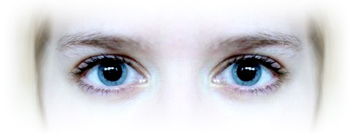
94. Pupil Dilation :
This is a German folktale. Look at the mirror for at least one minute, and if the pupils dilate, it is aboy.
Otherwise, it is a girl.

Slide 99
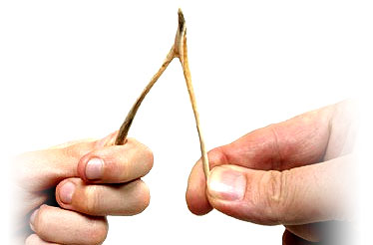
95. Turkey Wishbone
Let the mother-to-be and father-to-be hold each side of a turkey wishbone, and then break it.
If the father-to-be gets the bigger end, the baby is a boy.
If the mother-to-be gets the bigger end, the baby is a girl.

Slide 100
96. Sprinkle Salt
A test from Romania. Let the father-to-be sprinkle some salt in the mother-to-be’s hair silently, and watch where she scratches first.
If she itches her lips, she is having a girl,
her nose, a boy.

Slide 101

97. Cat Test
Ask the pregnant woman to stay in a room with another lady, and have them sit on chairs in opposite sides of the room. Then let a cat enter the room.
If the cat takes a glance at the pregnant woman first (preferably jumping in her lap) , she is going to get a boy.
If the cat ignores the pregnant woman and goes for the other lady, a baby girl is predicted.

Slide 102
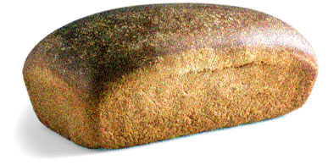
98. Bread Test
Serve a pregnant lady a loaf of bread,
if she prefers the heel, it is going to be a son,
if she refuse to eat the heel, it is a daughter. This test is said to originate from Italy.

Slide 103
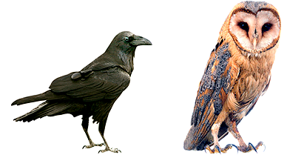
99. Owl or Raven
In Albania, the cry of an owl presages the birth of a daughter,
while the croaking of a raven is a sign of a son.

Slide 104
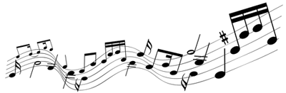
100. Baby Dancing
In Vienna, the City of Music,
if the fetus dances with music, it is a girl.
If the fetus remains quiet, it is a boy.

Slide 105
101. Facial Tissue
Lay a facial tissue flat on a table. Then ask the mom-to-be to grab the tissue right in front of a few people.
If she grabs the edge of the tissue, she is having a girl.
If she grabs the corner of the tissue, she is having a baby boy.

Slide 106
102.Mood swings
women who felt sick and felt disgusted about anything and everything during the first two trimesters of their pregnancy were more likely to give birth to male babies as compared to
women who felt balanced during the initial days of their pregnancy.
Probably this explains why men lack patience over everything!

Slide 107
103.Food aversions
The Polish study also mentioned that women who developed food aversions or felt nauseated after meals were more likely to give birth to boys.
The reason being the mother’s body feels a need to protect the growing male embryo which is more vulnerable than the female embryo, according to the study.

Slide 108
104.Moodiness and a Little Pecker
If you are really moody, you are having a girl since you have another extra girl hormones in you.
Your pregnancy will make you smile and be more happy if you are having a boy because there’s a little penis inside you.

Slide 109
105.Clumsy vs. Graceful
If the pregnant woman is graceful throughout her pregnancy, she’s having a girl.
If she becomes clumsy, she’s having a boy.

Slide 110
106.Legs
If your legs get really big, you’re having a boy. If your legs stay in shape and lean, it’s a girl

Slide 111
107.Hands are Dry
If your hands are constantly dry, it’s a boy.

Slide 112
108.North or South?
When you sleep, is your pillow north or south?
If it’s north, then expect a boy, or
south means a girl is on the way.

Slide 113
109.Ultrasounds Are Always Right
This one is definitely false. We have heard many stories where a woman has received an ultrasound, and sometimes more than one ultrasound where the doctor claims that she is having either a boy or a girl. The mother buys everything she needs for her little son or daughter, and when the day of delivery comes she is surprised with a baby of the opposite sex. Most of the time the ultrasound technician gets it right, but that is not always the case.

Slide 114
The simple truth is that every home method of predicting the sex of an unborn baby has a fifty percent chance to be right, and a fifty percent chance to be wrong.
It will be either a boy or a girl.

Slide 115
If you want to know which for certain, medical tests or sonograms are really the only reliable way to find out, although keep in mind that even sonograms or ultrasounds are only about 95% accurate.

