Slide 1

Emesis &Hyperemesis Gravidarum
Problem Solving
January ,2013
Dr. Mohamed El Sherbiny
MD Ob.& Gyn
Damietta, Egypt

Slide 2
Case 1
A 23-year-old G1P0 woman 9 weeks GA .She is coming for:
Worsening nausea and vomiting for the past 2 weeks
Heart palpitations & fatigue for the last 3 weeks

Slide 3
What Is The differential diagnosis for this patient ?
Differential diagnosis
Nausea and vomiting of normal pregnancy (Emesis)
Hyperemesis gravidarum
Hyperthyroidism
Cardiac disease.
GIT (Peptic or duodenal ulcer, hepatic ,gall B. or Iron medication

Slide 4
In The History, What Issues Support the Diagnosis?
Exclusion of GIT disorder or Iron medication (past/present H.)
Exclusion of Hyperthyroidism
Exclusion of Cardiac disease.
Is it Emesis or Hyperemesis gravidarum

Slide 5
Hyperthyroidism ?
Past or present History of Hyperthyroidism
symptoms &signs of Hyperthyroidism
But typical symptoms &signs of Hyperthyroidism are difficult to elicit in pregnancy

Slide 6
Hyperthyroidism When Suspect?
Any of the following will increase the suspicion:
1- Poor weight gain despite adequate food intake
2- Tachycardia > 100 beats per minute (bpm) that is unresponsive to a Valsalva manoeuvre may indicate the disease.
3- Eye signs e.g. eyelid lag or retraction, infrequent blinking, or exophthalmos.
Laboratory confirmation: Markedly depressed TSH level &elevated free T₄
Cunningham et al mWilliams Obstetrics, 23e > Chapter 53.

Slide 7
Diagnosis Of Heart Disease
The physiological adaptations of normal
pregnancy can induce symptoms and signs
that may be confused with that of the heart
disease.
Symptoms:
Dyspnea : ↑HR, consciousness of breathing (progesterone)
Orthopnea: Supine Hypocaval Syndrome.
Palpitation
Easily fatigability: Hormonal E&P
Cunningham et al mWilliams Obstetrics, 23e > Chapter 44.

Slide 8
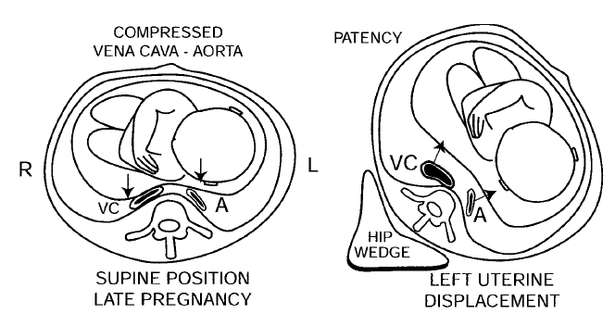
Supine Hypotensive Syndrome
Compression of the aorta (A) and vena cava (VC) when the mother is supine
When she is in the left lateral recumbent position (wedge under her right hip), both vessels are patent).

Slide 9
Signs:
Peripheral edema
Extrasystol
SVT
Prominent pulsation of the neck veins.
Accentuated 1st H. sound (DD :MS)
Functional systolic murmur : (DD: Aortic or P. stenosis)
Mammary Souffle(DD: P. ductus arteriosis)
.
Cunningham et al mWilliams Obstetrics, 23e > Chapter 44.

Slide 10
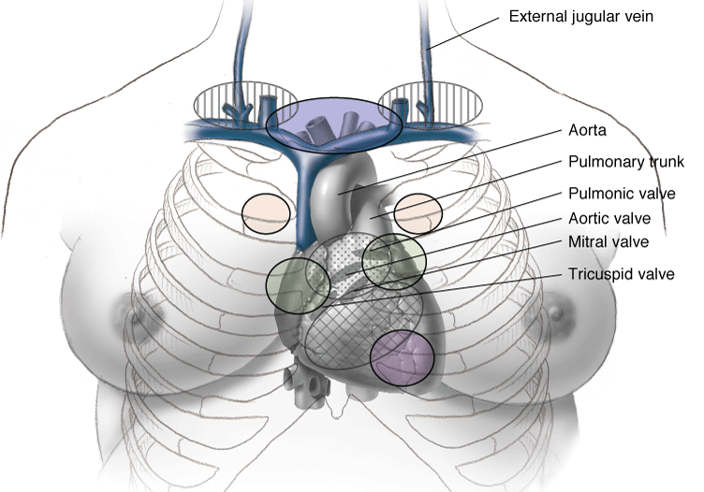
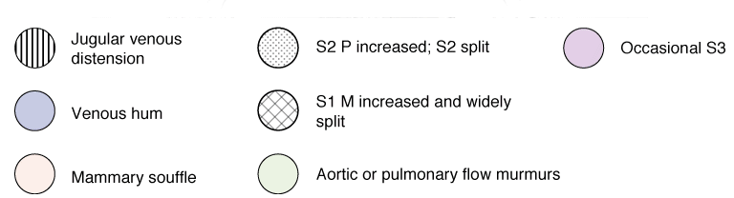
S₁ = first sound
M₁ = mitral first sound
S₂ = second sound, P₂ = pulmonary second sound.
Normal cardiac examination findings in the pregnant woman

Slide 11
Clinical Indicators of Heart Disease during Pregnancy
Symptoms:
Progressive dyspnea or
orthopnea
Nocturnal cough
Hemoptysis
Syncope
Chest pain
.
Cunningham et al mWilliams Obstetrics, 23e > Chapter 44.

Slide 12
Clinical Indicators of Heart Disease during Pregnancy
Signs
Cyanosis
Clubbing of fingers
Persistent neck vein distension
Systolic murmur grade≥ 3/6
Diastolic murmur
Cardiomegaly
Persistent arrhythmia
.
Cunningham et al mWilliams Obstetrics, 23e > Chapter 44.
Pregnant women who have none of these findings rarely have serious heart disease.

Slide 13
Nausea and Vomiting
They are common symptoms in early preg­nancy, affecting > 50% of pregnant women
Onset is at 5-6 W continue up to 14 to 16W
A 50%relief by 14 W, and 90 % by 22 weeks.
Women should be informed that most cases of nausea and vomiting in pregnancy will resolve spontaneously within 16 to 20 weeks and they are not usually associated with a poor pregnancy outcome.
NICE clinical guideline 62 AN care,2008

Slide 14
Hyperemesis gravidarum (HG)
Definition
It is defined as vomiting sufficiently severe to
produce weight loss, dehydration, alkalosis from
loss of hydrochloric acid, and hypokalemia.
It is the occurrence of >3 episodes of vomiting /D
with ketonuria and >3 kg or 5% weight loss.
The diagnosis is usually made clinically following
exclusion of other causes.
Incidence :0.3-3% & 20% need hospitalization
Cunningham et al Williams Obstetrics, 23e > Chapter 8 2010
Jueckstock et al. BMC Medicine 2010, 8:46

Slide 15
How Can HG Be Assessed?
History: Pregnancy (LMP, dates, progress to date,
previous pregnancies).
Frequency & timing of symptoms.
Ability to eat/drink
Weight gain/loss.
TTT tried.
Past medical history, allergies, any
supplements/medications, etc.
Examination: Dehydration, weight loss, postural hypotension, tachycardia, collapse, ketosis.

Slide 16
How Can HG Be Diagnosed ?
HG is causes of
persistent nausea and vomiting are ruled out.
( The Differential Diagnosis )
Nausea and vomiting that develop after 10 weeks
of gestation are not likely due to HG.
Investigation for :
1-The diagnostic work-up must always start with
confirmation of a viable, intrauterine pregnancy.
2-Investigation to exclude other causes of vomiting.
3-Work-up of severe HG where starvation and fluid
imbalance can be encountered .

Slide 17
Return to Case 1
A 23-year-old G1P0 woman 9 weeks GA
Complains:
Worsening nausea and vomiting for the past 2 weeks
Heart palpitations & fatigue for the last 3 weeks

Slide 18
Case 1 : History
No history of GIT D. or iron therapy
Loss of weight (one KG) in the last month
No pas or present history of thyroid D.
Palpitation occurs for 10-20 m /2-4 days
No history suggesting heart disease(in
the form of progressive dyspnea , octurnal
cough, hemoptysis , syncope or chest pain)
Vomiting :One episodes at morning and
occasional other one at midday

Slide 19
Case 1: Examination
On Exam. :
Thin-appearing female 58 KG
Temp 36.9°, BP 110/75, HR 84, RR 16
Thyroid: soft, mildly enlarged with
no nodules. No tremor.
Cardiac exam: Normal findings apart from functional systolic murmur

Slide 20
From The Clinical Data ,What Is The Most Likely Diagnosis ?
Emesis of Pregnancy
( mild to moderate vomiting during pregnancy)

Slide 21
What Is The Management of
Emesis of Pregnancy ?
The following interventions appear to be effective in reducing symptoms:
Non-pharmacological:
− Ginger
− P6 (wrist) acupressure
Pharmacological:
Antihistamines.
NICE clinical guideline 62 AN care,2008

Slide 22
What Is The Management of
Emesis of Pregnancy ?
1-Initial Approach
Dietary and lifestyle advices
& Non-pharmacologic TTT
2-Secondary Approach
First-line therapy
Second-line therapy
Smith et al ,UpToDate January 2013

Slide 23
Initial Approach
Generally, treatment begins with advice about:
Common Dietary Advice
Common Lifestyle Advice
Non-phAcupressure.
Hypnosis &Psychotherapy
Non- pharmacological interventions, such as :
Oral or rectal medications are added if symptoms
do not improve
Smith et al ,UpToDate January 2013

Slide 24
Common Dietary Advice
Drink small amounts often
Sometimes other fluids are better than water :
Flat lemonade, dilut. fruit juice, weak tea, clear soup
Small amounts of food more often, rather than large
Avoid having an empty stomach
Eating a dry biscuit before gettingout of bed morning
Salty foods may help(potato crisps or salty biscuits
Avoid fatty, rich or spicy foods.
Australian Family Physician Vol. 36, No. 9, September 2007

Slide 25
Common Lifestyle Advice
Make the most of your best time of day – eat well
when you feel best or whenever you feel hungry
If the smell of hot food makes you feel ill – try
having cold food instead.
If possible avoid cooking and ask for help from
friends and family
Lie down when nauseated
Avoid stress – living with the constant threat of nausea and/or vomiting is a stressor in itself
Australian Family Physician Vol. 36, No. 9, September 2007

Slide 26
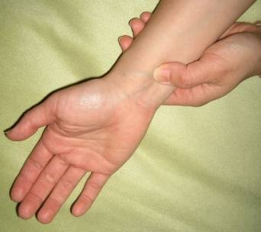
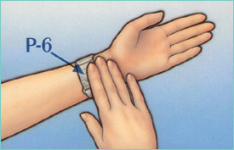
Acupuncture
Acupressure — P6& acupressure wristbands do
not require a prescription and have become
a popular self-administered intervention .
A Cochrane review of CRT did not find P6
acupuncture or acupressure wristbands
significantly more effective than sham therapy,
although some individual trials showed
a benefit
Smith et al ,UpToDate January 2013

Slide 27
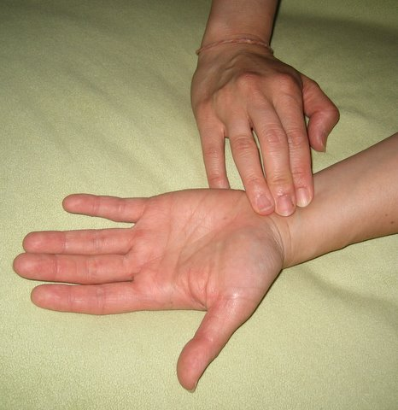
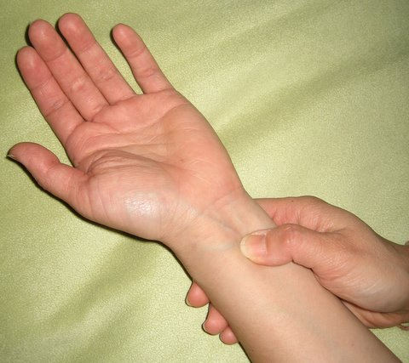
The P6 point is on the inside of the wrist, about 2–3 finger breadths proximal to the wrist crease between the between the palmaris longus and flexor carpi -radialis tendons about 1 cm deep.
Manual pressure is applied to this point for 5 minutes every 4 hours.

Slide 28
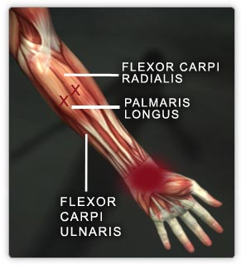
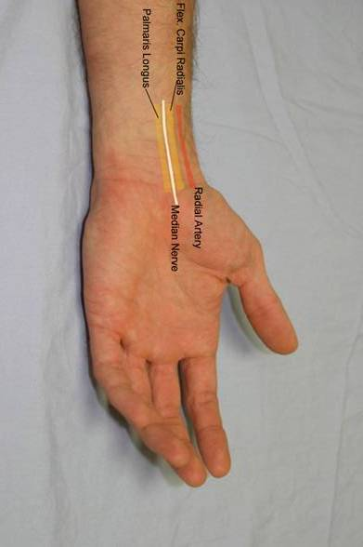

Slide 29

Alternatively pressure can be applied by
wearing an elasticised band with a 1 cm round plastic protruding button centred over the
acupressure point.

Slide 30

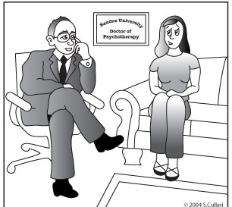
Hypnosis & Psychotherapy
Hypnosis has been reported to be helpful .
. Psychotherapy or or behavioural therapy can also be a useful adjunctive therapy, particularly if psychological sources of
anxiety are identified and can be ameliorated
In about 90% of all women hospitalized
for HG, symptoms ameliorate without any further therapeutic intervention.
Smith et al ,UpToDate January 2013

Slide 31
Complementary and Alternative Medications (CAM)
Ginger — RCT suggest that powdered ginger (1 to 1.5 grams in divided doses over 24 hours) is more effective than placebo, and equivalent to vitamin B6 (pyridoxine) for treatment of nausea and vomiting of pregnancy . No increased risk of adverse effects on pregnancy outcome has been reported .
Smith et al ,UpToDate January 2013

Slide 32

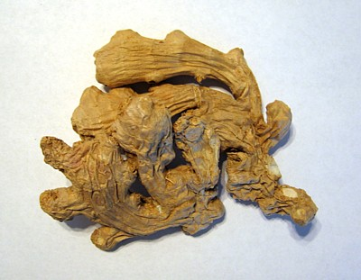
Ginger
Ginger containing foods (eg, ginger lollipops, ginger tea) or
Ginger supplements (eg, 250 mg capsules orally four times a day) for mild nausea and vomiting.
Smith et al ,UpToDate January 2013

Slide 33
What Is The Management of
Emesis of Pregnancy ?
1-Initial Approach
Dietary and lifestyle advices
& Non-pharmacologic TTT
2-Secondary Approach
First-line therapy
Second-line therapy
Smith et al ,UpToDate January 2013

Slide 34
Secondary Approach
If non-pharmacologic interventions fail, a reasonable approach is to consider the addition of pharmacotherapy with drugs that are reported to be effective and have the best maternal-fetal safety profile. If the initial drug is ineffective, other drugs are added in a step-wise progression
First-line therapy
Second-line therapy
Smith et al ,UpToDate January 2013

Slide 35
Management of Hyperemesis Gravidarum
1-Initial Approach
Dietary and lifestyle advices& Non-pharmacologic TTT
2-Secondary Approach
First-line therapy
Pyridoxine (vitamin B6)
Antihistamines (H1 antagonists)
Vitamin B6 & H1 antagonists combination
Smith et al ,UpToDate January 2013

Slide 36
Pyridoxine (vitamin B6)
It is most useful for mild disease rather than hyperemesis( 25 mg orally every 6-8 hours)
It has a good safety profile with minimal side effects and is a reasonable first-line treatment, either alone or in combination with antihistamines (H1 antagonists)
Smith et al ,UpToDate January 2013

Slide 37
Antihistamines (H1 antagonists
Meclizine (Postafen®) & Dimenhydrinate ( Dramamine® , Dramenex®):
1ry mechanism is H1 antagonists 2ry mechanism is on the vestibular system by& ↓stimulation of the vomiting center.
They appeared to have a protective effect on risk of malformations
Side effects include sedation, dry mouth, lightheadedness, and constipation
Smith et al ,UpToDate January 2013

Slide 38
Meclizine
FDA category B :
Dose: 25 mg orally /4-6 hours,
Meclizine has caused cleft palate in rats, but at
exposures far higher than those used therape-
utically.
Human data of an association between facial
and meclizine have been mixed, but three large
studies did not show an increased risk of
malformations
Smith et al ,UpToDate January 2013

Slide 39
Pyridoxine & H1 Antag. Combination
Pyridoxine (vitamin B6) & Antihistamines (H1 antagonists) combination :
Meclizine 25 mg (B) & Vitamin B6 50mg tab (A)
Navoproxin®
Dizirest B6 ®
Ezadoxin®
Postadoxin ®
Cyclizine Hcl 25 mg + vitamin B6 50mg tab
Emetrix ® tab
The combination appears to improve efficacy
(Egypt prohibit!)
Smith et al ,UpToDate January 2013

Slide 40
Management of Hyperemesis Gravidarum
1-Initial Approach
Dietary and lifestyle advices& Non-pharmacologic TTT
2-Secondary Approach
First-line therapy
Second-line therapy
Dopamine antagonists
1-Benzamides = Metoclopramide (Primperan ®)
2- Promethazine (Phenergan ®)
Smith et al ,UpToDate January 2013

Slide 41
Secondary Approach
Second-line therapy
Dopamine antagonists
1-Benzamides =Metoclopramide (Primperan ®) m10 mg orally, IV or IM (ideally 30 minutes prior to meal and at bedtime)
FDA Category B
No significant increase in risk of major congenital malformations, low birth weight, preterm delivery, or perinatal death compared with nonexposed infants
Matok I et al N Engl J Med. 2009;360(24):2528.
A large cohort study of 3458 infants
Smith et al ,UpToDate January 2013

Slide 42
Secondary Approach
Second-line therapy
Dopamine antagonists
2- Promethazine (Phenergan ®)10mg/8-h.It is primarily an H1 receptor blocking agent, but is also a weak dopamine antagonist.
There are conflicting reports for potential risk of neonatal respiratory depression and Neonatal platelet aggregation with using promethazine during labor in the newborn.
Available in Egypt as Phenergan ® 5mg /ml syrup .
Smith et al ,UpToDate January 2013

Slide 43
Case 2
An 18-year-old Gl at 10 weeks gestation complains of vomiting for the last 2 weeks.
She had received : Dizirest B6 ,the Primperan amp but the vomiting became intractable over the past 5 days
What is the Differential Diagnosis ?

Slide 44
What is the Differential Diagnosis ?
Pregnancy Induced Causes
Hyperemesis Gravidarum
Gastrointestinal causes
Appendicitis
Diaphragmatic hernia
Gastroenteritis
Iron medication

Slide 45
What is the Differential Diagnosis ?
Hepatitis or cholecystic disorders
Ileus and subileus
Pancreatitis
Stomach cancer
Stomach ulcer or duodenal ulcer
Metabolic causes
Addison's disease
Diabetic ketoacidosis
Hyperthyroidism
Pyelonephritis

Slide 46
Diagnosis
HG is considered when all other causes of
persistent nausea and vomiting are ruled out.
( The Differential Diagnosis )
Nausea and vomiting that develop after 10 weeks
of gestation are not likely due to HG.
Investigation for :
1-The diagnostic work-up must always start with
confirmation of a viable, intrauterine pregnancy.
2-Investigation to exclude other causes of vomiting.
3-Work-up of severe HG where starvation and fluid
imbalance can be encountered .

Slide 47
Case 2 : History
Vomiting in 3-4 episodes (3-5 times for every episode)
Loss of weight (3 KG) in the last month
No history of GIT D. , iron therapy
No diarrhea or abdominal colic
No history of diabetes, thyroid ,or suprarenal diseases

Slide 48
Case 2: Examination
On Exam. :
Lethargic female 62KG
Temp 36.2°, BP 100/60, HR 90, RR 20
Chest heart :Free.
Abdominal examination : No masses ,tenderness or rigidity

Slide 49
What Is The Most Likely Diagnosis ?
Case 2
Hyperemesis Gravidarum

Slide 50
What are the Appropriate Investigation ?
Case 2
FBC =CBC
MSU: Midstream Urine
US :Scan uterus & Liver
LFTs, :ALT (SGOT)& AST(SGPT)
TFTs : TSH & Free T4
E: Electrolytet
Davide &Luesley Ob-Gyn An Evidence Based Text fo MRCOG 2010

Slide 51
Investigation
Case 2
CBC: Hb12.3 gm ,WBC 12.000,Plt15,000
MSU: No abnormal finding
US : Pelvises Twines Living 10 w GA
US: No GB or ,liver or other abnormalities
LFTs, :SGOT 28 u& SGOPT 25u
TFTs : TSH m3.5 mu?ml & Free T4 1.4 ng/Dl

Slide 52
Case 2
Clinical Data
An 18-year-old Gl at 10 weeks gestation complains of vomiting for the last 2 weeks.
She had received : Dizirest B6 ,the Primperan amp but the vomiting became intractable over the past 5 days

Slide 53
Which Of The Following Indicate A More Serious Diagnosis Of HG?
a.Hypothyroidism
b.Hypokalemia
c.Weight gain
d.Proteinuria
e.Diarrhea
b

Slide 54
(Cunninham, pp 1050-1052.) Hyperemesis gravidarum is intractable vomiting of pregnancy and is associated with disturbed 1
nutrition. Early signs of the disorder include weight loss (up to 5% of Ibody weight) and ketonuria. Electrolyte abnormalities can also be present.
Because vomiting causes potassium loss, electrocardiographic evidence of potassium depletion, such as inverted T waves and prolonged QT and PR intervals, is usually a later finding, jaundice also is a later finding and is probably caused by fatty infiltration of the liver; occasionally, acute hepatic necrosis occurs. Metabolic acidosis is rare. Hypokalemic nephropathy with isosthenuria may occur late.

Slide 55
Hypoproteinemia also may result, caused by
poor diet as well as by albuminuria. Patients who have hyperemesis gravi-
darum are best treated (if the disease is early in its course) with parenteral
fluids and electrolytes, sedation, rest, vitamins, and antiemetics if necessary.

Slide 56
In some cases, isolation of the patient is necessary. Very slow reinstitution of
oral feeding is permitted after dehydration and electrolyte disturbances are
corrected. Therapeutic abortion may be necessary in rare instances; how- ever, the disease usually improves spontaneously as pregnancy progresses.

Slide 57
Hyperemesis Gravidarum

Slide 58
Hyperemesis gravidarum (HG)
Definition
It is defined as vomiting sufficiently severe to
produce weight loss, dehydration, alkalosis from
loss of hydrochloric acid, and hypokalemia.
It is the occurrence of >3 episodes of vomiting /D
with ketonuria and >3 kg or 5% weight loss.
The diagnosis is usually made clinically following
exclusion of other causes.
Incidence :0.3-3% & 20% need hospitalization
Cunningham et al Williams Obstetrics, 23e > Chapter 8 2010
Jueckstock et al. BMC Medicine 2010, 8:46

Slide 59
Etiology of HG
Not well known .
Adaptation that prevents the intake of potentially
noxious food (5400 women,21 studies) show that
most of them prefer food that are less likely toxic .)
Risk factors for Hyperemesis gravidarum include:
↑High HCG (GTD) , ↑T4, ↑ E2, ↑ Progesterone
Diabetes, Obesity & Nuliparty, GIT illnesses &Asthma
Previous molar pregnancy
GIT illnesses , asthma, obesity, metabolic disorders
Helicobacter pylori infection
Psychological :Anorexia N.,bulimia&H.of f migration

Slide 60
Human chorionic gonadotrophin( HCG)
↑HCG level is the most likely endocrine factor for
the development of Hyperemesis gravidarum( HG.)
This conclusion is based on observed associations of:
Molar pregnancy
Multiple pregnancies
HG symptoms is highest at the time of HCG peak
at pregnancy (around 9 weeks gestation)
It may be a hyper response to HCG

Slide 61
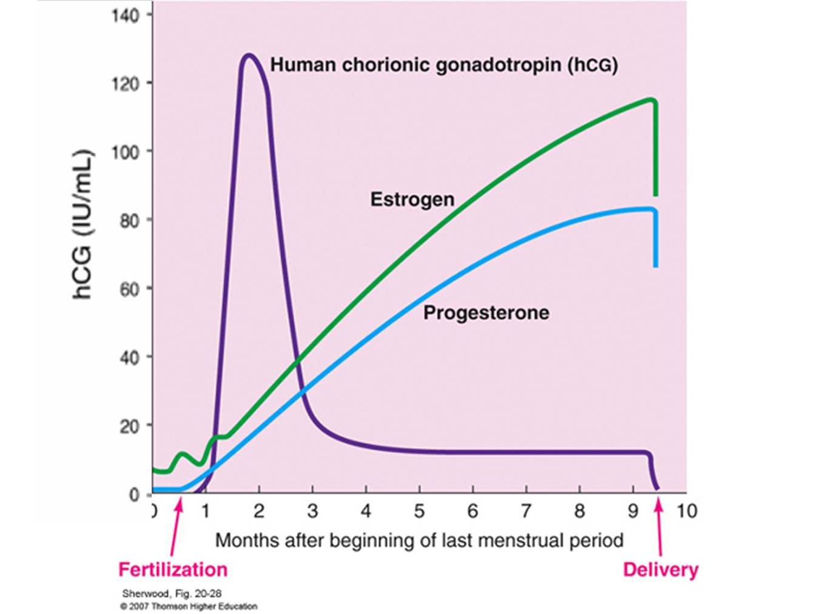

Slide 62
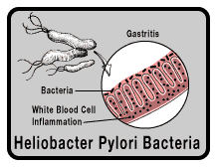
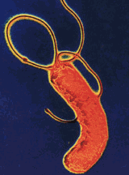
Helicobacter pylori Infection
It is a spiral-shaped gram negative
rods found on gastric mucosa .
It causes a non-invasive infection of the gastric epithelium and the mucous layer that coats this epithelium→chronic active gastritis.
Pregnancy: The elevated serum steroid hormone and HCG leads to a shift in pH and the altered humoral and cell-mediated immunity enhance the activity of the Helicobacter pylori
Emam et al Ob Gyn 2003

Slide 63
Helicobacter pylori Infection
Marked response with erythromycin in 2 studies
El Younis et al . Am J Perinatol 1998,,534-15;533
Jacoby et al. Am J Perinatol 1999, 16:85-88.
Good response with combination of :
Amoxicillin
Metronidazole
H2 receptors antagonist as: Cimetidine (Tagamet®), Famotidine (Pepcid)or Ranitidine.
(Paranteral 3 days then oral for 10-14 days)
Emam et al Ob Gyn 2003
Triple regimen group: Clarithromycin (Clarithro) , Amoxicillin &Omeprazole (Losec®)
Bahremand et al,Medical Journal of the Islamic Republic of Iran 19,1,29-31, 2005

Slide 64
Helicobacter pylori Infection
An association of H. pylori infection at pregnancy
has been proposed, but evidence is not conclusive
Although the analysis indicated an association
between H. pylori and hyperemesis,
heterogenicity between study groups was
extensive.
Certainly, the "cocktail(s)" required for eradication
would most likely cause vomiting in most women.
Goldberg et al , Obstet Gynecol 110:695, 2007 systematic review of 14 case-control studies.

Slide 65
Assessment
History: Pregnancy (LMP, dates, progress to date,
previous pregnancies).
Frequency & timing of symptoms.
Ability to eat/drink
Weight gain/loss.
TTT tried.
Past medical history, allergies, any
supplements/medications, etc.
Examination: Dehydration, weight loss, postural hypotension, tachycardia, collapse, ketosis.

Slide 66
Diagnosis
HG is considered when all other causes of
persistent nausea and vomiting are ruled out.
( The Differential Diagnosis )
Nausea and vomiting that develop after 10 weeks
of gestation are not likely due to HG.
Investigation for :
1-The diagnostic work-up must always start with
confirmation of a viable, intrauterine pregnancy.
2-Investigation to exclude other causes of vomiting.
3-Work-up of severe HG where starvation and fluid
imbalance can be encountered .

Slide 67
Markers of Severity
Weight loss >10 %
Abnormal thyroid function tests with:
↑Free thyroxine (T4)
↓ thyroid-stimulating hormone (TSH)
Abnormal liver function tests :
↑ SGOT
↑ SGOPT

Slide 68
Maternal Complication
Electrolyte and acid-base imbalance:
Hypokalemia
Hypochloremia
Metabolic alkalosis
Ketosis if caloric intake is minimal.
Hemoconcentration
Impaired liver enzyme
Mild hyperthyroidism
Smith et al ,UpToDate January 2013

Slide 69
Life-Threatening Complications of Resistant Hyperemesis Gravidarum
Depression—cause versus effect?
Esophageal ruptureBoerhaave syndrome
Hypoprothrombinemia—vitamin K
Hyperalimentation complications
Mallory-Weiss tears—bleeding
pneumothorax, pneumomediastinum,
pneumopericardium
Renal failure—may require dialysis
Wernicke encephalopathy —thiamine deficiency
Cunningham et al Williams Obstetrics, 23e > Chapter 8 2010

Slide 70
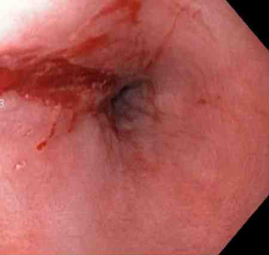
Endoscopic view of Mallory-Weiss tear.

Slide 71
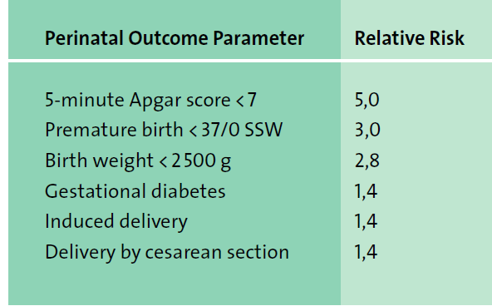
Perinatal outcome of Hyperemesis Gravidarum

Slide 72
Management of
Hyperemesis Gravidarum

Slide 73
Management of Hyperemesis Gravidarum
1-Initial Approach
Dietary and lifestyle advices& Non-pharmacologic TTT
2-Secondary Approach
First-line therapy
Second-line therapy
Third line therapy
Adjunctive therapy
Fluids and nutrition
3-Refractory Patients
4-Management of stable and improving patients
Smith et al ,UpToDate January 2013

Slide 74
Management of Hyperemesis Gravidarum
1-Initial Approach
Dietary and lifestyle advices& Non-pharmacologic TTT
2-Secondary Approach
First-line therapy
Pyridoxine (vitamin B6)
Antihistamines (H1 antagonists)
Vitamin B6 & H1 antagonists combination
Smith et al ,UpToDate January 2013

Slide 75
Management of Hyperemesis Gravidarum
1-Initial Approach
Dietary and lifestyle advices& Non-pharmacologic TTT
2-Secondary Approach
First-line therapy
Second-line therapy
Dopamine antagonists
1-Benzamides = Metoclopramide (Primperan ®)
2- Promethazine (Phenergan ®)
Smith et al ,UpToDate January 2013

Slide 76
Secondary Approach
Women without dehydration
Additional oral medications can be initiate
Non-oral routes of administration
Second-line therapy
Dopamine antagonists Metoclopramide &Benzamides
Third line therapy
Serotonin antagonists :Ondansetron
Hospitalization Fluids and nutrition : Dehydration, electrolyte abnormalities, acid-base abnormalities
Smith et al ,UpToDate January 2013

Slide 77
Secondary Approach
Third line therapy
Dopamine antagonists
Serotonin antagonists
Ondansetron (
Zeforan ® amp & tab 4&8 mg/8hours
hyperemesis is a common unlabeled indication for use.
FDA Category B
Side effects: Headache, fatigue, constipation, and drowsiness
Smith et al ,UpToDate January 2013

Slide 78
Hospitalization
In patients with more severe dehydration or
ketonuria, inpatient admission is required.
The primary therapeutic step is total food
withdrawal & quick and sufficient rehydration
(Volume and electrolyte replacement (at least 3 L/day)
Sometimes hospitalization alone may be
improve symptoms ('holding function') because it may provide psychological relief.
Jueckstock et al. BMC Medicine 2010, 8:46

Slide 79
Hospital Admission, When?
Severe vomiting with :Weight loss, ketonuria, dry mucous membranes, poor skin turgor, dehydration, hypotension, alkalosis from hydrochloric acid loss, hypokalemia, or nutritional deficiencies are admitted to the hospital
Persistent vomiting after rehydration and fail outpatient management.
Smith et al ,UpToDate January 2013

Slide 80
Protocol For The Management of Hyperemesis : Investigation
E: Electrolyte
FBC =CBC
LFTs, :SGOT& SGOPT
TFTs : TSH & Free T4
MSU: Midstream Urine
US :scan uterus & Liver
Davide &Luesley Ob-Gyn An Evidence Based Text fo MRCOG

Slide 81
Hospitalization
In patients with more severe dehydration or
ketonuria, inpatient admission is required.
The primary therapeutic step is total food
withdrawal & quick and sufficient rehydration
(Volume and electrolyte replacement (at least 3 L/day)
Sometimes hospitalization alone may be
improve symptoms ('holding function') because it may provide psychological relief.
Jueckstock et al. BMC Medicine 2010, 8:46

Slide 82
Hospital Admission, When?
Severe vomiting with :Weight loss, ketonuria, dry mucous membranes, poor skin turgor, dehydration, hypotension, alkalosis from hydrochloric acid loss, hypokalemia, or nutritional deficiencies are admitted to the hospital
Persistent vomiting after rehydration and fail outpatient management.
Smith et al ,UpToDate January 2013

Slide 83
Hospital Admission, When?
In women with persistent vomiting after hospitalization, it is important to exclude underlying diseases that can cause hyperemesis
Smith et al ,UpToDate January 2013

Slide 84
Protocol For The Management of Hyperemesis
Fluid
Normal saline 1 L/ 8-hourty
20-40 mmol KCI/8-hourty
Vitamin
Thiamine orally 25-50 mg tds or
Thiamine intravenously 100 mg in
100 mL normal saline weekly
Davide &Luesley Ob-Gyn An Evidence Based Text fo MRCOG

Slide 85
Common IV Vitamin B in Egypt
vitamin B1 (Thiamin Hcl) 10 mg
vitamin B2 (Riboflavin) 5.47 mg
vitamin B3 (Nicotinamide) 40mg
vitamin B5 (D-Panthenol) 6mg
vitamin B6 (Pyridoxine Hydrochloride) 4 mg
vitamin B1 (Thiamin Hcl) 10 mg
vitamin B2 (Riboflavin) 5.4 mg
vitamin B3 (Nicotinamide) 40mg
vitamin B5 (D-Panthenol) 3 mg
vitamin B6 (Pyridoxine Hydrochloride) 4 mg
B-Com ® amp (Amoun)
Becozym ®amp (Bayer)

Slide 86
Rehydration Therapy
The optimum replacement fluid regimen has not been studied
Up to 2 L IV Ringer’s lactate infused over
3-5 hours supplemented with appropriate
electrolytes and vitamins.
Subsequently, the infusion rate is adjusted
to maintain a urine output of at least 100
mL/h changed to dextrose 5% in 0.45% saline.
Smith et al ,UpToDate January 2013

Slide 87
Treatment of Hypokalemia
Normal S. potassium levels :3.5 - 5.0 mEq/L
Severe hypokalemia (<3.0 mEq/L) may
Require IV supplementation.
Typically, a saline solution is used, with
Potassium chloride
Maximum infusion rate: 10 mEq/hour
Maximum concentration: 40 mEq/L
Maximum 24-hour dose: 200 mEq

Slide 88
Rehydration Therapy
Dextrose infusion is delayed until after the patient has received thiamine in her initial rehydration fluid to avoid the theoretical concern of Wernicke’s encephalopathy with dextrose infusion in a thiamine-deficient state .
Davide &Luesley Ob-Gyn An Evidence Based Text fo MRCOG

Slide 89
Management of Hyperemesis Gravidarum
1-Initial Approach
Dietary and lifestyle advices& Non-pharmacologic TTT
2-Secondary Approach
First-line therapy
Second-line therapy
Third line therapy
Adjunctive therapy
Fluids and nutrition
3-Refractory Patients
4-Management of stable and improving patients
Smith et al ,UpToDate January 2013

Slide 90
Parenteral Nutrition Via Peripheral
Venous or CV Access
Main infusion
500 ml Glucose 5% : Speed 50 ml/h
Adjuvant (daily dose)
200 mg vitamin B1 (thiamin chloride),
200 mg vitamin B6 (pyridoxine),
200 μg vitamin B12 (cyanocobalamine),
2000 mg vitamin C (ascorbic acid)
Jueckstock et al. BMC Medicine 2010, 8:46

Slide 91
Common IM Vitamin B in Egypt
vitamin B1 200 mg
vitamin B6 100 mg
vitamin B12 1000 μg
vitamin B1 100 mg
vitamin B6 40 mg
vitamin B12 1000 μg
Neuroton ® amp (Amoun)
Tri - B ® amp
(El-Nil)

Slide 92
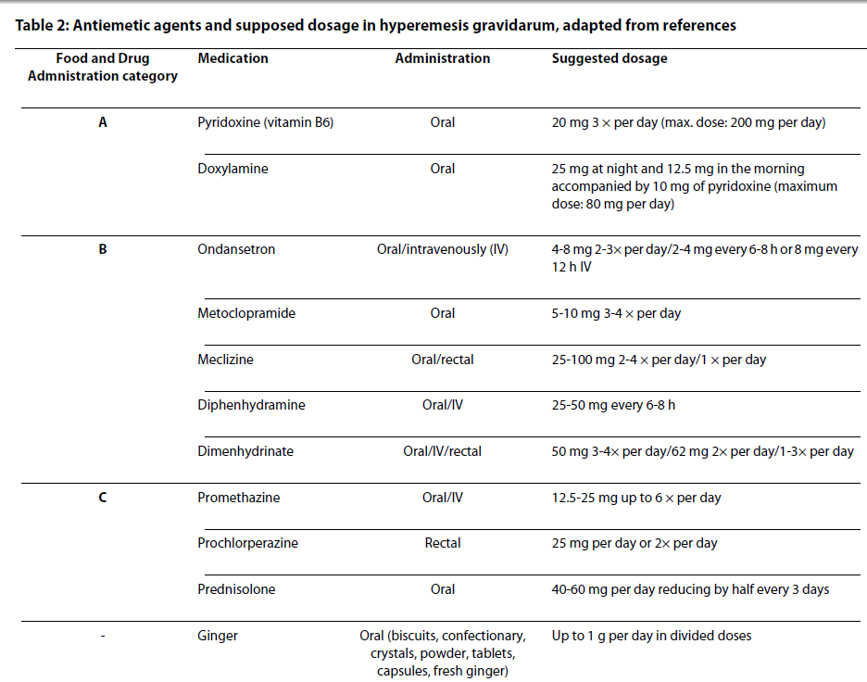

Slide 93
Refractory Patients
Chlorpromazine (25 to 50 mg IV or IM or intramuscularly or 10 to 25 mg orally /6 h to be helpful in refractory cases.
A rectal suppository may be available in some countries.
Adverse effects include extrapyramidal reactions, orthostatic hypotension, anticholinergic effects, and altered cardiac conduction.
Glucocorticoids
Enteral and parenteral nutrition
Smith et al ,UpToDate January 2013

Slide 94
Glucocorticoid
An effective dose is methylprednisolone (16 mg) intravenously every 8 hours for 48 to 72 hours
Glucocorticoid use has been associated with a slightly increased risk of oral clefts when the drug is administered before 10 weeks of gestation; therefore, ideally, use of glucocorticoids should be avoided in the first trimester .
If administered after 10 weeks, the palate has formed and is not at risk for developing defects.
Smith et al ,UpToDate January 2013

Slide 95

Nasogastric Feeding Tubes
Nasogastric feeding tubes is an another
alternative with advantage of cost effectiveness .
.In order to determine whether an underlying
Helicobacter pylori testing may be performed. I
In the event of a positive result, H2 blockers
( cimetidine) or proton pump inhibitors (
omeprazol) can be added
to infusions
Jueckstock et al. BMC Medicine 2010, 8:46

Slide 96
Management of stable & improving patients
Continue the drug regimen that has been effective until the patient has been completely asymptomatic (no nausea or vomiting) for at least a week.
If nausea and vomiting recurs, resume therapy. The majority of women will have resolution of nausea and vomiting by 16 to 20 weeks of gestation and will be able to discontinue their medications.
Rare patients require therapy beyond 20 weeks
Smith et al ,UpToDate January 2013

Slide 97
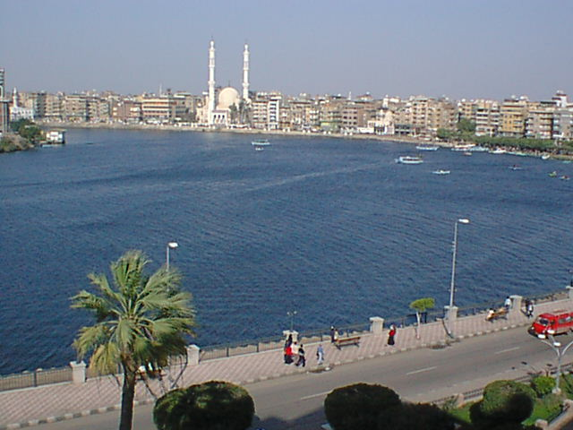
Thank You

Slide 98
49-7. Which of the following findings would be expected in women with hyperemesis gravidarum?
    a. hematocrit <30 vol%
    b. creatinine 0.3 mg/dL
    c. ALT 86 IU/L
  d. K+ 5.8 mEq/L
49-7. c
williamc

Slide 99
49-8. Which of the following complications in pregnancy are increased in women with a female fetus?
      a. cholelithiasis
    b. hepatitis
      c. reflux esophagitis
    d. hyperemesis gravidarum
49-8. d

Slide 100
49-9. Which of the following vitamin deficiencies is associated with hyperemesis?
        a. vitamin A
      b. vitamin B
        c. vitamin C
        d. vitamin K
49-9. d

