Slide 1

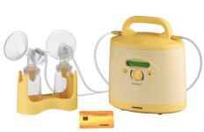
Induction Of Lactation In Fostering Mothers
Dr Muhammad El Hennawy
Ob/gyn Consultant
59 Street - Rass el barr –dumyat - egypt
www.mmhennawy.co.nr
Mobile 0122503011

Slide 2

Breastfeeding is commonly accepted as the preferred method of infant nutrition for various reasons, both nutritional and emotional.
For some who have become parents by adoption, there is a strong desire to induce lactation for adoptive nursing.

Slide 3
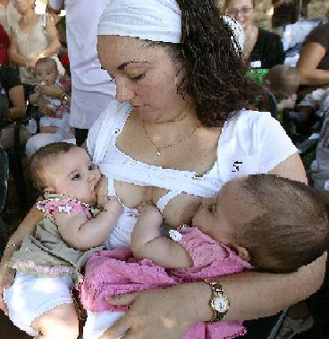
There is little in the medical literature on how to induce lactation.
The few studies available are small and were mostly done in women who had completed a pregnancy. There is even less known about how the herbal supplements work to increase lactation. These are areas of potential future research

Slide 4
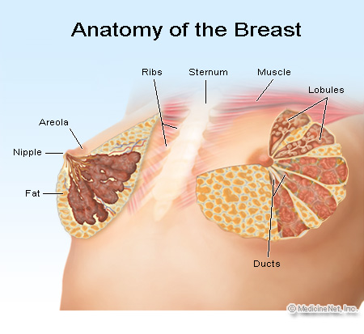
What is the breast?
The breast generally refers to the front of the chest and medically specifically to the mammary gland.
(The word "mammary" comes from "mamma," the Greek and Latin word for the breast, which derives from the cry "mama" uttered by infants and young children, sometimes meaning "I want to feed at the breast.")

Slide 5
several hormones work together in pregnancy to induce the breast change that are conducive to lactation.
Although estrogens stimulate the ductal epithelial cells to elongate their primary role appears to be to potentiate prolacti production.
Progesterone induces duct formations that branch from the main tubules. It is also considered the key inhibiting hormone, and the fall in progesterone on delivery of the placenta is the trigger for secretion of milk.
Human placental lactogen (HPL) is associated with mobilization of free fatty acids, inhibition of peripheral glucose utilization and stimulation of colostrum secretion.
Prolactin is the essential hormone in lactation, and attempts to induce lactation largely center on increasing prolactin. Prolactin is necessary for complete lobulo-alveolar development. It stimulates milk production and secretion from alveolar cells. Together with estrogen and progesterone, it attracts and retains IgA immunoblasts to the mammary tissue for development of the mammary gland immune system. The production and release of prolactin is dependent on the inhibition of prolactin inhibitor factor (PIF) secreted by the hypothalamus. PIF is dopamine mediated.
Oxytocin is responsible for the milk ejection reflex. It does not contribute to milk production directly.
Other hormones involved in breast development include growth factor, insulin, and corticosteroids. These hormones work together in a complex system of interactions.

Slide 6
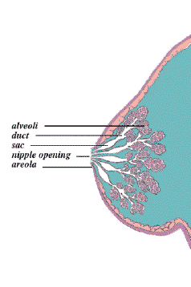
The most important physiologic component of the lactation process is nipple stimulation.
Nipple stimulation causes the production and release of prolactin from the pituitary gland.
Nipple stimulation, as well as auditory, olfactory and visual cues,induces oxytocin release.
These hormones stimulate milk synthesis and milk ejection.
Although prolactin is necessary for milk secretion, prolactin levels do not directly correlate with milk volume.
More importantly, local factors within the mammary gland that depend on milk removal are responsible for the day-to-day regulation of milk volume. When milk is not removed, secretion stops in a few days.
Thus suckling, emptying the breast and adequate precursors are essential to effective lactation

Slide 7
Protocols For Induction
a variety of recommendations on how to induce lactation.
If a woman is aware of the estimated placement date, It may take several weeks or months of preparation (long protocol) to obtain results prior to the arrival of the infant.
If placement is quick and there is no time for preparation ( short protocol ) , she can nurse with one of the available supplementers

Slide 8
How ?
Before nursing
Estrogen & Progesterone
Medical galactagogue
Herbal galactagogue
Nipple Stimulation
After nursing
Medical galactagogue
Herbal galactagogue
Nipple Stimulation
The drop and drip method
The Supplemental Feeding Devices

Slide 9
Estrogen and Progesterone
Estrogen and progesterone levels can be raised by using hormone supplementation.
Popular protocols use a combination oral contraceptive pill, usually one with a higher progestin effect.
These hormones are used to induce structural changes in the breast tissue, but they impede lactation. Therefore after breast changes have occurred but before nursing, they must be stopped.
The effect is similar to parturition and delivery of the placenta.

Slide 10
Galactogogues
Galactogogues are medications or other substances that are used to induce, augment, or maintain adequate milk production
Most exert their pharmacologic effects through interactions with dopamine receptors, resulting in increased prolactin levels and thereby augmenting milk supply.
Metoclopramide remains the galactogogue of choice due to its documented record of efficacy and safety in women and infants.
Domperidone crosses the blood brain barrier and into the breast milk to a lesser extent than metoclopramide, decreasing the risk of toxicity to both mother and infant possibly making it an attractive alternative.
Traditional antipsychotics, sulpiride and chlorpromazine, have been evaluated, but adverse events limit their use.
Human growth hormone, thyrotrophin-releasing hormone, and oxytocin have also been studied.
Finally, a natural product, fenugreek, has been purported to be effective in anecdotal reports. Use of this agent may be warranted after considering risks versus benefits

Slide 11
INDICATIONS FOR GALACTOGOGUES
Common indications for galactogogues are adoptive nursing (induction of lactation in a woman who was not pregnant with the current child),
Relactation (reestablishing milk supply after weaning), and increasing a faltering milk supply because of maternal or infant illness or separation. Mothers who are not directly breastfeeding but are expressing milk by hand or with a pump often experience a decline in milk production after several weeks.
One of the most common indications for galactogogues is to augment a declining milk supply in mothers of preterm or ill infants in the neonatal intensive care unit.

Slide 12
Metoclopramide = Plasil
Metoclopramide antagonizes the release of dopamine, which in turn inhibits the effect of PIF on the pituitary. Consequently prolactin production increases. Because metoclopramide crosses the blood-brain barrier, its use can be limited by significant CNS side effects. Sedation is the most common side effect, occurring in up to 10% of users. Depression occurs less frequently. Extrapyramidal side effects, such as tardive dyskinesia (~1%), can occur and are more common in women and children.
Although the medical literature reports a low incidence of depression, the widely held belief among women seeking to induce lactation is that depression is a very significant and common side effect. Therefore, many women choose to seek other alternatives

Slide 13
Domperidone =Motilium
Domperidone, like metoclopramide, is a dopamine antagonist. Side effects are few and include dry mouth, skin rash or itching, headache, and gastrointestinal disturbances. Unlike metoclopramide, domperidone does not cross the blood-brain barrier but exerts its effect peripherally and is associated with few CNS side effects. The pituitary is outside the blood-brain barrier and is affected by the increased dopamine levels. There have been rare case reports of dystonia with domperidone compared with metoclopramide. Domperidone is not available commercially in the United States.[5,6]
In July 2004, recognizing that many women were using domperidone to increase milk production, the FDA issued a warning against importing and using domperidone for any use, including lactation
The warning is based on published reports of cardiac arrhythmias and sudden death in patients treated with intravenous domperidone
Some, but not all, of these patients received doses above the manufacturer's recommended dose. Most of the patients were also being treated simultaneously with various chemotherapy drugs. At least one study on animal hearts demonstrated prolongation of cardiac repolarization with doses of domperidone used clinically.
Although in controlled trials metoclopramide was not associated with cardiac arrhythmias, there have been case reports of arrhythmias and heart block with therapeutic doses of it as well.

Slide 14
Sulpiride = Dogmatil
Sulpiride is a selective dopamine-2 antagonist with an antipsychotic (neuroleptic) medication not available in the United States that acts as a galactogogue by increasing prolactin-releasing hormone from the hypothalamus. Two studies have shown an increase in milk supply over placebo. Maternal side effects may include the extrapyramidal effects listed above for metoclopramide and possibly weight gain. The suggested dosage is 50 mg two or three times daily.

Slide 15
Chlorpromazine
Chlorpromazine is also an antipsychotic that appears to work by blocking dopamine receptors.
Side effects commonly include dystonic reactions and anticholinergic effects

Slide 16
Thyrotropin Releasing Hormone (TRH)
Thyrotrophin-releasing hormone (TRH) is used in the United States to assess thyroid function. It causes the release of both thyroid-stimulating hormone (TSH) and prolactin from the pituitary.
The most recent study suggests short-term use is both safe and effective, but long-term use has not been evaluated. Dosage was one spray (1 mg TRH) 4 times daily.
Other studies used IV (200 μg) or oral (5 mg) forms.32 TRH is not commonly used.

Slide 17
Human growth hormone
One randomized, double-blind, placebo-controlled trial of human growth hormone in a dose of 0.1 IU/kg/day subcutaneously noted a significant increase in milk volume by day 7 in 16 healthy lactating women.
There were no documented changes in milk composition or side effects reported in the mothers.
The usefulness of this expensive, injectable galactogogue appears limited

Slide 18
Oxytocin
Oxytocin nasal spray has been used in early lactation with some success in enhancing let-down (Newton and Egli, 1958 ),
although it has no effect on the secretion of prolactin. Therefore it could be considered once lactation has been initiated.
It has been associated with an easier establishment of breast-feeding and an improvement of milk production in puerperal women (Huntingford, 1961 ). Women using oxytocin nasal spray for induction of lactation were divided on the efficacy of its use, but often reported that the milk ejection response was more likely to occur if it was used in conjunction with nipple stimulation (Auerbach and Avery, 1981

Slide 19
Psychological factors
It can influence the prolactin and oxytocin reflexes
it has been suggested that confidence and a strong desire to lactate are important components of success (Lawrence, 1994; Nemba, 1994).
Support from her partner, family and friends for the mother in her attempt to breast-feed is essential (Lawrence, 1994).
This should be supplemented by professional support but unfortunately most clinicians are not familiar with the principles of induced lactation. Professional help is however available from qualified lactation consultants (International Board of Certified Lactation Consultants

Slide 20
Herbal Galactagogues
Fenugreek, Blessed Thistle, Brewers Yeast, Alfalfa are among a number of herbs that will help milk production increase. Alfalfa is known to have a few side effects – including alcohol production so it is best to speak with a trained naturopath or GP before trying this
The addition of herbs to augment milk supply is largely based on anecdotal evidence. Among the herbs mentioned above, fenugreek and blessed thistle appear more often in the popular protocols

Slide 21
Fenugreek
Fenugreek, Trigonella foenumgraecum, is an herb from the Fabaceae family, which includes peas and peanuts. This herb is very commonly recommended on breastfeeding web sites and references as a supplement to increase lactation.
The active ingredients are thought to be in the seed, although the mechanism of action is not clear. It is considered "possibly safe" when used in medicinal amounts, although it is considered "possibly unsafe" in children.
Side effects include diarrhea and flatulence, but the most noticeable is a body odor similar to maple syrup. There is also the potential for allergies because it is part of the pea family

Slide 22
Goat’s Rue
Goat’s Rue (Galega officinalis) is a traditional galactogogue, widely recommended in Europe, based on observations of increased milk supply when fed to cows in the 1900s. No controlled human trials have been done, and no adverse effects have been reported with the following possible exception:
Maternal ingestion of a lactation tea containing extracts of licorice (Glycyrrhiza glabra), fennel, anise, and goat’s rue was linked to drowsiness, hypotonia, lethargy, emesis, and poor suckling in two breastfed neonates. An infection work-up was negative, and symptoms and signs resolved on discontinuation of the tea and a 2-day break from breastfeeding.
The tea was not tested for contaminants or adulterants, and there have been no other adverse events reported in Europe or South America, where the herb is also used as a hypoglycemic agent. It is usually used as a tea (1 tsp dried leaves steeped in 8 oz water for 10 minutes) with 1 cup taken three times a day

Slide 23
Blessed Thistle
Blessed thistle, Cnicus benedictus, is another herb recommended to enhance lactation. It is distinctly different from milk thistle.
It is a member of the Asteraceas/Compositae family, which includes ragweed. Many parts of the plant are used to treat various ailments. The plant may have bacteriostatic, antitumor, and antihistamine activity.
How it works to enhance lactation is unknown. Blessed thistle is thought to be possibly safe when used medicinally.
Side effects include gastrointestinal irritation and potential allergies, because it is part of the ragweed family.
Many other herbs are reported to aid in lactation but are not suggested with quite the frequency as the aforementioned. Some of these include milk thistle, fennel, alfalfa, oats, and marshmallow root.

Slide 24
Nipple Stimulation
The cornerstone of any induction protocol is nipple stimulation (evidence level C, uncontrolled, case studies).
In fact, some protocols give no recommendations other than frequent nipple stimulation, usually every 2 to 3 hours, to mimic the nursing habits of newborns.
Nipple stimulation, via suckling or manual stimulation, initiates release of prolactin from the anterior pituitary and oxytocin from the posterior pituitary gland.
The release of prolactin from the anterior pituitary stimulates the production and secretion of breast milk, while the release of oxytocin from the posterior pituitary aids in the contraction of myoepithelial cells within the breast, resulting in milk letdown.
Stimulation can be done manually or with a breast pump.
Women report varying success with the different methods.
The popular wisdom is that using a double set up electric pump will give the best benefit and be the most time efficient. However, some women report better success with manual expression of the breast .

Slide 25
Suckling
In the beginning of the process, because there was little or no milk, the nipple would be coated with mashed fruits or other soft foods, and the infant would be placed at each nipple to suckle. The sweetness of the mashed fruit would serve to encourage the child to continue suckling until the volume of milk was high enough to sustain the infant, and also to temporarily supplement the nutritional needs of the child.

Slide 26
Manual Nipple Stimulation
Frequent nipple stimulation, usually every 2 to 3 hours, to mimic the nursing habits of newborns

Slide 27
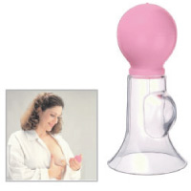
Simple Manual Breast Pump
Safe and easy to use.
-Adapts to most breast sizes.
-Polycarbonate horn and silicone sucking ball that are sterilize-able.

Slide 28
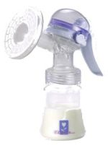
Manual Breast Pumps
Advantages
Their small size makes them convenient to pack and carry on a trip
Allows you to control the suction more directly since you are the one pumping
They are quieter than electric breast pumps
Disadvantages
It takes a long time to express your breast milk
Some women find that they are unable to empty breast fully which can lead to a lower milk supply
They are tiring to use. You have to provide all the power

Slide 29
Double pumping
Expressing simultaneously from both breasts, cuts milk expression time in half and increases prolactin levels and milk volume

Slide 30
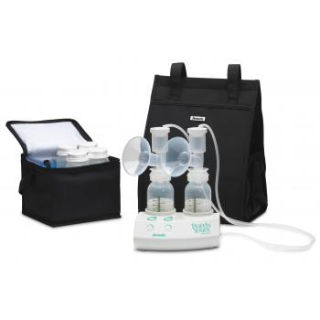
Double Electric Breast Pumps
Advantages
Pumping is quick and efficient with these electric models. If you are pumping often, it will make you experience much less bothersome
Most models allow for pumping both breasts at once which make things even faster
Electric models yield more breast milk than manual models. It will help increase your milk supply
Disadvantages
These models are significantly more expensive
They can be noisy
They can be heavy and cumbersome to pack and carry along with you

Slide 31
The Drop And Drip Method
An alternative to this is the drop and drip method to initiate suckling: milk is poured over the nipple drop by drop using a spoon and allowed to flow to the tip of the nipple

Slide 32
Syringe and Catheter
An alternative to this is the drop and drip method to initiate suckling: milk is poured over the nipple using syringe and catheter and allowed to flow to the tip of the nipple

Slide 33

The Supplemental Feeding Devices
Two popular devices are the SNS by Medela (McHenry, IL) and the Lact-Aid Nursing Training System (Lact-Aid International, Inc., Athens, TN)
Since frequent nursing encourages milk production, it is desirable to keep the baby at the breast for all feedings.
The best way to achieve both goals is to use a supplemental feeding device worn at the breast that delivers formula (or stored breast milk).

Slide 34
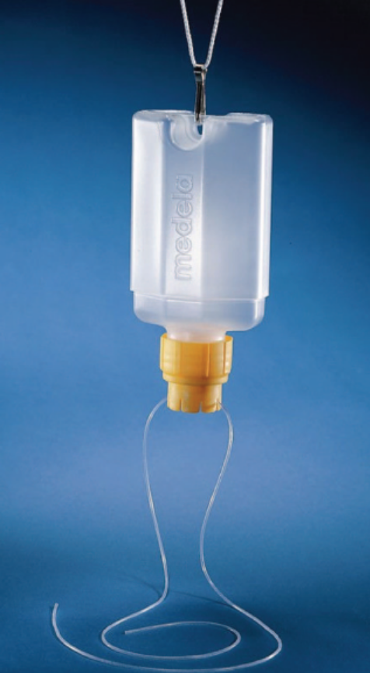
SNS by Medela
This system consists of a flexible tube attached to a bottle containing formula milk.
It is positioned near the mother's nipple, thereby providing nourishment for the infant while suckling at the breast, thereby stimulating milk production

Slide 35
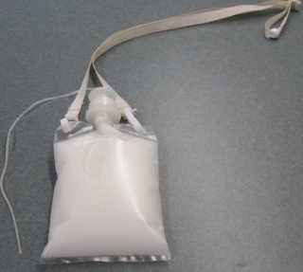
Lact-Aid Nursing Training System
This system consists of a flexible tube attached to a bag containing formula milk.
It is positioned near the mother's nipple, thereby providing nourishment for the infant while suckling at the breast, thereby stimulating milk production

Slide 36
Some Studies

Slide 37
Induction of lactation after adoption by a combination of nipple stimulation, the drop and drip method and metoclopramide 10 mg 8 hourly showed a 50% success rate (Banapurmath et al., 1993 ).

Slide 38
Metaclopramide in a dose of 10 or 15 mg three times a day has been shown to increase baseline prolactin levels and milk production in mothers of term and premature infants.
The mothers of the premature infants were expressing breast milk for their infants ( Ehrenkranz, 1986 , Kauppila, 1981 ).

Slide 39
Single doses of 5 mg and 10 mg of metoclopramide and 10 mg of domperidone were administered to nonpregnant women.
Prolactin levels were then measured at various time intervals. The findings of this study were that nulliparous women had a greater response (percentage of elevation above baseline) to the medications, having the greatest response to metoclopramide (10 mg).
Multiparous women had similar responses to all the medication doses

Slide 40
oral metoclopramide 10 mg three times daily; this was started for 3 month discontinued 1 week before the expected date of nursing
In addition to drug therapy, nipple stimulation was performed with an electric breast pump.

Slide 41
Placebo-controlled trials of metoclopramide found doses of 10 to 15 mg three times a day to be effective in increasing prolactin and milk production in women with lactation difficulties.
Similarly, a placebo-controlled study of domperidone 10 mg three times a day demonstrated increases in prolactin levels and milk production in women who were pumping milk for their infants in the NICU.
All these studies were short term (2 to 3 weeks).

Slide 42
One study of induced lactation using medications describes onset of milk production between 5-13 days.
This is similar to case reports of inductions using only nipple stimulation. At first, the mother may see only drops. During the time that milk production is building, women may notice changes in the color of the nipples and areolar tissue. Breasts may become tender and fuller. Some women report increased thirst, and changes in their menstrual cycle or libido.

Slide 43
The quality of milk and the physical means by which a woman lactates, after having artificially induced lactation, is identical to postpartum lactation with the exception of the production of colostrum.
Colostrum, which is normally produced for the first few days postpartum, is not produced during the process of induced lactation or relactation.
The only differences between induced lactation and postpartum lactation is the method by which the essential milk producing hormones are stimulated into production and the lack of colostrum.

Slide 44
Benefits To The Foster Mother
1.Certainly mothers have described that the act of breastfeeding helped them feel closer to their adopted child which may be at least partially due to the release of oxytocin during breastfeeding which promotes the development of maternal behavior (Uvnas-Moberg, 1996).
2.Alternatively it may be because breastfeeding requires mothers to maintain physical proximity to their child and to interact with them on a regular basis in a positive and intimate manner (Epstein, 1993).
3.Moreover, breastfeeding may help the mother cope with stress better as suckling at the breast has been associated with relaxation responses that have been measured via electroencephalograph (Cervantes et al 1992) and in decreased blood pressure and cortisol levels (Amico, 1994).

Slide 45
Some tips for naturally increasing your milk supply
•Increase your healthy, lean protein intake. This can mean lean meats, beans and legumes.
•Increase your fluids?that is water and whole juices. (Skip the caffeine and diet drinks, if possible.)
•Make sure that you are consuming enough calories daily. Remember, that just like when you were pregnant, breast feeding mamas need more calories than women who are not breast feeding.
•Get adequate rest.
•Don’t watch the clock while nursing. Nurse until your baby has finished one side, then offer the other side. (If he is full, offer that side at the next feeding. Pump if you need to relieve pressure, but still offer the un-nursed side at the next feeding.)
•If you can, take a “nursing vacation” even if it means just on the weekend, if you work out of the house. This means do nothing but nurse-on-demand, eat and drink healthy foods and beverages and rest. You may have to bring her to bed with you, or have her in the room with you. Delegate the household responsibilities to others and focus on your and your baby’s nourishment.
•Try pumping and nursing at the same time. (This is called switch nursing.) While nursing him on one side, pump the other side. Before he’s finished on that side, switch him and the pump.
•When you’re nursing (or pumping) make sure that you’re relaxed and calm.
•When you can and if you feel comfortable doing so, lose the bra (especially if it’s an under-wire bra). Ditching the bra will help encourage blood flow and promote good circulation. Your bra, no matter how “unstructured” it is, will constrict your breasts to some degree.
•Try massage. Work in a circular motion with your fingertips from your armpits down and from underneath them up and all around towards the center. Do this on each side. (It is a good idea to do this right before nursing or pumping.)
•Try nipple stimulation. Nipple stimulation releases into the bloodstream oxytocin, which is the hormone responsible for the milk ejection reflex.
•Try warm compresses or a rice-sock that has been warmed in the microwave for about 30 seconds before and during nursing or pumping.
•Get support and help from other breast-feeding mamas and/or a lactation consultant especially if your spouse/partner or family network is not as supportive as you need them to be.

