Slide 1
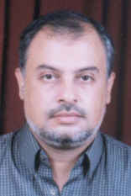
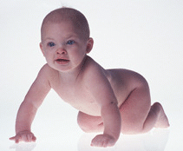
Cupping Therapy And Infertility
Dr Muhammad M El Hennawy
دكتور محمد محمد الحنا وى
Ob/gyn Consultant
Rass el barr central hospital and
dumyat specialised hospital
Dumyatt – EGYPT
www. Mmhennawy.co.nr

Slide 2
If you accept this lecture, take it as a science
If you not accept it, take it as a fun

Slide 3
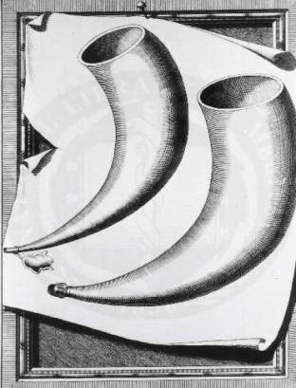
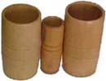
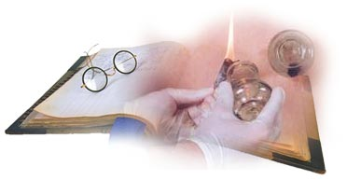
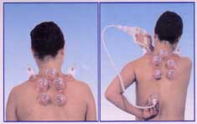

Cupping Therapy
Cupping is an ancient method of causing local congestion.
A partial vacuum is created in cups placed on the skin either by means of heat (old) or suction(recent).
This draws up the underlying tissues.
When the cup is left in place on the skin for a few minutes, blood stasis is formed and localized healing takes place.
Cupping therapy was originally used in Egypt and China dating back some 3,500 years
Cupping is applied by acupuncturists to certain Acupuncture points,
as well as to region of the organ or the area of dysfunction
as well as to regions of the body that are affected by pain (where the pain is deeper than the tissues to be pulled)

Slide 4
Types Of Cupping Therapy
Dry Cupping
Wet Cupping

Slide 5
Cupping has also been found to affect the body up to four inches into the tissues,
causing tissues to release toxins,
activate the lymphatic system,
clear colon blockages,
help activate and clear the veins, arteries and capillaries,
activate the skin,
clear stretch marks
and improve varicose veins.
Cupping is the best deep tissue massage available.
Cupping, the technique, is very useful and very safe,
being free from side effects and can be easily learned

Slide 6
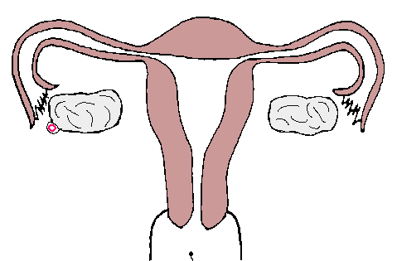
Infertility
Biologically, inability to procreate can be classified as
Infertility
  the inability of a couple to conceive after one year of unprotected intercourse (6 months for women over 35)
infecundity (the inability of a couple to produce a live birth)

Slide 7
Causes Of Infertility
  Female factor ~40%
  Male factor ~30%
  Combined ~30%
  AETIOLOGY
Sperm disorders 30.6%
Anovulation/oligoovulation 30%
Tubal disease 16%
Unexplained 13.4%
Cx factors 5.2%
Peritoneal factors 4.8%

Slide 8
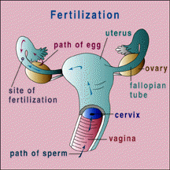
Female Infertility
Female
  Ovary
  Tube
  Corpus
  Cervix
  Peritoneum

Slide 9
Male Infertility
  Sperm count and function
  Ejaculate characteristics, immunology
  Anatomic anomalies

Slide 10
Female Infertility

Slide 11
Timing Of Treatment
around day 5 of the cycle until day 11 (induction-augmentation)
Ovulation phase (around day 12 of the cycle until day 16)--(triggering ovulation)
Luteal phase (around day 17 of the cycle until day 28)--(luteal phase support-improve implantation)

Slide 12
Ovulation Disorder stimulate follicle development It is likely that the hypothalamus-pituitary-ovary axis is involved in cupping -driven ovulation induction, but the mechanisms involved remain unclear
The result with an average of 38.7%
Hormonal Infertility

Slide 13
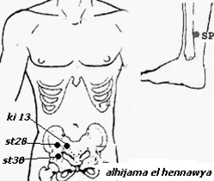
For Induction Of Ovulation(as clomid)
use st28 or st 30 or k13 or
Zi Gong or
+ or- sp6
3 times in follicular phase
(around day 5 of the cycle until day 11 ) eg At day 5,7,9

Slide 14
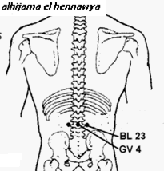
For Ovarian Hyperstimulation for IVF (augmentation of ovulation as hMg)
Bl 23 and Gv 4
Every 2 day till day of retrieval of ova

Slide 15
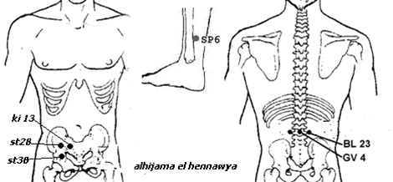
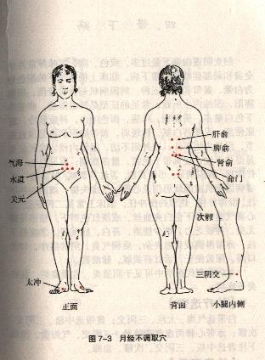
Some use st28 or st 30 or k13 or Zi Gong
+ or- sp6
Plus Bl 23 and Gv 4
In PCOS decrease points to avoid OHSS

Slide 16
Triggering Ovulation ( as HCG)
Ovulation phase (around day 12 of the cycle until day 16):
Two sessions of Cupping treatment,
using the acupoints CV3, CV4, ST29,
Zi Gong + or - SP6

Slide 17
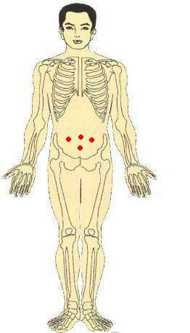
In Vitro Fertilisation
researchers have remarkably increased pregnancy rates in women undergoing in vitro fertilisation (IVF). .
In the cupping group, 42.5 percent of patients became pregnant, while in the IVF-only group, 26.3% of patients conceived
Many are using Cupping in conjunction with traditional medical treatments such as fertility drug
Cupping: Shuidao (ST28), Zhongji (CV 3) and Guanyuan (CV4) on days 3, 6, 9
and in some cases 11
Do with follicle-stimulating hormone injections
then one prior to having fertilized embryos transferred into their uterus,
and one directly afterwards

Slide 18
PCOS
it appears that cupping may have a beneficial effect on women with PCOS (polycystic ovary syndrome) and anovulation, supported by both clinical and experimental evidence.”
But In PCOS decrease points to avoid OHSS
Start at morning 8 am for ½ hr

Slide 19
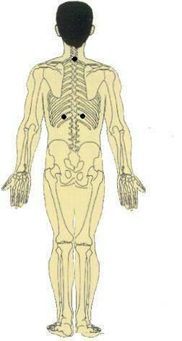

Hirsutism
Add D 14(C7-T1),
St 30 (ovary)
Bl 20( T11) (adrenal)

Slide 20
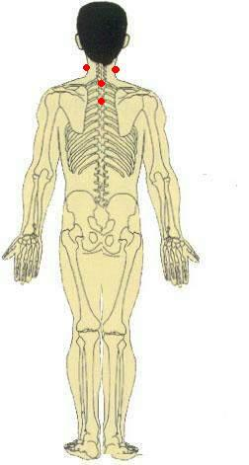
Thyroid Dysfunction
Add
Si 16 ( C3-C4)
D14(C7)
D12(T3)

Slide 21
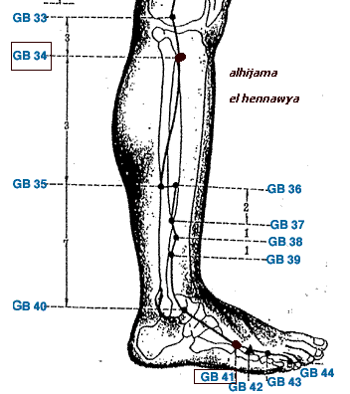
Galactorrhea
Add Gb 34, Gb41

Slide 22

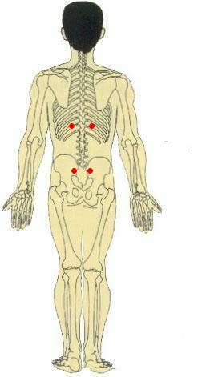
Tubal Inflammatory Block
Cupping is trying in the treatment of female infertility due to inflammatory obstruction of the fallopian tubes, where it seems to be superior to conventional therapy with intrauterine injection of gentamicin, chymotrypsin and dexamethasone
Because cupping stimulates ACTH which increases CORTISONE which relieves inflammation and edema
Bl32( S2), Cv4
+ or - Bl 20 ( T11)

Slide 23
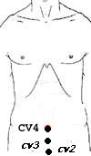
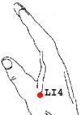
Uterine Cause
Increase receptivity Of Endometrium-- Cv3 or Cv2
Decrease contractility of uterus -- Li 4
Luteal Phase support –St28, Sp6 or Bl32
Twice / Week
For 4 Weeks after ovulation

Slide 24

Improve Implantation
“The peripheral impact of cupping in improving uterine artery blood flow and hence endometrial thickness also provides encouraging data regarding its potential positive effect on
Cv3 or Cv2

Slide 25
Luteal phase Support
Luteal phase (around day 17 of the cycle until day 28):
One to two Cupping sessions were given/week.
The acupoints used were ST29, Zi Gong + or - SP6

Slide 26
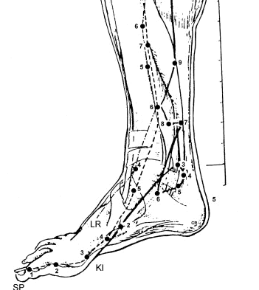
Endometriosis
Cv2, Cv4, Sp 8
+ or - D 10 ( T6-T7) + or- Cv 16
+ or – Bl20(T11)
10 minutes / point/day
Course -- 7 day
Need 2 courses

Slide 27
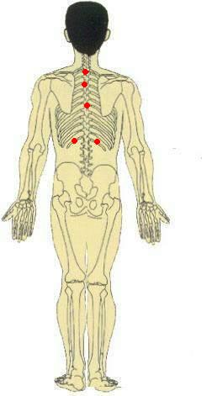

Obesity
Add
D14(C7)
D12(T3)
Bl 10(T6-T7)
Bl 21(T12)
Cv 16

Slide 28

Immunological cause
Add
D 10 ( T6-T7) , Cv 16

Slide 29

Psycological cause
Add
D20 - D14 (C7)- Bl 19(T6) – D3(L4-L5)

Slide 30

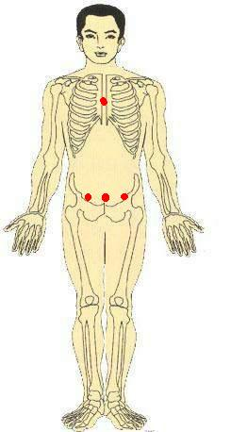
Unexplained Infertility
Cv 16
Cv3 or Cv2
St28 or St 30
Si 16 ( C3-C4)
D14 (C7)
Bl 19(T6)
D 10 ( T6-T7)
Bl 25
D3(L4-L5)

Slide 31
In Clinical Practice,
Cupping physicians typically see about a 30% success rate (depending on age of patient) to treat infertility.
The treatment course could be anywhere from 3 to 6 months or up to one year,
depending on severity.
The outcome can be most rewarding, however. Along with giving birth to a healthy baby,

Slide 32
Observation of the effectiveness of the treatment for each cause of infertility
Cause of infertility | Success rate(%)
Ovulatory factor | 48%
Tubal factor | 35%
Endometriosis | 36%
Unexplained | 48%

Slide 33
Observation of the effectiveness and the duration of treatment in cases pregnancy
Duration of the treatment | Percentage (%)
1st cycle | 24%
2nd cycle | 25%
3rd cycle | 22%
4th –9th cycle | 29%
    The results suggest that, among pregnancy cases, about 70% of the patients became pregnant in the first course (first three months) of the treatment.
    Nevertheless, still close to 30% of the patients became pregnant during the second or third course of the treatment.

Slide 34
How can Cupping help improve my success rate with in-vitro fertilization?
1. Regulate the hormones to produce a larger number of follicles
2. Improve the function of the ovaries to produce better quality eggs
3. Relax the patient and decrease stress
4. Increase blood flow to the uterus and increase the thickness of the uterine lining
5. Strengthen the immune system
6. Lessen the side effects of drugs used in IVF
7. Prevent the uterus from contracting
8. Improve semen to create better quality and quantity of embryos
9. Decrease chances of miscarriage

Slide 35
Conditions unlikely to respond to cupping
- complete blockage of the fallopian tubes,
- extremely low sperm count,
- Permanent premature ovarian failure.
In these cases,
IVF or other reproductive techniques are usually suggested

Slide 36
Male Infertility

Slide 37
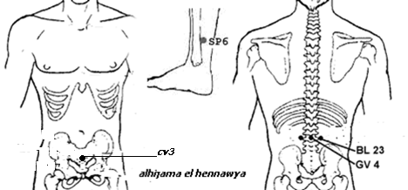
Spermatogenesis induction
use C3
+ sp6
Plus Bl 23 and Gv 4
Every 3 day for 3 month
With good diet
And calm head

Slide 38
Thyroid Dysfunction
Add
Si 16 ( C3-C4)
D14(C7)
D12(T3)

Slide 39
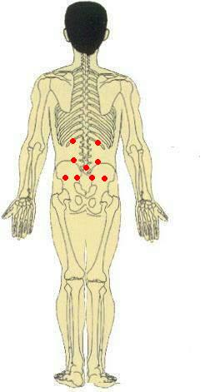

Varicocele
Add
St30
Bl 21(T12)
Bl 25(L4) –
D 3(L4-L5)
(S2)28-29 30-31

Slide 40

Prostate cause
Add
D14
D12
Bl 19
C4
C2

Slide 41
Genital Tract Inflammation
....” “Males with genital tract inflammation exhibited the most remarkable improvement in sperm density...” “It is concluded that cupping may be a useful, nontraumatic treatment for males with very poor sperm density
....“A definite increase in sperm count was detected

Slide 42


Sexual Weakness
Add
Cv 4-Cv3- Cv 2
St 30
D14(C7-T1)
D12(T3)
Bl 19(T6)
Bl 25(L4)
D3(L4-L5)

Slide 43
Obesity
Add
D14(C7)
D12(T3)
Bl 19(T6)
Bl 219T12)
Cv 16

Slide 44
Immunological cause
Add
D 10 ( T6-T7) , Cv 16

Slide 45
Psychological cause
Add
D20
D14 (C7)
Bl 19(T6)
D3(L4-L5)

Slide 46
Unexplained Infertility
Cv 16
Cv3 or Cv2
St28 or St 30
Si 16 ( C3-C4)
D14 (C7)
Bl 19(T6)
D 10 ( T6-T7)
Bl 25
D3(L4-L5)

