Slide 1

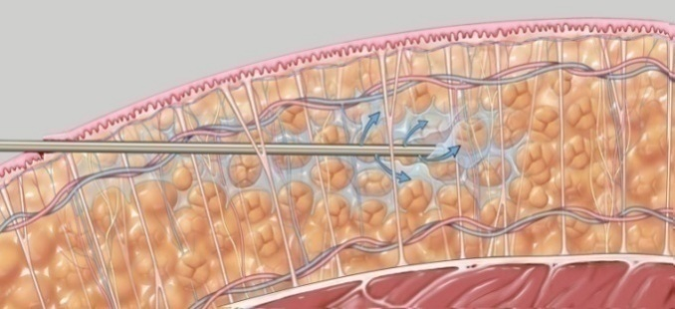
Local infiltrative anesthesia for cesarean section
Muhammad M Al Hennawy
Ob/gyn consultant
Egypt

Slide 2

Cesarean section under local anesthesia !
A step forward or backward?

Slide 3
Anesthesia for Cesarean section continues to be one of the most commonly performed world-wide.
Regional anesthesia has become the preferred technique for Cesarean delivery. Compared to general anesthesia,

Slide 4
Regional anesthesia is associated with reduced maternal mortality, the need for fewer drugs, and more direct experience of childbirth, faster neonatal-maternal bonding, decreased blood loss and excellent postoperative pain control through the use of neuraxial opioid.
However, it is important to prevent aorto-caval compression and promptly treat hypotension during regional anesthesia for Cesarean section.
The advantages of general over regional anesthesia are well known to include a more rapid induction, less hypotension, less maternal anxiety and its application in situations where there is a contraindication to regional anesthesia.

Slide 5
Although literatures available indicate that both techniques are safe. Loss of airway control has been associated with severe morbidity and mortality during general anesthesia.
The need for proper preoperative evaluation and airway assessment, the availability of an assistant, a backup plan for failed tracheal intubation, quick airway access and adequate oxygenation during general anesthesia for Cesarean section cannot be overemphasized

Slide 6
There are many cases where local anesthesia has been highly useful and even life saving

Slide 7
Local infiltrative anesthesia is not a common technique of anesthesia for Cesarean section.
This form of anesthesia is often practiced in poor resource settings.
It is frequently carried out by the surgeon.

Slide 8
The use of local anaesthesia for caesarean section requires that the provider counsel the woman and reassure her throughout the procedure.
The provider must keep in mind that the woman is awake and alert and should use instruments and handle tissue as gently as possible

Slide 9
Indications
It can be safely used in high-risk patients where sub-arachnoid block or general anesthesia can be associated with complications.
ACOG clearly states that infiltration of local anesthesia can be used for cesarean delivery when adequate general or regional anesthesia is unavailable
ACOG notes that maternal request is sufficient reason to provide pain relief.
The use of local infiltrative anesthesia has been used in very poor clinical state (Caesarean section especially in women with heart failure)
Patients who have difficult airway or severe coagulopathy

Slide 10
ContraIndications
Avoid use in women with eclampsia, severe pre-eclampsia ,
Previous laparotomy,
obese,
Associated adnexial pathology ,
Placenta previa,
apprehensive or allergic to lignocaine or related drugs and
If the surgeon is inexperienced at caesarean section.

Slide 11
Types
1- under local anesthesia along with Entonox inhalation before local anesthesia and fentanyl before closure of uterus and before closure of The sheath
2- under local anesthesia along with pethidine and promethazine before local anesthesia

Slide 12
The provider counsel the woman

Slide 13
Informed, high-risk consent was taken

Slide 14
The patient was shifted to the operating room

Slide 15
The surgeons
cleaned and
draped her abdomen.

Slide 16
If the fetus is alive, give pethidine 1 mg/kg body weight (but not more than 100 mg) IV slowly (or give morphine 0.1 mg/kg body weight IM) and promethazine 25 mg IV after delivery.
Alternatively,
pethidine and promethazine may be given before delivery, but the baby may need to be given naloxone 0.1 mg/kg body weight IV at birth.
If the fetus is dead, give pethidine 1 mg/kg body weight (but not more than 100 mg) IV slowly (or give morphine 0.1 mg/kg body weight IM) and promethazine 25 mg IV.

Slide 17
Or
Entonox was administered through a face mask (inhalation anaesthesia -- nitrous oxide plus oxygen in same bar).

Slide 18
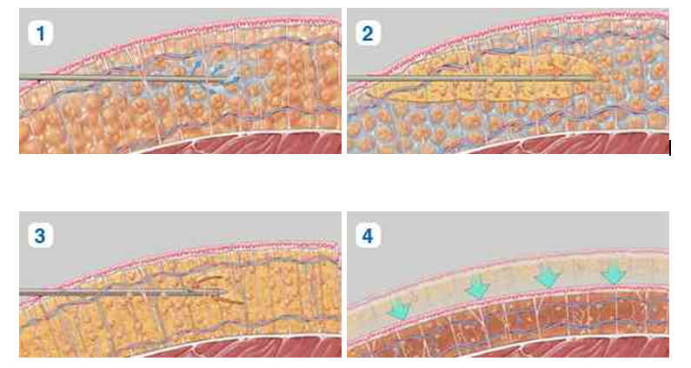
Prepare 200 mL
of 0.5% lignocaine
with 1:200 000 adrenaline.
Usually less than half this volume (approximately 80 mL) is needed in the first hour.

Slide 19
Epinephrine requires 5–7 minutes to take effect.
The maximal dosages of lidocaine and bupivacaine with epinephrine are as follows:
• Lidocaine with epinephrine increases to 7 mg/kg, and its effect lasts 1 1⁄2– 2 hours.
• Bupivacaine with epinephrine: dosing essentially stays the same at 2.0–3.0 mg/kg, and its effect still lasts 2–4 hours.

Slide 20
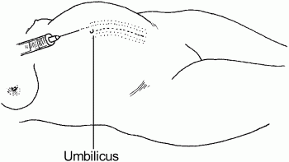
Using a 10 cm needle, infiltrate one band of skin and subcutaneous tissue--- Raise a long wheal of lignocaine solution
from the symphysis pubis to a point 5 cm above the umbilicus.
on either side of the midline, two finger breadths (3–4 cm) apart
A Pfannenstiel incision should not be used as it takes longer, requires more lignocaine and retraction is poorer.

Slide 21
Infiltrate the lignocaine solution down through the layers of the abdominal wall.
The needle should remain almost parallel to the skin. Take care not to pierce the peritoneum and insert the needle into the uterus, as the abdominal wall is very thin at term

Slide 22
At the conclusion of the set of injections,
wait 2 minutes and then
pinch the incision site with forceps.
If the woman feels the pinch, wait 2 more minutes and then retest.

Slide 23
Note:
Aspirate (pull back on the plunger) to be sure that no vessel has been penetrated.
If blood is returned in the syringe with aspiration, remove the needle. Recheck the position carefully and try again.
Never inject if blood is aspirated.
The woman can suffer convulsions and death if IV injection of lignocaine occurs.

Slide 24
Anaesthetize early to provide sufficient time for effect
The anaesthetic effect can be expected to last about 60 minutes.

Slide 25
Perform a midline incision
That is about 4 cm longer than when general anaesthesia is used.

Slide 26
A midline incision
There are three reasons for this.
First, the lower segment of the uterus is directly below the incision;
Second, there is no necessity for extensive wound retraction and
Third, the intestines are rarely encountered, thereby making laparotomy pads unnecessary.

Slide 27
Do not use abdominal packs.
Use retractors as little as possible and with a minimum of force.
Avoid any sudden movement

Slide 28
Inject 30 mL of lignocaine solution beneath the uterovesical peritoneum as far laterally as the round ligaments.
The peritoneum is sensitive to pain; the myometrium is not.

Slide 29
Inform the woman that she will feel some discomfort from traction when the baby is delivered.
This is usually no more than occurs during vaginal delivery.

Slide 30
Remove the placenta by controlled cord traction.

Slide 31
The patient was given 20 μg of fentanyl intravenously and the uterine incision was closed.

Slide 32
Repair the uterus without removing it from the abdomen.

Slide 33
Another 6 cc of 0.5% of bupivacaine was infiltrated in
the rectus sheath,
subcutaneous tissue and skin,
along with 10 μg of fentanyl intravenously,

Slide 34
Local anesthesia for LSCS causes loss of pain sensation in selected areas only,
With minimal disturbances of other systems, especially the cardiovascular and respiratory
The incidence of complications after using local anesthesia for LSCS, including fetal demise, was significantly lower
Infact, majority of the mothers opted for local anesthesia for a repeat LSCS.

Slide 35
It is safe and is beneficial
for the mother and child in the following ways:
• Can be a life saving procedure
• Recovering time is less
• None or very little side effects
• Economical (for both mother & Government)
• Post operative care is relatively easy
• Fetus will be in a good condition
• Makes surgical intervention easily available, accessible and affordable.

Slide 36
There are several advantages in this procedure which fully justify its use.
Local anesthesia does not impair the contractility of the uterine muscle so that there is usually much less bleeding than there is when a general anesthetic is given.
The postoperative convalescence is usually quite comfortable, vomiting rarely occurs, there is generally but little distention and
Smaller amounts of opiates are required than when a general anesthesia is administered.
There are none of the disadvantages of inhalation or the potential dangers of spinal anesthesia.
Active labor is not a contraindication, but the patient will continue to have labor pains until the uterus is emptied.
Local anesthesia is of special value when labor has been unduly prolonged and the patient is suffering from acidosis. Nephritis, pulmonary and cardiac disease are important indications for its use.

Slide 37
No disadvantage in the use of this method.
For the nervous type of woman, or for one who fears an operation, inhalation anesthesia may be better suited.
Private patients, or those who have been about the ward for a time, are usually very good subjects because we become better acquainted with them and they have less operating room phobia.

Slide 38
Conclusion
Although we do not advocate the use of local anesthesia for all Cesarean sections,
It can be safely used in high-risk patients where sub-arachnoid block or general anesthesia can be associated with complications or unavailable or with associated difficulties.
There is no evidence that Cesarean section under local anesthesia has an increased incidence of mortality than any other form of anesthesia.

