Slide 1
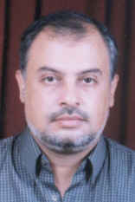
Balloon in uterus
Instead of Hysterectomy
( MTBEA)
Dr Muhammad El Hennawy
دكتور محمد محمد الحناوى
Ob/gyn Consultant
Rass el barr central hospital
Dumyatt – EGYPT
www.mmhennawy.co.nr

Slide 2
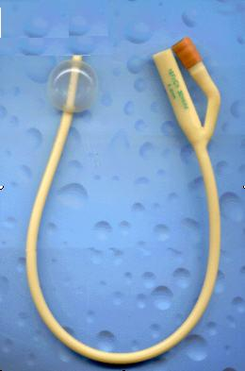
MTBEA
Modified Thermal Balloon Endometrial Ablation
In Teatment of intractable menorrhagia instead of Hysterectomy

Slide 3
Endometrial Ablation
It is destruction of endometrium
to sufficient depth
to prevent regeneration
and to increase adhesion between anterior and posterior endometrium
to decrease menstrual flow sufficient to avoid Hysterectomy

Slide 4


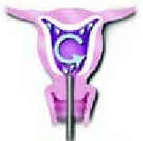
Methods of Endometrial Ablation
Resectoscope
Laser
Circulating hot water
Cryotherapy
Intracavitary radium

Slide 5
AIM
To evaluate clinical effect of Modified thermal Balloon System in ablation of endometrium in cases of Menorrhagia as alternative to Hysterectomy

Slide 6
33 Cases
during 2004 – 2005
33 cases
with menorrhagia more than 8 days more than 80 ml in day or affect general condition of woman
failed treatment ( medical and hormonal treatment for 6 months or d & c ) or not tolerate it
age ( 42 – 50 y )
complete her family
uterus length less than 12 weeks , uterine cavity less than 12 cm , more than 4 cm ( U/S )
Myometrial thichness more than 10 mm ( U/S )
no uterine or pelvic pathology ( U/S )
informed consent

Slide 7
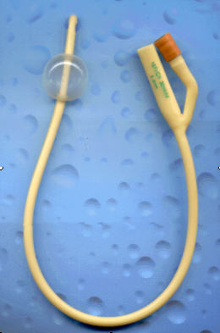
preoperative
patient after menses ( low thickness of endometium )
testing of silicon foley catheter
size 18 – 20
by inflation of balloon with 20 ml boiled water
also cut its tip above balloon
boil water in cup with electric apparatus to 90 degree

Slide 8
lithotomy position
under general anaesthesia (ampoule valium + 1/2 to 1 gram intraval )
vaginal speculum
volsellum to anterior lip of cervix
measure length of uterine cavity by sound
dilate cervix to 9 hegar
+ or - diagnostic hysteroscopy ( not done )
do curettage of endometrium and preserve specimen to histopathology to diagnose any abnormality and also to decrease thickness of endometrium

Slide 9
insert silicon foley catheter
to the same length measured by sound
put a towel in vagina around foley catheter
( 18 – 20 size ) to avoid burn of vagina if balloon rupture

Slide 10
inflate balloon of catheter by boiled water
( boiled saline ) till feel resistance
(20 – 40 ml ) with large syringe ( 8 – 10 ml still in catheter itself )
for 3 minutes
you can sure from its site under sonar
( NOT DONE )
deflate cooled water from balloon and repeat 3 times ( maximum 9 minutes )
then deflate balloon , remove vaginal towel , remove volsellum

Slide 11
follow up every month

Slide 12
results after 3month
6 cases 18% amenorrhea
13 cases 39% hypomenorrhea
10 cases 30% normal menses
4 cases 13% persistant menorrhagia
( failure )

Slide 13
in 4 cases of failure
We do hysterectomy
1 -- diffuse adenomyosis
2 --- localized adenomyosis
1 --- intramural fibroid 2 X 2 cm

Slide 14
benefits
safe
simple
Cheap
avaliable
effective
minimally invasive
with minimal risks

Slide 15
complication
rupture of balloon with boiled water --- nothing occur
( vaginal towel – no burn to vagina)
also
( boiled water coming quickly through catheter from passage of urine (

Slide 16
benefits over Hysterectomy
preservation of uterus
avoid surgical incision

Slide 17
benefits over Hysteroscopic ablation
similar results with simple cheap methods

Slide 18
conclusion
MTBEA
safe
simple
Cheap
avaliable
effective
minimally invasive
with minimal risks
But need long follow up

Slide 19
El hennawy
muhammad
With my best wishes

