Slide 1

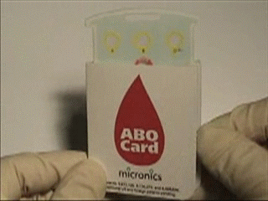
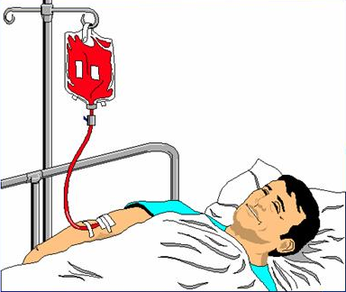
BLOOD
AND BLOOD PRODUCTS
TRANSFUSION IN OBSTETRICS AND GYNECOLOGY
Dr Muhammad El Hennawy
Ob/gyn Consultant
Rass el barr central hospital and
dumyat specialised hospital
Dumyatt – EGYPT
www. Mmhennawy.co.nr

Slide 2
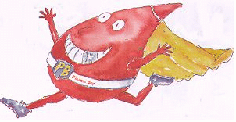
Transfusion Science
It involves
the procedures
and testing required
for the preparation
and transfusion
of blood
and blood products.

Slide 3
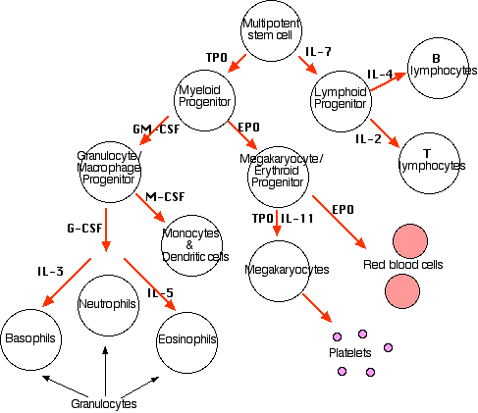
Components Of Blood
Cells
Plasma molecules & ions water
Function
Medium of transport
    Oxygen
    Carbon dioxide
    Other gases
    Ions
    Carbohydrates, proteins, fats
Immune response
    Humoral
    cellular
Cells
Erythrocyres
White cells
Granulocyes
neutophiles
Eosinophiles
Basophiles
Lymphocyes
Monocytes
Platelets

Slide 4

Whole blood | Blood components |  |  |  | Plasma fractions
Fresh old | Packed red cells | platelets | Fresh Frozrn Plasma | Cryoprecipitate
DIVC Massive haemorrhage Major liver trauma Bleeding associated with liver disease | -Washed RBC’s Pts with allergic reactions to plasma proteins -Leuko-poor RBC’s Pts with febrile, non-hemolytic reactions to plasma WBC’s | when platelet. count less than 50000/cmm or when massive blood loss or replacement has occurred | when PT & PTT are higher than 1.5 times control levels All clotting factors; no platelets Can supplement RBC’s when whole blood not available for exchange transfusion | when fibrinogen level is less than 80-100mg/dl Initially a tx for VW Dz, Hemophilia Now a source of fibrinogen in obstetric emergencies | Clotting factor concentrates Immunoglobulin preparations Saline albumin solution Salt-poor albumin
 |  | Platelet concentrates (1 pack/10kg) dose : 6units RDP or 1 unit SDP | normal dose: 12 - 15ml/ kg (4-5packs) | dose: 1- 1.5 -2 packs/ 10 kg (8-10 packs) | Clotting disorders Haemophilia Liver disease

Slide 5
Blood in History
- China, 1000 BC
The soul was contained in the blood.
- Egyptians bathed in blood for their health.
- Romans drinking the blood of
fallen gladiators to gain strength and vitality and to cure epilepsy.
- the practice of bathing in blood as it cascaded from a sacrificial bull, was practiced by the Romans.

Slide 6
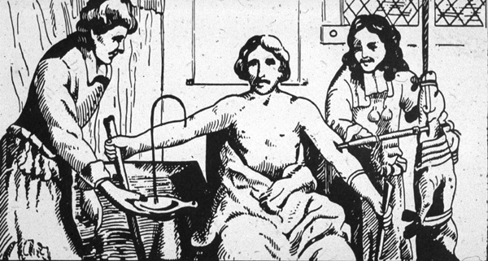
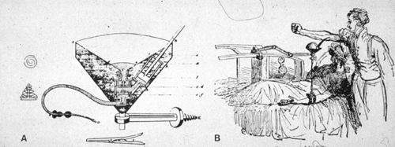
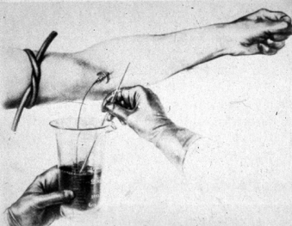
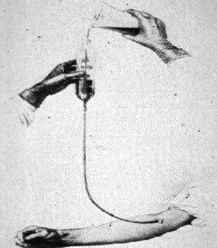
. Animal to animal --- Richard Lower ,1665
Animal to human --- Jean Denis , 1667
. Human to human --1818, James Blundell
-- 1900 The elucidation of the ABO blood group system by Landsteiner
-- 1914 Lewisohn - used citrate
-- 1940 Landsteiner and Wiener, in, describe Rh typing

Slide 7
Major Innovations in the 20th Century
Compatibility testing
Anticoagulant solutions
Preservative solutions
Refrigeration
Blood Banks
Venous access
Plastic blood bags
Component administration
Infectious disease testing
High-risk donor screening

Slide 8
Regarding Blood Transfusion in obstetrics:
TWO main causes of maternal morbidity and mortality are :
1- CHRONIC ANEMIA OF PREGNANCY
2- MAJOR OBSTETRIC HAEMORRHAGE

Slide 9
1- CHRONIC ANEMIA OF PREGNANCY

Slide 10
Chronic anemia of pregnancy is defined as :
Hb concentration below 11g/dl in 1st and 3rd trimester
&
Hb concentration below 10.5g/dl in 2nd trimester

Slide 11
Few points to remember…
* Anemia is a late manifestation of iron-deficiency
* Transfusion does not treat the cause of anemia
* Hb level ALONE is not the trigger for transfusion, but patient’s clinical need
Transfusion does not correct the NON-hematological effects of iron-deficiency as:
-Impaired neuro-muscular transmission that may lead to increased blood loss at delivery
-Abnormal cellular function that may lead to preterm birth
-Poor fetal growth
-Reduced iron stores in newborn in the first year of life

Slide 12
2- MAJOR OBSTETRIC
HAEMORRHAGE

Slide 13
DEFINITION
Any blood loss occurring in the peripartum period, revealed or concealed, that is likely to endanger life
N.B.
Physiological & hematological changes induced by pregnancy can hide signs of hypovolemic shock & patient can collapse suddenly.

Slide 14
Massive transfusion is arbitrarily definied as the replacement of a patient's total blood volume in less than 24 hours, or as the acute administration of more than half the patient's estimated blood volume per hour.
If Hb > 10g/dl transfusion is rarely indicated.
If Hb < 7g/dl transfusion is usually necessary.
With Hbs between 7 and 10 g/dl, clinical status, PvO2 and ER are helpful in defining transfusion requirements.

Slide 15
Response Of BP and P to Hypovolemia
Blood Volume | Percentage | Supine |  | Sitting
 |  | B.P | P | B.P | P
N | 100 | N | N | N | N
- 500 | -5 | N | N | N | N or ^
-1000 | -10 : 15 | N | N or ^ | N or ^ | ^
- 1500 | -20 | N or v | ^ | v | ^ or v
- 2000 | - 30 | v | ^ or v | vv | ^ or v

Slide 16
HAEMORRHAGE is associated with :
48%of direct causes of obstetric deaths
&
38% of all maternal deaths
(MOHP National Maternal Mortality Study 2000 )

Slide 17
Protocol for management of acute haemorrhage

Slide 18
1-Every obstetric unit should have a current protocol for major obstetric haemorrhage and all staff should be trained to follow it.

Slide 19
2-Initial resuscitation with replacement
Fluids (crystalloid or colloid infusions)
is a priority
to restore blood volume

Slide 20
DIC is a consequence of delayed or inadequate resuscitation

Slide 21
3-Obtain and send 2 blood samples:
*To blood bank for grouping and crossmatching
*To lab to obtain baseline for Hb, Htc, PT, PTT ,platelet count & fibrinogen levels

Slide 22
4- Inform blood bank that it is an emergency

Slide 23
Give Packed Red Cell
5- Initial packed red cell infusion
to restore O₂ delivery to tissues
- Give group O Rh –ve cells
should be available in 5 minutes
- Give group specific uncrossmatched blood
- Give fully matched blood

Slide 24
Oxygen demand (consumption)
- Transfusion requirements should be based on
the patient's physiologic needs,
defined by their oxygen demand (consumption).
- Oxygen consumption is given by :
Where CO = Cardiac Output, CaO2 and CvO2 are arterial and venous oxygen content respectively.
- Oxygen delivery is :
The extraction ratio (ER) is the ratio of oxygen consumption to oxygen delivery, normally around 25%.

Slide 25
Combinations of stored whole blood, packed cells, colloids & crystalloids are given to maintain blood volume or pressure at adequate levels and haemoglobin at around 7g/dl or haematocrit at 0.25

Slide 26
6-Component replacement therapy according to coagulation screen or if DIC is suspected :

Slide 27
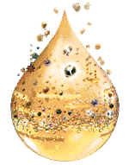
Blood components |  |  |  | Plasma fractions
Packed red cells | platelets | Fresh Frozrn Plasma | Cryoprecipitate
-Washed RBC’s Pts with allergic reactions to plasma proteins -Leuko-poor RBC’s Pts with febrile, non-hemolytic reactions to plasma WBC’s | when platelet. count less than 50000/cmm or when massive blood loss or replacement has occurred | when PT & PTT are higher than 1.5 times control levels All clotting factors; no platelets Can supplement RBC’s when whole blood not available for exchange transfusion | when fibrinogen level is less than 80-100mg/dl Initially a tx for VW Dz, Hemophilia Now a source of fibrinogen in obstetric emergencies | Clotting factor concentrates Immunoglobulin preparations Saline albumin solution Salt-poor albumin
 | Platelet concentrates (1 pack/10kg) dose : 6units RDP or 1 unit SDP | normal dose: 12 - 15ml/ kg (4-5packs) | dose: 1- 1.5 -2 packs/ 10 kg (8-10 packs) | Clotting disorders Haemophilia Liver disease

Slide 28
7- Continuous lab
& clinical monitoring to guide treatment.
During massive transfusion Monitoring

Slide 29
8- The priority to Identify and treat cause of bleeding
Consider surgery (definitive surgical arrest of haemorrhage from major vessels ) earlier
rather than later.

Slide 30
9- Massive transfusion of stored whole blood
can aggravate coagulopathy due to:
- Dilutional thrombocytopenia
- Coagulation factor depletion
- Acidosis
- Hypothermia
thus
1 unit of fresh blood for every 5 – 10 units of stored blood
IV 10% calcium gluconate 10 mls with every litre of transfused citrated blood
Warming blood
Microaggregate blood filters

Slide 31
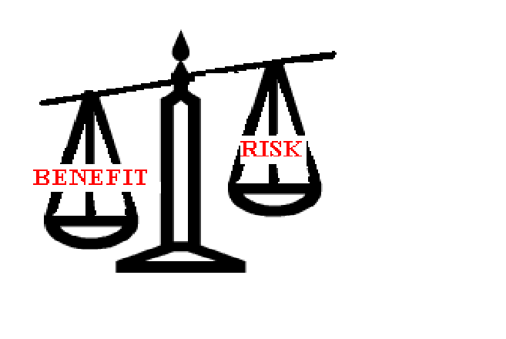
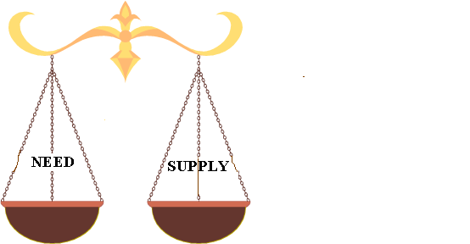
REMEMBER…
THE DECISION FOR BLOOD TRANSFUSION SHOULD ALWAYS BE A BALANCE BETWEEN

Slide 32
Alternatives To Blood Transfusion
Because the blood transfusions carry risks and because the blood supply is limited,
doctors try not to transfuse when possible.
In some cases, alternatives to blood product transfusions may be available
volume expanders
Growth factors
Intraoperative or postoperative blood salvage
Blood substitutes

Slide 33
Volume expanders
When a patient has lost a lot of body fluids but does not need red blood cells or other specific blood components, volume expanders may be given to prevent or treat shock caused by fluid loss.
The most common |  | Other
Crystalloids |  | Colloids
solutions that contain sodium |  | solutions that contain large molecular weight that do not readily cross capillary walls
normal saline | lactated Ringer’s | albumin | hydroxyethyl starch (HES), | dextrans | purified protein fractions

Slide 34
Growth factors
Scientists have learned how to make some of these growth factors in the lab to help people with low blood cell counts.
Growth factors can be used to raise red blood cell, white blood cell, or platelet counts.
Unlike transfusions, growth factors often take several days to raise blood counts, so they may not be useful in people who need blood cell levels raised quickly, such as those with active bleeding.
People who have severe bone marrow disease may not respond to the growth factors because they do not have enough blood-producing cells in their bone marrow.
Some growth factors might stimulate certain types of cancer cells (such as certain leukemia cells) to grow more quickly.
Growth factors are generally much more expensive than transfusions

Slide 35
Anteoperative, Intraoperative or postoperative blood salvage
Uses pt own blood prior to surgery , Remove 500 ml & store , 2 weeks later, may be transfused in op or 1000 mls taken to increase the stored amount Multiplier effect No danger of transmitted infections, infusing it back into the patient. during operation
New intraoperative autologous technologies (autotransfusion) this lost blood can be ‘salvaged’ by collecting it with a special machine and infusing it back into the patient at same time.
Also available are services that separate blood components of patient, such as platelets and plasma, during the operation. Separated platelets may be used to make “platelet gel” which acts both as a sealant and an adhesive to reduce bleeding.
Giving a person back his or her own (autologous) blood cuts down on the need for transfusions from other donors.

Slide 36
Blood substitutes
So far, there is no real substitute for human blood.
Researchers are working to develop a blood substitute that will not have the risks of blood transfusions.
New products, such as hemoglobin-based oxygen carriers and perfluorochemical compounds, can perform some red blood cell functions, such as carrying oxygen to tissues, but they do not replace human blood.
Most blood substitutes are thought to be experimental and are rarely used.
They may be used temporarily in patients whose religious beliefs do not allow them to have blood product transfusions.
They may also benefit patients with rare blood types whose immune systems would destroy available donated blood.
The substitutes may be used until compatible donated blood can be located, which in some cases might take several days

Slide 37
Complications of Blood Transfusion
Febrile reactions
Bacterial contamination
Immune reactions
Physical complications
  Circulatory overload
  Air embolism
  Pulmonary embolism
  Thrombophlebitis
  ARDS
Metabolic complications
  Hyperkalaemia
  Citrate toxicity & hypocalcaemia
  Release of vasoactive peptides
  Release of plasticizers from PVC-phthalates
Haemorrhagic reactions
  After massive transfusion of stored blood
  Disseminated intravascular coagulation
Transmission of disease
  Hepatitis, CMV. EBV
  AIDS (Factor VIII)
  Syphilis
  Brucellosis
  Toxoplasmosis
  Malaria
  Trypanosomiasis
Haemosiderosis
  After repeated transfusion in patients with haematological diseases

