Slide 1
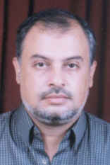

Uterine and Vaginal balloons for control of Massive PPH
Dr Muhammad El Hennawy
Ob/gyn Consultant
Rass el Barr Central Hospital and
Dumyat Specialised Hospital
Dumyatt – EGYPT
www.mmhennawy.co.nr

Slide 2
Postpartum hemorrhage (PPH)
It is a leading cause of maternal death all over the world
It remains a serious complication of childbirth in both developed and developing countries.
From 2% to 5% of deliveries may lead to PPH with a blood loss of > 1000 mL within the first 24 hours
The most common cause of PPH is uterine atony.
A delay in correction of hypovolumia and delay in the control of bleeding are the main avoidable factors in most maternal deaths caused by hemorrhage

Slide 3
The causes of postpartum hemorrhage can be thought of as the four Ts
tone, Uterine atony
tissue, Products of conception, blood clots
Trauma , Planned --- Cesarean section , episiotomy
Unplanned -- Vaginal/cervical tear, surgical trauma
Thrombin ,Congenital--- Von Willebrand's disease
Acquired --- DIC, dilutional coagulopathy, heparin

Slide 4
Whatever the cause of PPH, death should be preventable
Active management of the third stage of labor reduces uterine atony and is the mainstay of prevention of hemorrhage
The rapid correction of hypovolumia with crystalloid and red cells is the first priority of management of PPH.
Uterotonic drugs, such as oxytocin or ergometrine, are used as prophylaxis and for controlling PPH

Slide 5
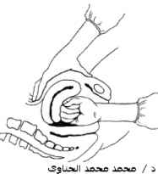
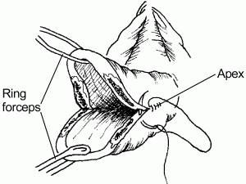
Management Steps in Primary PPH
Call for help
resuscitate
search for cause
  bimanual compression, examine placenta, examine and repair lower tract trauma
  uterotonics
    oxytocin,
    ergometrine,,
    misoprostol.

Slide 6
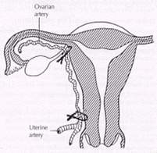
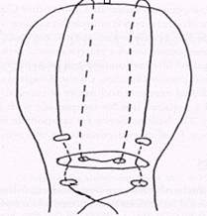
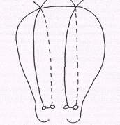
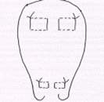
Unresponsive Uterine Bleeding
Tamponade techniques
  gauze
  balloons , condom/glove with Infiltration of placental bed with vasoconstrictors
  Laparotomy
  conservative
  Vessel ligation ( uterine , ovarian , hypogastric )
  Uterine -- Vertical full thickness sutures
  - Compression Suture (B-Lynch) 1997
  - Modified B-Lynch (Hayman ) 2002
  - Horizontal full thickness sutures
  - Square Suture 2000
  - figure of eight
  - Combination of sutures
  hysterectomy is the procedure of last resort, and a few patients really need it to save their lives
Embolization are effective methods for controlling intractable hemorrhage

Slide 7
Tamponade Techniques
Uterine gauze
Uterine Balloons
- Early Balloon 1951
-Sengstaken-Blakemore tube ( Tamponade Test ) 2003
- Sengstaken-Blakemore tube 2005
-Rüsch urologic hydrostatic balloon 2001
- St. Bartholomew’s catheter
- J- SOS Bakri tamponade balloon 2001
- Multiple foley’s catheters
- Eid Balloon (El Menia , Egypt ) 2004
- surgical glove 2004
- condom : Shivkar’s balloon pack ( india )1981
: Sayeba’s balloon pack (Bangladesh ) 2003
: Hennawy’s condom balloon pack (Rass el barr ) 2005
-finger glove: Hennawy’s finger balloon pack (rass el barr – egypt ) 2005
. Vaginal guaze
. Vaginal balloons : Hennawy’s vaginal condom balloon pack plud Abdomnal binder

Slide 8
Sengstaken balloon | SOS Bakri balloon | El Menia Balloon | Shivkar’s balloon | Sayeba’s balloon | Hennawy’s condom balloon | Hennawy’sFinger balloon
1951 | 2001 | 2004 | 1981 | 2003 | 2005 | 2005
Fill with fluid | Fill with fluid | Fill with air | Fill with fluid | Fill with fluid | Fill with fluid or air | Fill with fluid or air
Atonic PPH | Placental acreta (e.g. Placenta previa, low lying placenta). | Atonic PPH | - Atonic PPH - PPH due to coagulation failure, - in some cases of traumatic PP - inversion
Contraindication : suspected or diagnosed uterine rupture.

Slide 9
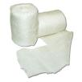
Gauze Uterine Packing
Formerly standard treatment until 1950
fell out of favour because
  concern for infection
  improved medical management of PPH

Slide 10
Uterovaginal packing was done under general anesthesia
16 meter sterile ribbon gauze with the help of spong holding forceps from the fundus in layers from left to right and front to back of fundus towards the cervix (uniformly applied side-to-side, front-to-back and top-to-bottom.9 ).
The vagina was also firmly packed to give additional pressure to the uterine packing.

Slide 11
Balloon is Better than Gauze
Simple to place and remove
fast
conforms well
gauze may miss spots
does not absorb so no delay and catheter channel prevents masked bleeding
atraumatic insertion
removal does not cause bleeding

Slide 12
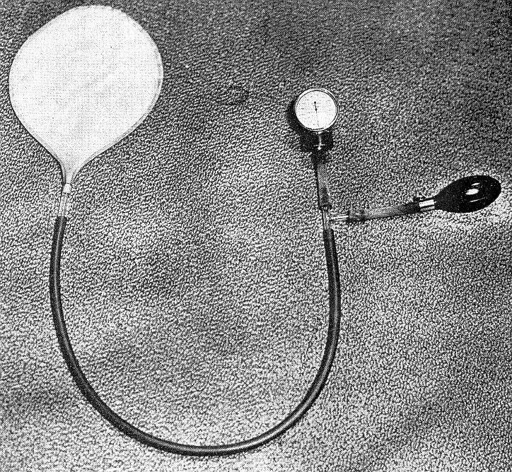
An Early Balloon (1951)
The pressure in the capillary system is 21-48 mm Hg
. Pressure in intervillous space is 25mm Hg

Slide 13
Sengstaken-Blakemore
The “Tamponade Test”
Sengstaken-Blakemore

Slide 14
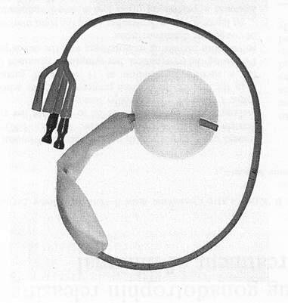
The “Tamponade Test”
(Condous, et al, Obstetrics and Gynecology, 2003 ,
n = 16 intractable PPH
  3.1 L average EBL
  6.2 units pRBC, 2.3 u FFP, 1.4 u platelets, 11mL cryoprecipitate
managed with usual algorithm of drugs
presurgical intervention
Technique
  minimal analgesia required
  cut off the distal end , ring forceps used
  filled with 70 - 300 c (avg 167) warm saline until uterus felt firm and balloon just visible at os
  continue oxytocin
  IV broad spectrum antibiotics
  removed next day in two stages, hours apart
Results
  14/16 successes i.e. 14 laparotomies avoided
  2 failed
    One was a missed cervical extension at cesarean
    One was thought to be due to inadequate inflation

Slide 15
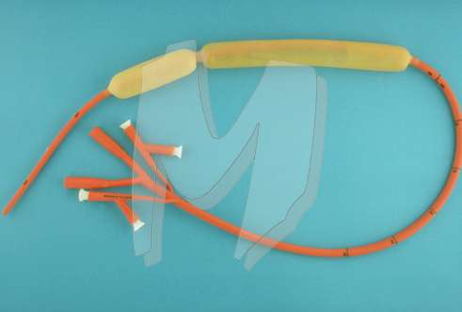
Sengstaken-Blakemore
Seror, et al, Acta Obstet Gynecol Scand, 2005
French case series of 17
  failed medical treatment
  average Hb drop 4 despite average 4.8 units pRBCs
Technique
  filled stomach balloon after cutting tip of catheter (with average of 250 cc (120 - 370)
  broad spectrum antibiotics
  removal at 3.5 to 82 hours (mean 30)
Results
  15/17 avoided laparotomy
    failed cases both due to cervical lacerations
  9/17 transferred to embolization centre but only 3 embolized
Contraindication ?
  one case of infection
    intrapartum fever and developed RDS requiring ICU and intubation x 24 hrs

Slide 16
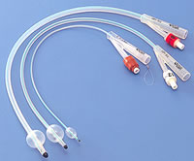
A large Foley catheter
A Foley catheter with a 30-mL balloon capacity is easy to acquire -----Using a No. 24F Foley catheter, the tip is guided into the uterine cavity and inflated with 60 to 80 mL of saline.
Additional Foley catheters can be inserted if necessary to control postpartum hemorrhage resulting from atony
Trial to Intrauterine irrigation with prostaglandin F2-α to control postpartum hemorrhage resulting from atony
inflating a large Foley catheter balloon with 60 ml of saline inside the cervical canal. to control postpartum hemorrhage resulting from a low placental implantation
three Foley’s balloons to provide tamponade of uterus for bleeding from placenta acreta to prevent obstetric hysterectomy
An intramural fibroid along the lower uterine segment incision line along the upper margin of the incision. After removal of the fibroid, the raw uterine bed started bleeding which was controlled to some extent by "O" catgut sutures One 30 ml inflated bulb of Foley's catheter was kept in the low bed of the uterine decidua and the other end of the Foley's catheter was brought to the exterior through the cervical canal After that uterus was closed carefully about the bulb of the Foley's catheter which controlled dramatically the uterine bleeding. Foley's catheter was removed after 24 hours.

Slide 17
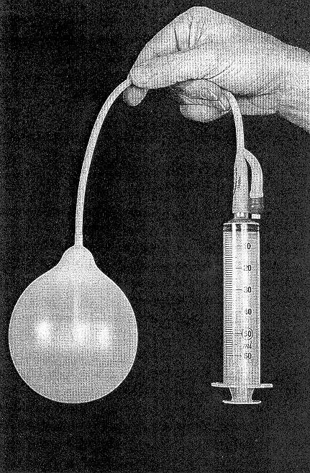
Rüsch Urologic Hydrostatic Balloon
Johanson, et al, BJOG, 2001
Used in urology for stretching the bladder and for stemming mucosal hemorrhage
Technique
    insert into uterus
    inflate with 400-500cc warm saline
    keep 24 hrs
    oxytocin
Case report (n = 2) in cases of accreta

Slide 18
St. Bartholomew’s Catheter
Used in urology for prostatic bed bleeding
not reported in the literature but analogous to other catheters

Slide 19
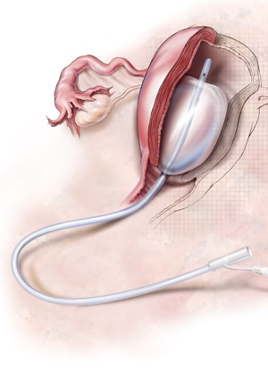
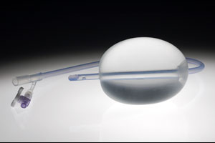
SOS Bakri Tamponade Balloon
Bakri, et al, Int J Gyne Obstet, 2001
Designed specifically for obstetrical hemorrhage
maximum capacity 800cc of balloon (recommended 250 to 500c)
wider caliber drainage shaft
article describes 5 successful cases with previas
It can be placed from above at time of C/S ( not from below )

Slide 20
Indication of Bakri Tamponade Balloon
Placental acreta (e.g. Placenta previa, low lying placenta).
Vaginal delivery.
The balloon catheter will not be used following cesarean section delivery except It can be placed from above at time of C/S .
Patients who were at least 19 weeks gestation

Slide 21
Contraindication of SOS Bakri Tamponade Balloon
Continuing pregnancy.
Cervical bleeding due to trauma.
Uterine atony bleeding.
Cases indicating hysterectomy.
Arterial bleeding requiring surgical exploration or angiographic embolization.
Purulent infections of the vagina, cervix, or uterus.
Untreated uterine anomaly.
Disseminated intravascular coagulation.
A surgical site which would prohibit the device from effectively controlling bleeding

Slide 22
SOS Bakri Balloon Catheter Insertion
Insert Foley catheter prior to the procedure.
Clean cervix and vagina with betadine..
Insert the catheter transvaginally under ultrasound guidance to:
Assure that the uterus is clear of any retained placental fragments, arterial bleeding, or lacerations.
Determine approximate uterine volume by ultrasound or direct examination
Insert the proximal end of the balloon catheter through the cervix into the uterus.
The balloon catheter should be gently inserted with a long
forceps (Do not use a tenaculum).
The entire balloon should be inserted past the cervical canal and internal os.
Avoid excessive force when inserting the balloon into the uterus. If resistance occurs during insertion, remove the catheter.
Fill the balloon with 250- 300 ml sterile saline through the stopcock.
Do not over inflate the balloon. Maximum inflation volume is 500 ml. Always inflate the balloon with sterile normal saline.

Slide 23
NEVER inflate the balloon with air, carbon dioxide, or any other gas.
To ensure that the balloon is filled to the desired volume, measure normal saline in a separate container (rather than solely relying on a syringe count) to verify the amount of fluid that has been instilled into the balloon.
Insert X-Ray detectable sponges.
Soak sponges with betadine and insert around shaft of the catheter to maintain correct catheter placement and maximize tamponade effect.
Count sponges prior to insertion and document on the Intraoperative Record/ Nursing flowsheet..
Apply gentle traction to the balloon shaft and secure it to the patient’s inner thigh to maintain tension.
The patient may experience vaso-vagal symptoms with continuous traction on the catheter. If this occurs, the physician should assess the patient and determine if the catheter should be removed. Connect the drainage port to a fluid collection bag (e.g. small Foley leg bag) to monitor hemostasis after the balloon is inflated.
Flush balloon drainage port and tubing with 15-30 mL sterile normal saline if there is no drainage and/or the fundus is increasing in height.
If the balloon catheter becomes dislodged due to shaft tension, deflate the balloon,

Slide 24
SOS Bakri Balloon Catheter Removal
Remove tension from balloon shaft.
Remove and count vaginal packing/sponges.
Obtain X-ray if sponge count is incorrect..
Deflate the catheter slowly prior to removal.
Using an appropriate size syringe, aspirate the contents of the balloon until fully deflated.
Verify that the the original volume inserted in the balloon was removed.
Gently retract the balloon from the uterus and vaginal canal and discard.
Continue to monitor the patient for signs of uterine bleeding after removal of balloon catheter

Slide 25
Advantages Bakri’s balloon pack over the conventional pack
The catheter has several benefits:
Easily inserted by the physician.
Quickly ascertain effectiveness.
Able to gauge ongoing blood-loss through inner lumen.
Easily removed without need for separate surgical procedure.
Conservatively manages hemorrhage

Slide 26
Condom Balloons

Slide 27
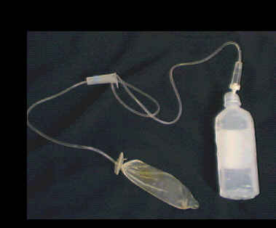
Condom Balloon 1
Shivkar’s balloon pack, ( india )
involves tying a condom to the intravenous drip set of a saline bottle
with the help of a latex rubber band 0.5 cm wide run fast over 1-2 minutes from a 60 cm height above the abdominal level.
Usually upto 300cc is required to fill up the dead space of the condom and also of the uterus. limit the intraballoon volume to 350 to 400cc
The IV bottle is then brought down to a 25 cm height from the abdomen. Usually this maintains the hemostasis
This is maintained for approximately 6-8 hours then
pack is removed by bringing the bottle down slowly by 5 cm every 15 minutes so that the uterus gradually contracts over the pack.
In cases of coagulation failure, it may be necessary to maintain the condom pack for longer periods.
over a period of 20 years since 1981 till 2003
Out of the 101 women,
75 showed complete cessation of bleeding;
20 showed partial response
6 failed to respond needing other active surgical intervention

Slide 28
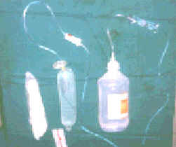
A condom (prewashed), a disposable IV set, normal saline bottle, scissors, artery forceps sterile roller gauze

Slide 29
Technique of Shivkar’s Pack Insertion
the terminal portion of the IV set is passed through the condom and is fixed to the condom with a latex rubber band, 0.5 cm wide so as to make the condom airtight. This width of the band is used because whenever the intraballoon pressure exceeds safety limits, the band gives way and fluid starts leaking out from the side of the IV tubing, eliminating the risk of overstretching and injuring the uterus. This latex band is laced on to the condom at a distance equal to the approximate length of the uterine cavity from the fundus to the internal os. The IV set is connected to the IV bottle as usual and the bottle is hung up on the calibrated IV stand at 60 cm. After removing all the trapped air from the assessembled condom, it is introduced inside the uterus so that the rubber band is placed at the level of the internal os. Neither anesthesia nor sedation is required. The IV flow controller is now released and fluid is allowed to run fast over 1-2 minutes from a 60 cm height above the abdominal level. Usually upto 300cc is required to fill up the dead space of the condom and also of the uterus. The IV bottle is then brought down to a 25 cm height from the abdomen. Usually this maintains the hemostasis. However the height of the bottle may be lowered or raised so as to achieve complete hemostasis with minimum possible pressure and volume. This is maintained for approximately 6-8 hours. A condom filled with fluid has a tendency to herniate into accessible spaces available; hence it is recommended that the vagina should be packed to prevent slipping of the condom. Total time taken for the entire assembly and achieving uterine tamponade is never more than 3 to 6 minutes.
The patient’s vital parameters are closely monitored during therapy. Once they improve, and complete hemostasis is achieved, pack is removed usually at the end of 6-8 hours, by bringing the bottle down slowly by 5 cm every 15 minutes so that the uterus gradually contracts over the pack. In cases of coagulation failure, it may be necessary to maintain the condom pack for longer periods.

Slide 30
Mechanism of Action of Shivkar’s balloon pack
Atonic PPH occurs due to failure of ‘living ligatures’ of uterine muscles to compress the vessels. This condom pack acts by –
directly compressing the bleeding vessels by hydrostatic pressure
improving the efficiency of failed live ligature by uterine muscle contractions
and
by allowing sufficient time for resuscitation of the patient, which enables the severely anoxic uterine muscle to recover from tissue anoxia and contract.
The pressure in the capillary system is 21-48 mm of Hg or 28.5-65.5 cm of water. Pressure in intervillous space is 25mm of Hg or 33.9cm of water. Hence the pack stops most of the bleeding except for arteriolar spurters wherein the pack may fail or be less effective

Slide 31
Indications
Atonic PPH is a most important and common indication, however it is effective in PPH due to coagulation failure, inversion and in some cases of traumatic PPH
Contraindications
The only contraindication is a suspected or diagnosed uterine rupture.

Slide 32
Advantages Shivkar’s balloon pack over the conventional pack
(i) Dynamicity of pack – The moment the uterus starts contracting, the pressure in balloon increases and it pushes out the fluid allowing the uterus to continue contraction. This does not happen with the conventional pack. When the uterus relaxes, the fluid is drawn in, maintaining the pressure against the uterine wall and preventing reopening of capillary channels and bleeders.
(ii) Nonporous nature – The conventional pack absorbs blood to some extent and hence exact amount of blood loss cannot be determined as against our pack which allows the amount of blood loss to be estimated accurately.
(iii) Infection risk in minimal
(iv) Exact intrauterine pressure can be monitored and hence problems of too tight or too loose packing are avoided.
(v) Even if the situation warrants a hysterectomy or internal iliac artery ligation, the pack can be used to minimize blood loss temporarily to buy time. Simplicity of the pack can allow a paramedical staff to use the pack even in remote places

Slide 33
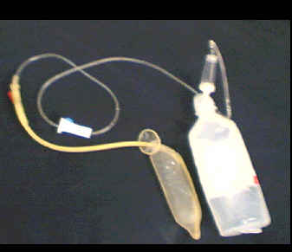
Condom Balloon 2
Akher, et al, MedGenMed, 2003
Bangladesh 2001-2002
152 cases of PPH, 23 used condom balloon
bleeding stopped within 15 minutes in all
Technique
a size 16 rubber catheter eg a Foley’s catheter was inserted within the condom and tied near the mouth of the condom by a silk thread
  200-500cc normal saline
  no infection (all given A/G/F x 7 days)
  removed after 24-48 hrs
  vagina packed with gauze or another condom
Benefits
  cheap
  universally available
  simple
  great for developing countries

Slide 34
primary health workers and other healthcare providers can apply this procedure before referring the patients to a higher center.
It is essential to exclude genital tract trauma before undertaking this procedure.
But in remote areas where primary healthcare providers are unable to detect or repair the injury in those cases,
this intrauterine tamponade method followed by vaginal packing will minimize the blood loss until the patient's arrival to the hospital, which will protect the patient from irreversible shock and even death.

Slide 35
Time of Application
the condom catheter was introduced
within 0-4 hours, after delivery.
or
between 5 and 24 hours after delivery.

Slide 36
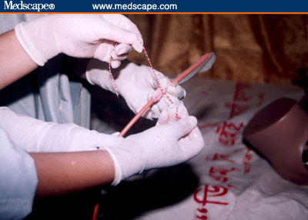
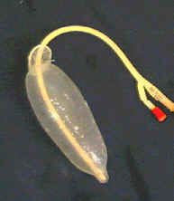
Insert Foley catheter in bladder prior to the procedure.
Clean cervix and vagina with betadine
Under aseptic precautions a size 16 sterile rubber catheter was inserted within the condom and tied near the mouth of the condom by a silk thread ,Inner end of the catheter remained within the condom

Slide 37
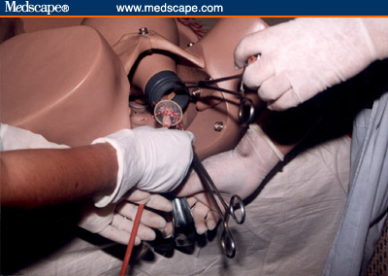
After putting the patient in the lithotomy position
Urinary bladder was kept empty by indwelling Foley's catheter
the condom was inserted within the uterine cavity
Outer end of the catheter was connected with a saline set the saline kept 60 to 70 cms above the abdomen and the condom was inflated.
From 200-500 mL (average 336.4 mL) saline was required to inflate the balloon of running normal saline

Slide 38
Method of Application
Grasp Anterior and Posterior lips of cervix with 2 ovum forceps
Then introduce it
Fill till balloon appears at cervix Bleeding reduced considerably, further inflation was stopped

Slide 39
Inflation Volume
Do not over inflate the balloon.
Maximum inflation volume is 500 ml

Slide 40
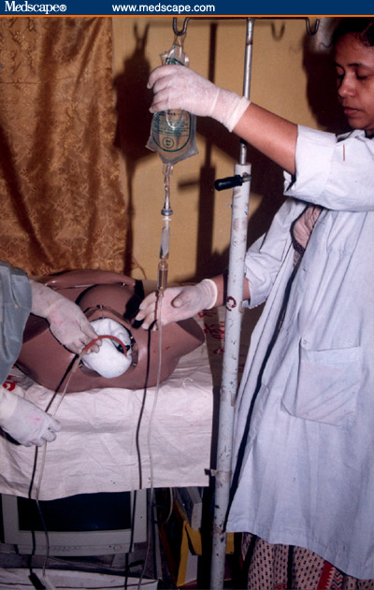
outer end of the catheter was folded and tied with thread

Slide 41
To keep the Uterine balloon in situ
the vaginal cavity was filled with roller gauze and finally a sanitary pad..
or the vaginal cavity was filled with another inflated condom placed in the vagina

Slide 42
Abdominal Ultrasound
if the concern for concealed hemorrhage still exists, ultrasound can more effectively
detect a developing hematoma when the contrast is a fluid-filled balloon .

Slide 43
Maintaining Uterus Contracted
An intravenous drip containing oxytocin was kept for at least 6 h after the procedure was performed to maintain the uterus contracted over the inflated balloon.
Temporary external compression of the uterus (Firm pressure was also applied by hand to the outer and inner side of uterine cavity )

Slide 44
For How Long ?
The condom catheter was kept for six to 24-48 hours ,
The mean duration of catheter in situ was 39 hours
then was deflated gradually over (10-15 minutes)
and removed.

Slide 45
antibiotic coverage
Patient was kept under triple antibiotic coverage
(amoxicillin [500 mg every 6 hrs]
+ metronidazole [500 mg every 8 hrs]
+ gentamicin [80 mg every 8 hrs]) administered intravenously
for 7 days.

Slide 46
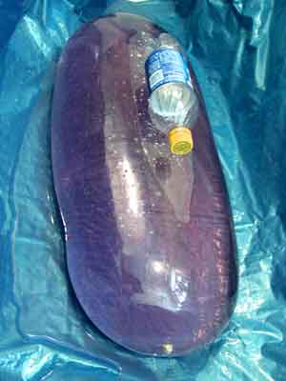

Condom is the best Balloon
It can expand to 20 litres and to stop bleeding one does not need to inflate it beyond one litre.”

Slide 47
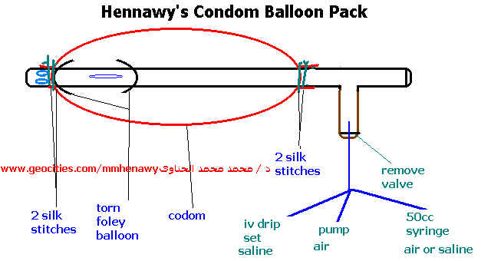
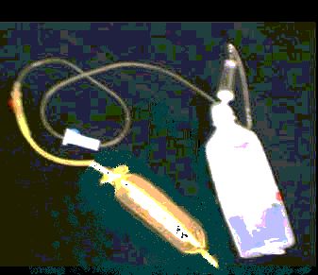
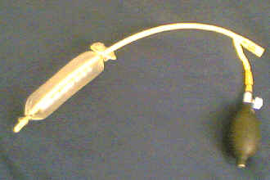

Slide 48
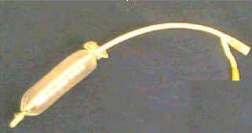
Condom Balloon 3
Hennawy, et al, 2005 (Hennawy’s Condom balloon pack )
a rubber catheter e.g a Foley’s catheter was inserted within the condom and tied near its mouth of the condom by a silk thread and tied near Foley’s tip by a silk thread after cutting foley;s inflatable balloon
  Put it Intrauterine , fill it with 200-500cc normal saline in the site of balloon
  A large drainage lumen allows continual monitoring of the tamponade process
  vagina packed with another condom
  Removed gradually after 6-24 hrs
  no infection (all given A/G/F x 7 days)
  Indications
  Atonic PPH
  PPH due to coagulation failure,
  in some cases of traumatic PPH
  If there is no drainage and/or the fundus is increasing in height, the balloon drainage port and tubing should be flushed clear of clots with 15-30 mL sterile isotonic saline

Slide 49
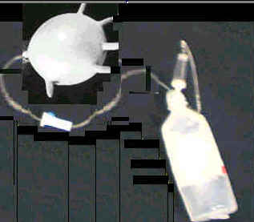
Glove Balloon
Basket, JOGC, 2004
Technique
  straight catheter and surgical glove
  tie at wrist with #1 vicryl
  insert and fill with 100cc

Slide 50

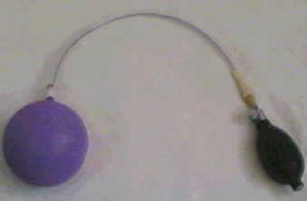
El-Menia Air-Infalted Eid Balloon
( el menia – egypt ) 2004
Technique
a Nelton’s catheter was inserted within the Ballon and tied near its mouth by a silk thread
Insert intrauterine
fill with 200-500 cc air
For Atonic PPH

Slide 51
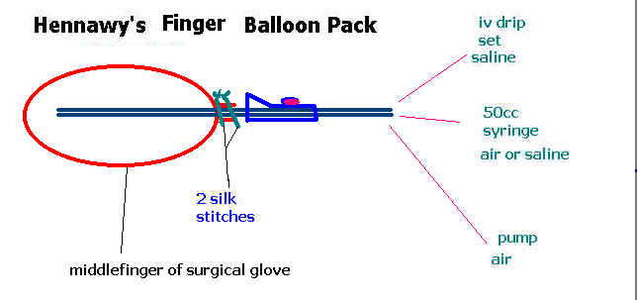

Slide 52
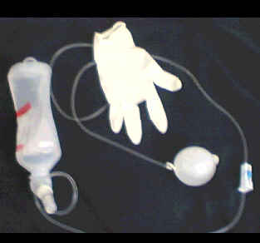
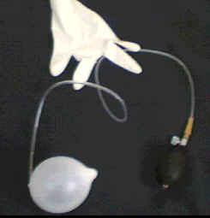
Finger balloon
Rass El Barr Balloon , Hennawy’s Finger balloon pack ( 2005)
Hydrostatic Uterine balloons
Technique 1
a Middle Finger Of Sterile Glove tied to the intravenous drip set of a saline bottle near its mouth by a silk thread
Insert finger balloon intrauterine
fill with 200-500 cc saline
Hydrostatic or Pneumatic Uterine balloons
Technique 2
a Middle Finger Of Sterile Glove tied to the intravenous drip set and 50 cc syringe
Insert finger balloon intrauterine
fill with 200-500 cc saline or air

Slide 53
Method of Application
Blind Method
Introduce your hand with it
Or a long forceps Then fill till no space
Go out with your hand or a long forceps
Continue filling till Bleeding reduced considerably, further inflation was stopped
Under Vision Method
Grasp Anterior and Posterior lips of cervix with 2 ovum forceps
Then introduce it
Fill till balloon appears at cervix Bleeding reduced considerably, further inflation was stopped
Under Ultrasound Guidance
Insert the catheter transvaginally under ultrasound guidance to:Assure that the uterus is clear of any retained placental fragments, arterial bleeding, or lacerations.
Determine approximate uterine volume by ultrasound

Slide 54
Conclusion
The hydrostatic condom catheter can control PPH quickly and effectively.
create a ballooning function by inflation with a reasonable amount of fluid.
This balloon exerts a similar pressure to that of other balloons to the open sinuses of the uterus and stops bleeding.
It conforms naturally to the contour of the uterus,
does not require any complex packing,
It does not require any anaesthesia
In developing countries where PPH remains a primary cause of maternal mortality, any healthcare provider involved in delivery may use this procedure for controlling massive PPH to save the lives of patients.
easy to remove.
In addition, it may be associated with lower infection risk as there is no direct intrauterine manipulation.
This intervention can be done cheaply, easily, and quickly,
and it does not require highly skilled personnel

Slide 55
Caution
It is not a substitute for surgical management and fluid resuscitation of life-threatening postpartum hemorrhage.
Signs of deteriorating or non-improving conditions should indicate more aggressive treatment and and management of postpartum uterine bleeding

Slide 56
Summary: Balloon Techniques
They all seem to work
most reported techniques call for
  warm NS 100-500 cc range
  consider vaginal packing
  prophylactic antibiotics
  stepwise removal at 6 -24 hours
It can also be inserted at time of cesarean from above

Slide 57
Uses of Uterine Balloons

Slide 58
when PPH that occurred as a result of atonicity
when PPH that occurred as a result of morbid adhesion (accreta) could not be controlled by uterotonics or a surgical procedure.
to control postpartum hemorrhage resulting from a low placental implantation
In patients who were in shock due to massive hemorrhage, a uterine balloon was introduced immediately without prior medical management
It is also used for bleeding related to abortion
Haemorrhage from the placental bed after removal of the ectopic Isthmico-cervical pregnancy by curettage
It is also used for repositioning of inverted uterus.

Slide 59
Uses of Vaginal Balloons

Slide 60
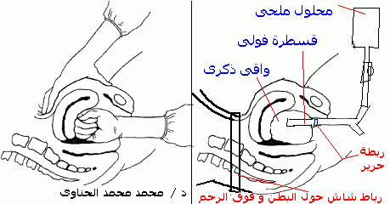
Bimanual compression of Uterus for slowing or stopping severe PPH | Hennawy Method of control severe PPH ( Vaginal condom balloon back Plus Abdominal binder (
The uterus is elevated out of the pelvis by the vaginal hand, and compressed against the back of the pubic bone by the abdominal hand | The uterus is elevated out of the pelvis by the vaginal balloon which inflated with 1000 cc saline or more, and compressed against the back of the pubic bone by the abdominal binder
 | Stop all types of PPH except retained parts of placenta
 | 2cases with good results
 | Need further evaluation

