Slide 1





Dr Muhammad El Hennawy
Ob/gyn Consultant
Rass el barr –dumyat - egypt www.mmhennawy.co.nr
Pernicious
Vomiting
Of
Pregnancy
Hyperemesis Gravidarum
( HG )

Slide 2

Names
Pernicious vomiting of pregnancy.
severe nausea and vomiting of pregnancy.
Severe Morning Sickness.
Persistent Vomiting of Pregnancy.
HG ( hyperemesis gravidarum) .
Uncontrollable vomiting during pregnancy .

Slide 3
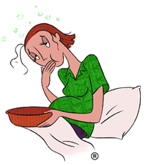
Nausea is the unpleasant, painless sensation that one may potentially vomit.
Vomiting is an organized, autonomic response that ultimately results in the forceful expulsion of gastric contents through the mouth.

Slide 4
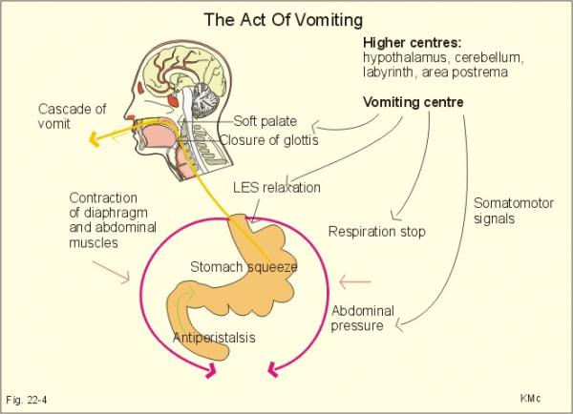
Act Of Vomiting

Slide 5
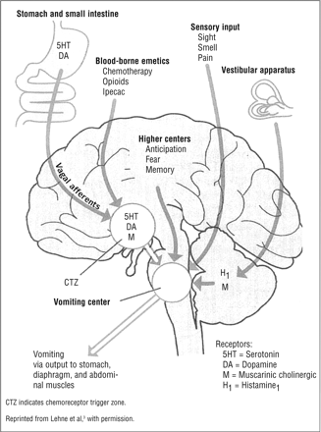
Protective Mechanism
Normal nausea and vomiting may be an evolutionary protective mechanism
It may protect the pregnant woman and her embryo from harmful substances in food, such as pathogenic microorganisms in meat products and toxins in plants, with the effect being maximal during embryogenesis (the most vulnerable period of pregnancy).
This is supported by studies showing that women who had nausea and vomiting were less likely to have miscarriages and stillbirth

Slide 6

Incidence
50 - 90 percent of pregnant women report having some nausea in their first trimester,
More than 40 percent report vomiting.
Vomiting usually begins around the fifth to sixth week of pregnancy and peaking at 9 weeks, and usually resolves on its own by week 16 – 18 .
However, symptoms may continue until the third trimester in 15 to 20 percent of gravida and until delivery in 5 percent.
If vomiting persists beyond a few days postpartum , other etiologies should be investigated.
Severe, persistent vomiting is called hyperemesis gravidarum. approximately 3.5 per 1000 pregnancies .
Hyper means ‘over’, Emesis means ‘vomiting’ and Gravidarum means ‘pregnancy’

Slide 7
Epidemiology
It is more common in:
Primigravida
Multiple pregnancy
History of previous hyperemesis
Mother or sister with HG
The presence of trophoblastic disease
Previous intolerance to oral contraceptives
Young maternal age under the age of 20
low to middle socioeconomic class
Lower levels of education
Carrying a female fetus.
No previous completed pregnancies
Obesity
History of infertility
Corpus luteum in right ovary,
Nonsmokers.
Women prone to travel sickness
Medical complications of hyperthyroid disorders, psychiatric illness, gastrointestinal disorders, pregestational diabetes, and asthma
It is less common with
Maternal age older than 30 years
Maternal smoking
Unmarried mothers.

Slide 8
Degree Of Nausea and Vomiting During Pregnancy
IN EARLY PREGNANCY
- Related to pregnancy
Mild --- in evening or morning ---- mild emesis gravidarum
Moderate – with meals ---- moderate emesis gravidarum
Severe --- frequent more than 10 times
- without affection of general condition of pregnant---severe emesis gravidarum
- with affection of general condition of pregnant ----- HYPEREMESIS GRAVIDARUM
= hyperemsis gravidarum without complications
= hyperemsis gravidarum with complications
- Other causes of nausea and vomiting
IN LATE PREGNANCY
-HYPEREMESIS GRAVIDARUM
- Other causes of nausea and vomiting

Slide 9
= hyperemsis gravidarum without complications
with affection of general condition of pregnant ( increase pulse over 100 + Decrease systolic blood presure below 100 + increase temp above 38 degree + dehydration like dry tongue , sunken eyes + ketosis
= hyperemsis gravidarum with complications
  Esophageal rupture or perforation
  Pneumothorax and pneumomediastinum
  Wernicke encephalopathy or blindness
  Hepatic disease
  Seizures, coma, or death
. Others complications include renal failure, pancreatitis, deep venous thrombosis, pulmonary embolism, central pontine myelinolysis, rhabdomyolysis, vitamin K deficiency and coagulopathy, and splenic avulsion.

Slide 10
Severity
Assessment of severity by checking for ketones is important as severity determines management

Slide 11
Emesis Gravidarum | Hyperemesis Gravidarum
common | rare
Confined to meals | Repeated throughout day severe and persistent
Not affect general condition | affect general condition weight loss, dehydration, nutritional deficiencies, electrolyte imbalance, pH imbalance (metabolic acidosis), and possible liver damage
suppress about 12 week Even without treatment | Progressive course even fatal unless effective treatment often persists for the duration of the pregnancy
A rarely need hospitalisation | Always need hospitalisation
Need Oral fluid | Need Enteral or Parenteral fluid

Slide 12
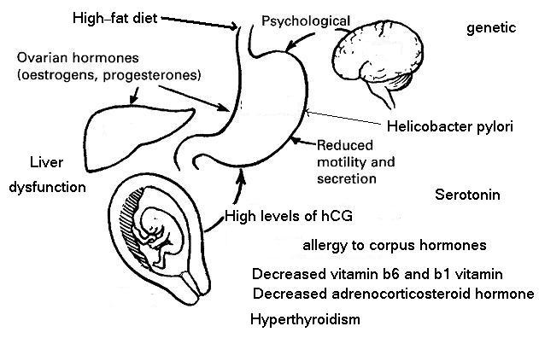

The Causes

Slide 13
The Causes
The pathogenesis of NVP is poorly understood and the etiology is likely to be multifactorial
Genetic component, as sisters and daughters of women with hyperemesis have a higher incidence .
Hormonal: high human chorionic gonadotrophin (hCG) stimulates the chemoreceptor trigger zone in the brain stem including the vomiting center. This is the most accepted theory and proved by the higher frequency in the conditions where the hCG is high as in:-
  early in pregnancy, - vesicular mole and - multiple pregnancy.
Allergy: to the corpus luteum or the released hormones. As Increased estrogen levels affects the part of the brain that controls nausea and vomiting.
Deficiency of: - adrenocortical hormone and /or, - vitamin B6 and B1
Nervous and psychological: due to
  psychological rejection of an unwanted pregnancy,
  fear of pregnancy or labour so it is more common in primigravidae.
Hyperthyroidism most probably because of the thyrotropic action of human chorionic gonadotrophin (HCG).
High-fat diet. women with a high-fat diet are at a much greater risk for developing hyperemesis gravidarum. Their risk increases five times for every additional 15 grams of saturated fat (such as a quarter-pound cheeseburger) they eat each day.
Helicobacter pylori. 90% of pregnant women with hyperemesis gravidarum are also infected with this bacterium, which may sometimes cause stomach ulcers
Gastrointestinal changes. During entire pregnancy -Gastric dysrhythmias have been associated with morning sickness because the gastrointestinal tract more sensitive to the neural/humoral changes . acid reflux and the stomach emptying more slowly, which can cause nausea and vomiting .
Liver dysfunction - Liver disease, usually consisting of mild serum transaminase elevation, occurs in almost 50% of patients with hyperemesis gravidarum as a cause or as a result
Vestibular and olfaction : Hyperacuity of the olfactory system or subclinical vestibular disorders
Overactivation of sympathetic nerves and enhanced production of tumor necrosis factor (TNF)-alpha.21 to induce secretion of hCG.
Increased Serotonin - still awaiting larger studies to confirm its role in hyperemesis gravidarum.

Slide 14
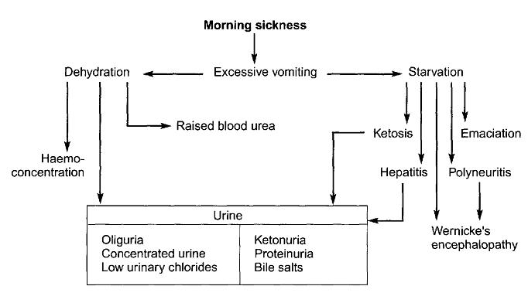
Effect Of Severe Vomiting

Slide 15
Pathological Changes
These are the same as in prolonged starvation:
Liver: small fatty infiltration.
Kidney: fatty degeneration of the convoluted tubules.
Heart: small subendocardial and subpericardial haemorrhages.
Brain: congestion and petechial haemorrhages in the brain stem resembling that of Wernicke’s encephalopathy.
Eye: optic neuritis and retinal haemorrhage.
Peripheral nerves: degeneration.
Blood:
  Hypovolaemia and haemoconcentration.
  Hyponatraemia, hypokalaemia and hypochloraemia.
  Increased blood urea.
  Hyperbilirubinaemia (due to liver damage).
  Acidosis.
Urine:
  Oliguria.
  Increased specific gravity.
  Decreased chloride.
  Albuminuria.
  Ketonuria.

Slide 16

Symptoms
Severe nausea
The patient cannot retain anything in her stomach, vomiting occurs through the day and night even without eating.
Thirst, constipation and infrequent urination
In severe cases, vomitus is bile and/ or blood stained.
Finally, there is manifestations of Werniche’s encephalopathy as drowsiness, nystagmus and loss of vision then coma.

Slide 17

Signs
Manifestations of starvation and dehydration:
Loss of weight -- loss of 5 or more pounds over a 1-2 week period.
Sunken eyes.
Dry tongue dry mucous membranes, and inelastic skin.
Teeth covered with sordes.
Breath acetone smell
Late , Slight jaundice (yellow coloring to skin or whites of eyes).
Pulse: rapid and weak.
Blood pressure: low.
Temperature: slight rise

Slide 18
Laboratory Studies
Initial lab studies for hyperemesis gravidarum should include the following:
Urinalysis for ketones and specific gravity: A sign of starvation, ketones may be harmful to fetal development. High specific gravity occurs with volume depletion.
Serum electrolytes and ketones: Assess electrolyte status to evaluate for low potassium or sodium, identify hyperchloremic metabolic alkalosis or acidosis, and evaluate renal function and volume status.
Liver enzymes and bilirubin: Elevated transaminase levels may occur in as many as 50% of patients with hyperemesis gravidarum. Mild transaminitis often resolves once the nausea has resolved. Significantly elevated liver enzymes, however, may be a sign of another underlying liver condition, such as hepatitis (viral, ischemic, autoimmune), or some other etiology of liver injury
Amylase/lipase: Amylase level is elevated in approximately 10% of patients with hyperemesis gravidarum. Lipase, when combined with amylase, can increase the specificity in diagnosing pancreatitis as an etiology.
TSH, free thyroxine: Hyperemesis gravidarum is often associated with a transient hyperthyroidism and suppressed TSH levels in 50-60% of cases. However, an elevated free thyroxine may suggest that overt hyperthyroidism is present, thus necessitating further workup and treatment.
Urine culture: This may be indicated because urinary tract infection is common in pregnancy and can be associated with nausea and vomiting.
Calcium level: Consider measuring Ca++ levels. Some rare cases have been reported of hypercalcemia being associated with hyperemesis gravidarum, resulting from hyperparathyroidism.
Hematocrit: This may be elevated because of volume contraction.
Hepatitis panel: If clinically indicated, hepatitis A, B, or C may be confused with hyperemesis gravidarum.

Slide 19
Imaging Studies
Obstetric ultrasonography is usually warranted in patients with HEG to evaluate for multiple gestations or trophoblastic disease.
Additional imaging studies generally are not needed unless the clinical presentation is atypical (eg, nausea and/or vomiting beginning after 9-10 wk of gestation, nausea and/or vomiting persisting after 20-22 wk, acute severe exacerbation) or another disorder is suggested based on history or physical examination findings.
If indicated clinically, performing upper abdominal ultrasonography to evaluate the pancreas and/or biliary tree appears to be a low-risk study.
In rare cases, abdominal CT scan or even MRI may be indicated if appendicitis is under consideration as a cause of nausea and vomiting in pregnancy.

Slide 20

Procedures
In patients with abdominal pain or upper gastrointestinal bleeding, upper gastrointestinal endoscopy appears to be safe in pregnancy,
Although careful monitoring is suggested.

Slide 21

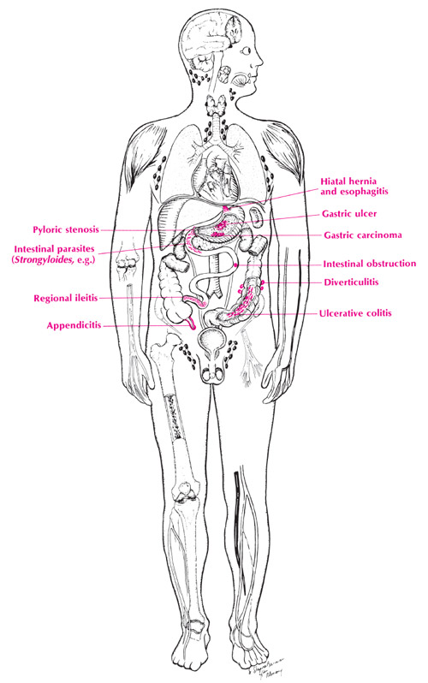
DD =rule out other possible causes
Vomiting due to pregnany : ectopic pregnancy, vesicular mole , acute hydramnios, acute fatty liver , severe pre-eclampsia , complicated ovarian tumours
Vomiting during pregnancy : cholecystitis, appendicitis, pyelonephritis, Esophagitis ,gastroenteritis, Irritable Bowel Syndrome , gall bladder diseases, , Hepatitis , Hyperthyroidism , Pancreatitis , Peptic ulcer disease , Thyrotoxicosis caused by Grave's disease), ,nephrolithiasis, diabetic ketoacidosis or gastroparesis, Vestibular lesions , benign intracranial hypertension, and migraine headaches.

Slide 22

Prophylaxis
Although there are no known ways to completely prevent hyperemesis gravidarum,
The following measures might help keep morning sickness from becoming severe:
Eating small, frequent meals
Eating bland foods
Waiting until nausea has improved before taking iron supplements
Using a pressure-point wrist band, vitamin B6, and/or ginger,

Slide 23
Aim Of Treatment
Hospitalisation for observation, fluid therapy and competition of neurosis
TTT dehydration ( Oral Or Intravenous Hydration ) .
TTT starvation ( Oral feeding Or Enteral nasogastric or gastric feeding Or Parenteral nutrition)
TTT electrolyte disturbance
TTT nausea and vomiting ( Vitamin B6 , antihistaminic , Anti-emetic , Prokinetic , corticosteroid )
Prevent and TTT complications

Slide 24
TTT
Treatment for Hyperemesis gravidarum is not cheap.

Slide 25
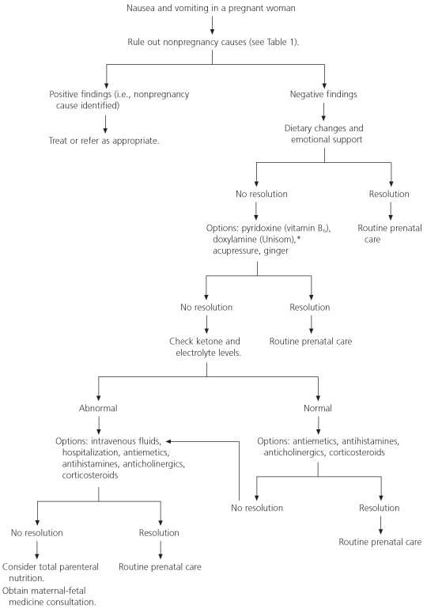

Slide 26
Patient Education
Early patient education about the signs and symptoms of pregnancy may be beneficial.
It is found an association between nausea and vomiting and insufficient knowledge about pregnancy, stress, doubts regarding the pregnancy, and poor communication with the doctor and spouse.

Slide 27
Activity
Some patients note improvement of nausea and vomiting with decreased activity and increased rest.
Other patients suggest that fresh outdoor air may improve symptoms.

Slide 28





Advice
Avoid :Stuffy rooms Odors (eg, perfume, chemicals, coffee, food, smoke) , Heat and humidity , Noise , Visual or physical motion (eg, flickering lights, driving) , Being tired
When eating
• Tea and dry biscuit before getting up
• Eat small frequent meals. Eat something every 2–3 hours to avoid hunger
• Drink fewer liquids with meals. Drinking liquids can cause a full, bloated feeling. Drink liquids 1/2 to 1 hour - at least 2 litres of fluids daily
• Drink cold, clear, and carbonated or sour fluids (eg, ginger ale, lemonade)
• When feeling nauseated, slowly sip on carbonated
• Not mixing solids and liquids can increase nausea
After meals
• Brushing teeth after eating may help prevent symptoms. Avoid lying down immediately after eating
• Rest after meals. Sit up in a chair for about an hour after meals
• Avoid sudden movements. Rise slowly from the bed
• Avoid these foods: – Fatty, greasy, or fried – Spicy or hot –– With strong odors, like cooked broccoli, cabbage, fish, etc.
Avoid fast-release sugar like very sweet, such as candy, cake or cookies is quickly metabolised and hypoglycaemia follows, leading to a vicious circle of eating – nausea – eating, and the risk of excessive weight gain. Slow-release carbohydrates are better, including bananas, porridge, jacket potatoes, wheatgrain toast, rice crackers etc.
• Choose bland foods. Try toast, crackers, pretzels, rice, oatmeal, skinned chicken (baked or broiled, not fried), and fruits and vegetables that are soft or bland, like canned peaches
• Eat easily digested starches, like rice, potatoes, noodles, cereal and bread
• Pick low fat protein foods. Eat lean beef and pork, skinless chicken or turkey, eggs, and boiled beans
• Try eating salty, sweet food combinations, like potato chips or pretzels and Lemonade or sour patch kids, before meals
• Prepare foods that do not require cooking, like sandwiches
• Smelling fresh lemon, mint, or orange or using an oil diffuser with these scents may also be useful
Wear loose clothes

Slide 29
Emotional Support
Although nausea and vomiting of pregnancy and hyperemesis gravidarum are not strongly associated with psychologic illness, some women may become depressed or exhibit other affective changes.
It is important that these women receive appropriate support from family members and medical and nursing staff.
Consultation is indicated if a pregnant woman is depressed, domestic violence is suspected, or evidence of substance abuse or psychiatric illness exists.
Diazepam (Valium) has been used in one randomized study and appeared to shorten hospitalization, significantly reduce nausea, and decrease readmission for HEG. No significant adverse effects or fetal abnormalities were observed. But Dose not established for HG.

Slide 30
Peppermint Essential Oil
The aroma of peppermint can help a queasy stomach.
Fill a large bowl with hot water. Place two drops of peppermint essential oil in the bowl and place it on a table near the bed.

Slide 31










GINGER
Ginger (Zingiber officinale) is present as a spice in foods and beverages.
It can also be taken in the form of tea or tablet extracts
There is only one RCT examining the efficacy, but not
the safety, of 1000 mg/day of ginger.
Adult 250 mg PO qid (powdered ginger root).
Ginger is a nonregulated food product and most preparations available are of uncertain purity and composition.
No evidence-based studies have been published to exclude the possibility of teratogenicity, and at the present time, large quantities of ginger should not be recommended as a treatment for NVP.

Slide 32
How To Make
Ginger Tea for Nausea
Ingredients
1 teaspoon fresh grated ginger
2 teaspoons tea powder
1 teaspoon sugar or honey
1/2 teaspoon lemon juice (optional(
4 cups water
Procedure
Add 1 teaspoon fresh grated ginger to 4 cups boiling water and simmer for about 5 minutes.
Now add 2 teaspoons of tea powder.
Strain the tea after a few minutes and
Mix 1 teaspoon sugar or honey to the strained tea.
Add 1/2 teaspoon lemon juice (optional) and serve hot.
Add some cloves, cardamom or lemon grass if pregnant wish to make the tea stronger.
For a sour taste, pregnant could add some orange peel strips.
Ginger tea recipe is a remedy for nausea.

Slide 33



Vestibular stimulation
NVP is triggered, and can be exacerbated by abnormal effects on the vestibular (balancing) mechanism in the ear
NVP is often worse for women prone to travel sickness, and normalisation of the balancing mechanism can be a simple means of reducing the severity of symptoms.
A contemporary commercial DVD (Morningwell) is now available uses inaudible pulsed frequencies overlaid with music, and must be used with personal headphones so that the pulsations rebound on the vestibular apparatus in the ears.
90% successful in suppressing NVP.

Slide 34
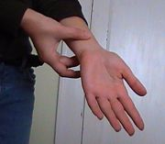

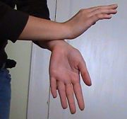
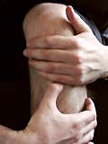
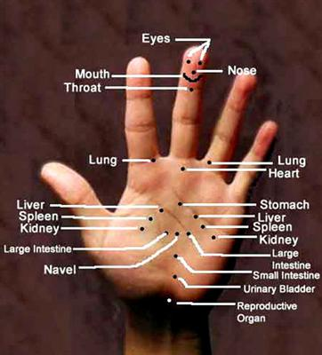
Acupressure
Acupressure is the stimulation by pressure on specific sites called acupoints.
Relief in 10-30 seconds. Sometimes, however, it can take up to five minutes.
The most common acupoint in the treatment of nausea and vomiting is the pericardium 6 (P6), located three fingers' width above the wrist on the inner arm surface
Or tap both wrists together gently at the acupressure points while taking deep breaths
Also St36 , On the front of the leg, one hand width (four fingers) below the knee cap, on the outside, in the depression between the shin bone and the leg muscle.
Also point in palm 2 finger breadth below the base of second and thied finger
The advantage of acupressure in treating NVP is that there is no exogenous source of risk to the fetus..
In addition, a transcutaneous electronic acoustic stimulator of P6 is available,

Slide 35


P6 Wrist Bands
They are inexpensive, can be positioned over acupressure points on both wrists .
On the other hand, traditional acupuncture should be performed only under the supervision of a trained professional.

Slide 36


Vitamins
Essential for normal DNA synthesis and play a role in various metabolic processes.
Vitamin B6 (Pyridoxine) which helps ease nausea (if pregnant can not take it orally pregnant can give it as an injection) 10-50 mg PO bid/qid (often 30-100 mg/d)
Tri-B Tablet - Ampoule
Each Ampoule 1 contains:- Vitamin B1--------100 mg. - Vitamin B6 ------- 40 mg.
- Ampoule 2 contains:- Vitamin B12------ 1000 mcg.
Each tablet contains: - Vitamin B1 ------ 125 mg. - Vitamin B6 ------ 125 mg.
- Vitamin B12 ---- 125 mcg. - Folic acid -------- 5 mg.
Dosage and Administration:-
- Injection: The contents of the ampoules 1 and 2 are mixed and injected intramuscularly daily.
- Tablets: 1- 2 tablets daily.

Slide 37
Antihistamines
Antihistamines (H1 histamine receptor antagonists) are effective in nausea and vomiting during pregnancy and in small numbers of patients with HEG, providing relief in 82% of patients.
It decreases excitability of middle ear labyrinth and
Blocks conduction in middle ear vestibular-cerebellar pathways.
Competes with histamine for H1-receptor sites on effector cells in the gastrointestinal tract, blood vessels, and respiratory tract;
Anticholinergic and
Sedative effects are also seen
eg : Cyclizine , Diphenhydramine (Benadryl) Dimenhydrinate (Gravol, Dramamine), Meclozine (Bonine, Antivert).

Slide 38
Antiemetics
ANTIDOPAMINERGICS: PHENOTHIAZINES :
Compazine, Stemetil (Prochlorperazine).
Phenergan (Promethazine).
Thorazine (Chlorpromazine).
SEROTONIN ANTAGONISTS :
Ondansetron: (Zofran) .

Slide 39
Prochlorperazine (Compazine)
May relieve nausea and vomiting by blocking postsynaptic mesolimbic dopamine receptors through anticholinergic effects and depressing reticular activating system. In a placebo-controlled study, 69% of patients given prochlorperazine reported significant symptom relief, compared to 40% of patients in the placebo group.
PO: 5-10 mg tid/qid; not to exceed 40 mg/d
IV: 2.5-10 mg q3-4h prn; not to exceed 10 mg/dose or 40 mg/d
IM: 5-10 mg q3-4h
PR: 25 mg bid

Slide 40
Promethazine (Phenergan)
For symptomatic treatment of nausea in vestibular dysfunction. Antidopaminergic agent effective in treating emesis. Blocks postsynaptic mesolimbic dopaminergic receptors in brain and reduces stimuli to brainstem reticular system
PO: 12.5-25 mg q4-6h prn (syr or tab)
PR: 12.5-25 mg q4-6h prn
IV/IM: 12.5-25 mg q4-6h; use caution with IV administration, concentration not to exceed 25 mg/mL, rate not to exceed 25 mg/min; do not administer SC or intra-arterially

Slide 41
Chlorpromazine (Thorazine, Ormazine)
Mechanisms responsible for relieving nausea and vomiting include blocking postsynaptic mesolimbic dopamine receptors, anticholinergic effects, and depression of RAS. Blocks alpha-adrenergic receptors and depresses release of hypophyseal and hypothalamic hormones.
PO: 10-25 mg q4-6h prn
PR: 50-100 mg q6-8h prn
IM: 12.5-25 mg once; if no hypotension, may administer 25-50 mg q3-4 h prn; caution with parenteral administration because of the potential for hypotension

Slide 42
Ondansetron: (Zofran)
Selective 5-HT3-receptor antagonist, blocking serotonin, both peripherally on vagal nerve terminals and centrally in the chemoreceptor trigger zone
4-8 mg PO q12h
Alternatively, 8 mg administered IV over 15 min q12h or 1 mg/h infused continuously for up to 24 h

Slide 43
Prokinetic drugs
Metoclopramide (Reglan)
Blocks dopamine receptors and (when given in higher doses)
Also blocks serotonin receptors in chemoreceptor trigger zone of the CNS;
Enhances the response to acetylcholine of tissue in upper GI tract causing enhanced motility and accelerated gastric emptying without stimulating gastric, biliary, or pancreatic secretions;
Increases lower esophageal sphincter tone
10 mg PO 30 min ac and hs or qid
Severe symptoms: 10 mg IV over 1-2 min prn or q4-8h
The US Food and Drug Administration has issued a black-box warning concerning the use of Reglan in general. Because the risk for tardive dyskinesia increases with the duration of treatment and the total cumulative dose, treatment duration should not exceed 12 weeks

Slide 44
ANTICHOLINERGICS/ANTISPASMODICS
Should not be used in treatment of hyperemesis gravidarum.
These agents slow gastric emptying and prolong GI transit time.
Since slowed gastric emptying is part of the etiology of HG, these agents are inappropriate.

Slide 45

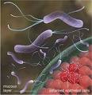


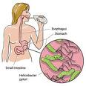
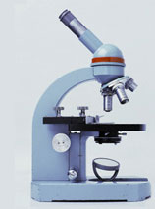
Helicobacter Pylori Treatment
Helicobacter pylori is a Gram-negative, microaerophilic bacterium that can inhabit various areas of the stomach, ‏
Good results have been reported following treatment with
an oral antibiotic
and proton pump inhibitor
and H2 antagonist.

Slide 46
Screening Tests Used To Detect H. pylori
* Blood antibody test. A blood test checks to see whether the body has made antibodies to H. pylori bacteria. If pregnant have antibodies to H. pylori in her blood, it means pregnant either are currently infected or have been infected in the past.
* Stool antigen test. A stool antigen test checks to see if substances that trigger the immune system to fight an H. pylori infection (H. pylori antigens) are present in the feces (stool). Stool antigen testing may be done to help support a diagnosis of H. pylori infection or to determine whether treatment for an H. pylori infection has been successful.
* Stomach biopsy. A small sample (biopsy) is taken from the lining of the stomach and small intestine during an endoscopy. Several different tests may be done on the biopsy sample.

Slide 47
Oral Antibiotic For H . Pylori
PPI (Bantobraozl 20 mg twice daily )
+ Clarithromycin 500 mg twice daily
+ Amoxicillin 1000 mg twice daily
or
PPI + clarithromycin + metronidazole
Dose taken with a glass of water before eating for a period of 14 days
Clarithromycin should not be administered in pregnant women except in clinical circumstances where no alternative treatment option is appropriate
Metronidazole also carry a black box warning because of its known ability to be carcinogenic in mice and rats
Rapid marked response of severe hyperemesis gravidarum to oral erythromycin.

Slide 48
Corticosteroids
For treatment for women with refractory hyperemesis gravidarum in women who fulfil the criteria of severe disease. .
Corticosteroids should only be given after 10 weeks of gestation, and only to women who do not have symptom relief with other treatments.
May improve symptoms of nausea and vomiting
The use of glucocorticoids before 10 weeks of gestation was associated with a 3- to 4- fold higher risk for cleft lip with or without cleft palate
Intravenous methylprednisolone (Medrol, Solu-Medrol) 40 of every 8 hours or an oral methylprednisone 8-12- 16 mg 3 times per day or oral prednisolone 10-15-20 mg t.i.d for three days was followed by an oral prednisone taper for 7 days.
Intravenous Hydrocortisone 150-300 mg as a daily dose (50-75-100 mg t.i.d ) then after 3 days the hydrocortisone was tapered completely during the course of 1 wk
Short course of corticosteroids is an effective treatment for intractable hyperemesis gravidarumand can significantly reduce the need for hospitalization.
Adrenal suppression isn't a concern unless a patient has been on systemic steroids for longer than 1 month--and again, most patients can be managed successfully with 2 weeks or less of therapy, she continued

Slide 49
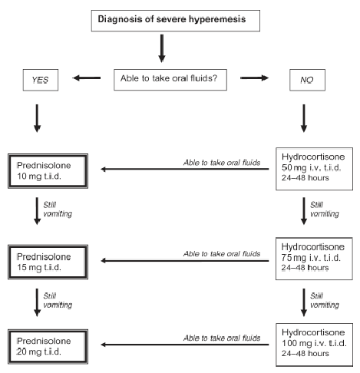

Slide 50
ACTH
Hyperemesis gravidarum were treated with intramuscular ACTH (0.5 mg) or placebo for 4 days in a randomized double-blind trial.
The two treatments were equally effective in relieving hyperemesis, although the function of the adrenal cortex was stimulated only during the ACTH therapy.
The administration of ACTH thus appears useless for the treatment of severe vomiting in early pregnancy.

Slide 51
ANTIREFLUX THERAPIES
The following adjuvant therapies are used primarily to reduce esophageal acid reflux associated with NVP.
They have all been shown to bring symptomatic relief in the non-pregnant population and are presumed to be effective in pregnancy as well.
Antacids usually contain salts of magnesium, calcium, or aluminum.
A wide proportion of pregnant women already use this kind of medication. These are not considered human teratogens when used in recommended doses.
H2 receptor antagonists include cimetidine, ranitidine( 400 mg twice daily ), and famotidine.
Use of these medications has not been associated with an increased risk for major malformations following first trimester exposure.
Proton pump inhibitors such as omeprazole ( 20 mg twice daily ) have been used in limited numbers during pregnancy.
A recent study did not show an increased risk of congenital malformations.

Slide 52
Anti-thyroid drugs
As hyperthyroidism has been noted in patients with hyperemesis gravidarum,
it is tempting to prescribe anti-thyroid medication in an
attempt to suppress symptoms.
However, the role of anti-thyroid drugs in management remains unclear.
A short course of anti-thyroid drugs may be beneficial and can be discontinued once the vomiting has settled.
Other researchers however, have reported no benefits with anti-thyroid drugs as the hyperthyroidism is transient and self limiting.
Until more evidence is available, anti-thyroid drugs should not be routinely prescribed.

Slide 53
Cannabis
Cannabis has anti-nauseant and anti-emetic effects
Dose not established for HG
Medical Marijuana is currently legal in the following states (US): Alaska, California, Washington, Oregon, Hawaii, Colorado, Arizona, Maine.

Slide 54
Hospitalization
Severe cases of hyperemesis gravidarum require hospitalization.
Once at the hospital, pregnant receive intravenous fluids, glucose, electrolytes, and, occasionally, vitamins and other nutritional supplements

Slide 55
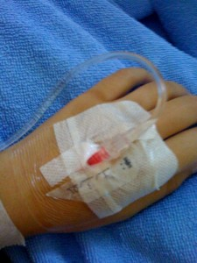
IV Fluid
At first, patients are given nothing by mouth.
Initial treatment is IV fluid resuscitation, beginning with 2 L of glucose 5% infused over 3 h to maintain a urine output > 100 mL/h.
Give Ringer's lactate according to acetone level ( 250-500 ml ) every 12 hour
Give thiamin 100 mg should be given IV Or IM first with glucose5%, to prevent Wernicke's encephalopathy. This dose of thiamin should be given daily for 3 days.
Subsequent fluid requirements vary with patient response but may be as much as 1 L q 4 h or so for up to 3 days.
Electrolyte deficiencies are treated; K, Mg, and P are replaced as needed.
Care must be taken not to correct low plasma Na levels too quickly because too rapid correction can cause osmotic demyelination syndrome.
Intravenous fluid therapy may be given in the hospital or at home by a visiting nurse

Slide 56
Nutritional Support
Women who do not respond to IV rehydration and medication may require nutritional support.
Patients might receive
Enteral nutrition (via a 6- to 8-French nasogastric tube or a percutaneous endoscopic gastrostomy (PEG).
Parenteral nutrition (intravenous feeding via a PICC line)

Slide 57
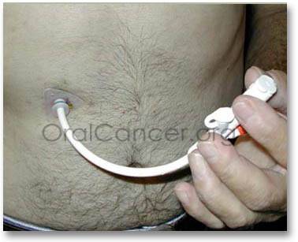
Feeding tubes
May be inserted through the nasal passage way for short-term use,
But for those patients who require longer use of the tube, it is customary to place the tube directly into the stomach through the abdominal wall. This second method is called a percutaneous endoscopic gastrostomy (PEG)
The lifespan of the feeding tube is about six months. When the tubing begins to wear, it may pull away from the stomach wall and cause leakage near the insertion point. The replacement process is relatively simple, and usually does not involve another endoscopic procedure. Typically, the tubing is merely pulled out through the stomach site and then replaced with a new catheter

Slide 58
ENTERAL NUTRITION REGIMEN
A polymeric formula with or without fiber may be used
for the majority of HEG patients.
In the clinic setting, health care providers can administer 25 mL and increase to 60–120 mL of the formula over a few minutes through the tube every hour ,
Followed by a water flush.
This will allow the clinician to check tolerance of the formula and provide some gastric nutrition to lessen the potential for nausea and emesis during the ride home

Slide 59
Parenteral Hyperelimentation (TPN)
Parenteral hyperalimentation (TPN) is the administration of an IV solution designed to provide complete nutritional support for a patient unable to maintain adequate nutritional intake.
The solution is normally composed of dextrose (5%35%), amino acids (3.5%5%), vitamins, electrolytes, and trace elements. Lipids (IV fat emulsions) are often given with TPN to supply essential fatty acids and calories
Maternal indications for TPN have been varied, with duration of therapy ranging from a few days to the entire pregnancy

Slide 60
Termination of pregnancy
Indications:
Persistent severe vomiting after one week of treatment.
Pulse is persistently above 100/min, temperature persistently above 38oC or the systolic blood pressure is persistently below 100 mmHg.
Jaundice or bile in urine.
Anuria, absence of chloride in urine, persistent albuminuria or high blood urea.
Retinal haemorrhage or Wernicke’s encephalopathy .
Methods of termination:
Vaginal evacuation: if pregnancy is less than 12 weeks.
Abdominal hysterotomy: if pregnancy is more than 12 weeks. Use nitrous oxide + oxygen for anaesthesia but not agents that affect liver as halothane. Prostaglandins cannot be used as it will aggravate the vomiting

Slide 61
Recommendations
Dietary and lifestyle changes should be liberally encouraged, and women should be counselled to eat whatever appeals to them. (III-C
Early recognition of the problem with adequate and prompt rehydration is essential. Withhold oral feeding until vomiting is under control
2. Alternative therapies, such as ginger supplementation, acupuncture, and acupressure, may be beneficial. (I-A)
3. A doxylamine/pyridoxine combination should be the standard of care, since it has the greatest evidence to support its efficacy and safety. (I-A)
4. H1 receptor antagonists ( antihistamincs ) should be considered in the management of acute or breakthrough episodes of NVP. (I-A)
5. Pyridoxine monotherapy supplementation may be considered as an adjuvant measure. (I-A)
6. Phenothiazines are safe and effective for severe NVP. (I-A) And Ondansetron (1-B).
7. Metoclopramide is safe to be used for management of NVP, although evidence for efficacy is more limited. (II-2D)
8. Corticosteroids should be avoided during the first trimester because of possible increased risk of oral clefting and should be restricted to refractory cases. (I-B)
. Prochlorperazine (category C) and Promethazine (category C)
9. When NVP is refractory to initial pharmacotherapy, investigation of other potential causes should be undertaken. (III-A)
Psychotherapy - might be necessary if there is clinical suspicion of a psychological problem

Slide 62
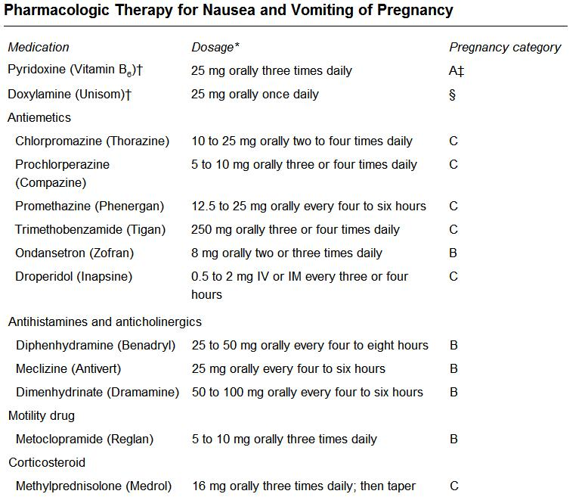

Slide 63
Maternal And Fetal Outcomes
. Women with uncomplicated nausea and vomiting of pregnancy (“morning sickness”) have been noted to have improved pregnancy outcomes, including fewer miscarriages, pre-term deliveries, and stillbirths, as well as fewer instances of fetal low birth weight, growth retardation, and mortality.
In contrast, hyperemesis gravidarum has been associated with increases in maternal adverse effects, including dehydration , malnutrition , hypoglycaemia, splenic avulsion, esophageal rupture, Mallory-Weiss tears of oesophagus ,wernicke’s encephalopathy, pneumothorax, peripheral neuropathy, thromboembolic disorders (deep venous thrombosis, pulmonary embolism), central pontine myelinolysis, rhabdomyolysis, vitamin K deficiency and coagulopathy, acute renal failure and preeclampsia, as well as increases in fetal growth restriction and mortality
Recent research in fetal programming indicates that prolonged stress, dehydration and malnutrition during pregnancy can put the fetus at risk for chronic disease, such as diabetes or heart disease ,later in life, or neurobehaviorial issues from birth
Complications associated with central hyperalimentation include sepsis, fungemia, tamponade, local infection, venous thrombosis, fatty infiltration of the placenta, and transaminitis.

Slide 64
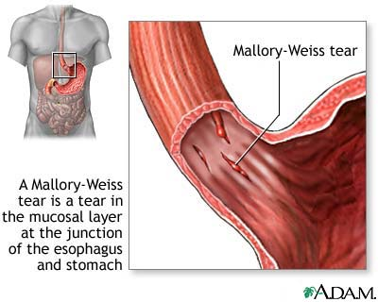
Mallory-Weiss Oesophegeal Tears
They are extremely rare, but do happen.
Tears to the cardiac part of the stomach from excessive vomiting

Slide 65
Wernicke's Encephalopathy
A syndrome related to thiamin deficiency that may cause disorientation, confusion, and coma
Have been reported in some rare cases
Treatment begins with intravenous or intramuscular injection of thiamine, followed by assessment of central nervous system and metabolic conditions.
In the presence of sub-clinical thiamine deficiency, a large dose of sugar (especially glucose) can precipitate the onset of overt encephalopathy
Therefore, correcting hypoglycemia should not be attempted before thiamine replenishment.
Rehydration to restore blood volume should follow, as needed

Slide 66

The physical And Emotional Impact Of NVP
It often results in feelings of anxiety and worry about the
effect of the symptoms on the fetus.
It has a negative impact on family relationships
and has major consequences on women’s working abilities;
47% of working women with NVP feel job efficiency is reduced,
35% lose work time (mean loss of 62 working hours per woman), and
25% lose time from housework (mean loss of 32 hours per woman).
NVP is also cited as a reason for elective termination of pregnancy.

Slide 67
Follow-up
Further Inpatient Care
Inpatient care of hyperemesis gravidarum may be necessary if outpatient treatment fails or if severe fluid and/or electrolyte imbalance and nutritional compromise exist
Further Outpatient Care
Monitor patients regularly, paying attention to symptoms and to the state of mind of the patient and family. Monitor weight and urinary ketones at each visit.

Slide 68
Prognosis
Hyperemesis gravidarum is self-limited
In most cases, improves by the end of the first trimester.
However, symptoms may persist through 20-22 weeks of gestation and,
In some cases, until delivery.

Slide 69
Recurrence Of Hyperemesis
Hyperemesis gravidarum is more strongly influenced by the maternal genotype than the fetal genotype, though environmental influences along the maternal line cannot be excluded as contributing factors
Daughters who were born after a pregnancy complicated by hyperemesis had a 3% risk of having hyperemesis in their own pregnancy, while women who were born after an unaffected pregnancy had a risk of 1.1%
Female partners of sons who were born after pregnancies complicated by hyperemesis had a risk of 1.2% .
Daughters born after a pregnancy not complicated by hyperemesis had an increased risk of the condition if the mother had hyperemesis in a previous or subsequent pregnancy if hyperemesis had occurred in one of the mother’s previous pregnancies and if it had occurred in a later pregnancy).

Slide 70
العلاج
راحة تامة بالسرير مع عدم التفكير الدائم بالحمل بتسلية ما
تسمع موسيقى بواسطة سماعات الأذن ( موسيقى هادئة مع خلفية موسيقى للطبيعة )
الضغط على باطن الرسغ على مسافة عرض 3 أصابع من نهاية كف اليد لمدة3 دقائق فى كلتا اليدين كل ساعة
لاشى بالفم لمدة يومين + 2أ مبول جلوكوز مركز كل 6 ساعات ( 100 سم جلوكوز مركز 25 % )
المحاليل = 2000 سم جلكوز 5% الآن على مدى ساعتين
ثم 500 سم جلكوز 5% كل 6-8 ساعات + 500 سم ملح كل 6-8 ساعات + 250- 500 سم رينجر لاكتات كل 12 ساعة بحيث يكون كمبة البول 100 سم فى الساعة
ملاحظة عدد مرات القىء و كميته و وجود دم به
تحليل بول للأسيتون كل 12 ساعة وحساب كمية البول كل 24 ساعة
تحليل بول كامل + تحليل وظائف كلى + تحليل وظائف كبد
عمل أشعة تليفزيونية على الرحم والجنين ( حمل عنقودى أ و توائم )
عمل جدول للسوائل الداخلة و الخارجة
امبول كالسيوم جلوكونات وريد ببطء يوميا
فيتامينات = امبول فيتامين ب (6+1) كل يوم ( أمبول تراى بى عضل يوميا ) + امبول فيتامين ج كل يومين + امبول فيتامين كاف كل 3 أيام
إعطاء أمبول مضادالهيستامين1 يوميا (أمبول أفيل )
إعطاء ACTH أمبول ( كورتجن ب6 أمبول ) كل 12 ساعة
إعطاء أدوية منظمة لحركة الجهاز الهضمي = أمبول بلازيل كل 12 ساعة
إعطاء مضادات القىء 2 دواء من الآتى = أمبول نيورازين 25 مجم كل 8 ساعات أو أمبول زوفران كل 12 ساعة أو إيميرال لبوس شرجى كل 12 ساعة أو موتيليوم لبوس شرجى كل 12 ساعة
إعطاء مضادات الحموضة = مثل إبيكو جيل 15سم كل 4 ساعات أو مضادات الهيستامين2 مثل زنتاك 400 محم مرتين يوميا أو مضادات مضخة البروتون مثل أوميبرال 20 مجم مرتين يوميا بالفم
إعطاء مضادات حيوية ضد ميكروب الهيلكوباكتر بيلوراى مثل الأموكسيسيلين 1000 مجم كل 12 ساعة بالفم
إعطاء مهدى مثل أمبول فاليوم مع العرض على طبيب أمراض نفسية
فى الحالات الشديدة إعطاء كورتيزون = هيدروكورتيزون 50 - 100 مجم وريد كل 8 ساعات لمدة 3 أيام ثم يخفض تدريجى على مدى أسبوع
إذا نجح العلاج --- تخرج من المستشفى ولكن إعرف أنها ستعود
إذا فشل العلاج بعد أسبوع إعطى تغذية بالرايل أو تغذية وريدية
فإذا نجح العلاج --- تخرج من المستشفى ولكن إعرف أنها ستعود
إذا فشل العلاج مرة أخرى بعد أسبوع أو ظهرت مضاعفات خطيرة -- تجرى عملية إجهاض للجنين

