Slide 1

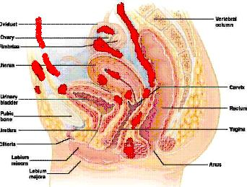
Puerperal
Genital Hematomas
Dr Muhammad M El Hennawy
Ob/gyn Consultant
59 Street - Rass el barr –dumyat - egypt
www. mmhennawy.co.nr

Slide 2
What Is A Hematoma?
Postoperative Hematoma is basically a localized collection of blood outside of blood vessels in the surgery site , prompting blood to seep out of the blood vessel into the surrounding tissues.
It develops just a few hours after the surgery, due to some kind of damage to the wall of the surrounding blood vessels (artery, vein, or small capillary) or as a result of poor aftercare of the patient.
A hematoma usually describes bleeding which has more or less clotted, whereas a hemorrhage signifies active, ongoing bleeding
Hematomas may occur in the potential pelvic extraperitoneal spaces, including the perivaginal space, pericervical space, presacral space, and broad ligament space, and may extend superiorly to contiguous abdominal extraperitoneal spaces

Slide 3
INCIDENCE
Puerperal hematomas are serious obstetric complications.
It occurs in approximately 1 in 500 to 1 in 1500 deliveries,
It occurs in approximately 1 in 1000 surgical intervention

Slide 4
Women At Increased Risk
The pregnant uterus, vagina, and vulva have rich vascular supplies that are at risk of trauma during the birth process, and trauma may result in formation of a hematoma
Women at increased risk include those who are
- nulliparous ,
- maternal age more 29 years ,
- who have an infant over 4000 grams ,
- Preeclampsia ,
- prolonged second stage of labor ,
- instrumental delivery ,
- multifetal pregnancy ,
- vulvar varicosities, or
- clotting disorders.
In cases of placenta accreta or increta, the uterus may invade other organs, making immediate surgery difficult, if not impossible. Under such circumstances, abnormal vascularity may be evident.

Slide 5
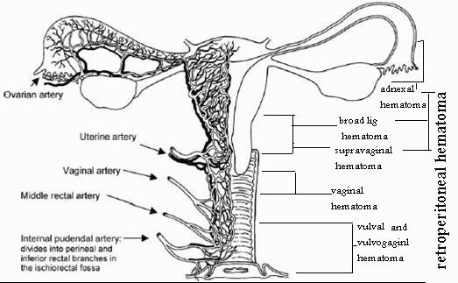
Blood Supply To Female Genital Tract

Slide 6
Superfacial wound hematoma
A swollen lump under the skin near the surgery wound .
It is a collection of blood and clot in the wound, is one of the most common wound complications and is almost always caused by imperfect hemostasis
The risk is much higher in patients who have been given systemically effective doses of anticoagulants and those with preexisting coagulopathies.
Vigorous coughing or marked arterial hypertension immediately after surgery may contribute to the formation of a wound hematoma.
Dehiscence is rare in patients under age 30
It is more common in patients with diabetes mellitus, uremia, immunosuppression, jaundice, sepsis, hypoalbuminemia, and cancer; in obese patients; and in those receiving corticosteroids.This is the single most important factor.
The fascial layers give strength to a closure, and when fascia disrupts, the wound separates.
Accurate approximation of anatomic layers is essential for adequate wound closure.

Slide 7
Rectus Sheath Hematoma (RSH)
Rectus sheath hematoma (RSH) is an uncommon and often misdiagnosed condition and an unusual cause of a painful abdominal mass.
The most frequent location is infraumbilical
It is the result of bleeding into the rectus sheath from damage to the superior or inferior epigastric arteries or their branches or from a direct tear of the rectus muscle.
The emergency physician should be familiar with rectus sheath hematoma because it can mimic almost any abdominal condition. While usually a self-limiting entity, rectus sheath hematoma can cause hypovolemic shock following sufficient expansion, with associated mortality
With early diagnosis and conservative management, surgical intervention can be avoided even with large hematomas
Spontaneous resolution of RSH, especially in large hematoma, however, takes place over several months.
Surgical intervention would be indicated primarily in cases in which homodynamic stability is not achieved

Slide 8
Hematomas above the arcuate line are generally caused by damage to the superior epigastric artery or its perforating branches. Patients usually present with unilateral, small, spindle-shaped masses because these hematomas are isolated by the rectus sheath and the tendinous inscriptions, causing tamponade of the bleeding. hematomas resolve by themselves within 1 month

Slide 9
Hematomas below the arcuate line are caused by damage to the inferior epigastric artery or its perforating branches. They protrude posteriorly and appear spherical because the rectus abdominis muscle is only supported posteriorly by the transversalis fascia and the parietal peritoneum. Below the arcuate line, hematomas bleed more and may dissect extensively because no posterior sheath wall or tendinous inscriptions are present to tamponade the bleeding. Rectus sheath hematomas below the arcuate line are more likely to cross the midline and become bilobar. hematomas usually resolve within 2-4 months.

Slide 10
Hematomas near the umbilicus are rare. They are small when they do occur because the microscopic anastomoses of the superior and inferior epigastric arteries near the umbilicus do not allow for significant bleeding.
Hematomas near the peritoneum can result in peritoneal irritation, subsequent abdominal rigidity, and gastrointestinal symptoms. Dissection of the hematoma inferiorly into the prevesicular space of Retzius can masquerade as a pelvic tumor or irritate the bladder, resulting in urinary complications

Slide 11
SubFacial Hematoma
Subfascial hematoma is an important complication of cesarean delivery
It results from extraperitoneal hemorrhage within the prevesical space, posterior to the rectus muscles and transversalis fascia but anterior to the peritoneum and umbilicovesical fascia.
Subfascial hematomas were found in 38% of patients referred for sonographic evaluation of a fever or a fall in hemoglobin that occurred after a cesarean delivery.
In all cases, sonography revealed cystic or complex masses of various sizes anterior to the bladder.
Some patients had concomitant bladder-flap hematomas between the lower uterine segment and posterior bladder margin.
The presence of subfascial hematomas should be specifically sought in the evaluation of a febrile postcesarean patient

Slide 12
Prevesical Or Retzius Space Hematoma
Hematoma in Retzius' space and the anterior wall of the bladder,
The venous load in the pelvic vascular system is increased during pregnancy; a stress-induced increase in venous blood pressure might play a prominent role, especially in cases of venous ectasia, where the resistance of blood vessel walls is reduced.
Intraoperative evidence seemed to suggest a haemorrhage secondary to the rupture of the venous vessels in the Santorini plexus.
The rupture was probably caused by the thrust of the fetal head, associated with abnormality or fragility of the blood vessels, or by some pathologic changes occurring in the anatomical structures during pregnancy, which could not be accurately defined because of the severity and degree of the haematoma infiltration found intraoperatively
In the postpartum period, the patient complained of urinary retention and pain in the hypogastric region

Slide 13
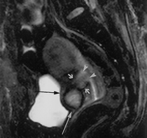
Bladder Flap Hematoma (BFH)
The bladder-flap hematoma (BFH) is an unusual complication of the cesarean section (CS) performed without peritoneal closure
It is an usual event after the visceral peritoneal closure performed during the traditional CS method.
A BFH is generally thought of as a blood collection located in a space placed between the posterior bladder wall and anterior wall of lower uterine segment (LUS), vescico-uterine space.
If, during a Stark CS, pathological fluid collections arise in this space by uterine suture bleeding, these decant into the large peritoneal cavity causing a hemoperitoneum. This last complication can be easily and accurately detectable by ultrasonography, which can be utilised by non-invasive monitoring as a guide for the clinical follow-up.
Significant bladder-flap hematomas were characteristically round, greater than 2 cm masses asymmetrically placed in or adjacent to the uterine incision. Gas within the hematoma strongly suggests an infected hematoma

Slide 14
Uterine Wound Hematoma
Hematoma represents the second-most common Cesarean wound complication, occurring after approximately 1.2 percent of deliveries
Using sonography, the incision site was visualized as an oval symmetric region of distinct echogenicity interposed between the lower uterine segment and the posterior wall of the urinary bladder.
Sometimes in asymptomatic patients, a small (less than 1.5 cm) round hypoechoic mass was present in or adjacent to the uterine incision and distinct from the normal incision. These probably represented insignificant hematomas

Slide 15
Intramural Uterine Hematoma
Couvelaire uterus -- Extravasation of blood into the uterine musculature and beneath the uterine peritoneum in association with severe forms of abruptio placentae
A pseudoaneurysm of uterine artery is an extraluminal collection of blood with turbulent flow that communicates with flowing arterial blood through a defect in the arterial wall , Transabdominal ultrasonography and magnetic resonance imaging revealed an intramyometrial hematoma in anterofundal region of uterus
Patient is complaining of a severe lower abdominal pain .

Slide 16
IntraUterine Hematoma
The content of the endometrial cavity was variable in amount and appearance
The presence of retained fluid: blood or lochias (blood in 64% of cases)
It was larger in the inferior uterine segment.
The presence of heterogeneous echo is consistent with blood products of different ages
Endometrial fluid usually resolves after 1 week
there may only be little fluid even on early post-partum scans.
Areas of hypointensity may correspond to air.
Air bubbles often are visible. Air in the endometrial cavity has been described in 25% of patients following vaginal delivery and 50% of patients following C-section

Slide 17
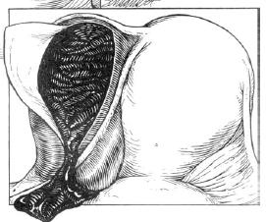
Broad Ligament Hematoma
Broad ligament hematoma results from a tear in the upper vagina, cervix, or uterus that extends into uterine or vaginal arteries,
most commonly following operative delivery, trauma, or surgery, but it may also occur following spontaneous vaginal delivery.
These can be dangerous as they may be silent and not cause obvious vaginal bleeding.
Most patients report back pain, fullness or pressure in the rectoanal area, or an urge to push, or they complain of dizziness and eventually may become hypotensive and anemic
Broad ligament hematoma may be treated either conservatively with blood transfusion, fluid resuscitation, and observation or with surgical exploration and evacuation.
Or it was successfully treated by uterine artery embolization

Slide 18
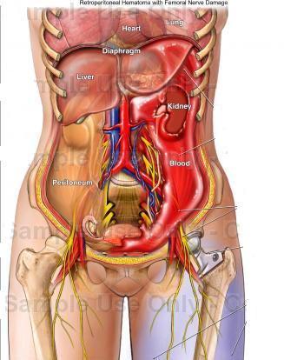
Retroperitoneal Hematoma
They are potentially life-threatening conditions.
The patient may complain of intense flank pain or back pain.
The patient may develop tachycardia and hypotension if the rate of hemorrhage is rapid.
Rarely, later in the course, the patient may has bulging flanks, and a bluish discoloration in the region of the flank.that appears 24 to 48 hours after a severe retroperitoneal bleed

Slide 19
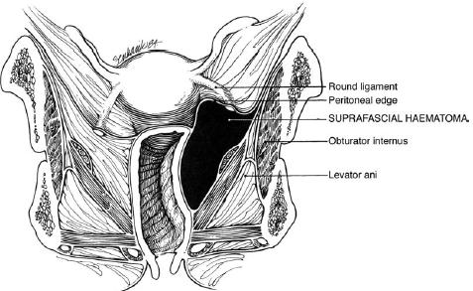
Supravaginal Hematoma
Supravaginal or subperitoneal
These are the result of damage to the uterine artery branches in the broad ligament. The haematoma can dissect retroperitoneally or develop within the broad ligament.
It can be clinically occult despite significant blood loss.
A high index of suspicion is required to diagnose and manage these haematomas promptly before signs of cardiovascular collapse develop.

Slide 20
Vaginal Hematoma
Vaginal or Paravaginal haematomas arise from damage to the descending branch of the uterine artery.
The haematoma is confined to the paravaginal tissues in the space bounded inferiorly by the pelvic diaphragm and superiorly by the cardinal ligament.,
Rectal pain, vague lower abdominal pain but hematoma will not be obvious externally but can be diagnosed by vaginal examination.
The mass often occludes the vaginal canal and extends into the ischiorectal fossa.

Slide 21
Vulval And Vulvovaginal Hematoma
In vulval haematomas bleeding is limited to the vulval tissues superficial to the anterior urogenital diaphragm. The haematoma will be evident on the vulva.
Vulvovaginal haematomas are also evident on the vulva but they extend into the paravaginal tissues.
Both types arise from injury to the branches of the pudendal artery (the posterior rectal, transverse perineal and posterior labial arteries).
Visible hematomas that are less than 4 cm in size and not expanding may be managed with ice packs and observation. Larger or expanding hematomas must be incised, irrigated and packed, with ligation of any obvious bleeding vessels

Slide 22
Investigations
Blood tests A full blood count and coagulation screen
Blood should be taken for cross matching, according to the clinical picture. Transfusion is more likely to be necessary with paravaginal and subperitoneal than with vulval haematomas.
Imaging : Ultrasound, computed tomography (CT) and magnetic resonance imaging (MRI) scans will mainly be useful for diagnosing haematomas above the pelvic diaphragm and to assess any extension into the pelvis, particularly as bimanual examination may not find them until they are quite large.
MRI can also be particularly useful in providing information on the location, size and extent of a haematoma and in monitoring progress or resolution.
.

Slide 23
Size Of Hematoma
The three main diameters of any detected echo free areas were measured (the radius was obtained by dividing this measurement by two).
The volume of the fluid collection was calculated using the formula for an ellipse (4/3π × r1 × r2 × r3).
The vaginal vault, the pouch ofDouglas, the bladder flap area and the abdominal wall were systematically examined.
Characteristics of the fluid collection were recorded.
A parietal wall collection was defined as any subcutaneous or subfascial echo-free area.
Pelvic collections were diagnosed when the volume
of the echo-free area was greater than 20 mL.

Slide 24
Prophylactic Antibiotics
One fourth of all postoperative hematomas are already contaminated.
Ultrasonographical examination is an effective method for early recognition of such postoperative hematomas. Ultrasonic diagnosis on a routine basis is not necessary, but it should be carried out as soon as clinical symptoms appear
Postoperative hematoma formation must be treated as a potential infection

Slide 25
Management
Management aims to prevent further blood loss, minimise tissue damage, ease pain and reduce the risk of infection.
Prompt resolution of the haematoma should result in reduced scarring, postpartum pain and dyspareunia.
Resuscitative measures should be considered the first line of treatment.
The extent of the blood loss is often underestimated and a high index of suspicion is required.Aggressive fluid replacement and assessment of coagulation status is essential if there is heavy bleeding or signs of hypovolaemia.
Blood should be available for transfusion.
A urinary catheter is generally advocated to monitor fluid balance and to avoid possible urinary retention resulting from pain, oedema or the pressure of a vaginal pack.

Slide 26
Small, static haematomas ( 5 cm in diameter) can be managed conservatively.
Conservative management of larger haematomas has been associated with longer stays in hospital, an increased need for antibiotics and blood transfusion and greater subsequent operative intervention.
A haematoma that expands acutely is unlikely to settle with conservative measures more 5 cm) vulval haematomas are best managed with surgical evacuation, primary closure and compression for 12–24 hours.
Surgical management of larger subperitoneal haematomas requires an abdominal approach with identification and ligation of bleeding vessels.or arterial embolisation under radiological control is now an alternative , The clot should be evacuated and.

Slide 27
They can be difficult to diagnose,
as symptoms can be non-specific and
bleeding is often concealed

Slide 28
Conclusion
Genital tract haematomas are uncommon and can cause diagnostic confusion.
Clinicians must be alert to haematomas as a differential diagnosis of postpartum pain and bleeding
The most important factor in correct diagnosis is clinical awareness
Excessive perineal pain is a hallmark symptom: its presence should prompt examination
Aggressive fluid resuscitation/blood transfusion may be required
Coagulation status should be monitored
Treatment should be carried out in an operating theatre
A urinary catheter should be used to prevent urinary retention and monitor fluid balance
The threshold for using antibiotics should be low
There is no evidence to support best management, which can be primary repair or packing, with or without insertion of a drain
Vigilance should be maintained after primary repair/packing, as recurrence is common

Slide 29
Postoperative fever
100 postcesarean routine examination
25 had fever
14 had hematoma
9 had badder flap hematoma no fever
5 had subfacial hematoma with fever
Postcesarean bladder-flap hematomas are not predictive of post-operative fever.
The presence of subfascial hematomas should be specifically sought in the evaluation of a febrile postcesarean patient.

Slide 30
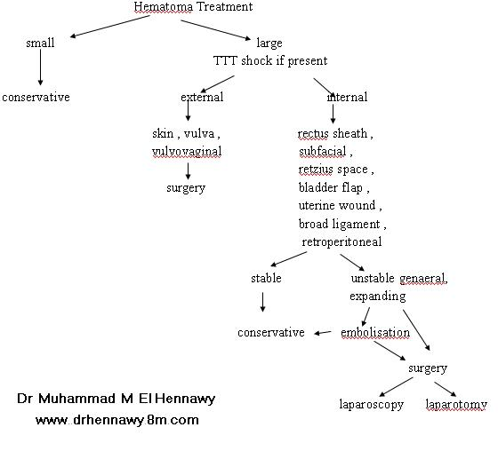

Slide 31

THANK YOU

