Slide 1

Alternatives
To
Insulin
For
Gestational Diabetes
Dr Muhammad M El Hennawy
Ob/gyn specialist
59 Street - Rass el barr –dumyat - egypt
www. drhennawy.8m.com
Mobile 0122503011

Slide 2
Gestational diabetes mellitus (GDM) is a common medical complication associated with pregnancy.
GDM is defined as any degree of glucose intolerance that occurs with pregnancy or is first discovered during pregnancy

Slide 3
Gestational diabetes (GD) develops because pregnancy increases requirements for insulin secretion while increasing insulin resistance.
Women with GD often have impaired pancreatic beta-cell compensation for insulin resistance.
The nature of GD is currently contentious, with debate about its existence, diagnosis and ramifications for both mother and offspring from pregnancy into later life

Slide 4
For The Mother
Maternal complications include pre-eclampsia, hyperglycemic crisis, urinary tract infections that may result in pyelonephritis, need for cesarean sections, morbidity from operative delivery, increased risk of developing overt diabetes, and possibly cardiovascular complications later in life, including hyperlipidemia and hypertension.
Mothers with GDM have a 50% chance of developing type 2 diabetes mellitus (T2DM) for the 20 years following their diagnosis of GDM .

Slide 5
For The fetus Or Neonate
Foetuses from pregnancies with GD have a higher risk of macrosomia (associated with higher rate of birth injuries), asphyxia, and neonatal hyperbilirubinemia , hypoglycaemia and hyperinsulinaemia , respiratory distress syndrome, cardiomyopathy, and hypocalcemia with higher rates of perinatal mortality
Uncontrolled GD predisposes foetuses to accelerated, excessive fat accumulation, insulin resistance, pancreatic exhaustion secondary to prenatal hyperglycaemia and possible higher risk of child and adult obesity and type 2 diabetes mellitus later in adult life

Slide 6
The Cause Of Fetal Congenital Anomalies
The poorly controlled glycaemic state was associated with the development
of foetal anomalies and not the agents used to control blood sugar levels.

Slide 7
Diagnosis of Gestational Diabetes
A 50-g, one-hour glucose challenge test at 24 to 28 weeks of gestation. Patients do not have to fast for this test. To be considered normal, serum or plasma glucose values should be less than 140 mg per dL
An abnormal one-hour screening test should be followed by a 100-g, three-hour venous serum or plasma glucose tolerance test. After the patient has been on an unrestricted diet for three days, venous blood samples are obtained following an overnight fast, and then one, two, and three hours after an oral 100-g glucose load. During the test period, patients should remain seated and should not smoke. Two or more abnormal values are diagnostic for gestational diabetes.

Slide 8
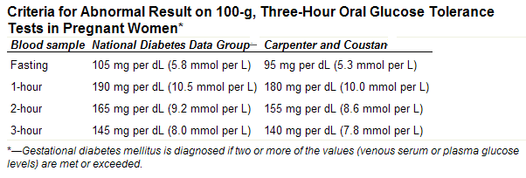

Slide 9
Accepted Treatment Goal
(BLOOD GLUCOSE MONITORING)
The commonly accepted treatment goal is to maintain a fasting capillary blood glucose level of less than 90 to 105 mg per dL
The postprandial treatment goal should be a capillary blood glucose level of less than 160 mg per dL at one hour and less than 140 mg per dL at two hours

Slide 10
- When treatment for gestational diabetes is indicated, the drug of choice, insulin,
- It can be problematic for some women because of the need for daily injections, which can affect compliance.
- Insulin therapy can also cause low blood glucose and weight gain in the mother.
- The cost of therapy may also be an issue for women in lower socioeconomic groups

Slide 11
TTT

Slide 12
Exercises
Regular exercise (30 minutes/day, 5 days/week following the largest meal of the day) has been shown to improve glycemic control in women with gestational diabetes, but it has not been shown to affect perinatal outcomes
Ensure adequate hydration and avoid overheating during all physical activity , actual heart rate should not exceed 140 beats/minute
Although it is not recommended in high risk pregnancies

Slide 13
Diet
No difference in the prevalence of birth weights greater than 4,000 g or cesarean deliveries in women with gestational diabetes who were randomly assigned to receive primary dietary therapy or no specific treatment.
The ideal diet for women with gestational diabetes remains to be defined, and current recommendations are based on expert opinion

Slide 14
- The use of oral hypoglycaemic drugs in pregnancy is not recommended in the past because of reports of foetal anomalies, neonatal hypoglycaemia and the development of pre-eclampsia in animal studies and in some human
cases.
- However, recent studies have suggested that some oral hypoglycaemic drugs may be used in pregnancy.

Slide 15
Glibenclamide ,
Glyburide
( Doanil )
- Among the sulphonylureas, only glibenclamide has been shown not to cross the placenta

Slide 16
Dose
Begin at a low dose of 2.5 mg ( half tablet ) once per day the
dose should be given 30–60 minutes before breakfast or dinner and should not be given before bedtime ) Glyburide peaks 2–3 hours( but if the response has been inadequate within 3 day, it is usually safe to double the initial dose.
Increase dose by 2.5 mg every 3 day ( once morning and then evening)
It is generally recommended that the total 24-hour dose of glyburide not exceed 20 mg ( 4 tablets )
If adequate glycemic control is not achieved within 2 weeks, consider changing over to insulin.
Side-effects are usually minimal but women will complain of episodic hypoglycemia and, in some cases, the use of glyburide is accompanied by excessive weight gain unless dietary intake (and exercise) is adjusted to compensate for the increased efficiency of utilization of the ingested calories!

Slide 17
Not To Cross The Placenta
- There was no significant transport of
glibenclamide in the maternal-to-foetal and foetal-to-maternal directions.
- Glibenclamide remained undetected when cord blood was analysed using high performance liquid chromatography.
- At least 99.8% of the glibenclamide was bound to protein so it was neither metabolised nor appropriated by the placenta

Slide 18
Metformin
(Glucophage)
The use of metformin, which usually returned blood glucose to normal, rather than dropping it too low, and also is associated with maternal weight loss

Slide 19
Dose
Usually begin at 500 mg twice per day.
If the response has been inadequate within a week, the dose can be increased by 500 mg per day on a weekly basis until 2,000 per day is reached.
If adequate glycemic control is not achieved within 2 weeks, one can either change to or add insulin to the current metformin regimen
Side-effects of metformin include gastrointestinal intolerance and, even though food decreases its absorption, it is still suggested that metformin be given with meals during pregnancy to minimize this complication. Hypoglycemia is generally rare with metformin, but it can occur and in rare circumstances (0.03 cases per 1,000 patients) lactic acidosis has been described

Slide 20
Metformin and Early Pregnancy Loss
women with PCOS who became pregnant while taking metformin and remained on metformin throughout their pregnancy
the pregnancy loss rate of the metformin
was quite similar to the rate of 10% to 15% reported for clinically recognised pregnancies in normal women.

Slide 21
Metformin and Insulin, Insulin Resistance and Testosterone Levels
Pregnancies in women with PCOS who took metformin throughout their pregnancy.reduces the likelihood of diabetes developing and prevents androgen excess for the foetus.

Slide 22
Metformin and Development of Gestational Diabetes
Non-diabetic women with PCOS who were on metformin during pregnancy
GD was developed in only 3% of the women who took metformin as compared to 27% of those who did not

Slide 23
Metformin and Pre-eclampsia
Pregnancies of women with PCOS taking metformin did not differ between the metformin group and the control group

Slide 24
Metformin and Foetal Outcomes
Metformin-treated pregnant women that infant morbidity was low and mortality rates were not higher in the metformin-treated patients compared to insulin-treated patients

Slide 25
Metformin and Infant Development
Neonates born to women with PCOS who
conceived while taking metformin and continued taking it through their pregnancy.
There were also no motor-social developmental delays noted in the drug-exposed infants

Slide 26
Metformin May Have Higher Failure Rate Than Glyburide for Gestational Diabetes
The failure rate of metformin was approximately twice that of glyburide when used in the management of gestational diabetes mellitus (GDM)

Slide 27
Insulin
Insulin therapy traditionally has been started when capillary blood glucose levels exceed 105 mg per dL in the fasting state and 140 mg per dL two hours after meals
There are no specific studies declaring one type of insulin or a certain regimen as superior in affecting any perinatal outcome

Slide 28
Dose
A common initial dosage is 0.7 units per kg per day,
one dose consisting of two thirds of the total amount given in the morning and one dose consisting of one third of the total amount given in the evening.
One third of each dose is given as regular insulin, and the remaining two thirds as NPH insulin.
A recent study of women with gestational diabetes supports the safety of very-short-acting insulin lispro, which can be used with once-daily extended insulin ultralente.
The simplest regimen that will control blood glucose levels is the best

Slide 29
Suggested Flow Chart
For GD Treatment

Slide 30
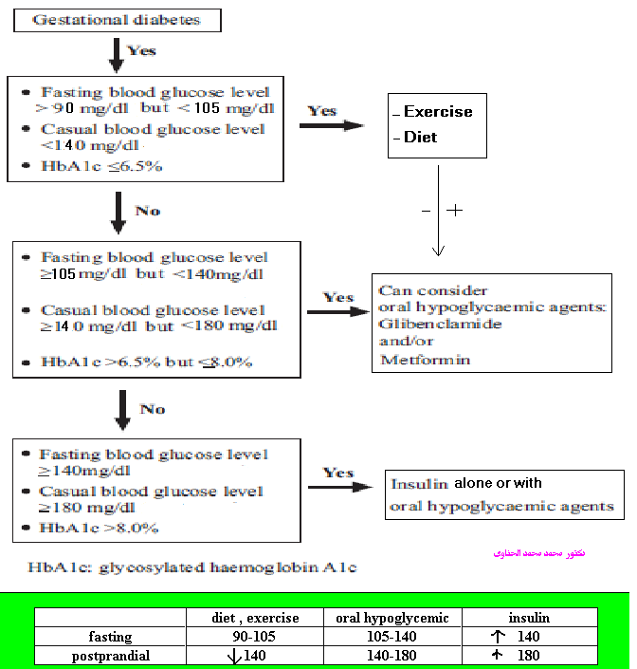

Slide 31
Conclusions
There is now a changing trend in the acceptability of using oral hypoglycaemic agents in non-insulin dependent pregnant diabetics
Both glibenclamide and metformin are currently classified by the FDA as Category B drugs for use in pregnancy,
which means that there is no evidence of risk in humans.

Slide 32
TIMING AND ROUTE OF DELIVERY
A reasonable approach is to offer elective cesarean delivery to the patient with gestational diabetes and an estimated fetal weight of 4,500 g or more, based on the patient's history and pelvimetry, and the patient and physician's discussion about the risks and benefits.
There are no indications to pursue delivery before 40 weeks of gestation in patients with good glycemic control unless other maternal or fetal indications are

Slide 33
INTRAPARTUM MANAGEMENT
The goal of intrapartum management is to maintain normoglycemia in an effort to prevent neonatal hypoglycemia. Patients with diet-controlled diabetes will not require intrapartum insulin and simply may need to have their glucose level checked on admission for labor and delivery.
While patients with oral hypoglycemic or insulin-requiring diabetes are in active labor, capillary blood glucose levels should be monitored hourly. Target values are 80 to 110 mg per dL

Slide 34
POSTPARTUM MANAGEMENT
Patients with diet-controlled diabetes do not need to have their glucose levels checked after delivery.
In patients who required oral hypoglycemic or insulin therapy during pregnancy, it is reasonable to check fasting and two-hour postprandial glucose levels before hospital discharge
Because women with gestational diabetes are at high risk for developing type 2 diabetes in the future, they should be tested for diabetes six weeks after delivery via fasting blood glucose measurements on two occasions or a two-hour oral 75-g glucose tolerance test.
Normal values for a two-hour glucose tolerance test are less than 140 mg per dL.
Values between 140 and 200 mg per dL represent impaired glucose tolerance, and
Greater than 200 mg per dL are diagnostic of diabetes.
Screening for diabetes should be repeated annually thereafter, especially in patients who had elevated fasting blood glucose levels during pregnancy

Slide 35
Breastfeeding
Breastfeeding improves glycemic control and should be encouraged in women who had gestational diabetes

Slide 36
Metformin And hypoglycemic drugs with breastfeeding
Metformin is considered a first-line agent for the management of type 2 diabetes or gestational diabetes.
The very limited amounts of metformin observed in breast milk are highly unlikely to lead to substantial exposure in the breastfed baby.
Metformin can be considered a safe medication for the treatment of type 2 diabetes in a breastfeeding mother.
The levels of glyburide and glipizide in milk are negligible and would not be expected to cause adverse effects in breastfed infants
monitoring of the breastfed infant for signs of hypoglycemia is advisable during maternal therapy with any of these agents

Slide 37
