Slide 1
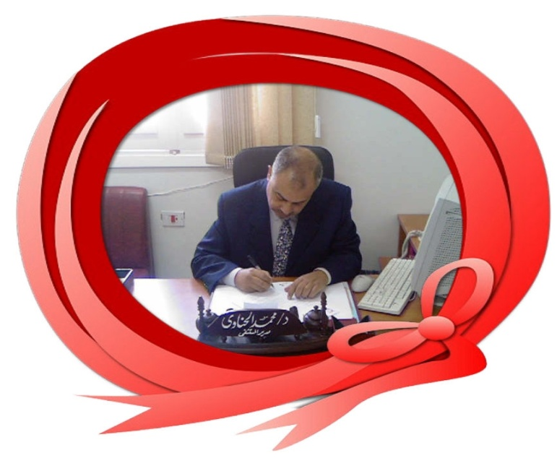

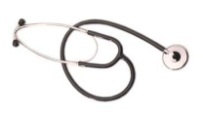

Evidence Based Medicine Alternatives
Or
Alternatives Based Medicine
Dr Muhammad El Hennawy
Ob/gyn Consultant
59 Street - Rass el barr –dumyat - egypt
www. mmhennawy.co.nr
Mobile 01222503011

Slide 2
Evidence-based medicine (EBM)
It is the science of getting research into practice
Aiming to improve care of patient
By markedly use of the best available evidence
This is achieved by integrating the best research evidence with clinical expertise and patient values
clinical expertise
patient values
best avaliable evidence

Slide 3
When there is no evidence
When you do not know the evidence
When you want to support the evidence
You may use alternatives to evidence

Slide 4
There are plenty of alternatives for the practising physician in the absence of evidence.
This is what makes medicine
an art
as well as
a science.
Also it is very close to reality, seems to establish a new classification in the Art of Medicine

Slide 5
Two people have just met,
But within seconds
One has begun to tell the other intimate personal details about his health.
What is more,
It is likely that, in a few minutes,
He will be prepared to remove some of his clothes
And submit to a physical examination.

Slide 6
Doctor-patient communication is difficult because each “party” is coming at the picture from a totally different perspective and probably from a different education level .
Doctors and patients are on different wavelengths and that will always be the case – BUT, with the knowledge above we’ll be on track to close the gap between the wavelengths

Slide 7
Every Physician has practiced
one or more of
EBM alternatives

Slide 8
According to
Doctor appearance, dress, personality, talking,
Surrounding,
Patient beliefs and religion

Slide 9
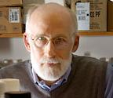
Age Based Medicine
Substitute advanced age for evidence .
Experience, it seems, is worth any amount of evidence

Slide 10
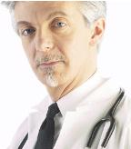
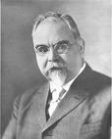
Hair Based Medicine
Substitute balding pate, long blond hair, highlighted their hair or white head hair for evidence.
These are called the "halo" effect.

Slide 11

Race-Based Medicine
The doctor is commonly white and middle class and the patient black and indigent.
Racial differences, even in the absence of social class differences, may have a negative impact on the quality of the doctor-patient relationship
It is essential for patient satisfaction and optimal patient care.

Slide 12
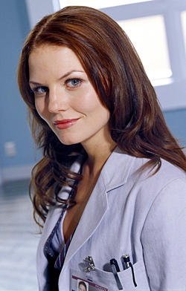
Beautiful Doctor – Based Medicine
Substitute beauty of face , eye , body shape for evidence
Beauty male doctor ---- at the hospital or clinic ……………………
Beauty female doctor --- at the hospital or clinic ………………..

Slide 13

Doctor's Gender-Based Medicine
A male or a female?
Does one hold an advantage over the other?
Many Patients say yes, there are huge differences,
while others say no.

Slide 14
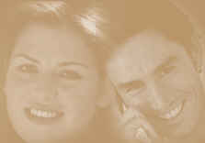
Smile – Based Medicine
A beautiful smile can increase confidence and self-esteem,
Giving an edge in everyday activities
by improving professional and personal image.

Slide 15
Dress Based Medicine
when it comes to patients' confidence,
Not wearing a tie does not have the biggest negative effect.
While not wearing formal trousers and shirt (Trousers- changed from dress pants to flared jeans, Shirt -- changed from dress shirt to Hawaiian shirt ) — accounted for most of the patients' confidence,

Slide 16
Tie Based Medicine
Substitute ties for evidence
The necktie (conventional ties and bow ties) that traditional symbol of male medical authority
Wearing a tie may enhance patients' satisfaction and confidence,
A dangling tie or bow tie also substantially increases the risk of passing infection from one patient to another
Doctors should either not wear a tie at all

Slide 17

Clothes Based Medicine
- Substitute sartorial elegance eloquence for evidence
. carnation in the button hole,
. silk tie,
.Armani suit
. wield a big pen

Slide 18



White Coat Based Medicine
Substitute white coat for evidence
For some medical students and physicians, the white coat is a source of pride; for others it’s a source of controversy
Still, all agree the colorless garment wields great symbolic power for those who practice medicine and for the patients they treat.
The coat protected the physician from the patient and vice versa.

Slide 19

Pen Based Medicine
Substitute Pen in pocket for evidence .

Slide 20
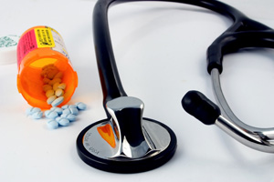
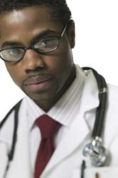
Stethoscope Based Medicine
Stethoscope around neck
A traditional stethoscope lets you only hear the sound with no amplification. But digital stethoscopes can amplify sound and record sound.

Slide 21

Glasses Based Medicine
Substitute glasses for evidence.

Slide 22
Verbal Or Tongue Based Medicine
Substitute verbal eloquence for evidence
Tongue should all be equally smooth

Slide 23
Empathetic Voice Based Medicine
Empathetic voice improves doctor-patient communication
Doctors mainly used three 'voices' when talking to patients:
The 'doctor voice' (seeking information),
The 'educator voice' – when seeking to inform and educate the patient about their condition, and
The 'fellow human voice' – when trying to get patients to talk about their problems.
the use of a more empathetic 'fellow human voice' resulted in better treatment practices and more cooperation from patients.

Slide 24
Listening Based Medicine
The commonest complaint is that doctors do not listen to the patient.
Patients want more and better information about their problem and the outcome, more openness about the side effects of treatment, relief of pain and emotional distress, and advice on what they can do for themselves.
Many doctors do not see the role of physician as listener, but instead view their function more as a human car mechanic:
Find it and fix it.
Yet patients often feel devalued when their illness is reduced to mechanical process

Slide 25
Explanation Based Medicine
Explanation concerning diagnosis and causation of illness, in simple words and not to use of medical jargon.

Slide 26

Confidence Based Medicine
More with Surgeons
Take these and everything will be just fine!

Slide 27
Conviction Based Medicine
Substitute Conviction for evidence
There is a steadily declining faith in physicians
The kinds of medical care that patients find satisfying tends to alleviate psychosomatic symptoms and make patients more compliant with their treatment regimes, and thereby produce better clinical outcomes

Slide 28
Vehemence Based Medicine
The substitution of volume for evidence
It is an effective technique for brow beating your more timorous colleagues and
To speak loudly for convincing relatives of your ability

Slide 29

Nervousness Based Medicine
Fear of litigation is a powerful stimulus to overinvestigation and overtreatment.
In an atmosphere of litigation phobia, the only bad test is the test you didn't think of ordering.

Slide 30
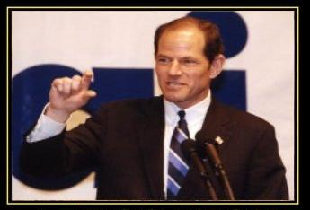
Arrogance Based Medicine
Substitute arrogance for evidence
This is particularly relevent in hospitals where opinions are given out as fact, and no explanations are needed.

Slide 31

Annoyance Based Medicine
This occurs when a patient, family, or other practitioners become so annoying in their demands for a specific course of care, that the physician gives in.
e.g.:
The mother who demands antibiotics for her childs colds;
The patient who demands unnecessary diagnostic tests incessantly, until through nagging, the physician orders them;
The Internist who is convinced that his patients problem is due to his gallbladder, who refers to a surgeon repeatedly until he/she gives in and does a cholecystectomy (usually not relieving the patients symptoms)

Slide 32

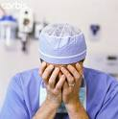
Providence Based Medicine
(Just Let God decide)
If the caring practitioner has no idea of what to do next, the decision may be best left in the hands of the Almighty.
Too many clinicians, unfortunately, are unable to resist giving God a hand with the decision making.

Slide 33
God Based Medicine
Substitute God's word for evidence
Allah made for every sickness, a remedy. We must not accept that there any sickness without remedy

Slide 34
Prophet - Based Medicine
Substitute what prophet said Prophet's Hadith, practices and approvals or did for evidence
Healing with the Medicine of the Prophet is the panacea for those in search of good health.
The Prophet Muhammad says:
- "Stomach is the home of disease.
- Diet is the main medicine."

Slide 35
Medical Myths-Based Medicine
Substitute Medical Myths for evidence
some of these medical myths which have not withstood scrutiny.
Note that most of these myths are debunked by clinical trials, rather than systematic analyses.
Eg :
Myth: Home pregnancy tests are over 95% accurate.
Myth: Patients with musculoskeletal back pain respond best to bed rest followed by a specialized back exercise program.
Myth: Worried patients are reassured by normal test results
Myth: Rectal temperature can be accurately estimated by adding 1°C to the temperature measured at the axilla.

Slide 36
Genetic Or Information -Based Medicine
It is a new era of medicine, in which doctors will have more information at their fingertips, along with the ability to manage information in new ways, to make better diagnostic and treatment decisions.
The map of the human genome triggered a race to understand the origins of diseases and how to combat them, as well as how genes and proteins can influence a person's well-being
In the future, doctors will be able to diagnose and treat patients as individuals, not as statistics.

Slide 37
Over-Specialization Based Medicine
One trend has been the rapid proliferation of specialization among physicians.
Only one in ten physicians are in "general practice" with a claim to a holistic approach to patients' concerns.
Increasing specialization will continue to "technologize" and "compartmentalize" doctor-patient interaction.
As patients see increasing numbers of poorly coordinated specialists for their myriad problems, the need for "case-managing" generalists becomes ever more acute

Slide 38
Sex-Specific Based Medicine
Substitute sex-specific for evidence
It is traditionally as the study and treatment of conditions affecting only men or only women, such as reproductive health and sex-specific cancers
Specialist in obgyn or men health

Slide 39
Social Or Free - Based Medicine
Substitute free for service for evidence
Our medical system refuses to deny services to those unable to pay
Medical costs sky rocket because, in effect, we are paying for emergency care for the poor.
It taxes the system in such a way that hospitals have to shift costs of those that won’t pay on to those that can pay.
It is a rather precarious situation to be in since as costs rise,
The number of people that are able to pay decreases, meaning an ever increasing burden is placed on those “doing the right thing.”

Slide 40

Insurance - Based Medicine
Substitute insurance for evidence
The amount of time a doctor can spend with a patient is limited
Insurance companies may restrict treatments, surgery or challenge doctors’ judgment

Slide 41
Opulence Based Medicine or Profit-Based Medicine
Substitute fee for service for evidence
It is prevalent especially in private practice and fee-for-service based remuneration systems
The conscientious, explicit and judicious use of the most profitable and lucrative interventions when making decisions about the care of individual patients

Slide 42
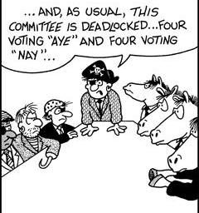
Opinion Or Expert-Based Medicine
Substitute opinions of colleagues, experts and journal editors for evidence
In the real world of individual patients with multiple diseases who are receiving a number of different drugs, the practice of evidence-based (or even opinion-based) medicine is extremely difficult.
For each patient a judgment has to be made by the clinician of the likely balance of...

Slide 43
Etiquette-Based Medicine
Substitute etiquette behavior towards the patient for evidence
Patients ideally deserve to have a compassionate doctor,
But might they be satisfied with one who is simply well-behaved ?
When I hear patients complain about doctors, their criticism often has nothing to do with not feeling understood or empathized with. Instead, they object that
“He just stared at his computer screen,“
“He never smiles,"

Slide 44

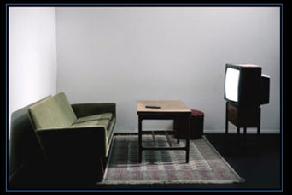

Propaganda Based Medicine
Propaganda is a specific type of message presentation, to create a false image in the mind which are persuasive, but false
Medical Degree Based Medicine – substitute medical degree for evidence
Posters Based Medicine – substitute posters on the walls or in the newspapers for evidence
Clinic Based Medicine – substitute shape and furniture of clinic for evidence
Pharmaceutical Rep Based Medicine – substitute information on drugs from pharmaceutical Rep for evidence

Slide 45
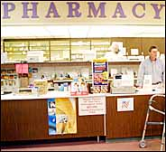
Pharmaceutical Rep Based Medicine
The concept that reps provide necessary services to physicians and patients is a fiction.
Pharmaceutical companies spend billions of dollars annually to ensure that physicians most susceptible to marketing prescribe the most expensive, most promoted drugs to the most people possible.
Physicians are susceptible to corporate influence because they are overworked, overwhelmed with information and paperwork, and feel underappreciated..
Every word, every courtesy, every gift, and every piece of information provided is carefully crafted, not to assist doctors or patients, but to increase market share for targeted drugs
In the interests of patients, physicians must reject the false friendship provided by reps.
Physicians must rely on information on drugs from unconflicted sources, and seek friends among those who are not paid to be friends.

Slide 46
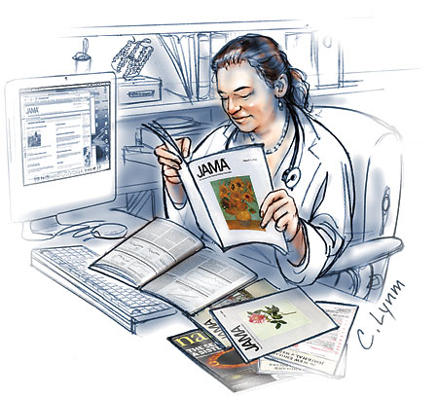
Webidence Or Internet-Based Medicine
Here a click…there a click… everywhere a click, click.
Webidence is
- scientific (type 1) and
- pseudo-scientific (type 2) medical advice and opinion posted on a web site
Unfortunately no reputable authority exists for separating type 1 and 2.

Slide 47
Medicine - Based Evidence
Doctors are taught to be parsimonious in their explanations of scientific facts, not to generate needless hypotheses when there are perfectly good explanations at hand.
We are taught, in fact, to take an almost Sherlock Holmesian view of medical investigations, so that, when all investigations for all possible causes of illness have been performed whatever explanation is left after all the others have been excluded must be the cause.

Slide 48
Celebrity-Based Medicine
Substitute celebrity for evidence
Find out what form of complementary and alternative medicine celebrities ( singers or actors) currently uses, and do likewise
The range of reported CAM interventions is wide, with some celebrities using several types simultaneously. The most popular modality is homeopathy, followed by acupuncture

Slide 49
Rheumatism-Based Medicine
Substitute rheumatism evidence
In that practice the diagnosis is very simple.
A patient with any pain always has rheumatism. .
Requesting the following tests: blood cell count, erythrocyte sedimentation rate, antinuclear antibodies, rheumatoid factor, LE cell test, antistreptolysin O titers (ASO), serum urate, protein electrophoresis, mucoprotein,and C- reactive protein.
The objective is to know what is the rheumatism type
Next step is the treatment.
The most frequent rheumatism type is blood rheumatism
benzathine penicillin is always used monthly, weekly or daily, with or without corticosteroids and nonsteroidal anti- inflammatory drugs. If the serum urate is high, then allopurinol is added.
The prognosis is very bad because there's no cure for rheumatism, and the patient has to take medicine forever, and has to come back to the physician office to repeat the blood tests monthly.

Slide 50
Cold-Based Medicine
Substitute cold evidence
In that practice the diagnosis is very simple.
A patient with any symptoms always has and always will have cold.
Requesting the some non specific tests
The treatment is symptomatic

Slide 51
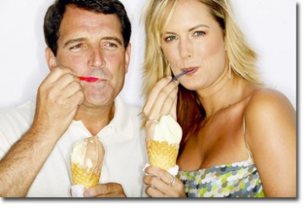
Taste Based Medicine
Taste drugs before writing prescription
For increasing sales and consumer satisfaction

Slide 52
Cleverness Based Medicine
“The good physician treats the disease;
The great physician treats the patient who has the disease.”
The great physician understands the patient and the context of that patient's illness
Be a great physician. Understand the full story. Make correct diagnoses. Consult the patient in designing the treatment plans that best fit that patient

Slide 53
Surrogate Marker Based Medicine
Surrogate markers are used when it is unethical to look for the end point (e.g., death) in the experiment, or when the number of end point events is very small, thus making it impractical to conduct an experiment to look for the end point.
The measurement of surrogate markers provides a way to test the effectiveness of a treatment for a fatal disease without having to wait for a statistically significant number of deaths to occur
A commonly used example is cholesterol.
A clinical trial may show that a particular drug is effective in reducing cholesterol. A high cholesterol is associated with death from heart disease, so it is believed that a treatment that is effective in reducing cholesterol must also be effective in reducing death from heart disease.
"Death from heart disease" is the endpoint of interest, but "cholesterol" is the surrogate marker .

Slide 54
Empirical Based Medicine
Empirical evidence was dismissed
on the basis that boiling does not change the chemical nature of water (chemistry as a basic science discarded a biological observation which could only be explained after microbes were discovered!).
Similarly, hand washing to reduce puerperal sepsis in Semmelweis time had no biological plausibility and was not accepted.
Explanations can come in the future if your data is sound and shows a difference.

Slide 55
Litigation-Based Medicine
when science is used to serve the purposes of litigation or administrative proceedings, great care is needed to ensure its proper deployment, and a courtroom judge is probably not the appropriate person to decide on the reliability and relevance of scientific evidence.
Furthermore, the perception that bias is inherently bad or avoidable may itself be biased .

Slide 56
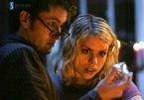
Duress Or Consent Based Medicine
Informed consent is the process through which the patient becomes educated about the procedure - including its benefits, risks and alternatives - and makes the decision to have the procedure performed.
Informed consent implies that the patient fully understands the issues, has asked any questions she has, had her questions answered, and makes her decision under no duress.
Adequate time should be allowed for a patient to think about all of the issues before consenting to the operation.
Where an adult patient is unable to give or refuse consent - for example, because he is unconscious or mentally disabled, the doctor has a right - perhaps even a duty - to give treatment that is in the patient's best interests, to save his life or to prevent deterioration or ensure improvement in his physical or mental health. Lord Goff;
Duress of circumstances -necessity - distinction between innocent life and one that threatens life of another]

Slide 57
There are plenty of alternatives for the practising physician in the absence of evidence.
This is what makes medicine
an art
as well as
a science.

Slide 58
In the past decade,
Evidence-based medicine has contributed much to how
we teach, deliver, and think about clinical services.
In the coming decade,
We must continue to ensure that evidence-based
medicine is not simply used widely, but that that it is also
used wisely.

Slide 59
EBM Is A One-Size-Fits-All Mentality!
One size fits all" rarely does.
From clothes to shoes to hats,.
So why do we entrust the health of our bodies -- one of the most important assets we have -- to a one-size-fits-all mentality?
Unfortunately, policies being advanced under the guise of "evidence-based medicine “ (EBM) could do just that.
The canard of evidence-based medicine is the belief that practice variation is bad and that one-size-fits-all medicine is good.
EBM presupposes that all people respond precisely the same way to all medicines. But that's simply not true.
At its core evidence-based medicine is cost-based rather than patient-based.
Disease varies by individual, and selection of treatment must be driven by diagnostics, not just guidelines.

