Slide 1

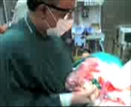
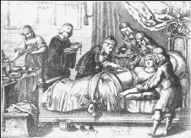
Cesarean section simplified technique
(The Silent Knife )
Dr Muhammad El Hennawy
Ob/gyn Consultant
59 Street - Rass el barr –dumyat - egypt
www. mmhennawy.co.nr
Mobile 01222503011

Slide 2
Definition
Cesarean Section is removal of a fetus from the uterus by
abdominal and uterine incisions, after 28 weeks of pregnancy.
It is called hysterotomy, if removal is done
before 28 weeks of pregnancy.

Slide 3
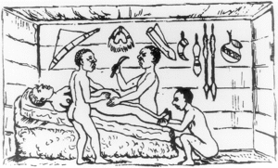
A large number of techniques and materials for cesarean section have been proposed to reduce the operating time, the hospital costs and to make the procedure easier for the surgeon.
However,
Few of these interventions have been rigorously evaluated before being incorporated into practice.

Slide 4
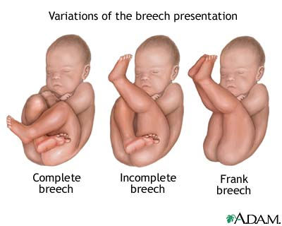
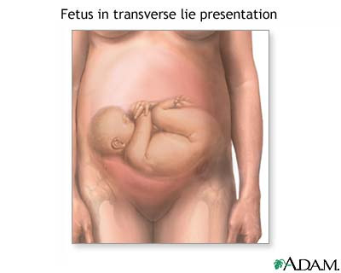
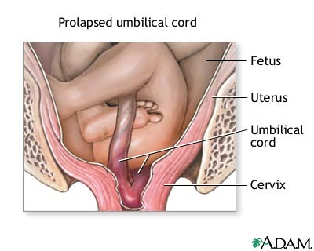
The five Most Common Causes of Cesarean Section
CS on Request
Routine repeat cesareans .
Dystocia (non-progressive labor) .
Abnormal fetal presentation eg breech , transeverse , cord presentation .
Fetal distress .

Slide 5

Reasons suggested for the increase in caesarean section rates
Advancing maternal age, -Socioeconomic factors, - Reduced parity
Improvements in surgical techniques -- Decreased morbidity and mortality
Increased repeated C.S due to increased primary C.S
Type of health insurance, whether the hospital is private or public, whether or not there is a neonatal resuscitation unit, the size of the city,
The obstetrician’s experience and type of training
Choose the time and day of delivery
Procedures as high forceps and difficult mid forceps are abandoned in favour of Caesarean Section (C.S.)
Destructive operations are abandoned in favour of C.S
The introduction of epidural anaesthesia has reduced the anaesthetic risks of the procedure. This has led to a lower threshold for doing a Caesarean section in the second stage of labour rather than performing rotational/high cavity forceps deliveries which led to maternal and neonatal morbidity.
The increased use of electronic fetal monitoring has increased our awareness of fetal distress although the majority of babies are born in good condition despite an abnormal CTG and/or low pH at fetal blood sampling.
The reduction in the number of rotational forceps deliveries has led to a deskilling of obstetricians who do not feel confident to carry out these procedures.
The evidence that breech presentation babies have a reduced morbidity and mortality if delivered by elective Caesarean section
An increasing demand from women for elective Caesarean sections with no medical reason.

Slide 6
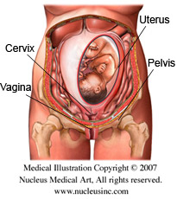
Avoiding First C-Section Should Be Priority
Avoiding primary cesarean sections unless there is a medical necessity

Slide 7
once a cesarean, always a cesarean has been changed to Once a cesarean always a Hospitalisation , also has been changed To Once a cesarean always a controversy
For the physician, elective repeat cesarean offers advantages, including convenience, time savings, and sometimes increased compensation even physicians earnestly want to avoid unnecessary repeat cesarean operations but fear that they will be found legally liable if any untoward event occurs during a trial labor specially if it is not possible to perform a "crash" cesarean within 10-15 minutes of the onset of an ominous fetal monitor pattern...
Elective repeat cesarean also is convenient for the patient and her family even the patient who strongly requests a VBAC but then demands a cesarean in the midst of labor. .

Slide 8

Cesarean Section By Choice
Or Cesarean Section On Demand
Or Prophylactic Caesarean Section
the women are requesting elective caesarean section by choice as a mode of delivery in the absence of any specific indication as nonvertex presentation, previous C-section, or prior perineal or pelvic reconstructive surgery.
Because women are afraid from vaginal delivery that can cause pudendal injury, which leads to persistent fecal and stress incontinence and genital prolapse and affect sex

Slide 9
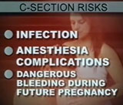
Cesarean section is safe, but it’s not as safe as a planned vaginal delivery.
Many pregnant women believe that undergoing a cesarean section is a no risk surgery
They suffer more than three times the number of cardiac arrests, blood clots and major infections than those who deliver vaginally
Doctors, midwives, and childbirth educators must give full and honest advice based on the available information; they may persuade but never coerce. Active participation by patients should be encouraged to arrive at a safe and logical informed decision about method of delivery, with carers recommending what they perceive to be the best course of action in keeping with the available evidence

Slide 10
Assist the woman and her family to prepare emotionally and psychologically for the procedure.

Slide 11
Consent for CS
Consent for CS should be requested after providing pregnant women with evidence based information and in a manner that respects the woman’s dignity, privacy, views and culture whilst taking into consideration the clinical situation.

Slide 12
Maternal Satisfaction during CS
Women’s preferences for the birth,
such as
music playing in theatre,
lowering the screen to see baby born, or
silence so that the mother’s voice is the first baby hears, and
lowering the lights in theatre
during CS are needed should be accommodated where possible.
If CS is doing under regional anasthesia

Slide 13
Timing Of CS
Cesarean deliveries may be performed because of maternal or fetal problems that arise during labor, or they may be planned before the mother goes into labor
Elective cesarean delivery
elective caesarean section may be justified, but decisions must take into account the risk to the infant associated with delivery before 39 weeks' gestation
It is now clear that respiratory distress syndrome is indeed seen in "term" infants and is a considerable source of morbidity and mortality in this group
mechanical ventilation to treat presumed surfactant deficiency is 120 times more likely to be needed after elective delivery at 37-38 weeks than after delivery at 39-41 weeks
Emergency cesarean section
In cases of suspected or confirmed acute fetal compromise,
delivery should be accomplished as soon as possible.
The accepted standard is within 30 minutes.

Slide 14
Elective caesarian section (Planned operation)
Advantages are:-
Patient with empty stomach and surgeon usually with full breakfast
Best anesthetist available at that time
Best assistant and nursing staff.
Disadvantages are :-
If wrong judgment, premature child may be born.
Cervix may not be dilated and hence poor drainage of lochia
Lower segment is not formed and hence uterine incision in lower part of upper segment.
Emergency caesarian section (Unplanned)
Working under adverse circumstances:-
Patient may be with full stomach and surgeon may be with empty belly
Odd working hours either of day or night
Anesthetist, assistant and nursing staff may not be of your choice
Advantage is :-
Mature child as patient is in labor
Cervix is open, better drainage of lochia.
Lower segment is well formed

Slide 15
Preoperative testing and preparation for CS
Pregnant women should be offered a haemoglobin assessment before CS to identify those who have anaemia. Although blood loss of more than 1000ml is infrequent after CS (it occurs in 4 to 8% of CS) it is a potentially serious complication.
Pregnant women having CS for ante partum haemorrhage, abruption, uterine rupture and placenta praevia are at increased risk of blood loss greater than 1000 ml and should have the CS carried out at a maternity unit with on-site blood transfusion services.
Prescribe antibiotics (one dose of first-generation cephalosporin or ampicillin)
Assess risk for thromboembolic disease (offer graduated stockings, hydration, early mobilisation and low molecular weight heparin)
To reduce the risk of aspiration pneumonitis: Empty stomach, Pre-medication with Give an antacid (sodium citrate 0.3% 30 mL or magnesium trisilicate 300 mg) + Cimetidine IV 1 hr before CS
Women having CS with regional anesthesia require an indwelling urinary catheter to prevent over-distension of the bladder, because the anaesthetic block interferes with normal bladder function

Slide 16
Maternal Position During CS
All obstetric patients undergoing CS should be positioned with left lateral tilt to avoid aorto-caval compression
By tilting the operating table to the left
or place a pillow or folded linen under her right lower back

Slide 17
Catheterisation
-- Routine catheterisation vs no catheterisation
  In-dwelling vs in-and-out catheter
  In-dwelling catheter for duration of CS vs for 24 hrs
  No evidence
Cochrane Protocols Indwelling bladder catheterisation as part of postoperative care for caesarean section

Slide 18
Preoxygenation Before Induction for Cesarean Section
4 maximally deep inspirations
were demonstrated to be as effective
as a 5-min inhalation of 100% O2
for preoxygenation
before induction of a general anaesthesia
for Cesarean section,

Slide 19
Anaesthesia
1 General anaesthetic.
2 Regional anaesthesia ( Epidural block. - Spinal block ).
3 Infiltration of local anaesthetic agents.
Regional anaesthesia is regarded as considerably safer than general anaesthesia with respect to maternal mortality
Regional anesthesia is generally preferred because it allows the mother to remain awake, experience the birth, and have immediate contact with her infant. It is usually safer than general anesthesia. Many practitioners prefer spinal or CSE to epidural techniques because of more rapid onset and better blockage of pain

Slide 20
Caesarian section
Local anesthesia
This is rarely requires except in conditions, eg in deeply sedated Pt. of eclampsia.
If doctor is working in a place where anesthetist is not available and surgeon has to manage all alone, local anesthesia is used.
Drug used is 0.5% Lignocain. Total quantity to be used is not more than 100 c.c.
In this anesthesia, the surgeon may not be as comfortable as spinal or general anesthesia.

Slide 21
Prepare The skin
Wash the area around the proposed incision site with soap and water,
Do not shave the woman’s pubic hair as this increases the risk of wound infection. The hair may be trimmed, if necessary

Slide 22
Sterlize The Skin
Patients skin at the operation site is routinely cleaned with antiseptic solutions before surgery. Antiseptic skin cleansing before surgery is thought to reduce the risk of postoperative wound infections
Apply antiseptic solution three times to the incision site using a high-level disinfected ring forceps and cotton or gauze swab. If the swab is held with a gloved hand, do not contaminate the glove by touching unprepared skin;
Begin at the proposed incision site and work outward in a circular motion away from the incision site;
At the edge of the sterile field discard the swab.
Never go back to the middle of the prepared area with the same swab. Keep your arms and elbows high and surgical dress away from the surgical field.
But There is insufficient evidence on whether cleaning patients' skin with antiseptic before "clean" surgery reduces wound infections after surgery

Slide 23
Drape The Skin
Drape the woman immediately after the area is prepared to avoid contamination:
-If the drape has a window, place the window directly over the incision site first.
-Unfold the drape away from the incision site to avoid contamination

Slide 24
The use of separate surgical knives to incise the skin and the deeper tissues at CS is not recommended because it does not decrease wound infection.

Slide 25
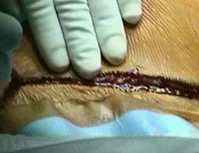
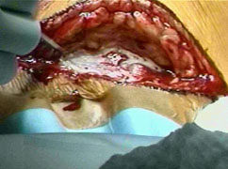
RCTs are needed to evaluate the effectiveness of incisions made with diathermy compared with surgical knife in terms of operating time, wound infection, wound tensile strength, cosmetic appearance and women’s satisfaction with the experience

Slide 26
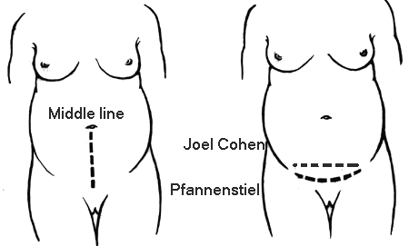
Abdominal entry

Slide 27
JC incision (JC)
The JC incision is performed by a superficial transverse cut in the cutis, about 3 cm below an imaginary line connecting the spinae iliacae antero- superior, cutting only through the cutis.
In the midline, which is free from large blood vessels, the cut is deepened to the fascia.
A small transverse opening is made in the fascia, and then the fascia is opened transversely underneath the fat tissue and blood vessels by pushing the slightly open tip of a pair of straight scissors, first in one direction, and then in the other.
The fascia is stretched caudally and cranially using the index fingers to make room for the next step.
The surgeon and his assistant each insert their index and third fingers under the muscles, and stretch the muscles, blood vessels, and the fat tissue by manual bilateral traction.

Slide 28
Sharp (Pfannenstiel) vs blunt (Joel Cohen)
  --improvement in febrile morbidity with J-C.
  There was little difference in wound infection.
  No data available for endometritis.
  The basic principles of the blunt Joel Cohen incision include a shorter surgical time , minimisation of tissue damage, operating in harmony with body's anatomy & physiology and minimal use of instruments.less fever, less pain and less analgesic requirements; less blood loss; and shorter hospital stay

Slide 29
Excision of previous scar
Always at the beginning of operation by
an elliptical incision.
- Excising previous scar
at the end of operation is difficult
- Or incise in the same incision with trimming
of the fibrosed edges of the wound
to help good healing
Multiple scars –multiple surgeon’s name,
multiple signatures on skin.
Name of the surgeon is always
written on the scar

Slide 30
Parietal Peritoneal Incision
Use fingers to make an opening in the peritoneum near the umbilicus then lengthen the incision up and down in order to see the entire uterus.
Or Use scissors to lengthen the incision up and down in order to see the entire uterus.
Carefully, to prevent bladder injury, use scissors to separate layers and open the lower part of the peritoneum

Slide 31
Packs
The uterus is centralised, the bowel and omentum are packed off with moist laparotomy pads,
however
this is usually unnecessary

Slide 32
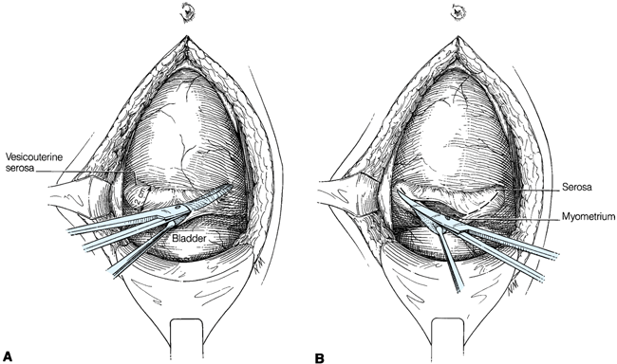
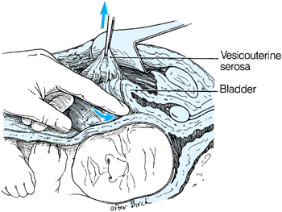
Visceral Peritoneal Incision
Place a bladder retractor over the pubic bone.
Use forceps to pick up the loose peritoneum covering the anterior surface of the lower uterine segment and incise with scissors.
Extend the incision by placing the scissors between the uterus and the loose serosa and cutting about 3 cm on each side in a transverse fashion.
Use two fingers to push the bladder downwards off of the lower uterine segment. Replace the bladder retractor over the pubic bone and bladder.

Slide 33
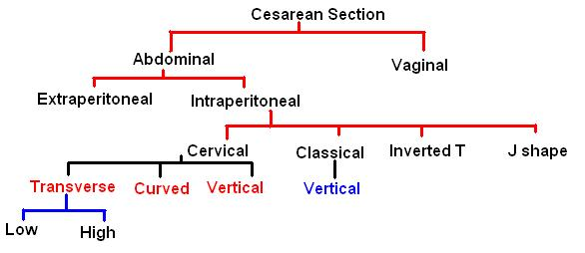

Slide 34
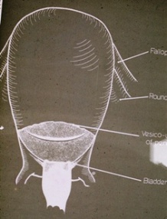
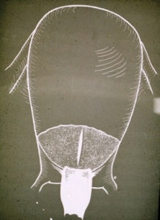
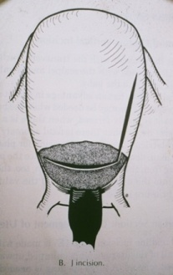
Uterine Incision
Abdominal cesarean section
Extraperitoneal cesarean section Latzko operation
intraperitoneal cesarean section
1-Cervical A-- a transverse or curved (horizontal) Kerr operation
Low transverse– if cx is dilated less than 5 cm
High transverse– if cx is dilated more than 5 cm
B--vertical incision in the lower uterus Selheim operation
2 -Classical--a vertical incision in the main body of the uterus. Sanger operation
3-Inverted T-shaped incision Delee operation
4 -J shaped
Vaginal cesarean section

Slide 35
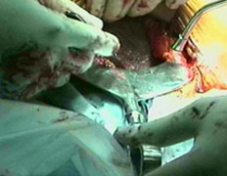
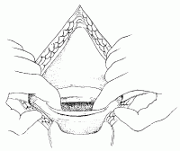
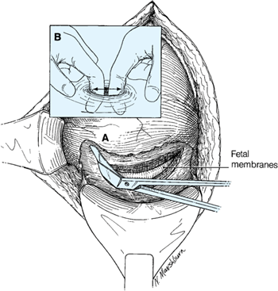
Sharp vs blunt uterine entry
Not enough evidence
A semilunar mark is made by the scalpel cutting partially through the myometrium for 10 cm.
A short (3cm) cut is made in the middle of this incision mark reaching up to but not through the membranes.
The incision is completed by the 2 index fingers along the incision mark.
If the lower uterine segment is very thin, injury of the foetus can be avoided by using the handle of the scalpel or a haemostat (an artery forceps) to open the uterus
The short (3cm) middle incision may be enlarged by a bandage scissors over 2 fingers introduced into the uterus to protect the foetus.

Slide 36
Narrow uterine incision
Extension of the lower uterine segment incision may be done by:
1- "J" shaped or hockey-stick incision: i.e. extension of one end of the transverse semilunar incision upwards.
2- "U"- shaped or trap-door incision: i.e. extension of both ends upwards.
3- An inverted T incision: i.e. cutting upwards from the middle of the transverse incision. This is the worst choice because of its difficult repair and poor healing

Slide 37
Problem of central placenta pravia
Anterior placenta-
Try to find out membrane up or down, rt. Or left.
If you fail, cut placenta quickly and first remove child.
Posterior placenta–
(Dangerous placenta of Stall-Worthy.)
To stop bleeding or oozing from lower post segment,
pack it systematically with multiple roller packs. Push first
end in cervical canal.
Remove pack after 24 hours.
Some time as a desperate measure you may need
Internal iliac ligation, or subtotal hysterectomy, to save Pt.

Slide 38
Membranes are ruptured by toothed or Kocher’s forceps

Slide 39
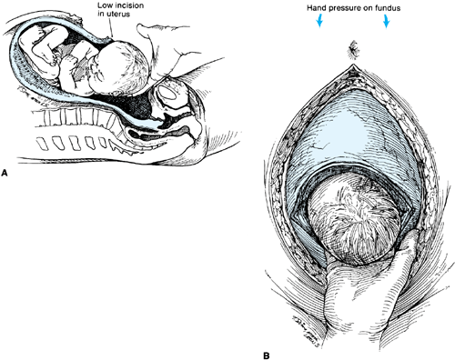
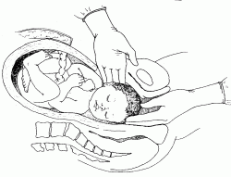
DELIVERY OF THE BABY
To deliver the baby, place one hand inside the uterine cavity between the uterus and the baby’s head.
With the fingers, grasp and flex the head.
Gently lift the baby’s head through the incision taking care not to extend the incision down towards the cervix.
With the other hand, gently press on the abdomen over the top of the uterus to help deliver the head.
If the baby’s head is deep down in the pelvis or vagina
Ask an assistant (wearing high-level disinfected gloves) to reach into the vagina and push the baby’s head up through the vagina. Then lift and deliver the head

Slide 40
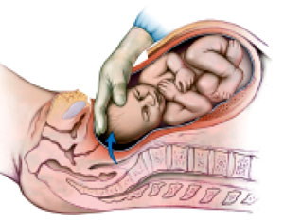
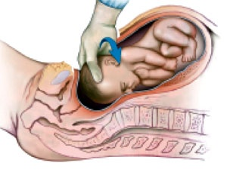
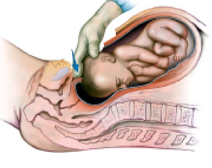
Safe delivery of the fetal head during cesarean section
With the goals of minimizing delay, head compression, and strain on the uterine incision, a sequence of maneuvers the elevate, rotate, and reduce (ERR) technique for expeditious delivery of the head from a deep pelvic station To prevent extension of the uterine incision and risk injury to the uterine vessels and bladder
Position yourself so your upper trunk, arm, and hand move as a unit to elevate the head.
Elevate. Lock the fingers into a quarter-circle around the vertex. Apply traction out of the pelvis with the hand and the entire extended arm
Rotate. Grasp the fetal head between the thumb and fingers and rotate it so the occiput faces the incision.
Reduce. Push the lower edge of the uterine incision down until it is posterior to the fetal head..

Slide 41
Delivery of trunk
At the time of delivery of trunk
bi-aromial diameter should always be in line of uterine incision and not perpendicular to it.

Slide 42
Aspirate nose and mouth of newborn

Slide 43
Cord Clamping
Suggested benefits of delayed cord clamping include decreased neonatal anaemia;
Better systemic and pulmonary perfusion; and better breastfeeding outcomes.
Possible harms are
polycythaemia, hyperviscosity, hyperbilirubinaemia, transient tachypnoea of the newborn and risk of maternal fetal transfusion in rhesus negative women.

Slide 44
Give Newborn To Pediatrition

Slide 45
Presence of paediatrician at CS
An appropriately trained practitioner skilled in the resuscitation of the newborn should be present at CS performed under general anaesthesia or where there is evidence of fetal compromise.
infants born by CS with general anaesthesia are at an increased risk of having 1- and 5-minute Apgar scores of less than 7 when compared with those born by CS with regional anaesthesia (1-minute Apgar less than 7

Slide 46
Maternal contact (skin to skin)
Early skin-to-skin contact between the woman and her baby should be encouraged
and facilitated because it improves maternal perceptions of their infant, mothering
skills, maternal behaviour, breastfeeding outcomes, and reduces infant crying.

Slide 47
Breastfeeding
Women who have had a CS should be offered additional support to help them to start breastfeeding as soon possible after the birth of their baby.
This is because women who have had a CS are less likely to start breastfeeding in the first few hours after the birth, but, when breastfeeding is established, they are as likely to continue as women who have a vaginal birth.

Slide 48
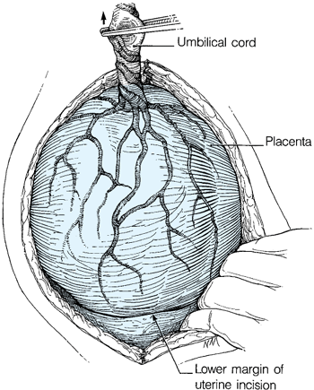
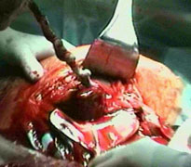
The placenta was manually removed or spontaneously delivered
At CS, the placenta should be removed using controlled cord traction and not manual removal as this reduces the risk of endometritis.
Spontaneous delivery of the placenta may reduce blood loss and decrease the chance of postoperative endometritis
By Keeping gentle traction on the cord and massage (rub) the uterus through the abdomen.
Deliver the placenta and membranes

Slide 49
Give Oxytocin
Give oxytocin 20 units in 1 L IV fluids (normal saline or Ringer’s lactate) at 60 drops per minute for 2 hours.
to encourage contraction of the uterus and to decrease blood loss.

Slide 50
Prophylactic antibiotics with cesarean section
(immediately after the cord is clamped versus pre-operative)
Give a single dose intravenously of prophylactic antibiotics after the cord is clamped and cut:
- ampicillin 2 g IV OR cefazolin 1 g IV provides adequate prophylaxis.
No additional benefit has been demonstrated with the use of multiple-dose regimens.
however, no consensus on the optimal timing of administration and doses
There is also no evidence that the transplacental passage of prophylactic ampicillin increases immediate or delayed neonatal infections

Slide 51
Exteriorisation of uterus for repair vs intra-abdominal repair
    Exteriorisation associated with reduction in febrile
    morbidity and diagnosis of uterine anomalies
    but no effect on endometritis, wound
    complication, sepsis or blood transfusion

Slide 52
Uterine swabbing vs no swabbing prior to uterine closure
No evidence.

Slide 53
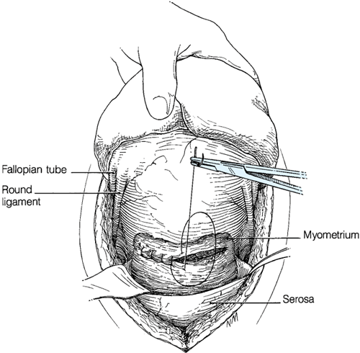
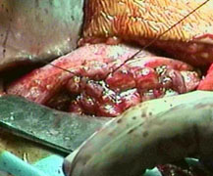
Single vs double layer uterine closure
no difference found between the groups
    No effect on endometritis or blood transfusions
    The effectiveness and safety of single layer closure of the uterine incision is uncertain.Except within a research context the uterine incision should be sutured with two layers..

Slide 54
Uterine repair
  chromic catgut vs vicryl
  locking vs non-locking suture
  continuous vs interrupted sutures
    No studies found.

Slide 55
Peritoneal Closure
peritoneal closure vs non-closure (Pelvic, parietal, both )
  Non-closure associated with less post-op fever
  but no significant effect on wound infection or endometritis.
  New trial fewer adhesions in closure
Neither the visceral nor parietal peritoneum should be sutured at CS as this reduces operating time, the need for postoperative analgesia and improves maternal satisfaction.
None of the RCTs reported long term outcomes related to healing and scarring or implications for future surgery.

Slide 56
Materials for closure of the peritoneum
plain catgut vs vicryl vs chromic catgut
No evidence

Slide 57
Cesarean section
The laparotomy pads put in abdominal cavity are all
removed & counted doubly
by surgeon himself and then by nurse.

Slide 58
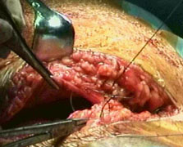
Sheath
Chromic catgut vs plain catgut vs vicryl for sheath repair
no studies found.
Locked continuous vs non-locked continuous closure
no studies found.

Slide 59
the subcutaneous tissue
the subcutaneous tissue (fat and/or camper fascia) closure vs no closure.
No effect on wound infection alone (but closure associated with less “wound complication” and no effect on endometritis).
Routine closure of the subcutanoues tissue space should not be used, unless the
woman has more than 2 cm subcutaneous fat, because it does not reduce the
incidence of wound infection.

Slide 60
Subcutaneous continous absorbable suture vs
interrupted absorbable suture
  No effect on infection

Slide 61
liberal vs restricted use of a sub-sheath drain
Superficial wound drain should not be used at CS because they do not decrease the incidence of wound infection or wound haematoma.

Slide 62
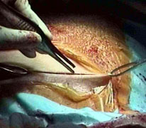
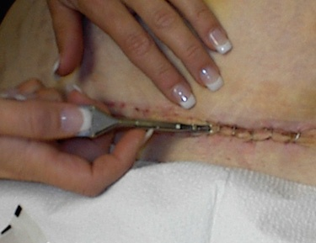
Skin closure
Compared staples vs absorbable sub-cuticular suture.
  No effect on infection.
  Obstetricians should be aware that the effects of different suture materials or methods of skin closure at CS are not certain.
  More RCTs are needed to determine the effect of staples compared to subcuticular sutures for skin closure at CS on postoperative pain, cosmetic appearance and removal of sutures and staples.

Slide 63
Immediate post-operative care
After surgery is completed, the woman will be monitored in a recovery area
to ensure that the uterus remains contracted, that there is no excessive vaginal bleeding or bleeding at the incision site, that there is adequate urine output, and to monitor routine vital signs (blood pressure, temperature, breathing). Pain medication is also given, initially through the IV line, and later with oral medications.
When the effects of anesthesia have worn off, about four to eight hours after surgery, the woman is transferred to a postpartum room

Slide 64
Analgesia After Cesarean Section
Adequate postoperative pain control is important. A woman who is in severe pain does not recover well.
Avoid over sedation as this will limit mobility, which is important during the postoperative period.
Women should be offered diamorphine (0.3–0.4 mg intrathecally) for intra- and
postoperative analgesia because it reduces the need for supplemental analgesia after
a CS
Ideally, a multimodal approach to postoperative analgesia is employed in order to best control the patient’s pain synergistically.
In this manner, ideally, less of each individual drug is required to control pain.
NSAIDs have been shown to potentiate the effects of opioids.
Adding acetaminophen also potentiates the effects of the other medications with very little additional adverse risk
analgesic rectal suppositories for relief of pain in women following caesarean section
Wound infiltration with local anaesthetic may further assist with postoperative analgesia and certainly carries minimal risk, although studies of benefit are conflicting to date

Slide 65
Antibiotics after cs
If there were signs of infection or the woman currently has fever, continue antibiotics until the woman is fever-free for 48 hours.

Slide 66
Oral fluids and food after caesarean section: early versus delayed initiation
If the surgical procedure was uncomplicated, give the woman a liquid diet.
If there were signs of infection, or if the cesarean was for obstructed labour or uterine rupture, wait until bowel sounds are heard before giving liquids.
When the woman is passing gas, begin giving her solid food.
If the woman is receiving IV fluids, they should be continued until she is taking liquids well.
If you anticipate that the woman will receive IV fluids for 48 hours or more, infuse a balanced electrolyte solution (e.g. potassium chloride 1.5 g in 1 L IV fluids).
If the woman receives IV fluids for more than 48 hours, monitor electrolytes every 48 hours. Prolonged infusion of IV fluids can alter electrolyte balance.
Ensure the woman is eating a regular diet prior to discharge from hospital.
Women who are recovering well and who do not have complications after CS can eat and drink when they feel hungry or thirsty

Slide 67
Drinking after cs
oral intake was initiated earlier in the simplified technique group (6-8 hours-op vs 10-12 hours post-op);

Slide 68
Removal of the urinary bladder catheter should be carried out once a woman is mobile after a regional anaesthetic and not sooner than 12 hours after the last epidural ‘top up’ dose.

Slide 69
Ambulation after cs
Ambulation started earlier in the simplified technique group (6-8 hours post-op vs 10-12 hours post-op).
Ambulation enhances circulation, encourages deep breathing and stimulates return of normal gastrointestinal function. Encourage foot and leg exercises and mobilize as soon as possible, usually within 24 hours

Slide 70
A pediatrician will examine the baby within the first 24 hours of the delivery

Slide 71
Dressing and wound care
The dressing provides a protective barrier against infection while a healing process known as “re-epithelialization” occurs. Keep the dressing on the wound for the first day after surgery to protect against infection while re-epithelialization occurs. Thereafter, a dressing is not necessary.
If blood or fluid is leaking through the initial dressing, do not change the dressing:
Reinforce the dressing;
Monitor the amount of blood/fluid lost by outlining the blood stain on the dressing with a pen;
- If bleeding increases or the blood stain covers half the dressing or more, remove the dressing and inspect the wound. Replace with another sterile dressing.
If the dressing comes loose, reinforce with more tape rather than removing the dressing. This will help maintain the sterility of the dressing and reduce the risk of wound infection.
Change the dressing using sterile technique.

Slide 72
Length of hospital stay
Length of hospital stay is likely to be longer after a CS (an average of 3–4 days) than after a vaginal birth (average 1–2 days). However, women who are recovering well, are apyrexial and do not have complications following CS should be offered earlydischarge (after 24 hours) from hospital and follow up at home, because this is not associated with more infant or maternal readmissions.

Slide 73
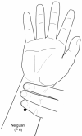
Vomiting after cs
Nei Guan (P 6) point is located 2 cun or about 5 cm above the transverse crease of the wrist between the tendons of m. palmaris longus and m. flexor carpi radialis. The name of the point means “Inner Pass” or “Inner Gate
Stimulation of Neiguan (PC 6) induced favorable regulation of both the peripheral nervous system and central nervous system, and changes of the gastrointestinal hormone secretion may contribute to its effects in treating various disorders.
There is scientific evidence from numerous studies supporting the use of wrist acupressure at the P6 acupoint (also known as Neiguan) in the prevention and treatment of nausea and vomiting. In particular, this research has reported effectiveness for postoperative nausea, intra-operative nausea (during spinal anesthesia), chemotherapy-induced nausea, and motion-related and pregnancy-related nausea (morning sickness). Effects have been noted in both children and adults. This therapy has grown in popularity because it is noninvasive, is easy to self-administer, has no observable side effects and is low cost.
Success of acupuncture and acupressure of the pc 6 acupoint in the treatment of hyperemesis gravidarum

Slide 74
the Hemostatic Cesarean Section,.
as a new surgical technique to manage pregnant women infected with HIV-1
This is an elective cesarean section with technical modification. It is used in all patients plus antiretroviral treatment(ARV) and breast feeding period has been inhibited.
The Hemostatic Cesarean Section (programmed at 38 weeks from gestation in intact membranes and not in labour), and consent of patients. It consist in the management of lower uterine segment keeping integrity of membranes, avoiding the massive contact between maternal blood and the fetus
This technique has shown to be useful, as it decreases vertical transmission to less than 2%

Slide 75
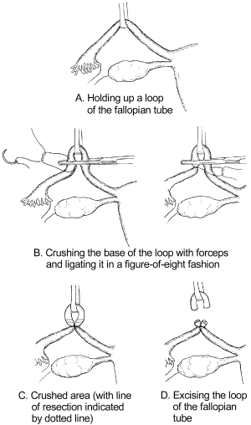
Caesarean Sterilization
Tubal ligation (sterilization), may also be performed during cesarean delivery
Tubal ligation can be done immediately following caesarean section if the woman requested the procedure before labour began (during prenatal visits). Adequate counselling and informed decision-making and consent must precede voluntary sterilization procedures; this is often not possible during labour and delivery.
Review for consent of patient.
Grasp the least vascular, middle portion of the fallopian tube with a Babcock or Allis forceps.
Hold up a loop of tube 2.5 cm in length (Fig P-24 A).
Crush the base of the loop with artery forceps and ligate it with 0 plain catgut suture (Fig P-24 B).
Excise the loop (a segment 1 cm in length) through the crushed area (Fig P-24).
Repeat the procedure on the other side

Slide 76
Caesarean myomectomy
there is no significant difference in intra-operative and post-operative morbidity and blood loss in performing caesarean section alone and caesarean section with myomectomy when a tourniquet is applied.

Slide 77
Caesarean section in ART
The average incidence of CS is 20%
Caesarean section is 3 times higher in ART due to
  Advanced age of the mother
  Precious baby
  More incidence of plural pregnancy

Slide 78
Cesarean Hysterectomy
Hysterectomy is carried out after caesarean section in the same sitting for one of the following reasons:
Uncontrollable postpartum haemorrhage.
Unrepairable rupture uterus.
Operable cancer cervix.
Couvelaire uterus.
Placenta accreta cannot be separated.
Severe uterine infection particularly that caused by Cl. welchii.
Multiple uterine myomas in a woman not desiring future pregnancy although it is preferred to do it 3 months later.

Slide 79
Perimortem Cesarean Delivery( PMCD)
PMCD has evolved through 23 centuries from a means of providing appropriate burial and/or ritual for both mother and baby to a way of saving a child's life when maternal death is inevitable to a method of optimizing resuscitation for both mother and baby.

Slide 80
Repeated CS is safer than VBAC
should we be promoting VBAC which may carry greater risks
to the individual for the purposes of reducing “an undesirable statistic”?
In our country where family sizes are now voluntarily limited,
is it in the woman’s interests to try for a VBAC?

Slide 81
Causes of a weak scar
Improper haemostasis
Imperfect coaptation (Undue haste)
Inversion of decidua
Extension of the angles
Infection during healing
Placental implantation
Overdistension of the uterus
The most weak scar is that of the upper segment of the uterus

Slide 82
Assessment of scar integrity
Hysterogram
  Defect in the lateral view
Ultrasonic measurement
  Scar defects
  Scar thickness
    Cut-off value of 3.5 mm at 36 weeks (NPV of 99.3% (Rozenberg et al 1996)
Manual exploration
    Bleeding
    Third stage troubles

Slide 83
Impending scar rupture
Pain over the scar
Maternal tachycardia
Fetal distress
Poor progress
Vaginal bleeding

Slide 84
VBAC should be individualized
The mother should share in the decision
Only tried in well equipped hospitals
Difficult vaginal trial ending in failure, uterine rupture, or pelvic floor dysfunction leaves in the patient’s mind a scar more worse than the scar on her abdomen

Slide 85
Surgical techniques for cesarean section.
Cesarean section is probably one of the oldest and certainly one of the most commonly performed surgical procedures in obstetrics and gynecology. There is always a risk in attempting to elaborate excessively on such a common operation. Each of us will develop our own personal biases based on individual experience and expertise. These differences are superficially distinct but usually have underlying similarities that allow us to achieve similar outcomes and expectations. At the same time, however, it is important to recognize that there is a difference between repetition and habit as opposed to altering a technique in order to meet a specific end. Obviously, with cesarean section, there can be several ways to accomplish the same result, and certain situations will dictate the individualization (patient, not physician) of technique. Certainly, one has to be aware of his or her own expertise and at the same time know his or her options. It seems best not to limit oneself to the same technique under all circumstances but to be able to anticipate problems and know how to rectify them in a manner that will avoid undue injury or compromise to the infant and mother.

Slide 86
Do
􀀹 Wear double gloves for CS for women who are HIV-positive
􀀹 Use a transverse lower abdominal incision (Joel Cohen incision)
􀀹 Use blunt extension of the uterine incision
􀀹 Give oxytocin (5iu) by slow intravenous injection
􀀹 Use controlled cord traction for removal of the placenta
􀀹 Close the uterine incision with two suture layers
􀀹 Check umbilical artery pH if CS performed for fetal compromise
􀀹 Consider women’s preferences for birth (such as music playing in theatre)
􀀹 Facilitate early skin-to-skin contact for mother and baby

Slide 87
Don’t
􀂃 Don’t Close subcutaneous space (unless > 2 cm fat)
Don’t Use superficial wound drains
􀂃 Don’t Use separate surgical knives for skin and deeper tissues
􀂃Don’t Use routinely use forceps to deliver babies head
Don’t Suture either the visceral or the parietal peritoneum
􀂃Don’t Exteriorise the uterus
􀂃Don’t Manually remove the placenta

Slide 88
Consider CS complications
Endometritis if excessive vaginal bleeding
Thromboembolism if cough or swollen calf
Urinary tract infection if urinary symptoms
Urinary tract trauma (fistula) if leaking urine

Slide 89
Cesarean section simplified technique
VS conventional technique
The cesarean section simplified technique is a safe procedure, fast and easy to perform, that decreases the postoperative pain and decreases the appearance of postoperative paralytic ileum

