Slide 1


Female
Coital Incontinence
Dr Muhammad M El Hennawy
Ob/gyn Consultant
59 Street - Rass el barr –dumyat - egypt
www. mmhennawy.co.nr
Mobile 01222503011

Slide 2
In spite that this lecture contains medical evident informations
If you accept this lecture ,
take it as a sciense
If you do not accept it,
take it as a fun

Slide 3
Female Coital Incontinence
It is the leakage of urine , stool or faltus During Intercourse ( at sexual arousal , penile penetration Or at orgasm )

Slide 4
Coital incontinence might adversely affect sexual life and cause personal distress of sexually active women
One of the biggest impediments to having sex for pregnant women is incontinence. The problem can last for up to six months after pregnancy

Slide 5
Coital Incontinence
(at arousal, at penetration , at orgasm)
Urinary vaginal Anal (vaginal sex,anal sex)
Urine ejaculation Flaturia faeces
?
air flatus
Vaginal Wind
(Fanny Farting)

Slide 6
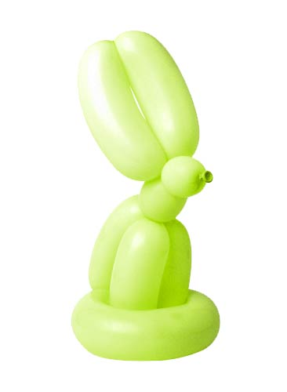
Types
Coital Urinary Incontinence
Coital Anal Incontinence
Coital Vaginal Incontinence

Slide 7
Coital Urinary Incontinence

Slide 8
Coital Urinary Incontinence
It is a frequently underreported symptom
Coital Urinary incontinence during sexual intercourse occurs :
in 1% of women in the community
in 24%- 34 % of women attending urogynaecology clinics.

Slide 9
Names
Coital Urinary Incontinence
Bladder Leakage during Intercourse
Female Urinary Incontinence During Sexual Intercourse

Slide 10
Types Of Coital Urinary Incontinence
the leakage of urine at sexual arousal or and
the leakage of urine at penile penetration or and
the leakage of urine at orgasm ( D.D from female ejaculation )
It can occur with a sexual partner or with masturbation

Slide 11
Causes
Stress incontinence often happens at predictable times, most often right at the beginning of intercourse when penetration alters the angle of the bladder and urethra. Urinating just before having sex will usually prevent this problem.
Women with urge incontinence often lose urine during an orgasm, it is unpredictable and unavoidable which may be particularly upsetting. Also, the amount of urine leaked because of an overactive bladder is usually greater than with stress incontinence
CI is a result of underlying pelvic floor dysfunction whose etiologies are multifactorial

Slide 12
risk factors
Well-known risk factors for SUI and OAB include genetic predisposition, race, pregnancy and vaginal birth, age and menopause, hysterectomy, obesity, chronic cough, and constipation.
All women should be screened for CI in addition to other aspects of sexual dysfunction.

Slide 13
Female Ejaculation
Women who experience female ejaculation may have normal voiding patterns, no bothersome incontinence symptoms, and no demonstrable detrusor overactivity.
Women who report female ejaculation, in the absence of other lower urinary tract symptoms, do not require further investigation, and may be reassured that it is an uncommon, but physiological, phenomenon.
This area remains controversial and even less studied than CI.
Ejaculate fluid expelled during orgasm may derive from the paired Skene’s glands next to the urethra during arousal or orgasm, or may be urine lost from the urethra, or a mixture of both

Slide 14
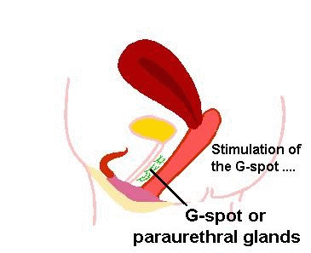
Female Ejaculation
I think that
when the amount of female ejaculate is small – it contains ejaculation fluid from urethera and vaginal lubrication fluid from vagina
when the amount of female ejaculate is large -- it contains ejaculation fluid from urethera and vaginal lubrication fluid from vagina and amounts of urine from bladder

Slide 15
DIAGNOSIS
Most women who present with UI may have a combination of both stress and urge incontinence.
A careful history will help differentiate the predominating type of incontinence, in addition to CI, if present. Straining, exercise, coughing, and sneezing will provoke stress incontinence, which is correlated to leakage with penetration. Urgency, frequency, and leakage with urgency, in the absence of infection or other inciting factors such as food stimulants or diuretics, point to urge incontinence, which is correlated with leakage with orgasm.
Sexual history and
full pelvic exam for pelvic organ prolapse are necessary.
Urodynamic testing may be required if surgery is considered

Slide 16
Prophylactic TTT
For women with coital incontinence, it is advisable to empty the bladder prior to sexual intercourse

Slide 17
TTT
Women who experience urinary incontinence may be helped by pelvic floor muscle exercises (Kegel Exercises) , behavioral TTT and advice.
coital urinary incontinence at penetration can be cured in more than 80% of cases by surgery in the presence of USI (Traditional repairs (eg, Burch retropubic urethropexy, suburethral sling , Midurethral sling, Burch colposuspension
TVT,TOT ) .
coital urinary incontinence during orgasm is curable by antimuscarinic treatment in about 60% of cases when associated with detrusor overactivity .

Slide 18
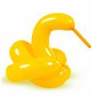
Coital Anal Incontinence

Slide 19
Names
Coital Anal Incontinence
Anal Leakage during Intercourse
Female Anal Incontinence During Sexual Intercourse

Slide 20
ANAL INCONTINENCE
Anal incontinence : It is involuntary leakage of flatus or stool from the anus with intercourse.

Slide 21
Types Of Coital Anal Incontinence
the leakage of stool or flatus at sexual arousal or and
the leakage of stool or flatus at penile penetration or and
the leakage of stool or flatus at orgasm ( D.D from Vaginal Wind )
It can occur with a sexual partner or with masturbation

Slide 22
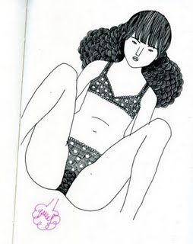
Flaturia
It is a passage of flatus at coitus
The distal end of the erect penis seems to buffet the lower rectum at coitus.

Slide 23
Causes
Muscle damage , Nerve damage and Pelvic floor dysfunction
It is primarily on third- and fourth-degree postdelivery vaginal lacerations.
May be Anal sex

Slide 24
TTT
Women who experience Anal incontinence may be helped by pelvic floor muscle exercises (Kegel Exercises) , behavioral TTT and advice
Dietary changes make food firmer
Medication consists primarily of antipropulsive drugs.
Surgery following sphincteroplasty improved sexual function

Slide 25
Coital Vaginal Incontinence

Slide 26
Vaginal Wind (Queefing )
Queefing during sex means fanny farting
it is caused by
1 -the man pushing too much air into the vagina, when he thrusts into it then it quickly escapes causing the sound
2 - with the stages of arousal and orgasm. Just before orgasm, the vaginal walls balloon out a bit, sucking in air. When the vagina goes back to its normal state, the air escapes. Air might also get trapped in the vagina during certain sports.

