Slide 1

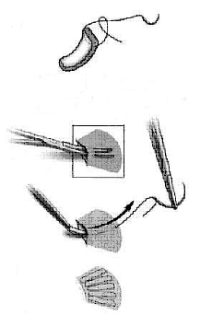
Ovarian
Cortical Strips Transplantation
Dr Muhammad El Hennawy
Ob/gyn Consultant
59 Street - Rass el barr –dumyat - egypt
www.mmhennawy.co.nr
Mobile 01222503011

Slide 2
The Ovaries
The ovaries are two nodular bodies, situated one on either side of the uterus in relation to the lateral wall of the pelvis, and attached to the back of the broad ligament of the uterus, behind and below the uterine tubes
Ovaries are of a grayish-pink color, and present either a smooth or a puckered uneven surface.
They are each about 4 cm. in length, 2 cm. in width, and about 1 cm in thickness,

Slide 3
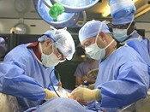
Why? !
Ovarian tissue transplantation is an option for women who want to protect their fertility and hormones while they undergo treatment for cancer, including chemotherapy and radiotherapy
For women undergoing oophorectomy (in severe or recurrent ovarian disease such as cysts, benign tumours or endometriomas or ovarian pain ), accidental bilateral salpingo-oophorectomy for huge uterine fibroids and dense pelvic adhesion--- not only to maintain endocrine functions but also for fertility preservation
Ovarian dysgenesis with missing normal ovarian complement and premature ovarian failure has come in the forefront.
Women in their 20s or 30s could theoretically have an ovary removed and frozen, and then have it reimplanted years later when they are ready to have children as “We are in the middle of an infertility epidemic

Slide 4
Types
Fresh or Frozen-thawed
Whole ovary (with vascular anastomosis) immediate restoration of vascular supply and ovarian hormonal functions is possible.
or ovarian cortical strips (without vascular anastomosis )
xenografting (human to animal ) to avoid recurrence of cancer
Orthotopic (near the infundibulopelvic ligament or on an present ovary) lead to natural conception or Heterotopic (the tissue is grafted subcutaneously to the forearm or suprapubic area) does not require general anesthesia or abdominal surgery. It is also easy to monitor follicle development and to remove the transplanted tissue from the subcutaneous site when necessary
allotransplantation ( human to human ) or Autotransplantation ( Human to herself or to monozygotic twin) without immunosuppressant treatments

Slide 5
Xenograft
The growth of ovarian tissue from one species within another species
This technique has shown early promise, and even patients with ovarian cancers may be able to use this technique to recover normal eggs without the risk the restoration of any associated cancer cells.
Furthermore this technique allows the more efficient maturation and retrieval of eggs for IVF.
Moreover the limited quantity of ovarian tissue allows strips to be unfrozen gradually over time to allow additional attempts to produce offspring.
Even small biopsies of tissue, if proven adequate for IVF, may be taken to create an egg bank for later use

Slide 6
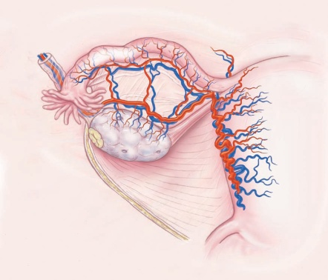
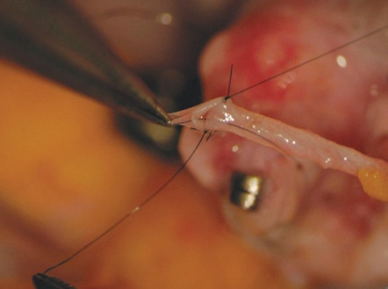
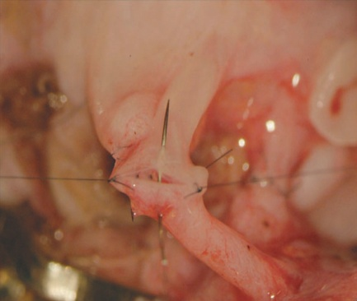
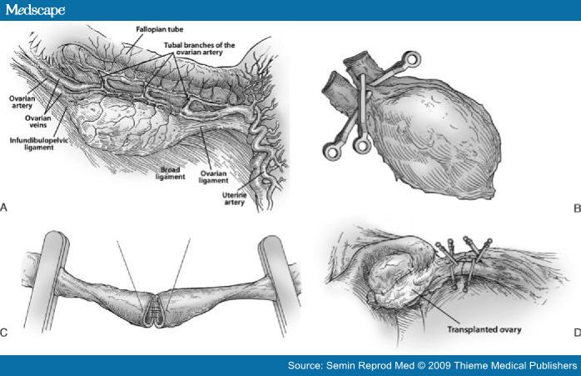
Orthotopic Whole Fresh Ovary Microsurgical Transplantation
(A) Depiction of donor oophorectomy.
(B) Microsurgical isolation of donor ovary blood supply.
(C) End-to-end anastomosis of ovarian blood vessel.
(D) Completed anastomosis of ovarian artery and veins.

Slide 7
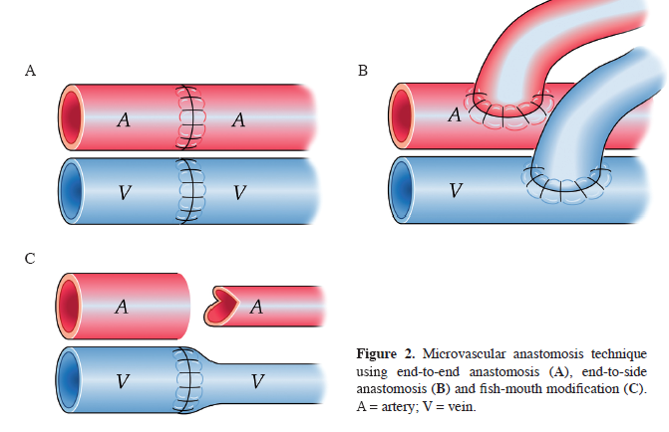
Heterotopic Whole Fresh Ovary Microsurgical Transplantation
the patients' own ovaries were transplanted to their upper limb to avoid the effect of pelvic radiation as a treatment of Hodgkin lymphoma in one patient and uterine cervical cancer in the other

Slide 8
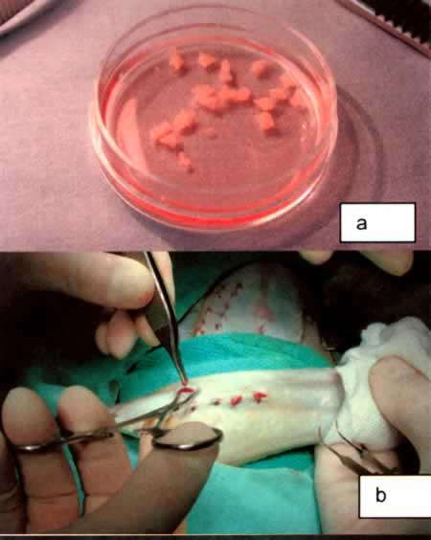
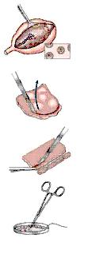
How To Prepare Ovarian Cortical Strips
Under general anesthesia
One ovary was removed laparoscopically or minilaparotomy,
The whole ovary was transferred to a Petri dish
Under Microscope . dissection with a scalpel and toothed forceps.
It was felt important to prepare a cortical tissue slice no thicker than ~1.0 mm to facilitate rapid revascularization
While keeping the tissue constantly irrigated with ice-cold medium
Its cortex was prepared in 8 strips of 50x 5 x 1 to 2 mm
DEPENDING ON PATIENT SIZE : from 5 to 15 pieces
The cortex of each ovary was cut into pieces 10 × 10 × 1 mm. ---- 2 or 3 pieces for woman
or The cortex of each ovary was cut into pieces 15 × 5 × 1 mm. ---- 3 or 4 pieces for woman

Slide 9
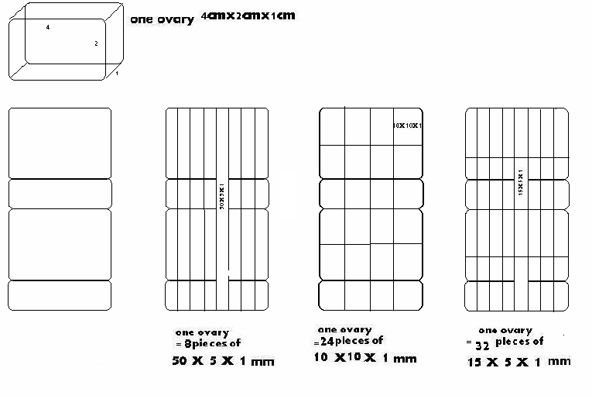
Number Of Pieces /One Ovary

Slide 10
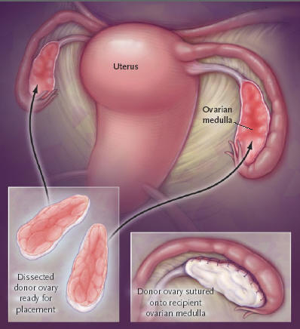
An Ovarian Cortical-Tissue Grafting
Under general anesthesia, one ovary was removed from donors using laparoscopy or minilaparotomy.
prepare a cortical tissue slice no thicker than ~1.0 mm to facilitate rapid revascularization
The pared cortex was divided into three or four pieces of approximately equal size for grafting, one piece to each recipient ovary.
The tissue graft was trimmed to the dimensions of the exposed surface of the recipient organ and attached using 9–0 interrupted sutures under an operating microscope
The medullary bed was sutured to the under surface of the cortical graft with 9–0 sutures to maintain tight tissue approximation.

Slide 11
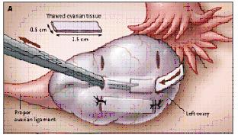
Transplantation of fresh ovarian cortical pieces under the tunica albuginea
Three pairs of 5-mm transverse incisions were made in the left ovary through the tunica albuginea
With blunt dissection, cavities were formed beneath the cortex for each of the three strips.
Each piece of thawed ovarian tissue (1.5 by 0.5 cm in area and 0.1 to 0.2 cm in thickness) was gently placed in a cavity, and the incisions were closed with 4/0 Vicryl sutures.

Slide 12
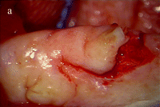
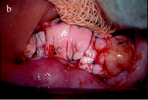
Transplantation of fresh ovarian cortical pieces between monozygotic twins
Ovarian cortical pieces measuring 4–5 mm to 1 cm in size were grafted onto the remaining ovary after the cortex of this ovary had been removed.
(a) Cortex of the remaining ovary was removed.
(b) Cortical pieces were sutured with 7-0 stitches.

Slide 13
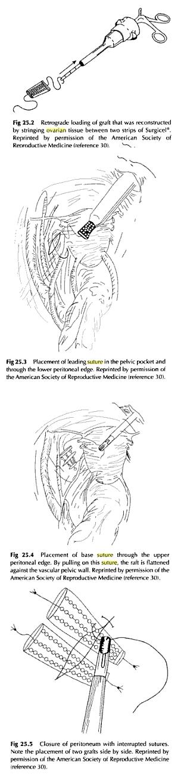
Transplantation Of Fresh Ovarian Cortex Strips In Lateral Wall Of The Pelvis
Ovarian strips strung with a 6.0 delayed absorbable suture and 3 strings of pieces were attached to an cellulose membrane
The grafts were sutured to a peritoneal pocket created in the left pelvic ovarian fossa and to ovarian fossa caudal to the first by pulling on the suture , thus The graft is flattened against the vascular pelvic wall
The placement of 2 grafts side by side
Closure of peritonium with interrupted sutures

Slide 14
Ovarian Cortical Strips Transplantation into a muscle pocket in the rectus muscle of abdomen
Cortical ovarian tissue was minced into 40–45 fragments 2–3 mm3 and then placed into a muscle pocket in the rectus muscle of abdomen according to the technique principles used for the heterotopic parathyroid autotransplantation in the sternocleidomastoid muscle
The muscle pocket and fascia were closed with stiches of vicryl

Slide 15
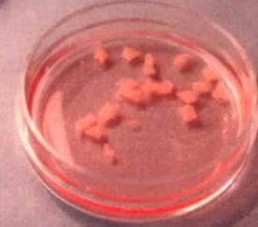
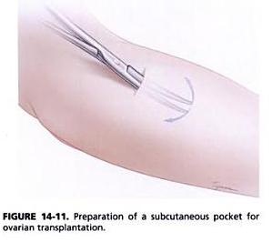
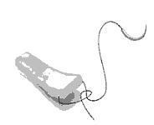
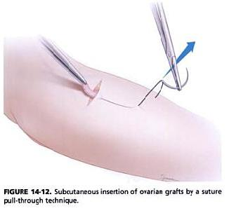
Ovarian Cortical transplantation under the skin of the forearm
after oophorectomy, ovarian cortical strips are prepared
if the tissue will be cryopreserved 1x 0.5 cm strips 1-3 mm in thickness are prepared
if transplantation will be performed with the fresh tissue , the strips can be cut longer 5 x 0.5 cm strips 1-3 mm in thicknesss will facilitate the transplantation procedure
a 1 cm transeverse incision is made over brachioradialis muscle , 5 cm below the antecubital fossa
using blunt dissection , a pocket is created between the fascia and subcutaneous tissue
this area is relatively vascular , so attention must be focused on preventing major bleeding , because the ovarian tissue will acquire its blood supply from these vessels , it is not desirable to perform extensive cauterization
then each piece is ragged with 4.0 vicryl by passing the needle between stroma and cortex under an operating microscope

Slide 16
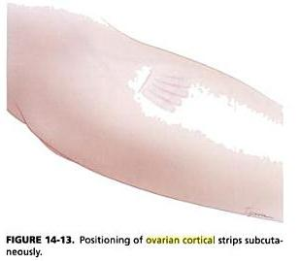
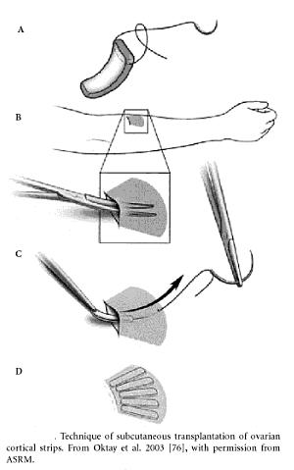
once the dissection is completed , the free end of the suture is threaded onto a reusable needle specially half circle cutting needle with chord length 25 to 38 mm
this needle is inserted into the subcutsneous pocket as far as possible
the needle is then is passed through the skin and the cortical piece is wedged into subcutaneous pocket by pulling on the suture
pieces are always inserted with the cortical side facing up
the needle is then removed
and free end of the suture is held with a mosquito clamp
the purpose of this suture pull-through technique is to guide the tissue placement
depnding on the patient size, 5 – 15 cortical pieces can be fanned out between the forearm skin
once satisfied with the tissue placement , the sutures are cut

Slide 17
after the skin is closed subcuticalarly , a nonpressure dressing is applied
pressure be avoided to prevent reducing the blood flow to the area
starting on the afternoon of the surgery , 75 IU/ dav of FSH in injected directly in the graft for 7 days
in addition , 80 mg of aspirin is admistered for 7 days
the patient,s forearm is splinted for 72 hours to prevent dislodgment due to muscle movement
hormone replacement therapy is started within 48 hours of transplantation and discontinued with the first sign of graft function
the return of ovarian function may take 2-3 months as heralded by development of ovarian follicles beneath the skin

Slide 18
Ovarian Cortical Strips Transplantation to the anterior abdominal wall at incision site of Pfannenstiel
Under local anaesthesia, implant 5- 15 ovarian cortical pieces according the size of the patient
with sizes ranging from 5 x 5x 1 mm to 15 x 5x 1 mm—beneath the skin of the patient’s lower abdominal wall with a suture pull-through technique, similar to technique applied in forearm transplantaion

Slide 19
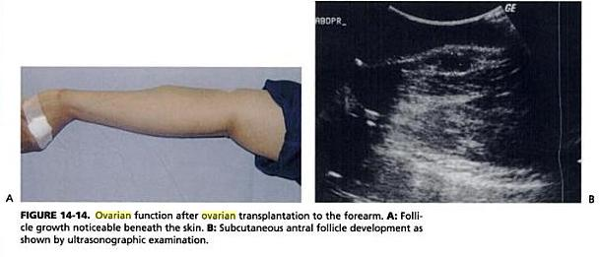
How To Diagnose Success?!
Follicular development evident after few months by ultrasound examination
Restoration of serum FSH and LH levels to nonmenopausal range
Disappearance of menopausal symptoms
And last for few years

Slide 20
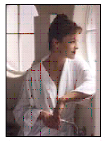

In The Future
Women in their 20s or 30s could theoretically have an ovary removed and frozen, and then have it reimplanted years later when they are ready to have children as
“We are in the middle of an infertility epidemic

