Slide 1

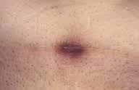
Cutaneous
Caesarean
Scar Endometriosis
Dr Muhammad M Al Hennawy
Ob/gyn Consultant
Ras el bar –dumyat - egypt

Slide 2
Cutaneous Cesarean Scar Endometriosis
It is a type of cutaneous endometriosis arising on or near a Cesarean section Scar

Slide 3
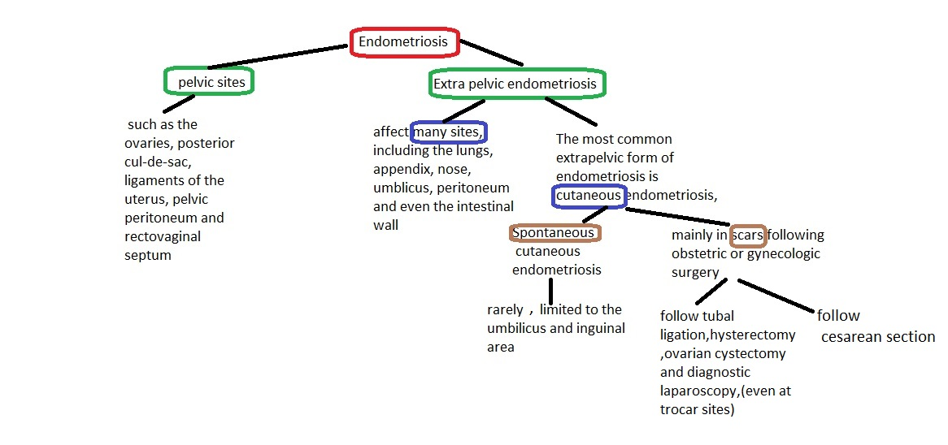
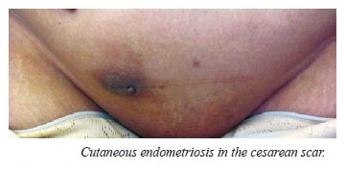
Endometriosis is defined as a growth of ectopic endometrial tissue outside the uterine cavity that responds to hormonal stimulation

Slide 4
A Caesarean Section Scar Endometriosis
It is a rare form of extrapelvic endometriosis
Deposits of endometrial glands and stromal cells can be located at
the dermis of skin,
subcutaneous tissue,
sheath,
rectus muscle,
intraperitoneally, or
in the uterine myometrium (within uterine wall Cesarean section scars).

Slide 5
Types of cutaneous endometriosis
Spontaneous cutaneous endometriosis is limited to the umbilicus and inguinal area
In other locations, such as the lower abdominal wall, it practically
always arises in surgical scars particularly those from caesarean sections
Cutaneous Cesarean Scar endometriosis is a type of cutaneous endometriosis arising on or near a Cesarean section Scar

Slide 6
Probabale Atiology
Scar cutaneous endometriomas are believed to be the result of mechanical transplantation of viable endometrial cells into the scar during surgery which subsequently proliferate and undergo metaplasia under estrogen influence
spontaneous cutaneous endometriomas not associated with surgical violation of the uterus is believed to be the result of hematogenous or lymphatic spread of endometrial tissue

Slide 7
Incidence
The exact incidence of scar endometriosis is unknown
The incidence of cesarean scar endometriosis is between 0.03% and 1.7%,
But clinical experience suggests that the actual incidence may be higher.

Slide 8
Certain Risk Factors May Be Associated With Scar Endometriosis
Hystrectomy
Cesarean section before onset of labour
Anterior placenta previa
Early hysterotomy less than 22 weeks (early decidua has more pluripotential capababilities and lead to cellular replication )
Heavy menstrual blood flow and
Alcohol consumption

Slide 9
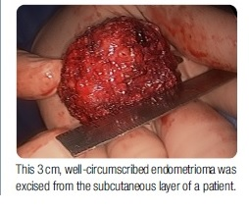
Macroscopy
It is appear as whitish fibrous tissue
with thick chocolate coloured liquid areas

Slide 10
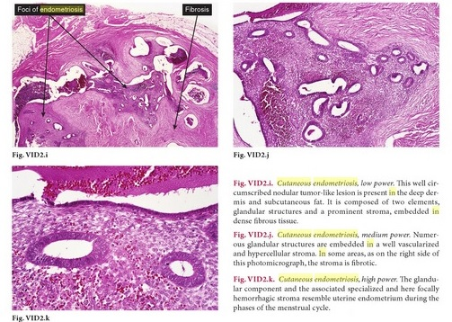
Microscopy
Major positive components of scar endometriosis are glandular and stromal elements
because of hormonal influence , Glandular epithelium my have appearance proliferative endometrium or secretory endometrium or menstrual endometrium
Columnar or cuboidal or flat epithelial cells line the glands
Mitoses are frequent during proliferative phase
Intracytoplasmic vacuoles are the hallmark of secretory phase
Intraluminal hemorrhage and degenerative changes of epithelial cells occur in menstrual phase
Stromal components consist of a mixture of spindle cells and inflammatory cells including hemosiderin- laden macrophages
Rarely , decidualisation can occur

Slide 11
Names
Endometrioma
scar endometriosis
Cutaneous endometriosis
Cesarean scar endometriosis

Slide 12
Symptoms
Patients may complain of tenderness to palpation and a raised, unsightly hypertrophic scar (89.0 %).
The overlying skin may be hyper-pigmented due to deposition of haemosiderin.
Most patients have cyclical pain (up to 70%)
The pain (94.0 %) is usually intermittent and associated with the patient's menstrual cycle but it may be constant in nature.
Some reports state that even as (50.0 %) of the patients exhibited cyclical symptoms.
Some patients may be asymptomatic

Slide 13
The median interval between the last cesarean section and admission to hospital was 36 month (range 12-120 mo)
the mean length of time between onset of symptoms to surgery being 31.7 months (range 1-62 months).

Slide 14
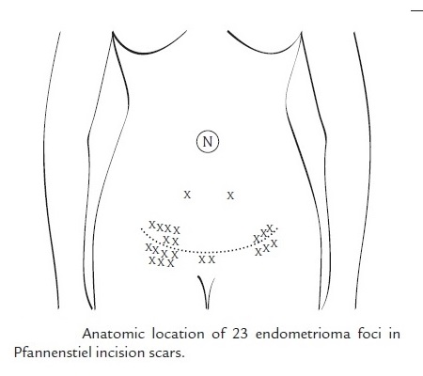
levels
Endometriosis, in patients with scars,
It is more common in the abdominal skin and subcutaneous tissue
compared to muscle and fascia.
Endometriosis involving only the rectus muscle and sheath is very rare.
lesions of scar endometrioma were more common in corner sites, i.e. 2/3 in midline vertical incision scars and 19/23 in Pfannenstiel incision scars,
with right side predominance
This phenomenon may be due to more operators standing on their patient’s right side during surgery and the endometrial inoculums not being easily found and removed.

Slide 15
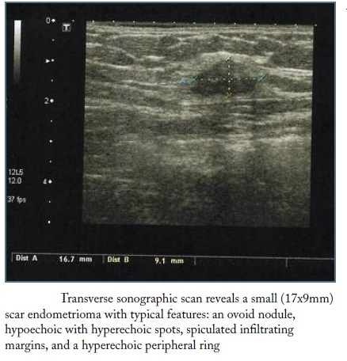
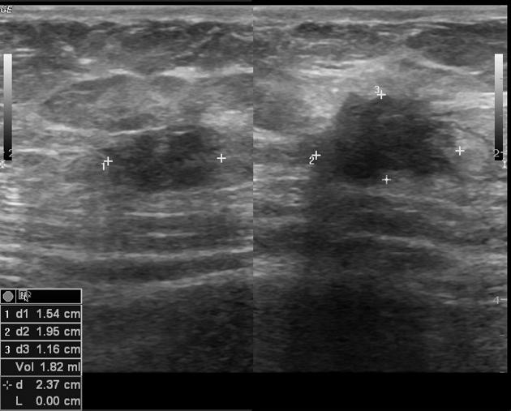
Pre-operative Diagnosis
Ultrasound-guided fine-needle aspiration cytology (FNAC) may be used in diagnosis and to rule out malignancy.
Abdominal ultrasound scan (US) including power Doppler examination (Sonographic features are not specific. A subcutaneous nodule having relatively irregular borders, a heterogeneous echotexture with internal scattered hyperechoic echoes surrounded by a hyperechoic ring of variable width, and vascularity may be present. Occasionally cystic changes may be present ),
Pelvis ultrasound scan
CT scan (Well defined soft tissue nodule with heterogenous post-contrast enhancement and streakiness in the surrounding tissue )or
MRI (Is the most sensitive imaging modality. Often accurately locates the lesion in relation to a previous C section scar, with signal characteristics similar to that of background endometriosis)

Slide 16
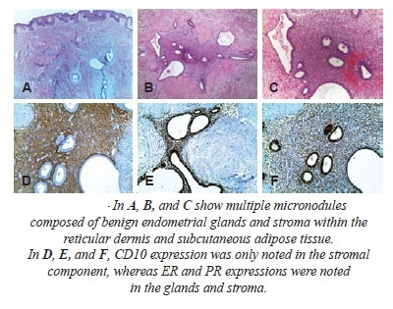
Post-operative diagnosis
A detailed examination of material from cases of cutaneous endometriosis revealed a range of histopathologic features similar to those found within the uterine endometrium at each of the main phases of the menstrual cycle. However, there appeared to be a poor correlation between histologic appearance and menstrual stage. Recognition of these cyclic variations is important for the accurate diagnosis of cutaneous endometriomas.
A Biopsy specimen showed fibrotic Dermis with increased numbers of blood vessels and Scattered glandular structures with areas of hemosiderin deposition consistent with a diagnosis of endometriosis.
Microscopic examination confirmed the preoperatively presumed diagnosis of cutaneous endometriosis
In addition, so-called Atypical features described in endometriosis affecting other anatomic sites may be seen in the skin

Slide 17
Differential Diagnosis
Scar endometriosis is rare and difficult to diagnose. It is often misdiagnosed as
stitch granuloma,
Pyogenic granuloma
inguinal hernia,
incisional hernia
lipoma,
Dermatofibroma
abscess,
cyst,
a strange body,
incisional hernia,
desmoid tumor,
keloid ,
sarcoma,
lymphoma, or
primary and metastatic cancer.

Slide 18
Prevention
-There would be no obvious prevention
the question arises again
- do you go to the effort and expense on 100% of patients to protect <0.5% of them from a benign, relatively easily treated problem?

Slide 19
- placing some type of barrier over each layer of the abdominal wall (especially the fascia) before conducting surgery within the peritoneum
the used sponge should be discarded immediately after cleaning the uterine cavity,
not allowing instruments and swabs which have touched the endometrium at the time of caesarian section from coming in contact with the subcutaneous tissues or skin.
the suture material used for uterus should not be reused while closing abdominal wall

Slide 20
Thorough sucking out and washing of endometriomas before ovarian cystectomy in chocolate cysts could also be useful in avoiding endometrial tissues from reaching the abdominal wall
- the surgical area should be cleaned thoroughly and irrigated with saline solution before wound closure and repair of peritoneum at the time of cesarean section closure
- Also it is strongly recommended that the abdominal wound be cleaned thoroughly at both corner sites (especially the operator’s side).

Slide 21
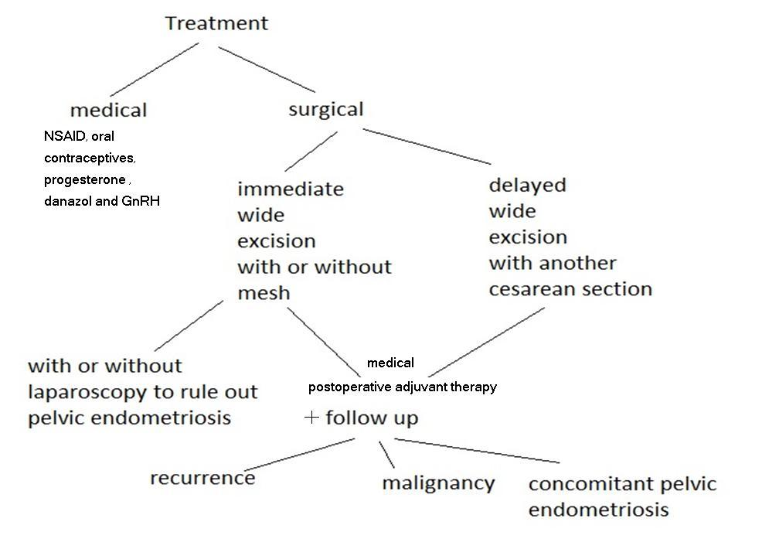

Slide 22
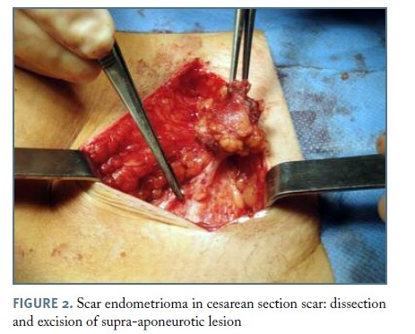
The Treatment Of Choice
In general, the treatment of choice for abdominal wall scar endometriosis or CS scar endometrioma is surgical excision, even for recurrent cases.
Wide surgical excision with at least a 1 cm margin and/or patch grafting for fascia defect have been emphasized to prevent hernias..
Medical therapies used in the treatment of endometriosis include nonsteroidal anti-inflammatory agents, oral contraceptives, and analogs of gonadotropin releasing hormone (GnRH). All medical treatments are equally effective, with 80% to 85% of patients having symptomatic improvement. The major differences are their side effects.
A combination of surgical excision and with either GnRH-agonist or danazol, is recommended

Slide 23
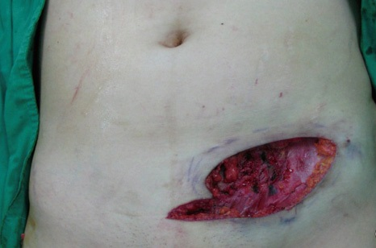
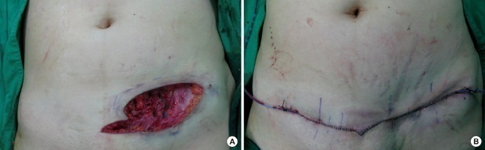
Surgical excision
Total surgical excision is considered to be the gold standard for both diagnosis and treatment. Resection must be complete with clear margins to prevent recurrence.
The depth of cutaneous endometriosis can only be determined at the time of surgery,
It is crucial to inform patients preoperatively about the possible placement of a mesh to repair the defect in the rectus sheath. Thus far, there have been some reports of the use of a Prolene mesh following excision of cutaneous endometriosis.
Functional, and cosmetic standpoints can be achieved with conservative excision followed by mini-abdominoplasty of extensive Cesarean scar endometriosis

Slide 24
Role of a gynecologist
Primary excision of the nodule may be done by the gynaecologist. However, sometimes the gynaecologist may be called in only after the diagnosis of endometriosis has been made on histopathology.
One has to decide whether a laparoscopy has to be done to rule out pelvic endometriosis. It has to be remembered that cutaneous endometiosis may be assossiated with pelvic endometriosis in 20±46% of cases.
If the diagnosis of endometriosis is made preoperatively,

Slide 25
Delayed excision
If an abdominal wall endometriosis is encountered after CS
But the patient plans to have future pregnancy and
The symptoms are mild,
Excision of the endometrioma may be deferred until the next indicated CS.

Slide 26
Follow-up
Follow up of endometriosis patients is important because of the chances of recurrence, which may require re-excision.
In cases of continual recurrence, possibility of malignancy should be ruled out.
The incidence of concomitant pelvic endometriosis with scar endometriosis has been reported to be ranging from 14.2% to 26%.26 Ideally,
all patients must be examined for concomitant pelvic endometriosis and at this point, postoperative follow-up should be done for a couple of years and the patient should be under the observation of the gynecologist

Slide 27
Malignant Transformation
Scar endometriosis, as well as endometriosis at other sites, can undergo malignant change.
This malignant transformation occurs rarely
Clear cell carcinoma is the most common histological subtype, followed by endometrioid carcinoma.
The outcome, after a short follow-up, is rapidly fatal with a survival rate of only 57%

Slide 28
Conclusion
Cutaneous cesarean section scar endometriosis may be caused by iatrogenic inoculation of endometrium into the surgical wound.
It is currently regarded as a rare disease entity. However, in the light of the rising CS rate, it may become more common.
So, it is strongly recommended that during obstetrical and gynecological operations caution should be practiced.

