Slide 1

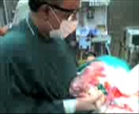
Delayed
Ligation Technique
In PeriPartum
Hysterectomy For Placenta Accreta
Dr Muhammad Al Hennawy
Ob/gyn Consultant
59 Street - Rass el barr –dumyat - egypt
www. mmhennawy.co.nr
E-mail : mmhennawy@hotmail.com

Slide 2
Peripartal Hysterectomy
It is removal of pregnant uterus at or near time of delivery ( performed within 24 hours of a delivery).
It includes cesarean hysterectomy and postpartum hysterectomy
A major surgical procedure still faces obstetricians in modern practice

Slide 3

It is a techniqually difficult operation especially if done as an emergency
It is a life saving procedure
Complication 4 times those of an elective procedure
Intraoperative and postoperative complication are much more than of gynecological hysterectomy and mortality is 5 times greater

Slide 4
Peripartum hysterectomy may be performed emergently as a last resort to save the life of a woman with persistent bleeding,
or as planned procedure, often in conjunction with cesarean delivery
It is performed in 0.05 to 0.1 percent of deliveries

Slide 5
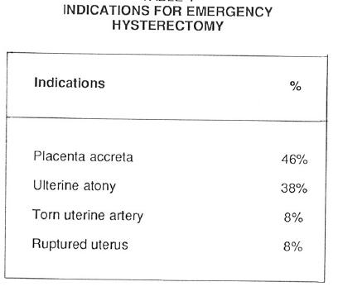

Slide 6
Needs
Proper and safer peripartal hysterectomy needs
1- adequate training and experience
skills are best acquired with an experienced mentor during scheduled non-emergency cases
2 - proper emergency and elective indications
3 - avoiding undue delay in emergency operations
4 - awareness of associated technical problems
Due to pregnancy changes
Due to associated conditions
5 - with PPH , use abdominal utero-aortic compression before opening and aortic compression after opening of abdomen
6 - Tourniquet technique prevents profuse blood loss in placenta accreta ( 2 methods )

Slide 7
Due to pregnancy changes
Excessive vascularity and back bleeding
Bulky very soft uterus
Thick oedematous pedicles that are friable and easily traumatised
Postoperative loose sutures as edema subsides
very lax pelvic tisssues with unintended more tissue dissection

Slide 8
Due to associated conditions
Anatomical distortion by hematomas , tumors etcs..
Excessive vascularity and tissue friability with placenta previa and or accreta
Adhesions with lower segment with more liability to urinary injuries

Slide 9
Abdominal utero-aortic compression
With PPH , Abdominal utero-aortic compression should be utilised once hemorrhage starts until the abdomen is opened
And then substituted with direct lower aortic compression till the end of operation

Slide 10
Peripartum Management
Preoperative Care
Hematocrit should be rechecked
Oral intake is stopped at least 8 hours before surgery
Antacid given shortly before the induction minimizes the risk of lung injury from gastric acid
Indwelling bladder catherter is placed

Slide 11
Regardless of the anesthetic technique used,
two large bore intravenous catheters,
arterial line and possibly central line should be inserted in patients undergoing cesarean section for abnormal placentation.
Two to four units of packed red blood cells should be immediately available.
Vasoactive drugs such as phenylephrine, ephedrine, dopamine and epinephrine should be immediately available

Slide 12
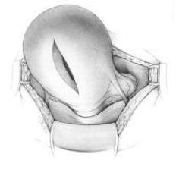
Vertical Incision Of The Uterus
Open uterus by vertical incision in upper segment
To avoid site of placenta adhesion
In case of placenta previa with accreta

Slide 13
Leaving placenta
Do not try to remove the placenta

Slide 14
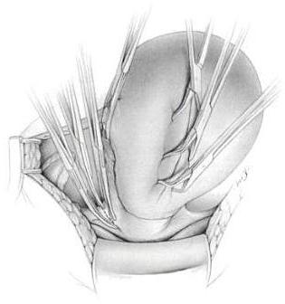
Close The Uterine Incision
Towel clamps are used to quickly close the edges of the cesarean incision and to control the bleeding
Alternatively, a single–layer running locking continous suture can be placed to quickly close the uterine incision and gain hemostasis
If bleeding is minimal, closure is not necessary

Slide 15
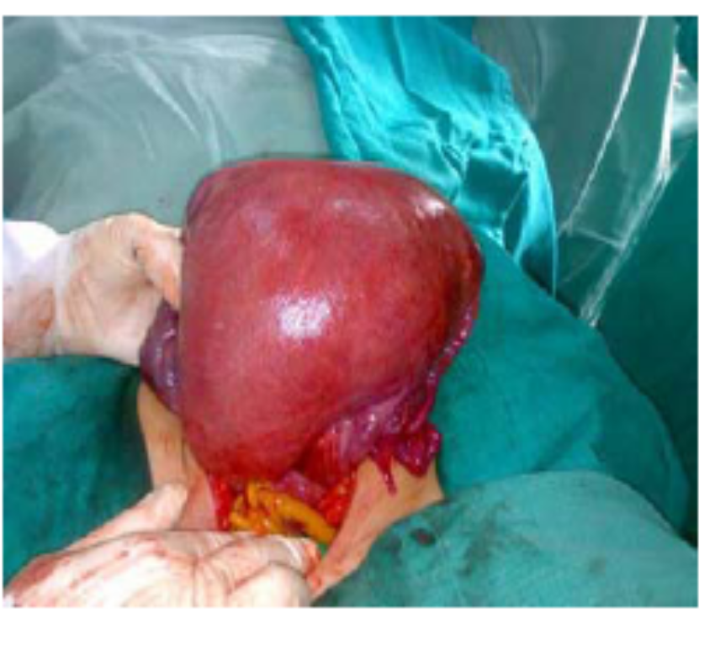
Tourniquet technique (method1)
A tourniquet technique to temporally shut off blood flow through the uterine and ovarian vessels at the level of the uterine cervix. The tourniquet consisted of manual compression followed by a rubber tube
The tourniquet is drawn very tight and secured by clamp in the back of the uterus
This technique not only prevented massive bleeding from the accreted placentation, but also allowed physicians time to consider the necessity of subsequent hysterectomy

Slide 16
Tourniquet technique (method2)
A tourniquet is passed through 2 openings in the broad ligaments below level the hysterectomy incision ( made by artery in avascular part )
The tourniquet is drawn very tight and secured by clamp in the back of the uterus
It as temporally shut off blood flow through the uterine vessels at the level of the uterine cervix.
It can not control collateral circulation from the ovarian vessels

Slide 17
Delayed ligation Technique
This technique quickly control all vascular supply to uterus
The clamped pedicles drop from operative field as the operator proceeds quickly from one pedicle to the next
Delaying suture ligation until all six vascular bundles are controlled
This technique gains complete hemostasis very quickly
Delayed ligation technique is also well suited to nonemergemcy and elective cases and can be used for many emergency cases

Slide 18
Delayed ligation Technique
It is The preferred Technique in which
Three sets of clamps ( double clamping) are placed in pre-planned fashion
On each of dissection to control
1- round ligaments and vessels in them
2- utero-ovarian ligaments and vessels in them
3-Ascending uterine blood vessels

Slide 19
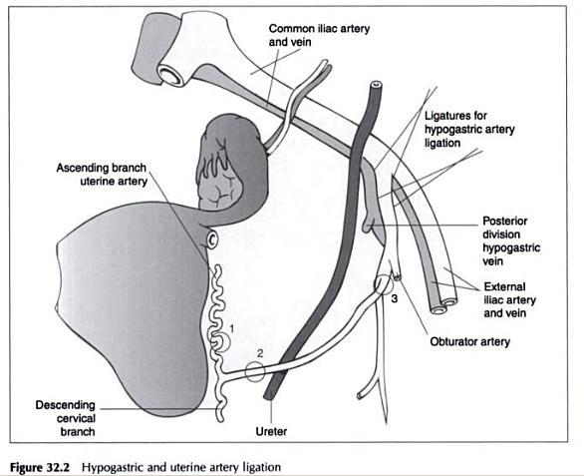
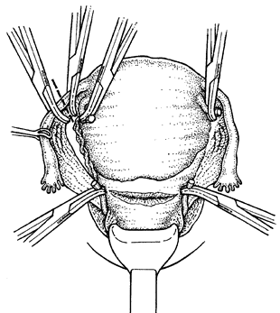

Slide 20
Peritonium
After cut round ligament , The incision in the vesicouterine serosa is extended laterally and upward through the anterior leaf of the broad ligament to reach the incised round lig
The posterior leaf of the broad ligament adjacent to the uterus is perforated just beneath the fallopian tube, utero-ovarian ligaments and ovarian vessels to clamp utero-ovarian pedicle
The posterior leaf of the broad ligament is divided inferiorly toward the uterosacral ligaments then clamp ascending uterine vessel
The bladder is dissected free for about 2 Cm below the lowest margin of the cervix to expose the uppermost part of the vagina then clamp cardinal ligament and uterosacral lig

Slide 21
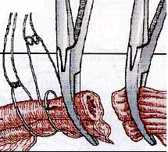
Suture ligation
Double ,
- The proximal one is ligation and
- The distal one is transfixing one
It is done in reverse order of clamping
Extra care for complete hemostasis from vaginal cuff

Slide 22
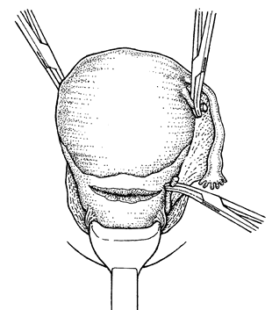
Subtotal (supracervical) hysterectomy
In case of placenta accerta in upper uterine segment
Amputate the uterus above the level where the uterine arteries are ligated, using scissors
Close the cervical stump with interrupted 2-0 or 3-0 chromic non absorbable (or polyglycolic) sutures.
Carefully inspect the cervical stump, leaves of the broad ligament and other pelvic floor structures for any bleeding.
If slight bleeding persists or a clotting disorder is suspected, place a drain through the abdominal wall. Do not place a drain through the cervical stump as this can cause postoperative infection

Slide 23
Total Hysterectomy
In case of placenta accerta in lower uterine segment
The following additional steps are required for total hysterectomy.
Push the bladder down to free the top 2 cm of the vagina.
Open the posterior leaf of the broad ligament.
Clamp, ligate and cut the uterosacral ligaments.
Clamp, ligate and cut the cardinal ligaments, which contain the descending branches of the uterine vessels. This is the critical step in the operation:
• Grasp the ligament vertically with a large-toothed clamp (e.g. Kocher)
• Place the clamp 5 mm lateral to the cervix and cut the ligament close to the cervix, leaving a stump medial to the clamp for safety
• If the cervix is long, repeat the step two or three times as needed
• The upper 2 cm of the vagina should now be free of attachments
• Circumcise the vagina as near to the cervix as possible, clamping bleeding points as they appear.
Place haemostatic angle sutures, which include round, cardinal and uterosacral ligaments.
Place continuous sutures on the vaginal cuff to stop haemorrhage.
Close the abdomen after placing a drain in the extraperitoneal space near the stump of the cervix

Slide 24
Postoperative care
If there are signs of infection or the woman currently has fever, give a combination of antibiotics until she is fever-free for 48 hours.
Give appropriate analgesic drugs (Meperidine 75~100 mg or morphine sulfate 10~15 mg, IM every 3~4 hours as needed for discomfort )
Must be monitored closely
  BP,P, urine flow ( > at least 30mL/hr )
3L of fluid should prove adequate during the first 24 hours after surgery
Encouraging deep breathing and coughing
In uncomplicated cases, solid food may be offered within 8 hours of surgery
The bladder catheter most often can be removed by 12 hours after operation
If there are no signs of infection, remove the abdominal drain after 48 hours.
Ambulation At least the day after surgery, with assistance, should get out of bed
  With early ambulation, venous thrombosis and pulmonary embolism are uncommon
Wound care - Inspected each day
  The skin sutures are removed on the fifth day after surgery
Laboratory Hct is routinely measured
Discharge from the Hospital - Generally discharged on the third or fourth postpartum day

