Slide 1


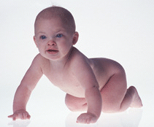
Does the Ovum select her gender?
Dr Muhammad El Hennawy
د/ محمد الحناوى
Ob/gyn Consultant
Rass el barr central hospital and
dumyat specialised hospital
Dumyatt – EGYPT
www. Mmhennawy.co.nr

Slide 2
it can now confirm astrology's claim that the Earth and Sun, the planets and the fixed stars,
are all charged bodies possessing magnetic fields of differing intensities.
determine the effect the moon had on the menstrual and conception cycle, and his findings heralded a revolution in the practice of fertility control for many women around the world.
also discovering the wisdom of working with the moon. Due to a greater tendency for excessive bleeding at the time of a full moon, some hospitals are exercising more caution in the scheduling of major operations.

Slide 3
in March 1933
two Russian scientists,
Mme Vera SCHROEDER and M. KOLTZOFF, who published an article in Nature describing the fact that depending on whether they carry an X or Y chromosome, spermatozoa have opposite polarisation. The X spermatozoa have a negative charge and the Y spermatozoa a positive charge.

Slide 4
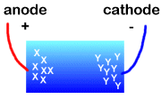
In 1958
professors Koltzoff and Shroder the famous Russian scientists concluded that it was possible to separate the sperms with y and x chromosomes through a charge from an anode or a cathode

Slide 5
In 1961
scientists had shown that sperms containing the X chromosome attracted to a negative
while sperms containing the Y chromosome were attracted to a positive charge.

Slide 6
Later a French cellular biologist
, Patrick Shoun's research led to the discovery of a charge on the ovum membrane.
The charge on the ovum membrane was not fixed but alternated from positive to nuetral and to a negative charge in a cycle.
This was called the polarity cycle of the ovum membrane.

Slide 7
polarity cycle of the ovum membrane.
This polarity was found to be preditable but totally separate from the menstrual cycle.
The polarity cycle which unknown to most of us, was there in addition to the ovulation/menstrual cycle.
When the ovum membrane is nuetral, sperms carrying either the X and Y chromosome can unite with the ovum and fertilize it. During this period, the chances of getting a baby boy or baby girl are 50 : 50.
When the ovum membrane is positively charged, it attracts the sperm carrying X chromosome (which is negatively charged) and a baby girl is produced.
When the ovum membrane is negatively charged, it attracts the sperm carrying the Y chromosome (which is positively charged), and a baby boy is produced.

Slide 8
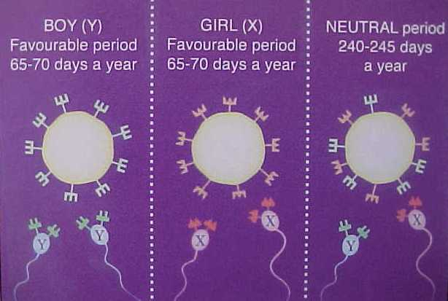

Slide 9

The ovum membrane's alternating polarity is nature's way of selecting sperm with different gender determining chromosomes.
There are up to 8 sure days every month when you can conceive only a boy or a girl. The French scientists discovered that the receptors on a mother's egg membrane have an alternating energy charge. At different times they accept or reject X (girl) or Y (boy) chromosome sperm. o

Slide 10
In the 1980's
Professor J. STOLKOWSKI announced that sex determination was possible by means of modifications in the ion content of food

Slide 11
In 1990
scientist at the university of Roscoff found that the fact of the Sperm joining the ovule produced an electrically influenced luminous ring

Slide 12
In 1992
the Science university of Tokyo confirmed the Koltzoff V Schroder findings and recognised the ability to separate the sperm containing y and x Chromosomes by electrolyses

Slide 13
In 1994
Patrick Schoun completed his 15 year study on 1000s of mammal case studies and in 1996 followed by his final tests of the BabyChoice method based on 155 human couples showing a 98.7% success rate.

Slide 14
Recently
work published by Dr. Kenneth GLANDER of Duke University, Durham, has allowed us to establish that in Brazil, in Muriquis monkeys, mothers-to-be are able to modify vaginal electric potential in order to promote fertilisation of the ovule by male or female spermatozoa according to need to preserve the male/female equilibrium of their group.

Slide 15
there are now four natural methods being advocated for pre-selecting a boy or girl
they are based on mainly The ovum membrane's alternating polarity on how they might work. These are:
Timing Method
Diet Method
Douching with acid or alkali Method

Slide 16
Timing Method
The main advocates for this method of sex selection are Shettles and Rorvik. They believed that the male sperm (Y sperm) are smaller and therefore can swim faster than their female rival (X sperm). They also believed the alkaline or acidic environment of the vagina affects the male and female sperm differently

Slide 17
Diet Method
For a boy, you need to eat food rich in sodium and potassium. Foods suitable for a boy include meat, salted meat products, sausages, fish (dried and salted fish particularly recommended), rice, pasta, potatoes, beans and most fresh vegetables, peaches, apricots, bananas and most fresh fruits, white bread, croissants, fruit loaf, honey, jam and soup, tea, coffee and fizzy drinks.
For a girl, foods rich in calcium and magnesium like dairy products should be eaten. These include eggs, milk or milk products, small amounts of fresh meat and fish allowed, no salt in food, tea, coffee, mineral waters, fresh fruit juice, wine, beer, yoghurt, rice, pasta, salt-free bread, ice cream and small quantities of fresh vegetables

Slide 18
The Vaginal Douching Method
Some doctors, including Dr Shettles, believe the Y sperm (male) prefer alkaline conditions whereas the X sperm (female) favours acidic environments. With this in mind, some doctors are still recommending the douching of the vagina with a solution of bicarbonate of soda for a boy or lemon juice (or diluted vinegar) for a girl 15-30 min before intercourse. The sodium bicarbonate will make the vagina more alkaline therefore favouring the conception of a boy whereas vinegar and lemon juice are both acidic thus favouring girls.

