Slide 1

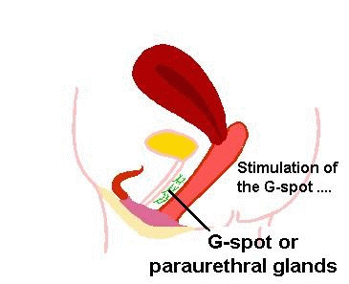
Female
Ejaculation
Dr Muhammad El Hennawy
Ob/gyn Consultant
59 Street - Rass el barr –dumyat - egypt
www. Mmhennawy.co.nr
Mobile 01222503011

Slide 2
In spite that this lecture contains medical evident informations
If you accept this lecture ,
take it as a sciense
If you do not accept it,
take it as a fun

Slide 3
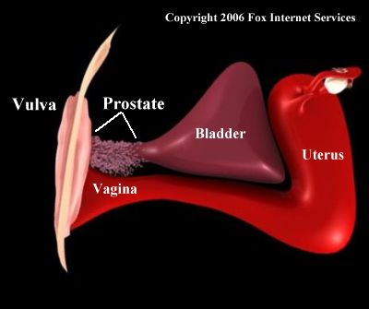
The issue of female ejaculation has become a source of controversy among feminists, sexologists, and the general public.
OBGYNs and other physicians often
misunderstand or even misdiagnose
female ejaculation

Slide 4
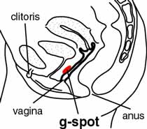
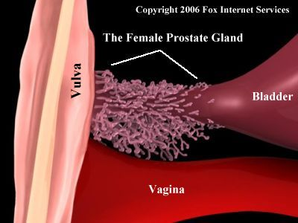
With the publication of The G Spot in 1982,
everyone's attention became focused on this tiny little organ, otherwise known as the urethral sponge ( female prostate ), that every woman was reported to have.

Slide 5
Names
A female semen -- Hypocrates
A female seminal liquid -- Galeno
A libidinous fluid --- De Graaf (1672)
A female ejaculate--- Grafenberg (1950)

Slide 6


Female Ejaculation
It refers to the expulsion of noticeable amounts of clear fluid or the emission of liquid by human females from the paraurethral ducts and/or urethra (through the genitals )during orgasm.
It is also known colloquially as squirting or gushing or dribbling

Slide 7
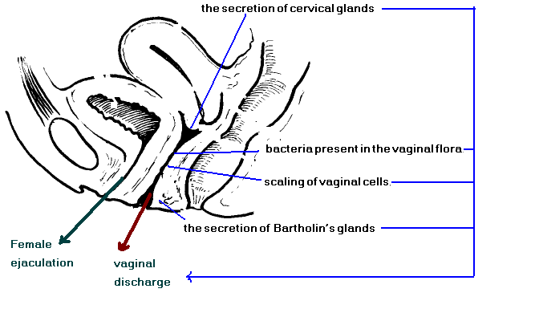
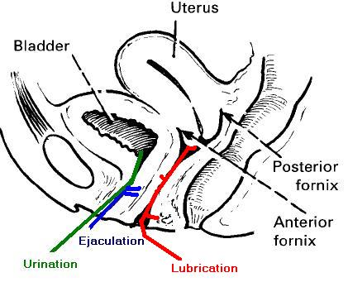
Source Of Fluids Expulsed By Females During Orgasm
1-Urethral ejaculate ---Female prostate fluid ---Female ejaculation !!!
2-Excess vaginal secretions ?? ---- vaginal ejaculation fluid--- leukorrhea --- vaginal lubrication ( 1- 4 ml in 24 hour )
which lubricates the vaginal walls and oozes out during sexual arousal. ,
it contains vaginal secretions from walls of the vagina..
its function is partly self-cleansing, partly lubrication and partly protection from infection.
3-Poor bladder control ?? --- urination

Slide 8


Ejaculate Fluid Comes From
From the urethra
Not from the bladder except in a very small number of women complaining from urinary incontinence
Not from the vagina

Slide 9
Saying
-Women lactate, men ejaculate,---------------- old saying
-Most women lactate, also ejaculate ,--------- new saying

Slide 10
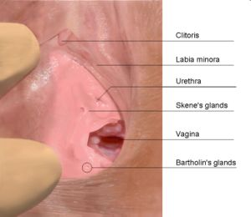
The Dual Function Of The Urethra
The fact that the ejaculation comes from the urethra is often pointed to as evidence that the liquid is urine and not ejaculate.
Can any people claiming that male ejaculate is anything other than a sexual fluid. Because of the dual function of the urethra,
Most men find it impossible to urinate when they are aroused and have an erection.
The same may well be true for women.
Just like a man can ejaculate and urinate out of his urethra can a woman!

Slide 11
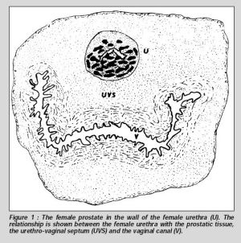
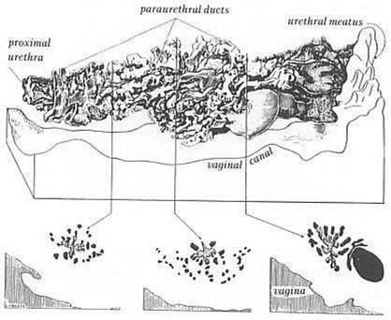
Female Urethra
The male prostate is an distinct organ that surrounds the male urethra
but the female prostate lies within the wall and along the length of the female urethra, as indicated in the illustrations shown
It is part of and contained within the wall of the urethra, and the urethra is contained within the wall of the vagina.
The average size of the female prostate is 1.3 inches long, 0.75 inches wide, 0.4 inches in height (3.3 x 1.9 x 1 cm), and weighs about 0.2 ounces (5.2 grams).
Which means it is a relatively small organ about the size of a woman's thumb. Despite its smaller size "it possesses all the structural components of the male prostate.“
The female prostate comes in many different shapes and sizes but the majority of women have a prostate that is positioned near the external urethral orifice, as shown

Slide 12
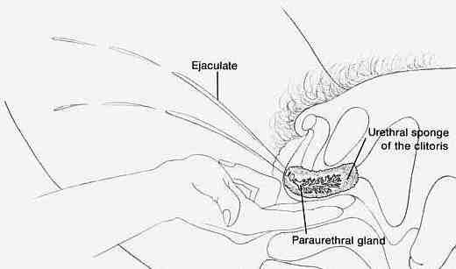
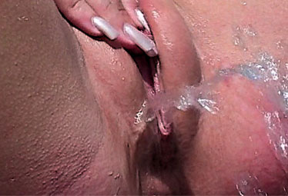
G-spot
During gestation the male and female start with the same tissues, it's only after sex differentiation at about 40 days that the genitals begin to look different in the male and female fetus. The tissue which becomes the prostate in the male does not just disappear in the female, it becomes the paraurethral glands which surround the urethra.
Based on postmortem dissections, the amount of glandular tissue varies from woman to woman, and some women have no discernible glandular tissue in their G-spot.

Slide 13

Types
Most women ejaculate, although they are variations in the quantity of the emitted liquid
With great force --- gushing or squirting --- 6% frequent and 13% infrequent
With little force --- dribble -- 55-60%
Almost-dry orgasm --- don't have any glandular tissue can't produce anything to ejaculate or very scarce secretion or the ejection takes the retrograde direction towards the bladder, as occurs in the retrograde ejaculation of some men

Slide 14

Direction
Most women ejaculate, although they are variations in the the direction of the emission

Slide 15
Female Prostate History
The first person known to have described the "female prostate" was Reinier De Graaf in the year 1672.
He described it as a collection of functional glands and ducts surrounding the female urethra.
He said the glands and ducts produced a "pituitoserous juice;" meaning it produces a thick mucous that is pale yellow or transparent in color.
He said the function of this fluid was to make "women more libidinous with its pungency and saltiness and lubricates their sexual parts in agreeable fashion during coitus.
female prostate disappear to for 329 years?
during the 20th century the female prostate was usually described as vestigial, i.e. not fully developed and non-functional, and was identified as either paraurethral or Skene's glands.
Since modern medicine did not see the female prostate playing an active and necessary role in reproduction it wasn't essential to understand its function and this likely contributed to the lack of interest within doctor offices and hospitals.
" Despite his observation modern Western medicine did not fully accept the concept of a "female prostate" until 2001 when the Federative Committee on Anatomical Terminology agreed to use this term in their next edition of Histology Terminology.

Slide 16
A Female Prostate
(A Woman's Love Button)
The average size of the female prostate is 1.3 inches long 0.75 inches wide 0.4 inches in height (3.3 x 1.9 x 1 cm).
An elliptical container about this size when filled with water would hold 0.17 oz [5 ml] or 1 teaspoon.
A cylindrical shape 0.75 inches across would hold 0.32 oz.
If the female prostate can contain less than 0.4 oz

Slide 17
Functions Of the Female Prostate
At present it is known to have two primary functions.
The first function is produce and store prostatic fluid in ducts, which is the function of an exocrine gland.
The prostatic fluid contains prostate-specific antigen (PSA), prostate-specific acid phosphatase (PSAP or PAP), and fructose, a sugar.
The numerous ducts of the prostate drain into the urethra. "Pure prostatic fluid has not yet been isolated and it has been studied only as a component of the female ejaculate..."
The second function is the releasing of hormones into the blood stream, as a result of stimulation by the nervous system; a process performed by neuroendocrine cells.
The only hormone known to be produced by the female prostate in this way, as of the year 2000, was serotonin.
Serotonin plays an active role in many functions of the body.

Slide 18


Ejaculate Fluid Amount
The quantity of fluid mentioned varies a lot according to different authors
from a few drops to a few tablespoonfuls
Belzer (1983) estimates 10 ml;
Goldberg (1983), from 3 to 15 ml.;
Bullough (1984) 12 ml;
Zaviavic (1987), 16 ml. and
Heat (1984) from 30 to 50 ml= [6 to 10 teaspoons] in 30 to 50 seconds

Slide 19
Incidence
the investigators that support the existence of female ejaculation, seem to agree that it is a possibility that actually occurs in very few women, they do not have voluntary control over its release:
10% for Whipple and Perry (1981),
14 % for Bullough et al. (1984),
40% for Darling, Davidson and Conway Welch (1990) and
6% for Kratochvil (1994)

Slide 20
Structure
The fluid doesn't look like urine, doesn't smell like urine, doesn't staine color on the bed and it has been proven in many chemical analyses that it is definitely not urine
it's usually clear, milky and relatively odorless, with a watery consistency and it's not lubrication.
It is very similar chemically to male prostate
The paraurethral glands produce an enzyme called prostatic acid phosphatase (PAP), along with prostate-specific antigen (PSA)
They also produce Human Protein 1, a trait formerly believed to be unique to the male prostate
female ejaculation can vary in color and thickness.
the taste of female ejaculation can vary from bitter to sweet according to diet, water consumption and a host of other environmental and biological factors.

Slide 21
Time
Before orgasm-- It's also possible that the fluid may leak out at any time during sexual arousal
before orgasm; men have a sphincter (valve) "downstream" of the prostate that keeps fluid from leaking, but women have no such sphincter
With orgasm– with the muscle contractions of orgasm
After orgasm – presence of ejaculate in urine, as the result of a retrograde ejaculation or just the urine washing a small amount of fluid out

Slide 22
How?
In some women
the paraurethral glands produce fluid when the woman is highly aroused.
Because the paraurethral glands open into the urethra,
the muscle contractions of orgasm force this fluid into the urethra, and out of the body,
creating an ejaculation of sorts.

Slide 23
Male Ejaculation
Male Ejaculation is the ejecting of semen from the penis, and is usually accompanied by orgasm.
It is usually the result of sexual stimulation, which may include prostate stimulation. Rarely, it is due to prostatic disease.
Ejaculation may occur spontaneously during sleep (a nocturnal emission).
During emission, the two ducts known as vas deferens contract to propel sperm from the epididymis where it was stored up to the ampullae at the top end of the vas deferens. The beginning of emission is typically experienced as a "point of no return," also known as point of ejaculatory inevitability. The sperm then passes through the ejaculatory ducts and is mixed with fluids from the seminal vesicles, the prostate, and the bulbourethral glands to form the semen, or ejaculate
During ejaculation proper, the semen is ejected through the urethra with rhythmic contractions

Slide 24


British Film Classification
In the United Kingdom, the British Board of Film Classification has neither confirmed nor denied the existence of the phenomenon of female ejaculation,
only claiming that all examples they have seen thus far during classification have been urination during sex.
Although urine and female ejaculation are both passed through the urethra, urine originates in the bladder and ejaculation originates in the Skene's glands. However, since the Skene's glands are the size of a pea, it's unlikely that women who ejaculate more than a teaspoon of fluid are ejecting pure ejaculation. It's far more likely that the small amount of fluid from her Skene's glands is mixed with some urine, producing the larger quantity

Slide 25

The Porn Industry
They have distorted and enlarged reality to a ridiculous point.
Pornography and borderline pornography have encouraged the idea that all woman can ejaculate.
They have also greatly exaggerated the quantity of fluid that is ejected.
Stories of putting out a quart or more of fluid in an hour.
At least half of the women had a combination of dilute urine and the "regular" female ejaculation. Perhaps both these fluids have some common biological trigger, or maybe only women who experience "regular" female ejaculation release the dilute urine.

Slide 26
Lack of understanding of this phenomenon has caused some women great anguish. Worried that she is urinating, or accused of such by her husband,
a woman may find the only way to avoid ejaculating is to not orgasm at all.
Finding out they are normal, and convincing their husbands they are not "peeing" can make a world of difference.

Slide 27
Female Ejaculation Stimulation
Many women claim that through clitoral, vaginal and/or G-Spot stimulation
It is mostly accomplished by stimulation of the urethral sponge (sometimes identified as the G-spot) an area purported to be near the front of the vaginal wall
More rarely, ejaculation can be accomplished through external stimulation of the clitoris alone, the internal tissue of the clitoris then contracting and stimulating the urethral tissue

Slide 28
I think that
when the amount of female ejaculate is small – it contains ejaculation fluid from urethera and vaginal lubrication fluid from vagina
when the amount of female ejaculate is large -- it contains ejaculation fluid from urethera and vaginal lubrication fluid from vagina and amounts of urine from bladder.

