Slide 1


Genital Self Examination
(GSE)
Dr Muhammad El Hennawy
Ob/gyn Consultant
Rass el barr central hospital and
dumyat specialised hospital
Dumyatt – EGYPT
www. Mmhennawy.co.nr

Slide 2
GSE need educated understanding women and I can not believe that GSE is done by women in my country except after many years and even some obgyn doctors do not hear about it
It is a simple exercise that should be performed by sexually active persons
Help to educate client about symptoms and signs of reproductive tract infections and cancers
During GSE can receive and diagnosis and treatment earlier than those who wait for annual check up to detect the disease or for severe symptoms to develop

Slide 3
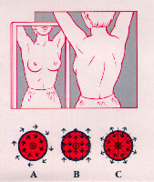
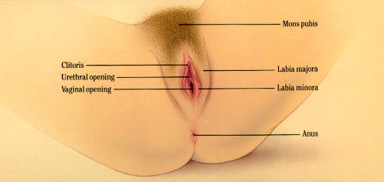

Self-Exams for Women
While a clinician at a gynecological exam will look for infections and abnormalities, she or he will recommend that a regimen of self-exams be practiced so that the woman herself can learn to recognize any physical changes which may suggest problems. The ability to examine one’s own breasts and vulva is an important part of personal health care for women.
while more than half would prefer a female doctor to examine their breasts and vulva

Slide 4
a woman learns techniques of the female self breast,vulval, vaginal,cervical and rectal examination in a clinic by doctor
It is important for women to learn early on what a "normal" vulva for them personally looks like, as vulvas can look very different from one woman to the next. If young women begin performing self-examinations early, they will be more aware if changes should occur.

Slide 5
Self examination should play an important part of sexual health.
Cancer is one of the biggest killers in the country and it does not just affect people who smoke.
Breast, cervical and testicular cancers can be removed easily and safely if detected early.
Female can do a simple examination at any time but when she have a bath is an ideal opportunity.
If she notice any changes or experience any pain consult her doctor

Slide 6
Self examination
Male self examination
Female self examination
Male Genital Self-Examination
Testicular self-examination
Male Rectal Self- Examination
Breast self examination
If not married
Vulval self examination
If married
Vulval self examination
Vaginal self examination
Cervical self examination
Rectal self examination

Slide 7
Self-exams
Knowledge of our body is key to good health.
If female don't know what she normally feel like, she won't be able to recognize signs of illness or infection.
Self-exams also allow them to take action in protecting themselves from cancer and cysts or the presence of a sexually transmitted infection (STI).,
since with regular self-exams they are more knowledgeable about their bodies than health practitioners who examine them once a year.
However, they should not replace annual exams by professionals

Slide 8
self-examination may reveal no signs or symptoms at all.
However, if she discovers anything suspicious, she should see a health care provider. Do not try to make a diagnosis on her own. What she finds may or may not be a sign of a sexually transmitted disease or cancer. Many conditions have similar appearances.
Only a health care provider can make a proper diagnosis.

Slide 9
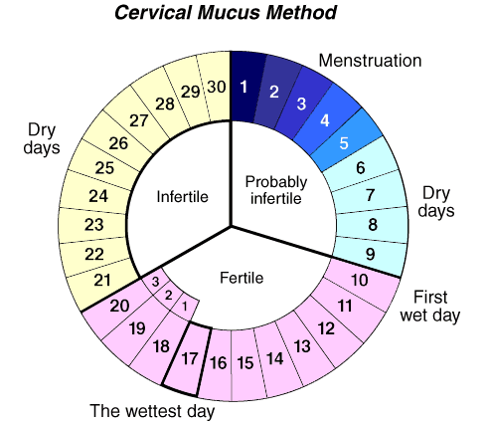
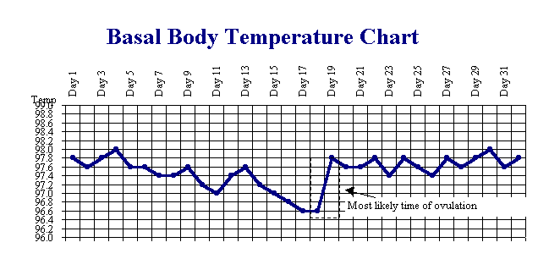
Why It Is Done
Help female learns more about her body and what is normal for her.
Help her to identify vaginal sores, abnormal discharges, or other abnormalities (such as genital warts).
Help locate the string of an intrauterine device (IUD) if it cannot be felt.
Note changes in her cervical mucus as part of fertility awareness. Fertility awareness can help her to determine the timing of sexual intercourse to help her either become pregnant or avoid pregnancy.

Slide 10
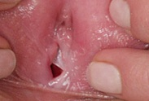
Vaginal Self-Exams
VSEs should be performed
once a month between menstrual periods.
Women with a history of vulvar disease should examine themselves more often, perhaps every two weeks.
VSEs are especially important because of the link between genital warts, which have increased by 500% over the last 15 years, and vulvar cancer. Other STDs can also play a role in vulvar

Slide 11
How to Prepare
A small flashlight or gooseneck lamp.
A handheld mirror, preferably with a long handle.
A vaginal speculum, so she can view her vaginal walls and cervix.( This cannot be performed if the hymen is intact )
A speculum is a small, handheld instrument with two curved blades that open outward. Most women can comfortably use a medium size. Ask her health professional to recommend the best size for her. .
Vaginal lubricant, such as K-Y Jelly.
Antiseptic soap or rubbing alcohol.
Warm water.

Slide 12
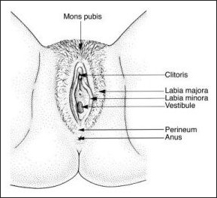
How It Is Done
Remove her clothes and underwear
expose her genital area.
Have all the equipment arranged so she can easily reach what she need.
Sit on a firm surface (floor, bed, or couch) and support her back with pillows. Bend her knees, set her feet well apart, and lean slightly backward.
Hold the hand mirror in front of her vagina and identify the major features of the external genitals, including:

Slide 13
Check the mons pubis (the area above the vagina around the pubic bone where the pubic hair is located).. Look for any bumps, warts, or ulcers. Also look for any changes in skin color, such as white, red, or dark areas. Then use her fingertips to check any visible changes and to sense any bump beneath the surface.
Check the clitoris (at the twelve o'clock position )and the areas around it (directly above the vagina) by looking and touching.
Examine the labia minora (sometimes called "inner lips"), (the smaller folds of skin just to the right and left of the vaginal opening).. Look and touch by holding the skin between thumb and fingers.
Then move on to examine the area around her urinary opening or pee-hole and beneath that there is the larger opening called vaginal opening (which may or may not be partially covered by her hymen). .
Look closely at the labia majora (sometimes called "outer lips") (the larger folds of skin just next to the labia minora).. Examine both right and left just as she did with the labia minora.
Move down to the perineum (the area between the vagina and the anus). and check carefully.
Examine the area around the anal opening( toward the six o'clock position). , both looking and touching.

Slide 14
If she is using a metal speculum, warm it first by placing it in warm (not hot) water. Lubricate the speculum with a vaginal lubricant (such as K-Y Jelly) or warm water to make its insertion smoother and easier. Hold the speculum handle with the blades closed. Make an effort to relax her vagina and abdominal muscles. Using the fingers of her other hand, spread apart the vaginal lips. With the handle of the speculum facing toward either leg, gently glide the closed blades of the speculum into the vaginal opening, If inserting the speculum is painful, stop and wait a minute or two before trying again. When she has inserted it up to the base of the blades, turn the speculum so that the handle is facing upward and gently open the blades.
When the speculum is positioned in her vagina and open, shine the flashlight or lamp into the mirror so the light reflects into her vagina. she may want to get help with this part of the test from her partner or a friend. Adjust the light, mirror, and speculum until she can see clearly into the vagina. she should be able to see the reddish pink walls of the vagina, which have slight folds or ridges known as rugae.

Slide 15
Note the vaginal discharge. A normal discharge usually is clear to cloudy-white, smells slightly acidic (like vinegar), may be thick or thin, and changes slightly throughout the menstrual cycle.
self sampling of the secretions of the lower genital tract by female patients and its reliability in the detection of sexually transmitted infections

Slide 16
At the back of the vagina, she may also be able to see the cervix, which appears as a rounded “doughnut” about 1 in. (2.54 cm) in diameter with a hole or slit in the center (the cervical os). It should look pink and wet..
If she is pregnant, her cervix may have a bluish tint. If she is breast-feeding or have gone through menopause, her cervix may appear pale.
The cervix is often difficult to locate. Try moving the speculum in or out a little, or slightly to the right or left, until the cervix comes into view. Do not be discouraged if she cannot see the cervix on the first try. Take the speculum out and try locating her cervix by placing a finger into her vagina before reinserting the speculum. Locating the cervix gets easier with practice.
Once she locate the cervix, lock the speculum in its open position. Using the light source and the mirror, spend a few moments examining the cervix and the vaginal walls.

Slide 17
When she is finished,
unlock the speculum but keep the blades slightly open to avoid pinching the vaginal walls, and slowly withdraw it. Clean the speculum with warm soapy water or rubbing alcohol and store it for later use.

Slide 18
How she Feels
When she insert the speculum, she may feel some pressure or mild discomfort.
Try to relax your vaginal and abdominal muscles as much as her can.
If she has a vaginal infection, she may experience pain or irritation.
If she uses a metal speculum, it may feel cold and hard. In some cases, she may have a small amount of vaginal discharge or bleeding after the test.

Slide 19
Risks
There are no risks associated with a vaginal self-examination.

Slide 20
Results
Normal: | The external genitals do not have sores or other abnormal growths (such as genital warts).
 | The vaginal walls are reddish pink and contain slight folds or ridges. No sores or growths are seen
 | The cervix is moist and looks like small, rounded "doughnut" with a hole or slit in the center. It may appear pinkish, bluish, or pale.
 | Any discharge should be clear and thin or white and creamy. The discharge should not have an unpleasant odor, contain blood, or appear curdy.
Abnormal | Sores or rough, raised spots on the skin (such as genital warts) may be seen on the external genitals. Redness and itching of the labia may indicate irritation (from feminine products or sexual activity) or infection (such as genital herpes or another sexually transmitted disease).
 | Vaginal discharge that has an unpleasant odor may indicate an infection such as trichomoniasis. Discharge that looks curdy (like cottage cheese) may indicate a vaginal yeast infection.
 | Redness of the cervix may be a sign of inflammation (cervicitis) or an infection.

Slide 21
What Affects the Test
she should not do a vaginal self-examination during or just after pregnancy, after recent surgery, or just after a miscarriage or an abortion. At these times there is an increased chance of injury or infection.
Menstrual bleeding, douching, or using vaginal products before she perform the self-examination may interfere with her ability to detect abnormalities.

Slide 22
What to Think About
A vaginal self-examination should supplement, but not replace, a regular pelvic examination and Pap test done by her health professional.
At birth, the vagina is covered by a thin layer of tissue called the hymen.
The hymen is often torn open if a young girl has been physically active (for example, by bike riding).
Vaginal self-examination cannot be performed if the hymen is intact. And she does vulval self -examination

Slide 23
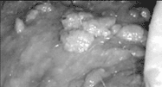
What to look for
condyloma acuminta
on keratinized skin
superior to the clitoris
a new mole, wart, or growth of any kind
new areas of discolored skin, especially newly developed white, red, or dark skin areas
ulcers or sores, except for any minor injury with a known cause
areas of continuing pain, swelling, or itching
Report any new growths or changes to your health practitioner as soon as possible

