Slide 1

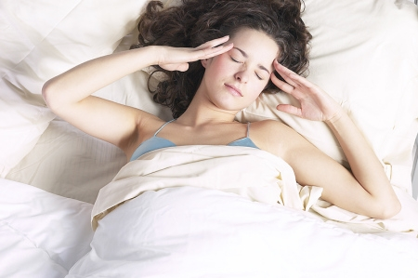
Cephalalgia or
Headache
During Pregnancy
Dr Muhammad M El Hennawy
Ob/gyn Consultant
59 Street - Rass el barr –dumyat - egypt
www.mmhennawy.co.nr
Mobile 01222503011

Slide 2
Synonym
Cephalalgia.
Cephalea.
Cerebralgia.
Cephalodynia.
Encephalalgia.
Encephalodynia.

Slide 3
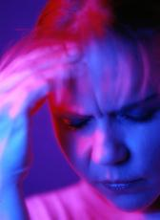
Headache Definition
Literally , It is a pain , ache or discomfort in the head.
But custom , It is a pain , ache or discomfort in the cranial vault

Slide 4
Headache is a common complaint in women of childbearing age.
Second most common complaint after back pain.
Approximately 83% of women ages 20 to 34 experience headaches, with 19% reporting migraine headaches.

Slide 5
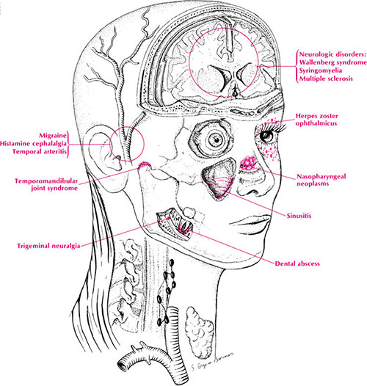
Headache During Pregnancy Types
Pregnancy Induced Headaches
- first trimester Headaches
- second trimester Headaches
- third trimester Headaches
Headache In Pregnancy
- primary headache disorders - migraine
-Tension
- cluster
-other primary headaches
-Primary stabbing headache:
- Primary cough headache
- Primary exertional headache
- Primary sexual headache
- Hypnic headache
- Primary thunderclap headache
- Hemicrania continua
- New daily persistent headache
- Secondary headache disorders
- others headache disorders :
-Cranial neuralgias
- others headache
- Complicated :- Secondary thunderclap headache
- unclassified : -

Slide 6
Pain sensitive structures
They include the eye, ear, paranasal sinuses, large extra and intra cranial arteries, dural sinuses, periosteum of the skull skin, cranial muscles, and the upper cervical spine

Slide 7
Referred Pain
Brain tissue → insensate
Anterior & middle fossae → anterior to coronal suture
Posterior fossa → occipital and upper neck
Sphenoid & sella → vertex

Slide 8
Assassment Of Headaches
History
Age of onset
Duration of complaint
Frequency of episodes
Duration of episodes
Location of pain
Quality of pain
Severity of pain
Time of onset during day
Associated phenomena
Aggrevating factors
Relieving factors

Slide 9
Assassment Of Headaches
Physical Examination
BP and Temprature
Head and neck
-bruirs
-Eyes , carotid , or vertebral arteries
Palpation
-painful areas , rigidity , masses , or trauma
Eye Examination
Nose , mouth , dentition
Neurological
-Carotid nerves
-Gait , meningeal signs
- Muscle Strength
Mental Status

Slide 10
Assassment Of Headaches
Diagnostic Tests
CBC and SED rate
Lumbar Puncture
CT or MRI

Slide 11
The First Trimester Headaches
Hormonal Changes == Increasing levels of estrogen , progesterone and hCG (nearly 10 times the amount of progesterone and 100 times the amount of estrogen at 40 weeks of pregnancy than a nonpregnant woman )
An increase in the blood volume circulating throughout the body.
Changes in the vision
Lack of sleep – TTT getting at least eight hours of sleep a night
Low blood sugar (hypoglycemia) –TTT if pregnant starts to feel bad takes a high-energy snack or a fruit
Hunger --TTT eats several small meals or snacks during the day instead of three big meals.
Dehydration – TTT pregnant drinks more water at least 6-8 glasses of fluid per day.
Congestion or nasal stuffiness is caused by the increase in vascularity in the nasal cavities
Caffeine withdrawal or sugar withdrawal –TTT one cup of coffee
Stress (too many changes) – TTT The easiest way to relax is to focus on her breath - the easiest way to do this is to count her breaths, and not think about anything else
Not getting enough rest – TTT pregnant assumes a comfortable position and takes a simple feat of lying down to rest or nap

Slide 12
The Second Trimester Headaches
Fortunately for most pregnant women, the occurrence of headaches tend to lessen or even disappear during the second trimester.
This could be explained by the fact that the hormones have stabilized and the body has adjusted to its altered chemistry.
Noxious fumes can cause headaches during the second trimester of pregnancy in particular because many women are more sensitive to smells during the second trimester of pregnancy – TTT avoid strong smells

Slide 13
The Third Trimester Headaches
Hormonal Changes == Increasing levels of estrogen and hCG
Lack of sleep
• Low blood sugar (hypoglycemia)
Hunger
Dehydration
Caffeine withdrawal or sugar withdrawal
Stress (too many changes)
Not getting enough rest
Poor posture -- TTT pregnant assumes a comfortable position
Tension from carrying extra weight
Pre-eclampsia -- checking the blood pressure regularly in prenatal clinics

Slide 14
Ways to Cope with a Pregnancy
Induced-Headache
• Avoid an overheated, smoke-filled , unventilated , noisy , glare or flickering lights room
• Pray
• Drink at least 1-2 glasses of water immediately
• Take a high-energy snack or a fruit
• Avoid noise or strong smells
• Cool or warm compresses to the aching area for ten minutes (If she has a sinus headache, applying a warm compress to her nose and beneath her eyes may help. If she has a tension headache, a warm or cold compress around her shoulders may ease it )
• Ask her spouse to massage her forehead, back of head, neck, shoulders and back using soothing warm oils to help her to relax
• Put her feet in a tub of warm water
• A warm shower or bath Or a cold shower or bath for migraine
• Assume a good posture
• Lie down in a quiet, comfortable darkened room and practice deep breathing
• Listen to Quran or soft music .
• Use a humidifier if pregnant have headaches caused by sinus congestion
• Try small amounts of caffeine
• Acetaminophen generally safe or Ibuprofens also generally safe before third trimester

Slide 15
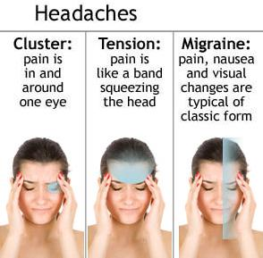
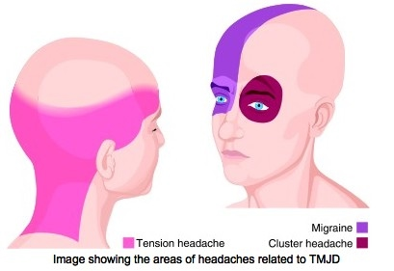
Primary Headaches Disorders
Over 90% of headaches
Not directly related to underlying pathology
1-Migraine
  Without aura
  With aura
2-Tension-type HA (TTH)
3-Cluster HA
4- Other primary headaches

Slide 16

Migraine
17% of females, 6% of males
Moderate to severe pain
Unilateral, pulsating
4 to 72 hours
Nausea, vomiting, photophobia or phonophobia
With or without aura
Causation :
- Sterile inflammation of intracranial vessels - trigeminovascular system , Serotonin (5-hydroxytryptamine) receptors
- Triggering factors :Stress , Menses ,OCP ,Infection ,Trauma ,Vasodilators ,Wine ,Aged cheeses

Slide 17
Treatment
Abortive : 5-hydroxytryptamine receptor agonists Imitrex (Oral, SQ, nasal spray) , Maxalt ,Zomig , Amerge ,Ergotamine ,Butorphanol , Midrin , NSAIDs , Lidocaine
Symptomatic : Prochlorperazine ,Dihydroergotamine ,Chlorpromazine ,Haloperidol ,Lorazepam
Preventative :Antidepressants , Bellergal (ergotamine) , NSAIDs , β-blockers , Calcium channel blockers?

Slide 18
Studies report that many women with a preexisting history of migraine will experience a reduction in headache activity after the first 3 to 4 months of pregnancy .
Retrospective studies report improvement for 50 to 70% of women with a prepregnancy history of migraine.
Conversely, for some women, the onset of migraine headache occurs for the first time during pregnancy, and
some women with a history of migraines may find that headaches worsen with pregnancy .

Slide 19
Migraine during pregnancy cannot be treated with the same range of medications available when not pregnant, as many headache medications can damage the developing fetus.
Some non-medicinal options include putting a cold compress at the base of the neck, taking a warm bath or getting a massage.
Acetaminophen (Tylenol) is considered safe throughout the entire pregnancy. Ibuprofen (Motrin and Advil) and naproxen (Aleve) are considered safe to take up until the third trimester .
Generally, medicine is used as little as possible for headaches during pregnancy.
Severe pregnancy headaches and migraines may be treated with doses of codeine, oxycodine, and meperidone. These powerful analgesics can be used safely during pregnancy for short-term treatments

Slide 20

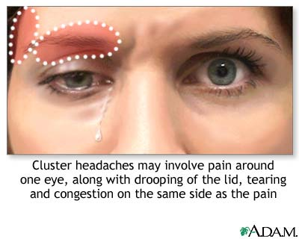
Cluster Headache
Intensely severe pain , Constant ,Unilateral , Periorbital
15 to 180 minutes with onset usually within 2-3 hours of falling asleep
Nausea and vomiting uncommon , No aura
Alcohol intolerance , Male predominance
Autonomic hyperactivity : Conjunctival injection , Lacrimation , Nasal congestion , runny nose , Ptosis , facial flushing , facial swelling and constriction of the pupils
Types
Episodic : Two episodes per year to one every two or more years
Chronic : Remission phases less than 14 days , Prolonged remission absent for > one year
Treatment
Preventative : Calcium channel blockers , Bellergal , Lithium , Methysergid , Steroids ,Valproat , Antihistamines
Abortive : Oxygen, 5-HT receptor agonists , Intranasal lidocaine

Slide 21

Tension Headache
Most common headache syndrome
Types : Episodic < 15 days per month , Chronic > 15 days per month
Characteristics : 30 minutes to 7 days , Pressing or tightening , Mild to moderate pain ,Variable location , often bilateral , Nausea and vomiting rare
Treatment
- Stress management : Biofeedback , Stress reduction ,Posture correction
  - Abortive: NSAIDs , ASA-caffeine-butalbital , Phenacetin
  - Preventative : Antidepressants , Muscle relaxants ,NSAIDs
Medication rarely needed : Benzodiazepines , amitriptyline

Slide 22
Tension-type headaches, tend to show less change during pregnancy,
with improvement in approximately 25% of women.

Slide 23
Other Primary Headaches
- Primary stabbing headache
- Primary cough headache
- Primary exertional headache
- Primary sexual (Pre-orgamic and Orgasmic) headache
- Hypnic headache
- Primary thunderclap headache
- Hemicrania continua
- New daily persistent headache

Slide 24
Primary stabbing Headache Previously used terms : Ice-pick pains, jabs and jolts, ophthalmodynia periodica
episodic stabbing pains in distribution of 1st division of trigeminal nerve (orbit, temple and parietal area)
Stabs last for up to a few seconds and recur with irregular frequency ranging from one to many per day
Primary cough headache Previously . used terms: Benign cough headache, Valsalva-manoeuvre headache
sudden onset headache with coughing, straining, or val salva maneuver
It is usually bilateral and predominantly affects patients older than 40 years of age
Other reported causes of symptomatic secondary cough headache include carotid or vertebrobasilar diseases and cerebral aneurysms. Diagnostic neuroimaging plays an important role in differentiating secondary cough headache from Primary cough headache.
Primary exertional Headache pulsating pain lasting 5min-48 hrs brought on by exercise such as “weight-lifters’ headache
particularly in hot weather or at high altitude
Indomethacin has been found effective in the majority of the cases.
Sexual activity Headache Headache precipitated by sexual activity
-- pre-orgasmic (as sexual excitement increases ): dull ache in the head and neck
-- orgasmic: suddenly explosive and severe HA occurring with orgasm in the absence of any intracranial disorder (need to exclude SAH and arterial dissection)

Slide 25
Hypnic Headache : alarm clock” headache
30 min of nocturnal head pain in elderly patient after age of 50 years
same time each night
Primary thunderclap headache :High-intensity headache of abrupt onset, reaching maximum intensity in <1 minute ,lasting from 1 hour to 10 days
mimicking that of ruptured cerebral aneurysm
Secondary Thunderclap headache is frequently associated with serious vascular intracranial disorders, particularly subarachnoid haemorrhage.
Primary thunderclap headache should be the diagnosis only when all organic causes have been excluded
Hemicrania continua Headache : Daily, continuous , for >3 months , unilateral headache , Moderate intensity, but with exacerbations of severe pain
At least one of the following autonomic features occurs during exacerbations and ipsilateral to the side of pain: 1- conjunctival injection and/or lacrimation 2.nasal congestion and/or rhinorrhoea 3.ptosis and/or miosis
Which completely resolves with indomethacin
New Daily-Persistent Headache (NDPH( :Daily, continuous , for >3 months , bilateral headache , Mild to moderate intensity
pressing or tightening in quality
No more than one of photophobia, phonophobia or mild nausea.
Two subforms: a self-limiting subform which typically resolves without therapy within several months and a refractory subform which is resistant to aggressive treatment programmes

Slide 26
Secondary Headaches Disorders
Fascial : sinusitis , temporal arteritis , narrow angle glucoma
TMJ , Ear , Teeth
Cervical : certvical spondylosis
Traumatic : post-traumatic
Systemic: Infection ,toxin – induced , drug- induced .
Homoeostasis : Hypoxia or Hypercapnia , Dialysis headache ,Arterial hypertension headache (primary and secondary hypertension) ,Hypothyroidism headache , Fasting headache , Cardiac headache
Intracranial Pressure Changes : idiopathic , neoplasms , cerebral edema , post lumbar puncture
Cerebrovascular Lesions : hemmorrhage, infarction , Aneurysm ( subarachnoid , cerebral , cerebellar ) , meningeal irritation , menengitis , encephalitis
Psychiatric Related Headache

Slide 27
Temporal Arteritis
Moderate to severe, unilateral pain
Focal at temporal artery or behind the eye or in proximal joint
Patients over 65
Tortuous scalp vessels
Malaise , low grade fever , ESR elevated
Biopsy for definitive diagnosis
Treat with steroids
Untreated complicated by vision loss

Slide 28
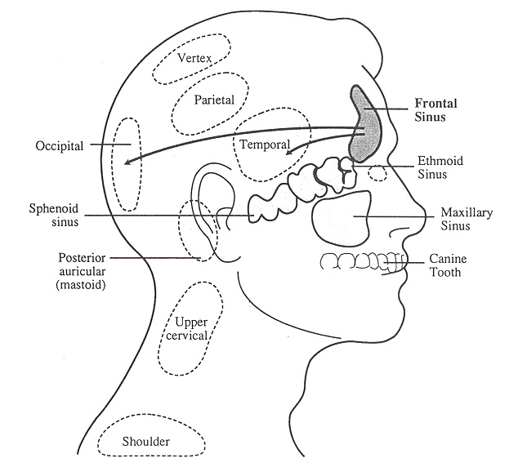
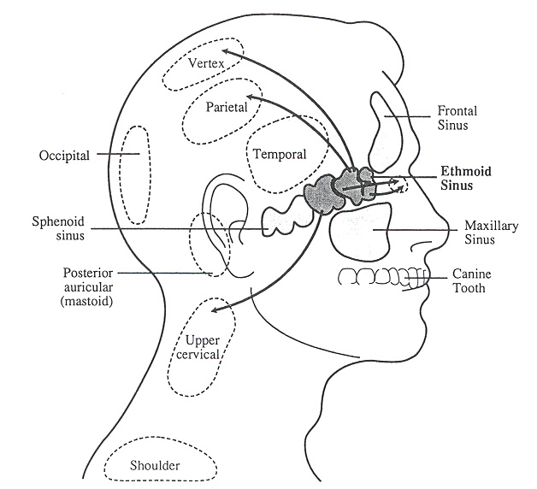
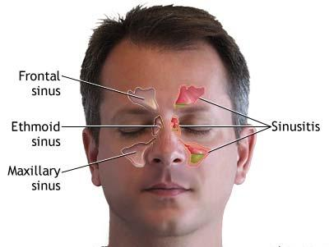
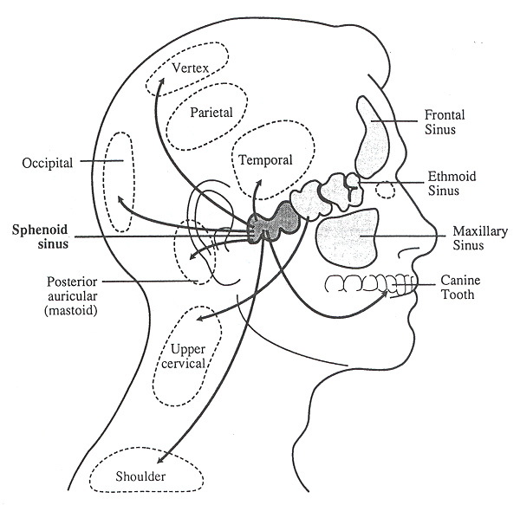
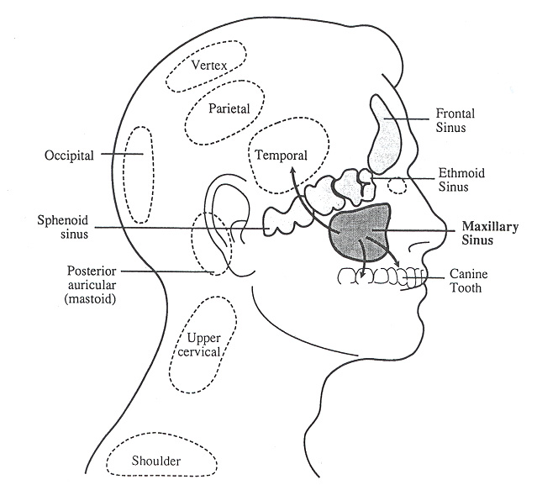
Frontal Sinus
Anterior Ethmoid
Paranasal sinuses
Posterior Ethmoid and Sphenoid
Maxillary Sinus

Slide 29
Sinusitis
Acute Bacterial Sinusitis
Severe headache
Present for hours or days
Localised
-frontal, face or vertex regions
-tenderness over sinus
May appear very ill
May spread to intracranial structures without treatment
Refer if periorbital edeama is present
Chronic Sinusitis
May occur regularly
-On awakening or in midmorning
-Worsened by stooping – bending – changes in atmospheric pressure

Slide 30
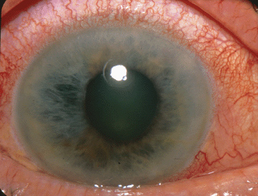

Headache caused by Eye problems
Errors of refraction one of the commonest of cause of headache especially in the young and children are often missed. In this disorder because of the error of refraction the optical system of one or both eyes cause the image being viewed to fall off the target in the retina. This may be because of hyperopia or astigmatism in which light rays failing to focus properly on the retina. This defect cause squinting in an effort to compensate and squinting causes muscular contraction which can trigger a headache?
Acute glaucoma : Sudden onset of eye pain radiating to head, ear, teeth, and sinuses. , Visual symptoms include blurriness, halos around lights, and scotomas.
Nausea and Vomiting
Due to congenital narrowing of the anterior chamber angle that leads to elevated intraocular pressure (IOP)
Medications that elevate IOP include mydriatics, sympathomimetics
Physical exam shows a red eye with a fixed middilated pupil and shallow anterior chamber (separates it from cluster HA)
IOP in the range of 60 to 90 mmHg ( not found in iritis)
Treatment includes topical miotics, b-blockers, carbonic anhydrase inhibitors, optho consult
Computer Or TY Headaches : “It” is called Eye Fatigue or Computer Vision Syndrome

Slide 31
Headache caused by dental disorders
Dental problems that induce headache are most often accompanied by symptoms that point to the teeth or gum as the cause of the head pain.
The commonest dental problem that causes headache is a tooth abscess.
Another dental related problem, temporomandibular joint pain, which affects the jaw hinge located in the front of the ear, can cause headache. Malocclusion due to ill fitting dentures or loss of molar teeth on one side with alteration of the normal chewing movements may lead to distortion of an ultimately degenerative changes in the joint and to pain in front of the ear, with radiation to the temple and over the face.

Slide 32
Cervicogenic Headache (CEH)
Cervical spondylosis, a degenerative change in the spine, is nearly universal with aging, and may be a common cause of headache in elderly patients. Typically the headache occurs on a daily basis, waxing and waning over periods of weeks. It is maximal in the nuchal and occipital regions but in many patients, migraine supervenes, leading to a hemicranial or pancranial headache that may obscure the cervical origin.
Other symptoms include neck pain radiating into the shoulder, shoulder pain, and evanescent paresthesias radiating down the arm. The trapezius and cervical paraspin­ous musculature are typically quite tender to firm palpation on the side of maximal head­ache.
Patients of any age may develop over­night a superfically similar neck pain syndrome that is probably related to a strained muscle or minor soft tissue injury and is distinguished by its abrupt onset and usually by the fact that the patient is too young to have significant spondylosis

Slide 33
Posttraumatic Headache (PTHA)
Estimated that 30-50% of 2 million closed head injuries per year develop headache.
Associated with dizziness, fatigue, insomnia, irritability, memory loss, and difficulty with concentration.
Acute PTHA develops hours to days after injury and may last up to 8 weeks.
Chronic PTHA may last from several months to years.
Patients have normal neurological examination and imaging
Treatment for acute PTHA is symptomatic while for chronic PTHA, adjunct therapies include beta-blockers and antidepressants.

Slide 34
Drug-Induced Headache
Medication use (exposure) eg : CO , alcohol , cannabis , food additive, nitrate
Medication abuse eg : analgesic , opioid , ergotamine or
Medication withdrawal (Rebound Headaches ) eg : chronic caffaiene, estrogen use
is the cause.

Slide 35
Carbon Monoxide Poisoning :Usually gradual, subtle, dull, nonfocal throbbing pain associated with nausea, chest pain.
Symptoms may wax and wane as patients may enter and leave the area of carbon monoxide
Exposure to engine exhaust, old or defective heating systems, most common in winter months.
Non focal neurological exams.
Diagnosis is made by elevated carboxyhemoglobin
Treatment is oxygen
Alcohol Headache : Alcohol also is a dilator of blood vessels. Some wines and other alcoholic beverages also contain a chemical called histamine another potent dilator. Red wine in particular may have a high histamine content and can trigger migraine and cluster headaches in susceptible individuals. The throbbing hangover headache that attacks on the morning after a heavy drinking is due to acetaldehyde and acetate - breakdown products of alcohol- circulating in the blood and dilating the arteries in the skull
Fast Food Headache : Victims of this complain of feelings of pressures or tightness in the face, a burning feeling over the trunk, neck, and shoulders, a pressing pain in the chest, and a headache after eating usually from restaurants and hotels. All this comes on about half an hour after eating and lasts about an hour. The cause is monosodium glutamate, which is widely used as a food additive, and this chemical dilates blood vessels causing headache
Withdrawal Or Rebound Headache : Caffeine, nicotine, and other substances can constrict blood vessels and thus diminish vascular headaches. If either these substances are continuously introduced into the blood by drinking coffee regularly or by smoking, blood vessels adapt a semi constricted state. However, if this is withdrawn, blood vessels dilate causing considerable headache. That is how stopping or delaying intake of coffee or tea can cause headache

Slide 36
Toxic-Induced Headaches
A number of toxins produced within the body or those that enter the body from outside can cause headache.
Most of the viral and bacterial infection that produce endogenous toxins can lead to fever and headache.
Exogenous toxins (that originate outside the body) that can cause headache includes such toxins as auto emissions, industrial fumes and wastes, polluted waters, pesticides in foods, preservatives in prepared foods, foul air in poorly ventilated places and smog.
Many common household items that may induce headache because they are inhaled or absorbed through the skin. This group includes such substances as cleaning fluids, fuels, and insecticides. The lead in cosmetics, gasoline additives, and paint can also cause headache.

Slide 37
Homoeostasis Headaches
Hypoxia or Hypercapnia
-High attitude Headache
-Diving Headache
-sleep apnea headache
Dialysis Headache
Arterial Hypertension Headache (primary and secondary hypertension)
Hypothyroidism Headache
Fasting Headache
Cardiac headache

Slide 38
High Altitude Headache : Main symptom of Acute Mountain Sickness , Can occur at altitudes higher than 5000 feet in unacclimatized individuals.
HA is throbbing, located in temporal or occipital area and worsens at night or early in the morning.
Treatment includes supplemental oxygen and descent to a lower altitude.
Sleep apnea and headache: Pancranial headache that is present when a patient first wakes up, as opposed to gets up, and gradually recedes over the course of the day, should raise the question of sleep apnea, particularly if the patient is elderly, male, obese, smokes, or has a history of chronic obstructive pulmonary disease. It may be that this headache is a form of migraine but it characteristically does not have the peculiar identifying symptoms of migraine. Successful treatment of sleep apnea usually relieves the headaches
Hypertensive Headache :Elevated blood pressure is not as important in headache as the rate by which the blood pressure increases
Nonetheless, HA with severe hypertension is well documented especially in hypertensive encephalopathy
Treatment is directed at lowering blood pressure slowly
Headache may last for days until brain edema has resolved
Fasting Headache : Fasting can lower the blood glucose level and can trigger migraine and a dull headache often accompanies any prolonged fast such as those urged in some weight-loss programme
Cardiac Cephalalgia : Headache develops concomitantly during treadmill , nuclear cardiac stress testing or acute myocardial ischaemia
Headache, may be severe, accompanied by nausea
Headache resolves and does not recur after effective medical therapy for myocardial ischaemia or coronary revascularisation

Slide 39
Idiopathic Intracranial Hypertension
Also known as Pseudotumor Cerebri.
Commonly seen in young obese women .
Predisposing factors include anabolic steroids, oral contraceptives, tetracyclines, Vitamin A
Caused by increased brain water content and decreased CSF ouflow
Most common symptom is generalized headache.
Eye movement, bending forward or Valsava may worsen headache
On exam patients have papilledema and visual defects, including an enlarged blind spot followed by loss of peripheral lesion
Treatment
-stop offending med
-lower CSF production with acetazolomide and furosemide.
-steroids
-repeat LPs
-ventricular shunt if with impending visual loss

Slide 40
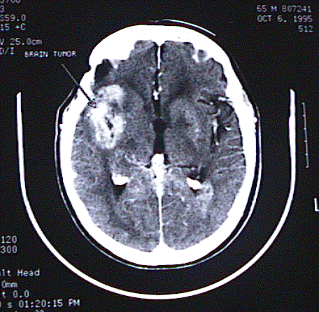
Brain Tumor
In elderly, brain tumor is usually metastatic from lung or breast carcinoma.
Primary brain tumor are more common in adults younger than 50 years
HA is caused either by direct pressure on the brain or elevated ICP
Typical presentation is headache that worsens over over weeks to months
HA is usually present on awakening initially, then it becomes continuous.
HA is often worse with sneezing, bending, coughing.
Diagnostic tools include CT with IV contrast or MRI(best test

Slide 41
Postdural Puncture Headache
Most common complication following lumbar puncture (up to 40%)
Most common in 18 to 30 year old patients
It can last up to 5 days
Bilateral throbbing Headache that worsens with upright position
Thought to be due to persistent leak of CSF that exceeds its production
Treatment includes rest, fluids, and blood patch, caffeine or theophylline for persistent Headache .

Slide 42
Subarachnoid Hemorrhage (SAH)
Extravasation of blood in subarachnoid space activates meningeal nocireceptors causing occipital pain and meningismus.
SAH accounts for 10% of all strokes and is most common cause of death from a stroke.
Causes are saccular aneurysms (80%), blood dyscrasias, arteriovenous malformations, mycotic aneurysms, cavernous angiomas.
1 to 4% of all ED patients with headache have SAH with 50% associated morbidity and mortality
Clinical Features of SAH : Sudden “thunderclap” headache
Can be associated with exertional activities , Nausea/vomitng-75% ,Neck stiffness-25% ,Seizures-10% , Meningismus-50% , Subhyloid or retinal hemorrhages ,Oculomotor nerve pulsy with dilated pupil , Restlessness and altered level of consciousness .
Treatment :
Airway, breathing, circulation and neurosurgical consultation.
Patients with Grade III SAH usually require endotracheal intubation
Nimodipine 60 mg PO or NG to lessen the chance of ischemic stroke due to vasospasm
Anticonvulsants for patients with evident seizure

Slide 43
Meningeal Irritation
Severe , progressive
Diffuse or occipital headache
Rapid or gradual onset
- over several hours or days
Fever
Neck stiffiness
Elevated WBC,s count
Impaired consciousness

Slide 44
Intracranial Infection
Meningitis | Severe headache, nuchal rigidity, meningismus
Encephalitis | headache, confusion, fever, change of mental status, seizures
Brain Abscess | headache, vomiting, focal neurological signs, depressed level of consciousness
AIDS | Toxoplasmosis, CMV, Cryptococcus
Headache is common complaint in meningitis, brain abscess, encephalitis or AIDS
Diagnostic tools include CT of head and LP

Slide 45
Psychiatric related Headache
Comorbidity of:
  Depressive disorders
  Anxiety disorders
  Chemical dependency
  Personality disorders

Slide 46
Others Headache Disorders
others headache disorders :
- Cranial neuralgias
- facial pain
- others headache
- Complicated :- secondary thunderclap headache
- Others : -
- Unclassified :-

Slide 47
Cranial Neuralgias
Neuralgia denotes a sharp, shooting (“lancinating”) pain, that is momentary but characteristically recurs.
It may be precipitated by touch to a sensitive area (“trigger zone”), or may occur spontaneously.
Unlike headache syn­dromes, which are probably mediated centrally, neuralgias are more characteristic of peripheral nerve localization.
Neuralgias may follow nerve trauma, herpes zoster infections, or may arise spontan­eously.

Slide 48
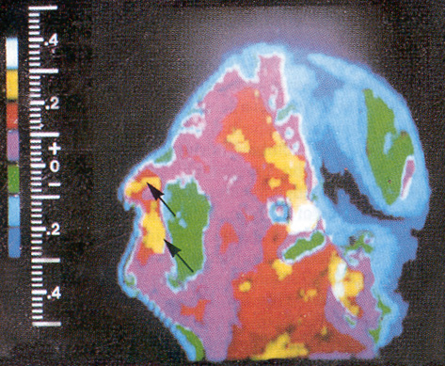
Trigeminal Neuralgia
Paroxysmal pain – seconds to < 2 min
Distributed along 5th cranial nerve
Asymptomatic between attacks - Trigger points
Treatment : Carbamazepine ,Gabapentin, Baclofen ,Phenytoin ,Valproate ,Chlorphenesin
Adjuvant :TCAs ,NSAIDs ,Surgery for refractory cases
Glossopharyngeal Neuralgia
Similar to Trigeminal Neuralgia
Unilateral pain
  Pharynx , Soft palate , Base of tongue , Ear , Mastoid
Treatment as for Trigeminal Neuralgia
Cold-Stimulus Headache
-Short-lasting pain , acute frontal non-pulsatile , which may be severe, induced in susceptible individuals by the passage of cold material (solid, liquid or gaseous) over the palate and/or posterior pharyngeal wall
- Due to ingestion of cold food ( ice cream or ice ), or drink ( cold water) or to inhalation of cold air (very cold weather ) .
-Headache develops immediately, and only, after cold stimulus
-Headache resolves within 5 minutes after removal of cold stimulus Eg : Ice Cram Headache.

Slide 49
Others Headaches Disorders
Complicated :- Secondary thunderclap headache
An extremely intense headache that comes on instantaneously and without warning. Thunderclap headaches are often caused by bleeding inside the brain, and therefore they should be taken very seriously
Unclassified : -
Headache is or has been present
Not enough information is available to classify the headache at any level of this classification

Slide 50
Historical Headaches Disorders
Bilious Headache
Gastric or Dyspeptic Headache
Reproductive System Headache
Constipation Headache
Congestive Headache
Anemic Headache
Uremic Headache

Slide 51
Bilious Headache: Sometimes referred to as “sick” headaches, bilious headache is linked to problems with the gall bladder or liver
Biliousness is “a symptom of a disordered condition of the liver causing constipation, headache, loss of appetite, and vomiting of bile” related to excess of bile that may be accompanied by fever.
Gastric or Dyspeptic Headache : Also sometimes called “sick” headache, gastric headache may overlap with biliousness, however the primary emphasis is on stomach dysfunction
Reproductive System Headache : This pattern of headache has many associated designations including pelvic, menstrual, ovarian, uterine, and womb
The common theme is reproduction system dysfunction (usually in women) that may be linked to hormonal imbalance or structural problems in the pelvic area
Constipation Headache :Constipation was cited in several historical medical texts as a cause of headache.
Also described as headache produced by “torpor of bowels
Congestive Headache :Congestive headache is probably a form of vasomotor disturbance wherein too much blood is allowed to accumulate in the head or face.
This type of headache may also be referred to as headache due to hyperemia
Anemic Headache :Anemia was cited as a cause of headache in several old texts
Uremic Headache : Uremic headache is associated with high levels of uremia in the blood resulting from kidney dysfunction

Slide 52
Summary
Rule out serious pathology
Look for secondary causes of HA (especially sinusitis)
If a primary HA, determine which type principally through history
Be aware of overlap in migraine and tension HA symptoms
Imaging is rarely necessary

Slide 53
The basic cause of primary headaches is unknown.
Treatment is directed at relieving
symptoms and preventing episodes.
Treatment of secondary headache usually focuses on treating the primary condition and providing symptomatic relief for the headaches

Slide 54
Nonmedical treatment for pain
Keep a "headache diary" to help identify specific triggers
pray
Use compresses - apply a warm or cool compress
Take a shower for some migraines, a cold shower works by constricting the dilated blood vessels
Get a massage
Eat frequent small snacks
Drink plenty of water
Avoid fatigue
Get regular exercise
Try relaxation techniques
acupuncture

Slide 55
Medical Treatment For Pain
Headaches during pregnancy cannot be treated with the same range of medications available when not pregnant,
as many headache medications can damage the developing fetus.
Some non-medicinal options include putting a cold compress at the base of the neck, taking a warm bath or getting a massage.
Acetaminophen (Tylenol) is considered safe throughout the entire pregnancy. Ibuprofen (Motrin and Advil) and naproxen (Aleve) are considered safe to take up until the third trimester .
Generally, medicine is used as little as possible for headaches during pregnancy.
Severe pregnancy headaches and migraines may be treated with doses of codeine, oxycodine, and meperidone. These powerful analgesics can be used safely during pregnancy for short-term treatments

Slide 56
When reviewing the tables, please consider the following key for the letters used.
A Controlled studies fail to demonstrate risk, and possibility of fetal harm appears remote.
B Either animal-reproduction studies have not demonstrated a fetal risk (but there are no controlled studies in pregnant women) or animal-reproduction studies have shown an adverse effect that was not confirmed in controlled studies in women in the first trimester (and there is no evidence of a risk in later trimesters).
C Either studies in animals have revealed adverse effects on the fetus (teratogenic [causing birth defects], embryocidal [causing death to the embryo], or other) (and there are no controlled studies in women) or studies in women and animals are not available. Drugs should be given only if the potential benefit justifies the potential risk to the fetus.
D There is positive evidence of human fetal risk, but the benefits from use in pregnant women may be acceptable despite the risk (for example, if the drug is needed in a life-threatening situation or for a serious disease for which safer drugs cannot be used or are ineffective).
X Studies in animals or humans have demonstrated fetal abnormalities, or there is evidence of fetal risk based on human experience, or both. The risk of the use of the drug in pregnant women clearly outweighs any possible benefit. The drug is contraindicated (not advised) in women who are or may become pregnant

Slide 57
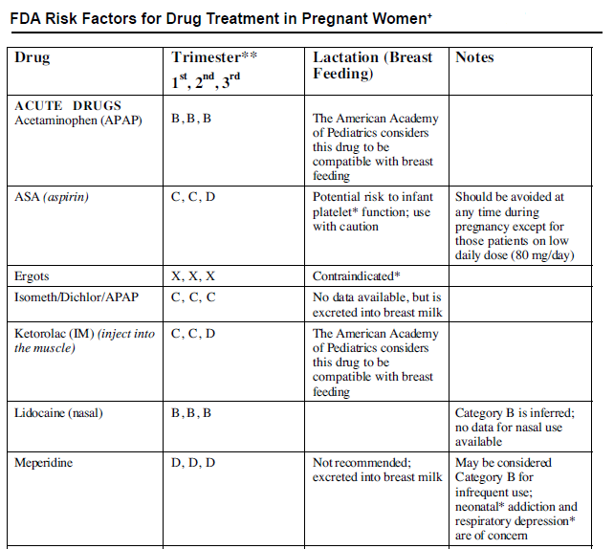

Slide 58
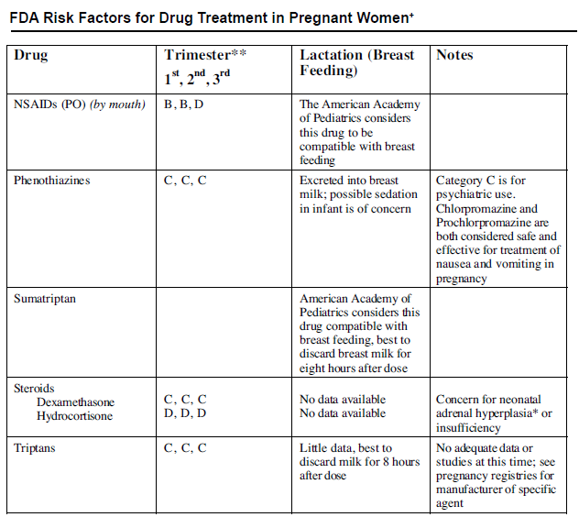

Slide 59
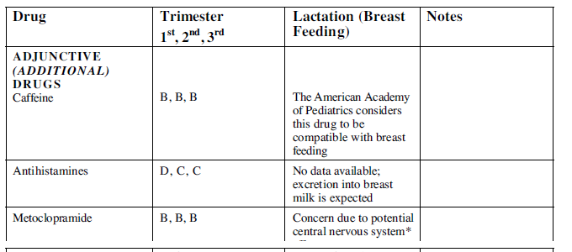

Slide 60
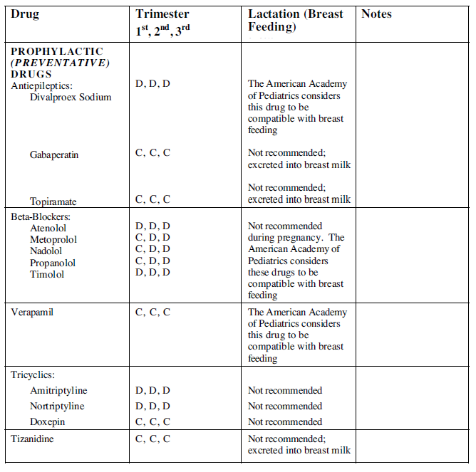

Slide 61
