Slide 1

Hymenoplasty
Dr Muhammad El Hennawy
Ob/gyn Consultant
Rass el barr central hospital and
dumyat specialised hospital
Dumyatt – EGYPT
www. Mmhennawy.co.nr

Slide 2
before
I have never seen it
I never do it
I do not recommend anyone to do it
But I have read about it and this is what I have collected about this subject

Slide 3
The hymen
Hymen (HI-min) - The hymen is a thin, delicate membrane (a membrane is like skin but much thinner). It partially covers the opening of the vagina in most girls.
The hymen is simply the vestigial membranes of the vagina and urogenital sinus at their point of fusion.
An elastic and collagenous tissue.
In younger women, hymen is very vascular as opposed to menopausal women, which are very thin.
In adult virginal women, the hymen is a different thickness that surrounds the vaginal opening more or less completed

Slide 4

Name
The hymen is named after, Hymenaeus, the Greek god of marriage and the wedding feast or song.
Hymenaeus, son of Aphrodite and Dionysus, is mentioned in the Illiad and the Aeneid and is typically depicted with the marriage torch held aloft.

Slide 5
Function of the hymen
The biological function of the human hymen is still uncertain;
scientists hypothesize that it protects the vagina from infection in infants.
The social function of the hymen, however, has been and still is a mythical symbol of virginity in many cultures
Allow outflow of menstrual blood

Slide 6
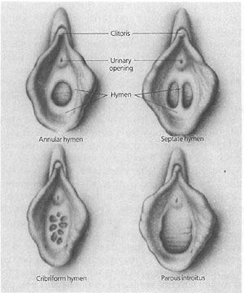
Types
Annular or circular – – in which the hymen forms a ring around the vaginal opening
Dentate fimbriated or denticular hymen -- a hymen with an opening which has serrate edges
crescentric or lunar hymen, a moon-shaped hymen.-- anterior , posterior
hymen bifenestratus, -- a hymen with two openings side by side and a broad septum between them.
Septate – a hymen in which the opening is divided by a narrow septum.
hymen subseptus-- a hymen in which the opening is partially filled by a septum growing out of one wall, but not reaching the other.
Cribriform or fenestrated - full of holes.
Complete absence of hymen
Microperforate --almost completely covers the opening but there is the opening which is very small
Imperforate --completely covers the opening

Slide 7
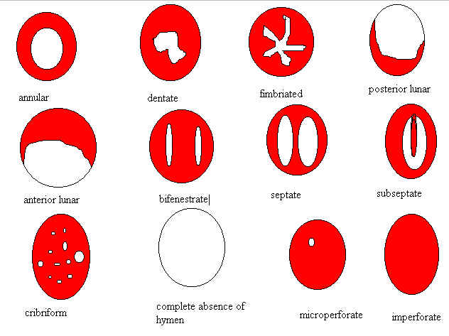

Slide 8


Tear causes
(Non sexual or Sexual)
Many girls and teens tear or otherwise dilate their hymen
during first intercourse (coitus) or Rape .
while participating in sports like bicycling, horseback riding, gymnastics
or inserting tampons,
or while masturbating.
A girl may not even know this has occurred, since there may be little or no blood or pain involved when this happens.

Slide 9
The hymental opening As a role, the hymen is torn during first intercourse (coitus) specially posteriorly or posterolaterally in two or more portions.
commonly , rupture of the hymen is accompanied by slight bleeding, which stop spontaneously
Occasionly a rather large vessel is torn and can bleed profuesly that can cause shock and need of blood transfusion , it can be controlled by applying direct pressure to bleeding point but if it fail you must ligate or suture bleeding point
The hymen may not be lacerated even with repeated coitus ( wide or elastic hymen ).
In fact, many cases of pregnancy have been reported in women in whom the hymen has not have been ruptured.
Some women are even born without a hymen

Slide 10
A woman's future can hang, literally, by a membrane
The hymen's a delicate membrane that separates girls from women
In some societies, the hymen must be intact in unmarried women as proof of virginity.
Without it,-- women are shunned as whores
--in extreme cases even murdered by male relatives to restore family honour.

Slide 11
"virgin
The term "virgin" typically means someone who has never had sexual intercourse (specifically the penis entering the vagina)
a man loses his virginity the first time his penis
enters the vagina. Similarly, a woman loses her virginity the first time a penis enters her vagina
For the most part, being a virgin is not about whether a woman's hymen is intact or broken
It used to be that on her wedding night, if a woman's first sexual intercourse (losing her virginity) was painful and there was blood on the sheets, that was proof that she was a virgin

Slide 12
Virginity in Egypt
It is a sine qua non for marriage in Egypt,
it is not unusual for a rape victim to marry her rapist to maintain at least the appearance of honor.
In fact, according to Egyptian law, once a rapist marries his victim, charges against him are dropped, and honor is restored to the woman and her family.

Slide 13

It is not uncommon for a gynecologist
to find in his office a blushing young female surrounded by a whole horde of male relatives demanding that she be examined
She did not bleed during sexual intercourse on her wedding night, and the men all want to know why.
You always have to favor the girl, because if you don't, she'll be killed by her family.
Sometimes, if the girl has the opportunity, she'll beg you to cover for her. They are very frightened, they know they will be killed.
So you tell the male relatives the bride had an elastic hymen, which many women do anyway, and in such cases she wouldn't bleed.
"Honor killings are still carried out in Arabic country.
A family will arrange for an underage brother or male relative to do it. Then when there is an investigation, nothing happens. The case is dropped

Slide 14
the classic Arabic saying
The honor of the girl is like a single match, Once spent, it's gone forever
the hymen is referred to colloquially as "wish al-bent," or "face of the girl." In other words, without it, you have no identity, you are no one.

Slide 15
Surgeon restore hymens for
for cultural reasons --- very important situation for some women, and this operation quite honestly saves lives
For tighten vagina walls for better sex

Slide 16

Hymenorrhaphy, hymenoplasty, or Hymen restoration or Hymen replacement surgery or Restoration of the hymenal ring
It is a medical procedure offered in countries.
It is illegal in most Arab countries
It is done on an outpatient basis and with or without anesthesia

Slide 17
Types of surgery
if it is not too damaged (surgical repair)
--piecing together its remnants
when the hymenal remnants are insufficient
---stitch across hymen
-- Cerclage around hymenal ring by thread from underwear of wedding night
---approximates undermined hymen remnants
--- approximates a flap from the vaginal wall across the opening
--- Alloplant for hymenoplasty

Slide 18
The simplest technique of hymenorraphy (surgical repair)
Pain-killing medicine is taken 1 hour before the operation.
The actual operation is performed under a general or local anaesthetic with muscle relaxants.
The hymen is reconstructed, recreate the hymen by piecing together its remnants if it is not too damaged, restoring its original appearance as a circular membrane with a central opening
Surgery can also include inserting a gelatin capsule filled with a blood-like substance that will burst during intercourse, simulating bleeding.
Must be done three to seven days before the wedding. Because the tissue is simply pulled together and the procedure doesn’t last, catgut sutures are used to approximate hymen remnants.
Because healing is rare because hymen is relatively avascular

Slide 19

Stitch across hymen
by thread from underwear of wedding night
-- tied inside

Slide 20

Cerclage around hymen
when the hymenal remnants are insufficient
-- Cerclage around hymenal ring by thread from underwear of wedding night -- tide inside

Slide 21

A gelatin capsule
inserting a gelatin capsule filled with a blood-like substance that will burst during intercourse, simulating bleeding.

Slide 22
The definitive procedure
HYMEN REPLACEMENT SURGERY
when the hymenal remnants are insufficient
1 -approximates undermined hymen remnants
2- or a vaginal flap

Slide 23
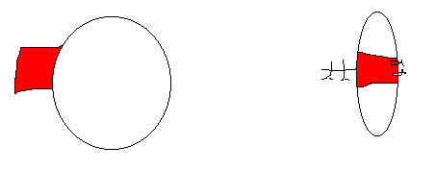
1 - approximates undermined hymen remnants and often produces vascular bands across the introitus

Slide 24
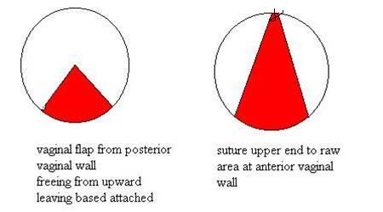
2- he attaches a vaginal flap (A small section) from the vaginal wall across the opening ,often produces vascular bands across the introitus

Slide 25
. The process takes one to two hours, and patients can return to work the next day.
It is procedure that can be done under local anaesthetic and done as a day care surgery.
The sutures are dissolvable.
One should allow it to heal and avoid getting married for three weeks after surgery.
These women may be told to instruct their husbands that their hymen is very vascular and that he should cut it with a "sharp instrument" before they attempt sexual intercourse

Slide 26
Alloplant for hymenoplasty
The allografts with controllable extraction of glycosaminoglycans from collagen fibres having low antigenicity non-toxic, not encapsulated, gradually resorpted and replaced mostly by natural recipient tissue, were named "Alloplant".
Alloplant biomaterials can selectable stimulate the natural tissues regeneration. Therefore, alloplant biomaterials can be tried in surgery for selectable restoration of different tissues.

Slide 27
Wassel &Tantawi
In late November 1998, the Grand Mufti Wassel stated that a rape victim is permitted to undergo hymen repair surgery.
Tantawi argued that the procedure would constitute a form of deception against her future husband, and therefore not allowed.

Slide 28
The actual punishment for adulterers stated in the Koran
It applies to both men and women,
Muslim activists argue. Unmarried adulterers are to be punished with 100 lashes
while married adulterers should be punished by death
but only in the case that four witnesses have observed the actual event of intercourse.

