Slide 1



To Do
Or
Not To Do
(about the hysterectomy)
Dr Muhammad El Hennawy
Ob/gyn Consultant
Rass el barr - Dumyat – Egypt
Mobile 01222503011
www. Mmhennawy.co.nr

Slide 2

There Are Many Controversies About Hystrectomy
All medical conditions have more than one option for treatment.
Medicine is an evolving art as well as a science.
Recently, with more open attitudes towards women's opinions and feelings, and with the advent of new technology,
Doctors have been looking for new medical treatments for gynecologic symptoms in order to avoid hysterectomy.
There are possible side effects of hysterectomy, none of which are entirely predictable for each individual.
But, for some women, hysterectomy will be the right treatment.

Slide 3
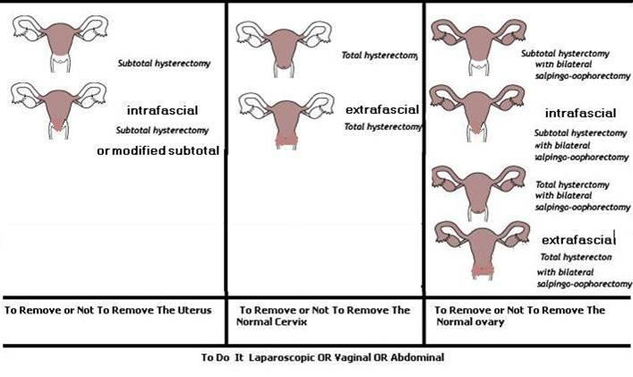
How Can we Answer These 4 Questions ?
1 -To remove or not to remove the uterus
2 - To remove or not to remove the normal cervix
3 - To remove or not to remove the normal ovaries
4 - To do it laparoscopic , vaginal or abdominal

Slide 4
I answered 4 questions with all opinions I found

Slide 5
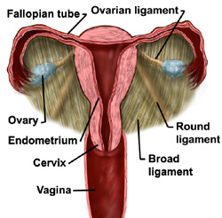
To Remove or Not To Remove The Uterus

Slide 6
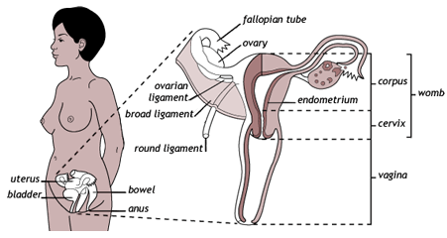
To Remove The Uterus
Hysterectomy is the surgical removal of all or part of the uterus
Hysterectomy is one of the most frequently performed of all surgical operations
Reasons why hysterectomies may be recommended fall into three categories:
1- to save lives;
2 - to correct serious problems that interfere with normal functions;
3- to improve the quality of life.

Slide 7
One Of The Most Commonly Performed Operations In The World
Hysterectomy has long been regarded as an operation performed by “hyster-happy," mostly male, surgeons
In the United States,
Hysterectomy is the second most common major operation performed in the United States today, second only to cesarean section
600 000 hysterectomies are performed each year
or one hysterectomy every minute.
By the age of 60, one out of every three women in the U.S. has had a hysterectomy
In the United Kingdom, women have a one in five chance of having a hysterectomy by the age of 55
Nine of every 10 hysterectomies are performed for non-cancerous conditions.
In many of these, no disease is present—and the term dysfunctional uterine bleeding is used to describe these cases.
When there is disease it is commonly limited to the uterus and, in most parts of the world, is more likely than not to be a leiomyoma

Slide 8
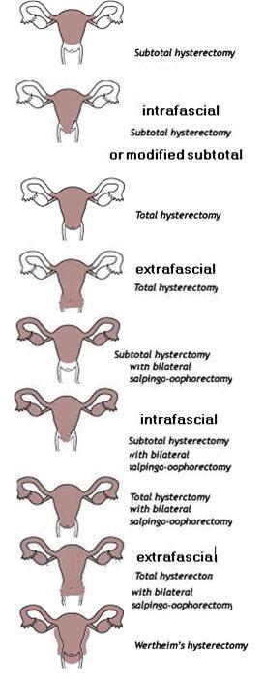
DIFFERENT TYPES OF HYSTERECTOMIES
SUBTOTAL HYSTERECTOMY OR SUPRACERVICAL Hysterectomy
MODIFIED SUBTOTAL HYSTERECTOMY
TOTAL HYSTERECTOMY
EXTRAFACIAL HYSTERECTOMY
SUBTOTAL OR MODIFIED SUBTOTAL OR TOTAL OR EXTRAFACIAL HYSTERECTOMY WITH BILATERAL OR UNILATERAL SALPINGO-OOPHORECTOMY
RADICAL HYSTERECTOMY Or WERTHEIM‘S HYSTERECTOMY

Slide 9
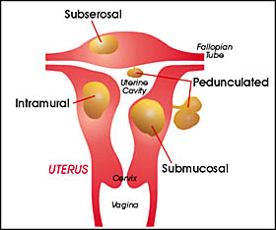
Indications For Hysterectomy In American Women
Treatment of fibroid tumors, accounting for 30% of these surgeries
Treatment of endometriosis is the reason for 20% of hysterectomies
20% of hysterectomies are done because of heavy or abnormal vaginal bleeding that cannot be linked to any specific cause and cannot be controlled by other means.
20% are performed to treat prolapsed uterus, pelvic inflammatory disease , pelvic pain, or endometrial hyperplasia, a potentially pre-cancerous condition.
About 10% of hysterectomies are performed to treat cancer of the cervix, ovaries, or uterus

Slide 10
Subtotal hysterectomy was the most common type of hysterectomy performed before 1940. Leaving the cervix in place avoided some of the risk of injuring the nearby ureters, bladder or intestines and reduced blood loss.
However, the remaining cervix was susceptible to developing cancer, a fairly common condition at that time.
As surgical and anesthetic techniques became safer and antibiotics became available, doctors began performing more total hysterectomies in order to prevent the future development of cervical cancer.
These changes all preceded the discovery of the pap smear. Once the pap smear became widely used as a means to find pre-cancer, an easily curable condition, removing the cervix was no longer essential for all women.

Slide 11
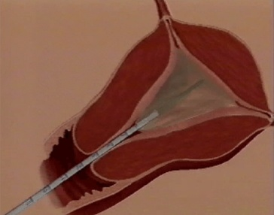
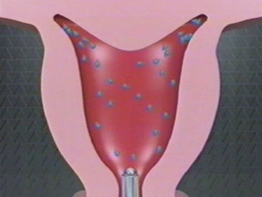
Do Not Remove The Uterus remove the disease not remove the organ ALTERNATIVES TO HYSTERECTOMY
uterus is not organ to discard after woman complete her family
uterus is not a a foreign body after woman complete her family
ALTERNATIVES TO HYSTERECTOMY –
less expensive --less psychologic instability ---- Eg :
Laparoscopic uterine artery ligation
Uterine artery embolisation
Hormone levonorgesteil IUD
medical treatment options, including progesterone antagonist mifepriston (RU 486) and gonadotropin-releasing hormone (GnRH) antagonists
Endometrial ablation utilizes laser, thermal (thermal balloon ablation – foley’s catheter balloon ablation), cold, microwave or electricity to remove those areas of the uterine lining which are causing the high rate of bleeding
Transcervical resection of endometrium
Myolysis is the destruction of fibroids (necrosis) by different methods, including coagulation of the tumors with bipolar or unipolar electric electrodes or laser beams. Another technique for destruction of fibroids utilizes a freezing probe (cryomyolysis)
Thermal ablation of myoma with focused ultrasound surgery without probe ( totally non-invasive )
Hysteroscopic, laparoscopic or abdominal myomectomy

Slide 12
Hysterectomy is a major operation and carries with it risks of infection, injury to other organs, anesthetic complications, and blood loss that can sometimes result in the need for transfusion.
While complications are uncommon, they should not be taken lightly.
Recovery from abdominal hysterectomy takes four to six weeks, recovery from vaginal hysterectomy takes about three to four weeks, and recovery from laparoscopic hysterectomy takes about two weeks.
The cost of surgery is expensive, including doctors' fees, anesthesia fees, hospital charges, and operating room charges. It's preferable to avoid major surgery if possible

Slide 13
Hysterectomy is never needed for fibroids unless a woman has the wrong doctor
Most fibroids do not cause more than annoying symptoms, but in the event that they do cause a true medical problem
fibroids can be removed by myomectomy.
Myomectomy is surgical removal of fibroids leaving the uterus intact.
The uterus is a hormone responsive reproductive sex organ that supports the bladder and the bowel. It has essential functions all of a woman’s life.

Slide 14
NEPRINOL??
. NEPRINOL contains Serrapeptase and Nattokinase, two systemic enzymes that are remarkably efficient at removing fibrous tissue.
Clinical studies illustrate how the enzymes in NEPRINOL work to emulsify fibrosis and may significantly reduce the size of a fibrous tumor in just a few months

Slide 15
Myolysis
Myolysis is the destruction of fibroids (necrosis) by different methods, including coagulation of the tumors with bipolar or unipolar electric electrodes or laser beams. Another technique for destruction of fibroids utilizes a freezing probe (cryomyolysis).
The probe is inserted into fibroids through the laparoscope and the electrical, laser or freezing apparatus is activated, resulting in necrosis of the affected portions inside the fibroid.
This is repeated several times, at different locations inside the individual fibroid, until the extent of the necrosis inflicted in a certain fibroid is considered sufficient

Slide 16
Endometrial Ablation
Endometrial ablation destroys the endometrial lining to various extent (depending on technique and skill). There are numerous different techniques to achieve endometrial ablation that lead essentially to the same end result. These techniques include hot water balloon, cryo- ablation (freezing the endometrium), laser ablation, roller ball cautery and electric loop resection of the endometrium.
These procedures are quite effective for the treatment of true functional uterine bleeding (bleeding due to hormonal imbalance without the presence of any anatomical abnormality) but in the presence of sub mucous fibroids endometrial ablation usually fails (unless effective myomectomy is also performed at the same time). Ablation also fails when the bleeding is caused by deep adenomyosis. Unfortunately, failure to recognize the presence of adenomyosis happens frequently.

Slide 17
MR-guided Focused Ultrasound Surgery for Uterine Fibroids
This is the first non-invasive therapy for uterine fibroids. The patient lies on her back and ultrasound waves are focused with the guidance of Magnetic Resonance Imaging into the center of a particular fibroid. The treatment is limited only to those fibroids where the focused ultrasound energy does not traverse bowel or bladder on its way to reach the fibroid. Otherwise, the bladder or bowel may sustain damage. The focused ultrasound energy is continued long enough to produce thermablation of the center of the sonicated fibroid. This volume will become necrotic and eventually shrink.
Presently, the procedure is allowed to continue for two or three hours and is limited to fibroids smaller than 7 cm. The treatment leads to a modest reduction in the fibroid volume of about 13%. However, improvement in the quality of life, such as bleeding, pain, and pressure is apparently more significant.
Frequently, the procedure has to be discontinued because of the patient's inability to lie still on her back for such a long time. She often has to tolerate three or more 3-hour sessions inside a noisy, cramped MRI machine without moving. The procedure may cause skin burns at the treatment site and possibly some damage to adjacent tissues such as nerves. The procedure is still in its early stages of evaluation and long term results and complications are unknown.

Slide 18
Uterine Artery Embolization (UAE
Uterine artery embolization (UAE) is a radiological procedure recently introduced as an alternative treatment for symptomatic uterine fibroids.
The American College of Obstetrics and Gynecology officially considers UAE at the present time an investigational procedure, and cautions about its potential for infection and other serious complications requiring emergency surgery.
The radiologist introduces a catheter, usually through the right femoral artery, into each of the two uterine arteries, which supply blood to the uterus and, in turn, to the fibroids. A solution containing small particles is injected into the uterine arteries. The particles occlude the branches of the uterine arteries (blood outflow) and thereby drastically reduce blood supply to the uterus and the fibroids. The procedure is usually done under conscious sedation and local anesthesia, without general anesthesia

Slide 19

To Remove or Not To Remove The Normal ovary
Prophylactic oophorectomy remains a controversial issue among gynecological surgeons

Slide 20
To Remove The Normal Ovary
(Female Castration)
The main reason to remove normal ovaries is the prevention of ovarian cancer.
The probability of developing ovarian cancer in a lifetime is approximately 1 in 70.
The disease is almost uniformly fatal except for early stage disease which unfortunate is not common.
It decreases residual ovary syndrome
There are 4 opinions :
1-The predominant teaching is that [ovary removal] in the low-risk patient should be avoided under the age of 40, should be routinely performed over age 50, and should be considered and discussed in the interval between (40 - 45 year discus -- 45-50 year consider--- above 50 year – remove )
2- should be routinely performed all above 40 year
3 - should be routinely performed all above 65 year
4 - The American College of Obstetricians and Gynecologists (ACOG) officially recommends that the decision about ovary removal be made on a case-by-case basis

Slide 21
Ovarian cancer is the fifth leading cause of cancer death in women and the leading cause of death from gynecologic cancer
the remaining ovaries cease to function after two or three years, although this is more contentious
the flushes/sweats: if these are hormone-related, which is likely, HRT (hormone replacement therapy) is now pretty effective
Why??
(1). One simple and effective method of prevention is prophylactic oophorectomy in women undergoing hysterectomy for gynecologic indications
(2).Prophylactic oophorectomy has advantages and disadvantages.
The actual incidence of cancer in retained ovaries is difficult to estimate.
The risk of woman developing ovarian cancer is 1.4% and previous studies have reported an incidence of up to 1.2% in retained ovaries (3). Consideration should be given to prophylactic oophorectomy in younger women undergoing pelvic surgery if they have high-risk factors
(3). Although prophylactic oopherectomy may not completely eliminate the potential for intra-abdominal carcinomatosis
(4), it remains an effective strategy for the prevention of ovarian cancer. This approach is not limited by age

Slide 22
Do Not Remove The Normal Ovary
Ovary not die till woman died
Create harm that oppose benefit of cancer ovary
The main reasons not to remove normal ovaries are that it will cause acute menopause in the pre-menopausal woman and that the ovary, at all stages of a woman life, produces many poorly understood hormones which may help someone feel better and which cannot always be replaced.
Most gynecologists would not recommend the routine removal of ovaries in women under the age 40-45 and would recommend their removal after menopause. Removal of healthy ovaries at any age requires an adequate informed consent

Slide 23
Ovarian Hormones
the ovaries continue to produce hormones for many years after menopause and these hormones have many health benefits, as well as benefits for improved mood, prevention of vaginal dryness, preservation of skin tone and elasticity
Significantly, the ovaries produce hormones long after menopause. Estrogen continues to be produced in small amounts,
about 25 percent of normal pre-menopausal levels.
Testosterone is another hormone normally produced by the ovary and the ovary continues to make testosterone for about 30 years after menopause.
Muscle, skin and fat cells change testosterone into estrogen, so the ovary continues to make estrogen this way for many, many years. This source of estrogen appears to be responsible for the lower risks of heart disease and osteoporosis that have been found in the studies of women who still have their ovaries
In addition, ovaries produce several hormones which are beneficial to women. They protect against serious common diseases such as heart disease and osteoporosis and contribute to sexual pleasure.

Slide 24
Ovarian Canaer
Ovarian cancer is rare and because removing the ovaries does not always guarantee women will not develop ovarian cancer.
(Rarely, the cells that cause ovarian cancer can be present in the body even after the ovaries are removed.)

Slide 25
To Remove or Not To Remove The Normal Cervix

Slide 26
To Remove The Cervix
It is done by senior well experience well knowledge doctors done by academic doctors
In well equipped public hospital
It decreases CIN or cancer cervix stump

Slide 27
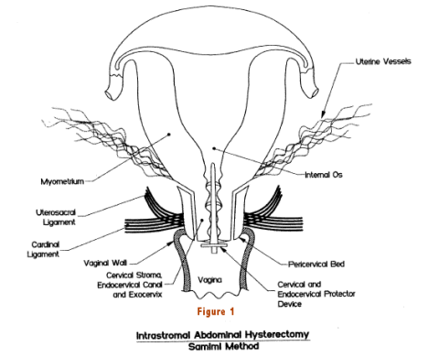
Intrafascial Or Intrastromal Or Modified Hysterectomy
(Classical Intrafascial Supracervical Hysterectomy = CISH (
technique, similar to standard supracervical hysterectomy, leaves the cardinal ligament, uterosacral ligament, vascular supply, and innervation to the upper vagina and cervix intact,
but unlike supracervical hysterectomy removes the transition zone and endocervical canal
whereas the bed and the pericervical stroma remain. In the outer stroma of the cervix is a pericervical bed, and the cervix is removed from this bed
It can be done by laparotomy . Laparoscopy or vaginal

Slide 28
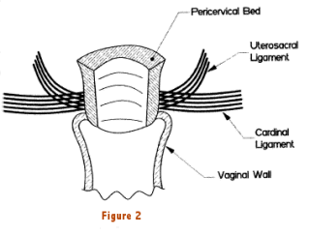
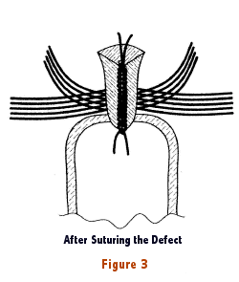
The advantage of this technique
The advantage of this technique is that the pelvic floor integrity remains intact (nerval and vascular side); , and because uterine arteries and ureters were not touched, the so called "complication zone" is thus avoided. continuation of the normal sexual life for both partners; and protection
This technique pretends to combine the advantages of the traditional supracervical hysterectomy, including a shorter operative time and the preservation of the cardinal ligaments and pericervical tissue, with the prevention against cervical carcinoma
Intrastromal Abdominal Hysterectomy is a bloodless, nerve-sparing technique that does not disturb the pelvic support system. It also proves to be an effective alternative to the traditional hysterectomy, with advantages such as reduced blood loss, shorter hospital stay, and less frequent post-operation complications. Throughout this process, it is imperative that the patient’s fear cervical cancer should not be ignored
.

Slide 29
In traditional hysterectomies,
most surgeons remove the uterus by cutting the uterosacral ligaments, the cardinal ligament of Mackenrodt, and the uterine vessels prior to entering the vaginal fornix
In this procedure, significant damage occurs to nerves in Franken Hauser’s nerve plexus, the vesical plexus, and other downstream nerves.
Additionally, the fibrous condensation in the endopelvic fascia are severed and no longer support the vaginal Hysterectomy to alleviate the traditional concern about possible interference with sexual or bladder function postoperatively as well as blood loss and length of hospital stay.

Slide 30

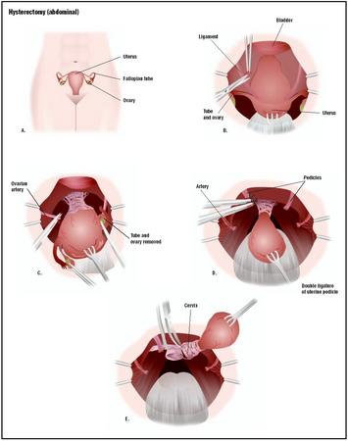
Total Hysterectomy
In a hysterectomy,
the reproductive organs are accessed through a lower abdominal incision or laparoscopically or vaginally
(A). Ligaments and supporting structures connecting the uterus( including cervix) to surrounding organs are severed
(B). Arteries to the uterus are severed
(C). The uterus, fallopian tubes, and ovaries are removed (D and E).

Slide 31
Extrafascial Hysterectomy
the extrafascial hysterectomy are the following:
the uterine vessels are skeletonized (to lessen the need to slide the tip of the clamp off the cervix) and are clamped and cut to allow the ligated vessels to fall away from the cervix;
(2) the pubovesicocervical fascia is not separated from the cervix and is excised with the specimen;
(3) the plane for bladder separation from the cervix is created with sharp dissection because blunt dissection is more often associated with accidental entry into the bladder; and
(4) the uterosacral ligaments are transected separately near their insertion into the cervix. This frees the uterus and cervix posteriorly and gains mobility for the specimen. This facilitates amputation of the vagina in front of the cervix, securing at least a 1-cm vaginal cuff.
The extrafascial technique permits removal of the intact uterine fundus and cervix, leaving the parametrial soft tissues or a portion of the upper vagina. Extrafascial hysterectomy can be accomplished through an abdominal incision, transvaginally, or by using a combination of laparoscopic and transvaginal techniques.

Slide 32

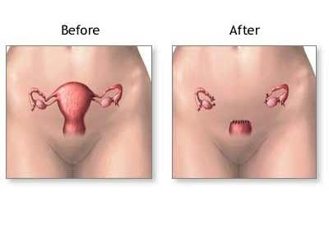
Do Not Remove Normal The Cervix
Supracervical hysterectomy
It Is done by jenior less experience less knowledge doctor
done by non - academic doctors
In less equipped private hospital
It is followed by better sexual life , bladder function , rectal function
It is easier
Reduced operating time
shorter recovery period
less operative complications - injury to bladder , ureter, colon
less post-operative complications
gynecologist prefer subtotal hysterectomy
It is good in presence of adhesions
It is good in postpartum emergency
It is not followed by vault ganuloma
a cost-effective
No loss of some sexual sensation due to loss of cervix
Cancer of the cervical stump is an uncommon and largely preventable occurrence due to Cervical cytologic screening and effective outpatient treatment of preinvasive cervical disease

Slide 33
It is easier to leave in the cervix if the uterus is removed through the abdomen, but the reverse is true for a vaginal hysterectomy.
Although we have good screening methods for cervical cancer, adenocarcinoma (cancer of the glands inside of the cervix) is increasing in frequency, and can be fatal.
In addition, there are now reports of having to go back and remove the cervix after a supracervical hysterectomy because of bleeding or other problems.
There is a small but definite risk of cancer in a remaining cervix, and of needing to have surgery to remove the cervix at a later time if it causes problems. The arguments about pelvic support and sexual functions have not been tested, so their validity is unknown. Hopefully there will be good prospective studies to better determine whether or not it is best to remove the cervix.

Slide 34
To Do It Laparoscopic OR Vaginal OR Abdominal

Slide 35
Three factors should be considered in the selection of surgical route regardless of the scope of the patient's condition:
1 - Uterine size
Weight >280 g or 12 weeks' gestational size versus <280 g
2 - Uterine attachments
Patients with a history or clinical findings suggestive of
- Endometriosis - Adnexal disease - Chronic pelvic pain - Adhesions - Previous pelvic surgery
- Chronic pelvic inflammatory disease
may be candidates for a laparoscopy-assisted vaginal hysterectomy
If the laparoscopic score is less than 10, a vaginal hysterectomy is performed without further laparoscopic assistance.
Scores between 11 and 19 indicate use of laparoscopic surgical techniques, such as adhesiolysis or fulguration of endometriosis, to convert the score to 10 or less before proceeding with a vaginal hysterectomy.
Patients with a score of 20 or higher are best managed with abdominal or laparoscopic procedures
3 - Anatomic accessibility
a - Bituberous diameter <9 cm
b - Pubic arch <90°
c - Narrow vagina (less than two fingerbreadths, especially at the apex)
d - an undescended uterus

Slide 36
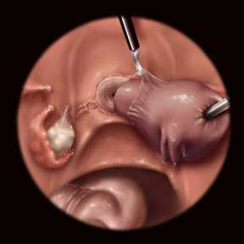
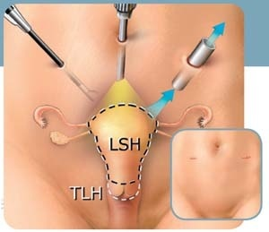
Do It Laparoscopic
Laparoscopic hysterectomy is a safe procedure for selected patients scheduled for abdominal hysterectomy, and offers benefits to the patients in the form of less operative bleeding, less post-operative pain, shorter time in hospital and shorter convalescence time , leave smaller scarc on the abdomen than abdominal
But it takes more operative time, uses more operating room equipment (some of which is “single-use” equipment, which can be expensive), and requires specialized surgical skills
most doctors don’t practice modern endoscopy techniques due to lack of training facility for the same
A LAVH or LH is often less invasive than an abdominal hysterectomy, but more invasive than a vaginal hysterectomy

Slide 37
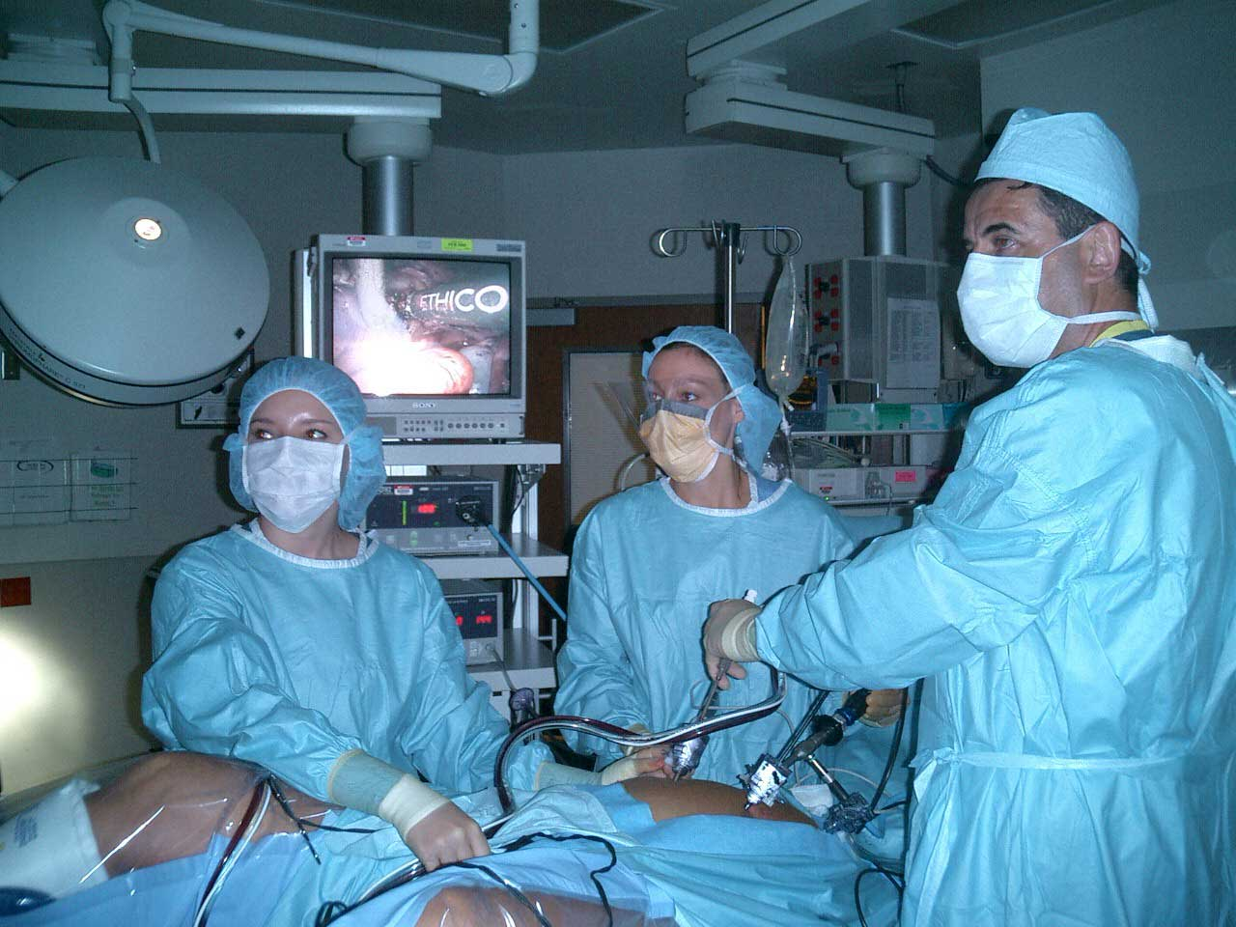
Laparoscopically Assisted Vaginal Hysterectomy Just like in a TAH or TVH, the uterus (including the cervix) is detached from the ligaments that attach it to other structures in the pelvis, and removed through a cut at the top of the vagina which is repaired with stitches
Laparascopic Supracervical Hysterectomy This procedure is done completely laparoscopically and does not remove the cervix
Laparascopic Total Hysterectomy This procedure is done completely laparoscopically and remove the cervix also

Slide 38
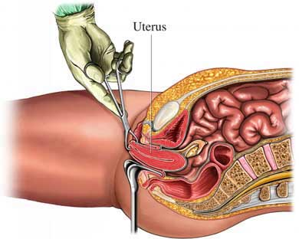
Do It Vaginal
Vaginal subtotal hysterectomy (conservation of the cervix ) and sacrospinous colpopexy in the management of patients with marked uterine prolapse who desire retention of the cervix
Total Vaginal Hysterectomy This procedure is the same as in the TAH, performed vaginally
less morbidity less mortality
Only gynecologist can do vaginal hysterectomy

Slide 39
Three factors should be considered in the selection of
Vaginal route
1 - Uterine size
Weight>280 g or > 12 weeks' gestational size
2 - Uterine attachments
Patients with no history or clinical findings suggestive of
- Endometriosis - Adnexal disease - Chronic pelvic pain - Adhesions - Previous pelvic surgery
- Chronic pelvic inflammatory disease
3 - Anatomic accessibility
a - Bituberous diameter <9 cm
b - Pubic arch< {90°
c -wide vagina (more than two fingerbreadths, especially at the apex)
d - descended uterus

Slide 40
The advantages of this procedure are that it leaves no visible scar and is less painful, a shorter hospital stay, Fastest return to normal activities Highest quality of life scores , Lowest hospitalization and postoperative costs
The disadvantage is that it is more difficult for the surgeon to see the uterus and surrounding tissue. This makes complications more common.
Large fibroids cannot be removed using this technique.
unable to remove a very large uterus or areas of endometriosis, adenomyosis, or scar tissue (adhesions)
Doesn't allow free access to the pelvic organs , It is very difficult to remove the ovaries during a vaginal hysterectomy, so this approach may not be possible if the ovaries are involved.

Slide 41
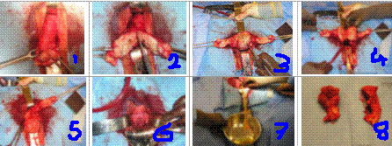
VH for large uterus
1 - cervix prolapsing through vaginal introitus grasped by tenaculi
2 - cervix being bivalved with scalpel
3 - uterine corpus being bivalved after separation of cervix has been completed
4 - uterus halved after bivalving procedure to facilitate its removal
5 - after half of uterus is removed. cervix is grasped with uterine corpus below
6 - vaginal cuff closed with suture after removal of uterus
7 - following procedure bladder is drained with foley catheter revealing non-bloody urine
8 - removed uterus sent for pathology examination

Slide 42
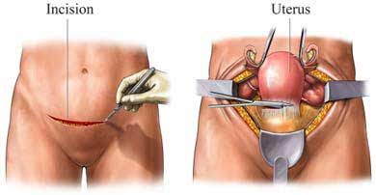
Do It Abdominal
Physicians use the procedure they are most comfortable with, and residents lack sufficient hands-on experience with laparoscopic and vaginal surgery.
Medicolegal risk and reimbursement also have an impact

Slide 43

The advantages of an abdominal hysterectomy are that the large uterus can be removed even if a woman has internal scarring (adhesions) from previous surgery or her fibroids are large. The surgeon has a good view of the abdominal cavity and more room to work. Also, surgeons tend to have the most experience with this type of hysterectomy.
Requires less time under anesthesia and in surgery than a laparoscopic hysterectomy but more than vaginal hysterectomy
But The abdominal incision is more painful than with vaginal hysterectomy, and hospital stay and recovery period is longer
Costs more than a vaginal hysterectomy but less than laparoscopic
Twice the risk of postoperative fever
Significantly increased blood loss

Slide 44
Abdominal hysterectomy remains the predominant method of uterine removal in the United States, despite evidence that vaginal hysterectomy offers advantages in regard to operative time, complication rates, return to normal activities, and overall cost of treatment.
We must improve training in vaginal surgery for the younger generation of gynaecologists, and our colleges should now establish clinical guidelines for selecting the appropriate route of hysterectomy, based on the best available evidence. Such guidelines have been shown to enhance the uptake of vaginal hysterectomy

Slide 45
Is it necessary to get a Second Or Third opinion before Hysterectomy?
The second opinion will confirm any concerns about whether Her was correctly diagnosed
Getting a second opinion from another doctor is a good way to make sure that hysterectomy is the right option for her
Don't be uncomfortable about telling Her doctor She want a second opinion.
Doctors expect their patients to ask for another opinion. .

Slide 46
Many factors are embodied in these differences
cultural attitudes, physician training, the availability of elective surgery in a particular country, the ability to pay for care, etc.
Women tend to make very different decisions based on their particular circumstances, their feelings about estrogen replacement therapy, and their risk and fear of ovarian cancer. However, it is always best to make these decisions based on accurate and current medical information. This decision is yours to make and should be discussed in detail with her doctor. As always, if there are unanswered questions or concern, get a second opinion.
the final decision about the appropriateness of a hysterectomy, or any type of surgery or medical care, should be made by each woman herself

Slide 47
Conclusion
Each case is differrent and decision is difficult
Doctor must share decision with Her patient and her family
Every Step should be offered as an option to selected patients
Decision is based on guidelines rather than physicians' preferences or experience
Final decision should be made by the woman herself
based on her age, her options, and the severity of her symptoms

Slide 48
My Opinion
the decision should be made on a case-by-case basis
If medical or hormonal ttt or hystrectomy alternatives are failed –
I do hysterectomy --- specially classical intrafascial subtotal hysterectomy
I remove the the cervix
if cervix is unhealthy
when vault well not supported
or patient can not recur regularly for follow up ( Pap smear)
I try to leave at least one normal ovary to patient who is still menstrating
and I remove both
after menopause
or patient have relative with cancer ovary or breast
Attention : I may change my opinion later

