Slide 1


Natural Cesarean
Section
(NCS)
Dr Muhammad M
Al Hennawy
Ob/gyn consultant
Egypt

Slide 2
A typical Cesarean Section
(Born by knife )
It starts mom being restrained to the surgical table.
This is supposed to ensure that she cannot accidentally interfere in the surgery.
She is hidden behind a curtain where she cannot see her own baby being born, isolating her from her own birth.
The cord is immediately clamped and cut.
The baby may be shown to mom, but because her hands are immobilized, she cannot hold, much less nurse, her baby without help from others.
Often the baby is quickly taken to an infant nursery and only brought back to the mother later, often after hours.

Slide 3
Historically
Cesareans were emergency procedures that emphasized rapid delivery and immediate access to the baby for resuscitation. As cesareans have become more commonplace and oftentimes less urgent, some obstetricians have begun doing the surgery more slowly and encouraging immediate skin-to-skin contact between the mother and baby after the delivery.
A scientific paper published in 2008 describes the process as a “woman-centered technique” that allows for a slow delivery that also gives parents the opportunity to watch the child’s birth as “active participants.” Other natural Cesareans have had the mother actually helping to pull the baby out of her womb.

Slide 4
the "natural" cesarean birth claims to be slower, more calm and mimic what happens in a vaginal delivery.
Gentle C-sections invite the mother and partner to be more active participants in the process. In essence, to make the operation more like a birth.
For the woman that needs a C-Section, the Gentle Cesarean is about as close as you’ll get to a more natural feeling birth and who can argue with giving birth in a friendlier more natural setting with the ability to bond immediately with baby? But there may be a slight downside.
In a less stressful environment and strengthen the bond between mother and child.
It’s an effort to make cesarean birth more respectful of families’ emotional and physical needs, and elements of it are catching on in may hospitals.

Slide 5
A Natural Or Normal Caesarean
It is an abdominal surgery that they regarded as a series of measures to mimic the situation at vaginal birth

Slide 6
Three Main Characteristics Of NCS
They connect this operation to what is usually called ‘natural birth’.
First, parents can see their baby when she/he is extracted from the mother’s abdomen, since the drape ‘that “divorced” the upper part of her body from the birthing scene is dropped at the right moment’.
Second, the baby is extracted slowly so that s/he ‘is able to “autoresuscitate” –start breathing unaided’ (
Third, the newborn is immediately handed to the mother for the skin-to-skin first contact allowing ‘bonding’, a practice that today is standardised in several European countries after a woman has had a vaginal birth.
Furthermore, as stated by one member of Professor Fisk’s team, ‘the father can perform a second “cutting of the cord” and the midwife can show him where to clamp it’

Slide 7
Names
Natural caesareans
The 'slow' Caesarean
Gentle Caesarean
a 'skin-to-skin' cesarean
Women- centered cs
Family- centered cs
Mother Friendly cs
A mother and baby-centered cesarean delivery
Clear-drape cesarean section

Slide 8
Types
Spontaneous natural Cesarean--- allows baby to emerge from the womb by itself
Assisted natural Cesarean---- slow delivery of fetus by doctor
Self natural Cesarean -- the mother actually helping to pull the baby out of her womb

Slide 9
NCS Only Offered To
The 'natural' way is only used for elective C-sections and not in an emergency situation.
Natural caesareans are only offered to women who have reached
- the full-term 37 weeks of pregnancy and
- have no complications.
- The baby must be head-first in the womb,
- with a healthy heartbeat.

Slide 10
Antenatal preparation
The approach is discussed in antenatal classes, with video clips and photographs available.
Women are encouraged to bring their own music into theatre

Slide 11
It is a planned ceasarean section,
The date must be known.

Slide 12
In theatre
Preparation is routine
The baby’s heart rate is continuously monitored by cardiotocograph prior to skin preparation.
Music is played if the couple wish.

Slide 13
The temperature is around 22 degrees Celsius (instead of 18 degrees Celsius).

Slide 14
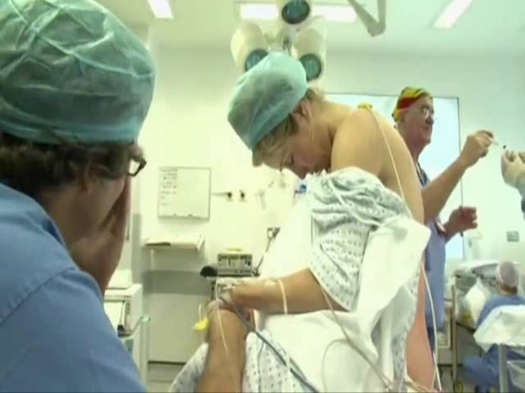
Under regional anaeshesia
Instead of a full narcosis, an epidural is applied
So the mother can experience the birth fully consciously.

Slide 15
Following insertion of the regional anaesthetic,
the clothing is removed from one of the woman’s arms so the baby can easily be placed skin-to-skin following birth.
The blood pressure cuff is covered in a clear plastic cover to keep it clean.
The pulse oximeter is usually placed on a finger, but could be placed on a toe to free the woman’s hands to hold the baby.
The intravenous cannula is situated as normal in the non-dominant arm for ease of holding the baby.

Slide 16
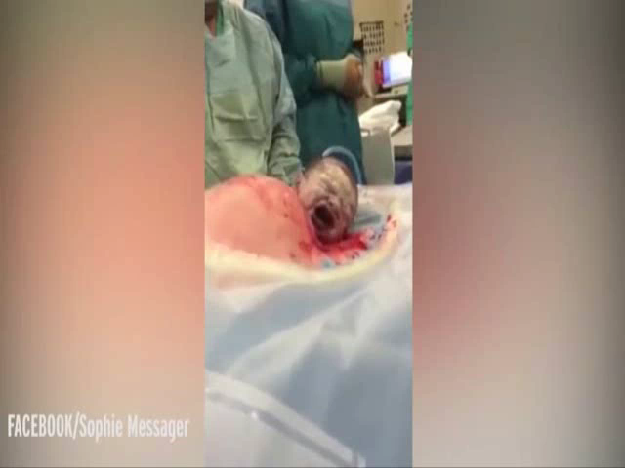
After making an incision into the womb and
bringing out the baby’s head.

Slide 17

a clear surgical drape that allows the mom to actually see the birth
sitting up to see her half-born child breathing his first breath

Slide 18
The light is dimmed during delivery of the baby’s head, in order to reduce stress levels for the baby.
Sound levels are as low as possible so the baby can hear the voices of the father and mother.

Slide 19
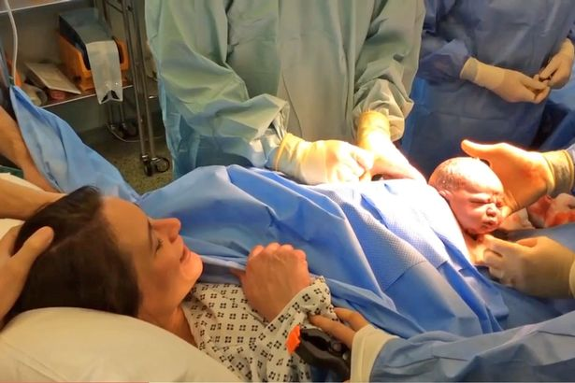
Once the baby’s head is out,
the surgeon pauses to allow ‘auto-resuscitation’ of the baby.
Once the baby’s face is exposed to the relatively cold room air,
she/he will be stimulated to begin to breathe through the nose and mouth, while the body remains in utero, still attached to the placental circulation (like a vaginal birth when the head is delivered).
The baby’s head is usually facing to the side and, after a couple of moments, lung fluid is usually clearly visible, draining from the baby’s nose and mouth as a result of pressure from the uterus as it begins to contract down, and from the mother’s abdominal wall, on the chest.

Slide 20
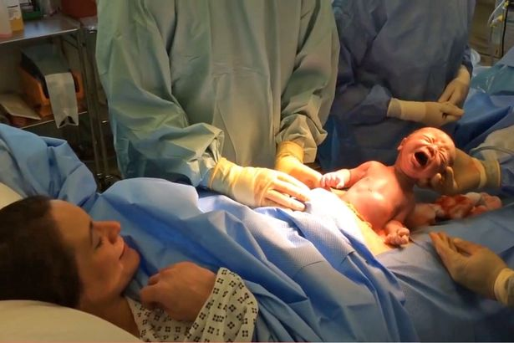
This gradual birth of the baby also allows the time for the chest to be squeezed on the way out similar to a vaginal birth and the lung fluids to clear spontaneously

Slide 21
Once the baby begins to cry, the shoulders are freed from the uterus by the surgeon,
the baby’s head is gently turned to face his mother and the baby is born,
assisted by uterine contractions.
Frequently the baby releases its arms itself, through a vigorous extensive reflex.
The surgeon then supports the baby as it wriggles out.
(a process that "mimics natural childbirth

Slide 22
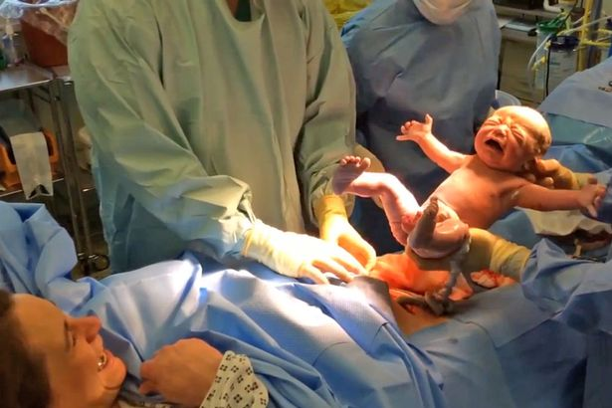
When it wriggles out it is the parents that first determine the sex

Slide 23
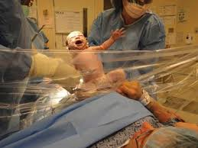
It can take up to four minutes for the baby to be born during a natural caesarean, before it is placed on the mother’s chest, which is thought to help bonding.

Slide 24
Following the birth, the midwife, maintaining sterility, goes to the ‘head end’ to receive the baby, after the cord is cut by the obstetrician, and
To place the baby directly on the mother’s chest andto keep the baby warm and the towels covering the baby are changed (if damp) to prevent cooling from evaporation exacerbated by the theatre ventilation system.
The midwife, partner/birth partner and anaesthetist observe the baby on the mother

Slide 25
Complete cesarean section as usual
Put surgical drape to hide operation field
not exteriorize the uterus when possible.
When the uterus is pulled out of mom’s abdomen, there is more internal stress and trauma and recovery can be dramatically more difficult
Immediately following the birth, the anaesthetist administers oxytocin and antibiotic drugs and, with the rest of the team, promotes mother-baby interaction

Slide 26
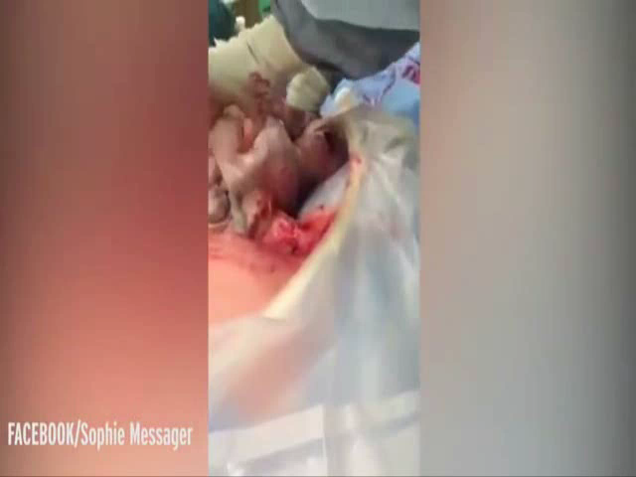
all newborn tests, measurements, and procedures performed with the baby on chest, not in the warmer.”

Slide 27
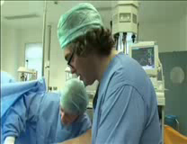
Father cut Or recut umblical cord guided by a nurse
The umbilical cord can be cut by the doctor after the baby is taken out
or after the baby lay on the mother’s chest for a few minutes.
Sometimes the father can cut part of the umbilical cord as well.
If the baby needs to be checked,
it is returned to the mother as soon as possible and stays there as long as possible.
Mother, child and father are not separated, although sometimes a quick check by the doctor may be necessary.

Slide 28
While keeping the baby in skin-to-skin contact on the mother’s chest. Occasionally the baby starts suckling at this stage, while surgery is ongoing.
Washing the baby, applying vitamine K and dressing only start in a later phase.

Slide 29
Vaginal Microbiome Transfer
Studies around the world are demonstrating an important link between disruption to the complex microbial communities living in and on the human body and many of the modern illnesses that have been on the rise in developed countries over the past 60 years.
Allergies, autoimmune diseases, and obesity, in particular, are now thought to have their roots in a disrupted gut microbiota.
The technique of Vaginal Microbiome Transfer was simple.
Some of the mothers due to give birth by C-section had a piece of gauze inserted into the vagina one hour before surgery.
The microbe-laced gauze was removed and placed in a sterile pot just before the C-section was performed, and
immediately after each baby had been delivered, its body was wiped with the gauze, beginning with the mouth, then the head, and then the rest of the body.

Slide 30
Benefits For Mothers
A more family-centered experience for the mother and partner,
Slow evacuation of uterus decrease postpartum hemorrhage
Less breast engorgement/pain at 3 days
Less anxiety 3 days after birth
overall greater satisfaction with the procedure
Eliminate the hours of pain following surgery.
lessen postpartum depression
It’s also likely to help moms heal faster,
Enjoy their baby’s birth more and have healthier babies.

Slide 31
Benefits For New Borne
It takes four minutes for baby to be decrease respiratory problems of neonate improved thermoregulation of the neonate,
Better bonding,
Early feeding procedure
More effective suckling during the initial breastfeeding session
Less crying– babies who received skin-to-skin care were 12 times less likely to cry during the observation period
Heart rate, respirations, and temperature were more likely to remain stable
A beneficial increase in blood sugar

Slide 32
Difficulty
That need for sterility is a major hurdle to innovation.
Members of the team —obstetricians, residents, nurses, pediatricians and anesthesiologists — may be hesitant to change their routines, which are built around reducing risk.
Logistically, the most difficult change is getting baby directly from incision to mama's chest. That's because it requires an extra person — usually a nurse or midwife — who is scrubbed and ready to take baby from the doctor to the mother, and to closely monitor the baby there.

Slide 33
Here are some of the features of a ‘natural’ caesarean:
The birth of the baby can be carried out slowly and gently over several minutes so the parents can participate.
In particular, the baby can be lifted out slowly – Professor Fisk calls this ‘walking the baby out’.
If the cord is not cut immediately the baby will still be getting oxygen from the placenta so there is no need to rush.
This slow approach is more like a vaginal birth – a slow calm entry into the world for the baby.
The back of the bed can be raised a little and the screen lowered so the parents can be involved in the birth and see the baby’s head being born and then, gradually, the body.
This gradual birth of the baby also allows the time for the chest to be squeezed on the way out similar to a vaginal birth and the lung fluids to clear spontaneously.
The baby is placed straight onto the mother’s chest ‘skin-to-skin’, which helps to regulate the baby’s breathing. Here the baby can gradually acclimatise to being in the world safe and warm on the mother’s body, close to her familiar heartbeat.
There is no rush to clamp and cut the cord, which can be left intact for a few minutes so baby can benefit from the placental transfusion.
The placenta can be removed prior to the clamping/cutting of the cord and kept close to the baby for a little while.

