Slide 1

PenoVaginal
Disproportion
Dr Muhammad El Hennawy
Ob/gyn Consultant
دكتور محمد محمد الحناوى
Rass el barr central hospital and
dumyat specialised hospital
Dumyatt – EGYPT
www. Mmhennawy.co.nr

Slide 2
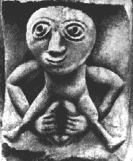
This Lecture explains
my personal opinion
In spite that this lecture contains medical evident informations
If you accept this lecture ,
take it as a sciense
If you do not accept it,
take it as a fun

Slide 3
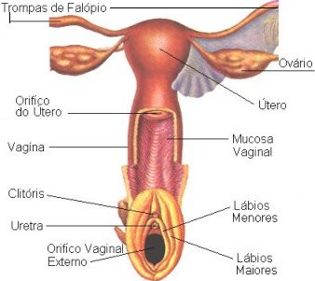
Vagina
Normal vagina
Abnormal vagina : Absent
: Hypoplastic
: Wide

Slide 4
The Normal Vagina
It is a hollow fibromuscular tube extending from the vulvar vestibule to the uterus.
In the dorsal lithotomy position, the vagina is directed posteriorly toward the sacrum, but its axis is almost horizontal in the upright position.
It is attached at its upper end to the uterus just above the cervix.
The spaces between the cervix and vagina are known as the anterior, posterior, and lateral vaginal fornices. Because the vagina is attached at a higher point posteriorly than anteriorly, the posterior vaginal wall is about 3 cm longer than the anterior wall
Vaginal length is variable, but it usually ranges from 8 to 10 cm. In a standing position its orientation is not vertical. Rather it is directed cephalad

Slide 5
The vagina is a strong canal of muscle approximately 7.5 cm long that extends from the uterus to the vestibule of the external genitalia, where it opens to the exterior.
Its long axis is almost parallel with that of the lower part of the sacrum, and it meets the cervix of the uterus at an angle of 45–90 degrees.
Because the cervix of the uterus projects into the upper portion, the anterior wall of the vagina is 1.5–2 cm shorter than the posterior wall.
The circular cul-de-sac formed around the cervix is known as the fornix and is divided into 4 regions; the anterior fornix, the posterior fornix, and 2 lateral fornices.
Toward its lower end, the vagina pierces the urogenital diaphragm and is surrounded by the 2 bulbocavernosus muscles and bodies, which act as a sphincter (sphincter vaginae).
In the virginal state, an incomplete fold of highly vascular tissue and mucous membrane, the hymen, partially closes the external orific

Slide 6
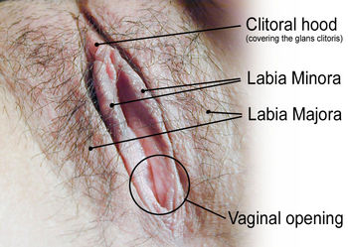
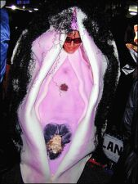
The vagina itself
is a very elastic environment
through which an infant can pass,
yet it also easily retains a tampon.
It will accommodate and adjust to the entity it surrounds

Slide 7
The human vagina is an elastic muscular tube about 4 inches (100 mm) long and 1 inch (25 mm) in diameter that connects the vulva at the outside to the cervix of the uterus on the inside. If the woman stands upright, the vaginal tube points in an upward-backward direction and forms an angle of slightly more than 45 degrees with the uterus.

Slide 8
The most sensitive area of the vagina is the section closest to the outside of a woman's body
which is roughly 10 centimeters (4 inches) in length.
Given that the average penis size is above this length,
most men should be able to easily reach and stimulate these erotic nerve endings

Slide 9
This unstretched measurement is not a good description for sex.
I can always push further into my vagina, and can fit my beloved's whole unit inside me, or our whole rubber toy.
So my vagina can stretch from around 4 inches deep to around 8. It's actual depth gets to be kind of irrelevant. It can accomodate.
The width of my vagina is also difficult to describe, as it is very elastic. It collapses shut when not held open, but can stretch about as wide as hand. This is about how big the ring of my pelvic bones is. My vagina feels stretched if it is opened wider than two fingers or so. I think it is wider front to back than side to side when it is empty and resting.

Slide 10
minor surgery without anesthetic can be conducted on the inner portion of a woman's vagina without discomfort.
Most women attest to a feeling of being "filled up" by larger than average penises,
yet few can claim to feel erotic sensations in the deeper regions of the vagina.
In fact, stimulation of the G-Spot is often more effective if the man's penis is slightly shorter than average, as this highly sensitive area of the vagina is located closer to the opening of vagina than to the recesses of its canal

Slide 11
Stimulation of the G-Spot may be more effective if the man's penis is thicker than average, since the pleasure sensations from this area are activated primarily by pressure.
A thicker penis may provide more friction against the vestibular bulbs, which are located in close proximity and anteriorly on either side of the urethra.
Additionally, some claim that if a penis is thick enough compared with the vaginal opening, i.e. vulva, stretching will occur. This stretching can supposedly cause the clitoral hood to pass back and forth across the clitoris, which would provide additional stimulation of this large concentration of nerve endings.
This stretching is claimed to pull the clitoris down into the path of the thrusting penis, causing it to make contact with, and rub across, the top or dorsal section of the penis. This may facilitate even greater clitoral stimulation

Slide 12
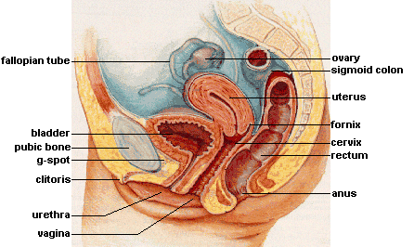
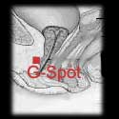
G-Spot" The Grafenberg spot, is an area located within the anterior (or front) wall of the vagina, about one centimetre from the surface and one-third to one-half way in from the vaginal opening
It is reported to consist of a system of glands (Skene's glands) and ducts that surround the urethra (Heath, 1984). Some authors write that you must press "deeply" into the tissue with two fingers to reach it with any effectiveness.
The significance of the G-spot is that some women (about half) report that it is a highly sensitive area that under the right conditions can be very pleasurable if stimulated.
For some women, it can be a primary source of stimulation leading to orgasm during intercourse.
Other women report no particular stimulation, and some say that it feels as if they need to urinate.
The G-Spot has been linked to the phenomenon known as female ejaculation. To date, there is little data about female ejaculation, although there is some speculation that it is the product of the Skene's glands. .

Slide 13
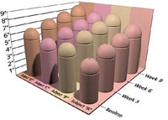
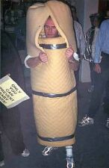
width rather than length
penis size--- width rather than length is the most important factor of sexual stimulation.
The most obvious would be genetics while some may link penis size to culture; specifically to diet.

Slide 14
it is possible for an exercised vagina to shoot ping pong balls
it is possible for an exercised vagina to pick up a coin
it is possible for an exercised vagina to crush an egg inserted in her vagina using her vaginal muscles strong(try to crush an egg in your fist
it is possible for an exercised vagina to lift more than 11 lbs(5 kg) with their vagina (weight attached to a vaginal ball).

Slide 15
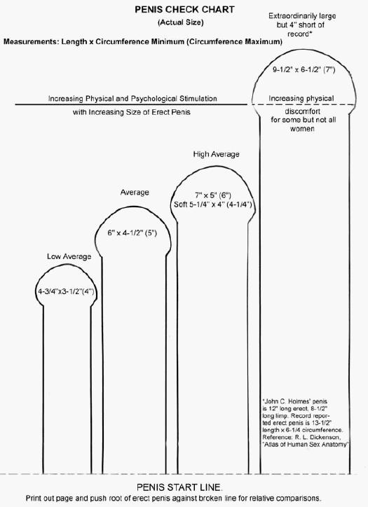
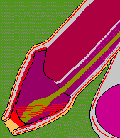
Is penis size important?
This is probably one of the most frequently asked questions
Penis size is important if and only if you think it is. If you have sex with men and you desire a large penis, then penis size is important to you, and only to you. If you feel your penis should be larger, then penis size is important to you, and only to you.
Many women report that too many men are hung up on the size of their penises. The vagina is only eight to thirteen centimeters long, and even a small penis can touch every square centimeter within the vagina.

Slide 16
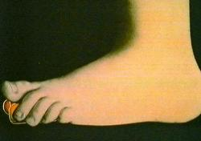

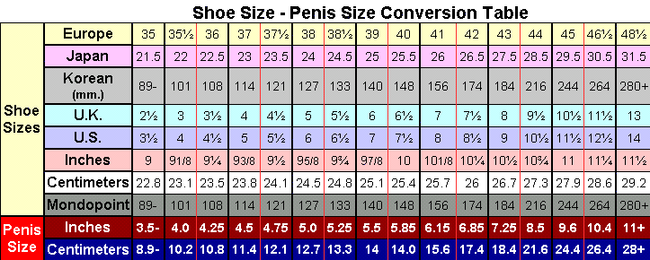
Shoe Size - Penis Size Conversion Chart
American, British, European, Japanese, Inches, Centimeters, & Mondopoint Shoe Sizes vs. Penis Size
The most recent study indicated there was no correlation between shoes and penises.

Slide 17


Remember, that old saying... it's not how long your pencil is -- it's how you write your name. Or, "it's not the wand it's the magician".

Slide 18
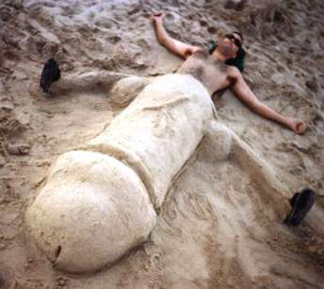
Penis-enlargement

Slide 19
vaginal length, lining thickness and muscle strength
There was no relation between these measurements and sexual desire frequency of sexual relations, vaginal dryness or pain on intercourse

Slide 20
No one description characterized the shape of the human vagina.
Although there is variation among women, variables such as parity, age and height are positively associated with differences in baseline dimensions.
Mean vaginal length from cervix to introitus was 62.7 mm. Vaginal width was largest in the proximal vagina (32.5 mm), decreased as it passed through the pelvic diaphragm (27.8 mm) and smallest at the introitus (26.2 mm).
Significant positive associations were parity with vaginal fornix length, age with pelvic flexure width and the height with width at the pelvic flexure.

Slide 21
sexual desire in women
It is related to blood levels of the male hormone, testosterone. Women with low levels (below 30 nannograms) have significantly decreased desire, while female athletes who take synthetic male hormones to make themselves stronger often have ravenous sexual appetites.
Women with decreased sexual desire who are healthy and in a healthy relationship can be treated with injections of 100 mg of testosterone enanthate every three weeks for several weeks

Slide 22
Sexual function and satisfaction improved or did not change in most women after surgery for either prolapse or urinary incontinence, or both. However, the combination of Burch colposusupension and posterior colporrhaphy was especially likely to result in dyspareunia.

Slide 23
THE RIGHT PROCEDURE
Our specialized non-surgical procedures for tightening, toning and restoration of the vagina to a feminine state, focus on each woman’s individual needs.
We focus the techniques in restoring a more normal, more appealing size to the female organ.
One that gives your femininity back to you, in a youthful and feminine state, allowing you to feel adequate with your body and with your partner.
• You will no longer suffer from embarrassing size problems.
• Feel every inch of your partner inside of you tightly.
• Enjoy sex and experience orgasms during coitus.
• Experience life with a tight and normal vagina, like other women.
• Grip a finger or member firmly with your tight vagina.
• Increase your femininity becoming happier and more comfortable with your body.
• Enjoy an increase of self-esteem and confidence

Slide 24
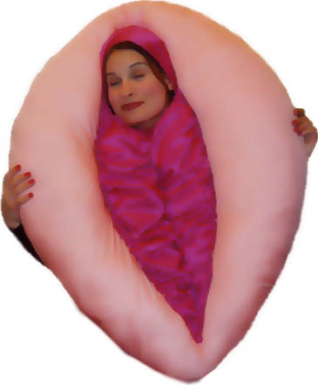
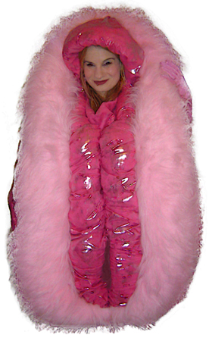
pain on intercourse or vaginal dryness. The most common causes are vaginal infections and inadequate foreplay, which can be treated with appropriate antibiotics and patience.

Slide 25
Unfortunately, there's a very common myth to the effect that a woman who has lots of sex will get a large vagina.
This is just nonsense! No matter how much sex you have, it won't affect your vaginal or vulval size.
But what does affect your dimensions is childbirth.
Unfortunately, the more babies you have, the more likely your vagina is to become widened. This is due to damage to the muscles and other supporting tissues of the vaginal walls. It's more common after difficult and prolonged labours. It can often be prevented by very determined use of the postnatal exercises that midwives and physiotherapists teach.

Slide 26
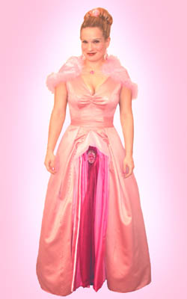
What happens if your vagina or vulva really is too big?
Let’s look at the vagina (ie the interior) first.
If your vaginal 'barrel' is excessively big, so that you are 'slack', this can have the following effects:
intercourse may be less satisfactory for you.
intercourse may be less satisfying for your partner.
you may be more liable to experience the phenomenon of air getting into (and out of) the vagina - a phenomenon known in some parts of the country as 'fanny farting'.
bath water may get into your vagina - though this isn't likely to be a health problem.
much more seriously, lax muscles and ligaments around the vagina may lead to prolapse (descent of the womb and other organs) in middle age or later life.

Slide 27
What if you think that you're too small?
Alternatively, do you think that you are 'built' too small?
I have to tell you that statistically this is most unlikely. Vast numbers of patients think that they are excessively small, but only once in a blue moon are they actually right.
The symptoms that make them feel that they are unusually small include:
pain on intercourse
inability to have sex at all
inability to insert a tampon.
But the vast majority of women who complain of these problems do eventually turn out to be normal-sized.
Nearly always, they are suffering from a degree of vaginismus - the common condition that makes the vaginal muscles contract whenever any approach is made to the genitals

Slide 28
COMMON SYMPTOMS THAT INDICATE A LOOSE VAGINA
Women suffering from an embarrassing inadequacy of being big and loose, usually experience one or all of the following symptoms.
• The need for the insertion of larger objects in order to feel some sexual stimulation.
• The inability to grip your index finger with your vagina.
• The feeling of just being big and looking big.
• Your vagina emits a lot of odor.
• Your vagina does not close completely during the non-aroused state.
• Being able to insert 3 or more fingers into your canal with little to no resistance.
• The inability to reach orgasm during coitus.
• The inability to satisfy your partner and provide proper stimulation to him.
These are the most common symptoms associated with women who have an inadequate vaginal size where it is too big and loose, causing distress to any women who suffers from this disorder.

Slide 29
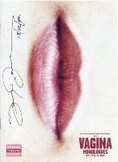
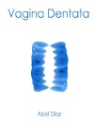
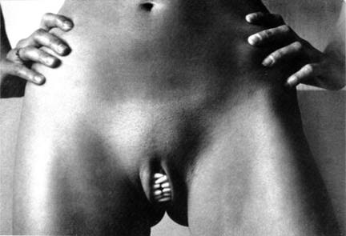
Dentata Vagina
Toothed vagina
the classic symbol of men's fear of sex, expressing the unconscious belief that a woman may eat or castrate her partner during intercourse.
Apparently this vaginal teeth motif is in myths and stories
and even jokes all over the world,
showing up as a symbol of aggression in women, or of weapons that they can use to rape and kill men.
In many of the stories, apparently the women marry the men who detoothed their vaginas and made them safe
Three things are insatiable: the desert, the grave, and a woman's vulva

Slide 30
Vaginal Hypoplasia
A survey of textbooks and medical papers reveals average lengths ranging from 9 to 11 cm for the longest (posterior) wall in normal XX women.
found that 6 cm was the cut-off point below which patients and their partners had problems in achieving intercourse
Treatments - Introduction
There are two basic approaches to treating vaginal hypoplasia. One is to use plastic surgery (vaginoplasty) techniques to construct a new vagina out of tissue from various donor sites. The other is to expand and enlarge the tissue already present at the vaginal entrance by applying pressure (pressure dilation) over an extended period of time.
The results of pressure dilation are superior to those of vaginoplasty. After dilation, the vagina is lined with mucosal tissue very similar to that of a normal vagina, which has tactile sensation, and which lubricates with sexual arousal
The No-Treatment Option Of course there is also the option of not undergoing any physical treatment for vaginal hypoplasia but instead being offered psychological counselling tailored to exploring the various aspects of sexual expression, and maybe adopting the attitude that human intimacy is not necessarily all about penetrative sex.

Slide 31
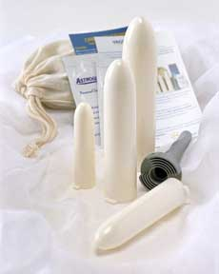
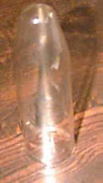
Pressure Dilation Techniques
Intermittent Pressure (, in 1938 Frank Method) Rounded rod-shaped appliances are placed at the vaginal introitus (entrance), and gentle pressure (enough to cause mild discomfort) is applied. This is typically done once or twice per day for 20 to 30 minutes. The time to completion of treatment can vary from less than one month to over a year. An adequate dosage of oral estrogen, plus local application of vaginal estrogen cream may be helpful . ( In 1981 Ingram) not only developed a set of Lucite appliances, but also introduced a specialized stool ("bicycle seat") which allows dilation to be carried out while the patient is clothed and in a sitting position. The pressure is applied to the base of the appliance by the seat of the stool. This frees the patient to perform activities such as schoolwork concurrently with dilation. In around 1997 Dr. D. Veronikis, in a further refinement, developed appliances that are also designed to be used in a seated position, but on an ordinary chair, thus removing the need for the cumbersome stool. They have a design that allows adjustment of their length in very small increments, which helps make the process less uncomfortable. There are two versions of the kit, one for use after surgery, to maintain vaginal length, and one for use when starting from scratch to form a vagina by pressure dilation alone.
Vaginal Oestrogen Preparations Vaginal oestrogen is available in the form of creams (e.g. Ortho-Dienoestrol, Ovestin, and Premarin) or as pessaries (e.g. Ortho-Gynest and Tampovagan), or tablets (e.g. Vagifem), or a vaginal ring (e.g. Estring) which releases oestradiol locally over three months. , Systemic HRT (tablets, patches etc.) does not always produce an improvement in vaginal symptoms (dryness, and atrophy or shrinkage of tissue)
Continuous Pressure (Vecchietti Procedure) Pressure is applied in the vaginal area by a dilation 'olive', a plastic bead through which traction sutures or threads are threaded (think of a small horse chestnut 'conker' on a string!). The traction sutures run through the abdominal cavity to a traction device placed on the outside of the abdomen. The vagina is not constructed during the operation (under anaesthetic) to place the traction sutures, but is formed by the stretching forces applied once the patient has recovered from this. Over the course of 7-10 days, the vagina lengthens to about 8-12 cm by gradually increasing the tension on the traction sutures. Intercourse is said to be possible after 3-5 weeks. The Vecchietti procedure is useful when manual dilation is excessively uncomfortable, or when progress in dilation is poor. Its relative advantages over manual dilation are greater when the vagina is initially represented by only a very short dimple.

Slide 32
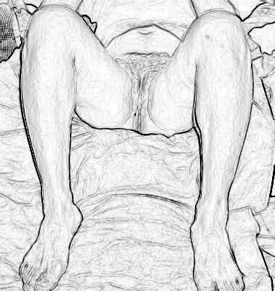

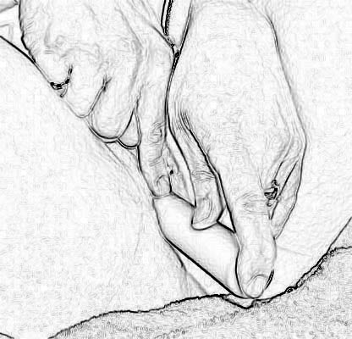
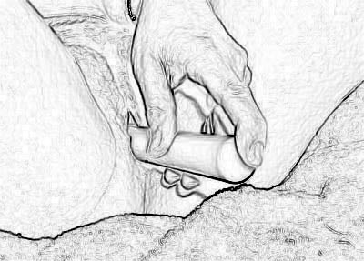
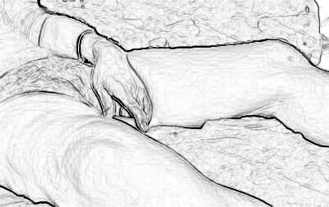
Place your feet about the width of your hips apart and bend your knees at about a 45 degree angle.
Now lubricate the dilator you will be starting with .
Also insert some of the lubricant into the vagina prior to inserting the dilator
NEVER insert the dilator at a downward angle
Always insert at a flat or slightly upward angle, as if pointing toward the navel
It may be necessary to put your thumb or finger on the top of the dilator shaft and apply slight pressure so that the nose of the dilator passes under the pubic bone
Once the dilator is inserted, relax your legs by bringing your knees together and straightening them as much as you can. You may roll over on your side with your knees slightly bent if you wish
An accurate measurement of vaginal depth can be made immediately following dilation. Remove the dilator and wipe off any remaining lubricant. Insert the dilator to full vaginal depth and rotate it in one direction for 3 or 4 turns. There will be adequate lubricant remaining in the vagina for this. Remove the dilator and measure the part of the dilator that is covered by the lubricant
Using an in-and-out motion, repeat this over 10 to 15 minutes.
4. The dilator may be washed with mild soap, dried well, and stored until next use

