Slide 1


Pica
In Pregnancy
Dr Muhammad El Hennawy
Ob/gyn Consultant
59 Street - Rass el barr –dumyat - egypt
www. mmhennawy.co.nr

Slide 2

Cravings are something that are commonly associated with pregnancy.
The old standard being pickles and ice cream.
The truth is that as many as 68% of all pregnant women will experience cravings, usually due to hormonal changes.
Throughout pregnancy, as the different hormones fluctuate, women may find that they are sensitive to the smells of certain foods, actually to the point of nausea in some cases.
Others may find that their once favorite food is no longer tolerated, or that a food that was always a least favorite is now top on the list.

Slide 3

What do pregnant women crave?
Almost 40 per cent 'something sweet'.
Slightly fewer (33 per cent) opted for salty snacks.
Fans of spicy food came in third (17 per cent).
Trailing behind (at 10 per cent) were those who craved citrus fruit, green apples and other lip-puckering tart or sour foods.

Slide 4

PICA is eating disorder
It is abnormal and very misunderstood problem
PICA is defined as persistent compulsive
Bizarre Craving (abnormal appetite ) of ,
Mouthing of or
Eating (ingesting ) of
Non-food (clay, dirt, sand, stones, pebbles, hair, feces, lead, vinyl gloves, plastic, pencil erasers, fingernails, plaster, wax, paper, paint chips, coal, chalk, wood, light bulbs, needles, string, cigarette butts, wire, burnt matches and ashes) ,
Or Non-nutritive items (some things that may be considered foods, such as food ingredients (e.g., flour, raw potato, starch , cornstarch, laundry starch, dry milk of magnesia, paraffin, coffee grounds or ice)
for a period of at least 1 month

Slide 5

How long ?
In order for these actions to be considered pica, they must persist for more than one month

Slide 6


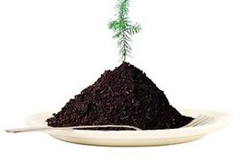
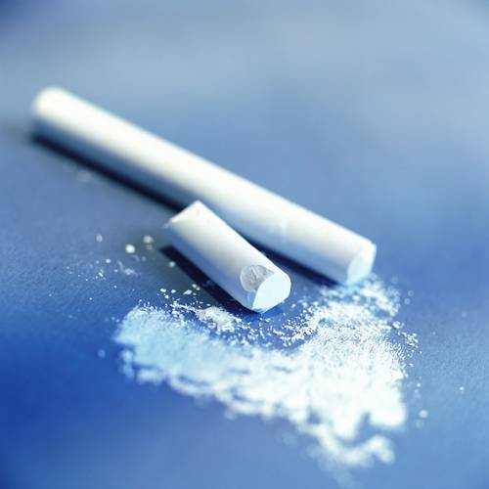
The word pica comes from the Latin word magpie which is a bird that will eat anything on whatever it finds or comes across.

Slide 7

Types of Pica
Amylophagia (consumption of starch and paste)
Coprophagia (consumption of excrement)
Geophagy (consumption of soil, clay, or chalk)
Consumption of dust or sand has been reported among iron deficient patients.
Hematophagy (ingestion of blood)
Hyalophagia (consumption of glass)
Pagophagia (pathological consumption of ice)
Self-cannibalism (rare condition where body parts may be consumed
Trichophagia (consumption of hair or wool)
Urophagia (consumption of urine)
Xylophagia (consumption of wood)
Cautopyreiophagia (ingestion of burnt match heads).

Slide 8

Commonly
Pica commonly occurs in pregnant women who are:
- experiencing their first pregnancy
- have a history of pica in their family
- under the age of 20
- have suffered from pica as a child

Slide 9
Causes
While the exact cause for pica is still uncertain,
Nutritional Deficiency One of the theories for the cause of pica in pregnant women is they have a mineral deficiency and their bodies crave substances that contain that mineral. There is no research that supports this theory, Still, the link between what body needs and what crave seems weak.
Cultural Factors: Cultural factors do play a role in some cases of pica. Pica is accepted in some cultures as a way of increasing spirituality or treating certain physical illnesses, like morning sickness.
Psychological Reasons: Mental illness or psychological trauma can trigger pica in some people. Pica is often a hallmark of extreme stress, fear, or abuse
Factors such as emotional deprivation, poverty, poor nutrition, anemia, neglect, lack of parental supervision, or developmental delay increase the risk for a person developing this eating disorder

Slide 10

Symptoms
Craving and eating non-food substances Or Non-nutritive items

Slide 11
Associated With
pica practices are associated with significantly lower maternal hemoglobin levels at delivery but are not associated with pregnancy outcomes. Dietitians should ask pregnant women with anemia about pica and should counsel women who report pica regarding the health risks associated with it.

Slide 12
Lab Studies
No specific laboratory studies are indicated in the evaluation of pica.
Laboratory studies may be indicated to assess the consequences of pica, depending on the characteristics and nature of the ingested materials and the resultant medical sequelae
Various imaging studies may be used to identify ingested materials and aid in the management of GI tract complications of pica. These may include the following:
Abdominal radiographs
Upper and lower GI barium examinations
Repeated imaging at regular intervals to track changes in location of ingested materials
Upper GI endoscopy to diagnosis bezoar formation, identify associated lesions, or both

Slide 13

Dangers of Pica
Though pica is common and often harmless, it can be very dangerous.
The nature and amount of the ingested substance determine the medical sequelae.
Pica can cause a number of serious conditions including iron-deficiency anaemia
Pica has been shown to be a predisposing factor in accidental ingestion of poisons, particularly in lead poisoning.
The ingestion of bizarre or unusual substances also has resulted in other potentially life-threatening toxicities, such as hyperkalemia following cautopyreiophagia (ingestion of burnt match heads).
Exposure to infectious agents via ingestion of contaminated substances is another potential health hazard associated with pica, the nature of which varies with the content of the ingested material. In particular, geophagia (soil or clay ingestion) has been associated with soil-borne parasitic infections, such as toxoplasmosis and toxocariasis.
Gastrointestinal (GI) tract complications, including mechanical bowel problems, constipation, ulcerations, perforations, and intestinal obstructions, have resulted from pica.
Eating non-food items can actually prevent body from absorbing the proper minerals and nutrients. This could mean that baby is not receiving the proper nutrition, increasing the risk for a variety of complications, including low birth weight, preterm labor, and stillbirth

Slide 14
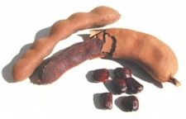
Prevention
There are no known methods of preventing pica. However, once pica is known or suspected, measures can be taken to reduce further ingestion of non-food substances.
Removing the particular substance from readily accessible areas can be helpful.
Close observation of the individual with pica may limit inappropriate eating behaviors

Slide 15
Treatment
Treatment emphasizes psychosocial, environmental, and family guidance approaches.
Treatment of pica will often depend on the cause and type of pica.
Conventional medical treatment may be appropriate in certain situations. For example, supplementation with iron-containing vitamins has been shown to cause the unusual cravings to subside in some iron-deficient patients.
Medical complications and health threats, including high lead levels, bowel perforation or intestinal obstruction, will require additional medical management, beyond addressing the underlying issue of pica.
behavior therapy , Treatment options include:
- discrimination training between edible and nonedible items,
- self-protection devices that prohibit placement of objects in the mouth
- sensory reinforcement involving screening (covering eyes briefly), contingent aversive oral taste (lemon), contingent aversive smell sensation (ammonia), contingent aversive physical sensation (water mist),
- brief physical restraint, and overcorrection (correct the environment, or practice appropriate or alternative responses).
Medications may be helpful in reducing the abnormal eating behavior if pica occurs in the course of a developmental disorder, such as mental retardation or pervasive developmental disorder. These conditions may be associated with severe behavioral disturbances, including pica. These medications enhance dopaminergic functioning, which is believed to be associated with the occurrence of pica.

Slide 16

Prognosis
The prognosis for individuals with pica varies greatly,
according to the type and amount of substance ingested, the extent of presenting side effects, and the success of treatment.
Pica frequently spontaneously remits in young children and pregnant women; however, it may persist for years if untreated, especially in individuals with mental retardation and developmental disabilities.
Many of the side effects and complications of pica can be reversed once the behavior is stopped,
while other complications, including infection and bowel perforation, pose significant health threats and if not successfully treated may result in death.

