Slide 1

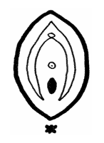
Plastic Surgery of Vulva and Vagina
Dr Muhammad El Hennawy
Ob/gyn Consultant
Rass El Barr Central Hospital and
Dumyat Specialised Hospital
د / محمد محمد الحناوى
www. Mmhennawy.co.nr

Slide 2
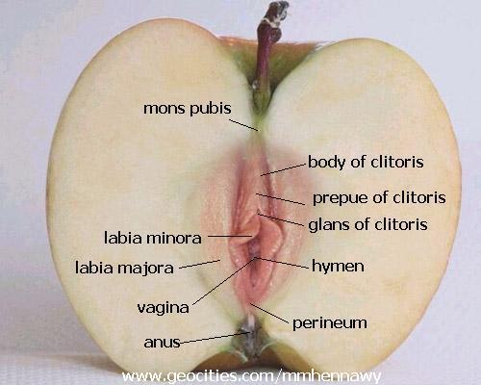
I decided to write about the plastic surgery of vulva
and vagina in short after a patient came to me
for examination of her vaginal discharge
After I examine her for vaginal discharge
She asked me what is the type of her hymen, if vulva is in good appearance and if her vagina is wide or normal
I can not answer
because I was interested
in examination of discharge
And I notice that most of
GYNECOLOGIST are like me
So , I decide to introduce
this short notes in this subject

Slide 3
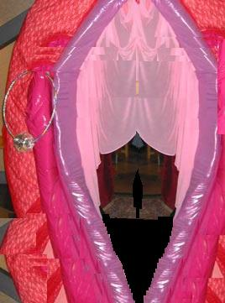
Why do plastic surgery ?
discomfort with wearing certain clothing,
performing certain exercises, or during sex.
abnormal appearance and this can lead to self-consciousness. And uncomfortable with their vulva shape
Sexual complaint (wide or stenosed or absent vagina, redundant or stenosed prepuce, enlarged clitoris)
Ambiguous vulva ( Hermaphroditism )
Psychological (Transsexual Surgery ) not in Islamic countries

Slide 4
Mons pubis | - thick pubic fat pad
Prepuce of clitoris | - Redundant prepuce - Stenosed prepuce - Chronic Inflammation of prepuce
Clitoris | - Clitoromegaly - Enlarged glans
Labia minora | - Enlarged Labia Small Labia fused labia
Labia majora | - Enlarged Labia Small Labia
Hymen | - Imperforate Hymen - Rigid Hymen - Torn Hymen
- Vagina | - Absent Vagina - Dilated Vaginal Orifice - Stenosed Vaginal Orifice
Perineum | - relaxed or aging perineum or torn perineum - episiotomy scars

Slide 5
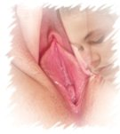
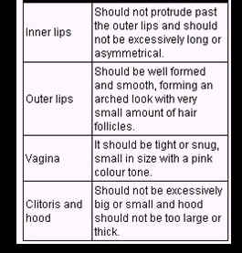
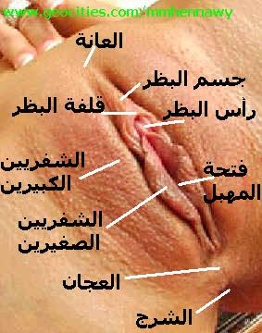
Aim of Our Surgery to reach to Ideal Vulva and Vagina

Slide 6
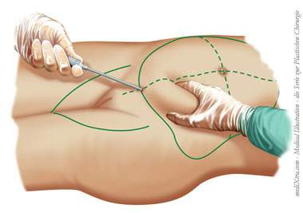
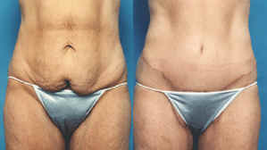
pubis
thick pubic fat pad
reduced by liposuction of pubis + or- lower abdomen

Slide 7
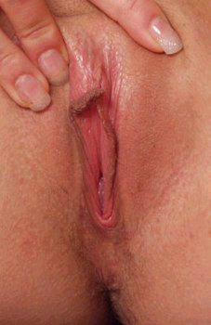

Prepuce Of Clitoris
Chronic Inflammation of prepuce | Stenosed prepuce | Redundant prepuce

Slide 8
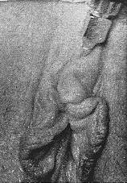
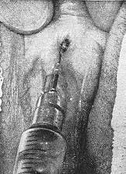
Anesthesia of Prepuce
Allow two weeks before the next menstrual period.
Give 3/4 gr. seconal one-half hour prior to surgery.
Trilene inhalation makes the injection of 2 per cent Xylocaine or Nesacaine less painful.
Most of the injection for adequate anesthesia can be made from one point, starting at the mid-line, about one inch anterior to the edge of the prepuce. The first injection is made three-eighths inch deep, to each side of the clitoris Without removing the needle from the skin, the anesthetic is then injected subcutaneously to the base of the lateral attachment of the prepuce. The needle is then removed and injections are directed cephalad, as close as possible to the sides of the clitoris This latter injection reduces the discomfort of separating the phimosis. The clitoris itself is not injected.
Site of entry for the first four injections | Injecting close to each side of clitoris. Site of clitoris marked with dye

Slide 9
Clitoral De-Hooding
Stenosed prepuce -- preputiotomy
Chronic Inflammation of prepuce
-- preputiectomy
Redundant prepuce -- preputiectomy

Slide 10
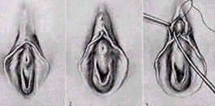
preputiotomy
Grasp the hood in the center with a pointed hemostat;
lift it up from the clitoris and, with scissors, cut
With a No. 0 plain catgut suture, take a stitches uniting the under mucous membrane to the outer skin
put a drop of flexible collodion on the clitoris, holding the hood up until it dries.
It will then require no further attention
When strong adhesions have been broken up, it will be necessary to slide the hood up each day to prevent their reforming.

Slide 11
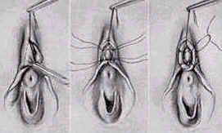
Preputiectomy
If very redundant, it will require a large piece cutting a V-shaped piece from the hood over the center of the clitoris.
Grasp the hood in the center with a pointed hemostat; lift it up from the clitoris and,
with scissors, cut each side of the forceps, the cuts meeting above the point of the forceps, taking out a V from the hood.
With a No. 0 plain catgut suture, take a stitch in the point of the V, uniting the under mucous membrane to the outer skin, just as in circumcision in the male.
Usually an additional stitch will be required on either side to join the skin and mucous membrane.
When strong adhesions have been broken up, it will be necessary to slide the hood up each day to prevent their reforming.
What is preferable is to put a drop of flexible collodion on the clitoris, holding the hood up until it dries. It will then require no further attention

Slide 12
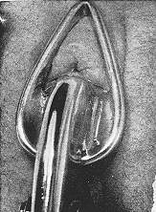
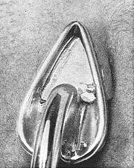
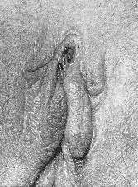
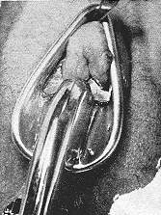
Preputiectomy (another method)
Site of entry for the first four injections | Injecting close to each side of clitoris. Site of clitoris marked with dye | Phimosis freed, redundant prepuce clamped four or five minutes. | Excision, prepuce within clamp | Appearance before removing clamp | Clamp removed. Compare with Figure 5.

Slide 13
Female Islamic Circumcision
( Preputiectomy or preputiotomy)
clitoral hood removed
(female circumcision) to improve sensitivity and cleanliness
The sensitivity in The glans clitoris is increased also ability to orgasm has increased.

Slide 14
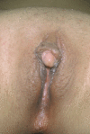
Clitoris Enlargement
Clitoral hypertrophy is usually seen in
congenital malformations,
specifically in intersexual stages
of hormonal expression
Acquired clitoral hypertrophy
is a relatively rare condition
The first step in correcting acquired clitoral enlargement
must be to determine and stop the cause
of the hypertrophy,
followed by a period of simple observation.
If clitoral enlargement does not disappear over time,
surgical correction is necessary.

Slide 15
TYPES OF CLITORAL SURGERY
There are three main groups of plastic clitoral procedures
complete Clitorectomy or Clitoral Amputation
This operation simply removes all that can be seen of the clitoris (i.e. all of the glans clitoris),
Clitoral Recession
the clitoral structures are dissected out and then folded up and moved in their entirety, backwards under the symphysis pubis.
Clitoral Reduction (Clitoroplasty ) Clitoral shaft resection
the glans clitoris is preserved, and the corpora are dissected and partially or totally removed. Most procedures today will identify the two dorsal clitoral nerves and maintain their connection to the clitoral glans.
. Reduction of Glans
the clitoral glans will be reduced in size by wedge excisions, either laterally, ventrally or dorsally.

Slide 16
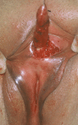
Reduction Clitoroplasty with preservation of neurovascular pedicles
Clitoral reduction was done through a semicircular incision in the phallus, with preservation of dorsal and ventral neurovascular pedicles
A traction suture of 3/0 nylon was placed in the glans of clitoris
An incision was made on the lateral phallus perpendicular to the axis of the clitoral shaft, and carried through a 270 degree semicircular arc to the base of the glans
Two longitudinal incisions were made lateral to the dorsal neurovascular bundle.
total mobilization of the neurovascular bundles (NVB) through parallel ventral midline incisions of Buck’s fascia,
no reduction or excision of the glans clitoris,
irrigation of the NVB with papaverine and
clamped and the mid-body of the clitoris was resected. subtotal excision of 2 the corpus cavernosal tissue
The base of the glans was sutured to the divided corpora with 4/0 vicryl, and proximal and distal ends of the corpora were closed with 4/0 vicryl.
The skin was closed with 4/0 vicryl sutures as well.
Sometimes the clitoral glans will be reduced in size by wedge excisions, either laterally, ventrally or dorsally
Patients were followed up
There was no early or late post-operative complication.
Sensation was normal and patients were satisfied with the aesthetical and functional results.

Slide 17
Reduction of Glans
the clitoral glans will be reduced in size by
wedge excisions, either
laterally,
ventrally
or dorsally.

Slide 18
Labia Minora
LABIA REMODELLING
A – Enlarged Labia minora --- to reduce and reshape the labia minora to a thinner and more comfortable shape and appearance
B – Small Labia minora
C – Fused Labia minora

Slide 19
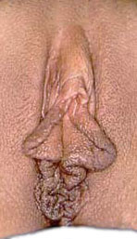
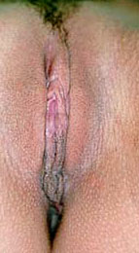
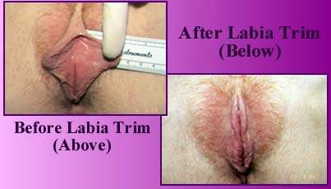
,labial reduction surgery (labiaplasty,
Reduction Labioplasty, Labia Trim)
This condition, whether inherited or a result of childbirth, for women with enlarged, hypertrophic, or asymmetrical labia minora.
Some women are uncomfortable with their enlarged labia minora which can lead to discomfort with wearing certain clothing, performing certain exercises, or during sex.
The enlarged labia can have a protuberant and abnormal appearance to some, and this can lead to self-consciousness.
TTT by a special reconstructive plastic surgical technique to reduce the large or uneven labia minora
Labia reduction: Most patients are happy after simple removal of the redundant labia.
Labioplasty: A more complicated technique preserves some of the outer, dark brown skin, by removing more of the internal skin

Slide 20
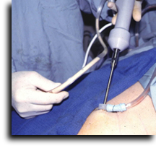
Augmentation Labioplasty
The procedure usually requires sedation and always requires local anesthesia.
The fat is removed by using a fine liposuction cannula from some other area of the body (usually the abdomen, thigh or hip)
then reinjecting (Fat injections) it to TTT Loss of fullness of the labia minora or by insertion of various graft materials .
usually create a significant amount of swelling, which subsides within a week to 10 days.

Slide 21
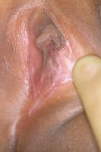
labial adhesion (fused labia).
Not to be confused with imperforate hymen
They are not congenital and result from labial agglutination due to inflammation
a - Small areas of labial adhesions can be managed expectantly.
b - Extensive labial adhesions or those associated with such symptoms as recurrent urinary tract infections can be managed easily using the topical application of estrogen cream for 2-6 weeks.
c -thick adhesions--- Separation under general anesthesia in an operative setting may be required.
d -The thick adhesions that result from female genital mutilation may require surgical separation and management by a gynecologist with experience in managing female genital mutilation.
Labial adhesions may be confused with posterior labial fusion encountered in persons with congenital adrenal hyperplasia and may be differentiated by careful physical examination with attention to the presence or absence of clitoromegaly.

Slide 22
Labia Majora
Remodeling of labia majora
A - Augmentation Labioplasty
B - Reduction Labioplasty

Slide 23
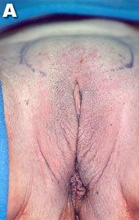
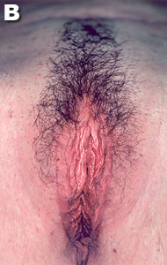
Augmentation Labioplasty
Loss of fullness of the labia majora can be corrected by fat injections or by insertion of various graft materials

Slide 24
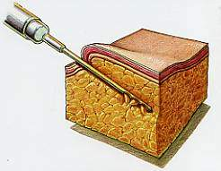
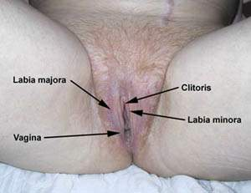
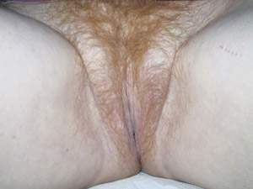
Reduction Labioplasty
for women with enlarged, hypertrophic, or asymmetrical labia majora
Some women are uncomfortable with their enlarged labia majora which can lead to discomfort during sex.
The enlarged labia can have a protuberant and abnormal appearance to some, and this can lead to self-consciousness.
TTT by a special reconstructive plastic surgical technique to reduce the large or uneven labia majora
A -If a woman has excessively large labia majora due to an excess of skin, this excess skin can be removed without leaving a visible scar
B -If a woman has excessively large labia majora due to an excess of skin and excess fat after Liposculpting which can alleviate the unsightly fatty bulges of this area and produce an aesthetically pleasing contour, excess skin can be removed without leaving a visible scar

Slide 25
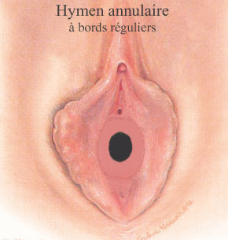
Hymen
Imperforate Hymen
Rigid Hymen
Torn Hymen

Slide 26
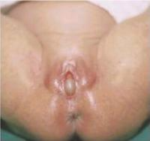
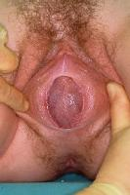
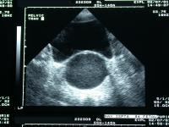
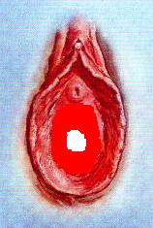
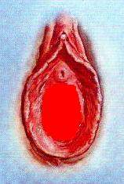
Imperforate Hymen
Most cases of imperforate hymen are congenital due to failure of degeneration of central epithelial cells of the hymenal membrane.
The diagnosis of an imperforate hymen
a - during routine neonatal and pediatric examinations;
b - a teenager present with the typical picture of primary amenorrhea, cyclic or acyclic pelvic pain, bulging hymen, and hematocolpos. Hematometra does not usually develop with simple imperforate hymen because the vagina has great distensibility and can accommodate a large amount of blood..
Treatment
The surgical therapy consists of hymenotomy then the central part of the hymen should also be excised
(partial hymenectomy).

Slide 27
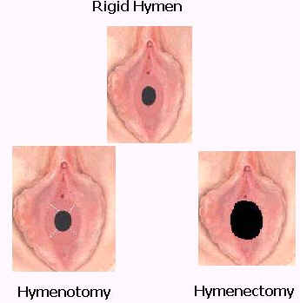
Rigid Hymen

Slide 28
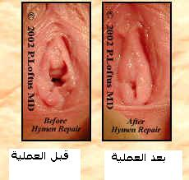
Hymen Reconstruction ,
, hymen repair surgery ,hymenoplasty hymenorrhaphy
Torn Hymen
can repair the hymen as if nothing happened

Slide 29
Types of surgery
if it is not too damaged (surgical repair )
-- piecing together its remnants
when the hymenal remnants are insufficient
-- stitch across hymen
-- Cerclage around hymenal ring by thread from underwear of wedding night
-- approximates undermined hymen remnants
-- approximates a flap from the vaginal wall across the opening
-- Alloplant for hymenoplasty

Slide 30
Vagina
Absent Vagina
Dilated Vaginal Orifice
Stenosed Vaginal Orifice

Slide 31
( Absent Vagina) Vaginal agenesis
A -Partial vaginal agenesis is more rare and is characterized by a normal uterus and small vaginal pouch distal to the cervix.
B -Complete vaginal agenesis (MRKH syndrome) is more common and is characterized by congenital absence of the vagina and the uterus in 90-95% of cases
Neovaginal Construction
A -the McIndoe procedure Each procedure involves developing a space between the bladder and the rectum.
A stent covered by a split-thickness skin graft is placed in the freshly dissected space to ensure its patency while healing.
Other tissues used for the graft include the large and small intestine, human amnion, peritoneum, and myocutaneous flaps
. B -The Williams vulvovaginoplasty It uses full-thickness skin flaps from the labia majora to create a vaginal pouch which axis is directly posterior and horizontal to the perineum; however, the vagina is functional and well received by patients

Slide 32
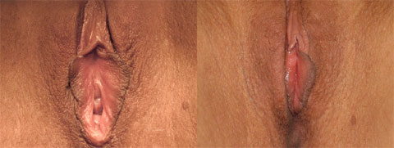
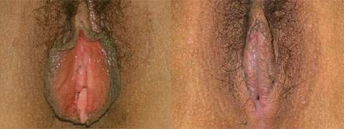
Dilated Vaginal Orifice
vaginal rejuvenation (vaginoplasty or colporrhaphy) for patients with vaginal looseness involves the tightening of the vaginal muscles and support tissues, as well as the reduction of redundant vaginal mucosa (relaxed vaginal lining).
By reconstructing the “optimum structural architecture” of the vagina -- namely, by reconstructing the outer third of the vagina: the orgasmic platform, internal and external vaginal diameter (introitus) and the perineal body

Slide 33
Symptoms of Dilated Vaginal Orifice
Women suffering from an embarrassing inadequacy of being big and loose, usually experience one or all of the following symptoms ..
• The inability to grip her index finger with her vagina
• The feeling of just being big and looking big
• her vagina emits a lot of odor
• her vagina does not close completely during the non-aroused state
• Being able to insert 3 or more fingers into her vagina with little to no resistance
• The inability to reach orgasm during coitus
• The inability to satisfy her partner and provide proper stimulation to him

Slide 34
Stenosed Vaginal Orifice
This is mainly acquired
after vaginal surgery ( posterior colpoperineuraphy) Or
after menopause
TTT -- mainly by E therapy
-- Or Vaginal Dilators
If failed --- widening the vaginal orifice is done

Slide 35
perineum
relaxed or aging perineum
Or torn perineum
Surgical Perineoplasty
It can also enhance the sagging labia majora and labia minora to provide a youthful and aesthetically appealing vagina

Slide 36
Episiotomy scars
episiotomy scars can all be surgically refined

Slide 37
Combined Operations

Slide 38
Pubic Liposculpting
Vulvar Lipoplasty removes unwanted fat from the mons pubis (mons pubis) and upper parts of the labia majora.
Liposculpting can alleviate the unsightly fatty bulges of this area and produce an aesthetically pleasing contour

Slide 39
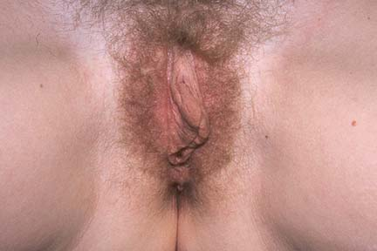
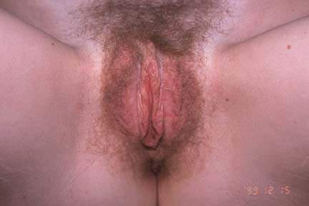
LABIA MINORA REDUCTION AND CLITORAL UNHOODING

Slide 40
VULVA ENHANCEMENT
The surgical procedures and results are tailored on an individual basis to meet the patient's desires.
this consists of clitoral de-hooding, labia majora and or labia minora reduction and episiotomy scar revision with or without vaginal tightening.
The labia majora can be increased with fat injections and a thick pubic fat pad reduced by liposuction. Plastic surgery of the vulva is being considered by women of all ages whether or not they have had children.

Slide 41
reconstruction genital External
Deformities of the external genitalia
from cancer surgery
female genital mutilation
or other causes are not uncommon
Reconstruction with major improvement is possible for many of these deformities
Each case is evaluated and treatment individually determined
Plastic surgical techniques are applied to solve these problems

Slide 42
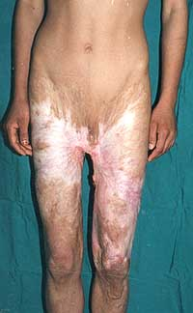
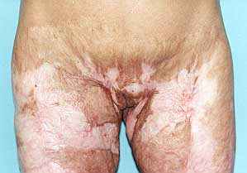
RECONSTRUCTION OF VULVA IN A FEMALE PATIENT HAVING LONGSTANDING GENITAL BURN CONTRACTURE WITH SEVERE WEB AND MARJOLIN'S ULCER

Slide 43
Intersex
Intersex refers to a variety of patients with different genital deformities such as hermaphrodites, pseudohermaphrodites, and inadequate genitalia.
there is the situation where at birth a baby has genitals that are 'ambiguous' (i.e. not typical of either of the two currently recognized sexes) such that questions arise about the appropriate sex of rearing and about whether surgery should be employed to reinforce the chosen gender,
and secondly there is the situation where the child is clearly at the female end of the male/female continuum of genital appearance but has a larger than average clitoris.
Reconstruction to create normal functioning genitalia is performed using many different techniques.

Slide 44
Transsexual Surgery
Gender reassignment
-Male to female
-Female to male
sex reassignment surgery, sex change surgery is a procedure that changes genital organs from one gender to another
Once the psychiatrist has certified surgery can be undertaken
Not accepted in Islamic Country

Slide 45
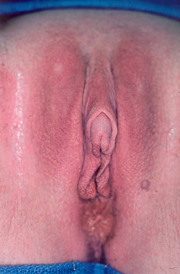
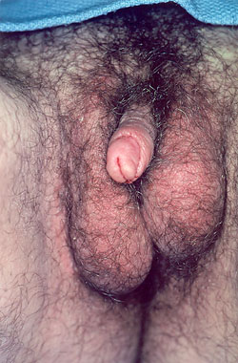
Female To male Gender
Reassignment

Slide 46
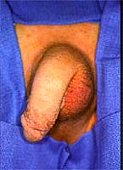
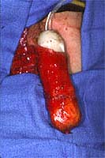
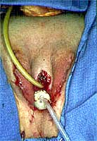
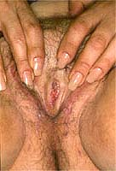
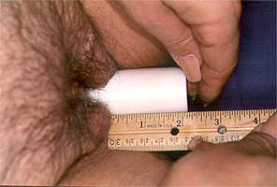

Male To Female Gender Reassignment
Reassignment
the construction
of a cosmetically
acceptable vulva

Slide 47

female genital cutting
(FGM)
Female Genital Mutilation
(FC)
Female circumcision
For medical
reasons
Female Genital
Cosmetic Surgery
Type 1
Type 2
Type 3
Transsexual Surgery

