Slide 1
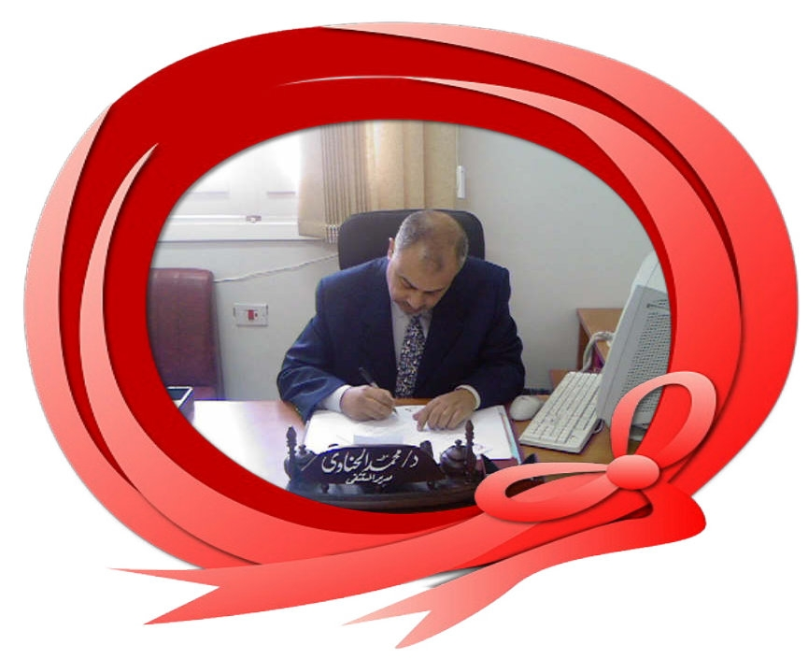

PostOperative
Chewing
Gum
Dr Muhammad El Hennawy
Ob/gyn Consultant
59 Street - Rass el barr –dumyat - egypt
www.mmhennawy.co.nr
Mobile 0122503011

Slide 2
Gum chewing will kickstart bowel function
after abdominal surgery
and possibly reduce hospital stay as well

Slide 3
Ileus is the absence of intestinal peristalsis without mechanical obstruction;
postoperative ileus refers to the time after surgery before coordinated electromotor bowel function resumes.

Slide 4
The small bowel normally resumes activity several hours after surgery,
The stomach 24 to 48 hours after surgery, and
The colon 3 to 5 days after surgery.
When postoperative ileus persists longer than this, it can be considered pathologic and is sometimes called paralytic ileus

Slide 5
Recovery of gastrointestinal function after gastrointestinal surgery is clinically important because paralytic ileus may contribute pain, nausea, vomiting, and pulmonary dysfunction.
Food intake has been reported to stimulate bowel motility. Gum-chewing is postulated to work because it mimics food intake, i.e. sham feeding

Slide 6
Patients
Pregnant women delivered by elective caesarean section (CS) under general anaesthesia.
Women undergone gynecologic surgery under general anaesthesia

Slide 7
Dose
patients chew sugarless gum for
a period ranging from five to 45 ( 30 ) minutes three times a day after surgery
Or for 15 minutes starting two hours after end of operation
every two hours thereafter
(during waking time, stopped during overnight sleep)
until the hearing normal intestinal sounds or the passage of flatus or the passage of bowel movement

Slide 8

Evaluation
All patients were evaluated hourly after surgery
by the same resident physicians,
who precisely recorded times of first bowel sounds,
first flatus and
first defecation

Slide 9
Fluid And Diet
They had oral intake of clear fluids allowed after hearing of normal intestinal sounds or the passage of flatus
They had regular diet with the passage of flatus or the passage of bowel movement .

Slide 10
For analgesia
Two intramuscular doses of 75 mg diclofenac sodium , a nonsteroidal anti-inflammatory medication, will be routinely given at 2 and 12 hours post-operatively.
The need for additional use of narcotics (pethidine, 1 mg/kg) will be recorded.

Slide 11
Time to first hearing of normal intestinal sounds (10.9 ± 2.7 versus control 15.6 ± 3.7 hours),
Time to first passage of flatus (17.9 ± 4.6 versus control 24.4 ± 7.1 hours),
Time to first defecation (21.1 ± 4.7 versus control 30 ± 8.2 hours) , and
Time to first tolerated oral feeding
Time to discharge from the hospital (40.8 ± 10.6 versus control 50.5 ± 8.9 hours ( The potential cost savings from the reduction of even one postoperative day compared with the cost of several sticks of chewing gum are huge )

Slide 12
How ?
Gum chewing acts as "sham feeding“
To stimulates gastric, duodenal and rectal motility
To produce saliva and pancreatic secretions and
To trigger gastrointestinal hormone release and
To trigger cephalic-vagal stimula
While avoiding the complications observed with early oral feeding

Slide 13
Conclusion
Gum chewing after abdominal operations is
Safe,
Well tolerated, and
Associated with rapid resumption of intestinal motility and
Shorter hospital stay;
With potential impact on reducing the overall healthcare costs in case of routine implementation

