Slide 1

Premenstrual Changes
(PMCs)
Dr Muhammad El Hennawy
Ob/gyn Consultant
Rass el barr - Dumyatt – EGYPT
www. mmhennawy.co.nr

Slide 2
PMCs (Premenstrual Changes) are a budding issue having both the psychiatry and gynecology-related symptoms with adverse social consequences.

Slide 3
PMCs (Premenstrual Changes) are a common cyclic affective disorder of young and middle-aged occuring in the luteal phase.
PMCs range from mild mood fluctuations, called Premenstrual Syndrome (PMS) to severe mental and physical disturbances, called Premenstrual Dysphoric Disorder (PMDD).
The exact aetiology of PMCs is largely under-explored.
Its diagnosis and management are often difficult.

Slide 4
Incidence
Premenstrual syndrome and premenstrual dysphoric disorder are diagnoses of exclusion; therefore, alternative explanations for symptoms must be considered before either diagnosis is made
Milder symptoms are believed to occur in about 30% to 80% of reproductive-age women, while severe symptoms are estimated to occur in 3% to 5% of menstruating women.

Slide 5
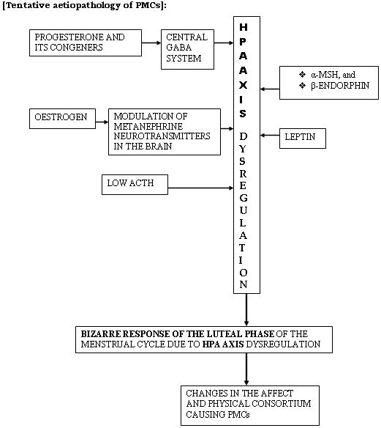
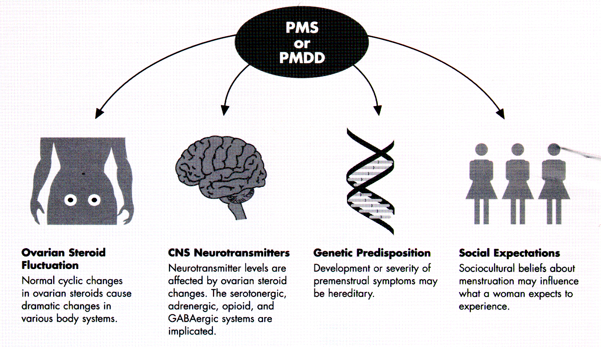
Aetiology

Slide 6
Cerebral serotonin neurotransmitter system (5-HTs) is an important component, involved in a large number of psychiatric illnesses where the affect is disturbed.
PMDD is another extreme reflection of the affective disturbances. Therefore, it is interesting to note whether 5-HTs play any role in the development of PMCs. Studies have shown that post-synaptic serotonergic response possibly is disturbed during the late-luteal-premenstrual phase of the MC or even throughout the cycle in those who have severe vulnerability trait
Though the gonadal hormone (oestrogen and progesterone)-induced modulation of 5-HTs is a known fact at the backdrop of schizophrenia
, in PMCs, differential effects in the cerebral 5-HTs due to differential hormonal changes in the MC

Slide 7
Diagnosis
Screening of patients could easily be done by asking the patients to maintain regular menstrual diary for at least two consecutive cycles to note the target symptoms.

Slide 8


Slide 9
Diagnostic Criteria for Premenstrual Syndrome
National Institute of Mental Health
A 30% increase in the intensity of symptoms of premenstrual syndrome (measured using a standardized instrument) from cycle days 5 to 10 as compared with the six-day interval before the onset of menses and Documentation of these changes in a daily symptom diary for at least two consecutive cycles
University of California at San Diego
At least one of the following affective and somatic symptoms during the five days before menses in each of the three previous cycles:
  Affective symptoms: depression, angry outbursts, irritability, anxiety, confusion, social withdrawal
  Somatic symptoms: breast tenderness, abdominal bloating, headache, swelling of extremities
  Symptoms relieved from days 4 through 13 of the menstrual cycle

Slide 10
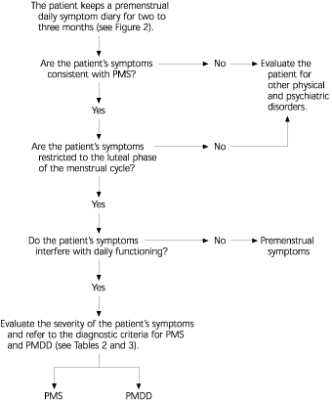

Slide 11
Common Symptoms of PMS
Women with PMS
Symptom Showing Symptoms (%)
Behavioral
Fatigue 92
Irritability 91
Labile mood with alternating
sadness and anger 81
Depression 80
Oversensitivity 69
Crying spells 65
Social withdrawal 65
Forgetfulness 56
Difficulty concentrating 47

Slide 12
Common Symptoms of PMS
(Continued)
Physical
Abdominal bloating 90
Breast tenderness 85
Acne 71
Appetite changes and
food cravings 70
Swelling of the extremities 67
Headache 60
Gastrointestinal upset 48

Slide 13
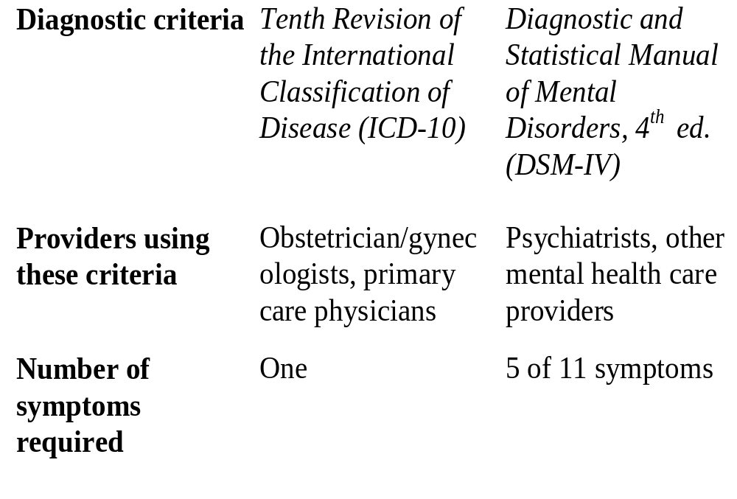
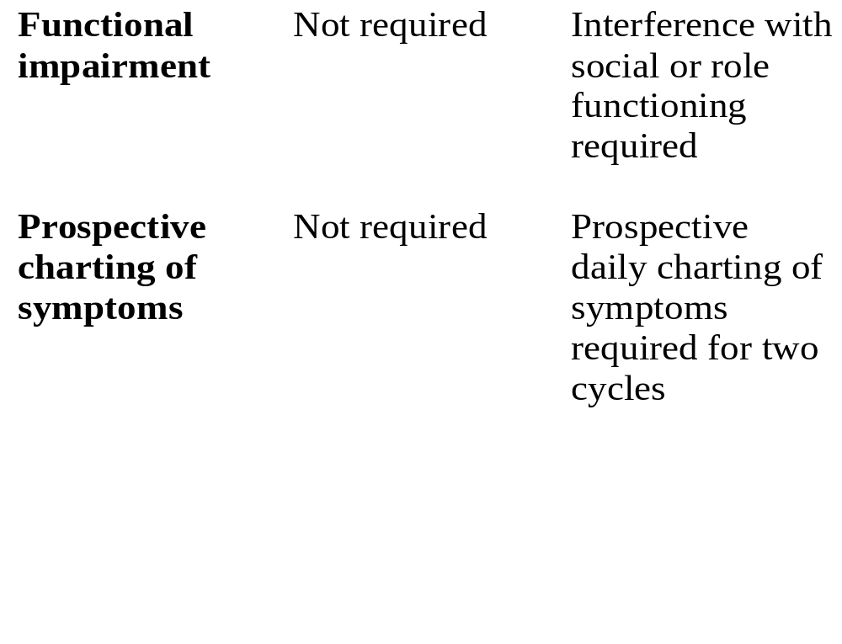
Differences Between PMS and PMDD

Slide 14
Patterns of PMS
Premenstrual symptoms can begin at ovulation with gradual worsening of symptoms during the luteal phase (pattern 1).
PMS can begin during the second week of the luteal phase (pattern 2).
Some women experience a brief, time-limited episode of symptoms at ovulation, followed by symptom-free days and a recurrence of premenstrual symptoms late in the luteal phase (pattern 3).
The most severely affected women have symptoms that at ovulation worsen across the luteal phase and remit only after menses cease (pattern 4). These women describe having only one week a month that is symptom-free.

Slide 15
Differential Diagnosis
Psychiatric disorders
Major depression
Dysthymia
Generalized anxiety
Panic disorder
Bipolar illness (mood irritability)
Other
Medical disorders
Anemia
Autoimmune disorders
Hypothyroidism
Diabetes
Seizure disorders
Endometriosis
Chronic fatigue syndrome
Collagen vascular disease

Slide 16
Differential Diagnosis
(Continued)
Premenstrual exacerbation
Of psychiatric disorders
Of seizure disorders
Of endocrine disorders
Of cancer
Of systemic lupus erythematosus
Of anemia
Of endometriosis
Psychosocial spectrum
Past history of sexual abuse
Past, present, or current domestic violence

Slide 17
Management protocol
Management of PMCs is often extremely difficult
Patients qualified for PMCs could be rated for the symptoms severity under the three-point scale:
mild, moderate and severe.
According to the symptom rating, the guidelines for the management of PMCs could be adopted as follows

Slide 18
A. Life style modification including counseling or behavioral psychotherapy for coping up with the symptoms when the symptoms are mild, and
B. Pharmacotherapy when the symptoms, although mild, are not been tackled by simple life style modification or counseling and psychotherapy or the symptoms are moderate to severe and incapacitating.

Slide 19
Strategies to cope up PMCs by modifying life styles:
Doctors often prescribe/advice the followings for their patients with mild PMCs as the first-line of management:
Prohibition for caffeine, refined sugars, and crude salt intake,
Avoiding alcohol and related beverages
Regular exercise, especially isotonic
Increase carbohydrate intake in the diet , and
Cognitive-behavioral psychotherapy, if required

Slide 20
Though the role of these are quite under tested, the reasons for such age-old prescriptions are probably continuing due to the other benefits and safety
. If these are found to be ineffective or inadequate, or the symptoms are severe, pharmacotherapy remains the mainstay of the treatment

Slide 21
Strategies for opting for the pharamacological agents
Vitamins and minerals as dietary supplements,
Psychopharmacologiucal drugs, and
Hormonal agents:
Vitamins and minerals

Slide 22
Treatment of PMS
NOT EFFECTIVE
Progesterone , Pyridoxine, Bromocriptine, Combination Oral contraceptives (OCPs)
POSSIBLY EFFECTIVE
Diet , Aerobic exercise , Psychological approaches, Magnesium , Evening Primrose Oil , Vitamin E , Spironolactone , Non Steroidal Anti-inflammatories ,) Ovulation Suppression
EFFECTIVE
Calcium , Selective Serotonin Reuptake Inhibitors
NATURAL THERAPIES
Black Cohosh , Borage Seed oil , Dandelion , Dong Quai

Slide 23
NOT EFFECTIVE

Slide 24
Progesterone
The role of Progesterone in the treatment of PMS probably arose from the theory that the syndrome is caused from a lack of progesterone which was popular back in the 1950s up until the 1980s.
Treatment with high doses of "natural" progesterone vaginally became popular in the 1970s after the publication of a large number of case reports in the lay press,
none of which had any true control groups. Since then, several randomised-controlled trials have failed to show any benefit from topical or oral micronized progesterone over placebo Topical progesterone preparations are also expensive. Given the lack of efficacy and the expense of the product, Progesterone can not be recommended as a treatment of PMS.

Slide 25
Pyridoxine vitamin B(6)
Pyridoxine or vitamin B6 is the most widely used supplement used to treat PMS.
It has been proposed that vitamin B6 may help to correct a "deficiency" in the hypothalamic pituitary axis. Vitamin B6 is a cofactor in the synthesis of tryptophan and tyrosine, which are the precursors of serotonin and dopamine respectively. Theoretically, low levels of vitamin B6 may lead to high levels of prolactin which in turn could underlay the edema and psychological symptoms associated with PMS.

Slide 26
it would appear that there is very limited evidencve to support the generalized use of vitamin B6 for the treatment of PMS.
Vitamin B6 can also cause significant toxicity and unpleasant side effects. It can produce a progressive sensory ataxia taken at doses as low as 500 mg. a day and can also cause a number of gastrointestinal side effects, particularly nausea.
Consequently, given the lack of clear scientific evidence for its effectiveness, and the associated risks of treatment, vitamin B6 can not generally be recommended as a treatment for PMS.

Slide 27
Bromocriptine
Another theory that was popular in the 1970s was that PMS was caused by increased levels of, or an increased sensitivity to, Prolactin.
Bromocriptine is expensive and has a number of side effects. Consequently its use can not be recommended for the general treatment of PMS
One exception is severe cyclical mastalgia for which Bromocriptine may be effective.

Slide 28
Combination Oral contraceptives
Combination oral contraceptives are also widely used to treat PMS. Despite their popularity,
Consequently, the lack of scientific evidence for their effectiveness along with the associated expense and potential risks,
OCPs can not be recommended for the treatment of PMS

Slide 29
POSSIBLY EFFECTIVE

Slide 30
Diet
Dietary recommendations are commonly recommended to help alleviate the physical and psychological symptoms of PMS.
The most common dietary recommendations are to restrict sugar
and increase the consumption of complex carbohydrates.during the latter half of their cycle may help alleviate some of the psychological symptoms of PMS

Slide 31

Aerobic exercise
Women who have PMS are often encouraged to increase their activity level. It has been hypothesised that exercise; particularly aerobic varieties increase endorphin levels, which in turn improves mood
, it would seem reasonable to recommend an aerobic exercise program to alleviate PMS symptoms

Slide 32
Psychological approaches
various psychological approaches including instruction on
relaxation techniques,
cognitive behavioural strategies
and information giving may all help relieve PMS symptoms.

Slide 33
Magnesium
Studies have found that women who suffer from PMS have lower levels of erythrocyte and monocellular magnesium during their menstrual cycles than women who do not have PMS.
Accordingly, magnesium supplementation has been used as a potential therapy.
It reported less fluid retention .Menstrual cramps, irritability and fatigue, but They did not have any improvement in mood, cramping or food cravings
Magnesium is considered safe at doses up to 483 mg. per day in healthy adults. It must be used with caution, however, in people with significant heart and renal disease

Slide 34
Evening Primrose Oil
Evening Primrose Oil is used extensively to alleviate PMS symptoms. EPO contains two essential fatty acids: linoleic and gamma linoleic acids. It has been hypothesised that women with PMS are deficient in gamma linoleic acid which is necessary for prostaglandin
EPO may be of some benefit to those women with cyclical mastalgia but is probably of limited if any benefit to women who have significant mood and cognitive symptoms

Slide 35
Vitamin E
Vitamin E has been used to treat PMS and general breast tenderness. There have been only a few studies that have addressed this issue.

Slide 36
Spironolactone
Diuretics have been used to treat the fluid retention associated with PMS for over 50 years.
Despite their wide spread use, there is no evidence that the thiazide diuretics are of any benefit. These medications are also associated with significant side effects including hypokalemia, secondary aldosteronism and cyclical edema. Consequently they can not be recommended for the treatment of PMS.

Slide 37
Non Steroidal Anti-inflammatories
There is some evidence that NSAIDS given during the luteal phase does help relieve the physical and affective symptoms of PMS. Mefenamic acid (500 mg. T.I.D.), Naproxen
when administered during the luteal phase of the cycle.

Slide 38
Ovulation Suppression
The use of Danazol and Gonadotrophin Releasing Hormone Agonists to suppress ovulation have been shown to reduce the symptoms of PMS.
The significant side effects associated with these treatments however, makes them generally unacceptable for use in Primary Care..
It is important to appreciate that the synthetic hormones vary in their chemical composition and effects from each other and the natural products. Consequently differences in chemical compositions, even relatively subtle ones, may underly the differences in response to various hormonal treatments including hormonal regimes that have been found to be effective and the OCPs and natural progesterone which have not been found to be effective

Slide 39
EFFECTIVE

Slide 40
Calcium
findings provide good evidence for the effectiveness of calcium carbonate as a treatment for PMS.
Calcium is also relatively inexpensive and plays an important role in the prevention of osteoporosis, therefore it is recommended for the treatment of PMS.

Slide 41
Selective Serotonin Reuptake Inhibitors
PMS has been linked with dysfunctional serotonin metabolism and there is experimental evidence that hormonal fluctuations do affect central serotonin levels
strongly support the effectiveness of SSRIs in the treatment of PMS. Interestingly,
It was found no difference in the effectiveness of continuous compared to intermittent therapy during the luteal phase.
The doses used for PMS also tend to be lower than that used for depression.
Consequently the incidence of side effects tend to be lower as well The use of the SSRIs is not with out its drawbacks. A host of side effects have been reported including headache, nervousness, insomnia, drowsiness, fatigue, sexual dysfunction and gastrointestinal complaints.
The SSRIs are also relatively expensive
Nonetheless given their proven efficacy, they are recommended, particularly for women with severe affective symptoms for whom other measures have not been effective.

Slide 42
The ACOG recommends SSRIs as initial drug therapy in women with severe PMS and PMDD. [Evidence level C, expert/consensus guidelines]
Common side effects of SSRIs include insomnia, drowsiness, fatigue, nausea, nervousness, headache, mild tremor, and sexual dysfunction.
Use of the lowest effective dosage can minimize side effects. Morning dosing can minimize insomnia.
In general, 20 mg of fluoxetine or 50 mg of sertraline taken in the morning is best tolerated and sufficient to improve symptoms.
Benefit has also been demonstrated for the continuous administration of citalopram (Celexa).
alleviating physical and behavioral symptoms, with similar efficacy for continuous and intermittent

Slide 43
SSRIs | Dosage | Recemmendations for use | Side effects
Fluoxetine (Sarafem) | 10 to 20 mg per day | First-choice agents for the treatment of PMDD; at present, only fluoxetine is labeled for this indication. Clearly effective in alleviating behavioral and physical symptoms of PMS and PMDD For intermittent therapy, administer during luteal phase (days before menses). | Insomnia, drowsiness, fatigue, nausea, nervousness, headache, mild tremor, sexual dysfunction
Sertraline (Zoloft) | 50 to 150 mg per day
Paroxetine (Paxil) | 10 to 30 mg per day

Slide 44
NATURAL THERAPIES
Following is a description of some of the more commonly used herbal preparations used to treat PMS. Our current knowledge about these substances is largely based on pharmacological and descriptive data, which significantly limits our ability to draw conclusions about their effectiveness and long term safety.

Slide 45
Black Cohosh
This herbal remedy is derived from the rhizome and root of the plant. Its action is related to the binding of estrogens receptors and suppression of leutinizing hormone although it is not thought to increase the risk for endometrial and breast cancers. It has been rated as "possibly effective" for the treatment of pre-menstrual discomfort. It is likely safe when taken in low doses (0.3 to 2 mg. T.I.D.) for less than six months.
Black Cohosh also contains Salicylic acid and consequently should not be taken by people who should avoid aspirin or who are at risk of bleeding. Similarly, it should be avoided in women in whom estrogen is contraindicated. Overdose of Black Cohosh can cause nausea, vomiting, dizziness, visual disturbance, and decreased heart and respiration rates
Borage Seed oil
Borage seed oil contains 26% gamma linoleic acid and is used as a replacement for evening primrose oil. It is "likely safe" if used orally as directed. Gamma linoleic acid can prolong bleeding time and therefore should be used with caution in people at risk of serious bleeding including those who are taking other medications and herbal products that can prolong bleeding times.

Slide 46
Dandelion
Dandelion is used for a variety of medicinal purposes. It has been shown to have mild diuretic and anti-inflammatory properties in animal studies. It has been rated as "possibly effective" for promoting diuresis and may be of some benefit in treating the fluid retention associated with PMS.
Theoretically dandelion can have hypoglycemic effects and therefore should be used with caution in individuals taking diabetic medications
. Individuals who have environmental allergies to members of the Asteracae family, which includes ragweed, chrysanthemums, marigolds and daisies, should also avoid this herb
Dong Quai
Dong Quai is a commonly used herb used for a variety of gynecological symptoms including PMS. It contains a number of different constituents, which are thought to have vasodilating, antispasmodic, and anti platelet activities.
Dong Quai does have carcinogenic and mutagenic properties and can cause severe photodermatits especially when used in large amounts.
It is rated as "possibly unsafe" by the Natural Medicine Comprehensive Database.
It may also interact with several medications and other herbal remedies

Slide 47
RECOMMENDATIONS

Slide 48
How do we organise the above information into a practical concise set of guidelines for Family Physicians?
The following recommendations are based on interpretation of the strength of evidence for effectiveness of the various therapies, as well as the potential costs, adverse effects and long term risks involved.
The nature of the symptoms was also taken into account. Johnson describes a similar but not identical approach in her very comprehensive review article on the subject

Slide 49
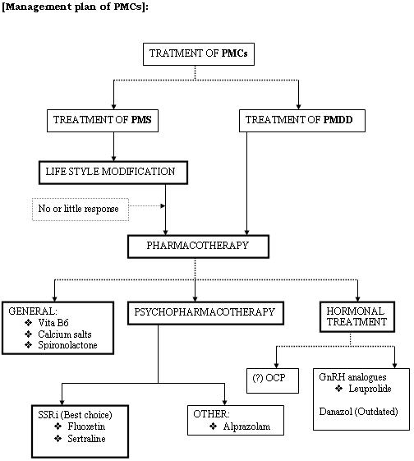

Slide 50
Summary of Management Guidelines
All women with PMS or PMDD
Nonpharmacologic treatment: education, supportive therapy, rest, exercise, dietary modifications
Symptom diary to identify times to implement treatment and to monitor improvement of symptoms
Treatment of specific physical symptoms
Bloating: spironolactone (Aldactone)
Headaches: nonprescription analgesic such as acetaminophen, ibuprofen, or naproxen sodium (Anaprox; also, nonprescription Aleve)
Fatigue and insomnia: instruction on good sleep hygiene and caffeine restriction
Breast tenderness: vitamin E, evening primrose oil, luteal-phase spironolactone, or danazol (Danocrine)
Treatment of psychologic symptoms
For symptoms of PMDD, continuous or intermittent therapy with an SSRI
Treatment failure
Hormonal therapy to manipulate menstrual cycle

