Slide 1

Psychogenic infertility
Dr Muhammad El Hennawy
Ob/gyn Consultant
59 Street - Rass el barr –dumyat – egypt
01222503011
www. mmhennawy.co.nr

Slide 2
It is a part of unexplained infertility
The prevalence of psychogenic infertility is likely to be 5 per cent

Slide 3
Historically
Infertility, particularly "functional" infertility, was attributed to abnormal psychological functioning on the part of one or both members of the couple.

Slide 4
In the 1940s and 1950s
Preliminary work considered "psychogenic infertility" as the major cause of failure to conceive in as many as 50% of cases.

Slide 5
The Late 1960s
It was commonly believed that reproductive failure was the result of psychological and emotional factors
Psychogenic infertility was supposed to occur because of unconscious anxiety about sexual feelings, ambivalence toward motherhood, unresolved Oedipal conflict, or conflicts of gender identity

Slide 6
Modern Research
Fortunately, advances in reproductive endocrinology and medical technology as well as in psychological research have de-emphasized the significance of psychopathology as the basis of infertility
It shows that there is little evidence to support a role for personality factors or conflicts as a cause of infertility.
This perspective unburdens the couple by relieving them of the additional guilt of thinking that it is their mental stress that may be responsible for their infertility.

Slide 7
HOW ?? 1
Hypothalamus regulates both stress responses as well as the sex hormones,
Excessive stress may even lead to complete suppression of the menstrual cycle, and this is often seen in female marathon runners, who develop "runner's amenorrhea".
In less severe cases, it could cause anovulation or irregular menstrual cycles.
When activated by stress, the pituitary gland also produces increased amounts of prolactin, and elevated levels of prolactin could cause irregular ovulation

Slide 8
HOW ?? 2
The female reproductive tract contains catecholamine receptors
Catecholamines produced in response to stress may potentially affect fertility,
by interfering with the transport of gametes through the fallopian tube
or by altering uterine blood flow.

Slide 9
HOW ?? 3
the brain produces special molecules called neuropeptides, in response to emotions, and these peptides can interact with every cell of the body, including those of the immune system.
In this view, the mind and the body are not only connected, but inseparable, so that it is hardly surprising that stress can have a negative influence on fertility.

Slide 10
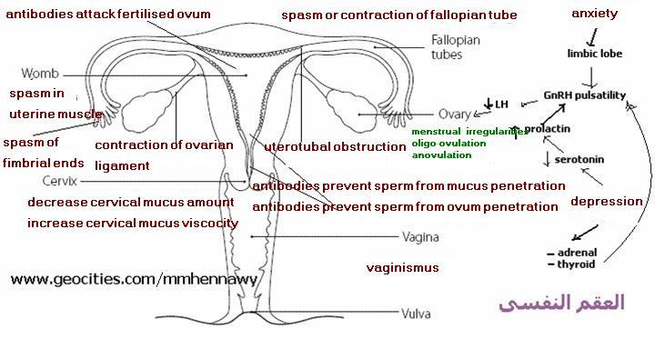

Slide 11
Female psychogenic causes
Vulva
Vagina | Vaginismus prevent coitus
Cervix | Decrease cervical secretion amount for Increase cervical mucus viscosity Antibodies prevent cervical mucus penetration by sperm
Uterus | Changing uterine blood flow Changing uterine motility Antibodies attack fertilised ovum
Tube | Uterotubal spasm Changing tubal motility interfering with the transport of gametes through the tube fimbrial end spasm Antibodies prevent ovum penetration by sperm
Ovarian Ligament | Contraction of ovarian ligament
Ovary | Excessive stress may even lead to complete suppression of the menstrual cycle In less severe cases, it could cause anovulation or irregular menstrual cycles.
Endocrine glands | the pituitary gland produces increased amounts of prolactin, and elevated levels of prolactin could cause irregular ovulation
brain | brain produces special molecules called neuropeptides, in response to emotions, and these can interact with every cell of the body, including those of the immune system
 | lack of sexual desire

Slide 12
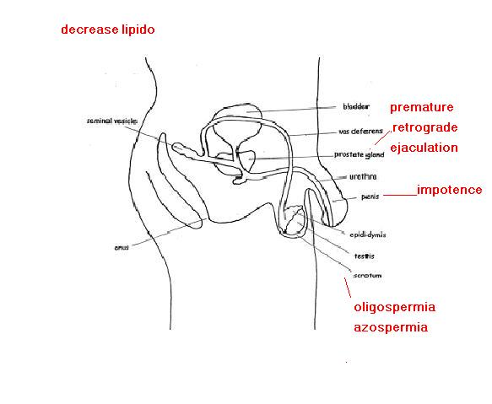

Slide 13
Male psychogenic causes
Penis | Faliure of erection ( impotence )
Urethera
Ejaculatory ducts | Premature ejaculation Retrograde ejaculation
Seminal vesicle
Prostate
Testis | oligozoospermic , morphological abnormalities , Azoospermia
Endocrine glands | oligozoospermic , Azoospermia
brain | lack of sexual desire

Slide 14
The relationship between stress and infertility is still poorly understood today
While there is little doubt that infertility causes considerable stress,
the question
whether stress can cause infertility,
and
whether stress reduction can enhance pregnancy rates in infertile couples,
is still very controversial

Slide 15
Although several authors have suggested an important pathogenic role for psychosocial factors in ‘functional’ infertility,
the extent to which depression, anxiety and expressed emotional patterns correlate to infertility is not yet clear.

Slide 16
Learning of one’s infertility can often generate depression and lack of sexual desire.
Work-ups and treatments can interfere with the couple’s intimacy, and the body image of each partner.
Sometimes the final arrival of a child cannot completely repair felt psychological failure

Slide 17
At Present
whether differences exist regarding
anxiety, depression, and anger management in couples with certain organic causes of infertility (‘organic’ infertility)
and those with infertility due to certain non-organic causes (‘functional’ causes).
Because these couples are exposed to the same stressor (infertility) the finding of different levels of anxiety, depression and anger might suggest a role of these elements in the pathogenesis of ‘functional’ infertility

Slide 18
the psychological features of infertility are based on two contrasting theoretical models
The first model (psychodynamic-oriented) consider the role of psychogenic elements among the causes of infertility (‘psychogenic’ hypothesis);
or
The second model consider a psychological distress is secondary to infertility.

Slide 19
Acupuncture and Infertility
Acupuncture affect both psychological and emotional factors as well as physical ones.
For example, extremely painful premenstrual or mid-cycle pain can be debilitating. This type of physical stress no doubt produces emotional stress as a result of missed work, interference in activities, and the pain itself, which in turn can compromise the function of the reproductive system.
The hormone ACTH, which is released as a response to acupuncture needle stimuli, has an antiinflammatory effect that may improve fertility (for example, by improving with tubal factor–based infertility as a response to pelvic inflammatory disease).
In addition, the insertion of acupuncture needles has been shown to effectively increase blood circulation. Enhanced blood flow to the uterine lining undoubtedly contributes to a healthier and more growth-oriented endometrium, especially when stimulation acupuncture points known as zigongxue, which reside above the ovaries.
Acupuncture releases endorphins that mitigate one’s response to stressful stimuli, thus enhancing the possibility of conception as stress reduces the hypothalamic-anterior pituitary-ovarian axis function

Slide 20
In a study
women who were about to undergo IVF were randomly assigned to receive acupuncture therapy before and after embryo transfer
In the women who received acupuncture, the needles were placed at points believed to influence reproductive factors (for example, by improving blood flow to the uterus).
The acupuncture group had a higher rate of pregnancy compared with those not given acupuncture (43% versus 26%), suggesting that acupuncture can be used to improve pregnancy rates during IVF.

Slide 21
Conclusions
The "psychogenic infertility model" has yet to receive scientific confirmation
Equating idiopathic infertility with psychogenic infertility is counter-productive because it can enhance emotional distress and feelings of guilt in infertile women/couples
The prevalence of psychogenic infertility is likely to be 5 per cent
Psychological counselling should be offered to all infertile couples independent of their individual diagnoses
Main focus in psychological counselling should be to help couples to cope with infertility and not to uncover unconscious conflicts towards parenthood

