Slide 1

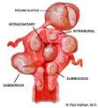
Selective
Cesarean
Myomectomy
Dr Muhammad M El Hennawy
Ob/gyn Consultant
59 Street - Rass el barr –dumyat - egypt
www. mmhennawy.co.nr

Slide 2
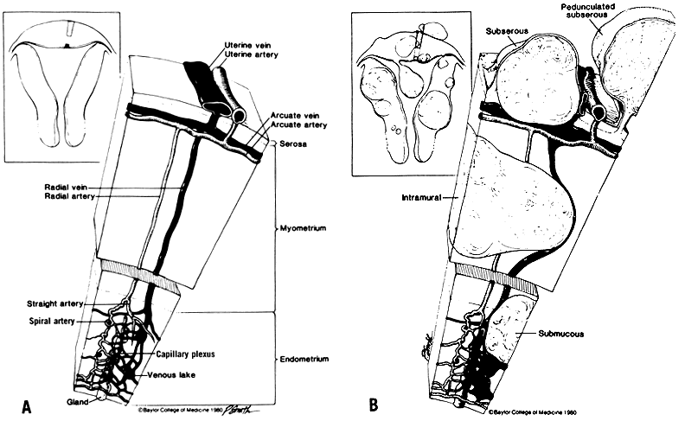
Uterine leiomyomata = benign smooth muscle tumors of the uterus
Described based on location in the uterus:
  Intramural: develop from within uterine wall, do not distort uterine cavity, <50% protruding into serosal surface
  Submucosal: develop from myometrial cells just below endometrium, often protrude into and distort uterine cavity
  Subserosal: originate from serosal surface of uterus, >50% protrudes out of serosal surface
  Cervical: located in the cervix, rather than uterine corpus

Slide 3
PREVALENCE
The prevalence of uterine fibroids in pregnancy varies between 1.6 and 10.7 percent depending upon the trimester of assessment and the size threshold

Slide 4
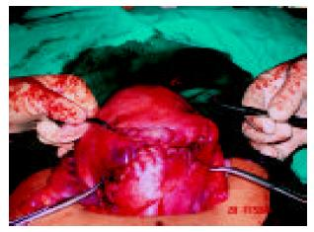
Uterine myomas are observed in pregnancy more frequently now than in the past
Because many women are delaying child bearing till their late thirties, which is the time for greatest risk of myoma growth.
Also the use of ultrasonography has improved the diagnostic capability of detecting small myomas and has increased our knowledge of myomas in pregnancy.

Slide 5
CHANGE IN SIZE DURING PREGNANCY
The growth of fibroids during pregnancy using ultrasonography have refuted the commonly held belief that fibroids increase in size throughout gestation
Indeed, the majority of uterine fibroids (49 to 60 percent) have negligible (defined as <10 percent) change in volume across gestation,
while 22 to 32 percent increase in growth, and
8 to 27 percent decrease in size
In those fibroids that do increase in size, most of the growth occurs in the first trimester, with little if any further increase in size during the second and third trimesters
Larger fibroids (>5 cm in diameter) are more likely to grow, whereas smaller fibroids are more likely to remain stable in size
The mean increase in fibroid volume during pregnancy is 12 percent, and very few fibroids increase by more than 25 percent

Slide 6
Time Of Diagnosis
= Simultaneous surgical removal of a previously diagnosed myoma during cesarean section
= Simultaneous surgical removal of a accidentally diagnosed myoma during cesarean section
-Unavoidable caesarean myomectomy with a huge uterine fibroid located in the lower segment
- Avoidable caesarean myomectomy

Slide 7
Indications For Myomectomy At Cesarean Section
7 Opinions ) (
1 -Leave it
2 -Leave it with UAL
3 - Remove pedunculated fibroids only
4 - Remove pedunculated , anterior subserous or lower uterine segment fibroids
5 - Remove all anterior uterine fibroids
6 - Remove all fibroids
7 - Selective removal of fibroids

Slide 8
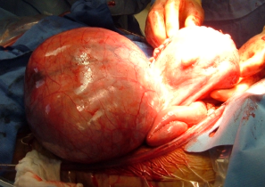
Leave It
Caesarean myomectomy was practically absent from the obstetric literature until the last decade.
Myomectomy during cesarean section is strongly discouraged in all the leading textbooks despite the lack of any direct evidence supporting the approach
This was due to the high risk of haemorrhage associated with this procedure and difficulty in securing hemostasis and the need for blood transfusion or hysterectomy and increased post operative morbidity
Leaving them is not entirely without complications

Slide 9
leave It With UAL
Uterine artery ligation appears to be a promising method for treating pregnant women with uterine leiomyomas, who are undergoing cesarean section,
Because it is able to reduce postpartum blood loss and minimize the necessity of future surgery.
Fertility is apparently not compromised by this treatment, which offers obstetricians with another choice between observation and myomectomy for pregnant women with leiomyomas who are undergoing cesarean section

Slide 10
Remove Pedunculated Fibroids Only
Some authors are of the opinion that small pedunculated uterine fibroids should be routinely removed
Suturing and excision of the pedicle may be done easily

Slide 11
Remove Pedunculated , Anterior Subserous OR Lower Uterine Segment Fibroids
Caesarean myomectomy when done is usually for
pedunculated fibroids, anterior subserous fibroids and most especially fibroids in the lower uterine segment;
Myomectomy in both instances allowed delivery of the fetus through the lower segment, making vaginal delivery in subsequent pregnancies possible.

Slide 12
Remove All Anterior Uterine Fibroids
Some authors are of the opinion that all anterior uterine fibroids should be routinely removed

Slide 13
Removal Of All Fibroids
Some authors are of the opinion that all uterine fibroids should be routinely removed
As they believe myomectomy during caesarean delivery does not increase the risk of hemorrhage, post operative fever or prolong hospital stay

Slide 14
Selective Removal Of Fibroids
Myomectomy during caesarean delivery can be safely
effective procedure in safe hands. The main principles of myomectomy during pregnancy are;
It should be done by an experience person.
It should be done in in a well equipped tertiary institution
With the advent of better anesthesia and availability of blood
4. It should be done with full consent of the patient.
5. It should be done in selected patients according to site and size of myoma
6. It should be done with techniques that decrease blood loss( UAL ,UAE , High Oxytocin )
7 - It is however important that baby must be delivered prior to attempting myomectomy
Selection of patients for caesarean myomectomy reduces blood loss, anaemia and other complications.

Slide 15
How ?
After completion of the CS,
An interlocked suture was temporarily placed on the uterine incision without closing it. This allowed working from within or from the outer part of the uterus without having any significant bleeding from the incision.
Myomectomy was performed using sharp dissection.
Oxytocin drip was given during and after the enucleating the fibroid..

Slide 16
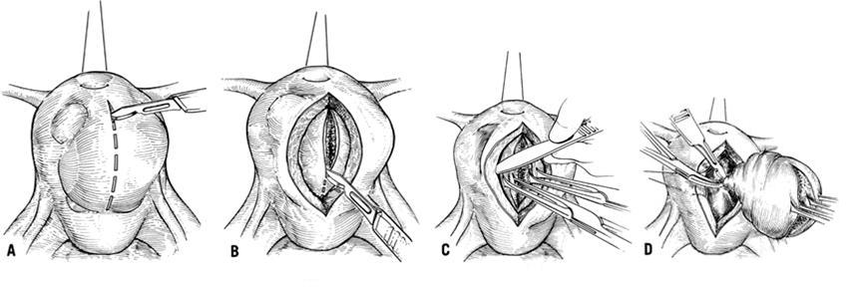
Enucleation of the fibroid is technically easier in the gravid uterus owing to the greater ‘looseness’ of the capsule
Retraction of the uterine muscle enhanced by syntocinon will help arrest haemorrhage
Also a uterus in the immediate postpartum phase is better adapted physiologically to control hemorrhage than in any other stage in a women’s life

Slide 17
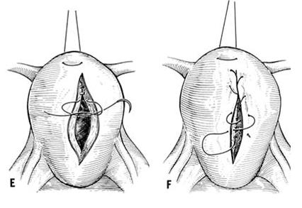
A three-layer closure of the incision is advocated in view of a larger surface area for closure.
After the first continuous locking suture to obliterate the endometrial surface,
A number of interrupted sutures were employed in both cases to obliterate the dead space.
The surface stitch was carried out continuously with an atraumatic needle

Slide 18
To Minimizing Blood loss
Tourniquet
UAL
Electrocautery
High dose Oxytocin

Slide 19
Tourniquet
It decreases intra-operative blood loss in cesarean myomectomy cases,
But Tourniquet method is not effective in the post-operative period since the tourniquet is taken out at the end of the operation.

Slide 20
Bilateral Ascending Uterine Artery Ligation
It decreases intra-operative blood loss in cesarean myomectomy cases,
And continues in decreasing blood loss in the post-operative period owing to its permanence quality.

Slide 21
Electrocautery
Avoid the extensive use of electrocautery
with unipolar electrocoagulation
Because it is associated with an increased risk of uterine dehiscence and rupture in next pregnancy

Slide 22
High dose Oxytocin
A high dose oxytocin infusion to contract the uterus
Start infusion at rate of 20 mU/min achieved (maximum rate )
Intra-operatively after delivery of the baby and post-operatively continued for 12-24 hours thereafter

Slide 23
Time Of Removal Of Fibroids
-Myomectomy was done after delivering the baby.
This was followed by suturing with adequate hemostasis
-Large myoma situated over lower segment
needing myomectomy before and for delivery of the fetus during LSCS

Slide 24
Sufficient grouped and matched blood must be made available
With prophylactic broad spectrum antibiotics to combat infection and
Analgesics were given in the postoperative period

Slide 25
The Recurrence Of Uterine Fibroids
After a myomectomy is not an uncommon finding.
With the growing evidence in support of the safety of
myomectomy at caesarean section, more cases are being
reported.
Although there is no documented recurrence rate of uterine fibroids after myomectomy at caesarean section,
It is likely to be higher than after myomectomy in the non-pregnant state..

Slide 26
Future Of Fertility
The future fertility and or subsequent pregnancy outcome was unaffected by caesarean myomectomy
(Evidence level III)

Slide 27
Studies
Several authors have published their results on myomectomy
during the course of pregnancy when conservative treatment
fails to relieve the woman of her symptoms.
Michalas et al reported 18 cases of myomectomy during pregnancy 16 of
whom delivered uneventfully at term.
Burton et al and Exacoustos and Rosati have reported similar results with a
good perinatal outcome but an increased preterm delivery rate. As far as myomectomy at the time of cesarean is concerned, some authors have cautioned against elective myomectomy at that time, because of reported high morbidity especially hemorrhage.
Burton et al have reported that myomectomy at cesarean section may be safe in carefully selected patients. In 13 cesarean myomectomies reported
by them only one was complicated by intraoperative hemorrhage.
On the other hand
Exacoustos and Rosati reported nine similar cases of whom three had severe
hemorrhage needing hysterectomy. obstructing the lower part of the uterus were removed during cesarean section without any complication

Slide 28
.
Ehigieba et al reported 25 cases of cesarean myomectomy in 12 women
without any complications. They reported that anemia was the most common form of morbidity.
Kwawukume reported cesarean myomectomy in 12 women, without any complications. Their mean operative time was 62.08 minutes, which is similar to that found in our study.
Roman and Tabsh in a retrospective study involving 111 women with myomectomy at cesarean section and 257 women undergoing cesarean section alone noted no significant difference in incidence of intraoperative hemorrhage, post partum fever, operative time, and length of hospital stay
Omar et al report two cases wherein myomectomy had to be done to facilitate the delivery of the baby during cesarean section with uneventful intraoperative and postoperative period.
Bmrton et al also shows that cesarean myomectomy is not as dangerous as generations of obstetricians have been trained to believe. Enucleation of the fibroid is technically easier in gravid uterus owing to greater looseness of the capsule Retraction of uterine muscles is enhanced by oxytocic agents to help arrest the hemorrhage.

Slide 29
These studies indicate that in selected patients and in experienced hands myomectomy during caesarean delivery can be safe procedure.
But in which patients? Clearly large fundal fibroids intuitively should be avoided. Although no statistically significant difference was found
between the patients who under went intramural myomectomy or myomectomy of fibroid > .6cm in size and the control group, this lack of difference may be
attributed to a small sample size and therefore insufficient power to detect such a difference. Thus intramural myomectomy should be performed with
caution. But in setting of symptomatic patient with an
accessible subserosal fibroid and pedunculated fibroid or the patients with fibroid obstructing lower uterine segment the study carried out in USA indicated that this procedure can be safely carried out, several recent
studies have described techniques which minimize blood loss at caesarean myomectomy, including uterine toniquet, bilateral uterine artery ligation, and
electrocautery.
There was also no increase in incidence of post operative fever, duration of hospital stay. No patient required hysterectomy.

Slide 30
My Opinion
The old dictum discouraging cesarean myomectomy should be reassessed.
Selective cesarean myomectomy can be a safe, effective procedure = in experienced hands = in a well equipped tertiary institution =With the advent of better anesthesia = with availability of blood = in selected patients according to site and size of myoma = with techniques that decrease blood loss( UAL ,UAE , High Oxytocin ) = Meticulous attention to hemostasis (enucleation using sharp dissection with scissors and adequate approximation of the myometrium and all dead spaces to prevent hematoma formation )
To eliminated the need for repeat laparotomy and its risk
To allow normal vaginal delivery
Myomectomy during CS can be performed in selected cases, but non selected patients had significant complications like postoperative ileus and postoperative atonic bleeding as blood transfusion greater than three packed red blood cells and two days longer than average hospitalization

