Slide 1
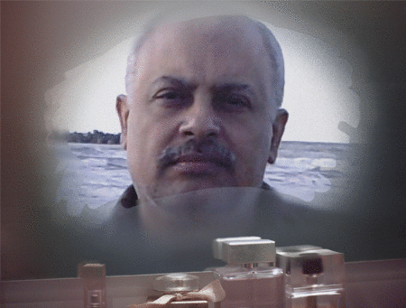
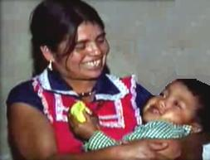
SeIf-Inflicted
Cesarean
Section
DR MUHAMMAD M AL HENNAWY
OB/GYN CONSULTANT
EGYPT
WWW.MMHENNAWY.CO.NR

Slide 2
This Lecture explains my personal opinion
In spite that this lecture contains medical evident informations
If you accept this lecture ,
take it as a sciense
If you do not accept it,
take it as a fun

Slide 3
A pregnant Mexican
Woman performs C-section
On herself
With kitchen knife
And the woman gave birth
To a healthy baby boy

Slide 4
In March 2000
Ines Ramirez Perez The mother, a 40-year-old
and
her son Orlando Ruiz Ramirez,
in their home in a rural area
with no running water and electricity.
The nearest hospital was eight hours away.
in the town of Rio Talea,
Mexico.
from the state of Oaxaca

Slide 5
She has given birth to seven kids before Orlando,
Her last son, and didn’t face any problems except for the baby that had died inside her as her midwife told her she needed a cesarean And
Can’t give birth naturally…..
Sadly, it was too late, and the baby passed away.

Slide 6
After losing a previous baby girl
The woman wasn't about to lose another child.

Slide 7
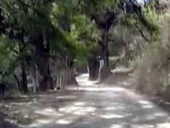
Alone
Alone in her one-room cabin high in the mountains of southern Mexico,
Ines Ramirez Perez felt the pounding pains of a child insistent on entering the world.

Slide 8
The sun had set hours ago.
The nearest clinic was 80km away over rough roads, and
Her husband, her only assistant with her previous 6 births was drinking at a cantina.
She had no phone and neither did the cantina.

Slide 9
"I couldn't stand the pain anymore," she said.
"And if my baby was going to die, then I decided I would have to die, too.
But if he was going to grow up,
I was going to see him grow up, and I was going to be with my child.
I thought that God would save both our lives."

Slide 10
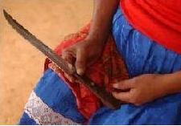
She sent Benito, her 8-year-old son to buy a kitchen knife
To ensure that it is new and sharp enough to cut through her skin.

Slide 11
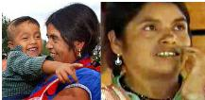
At midnight,
after 12 hours of continual pain,
By the light of a single dim bulb
Ramírez sat down on a low wooden bench and
Drank three small glasses of hard liquor.

Slide 12
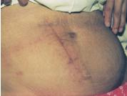
She then used a 15 cm kitchen knife
To cut open her abdomen by her index and thumb pressure on the knife..
In a total of three attempts.
Ramírez cut through her skin in a 17 cm vertical line several centimeters
To the right of her navel,
Starting near the bottom of the ribs and ending near the pubic area.
Ramirez sawed through skin, fat and muscle

Slide 13
After operating on herself for an hour,
She reached inside her uterus and Pushing aside her internal organs, she searched around inside and
Pulled out her son.
Luckily, the baby cried, and appeared healthy,
But Inés’s distress was just beginning.
Inés cut the umbilical cord with a pair of scissors before she put her organs back in place.

Slide 14
Became unconscious.
After regaining consciousness
She used clothes to bandage her wound, and
Sent one of her older sons to find help

Slide 15
Asked her 8-year-old son, Benito, to run for help.
Several hours later, the village health assistant and a second man found Ramírez conscious and alert, along with her live baby.

Slide 16
The local nurse first stitched the wound with
A sewing needle and
A cotton thread.

Slide 17
The two men lifted mother and child onto a thin straw mat,
lugged them up horse paths to the town's only road,
To local health center

Slide 18
Then to the nearest hospital,
Eight hours away by car.
For further treatment.

Slide 19
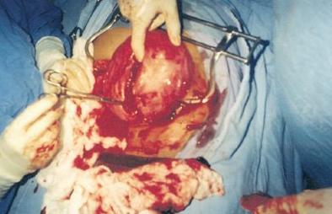
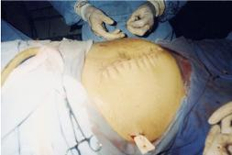
Sixteen hours thereafter she underwent
Surgical exploration and
Uterine repair and
Repair of the incision site.

Slide 20
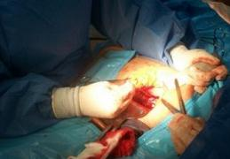

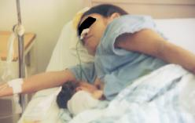
On the seventh post-operative day,
She underwent a second surgery to repair complications resulting from damage to her intestines incurred during her C-section.

Slide 21
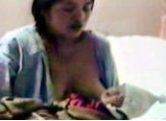
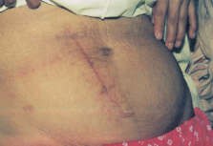
She was released from the hospital on the tenth day post-surgery, and went on to make a complete recovery.

Slide 22
Today the baby Orlando Ruiz Ramirez,. And
Ines Ramirez is
Recognized internationally
As a modern miracle:
She is believed to be the only woman known to have performed a successful Caesarean-section on herself.

