Slide 1

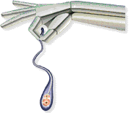
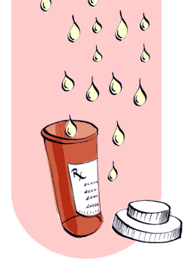
Semen As a Drug
SEMEN THERAPY in married couples
Dr Muhammad M El Hennawy
Ob/gyn specialist
Rass el barr central hospital and
dumyat specialised hospital
Dumyatt – EGYPT
www.geocities.com/mmhennawy

Slide 2
In spite that this lecture contains medical evident informations
If you accept this lecture ,
take it as a sciense
If you do not accept it,
take it as a fun

Slide 3
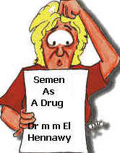
In Our Islamic , Arabic Countries
We can not accept semen as a drug except to the married couples
Promiscous use of sex without a religious relation lead to catastrophes

Slide 4
Names
Semen,
Seminal fluid,
the man-juice ,
the liquid of life ,
the liquid love ,
a biochemical cocktail ,
the magical fluid

Slide 5
benefits of semen is still-unexplained to females
Is semen a drug ?
Is it addictive ?
What is semen composition ?
what is normal semen values for fertility ?
how does semen form?
What is routes of adminestration?
What is its side effect ?
Does semen act as antidepresant ?
Does semen trigger or enhance the female orgasmic response ?
Does semen induce ovulation?
Does semen help women to conceive ?
Does semen preventimplantation failure ?
Does semen prevent miscarriage ?
Does semen make pregnancy safer and more successful ?
Does semen induce premature labour ?
Does semen initiate labour ?
Does semen prevent pre-eclampsia ?
Does semen help to reduce female hormonal imbalances ?
Is semen nutritious and delicious ?

Slide 6
Is semen a drug ?
semen is a rich chemical compound, containing testosterone, estrogen and other hormones: prostaglandins (made in the prostate gland), as well as luteinizing hormone and follicle-stimulating hormone
Scientists know that chemicals in semen are absorbed into a woman's bloodstream through the vagina.

Slide 7
Is it addictive ?
Women go through a kind of withdrawal when they stop getting it.
she often becomes depressed
(a lack of sexual intercourse made some women depressed -- published in New Scientist magazine ).
becomes fat or overweight and
no longer tries to look her best
or to take care of herself

Slide 8
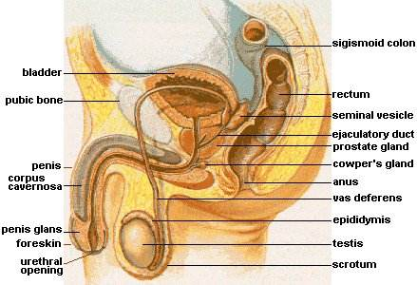
how does semen form?
Seminal fluid is composed of the secretory products of
the testis,
epididymis,
seminal vesicles,
prostate gland and
Cowper's gland

Slide 9
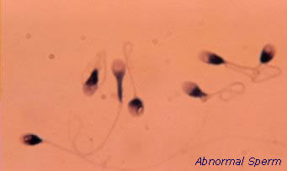
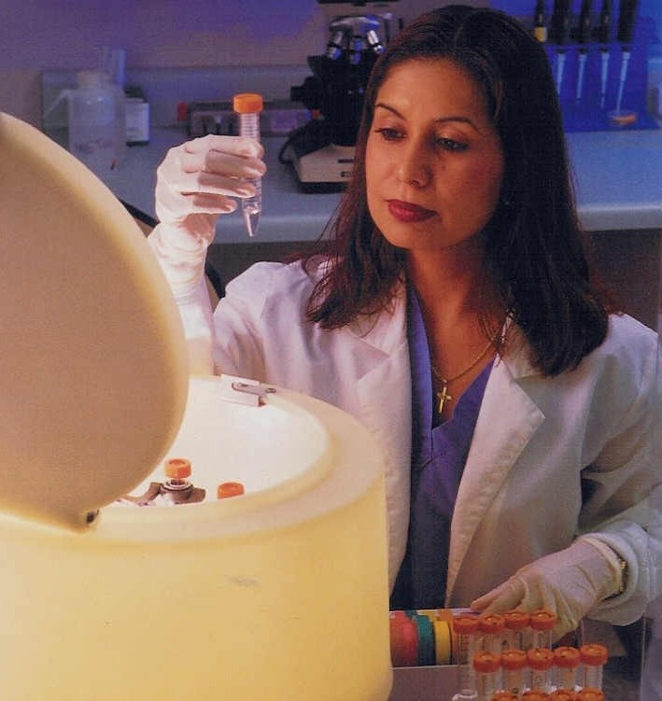
What is semen composition ?
While we sometimes refer to semen as "sperm," sperm cells (spermatozoa) actually constitute only about 10% of our total ejaculate.
That 10% contains from 200 million to 500 million sperm cells, though the figure can be higher for younger males due to the pubescent production of androgen hormones, such as testosterone, which also trigger the growth body hair and the lowering of the voice. (Remember: It takes only one sperm cell to fertilize an egg and make a baby.)
The remaining 90% is referred to as seminal plasma. (Plasma is defined as a fluid that carries a suspended solid, whether it's blood "fluid" carrying blood cells, or semen carrying sperm.) Composition of seminal plasma varies among individuals, and even in the same individual from time to time. It contains some 30 substances (many in minute quantities); some are produced by different parts of our male anatomy, and some are by-products of body functions. :

Slide 10
seminal plasma They include:
• ascorbic acid (vitamin C, for tissue maintenance)
• blood-group antigens (from immune system)
• calcium (mineral)
• chlorine (oxidizing agent)
• cholesterol (steroid alcohol present in body fluids)
• choline (base, part of the vitamin B complex)
• citric acid (occurs during cellular metabolism)
• creatine (nitrogenous substance found in muscle)
• deoxyribonucleic acid (DNA)
• fructose (sugar used for energy)
• glutathione (peptide amino acid)
• hyaluronidase (enzyme)
• inositol (sugar found in muscles)
• lactic acid (byproduct of muscle use)
• magnesium (mineral)
• nitrogen (gas found in all living tissue)
• phosporus (mineral)
• potassium (mineral)
• purine (compound of uric acid)
• pyrimidine (organic base)
• pyruvic acid (formed from either glucose or glycogen)
• sodium (salt)
• sorbitol (body alcohol)
• spermidine (catalytic enzyme)
• spermine (ammonia compound found in sperm)
• urea (from urine)
• uric acid (from urine)
• vitamin B12 (for proper function of nervous system and metabolism)
• zinc (mineral)

Slide 11
The amount of a compenent may rise or fall depending on a number of factors.
For example, the amount of lactic acid may rise significantly after excercise, since it's a byproduct of muscular activity. (Lactic acid is what causes muscular soreness after exercise.) Also, food intake can significantly affect chemical makeup — and taste of semen.
By the way, it is not the spermatozoa which can contain HIV (which causes AIDS) but the seminal plasma.
Seminal plasma is partially made up of a fructose-rich fluid — produced by the seminal vesicles — which provides nourishment for the sperm cells.
The seminal vesicles also make prostaglandins, unsaturated fatty acids used for hormonal actions.
The prostate gland produces a thin, milky, alkaline fluid that helps the sperm live when exposed to the acidic lining of the vagina and uterus.
The pea-shaped bulbourethral glands (Cowper's glands) at the base of the penis produce a fluid we refer to as "pre-cum." This is secreted to lubricate the urethra (the tube that runs through the penis) so the semen can travel more easily — however, some men do not secrete this fluid in visible quantities

Slide 12
Increase Semen Production
plenty of water, little dairy, no caffeine (or cocaine, or similar, bitter alkaloids), no smoking , no alcohol

Slide 13

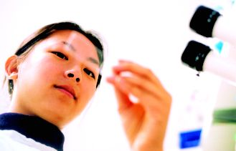
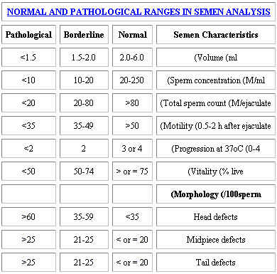
what is normal semen values for fertility ?

Slide 14
What is routes of adminestration ?
vaginal : The penis evolved as an internal fertilization device or as a semen displacement device
Intercourse Without Condom ,
diaphragm
Or coitus interruptus
Oral : ??xx
Anal : xxxx

Slide 15
Anal intercourse is extremely dangerous
all sex outside of marriage is wrong.
The law does not reflect this in non islamic countries. the lining of the rectum is almost always traumatized to some degree by any act of anal intercourse. Even in the absence of major trauma, minor or microscopic tears in the rectal lining allow for immediate contamination and the entry of germs into the bloodstream.
The semen action damages the bowel lining and the consequence is easy entrance of bacteria and viruses
there are no specific standards for the manufacture of condoms for anal sex -- there is still a risk of breakage and slippage
A condom only has to slip or break once for HIV to be transmitted

Slide 16
Package (Dosage Form )
Liquid preparation --- Aquous

Slide 17

What is its doses ?
Depends on Age, Weight and body surface
Average dose -- one teaspoon
(normally from half a teaspoon to a tablespoon although 2 to 6 ml is typical ejaculate volume )
Loading dose -- one daily
Maintenance regular dose -- a frequency of more than three times per week.
Increase frequency of ejaculation --- increase volume of semen but decrease number of sperm

Slide 18
Ejaculation Facts
Average volume of semen per ejaculation: 2 to 6 ml
Average number of times a man will ejaculate in his lifetime: 7,200
Average total amount of lifetime ejaculate: 17 litres or 18 quarts
Average number of calories in a teaspoon of semen: 7
Average duration of orgasm: 4 seconds
Average number of sperm cells in the ejaculate of a healthy man: 40 to 600 million
Distance sperm travels to fertilize an egg: 7.5-10 centimetres or 3-4 inches
Sperm lifespan: 2.5 months from development to ejaculation

Slide 19
Duration Of Action
Short Action
Long Action
Depends on
Rate of absorption from vagina
Rate of metabolism ( genetic )
Rate of execretion

Slide 20
Site Of Action
Local or topical
Systemic action after absorption from vagina to circulation to various tissues

Slide 21
What is its side effects ?
Allergy
Burning semen syndrome (BSS) is a rare but well-documented disorder that surfaced after the Persian Gulf War ended. burning semen syndrome caused symptoms in the men and in some female partners
seminal plasma hypersensitivity (SPH) in which only women experience symptoms after exposure to semen,
Researchers say that the precise causes and triggers for both conditions remain unknown.
However, use of condoms usually solves the problem for women suffering from SPH. Another treatment for both conditions entails using specific proteins from semen to desensitize the sufferer, much as allergy shots are used for desensitization to an allergen
Preterm labour
Infection

Slide 22
What is its Contraindication ?
Absolute Contraindication
antepartum hemorrhage
Relative Contraindication
preterm labour

Slide 23
Uses
Prophylaxis
Miscarriage
pre-eclampsia
Treatment
depression
PMS

Slide 24
Does semen act as antidepresant ?
Gordon Gallup, a psychology professor at the State University of New York in Albany
They divided 293 female students into groups on the basis of how often their partners wore condoms.
They used standard psychological tests to assess how happy they were and their overall mood.
women whose partners never used condoms were happiest.
They were followed by women whose partners sometimes used condoms.
Women whose partners always used or usually used condoms were less happy with suicide attempts were more common
Semen contains a range of hormones, including testosterone and oestrogen, both of which have been shown to improve mood which are known to function as anti-depressants.
On the other hand, women in general do not like condoms. They report that condoms make them feel "icky" or "yucky

Slide 25
Scores On Beck Depression Inventory
It Is standard psychological tests to assess how happy they were and their overall mood.
score above 17 as "moderately depressed.“
The young women whose husbands never used condoms scored 8 on average
those who sometimes used condoms scored 10.5,
those who always used condoms scored 11.5
those who usually used condoms scored 15
Women who weren't having sex at all scored 13.5

Slide 26
semen contains several mood-altering hormones, including testosterone, oestrogen, follicle-stimulating hormone, luteinising hormone, prolactin and several different prostaglandins.
Some of these have been detected in a women's blood within hours of exposure to semen
Seminal Follicle stimulating hormone (FSH) levels in semen are lower than in blood while Seminal luteinizing hormone (LH) levels in semen are higher than in blood
PMID: 6405705 [PubMed - indexed for MEDLINE]

Slide 27
Semen is a fast antidepressant
Tricyclic antidepressant drugs need few weeks to act
Tetracyclic antidepressant drugs need few days to act
Semen needs few seconds to act
semen promotes long-term mood enhancement
It is equal in effect as electroconvulsive shock therapy in treatment in depression

Slide 28
Does semen help to reduce PMS?
Psychological distress, often accompanied by physical pain and bloating, is commonly known as premenstrual syndrome (PMS).
Symptoms include stress, anxiety, depression, irritability, mood swings, and crying jags.
If these symptoms are severe enough to interfere with work or relationships, the condition is known as premenstrual dysphoric disorder (PMDD),
medications such as antidepressants may be helpful for treatment Premenstrual Tension Syndrome
Semen is a fast antidepressant - Semen needs few seconds to act - semen promotes long-term mood enhancement

Slide 29
Does semen trigger or enhance the female orgasmic response ?
semen is the single most powerful natural female viagra
Semen contains a lot of Prostaglandin E-1 and E-2 (PGE-1 and PGE-2 respectively) to trigger or enhance the female orgasmic response.
PGE-1 causes the relaxation and erection of the clitoral vaginal/urethral/cervical spongy tissues and
PGE-2 induce the cervical and uterine contraction for labor and orgasm

Slide 30
Does semen induce ovulation ?
semen is a rich chemical brine, containing testosterone, estrogen and other hormones: prostaglandins (made in the prostate gland), as well as luteinizing hormone and follicle-stimulating hormone (both trigger ovulation). Scientists know that chemicals in semen are absorbed into a woman's bloodstream through the vagina.

Slide 31
Does semen help women to conceive ?
prostaglandin E-2 in the semen suppresses natural vaginal antibiotic for sperms to survive and to swim into the uterus,
but rarely induces COX-2 expression (which leads to infection ) unless there is an excessive vaginal abrasion

Slide 32
Does semen prevent implantation failure ?
semen may help to prepare a women's immune system for pregnancy
Dr Sarah Robertson of the Department of Obstetrics and Gynecology at the University of Adelaide
semen contains large quantities of a protein called transforming growth factor beta (TGFß) which is essential in causing the necessary immune changes in the female uterus.
"The embryo is like an expert parasite that uses semen to get in early and sensitise and prepare the uterus in advance,"
sensitisation of the uterus was cumulative. In other words, the more semen of the father a mother's uterus is exposed to, the better the immune tolerance.
Clinical trials involving infertile women will check to see if pessaries or gel containing activated TGFß can produce the essential immune changes the researchers have seen after unprotected intercourse in normal women

Slide 33

Does semen prevent miscarriage ?
This is supported by previous evidence that shows that couples who use the barrier method of contraception, or who have only been having unprotected sex for a short period of time, are more likely to have problems such as miscarriage

Slide 34
Does semen make pregnancy safer and more successful ?
protective effect was strongest if the woman swallowed the semen
New research suggests oral sex may not only help a woman conceive but may make her pregnancy safer and more successful.
The Australian study found that semen contains a growth factor which helps persuade a mother's immune system to accept sperm.
It claims to have found evidence that regular exposure before pregnancy, especially by mouth, helps her immune system get used to her partner's sperm.
Disorders during pregnancy often stem from the battle between the immune system and the foetus as a 'foreign body'.
Many of its 'foreign' proteins come courtesy of the father's genes so if the mother is regularly exposed to them her body is more likely to accept them.
Professor Gustaaf Dekker, from the University of Adelaide, said: "If there's repeated exposure to that signal then eventually when the woman conceives, her cells will say, 'we know that guy, he's been around a long time, we'll allow the pregnancy to continue

Slide 35
Does semen induce preterm labour ?
The significantly higher increase in preterm labor in women who had symptoms of lower genital tract infection and coitus
implies that semen rather than coitus may affect the onset of labor.
PMID: 12320290 [PubMed - indexed for MEDLINE]
140 pregnant women at and beyond 28 weeks of pregnancy were studied Women with clinically evident causes of preterm labor like incompetent os, hydramnios, twins, and antepartum hemorrhage were excluded.

Slide 36
Does semen initiate labour ?
Studies have found that sexual intercourse during the last few weeks of pregnancy can help soften the cervix in preparation for labour. Some women are highly sensitive to the prostaglandins in semen

Slide 37
Does semen prevent pre-eclampsia ?
Does Immunological intercourse prevent pre-eclampsia ?
A number of studies have shown
Department of Obstetrics and Gynaecology, Adelaide University, SA 5005 Adelaide, Australia
in Lancet 344: 8 Oct 94 #8928
Science news 146: 246, dated 15 Oct 94
PMID: 12896827 [PubMed - indexed for MEDLINE]
pre-eclampsia to be more common in short duration (primigravida ) relationships than in longer one's in multiparas also.
PE to be more common in multiparas with new partners than women sticking with the same partner.
scientist already know that substances from the father (Researchers don't know whether the sperm itself, the accompanying white cells, or seminal plasma is responsible for the shielding effect ) lead to a beneficial immune response in the mother that helps sustain a healthy placenta.
In pre-eclampsia, blood flow through the placenta in inadequate

Slide 38
The immune system has the task of eliminating bacteria and foreign elements from the body. The placenta, as earlier mentioned, is considered genetically partly maternal and partly paternal and is therefore considered partly as a foreign element. This means that it would be expected to be rejected by the mother. Luckily, this does not happen. During pregnancy, the immune system has the capacity to adapt itself. Furthermore, the outer layer of the placenta is surrounded by a kind of protective layer, so that it cannot be recognised as a foreign body. In the case of preeclampsia, we believe this layer is probably damaged. How and why this occurs is not clear. However it is considered to play an important role in the development of preeclampsia.
Recent studies have proven that the longer a woman is exposed to the semen of her partner (in other words intercourse without the use of barrier contraceptives, e.g.: condoms, pessary), her risk for developing preeclampsia is diminished.

Slide 39
Department of Obstetrics and Gynaecology, Free University Hospital, Amsterdam, The Netherlands
the conclusions derived from epidemiologic studies may have consequences for practicing physicians:
1) according to the primipaternity concept, a multiparous women with a new partner should be approached as being a primigravid women;
2) artificial donor insemination and oocyte donation are associated with an increased risk of developing pregnancy-induced hypertensive disorders;
3) a more or less prolonged period of sperm exposure provides a partial protection against pregnancy-induced hypertensive disorders.
In the 1990s, all women with changing partners are strongly advised to use condoms to prevent sexually transmitted diseases
However, a certain period of sperm exposure within a stable relation, when pregnancy is aimed for, is associated with a partial protection against preeclampsia.
PMID: 9618714 [PubMed - indexed for MEDLINE]

Slide 40
The analgesic action of semen coicis on severe functional dysmenorrhea--a sequential trial observation.
  Second Hospital Affiliated to Shanxi Medical University, Taiyuan 030001, Shanxi Province.
  The analgesic effect of Semen Coicis was observed with the sequential trial in 26 cases of severe functional dysmenorrhea. The results showed that the markedly effective rate was 90%, which was much better than that of the control group treated by indomethacin plus subcutaneous injection of atropine (P < or = 0.01).
  PMID: 11263287 [PubMed - indexed for MEDLINE]

Slide 41
Does Semen Fight Cancer ?
at a frequency of more than three times per week.
the practice can aid in the prevention and treatment of cancer.

Slide 42
the sexual orgasm resembles the epileptic attack
The resemblance of the sexual orgasm to the epileptic attack has been noted by many authors.
The sudden withdrawal of calcium produced by the seminal discharge biochemically produces the tetany-like symptoms of the orgasm, which are so similar to those of the epileptic attack which usually follows it in those who are constitutionally predisposed
According to Acton, the sexual orgasm resembles the epileptic attack both in its phenomena and its effects.
The mental hebetude and physical prostration following the discharge of nerve force characteristic of an epileptic attack also follow the sexual orgasm.
The latter profoundly affects the whole nervous system with such intensity that Acton says that "it is only mature individuals who can bear even infrequent acts of copulation without more or less injury.
In young persons all the vital powers should be conserved for growth and development

Slide 43
coitus is a slight fit of epilepsy coitus resembles electric convulsive shock
Epilepsy | Coitus
Aura Stage | Excitement Stage
Tonic Stage | Erection Stage
Colonic Stage | Ejaculation and Orgasm Stage
Post fit Stage | Resolution Stage

Slide 44
Does semen fight germs, enhance skin complexion, and lead to a longer lifespan?.
After days of careful study, an overwhelming amount of male doctors in the United States agree that seminal fluids is very good for women's health.
Semen, they say, contains several essential vitamins and minerals, which can fight germs, enhance skin complexion, and lead to a longer lifespan. .
semen contains protien, which tightens the skin helping with wrinkles. Also, "contains an abundance of natural lipids and essential amino acids and prostaglandins, natural substances which aid in skin repair and increase blood flow bringing in more nutrients to the to the skin

Slide 45
Man Benifits
Man should ejaculate once a week at least
to cleanse his prostate
to unlock his brain's testosterone (Negative Feedback loop - the hypothalamus-pituitary-testicular axis)

