Slide 1

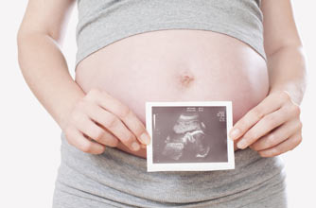

To Tell Or
Not To Tell ?! Boy Or Girl ?!
Dr Muhammad M El Hennawy
Ob/gyn Consultant
59 Street - Rass el barr –dumyat - egypt
www. mmhennawy.co.nr

Slide 2
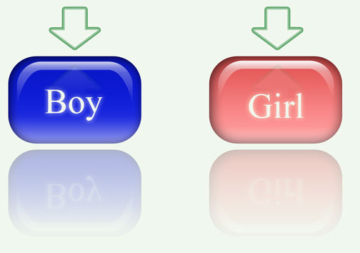
From almost the moment a woman discovers she's pregnant, the guessing games begin.
Everyone -- from her mother-in-law, to her next-door-neighbor, to the clerk in the convenience store
Baby Snookums will be a boy or a girl
Pink and Blue” emotion
Why ? To choose paint of room , clothes or names but there are unisex paint , uinsex clothes and unisex names. so what do the ladies or girls think?

Slide 3

Determining the gender of an unborn baby during routine ultrasounds is not standard practice because resources are too tight and medically speaking it’s not important

Slide 4
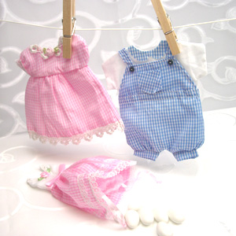
What to do ?
Ask if its a boy or a girl ?
Or
Wait untill birth to see if boy/girl?
To know or not to know – a very personal decision

Slide 5
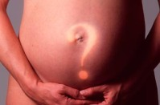
Some hospitals, however, have a no-tell policy. ‘Sonographers sometimes get it wrong, so some hospitals won’t tell mother in case of mistakes

Slide 6


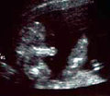
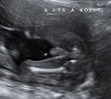

The Boy Ultrasound Gallery
Sonographer should reassure himself that he actually sees the penis and scrotum in the case of a boy

Slide 7
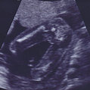
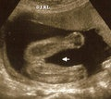

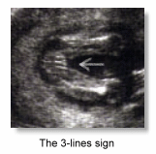
The Girl Ultrasound Gallery
Sonographer should reassure himself that he actually sees the labia in the case of a girl
The absence of the penis must not be taken as sufficient evidence of the fetus being a girl
The 3-lines sign which denotes the labia in the fetus is a very valid and accurate indication of the female gender .This is often called the "hamburger sign." Some technicians looks for two line

Slide 8
Ways Of Predicting The Sex Of A Baby
Traditional ways eg The shape of her bump , cravings for sweet food or salty food? , hanging a needle or wedding ring on a thread over her tummy and watching to see which way it moves? or measuring babies' heart rates in the uterus
Effective ways of are ultrasound scanning, amniocentesis or chorionic villus sampling (CVS). Although most women have an ultrasound scan at some stage of their pregnancies now, amniocentesis and CVS will only be offered if there is a medical need.

Slide 9
Ultrasound Accuracy Depends On Several Factors
Baby's cooperation the position of the fetus. Sometimes baby can be stubborn and refuse to give you a good view (such as if its legs are crossed )
The increasing number of obese women also makes it harder to see the fetus clearly
Gestational age
when there is insufficient fluid surrounding the genitalia (as is often the case later on in a pregnancy)
Modern/updated equipment
Technician's ability during the optimum period of pregnancy (the “anomaly scan”) are dependent both on the skill of the sonographer

Slide 10
Effect Of Knowing Sex of The Baby
Whether Right Or Wrong

Slide 11
Effect On Mother
Risk of sex-selected abortion : in India and China, where an overriding preference for male babies could prompt a rash of terminated pregnancies for women carrying girls
Disappointed
Depression antepartum and postpartum
I had been certain that first baby was a girl, and when they handed me a boy he felt like a stranger
Due to the mother's increasing immune tolerance of her children in utero – childern will suffer from bronchial asthma
Marrying the second woman is made
Divorce.

Slide 12
Effect On Father
Disappointed
Depression antepartum and postpartum
Marrying the second woman is made
Divorce
Husband did not buy tonic for her pregnant wife
Husband did not buy good diet for her pregnant wife
Husband leave her wife to deliver in cheap hospital
Men lie when they say we like female descendants, when their wife goes home they fight with them or even sometimes divorce them

Slide 13
Effect On Sons And Daughters
Disappointed
Depression antepartum and postpartum

Slide 14
Effect On Family
Serious Gender Imbalance in Population

Slide 15
Effect On Doctor
Lose his patients and their relatives
kiked
Killed by angery father
Doing cesarean section because this baby is precious

Slide 16
Effect On Hospital
In rare cases the declared gender is wrong,
Gurting patient confidence and
Possibly opening the hospital to a lawsuit

Slide 17
If anyone asks, "Is it a boy or girl?" just reply "Probably."

