Slide 1


Toxoplasmosis During Pregnancy
(widespread phobia)
Dr Muhammad El Hennawy
Ob/gyn Consultant
Rass el barr central hospital and
dumyat specialised hospital
Dumyatt – EGYPT
www. mmhennawy.co.nr

Slide 2
Widespread phobia
Tox is a part of TORCH syndrome
It is not a cause of habitual abortion
Only pregnant with primary active infection with tox during pregnancy leads to congenital tox and after primary infection there is persistence of cysts of tox BUT development of active immunity protect subsequent pregnancy
Very rarely reactivation of previously latent T. gondii infection induced by severe decrease of immunity(People on chemotherapy , People with congenital immune deficiencies , People with AIDS/HIV , long administration of corticosteroid drugs in the case of transplant patients)
Many doctors believe that is the case which has created
a widespread phobia among pregnant women and has given some sort of satisfaction among some doctors by treatment their pregnant women by chemotherapy which is in fact unnecessary

Slide 3
IN USA
the safety, effectiveness and feasibility of prenatal toxoplasmosis screening, diagnosis and treatment are not yet established. For these reasons,
in the United States, most pregnant women are not screened for toxoplasmosis.

Slide 4
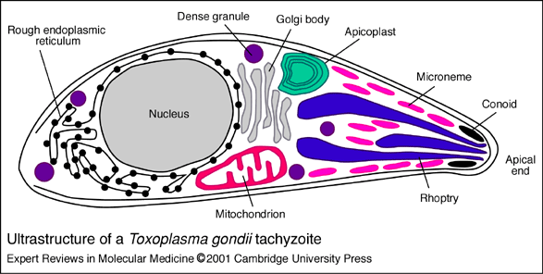
What is toxoplasmosis?
Toxoplasmosis is an infection that can threaten the health of an unborn child
Toxoplasma gondii is a sporazoan of the subclass Coccidia. The only species is Gondii.
It exists in three forms--tachyzoites (trophozoites), tissue cysts, and oocytes.
is a common intracellular protozoan which infects most species of warm-blooded animals, They span many vertebrates from rodents to domestic farm animals (including birds) to humans throughout the world.
A Zoonotic Infection of Humans
  Normal cycle in cats (lions, tigers and puddy tat )
    enteroepithelial (EE) cycle in definitive host
      asexual and sexual division is intracellular in MEC
      oocytes become infective after passage in feces (Oocytes do not become infectious until they sporulate. Depending on conditions such as temperature, sporulation occurs 2 to 21 days after the oocyte is excreted in the feces )
    tissue cycle in intermediate/carrier hosts
      all vertebrates are potential hosts (mice, birds,, ?)
      motile, disease producing phase = tachyzoites
      non-motile “slow” phase in pseudocyst = bradyzoites

Slide 5
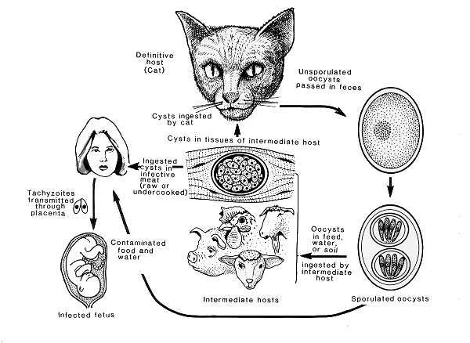

Slide 6
Sources of infection
Source of all oocytes ...
  Domestic (cats,dogs) and wild (zoo) cats
  ( Cats are the only known full-life-cycle host of the protozoan) parasite
  Rodents :rats
Persist in environment (soil) if moist
  reservoir of infective oocytes
Many intermediate hosts
  reservoir of infective tissue cysts( farm animals—cattle,sheep,rabbit)
Cycle in humans (an accidental host)
  Infected
    by ingesting infective oocytes (in >4 day old cat feces)
    by ingesting tachyzoites or bradyzoites in rare meat
    by receiving blood or tissues with “-zoites”
    CONGENITALLY by transplacental tachyzoites
  Proliferative stages in humans
    tachyzoites result from all infective stages
    bradyzoites predominate within pseudocysts as IgG

Slide 7
Cats
Cats are the only animal species to shed the infectious stage in their feces.
All animals however,can disseminate Toxoplasmosis if their infected meat is eaten.
cats get it by eating rodents, raw meat, cockroaches, flies, or by contacting infected cats, infected cat feces, or contaminated soil.

Slide 8
Immunity to TG
Active infection normally occurs only once in a lifetime.
Although the parasite remains in the body indefinitely latent infections usually persist for life (the immune system reacts against the parasite, causing the parasite to hide in an inactive form (cyst) in tissues throughout the body (usually the skeletal muscles and the brain). . ,
it generally is harmless and inactive unless the immune system is not functioning properly in immuno-compromised host -- the parasite can reactivate and cause serious illness, characterized by inflammation of the brain
If a woman develops immunity to the infection at least six to nine months before pregnancy, there rarely is any danger of passing it on to her baby because immunity is developed to it

Slide 9
incidence
Prevalence In Egypt -- 11.5 – 27.5 %
Seroconversion rate -----7.5% in Egypt
----- 50 % in USA
-----90% in France

Slide 10
Clinical pictures(difficult diagnosis)
Toxoplasma gondii can cause a wide spectrum of disease after infecting a new host, including acute, latent, and reactivated disease as well as congenital disease
Congenital tox
Maternal tox
+ inapparent—subclinical--usually is asymptomatic —most of cases
+apparent ( 10-20 %)—not specific
=generalised tox—flue like illness- fever,fatigue,weakness,malaise
= lymphatic tox---fever,generalised lymphadenopathy(retroperitoneal, mesentric{abdominal pain},lumbar,occiptal), liver and spleen enlargement The lymphadenitis may wax and wane for months and finally resolve spontaneously. It is commonly mistaken with infectious mononucleosis).
=neurological tox---encephalopathy,chorioretinitis
=exanthematous tox---generalised maculopapular erythramatous patches
= Ocular tox--- eye pain, Photophobia, blurred vision, scotoma ("blind spot"), chorioretinitis, Retinitis, blindness
=The acute acquired form however, can be a fulminating disease with an erythematous rash, fever, malaise, myositis, dyspnea, acute myocarditis,and encephalitis. Outcome can be fatal, but this form of toxoplasmosis is rare

Slide 11
Toxo Diagnosis
Morphologic
  tachyzoites in circulating WBC,
  bone marrow, lung, spleen, brain ?
  histopathologic examination
Culture or animal inoculation (rare) Isolation of parasites from blood or other body fluids, by intraperitoneal inoculation into mice or tissue culture. The mice should be tested for the presence of Toxoplasma organisms in the peritoneal fluid 6 to 10 days post inoculation; if no organisms are found, serology can be performed on the animals 4 to 6 weeks post inoculation.
Serologic (mainly)
Detection of parasite genetic material by PCR, especially in detecting congenital infections in utero.

Slide 12
Serologic Diagnosis of Toxo
unreliable in immunodeficient (AIDS) pts
normally IgM and IgG rise simultaneously
  IgG - persists for years
  IgM - undetectable after “cure”
elevated IgM titer is diagnostic of recent infection in persons with normal immunity
disseminated infection may exist in AIDS pts without demonstrable titer
A negative IgG or IgM test excludes Diagnosis
  both should be + if acutely infected
If IgG screening is + then do IgM test
  a + IgM test confirms acute toxoplasmosis or current Toxoplasma infection (measure IgM antibodies, have low specificity and the reported results are frequently misinterpreted. In addition, IgM antibodies can persist for months to more than one year)
Submit IgG positive sera to CDC for IgM testing for diagnosis of acute Toxo

Slide 13
Tests which employ whole parasites include
the dye test (Sabin-Feldman Dye Test (DT)
direct agglutination and the fluorescent antibody test,
whilst tests that use disrupted parasites as an antigen source include ELISA, latex agglutination, indirect haemagglutination and complement fixation.

Slide 14
CD4 Cell Counts
T-cells (or T-lymphocytes) are white blood cells that play important roles in the immune system.
There are two main types of T-cells.
One type has molecules called CD4 on its surface; these ‘helper’ cells orchestrate the body’s response to certain micro-organisms such as viruses.
The other T-cells, which have a molecule called CD8, destroy cells that are infected and shut down the immune response once the infection has been dealt with.
Doctors use a test that ‘counts’ the number of CD4 cells in a cubic millimetre of blood to identify how strong the immune system and helps predict the risk of complications and debilitating infections
A normal count in a healthy, HIV negative adult can vary, but is usually between 600 and 1200 CD4 cells/mm3.
when a person is first diagnosed as part of a baseline measurement. test should be repeated about four weeks after starting anti-tox therapy.
a CD4 count should be performed every three to four months thereafter.

Slide 15
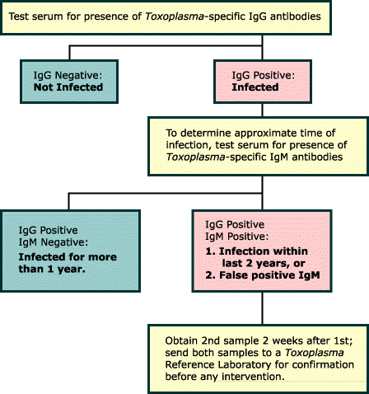

Slide 16
IgG levels begin to rise 1 or 2 weeks after infection. Peak levels are reached in 6 to 8 weeks, then gradually decline over a period of months or even years. Low levels of IgG are generally detectable for life.
Detectable levels of IgM antibody appear immediately before or soon after the onset of symptoms. IgM levels normally decline within 4 to 6 months, but may persist at low levels for up to a year
immunocompromised individuals may not produce any IgM. Antibody levels do not correlate with severity of illness

Slide 17
Polymerase Chain Reaction (PCR)
PCR amplification is used to detect T. gondii DNA in body fluids and tissues.
It has been successfully used to diagnose congenital, ocular, cerebral and disseminated toxoplasmosis.
PCR performed on amniotic fluid has revolutionized the diagnosis of fetal T. gondii infection by enabling an early diagnosis to be made,
thereby avoiding the use of more invasive procedures on the fetus.
PCR has allowed detection of T. gondii DNA in brain tissue, cerebrospinal fluid (CSF), vitreous and aqueous fluid, bronchoalveolar lavage (BAL) fluid, urine, amniotic fluid and peripheral blood.

Slide 18
Before pregnancy
testing for Toxoplasma antibodies when a woman is pregnant can be complicated and worrisome
Because testing for toxoplasmosis infection can be difficult to interpret, the test may need to be sent to a special laboratory
Women planning to become pregnant should discuss with their doctors whether they should have this blood test before pregnancy

Slide 19
Treatment:
NO TTT in Asymptomatic Because it is self limiting disease Exept in children to prevent retinal inflammation
In healthy people, infection with Toxoplasma gondii, leads to the production of sarcocysts in various tissues and immunity to additional infections. Thus, an infected but asymptomatic person in good health generally does not need treatment.
TTT of pregnant women is controversy because of toxicity of medication but TTT is still advocated

Slide 20
Prevention of Toxoplasmosis
Previous exposure prevents congenital
Toxo transmission - buy a cat !
education
avoiding exposure to the parasite, mostly by simple hygienic measures.
avoid exposure to oocytes
  no cats or cat feces !
  no raw meat for you or your kitty !
  keep house cats inside - avoid stray cats !
  let anyone empty the cat box !
  cover the kid’s sand box !
  wear gloves in the garden, wash your hands!
  wash all fruits and vegetables,
  wash hands carefully after handling raw meat, fruit, vegetables, and soil
  pregnant women should cook their meat until it is no longer pink and the juices run clear

Slide 21
Toxoplasmosis TTT
Drugs of choice for pregnant women or immunocompromised persons:
Spiramycin or Pyrimethamine plus Sulfadiazine
Treatment
pyrimethamine (Daraprim) + sulfadiazine
    side effects( skin rashes and leukopenia )are common in AIDS pts
    High-dose therapy is continued for 4-6 weeks, and lower dose maintenance therapy is given thereafter. Maintenance therapy can be discontinued in patients who have completed the course of initial treatment and are without symptoms,
  Spiramycin alone before 26 weeks
  pyrimethamine + clindamycin or dapsone
  Clindamycin, a similar drug, is often substituted for sulfadiazine in patients with sulfa allergy
  NB : Pyrimethamine can cause low blood counts in some people. To counter the possible effects of pyrimethamine on the bone marrow, another drug called leucovorin (folinic acid) is given along with pyrimethamine
Prophylaxis –in the primary prevention of toxoplasmosis in persons with HIV who have dormant or latent infection
  TMP-SMX - trimethoprim-sulfamethoxazole
  pyrimethamine plus folinic acid
  dapsone + pyrimethamine

Slide 22
Drugs
Spiromycin(rovamycin)
Daily for rest of pregnancy
OR 3weeks ttt then 1 week rest then repeat for rest of pregnancy
OR 1 week ttt then 1 week rest then repeat for rest of pregnancy
OR 3 weeks ttt

Slide 23
Congenital infections
Conditions of transmission
  [nfection during parasitemia – in unexposed mother with an active primary infection during pregnancy or previously exposed mother before pregnancy with immune compromise eg : (AIDS ) very rare
  tachyzoites cross placental barrier
  fetus becomes infected only about 40% of time
the risk of the baby's infection depend partly upon the timing of the mother's infection.
when mothers are infected in the first trimester, 15 percent of fetuses become infected,
as compared to 30 percent in the second trimester
and 65 percent in the third trimester.
severity of the baby's infection
the earlier in pregnancy the infection occurs, the more severe the fetal infection.
When the mother is infected between 10 to 24 weeks gestation, the risk for severe problems in the newborn is about 5 to 6 percent. When the mother is infected late in a pregnancy, the chance that the baby will have problems is very small.

Slide 24
Prenatal Management of Congenital Toxoplasmosis
  Identified acute maternal Toxo infection
  tested fetal blood for Toxo (culture/serology)
  confirmed fetal CNS involvement (ultrasound)
    spiromycin for acutely Toxo in affected mother
    added pyrimethamine /sulfadiazine if fetus is affected
      TTT reduced congenital symptoms by 70%
        2 of 15 children infected in utero had chorioretinitis
(While these results are encouraging, the safety, effectiveness and feasibility of prenatal toxoplasmosis screening, diagnosis and treatment are not yet established. For these reasons, in the United States, most pregnant women are not screened for toxoplasmosis. )

Slide 25
Congenital Toxoplasmosis
Two types:
  Asymptomatic (inapparent) Congenital Toxo
    60% of infected
    may suffer from Long Term Sequella
    up to 90 percent of infected babies appear normal at birth, 80 to 90 percent will develop sight-threatening eye infections months to years after birth. About 10 percent will develop hearing loss and/or learning disabilities
  Symptomatic Congenital Toxo
    40% of infected--About one in 10 infected babies has a severe Toxoplasma infection that is evident at birth. These newborns often have severe eye infections, an enlarged liver and spleen, jaundice (yellowing of the skin and eyes), pneumonia and other problems. Some die within a few days of birth. Those who survive sometimes suffer from mental retardation, severely impaired eyesight, cerebral palsy, seizures and other problems.
    more likely if mother infected in 1st/2nd Trimester
    Severe damage to fetus = stillbirth or abortion

Slide 26
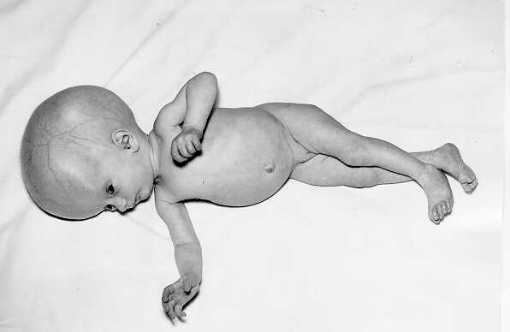
Treatment of Infected Newborns
Infected babies should be treated as soon as possible after birth with pyrimethamine and sulfadiazine which, as mentioned earlier, can help prevent or reduce the disabilities associated with toxoplasmosis.

Slide 27
Routine neonatal screening for toxoplasmosis identifies congenital and early subclinical infections. Treatment may reduce the severe long term sequelae.

Slide 28
Recommendations
An IgM test is used to help determine whether a patient has been infected recently or in the distant past. Because of the significant potential of misinterpreting a positive IgM test result, confirmatory testing should be performed.
Despite the wide distribution of commercial test kits to measure IgM antibodies, these kits often have low specificity and the reported results are frequently misinterpreted.
In addition, IgM antibodies can persist for months to more than one year.

Slide 29
IN USA
the safety, effectiveness and feasibility of prenatal toxoplasmosis screening, diagnosis and treatment are not yet established. For these reasons,
in the United States, most pregnant women are not screened for toxoplasmosis.

Slide 30
Under research
developing vaccines against Toxoplasma gondii by using surface plasmon resonance.

Slide 31
Thank You

