Slide 1

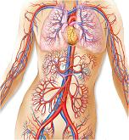
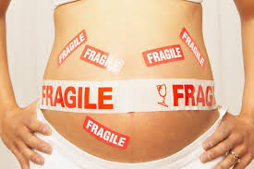
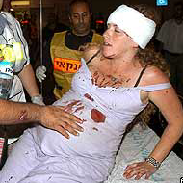
Trauma
In Pregnancy
(Trauma For Two)
Double Jeopardy
Dr Muhammad El Hennawy
Ob/gyn Consultant
Ras el bar –dumyat - egypt
www.mmhennawy.co.nr

Slide 2
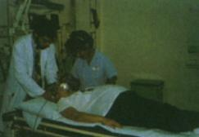
Evaluation of the pregnant trauma patient presents unique challenges since the presence of a fetus means that there are two patients potentially at risk,
both of whom require evaluation and management.
Knowledge of pregnancy-related anatomic and physiologic changes is also important in the evaluation and management of these women

Slide 3
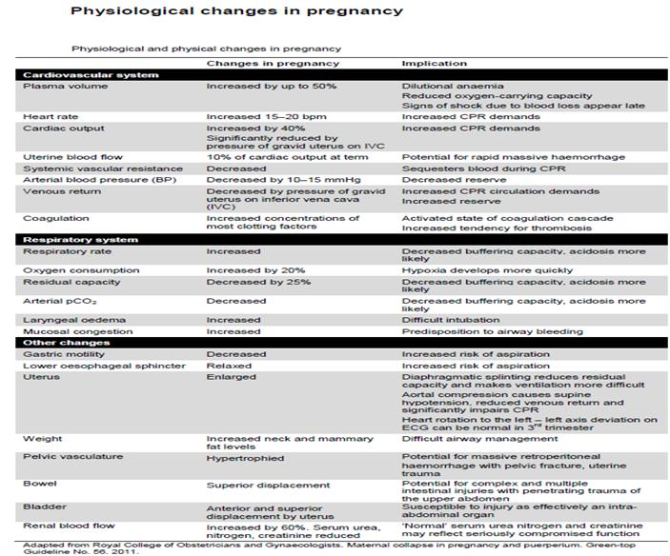

Slide 4
Key Points
All reproductive-age female trauma victims should have a pregnancy test because 8 percent of pregnant trauma victims have not yet had their pregnancies diagnosed.
Generally, medications, tests, treatments, and procedures required for the mother's stabilization should not be withheld because of pregnancy
Pregnant women beyond 20 weeks' gestation should be placed in the lateral decubitus position or in lateral tilt to prevent supine hypotension.
Abruptio placentae is the leading cause of fetal loss. Frequent uterine contraction, abnormal fetal heart tracing, vaginal bleeding, and uterine pain and tenderness are signs of abruption.
All pregnant patients with a viable fetus (beyond 22 to 24 weeks' gestation) should have continuous fetal monitoring (tocodynamometry) initiated as soon as it is feasible.
Because it is often difficult to determine degree of force, significant trauma should be anticipated with any mechanism of injury that is more than very minor
Always evaluate for possible pregnancy-related cause of an accident, e.g., seizure secondary to eclampsia in 3rd trimester patient

Slide 5
Incidence
7 percent of pregnant women will suffer physical trauma during their pregnancy.
  8% in first trimester
  40% in second trimester
  52% in third trimester
Conversely, of reproductive-age women presenting with trauma, approximately 3 percent are pregnant,
8 percent of whom were not known to be pregnant prior to presentation.
Because most physical trauma suffered during pregnancy is relatively minor, many of these women will not present for medical care
  Preterm Labor in 11.4 % & P. Abruption in 1.58 %
  Penetrating abdominal trauma during pregnancy, in which there were no maternal mortalities compared with a fetal death rate of nearly two-thirds
  Causes of Trauma
Motor Vehicle Accident 54.6 %
Domestic abuse & Assault 22.3 %
Falls 21.8 %
Penetrating inj. 1.3 %

Slide 6
The severity of the trauma
A critical factor to consider is that the severity of the trauma does not always accurately predict adverse fetal outcome.
Recognizing this, a general recommendation should be made that women who suffer any degree of truncal trauma during pregnancy should be evaluated.
This is particularly true once fetal viability has been established (i.e., beyond 22 to 24 weeks of gestation).
Case series of trauma during pregnancy and subsequent fetal loss bear this out, as 60 to 80 percent of all fetal losses result from relatively minor maternal trauma
The adverse effects, when they occur, are immediate (within the first few days of the trauma).
the following immediate adverse effects:
Rupture of membranes within 4 hours of injury.
Onset of labor within 4 hours of injury that resulted in delivery during the same hospitalization.
Placental abruption within the first 72 hours of injury.
Fetal death within 7 days of the traumatic event

Slide 7
Trauma Complications
Vaginal bleeding
Preterm rupture of membranes within 4 hours of injury
Uterine rupture
Placental abruption (minor trauma is low (1.6%), but in major trauma is (37.5%) within the first 72 hours of injury..
Maternal pelvic fractures
Fetal death within 7 days of the traumatic event
Fetal fractures, especially skull, clavicles, and long bones
Intracranial hemorrhage
Indirect injury is generally due to fetal hypoxia secondary to: maternal hypotension, fetal hemorrhage, placental abruption or other injury, cord injury, uterine injury
Other:
spontaneous abortion,
preterm delivery,
cesarean delivery and
RBC isoimmunization
. Rare: amniotic fluid embolus, chorionic villus embolus

Slide 8
Ruptured amniotic membranes
Vaginal fluid leak– avenue for infection.
By itself, not an emergency

Slide 9
Uterine Rupture
Life-threatening emergency, 10% maternal mortality
Fetus almost always dies
Sharp or blunt abdominal trauma can lead to uterine rupture
Signs and symptoms include shock, nonreassuring fetal heart rate tracing or fetal death, uterine tenderness, peritoneal irritation, and vaginal bleeding

Slide 10
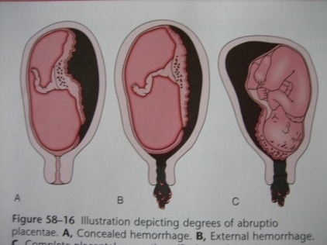
Abruptio Placentae
Accompanies 1-5% of minor injuries, 20-50% of major injuries.
the frequency of abruption after a motor vehicle accident with severe injury, nonsevere injury, or no injury was 13, 7.4, and 8.5 percent, respectively
the rate can be much higher (40 to 66 percent) in women who sustain severe trauma to the abdomen
a significant abruption can be asymptomatic or associated with minimal maternal symptoms.
Sonographic and laboratory assessments (eg, platelet count, fibrinogen concentration) support the diagnosis if abnormal, but may be normal despite mild to moderate pathology.
Ultrasound is of limited usefulness in diagnosing abruption; an abruption is likely if a subchorionic hematoma is observed, but many abruptions are not visualized sonographically

Slide 11
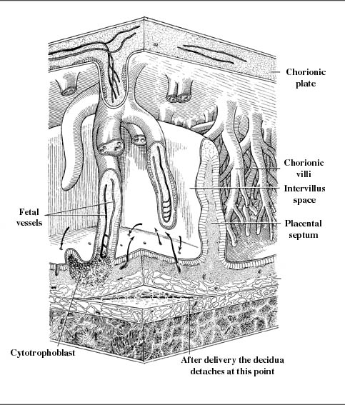
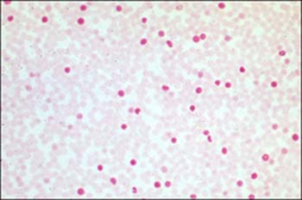
Placental trauma (+/- abruption):
Feto-maternal hemorrhage
More common with anterior placenta?
Chorionic villi break, releasing fetal RBCs into lakes of maternal blood.
Dangers:
  Iso-immunization of Rh- mother by Rh+ fetal cells.
  Fetal exsanguination / anemia / hydrops / brain damage.
  Premature labor (due to release of thrombin, lysozymes or prostaglandins into maternal circulation?).
  .Kleihauer- Betke preparation
Maternal blood smear eluted with acid wash.
Adult hemoglobin washed away
Fetal hemoglobin stays behind– a few brightly stained fetal cells amongst a sea of ‘”ghostly” maternal cells
One dose of RhoGam (anti-D antibody to destroy fetal Rh+ RBCs) is routine with trauma to Rh- mother (regardless of KB results).
Kleihauer – Betke prep sometimes used to assess:
  Need for repeated RhoGam doses (large FMH)
  Probability of pre-term labor (?)
Pregnant trauma patients who are Rh(D) negative with no preformed anti-D antibodies should be given CSL Rh(D) Immunoglobulin-VF, as follows:
• 250 IU: 1st trimester (<13 weeks gestation)
• 625 IU: 2nd and 3rd trimester (≥13 weeks), and 1st trimester multiple pregnancies.
• 2nd and 3rd trimester patients: quantitative assessment of fetomaternal haemorrhage (FMH)
is required (Kleihauer Test / flow cytometry) to determine if additional doses of Rh(D)
Immunoglobulin are required

Slide 12
Injury to the uterine vasculature
is uncommon, largely because the vessels are located quite lateral and posterior in later gestation.
However, because of the tremendous volume of blood flowing through the uterine vessels, injury to these vessels is likely to result in rapid deterioration of vital signs.
Unstable vital signs in the presence of a penetrating abdominal wound indicate the need for immediate laparotomy.
In the absence of unstable vital signs, peritoneal lavage has been shown to accurately diagnose hemoperitoneum during pregnancy, and it can be helpful in determining whether exploratory laparotomy is necessary

Slide 13
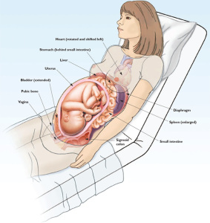
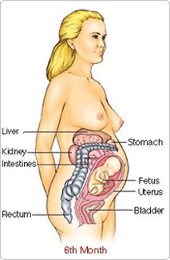
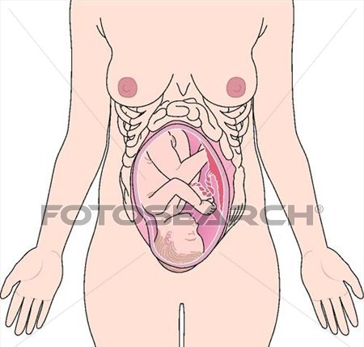
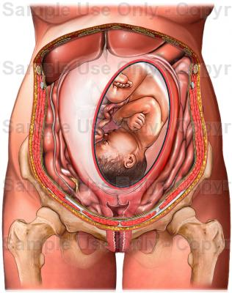
Injuries unique to pregnancy
Premature Contractions
  Rarely progress to preterm delivery
  Tocolysis is not proven in trauma.⁽ arely progress to preterm delivery
  Tocolysis is not proven in trauma
Abruptio Placentae
  Different elastic properties in uterus & placenta “shearing”
  3 % of minor trauma and upto 50 % in severe
Uterine Rupture
  Rare, 0.6 % of severe abdominal trauma
  Direct trauma after 12 wks of gestation
  Prior Surgery (C/S or Myomec.) -- the risk
Maternal-Fetal Hemorrhage
  Trimesters 1 3%, T2 12%, T3 45%
  4-5 X more common in injured pregnant women
  Causes isoimmunization & fetal death
  Kleihauer-Betke test - volume of fetal blood 0.01- 0.03 cc --- sensitize, 5 cc ----- +ve KB test. to determine amount of Rhogam needed
  trauma
Notes:
Very common after maternal trauma. It indicates uterine contusions or blood irritating the uterine muscle. They rarely progress to preterm delivery.
Placenta is devoid of elastic tissue while myometrium is very elastic predisposing to shearing
Abruptio placenta is most common blunt injury
Blunt trauma will deform the elastic and flexible myometrium which gets sheared from the relatively inflexible placenta.
Results b/c of ………..resulting in shearing effect and subsequently leading to seperatiion between placenta and the uterus.
It is common following blunt abdo. T., occurs in
Vag. Blding and abd. Tenderness are comon but abruption may be clinically occult.
CTG is most sensitive and indicates fetal distress.
U/S is specific but is not sensitive, it detects only 50 % of the cases

Slide 14
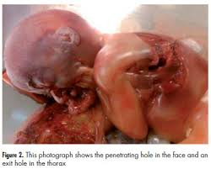
Causes of Death
Causes of maternal death
Most maternal deaths are due to head trauma or hemorrhagic shock.
Causes of fetal death
In severe maternal injury, it is maternal death.
In “minor” injury, it is placental abruption
overall maternal mortality is low ( 3.9 % ). Fetal mortality, on the other hand, is high, ranging between 40 and 70 %.

Slide 15
Injury Patterns in Pregnancy
Motor Vehicle Accidents (Blunt Abdominal Trauma )
Slips & Falls
Burns (Thermal Injuries )
Electrical Injuries
Domestic Violence
Penetrating Injuries
Toxic poisoning (Poisoning - Carbon Monoxide Poisoning )
Suicide & Homicide
Sexual Assault

Slide 16
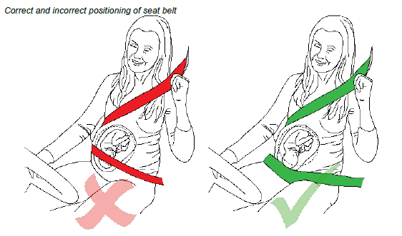
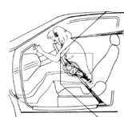
Blunt Abdominal Trauma

Slide 17
Causes Of Blunt Abdominal Trauma
It is most commonly caused by Motor Vehicle accidents, which account for 50 to 65 percent of all cases (from steering wheel or improper placement seat belt )
followed by Falls and
Direct Blows to the abdomen.
Domestic Violence is remarkably common during pregnancy; rates as high as 20 percent have been reported

Slide 18
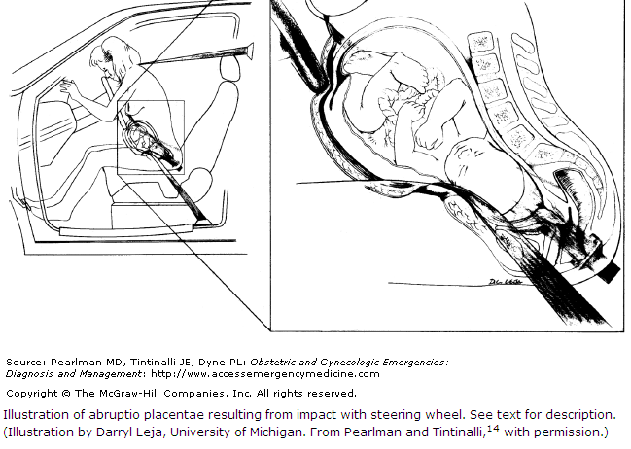
Blunt Abdominal Trauma from steering wheel

Slide 19
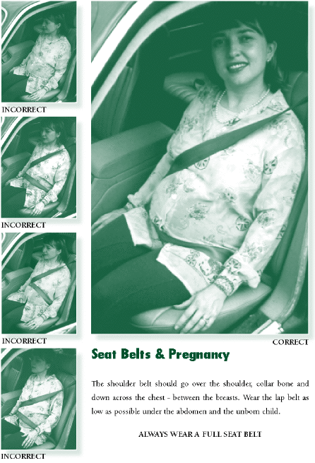
Blunt Abdominal Trauma from improper placement seat belt
Pregnant women need to wear seat belts properly:
One strap under uterus, the other between breasts.
Many women don’t wear them for fear of hurting the baby.
Improper placement can injure fetus.

Slide 20
Penetrating Trauma

Slide 21
Penetrating Trauma
Knife and gunshot wounds during pregnancy are not uncommon in urban settings.
73% were handgun-, 23% knife-, and 4% shotgun
Fall on sharp object and bull horn injury are common in rural Indian women
Understandably, there is considerable concern for fetal well-being when gunshot or knife wounds penetrate the abdomen.
Knife and gunshot wounds suffered elsewhere in the body should be managed just as they are in the nonpregnant individual except that the fetus should also be monitored if viable (beyond 22–24 weeks of gestation) once the woman has been stabilized.
However, penetrating wounds to the pregnant abdomen involve different considerations, because fetal or placental injury becomes an important issue
Penetrating trauma in pregnancy is associated with - Increased foetal mortality (as high as 73%) - Increased hospital stay, - Complications such as intestinal perforation . Haemo peritoneum due to intra abdominal organs like liver .spleen. Pregnant uterus. Big vessels etc

Slide 22
Take Care
Penetrating injuries are more likely to affect the foetus, especially those penetrating the pregnant uterus
If a thoracostomy tube is indicated, it should be placed 1-2 intercostal spaces above usual fifth intercostal space landmark to avoid abdominal placement & liver injury as the diaphragm is lifted up by the pregnant uterus
Pelvic fractures do not necessarily preclude vaginal delivery
If peritoneal lavage is indicated, an open technique is preferred
a placement of a Foley catheter and nasogastric tube

Slide 23
Gunshot Wounds
Most authors agree that gunshot wounds to the abdomen should be explored in all cases, since the course of the bullet cannot be predicted. Furthermore, due to cavitation and shock waves, tissue damage well outside of the projectile's path can be significant.
When extrauterine injuries do occur following penetrating abdominal trauma during pregnancy, they typically occur as a result of gunshot wounds.
All gunshot wounds to the abdomen should be explored

Slide 24
Knife Wounds
Knife wounds to the abdomen are much less likely to cause extrauterine injuries, and these injuries typically have a better prognosis than gunshot wounds.
The individual circumstances of knife wounds should be carefully weighed prior to making a decision to perform a laparotomy.
Stab wounds to the lower abdomen are much less likely to cause visceral injuries than upper abdominal wounds. However, any midline lower abdominal wound can cause bladder or ureteral injury.
Grubb demonstrated that in nonpregnant patients, stab wounds to the abdomen do not penetrate the peritoneum in about one-third of cases.
These extraperitoneal wounds generally do not require exploration unless they have injured a large blood vessel in the abdominal wall (e.g., the inferior epigastric artery). However, because of the enlarged gravid uterus, attenuation of the abdominal wall during pregnancy makes it more susceptible to peritoneal penetration

Slide 25
POISONING DURING PREGNANCY

Slide 26
POISONING DURING PREGNANCY
Poisoning relates mostly to intentional poisoning and / or suicide attempts
Accidental poisoning is not as widely reported and its actual incidence unclear

Slide 27
Carbon Monoxide Poisoning

Slide 28
Carbon Monoxide Poisoning
In the United States, carbon monoxide (CO) is the leading cause of death by poisoning.
As many as 8.4 percent of CO poisoning victims are pregnant.
CO diffuses readily across the placenta and can cause fetal tissue hypoxia. As the placental blood flow increases, so too does the diffusion of CO, such that CO diffusion capacity is directly proportional to fetal weight.
Fetal hypoxia results from both accumulation of CO in the fetus and also through decreased levels of oxygen in maternal hemoglobin due to displacement by CO.
Fetal carboxyhemoglobin levels are 10 to 15 percent higher than maternal levels, and elimination of CO is less rapid in the fetus.
Severe acute CO poisoning can result in permanent fetal neurologic injury, or even fetal death. Chronic CO exposure (e.g., cigarette smoking) may result in intrauterine growth restriction.

Slide 29
Hyperbaric Oxygen
Treatment of acute CO poisoning with hyperbaric oxygen works by both increasing the levels of dissolved oxygen in the blood and by increasing the rate of dissociation of CO from hemoglobin.
Treatment of CO poisoning during pregnancy begins by
- removing the victim from the source of CO and
- beginning 100 percent oxygen.
Strong consideration should be given to using hyperbaric oxygen for 2 hours at 2 atmospheres; this has been used successfully and safely during pregnancy.
Longer use of hyperbaric oxygen may be teratogenic, and abortion after first-trimester hyperbaric oxygen exposure has been reported. However, given the serious potential effects of hypoxia on the fetus, hyperbaric oxygen appears to be the treatment of choice for pregnant women suffering from CO poisoning.

Slide 30
Electrical Injuries

Slide 31
The experience with electrical injury during pregnancy is limited.
In this series of six pregnancies complicated by electrical injury,
There was one delayed fetal death complicated by growth retardation and oligohydramnios, and
Two of the three other live births were complicated by oligohydramnios.
Because of this, recommend serial ultrasound examinations to follow fetal growth and amniotic fluid volume.

Slide 32
Thermal Injuries

Slide 33
We recommend that severely burned women (more than 50 percent body surface area) In second- and third-trimester
Should be delivered immediately because maternal death is almost certain otherwise, and fetal survival is not improved by allowing the pregnancy to continue
Fetal mortality is approximately 63% when the body surface area burn is 25-50% and approaches
100% when the body surface area burn is >50%.
Maternal and fetal deaths are usually a result of inadequate fluid resuscitation, hypoxia or septicaemia.

Slide 34
SLIPS & FALLS DURING PREGNANCY

Slide 35
SLIPS & FALLS DURING PREGNANCY
It is known that pregnancy increases joint laxity and weight gain, enlarged and distended abdomen ,walking on slippery floors , hurrying,carrying heavy objects can affect gait and predispose pregnant women to slips and to falls
Dynamic postural stability decreases with pregnancy, especially during the third trimester
Approximately 1 in 4 pregnant women will fall at least once while pregnant
Types of Injuries
The fracture of the lower extremity/ pelvis.
spine are the most commonly associated injuries
Blunt injury to abdomen and pregnant uterus.
The majority of falls occur indoors and 39% involve falling from stairs.
Falling on sharp object may lead to penetrating injury also
Obstetrical complication
4-fold increase in preterm labor
An 8-fold increase in placental abruption
2-fold increase in foetal distress
A 2.9-fold increase in foetal hypoxia

Slide 36
DOMESTIC VIOLENCE

Slide 37
TYPES OF DOMESTIC VIOLENCE
Beating --- hurt on abdomen—with leg. Stick.
Pushing down from stairs.
Pushing her out of door
Torched with burning objects –wood , candle , Hot Iron ,hot iron rod ,intentional Kerosene stove burn/ cooking gas stove accident s
Sharp objects like kitchen knife,
NO food / drink even water for whole day and night.
Abusement.
Electric shock.
Pushing the head against pillar / wall.

Slide 38
SUICIDE & HOMICIDE IN PREGNANCY

Slide 39
SUICIDE & HOMICIDE IN PREGNANCY
Estimated rates of suicide and homicide in pregnancy were about 2.0/100,000 and 2.9/100,000 live births, respectively
Suicide are more common in post natal period due to puerperal psychosis and accounts for approximately 20% of postpartum maternal deaths
Interestingly, pregnancy may be protective in those women who are otherwise at high risk for suicide or homicide Risk factor
Substance abuse appears to be the best identifier for detecting women at risk for suicide
Another major risk factor for attempting suicide, especially during the postpartum period, is foetal or infant death
Suicide attempt by intentional self-poisoning clearly affects both foetus and mother; maternal death occurs in 1.8% of cases after suicide attempts by ingestion of medication
Often associated with / precipitated by DV/IPV

Slide 40
Modalities for Evaluating Trauma

Slide 41
Modalities for Evaluating Trauma
Lab Tests
Plain Films – X-rays
Ultrasound
CT
MRI
Cardiotocographic Monitoring
DPL (Diagnostic Peritoneal Lavage )
Several invasive tests short of exploratory laparotomy
Exploratory Laparotomy
Notes:
Essentially each of these modalities has the same advantages and disadvantages in the pregnant as in the nonpregnant patient.
Laparotomy is safe for both the mother and the fetus and there is no increased risk compared to the nonpregnant cohort. It is obviously invasive but the most complete and accurate study to evaluate for injury.
CT is safe. It may be somewhat difficult to interpret due to crowding of viscera in the upper abdomen. It is good for diagnosing retroperitoneal injuries.
DPL has historically been a relative contraindication in pregnancy. But it is safe if performed using an open technique and above the level of the uterus by someone experienced in the technique. It gives no information about the retroperitoneum or intrauterine injury.
Ultrasound may be very operator dependent.
Laparoscopy is still under scrutiny and not yet recommended for routine use.

Slide 42
Lab Tests
Basic trauma lab includes
Type and
Cross match,
Rh status, and
Antibody test.
Regardless of Rh status, a positive Kleihauer-Betke (KB) test may predict the risk of preterm labor. With a negative test, post-trauma electronic fetal monitoring may be limited to a shorter period. With a positive test, significant risk of preterm labor may require longer monitoring therefore K-B testing has important advantages to all maternal trauma victims.
However, a positive test does not necessarily indicate pathologic fetal-maternal hemorrhage.
Results of a Kleihauer-Betke test rarely affect clinical decision making.¹
For example, a fetus that suffers a massive fetomaternal bleed may exsanguinate, but clinical decision making will be dictated by an abnormal fetal heart tracing rather than Kleihauer-Betke testing, as the results from the latter frequently take hours to obtain
Nonetheless, in the Rh-negative woman, the possibility of isoimmunization due to fetomaternal hemorrhage is real and Rh immune globulin should be administered to Rh-negative women who have suffered blunt abdominal trauma. A 300-g dose is sufficient to cover 30 mL of whole blood (equivalent to a 15-mL RBC bleed). Fetomaternal hemorrhage greater than that requires additional Rh immune globulin. Because the Kleihauer-Betke test can identify these occasional large bleeds, its use in the Rh-negative woman may still have utility
If placental trauma or abruption is suspected, add coagulation profile (fibrinogen and fibrin degradation products) with INR-PTT.

Slide 43
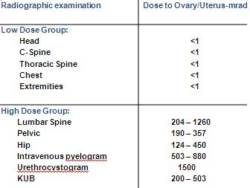
Plain Films
Risk of 1 rad to fetus is approx. 0.003
< 5-10 rads causes
  No risk on congenital malformation, abortions or intra-uterine growth retardation.
  Smaller risk of increase in childhood cancer
Radiation doses > 10 rads
  6 % chance of severe mental ret.
  < 3 % chance childhood cancer.
The following plain films must be taken
> Chest
> Pelvis
> Lateral C spine

Slide 44
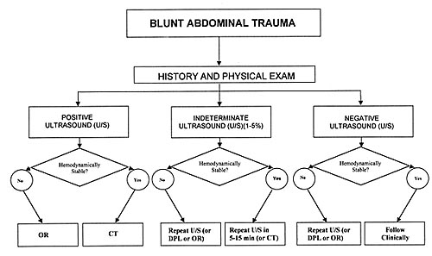
Ultrasound
Best modality to assess both fetus and mother
Not sensitive:
  Colonic lesions
  Biliary tree lesions
  Sub-placental hematoma
Safe procedure
This targeted ultrasound assesses 4 areas for evidence of free fluid: the subxiphoid; the right upper quadrant; the left upper quadrant; and the suprapubic area

Slide 45
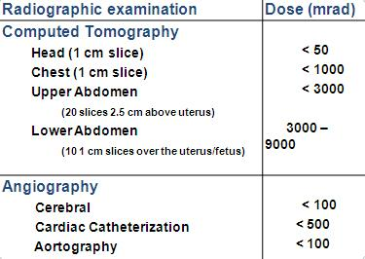
CAT SCAN
Complementary to U/S & DPL
Penetrating wounds of flank & back
Can miss diaphragmatic and bowel injuries
Portability
Spiral CT reduces radiation exposure by 14-30 %

Slide 46
MRI
MRI may be required for certain trauma, such as spinal cord injuries.
Generally it is considered safe in pregnancy.
Paramagnetic contrast agents have not been studied in pregnant women. Use of these agents in pregnancy should be based on risk-benefit analysis with consultation from appropriate specialists.

Slide 47
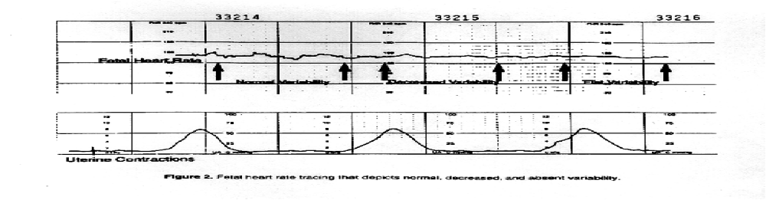
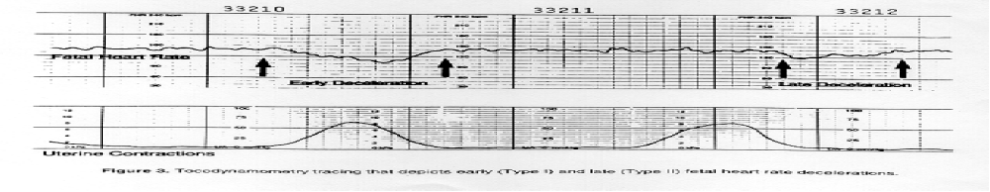
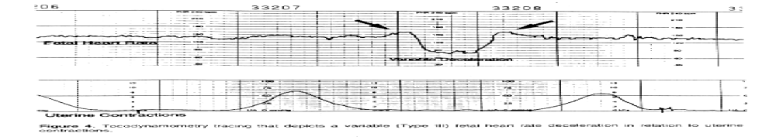
Cardiotocographic Monitoring
Variabilityi
Decelerations: Early and Late
Decelerations: Variable

Slide 48
Diagnostic Peritoneal Lavage
CT & U/S are better in stable patient.
Hypotensive unstable pt and if bedside U/S is not available
Can be performed in any trimester
Gravid uterus does not reduce the accuracy of DPL for OR
Limited in detecting bowel perforation and does not assess retroperitoneal hemorrhage or intra-uterine pathology

Slide 49
Several Invasive Tests Short Of Exploratory Laparotomy
Can be utilized to determine if there has been significant intraperitoneal injury.
Injection of radiopaque material into the entrance wound followed by a two-view radiograph may demonstrate spillage into the gastrointestinal or genitourinary tract. Such a finding would be an indication for laparotomy.
Second, amniocentesis to determine whether the amniotic cavity contains blood or bacteria has been advocated. However, the presence of blood or bacteria does not necessarily mandate delivery, and careful consideration with obstetric consultation should precede this decision

Slide 50
Exploratory Laparotomy
Whether or not to perform exploratory laparotomy will depend on
The patient's hemodynamic stability and
The presence or absence of hemoperitoneum.
It will also depend on the type of penetrating object.

Slide 51
Abdominal surgery in pregnancy and subsequent mode of delivery
If a woman, for whatever reason, undergoes abdominal surgery in the early phase of her pregnancy, it does not make subsequent caesarean delivery inevitable.
The mother may be anxious that her abdominal scar is still too fresh and therefore not strong enough to withstand the rigors of labor. This is not so and even a two­ week old scar can and will withstand labor

Slide 52
General Principles of Trauma Management

Slide 53
Goals of Treatment of the Severely Injured Pregnant Patient
Goal 1 –SAVE THE MOTHER
Goal 2 –Save the Fetus if possible

Slide 54
The management of pregnant women with moderate to severe injuries can be divided into:
Initial treatment and imaging priorities in the pregnant trauma patient are the same as for the non-pregnant patient
> Primary survey
> Resuscitation
> Secondary survey
> Definitive treatment
•SAVE THE MOTHER FIRST!!!
•Limit fetal radiation to 5 rads
•Limited role for emergency cesarean section
> Discharge
> Many of the steps will occur simultaneously once the woman is received in the trauma centre or an emergency department

Slide 55
Primary survey
> The primary survey is to identify and treat life threatening conditions
Airway and cervical spine
> Any woman with trauma who is unconscious or has a neck injury above the clavicle should be regarded as having a cervical neck injury until proven otherwise
Breathing
> Oxygen should be administered at rates of at least 10 litres per minute
Circulation and haemorrhage control
> Assess peripheral circulation, skin colour and pulse rate and character
> Control obvious external haemorrhage
> Position woman on her left side with lateral tilt 15˚ to 30˚
> If lateral tilt is not possible because of spinal injuries or other trauma, the uterus should be manually displaced to alleviate aorto caval compression
> Establish intravenous access with at least two large bore 16 gauge cannulae or larger in peripheral veins. Central veins are not the first choice of venous access

Slide 56
> Treat hypovolaemic shock with intravenous fluid or blood as indicated. The assessment of shock in young women is difficult and must not be based on blood pressure (BP). A normal BP does not mean a normal circulation. In shocked young people BP is maintained well until very late and in the pregnant woman mild hypotension is commonly encountered. The pulse rate and its character, peripheral perfusion and skin colour provide a more accurate assessment of the circulation. Sufficient intravenous fluid should be administered to improve these parameters in women with blunt injury. If the woman remains unstable despite ongoing resuscitation operative intervention is indicated
> An unstable woman must not be taken to the CT scanner
> With penetrating trauma, haemorrhage can only be controlled effectively by surgery. Resuscitation to normal BP results in an increase in mortality (Bickell et al. 1994). Until an operating theatre and surgeon can be organised, IV fluid administration should be limited to that sufficient to maintain a palpable radial pulse
Disability
> Initial neurological assessment using Glasgow coma scale and pupillary response
Exposure and environmental control
> The woman must be undressed to allow for a full physical examination
> The woman must always be kept warm or rarely cooled. Hypothermia is one of the main dangers in trauma contributing to worsening acidosis, coagulopathy and infection

Slide 57
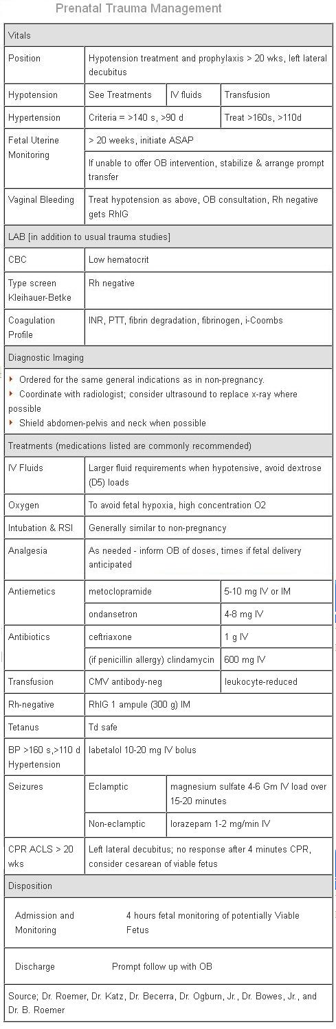
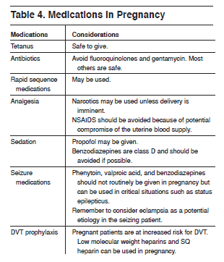

Slide 58
Resuscitation
> Monitor response to initial treatment with pulse rate and peripheral perfusion.
Blood pressure can be a distraction; if low it confirms the woman is significantly hypovolaemic but a normal BP does not necessarily imply a normovolaemic, fully resuscitated woman
> Radiology
> The following plain films must be taken
> Chest
> Pelvis
> Lateral C spine

Slide 59
Secondary survey
> A complete physical examination is performed to identify all other injuries.
Orogastric tube and urinary catheter are inserted
> Continue to regularly assess maternal pulse, blood pressure, urine output as appropriate
> Obstetric evaluation
> Fundal height
> Uterine tone, contractions, and tenderness
> Fetal heart rate
> Vaginal bleeding or evidence of spontaneous rupture of the membranes
> Pelvic examination
> Cardiotocography for at least 4 hours if 24 weeks or more
> Abdominal and obstetric ultrasound

Slide 60
> Radiographic imaging (CT scan) as indicated when the woman is stable
> Laboratory investigations for all trauma in pregnancy should include:
> Complete blood picture and coagulation studies
> Group and save
> Biochemistry
> Kleihauer test
> Laboratory investigations for women with moderate to severe trauma in pregnancy:
> Group and cross-match
> Coagulation studies
> Serum electrolytes
> Renal function test
> Serum glucose
> AST and ALT
> Amylase
> Arterial blood gas analysis
> Kleihauer test – quantify with flow cytometry, if the Kleihauer test indicates significant feto-maternal haemorrhage
> Urinalysis

Slide 61
Definitive care
> Ongoing management of any further injuries should be undertaken at good Medical Centre and Intensive Care Unit).
The pregnant woman should be retrieved or transferred as soon as possible
> In the presence of abdominal trauma (particularly with ultrasound evidence of intra peritoneal fluid), persistent hypotension and tachycardia despite appropriate fluid resuscitation is an indication for immediate midline laparotomy to definitively control intra abdominal bleeding (abruption, uterine rupture, splenic rupture, vascular injury etc)
> If a caesarean section is necessary trauma surgeons should be present to assess and treat any maternal injuries
> Consider venous thromboembolism prophylaxis
> Administer Rh (D) immunoglobulin (625 IU CSL for gestation > 12 weeks) if the woman is Rh negative and has no pre-existent Rh (D) antibodies

Slide 62
> Women suffering trauma in pregnancy should be admitted for fetal assessment if the gestational age is thought to be ≥ 20 weeks
Cardiotocography
> If the gestation is known to be or could be 24 weeks or more, electronic fetal monitoring (EFM) should be continued for a minimum of 4 hours following the initial abdominal trauma
> Maternal trauma may be associated with placental abruption
> In severe maternal trauma, CTG may be important, primarily as a monitor of maternal wellbeing. Placental circulation may be compromised before hypovolaemia is otherwise apparent.
> If the gestational age is unknown, a fundal height at the level of the umbilicus (20 centimetres or more) can be used as a guide until more accurate dating is possible
> Medical review after 4 hours continuous EFM
> If discharge criteria (see below) are not met, intermittent EFM should be continued for 24 hours (at least one 20 minutes trace every 4 hours)
> Indications for more extensive fetal monitoring are:
> Uterine contractions > 1 every 15 minutes
> Uterine tenderness
> Signs of fetal compromise on cardiotocography
> Evidence of vaginal bleeding
> Rupture of the membranes
> Positive Kleihauer test
> Ultrasound suggestive of placental or cord abnormality
> Any evidence of serious maternal injury

Slide 63
Discharge
> Review after 4 hours of initial electronic fetal monitoring
> Discharge criteria:
> No signs of fetal compromise
> No uterine activity
> No ruptured membranes
> No vaginal bleeding
> No evidence for feto-maternal haemorrhage on Kleihauer test
> Normal ultrasound findings
> Ensure all Rh (D) negative women with abdominal trauma have received a dose of 625 IU CSL Rh D immunoglobulin even if the Kleihauer test is negative
> Discharge home with instructions for the woman to return if:
> Any signs of preterm labour
> Abdominal pain and / or vaginal bleeding
> Change in fetal movements

Slide 64
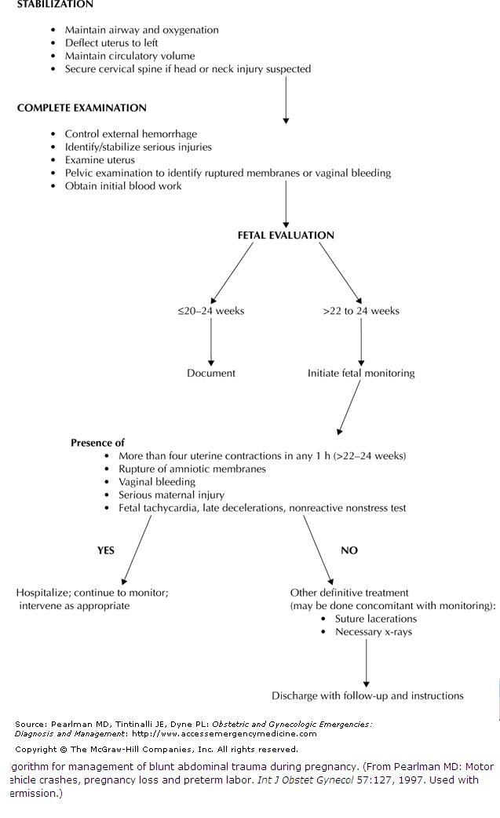

Slide 65
Peri-mortem Caesarean section
In the event of cardiac arrest, when initial resuscitation attempts fail,
delivery of the fetus by emergency caesarean section may improve the chances of successful resuscitation of the mother and fetus.
Caesarean section improves the chances of survival by relieving aortocaval compression caused
by the gravid uterus. Even with lateral displacement of the uterus, maternal cardiac output is
significantly impaired during CPR.
The UK Resuscitation Council recommends that caesarean section be performed early, aiming for delivery within 5 minutes of cardiac arrest;
however the gestational age of the fetus is important in determining specific management:
Gestational age < 20 weeks. Urgent caesarean need not be considered since aortocaval compression
by the uterus is unlikely to compromise maternal cardiac output.
Gestational age 20 – 23 weeks: Caesarean delivery within 5 minutes to maximize chances of maternal
survival but at this gestation, neonatal survival is unlikely.
Gestational age > 23 weeks. Caesarean delivery within 5 minutes to help save both mother and baby.
The neonate delivered during a peri-mortem caesarean section is likely to be severely acidotic and hypoxic and a paediatric team should be present to continue neonatal resuscitation and support following delivery

Slide 66
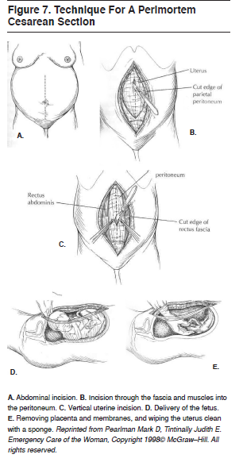
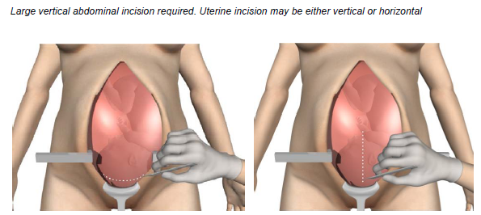
Perimortem Cesarean Section
Technique:
  Make sure it is indicated first and that resuscitative team is ready
  Vertical incision from xyphoid to pubis
  Continue straight down through abdominal wall and peritoneum
  Cut through uterus and placenta (if anterior) longitudinal or transverse
  Bluntly open uterus and remove fetus
  Cut and clamp cord

Slide 67
Summary 1
Motor Vehicle Accidents, falls and assaults are the commonest traumatic mechanisms in pregnancy.
Think of the possibility of domestic violence / partner abuse.
Pregnant women need to wear seat belts properly.
Don’t over-react to the fact that patient is pregnant.
ACLS and all usual diagnostic studies should be performed. Ultrasound may be useful, but perform needed x-ray studies!
Management of pregnancy is part of secondary survey.
Abruption is commonest cause of fetal death in non-life-threatening trauma to mother.
Abruption most likely with abdominal trauma.
Abdominal trauma can also cause feto-maternal hemorrhage, uterine rupture, rupture of membranes and pre-term labor.
Feto-maternal hemorrhage may be a cause of pre-term labor.
KB prep may have value in screening for severe feto-maternal hemorrhage and risk of pre-term labor.
One dose of RhoGam is routine in trauma to Rh- mother, regardless of KB results.

Slide 68
Summary 2
Pregnant women are vulnerable to apnea and have swollen airways.
They may be tolerant of blood loss, with delayed fall in BP. LUD is important for 3 reasons:
  Maternal hemodynamics
  Fetal oxygenation
  DVT prophylaxis
Fetal oxygen uptake is proportional to placental blood flow.
The fetus will drop heart rate in response to hypoxia. This is the basis for FHR monitoring after maternal trauma.
This response is related to the “mammalian diving reflex.”
To deliver an intact newborn, perimortem cesarean section should deliver baby within 5 minutes of cessation of maternal circulation and oxygenation.

Slide 69
Conclusion
Trauma has become the most frequent cause of maternal death in the United States of America. The main principle guiding therapy must be that resuscitating the mother will resuscitate the fetus.

Slide 70
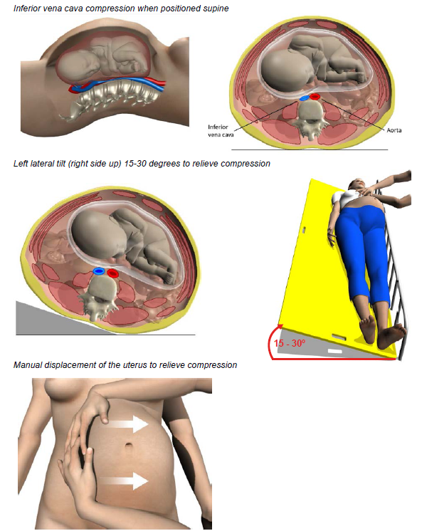

Slide 71
